Slide 1

Introduction
and
Overview
Week 1
2 September 2020

Slide 2
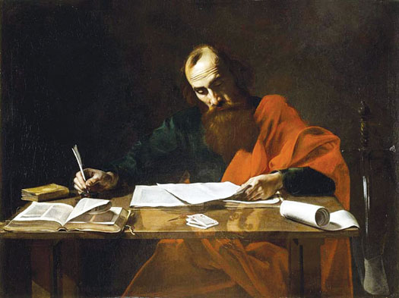
The Apostle Paul at his writing desk

Slide 3

The Pauline Epistles
First Missionary Journey:
Galatians (ad 48-49)
Second Missionary Journey:
1 Thessalonians (ad 50-52)
2 Thessalonians (ad 50-52)
Third Missionary Journey:
1 Corinthians (ad 55-56)
2 Corinthians (ad 56)
Romans (ad 57)

Slide 4
The Pauline Epistles
First Roman Imprisonment:
Ephesians (ad 60)
Philippians (ad 62)
Colossians (ad 62)
Philemon (ad 62)
While in Rome (free to travel)
1 Timothy (ad 62 – 66)
Titus (ad 64 – 66)
Second Roman Imprisonment:
2 Timothy (ad 67)
Hebrews (ad 68 – 69)

Slide 5


Slide 6
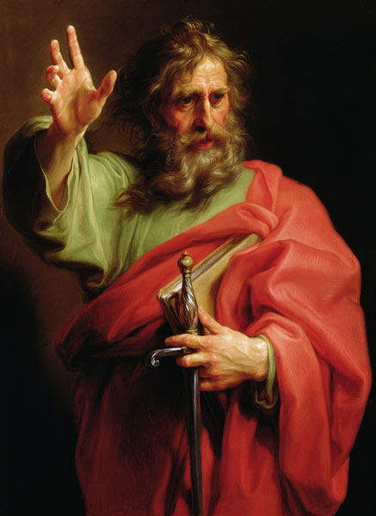
Hebrews
Who: Not stated. Some credit Paul, although his authorship is in dispute.
What: Words of exhortation to Hebrew believers affirming that God has a Son, his name is Jesus, and he is the Christ: Messiah or Anointed One.
Apostle Paul

Slide 7
Hebrews
When: c. ad 60 – 69, certainly before the destruction of the temple in ad 70.
Where: Unknown. Jerusalem most likely, (Rome has been suggested).
Apostle Paul

Slide 8
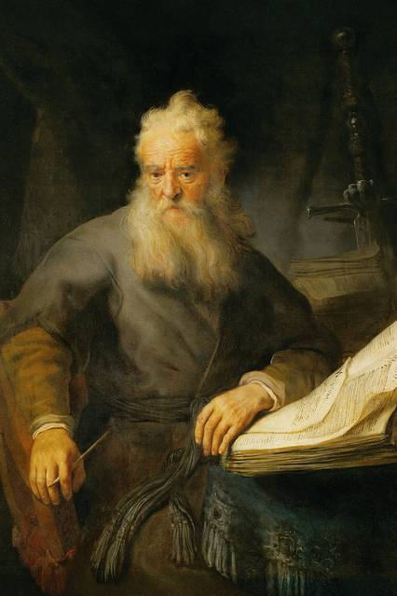
Hebrews
Why: To emphasize the superiority of Christ over the Old Covenant.
Synopsis: Jesus is better than any Old Testament person or sacrifice.
Comparison: The book of Hebrews is the “Gospel for the Jews” just as the Book of Romans is the “Gospel for the Gentiles.”
Apostle Paul

Slide 9
Hebrews
Themes concerning Jesus:
To confirm the last great Prophet,
To assert the last great High Priest, and
To proclaim the King of kings and Lord of lords.
Apostle Paul

Slide 10
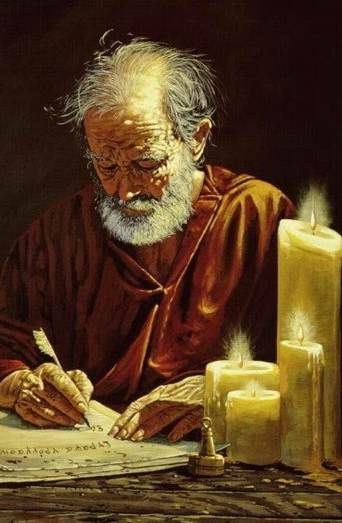
Hebrews
Outline (Chapter):
Jesus greater than Angels (1 – 2)
Jesus higher than Moses (3 – 4)
Jesus superior to Aaron (5 – 10)
Hall of Faith in Christ (11)
Living faithfully for Christ (12 – 13)
Apostle Paul

Slide 11
Hebrews
Central Message:
“For by one offering, He has perfected forever them that are sanctified . . . There is no more offering for sin.”
Hebrews 10:14, 18
Apostle Paul

Slide 12
Hebrews
Overview:
The author of Hebrews is not named within the letter, but we know that God inspired him, and it is in the canon of Scripture for us. Perhaps Origen says it best, “But who wrote the epistle, to be sure, only God knows.”
Evidence for Pauline authorship:
The writer had been in bonds (10:34).
He wrote from Italy (13:24).
His companion was Timothy (13:23).
Peter identifies Paul as the writer (2Peter 3:15, 16).

Slide 13
Hebrews
Overview:
Written to Jewish Christians (hence the name Hebrews), this long letter emphasizes the superiority of Christianity to Old Testament Judaism.
Jesus is “so much better” (1:4) than angels, Moses, and the previous animal sacrifices.
Jewish Christians, some of whom were apparently wavering in their commitment to Jesus – threatening to abandon the faith – to “drift away” (2:1).

Slide 14
Hebrews
Overview:
The book of Hebrews appeals to the Greek or Hellenistic mind as well as the Jewish mind. The Greeks saw everything on earth as the shadows cast by what was real, so they were always searching for reality.
Hebrews presents Jesus as the reality. The Jews were searching for a way to approach God because historically they had felt too unholy to approach Him.
The book of Hebrews presents Jesus as the approach.

Slide 15
Hebrews
Overview:
Readers are told that there can be no turning back to or continuation of the old Jewish system, which has been superseded by the unique priesthood of Christ.
God’s people must now look only to Jesus Christ, whose atoning death, resurrection, and ascension have opened the way into the true, heavenly sanctuary of God’s presence.

Slide 16
Hebrews
Overview:
Lost people are still in “Egyptian bondage” and need to be redeemed through faith in Christ. Those who are redeemed are privileged to enter spiritual inheritance (“Canaan”) and enjoy Christ’s “rest” (4:11).
The message of Hebrews is especially for them: “Let us go on to maturity.” Hebrews is one of three NT letters written to explain Habakkuk 2:4, “The just shall live by his faith” (Rom 1:17; Gal 3:11; and Heb 10:38).
The emphasis is on “by faith.” We are not only saved by faith, but we must live by faith.

Slide 17
Hebrews
Overview:
One key word in Hebrews is better:
Christ is better than the prophets and angels (Ch 1-2).
Christ is better than Moses, Joshua, and Aaron’s priesthood (Ch 3-8).
Christ has a better covenant (Ch 8), sanctuary (Ch 9), and sacrifice (Ch 10).
Christ gives His people a better life, and a life of faith (Ch 11-13).
Hebrews is one of only two New Testament letters that includes no greeting or hint of its author (the other being First John).

Slide 18
Hebrews
Overview:
A unique feature are the warnings throughout the book:
The warning against drifting (2:1-4)
Through neglect we can easily drift away.
The solution is to give the more earnest heed to the things we have heard.
The warning against departing (3:12-15)
Through sin’s deceitfulness we can become hardened and develop a lack of faith by which we can depart from the living God.
The solution is exhort one another daily and remain steadfast.

Slide 19
Hebrews
Overview:
The warning against disobedience (4:11-13)
Like Israel in the wilderness, we can fail to enter our rest through disobedience.
The solution is diligence and heeding the Word of God.
The warning against dullness (5:11-6:6)
Dullness of hearing can make it difficult for us to appreciate the extent of our blessings in Christ, and even falling away to the point of crucifying the Son of God afresh.
The solution is grasping the first principles of the oracles of God, and then pressing on to spiritual maturity and perfection.

Slide 20
Hebrews
Overview:
The warning against despising (10:26-39)
It is possible to so despise God’s grace as to no longer have a sacrifice for sins, but only a certain fearful expectation of judgment.
The solution is to hold unto our confidence in Christ, and believe with endurance.
The warning against defying (12:25-29)
It is possible to refuse to listen to the One who now speaks from heaven.
The solution is to look diligently to the grace of God, receiving it in such a way so we may serve Him acceptably with reverence and godly fear.

Slide 21
Hebrews
Overview:
The book of Hebrews was written to exhort Jewish Christians since some were tempted to go back to Judaism.
The book is concerned with the superiority of Christ and the new covenant, over against the old, without minimizing the old covenant.
The new covenant in Christ honors the old by fulfilling it.
end

