Slide 1

Jesus is Superior
to angles
Week 2
9 September 2020

Slide 2
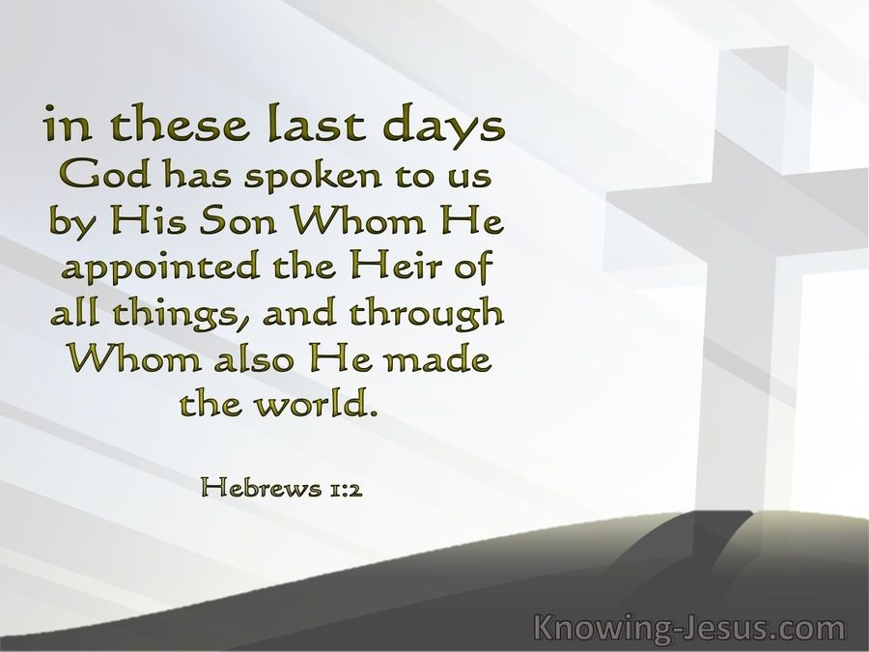

Slide 3

Hebrews chapter1
OVERVIEW:
Dispensing with greetings and salutations typical of letters at that time, the epistle to the Hebrews begins like a sermon, with the author immediately declaring the superiority of Jesus.
Jesus superior over prophets as spokesman (1-3) > “Who being the brightness of [God’s] glory, and the express image of his person ... ”
Jesus superior over angels by virtue of His deity (4-14) Angels are messengers and ministering spirits – while Jesus is the Son, the Creator, and Ruler of the age to come.

Slide 4
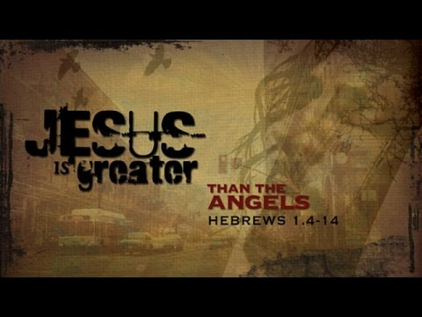

Slide 5
Hebrews chapter1
OVERVIEW:
While God spoke in times past to the fathers by the prophets, He now speaks to us through His Son (1-2).
The Father has chosen his Son to minister in four important areas (1-3) . . .
REVELATION – In the OT, God revealed through his messengers – In the NT, God revealed through his Messiah.
CREATION – Son made universe / Son maintains universe.
REPRESENTATION – Jesus represents God’s being.
PURIFICATION – Jesus died to cleanse us from our sin.

Slide 6
Hebrews chapter1
Seven things that describe the Son (2-3):
[1] He is the appointed heir of all things: What was lost in the first Adam is restored in the last Adam (1Cor 15:45).
[2] Through Him God made the worlds: All things were made by Him (Jesus), and without him was not any thing made that was made (John 1:3).
[3] He is the brightness of God’s glory: The Son of God eternally conveys the glory, majesty, and power of God from eternity past to eternity future.

Slide 7
Hebrews chapter1
Seven things that describe the Son (2-3):
[4] He is the express image of God’s person: Jesus the Son is completely the same in his being as God the Father.
[5] He upholds all things by the word of His power: Jesus upholds the world not by physical strength but by His almighty word.

Slide 8
Hebrews chapter1
Seven things that describe the Son (2-3):
[6] He purged our sins: What had been poisoned by sin was cured (purified) by the blood of Christ – forever, once for all, never to be repeated.
[7] He is now seated at the right hand of the Majesty on high: No exalted saint or powerful angel can sit at the right hand of the Father to receive praise and glory but the Son, Jesus Christ, the perfect Lamb of God (Rev 5:13).

Slide 9
Hebrews chapter1
Five ways Jesus is superior to angels (4-14):
[1] He is the “Son,” angels are not: God has highly exalted him, that at the name Jesus every knee will bow, and every tongue will confess that Jesus Christ is Lord (Phil 2:9ff).
[2] He is “the firstborn” who receives worship from angels: That angels are required to worship the Son because of who He is . . . all beings are inferior to the Son and thus must worship Him.

Slide 10
Hebrews chapter1
Five ways Jesus is superior to angels (4-14):
[3] He is “God” enthroned and anointed, angels are merely servants: As powerful creations of God, angels conduct various services for the Lord. Like us, angels render worship to Christ (Rev 5:13).
[4] He is “LORD” (Yahweh) who is the eternal Creator: As a son bears the name of his father, so the Son of God would bear the name of God, the divine name YHWH. Jesus is morally superior to all other creatures . . . He is righteousness incarnate.

Slide 11
Hebrews chapter1
Five ways Jesus is superior to angels (4-14):
[5] He is “sovereign” seated at the right hand of God, angels are ministering spirits: Not only is the Son superior to angels in His person and work, but He is also superior in His exalted position at the right hand of Majesty on high. Angels are “ministering spirits” rendering service on behalf of the Son for the benefit of the saints.

Slide 12
Hebrews chapter1
Christ superior to angels in three ways (4-14):
HIS RELATIONSHIP – The Father has declared Jesus to be his unique Son (4-7).
  When the Son took on a human nature, endured death for sin, rose from the dead victorious, and ascended into heaven, Jesus inherited a name that no angel had the right to bear.

Slide 13
Hebrews chapter1
Christ superior to angels in three ways (4-14):
HIS REIGN – It will be a righteous reign (8-9) and it will be an eternal reign (10-12).
  Even though everything in created is subject to growing old and wearing out like a garment of clothing, Jesus – as the God-man – will never perish.
  As God, Christ is eternal. He had no beginning. He will have no end.

Slide 14
Hebrews chapter1
Christ superior to angels in three ways (4-14):
HIS REWARD – The Father has promised to make Jesus’ enemies his footstool (13-14).
  God has never said to any of his angels, “Take your seat next to me at my right hand until I make your enemies a footstool for your feet.”

Slide 15
Hebrews chapter1
Old Testament passages referenced in Ch1 (5-13):
v5 – Psalm 2:7 > “I will declare the decree: the Lord hath said unto me, Thou art my Son; this day have I begotten thee.”
v5 – 2Samuel 7:14 > “I will be his father, and he shall be my son. If he commit iniquity, I will chasten him with the rod of men, and with the stripes of the children of men.”

Slide 16
Hebrews chapter1
Old Testament passages referenced in Ch1 (5-13):
v6 – Psalm 97:7 > “Confounded be all they that serve graven images, that boast themselves of idols: worship him, all ye gods.”
v7 – Psalm 104:4 > “Who makes his angels spirits; his ministers a flaming fire.”

Slide 17
Hebrews chapter1
Old Testament passages referenced in Ch1 (5-13):
v8-9 – Psalm 45:6-7 > “Thy throne, O God, is for ever and ever: the scepter of thy kingdom is a right scepter. ⁷Thou loves righteousness, and hates wickedness: therefore God, thy God, has anointed thee with the oil of gladness above thy fellows.”
v10-12 – Psalm 102:25-27 > “Of old hast thou laid the foundation of the earth: and the heavens are the work of thy hands. ²⁶They shall perish, but thou shalt endure: yea, all of them shall wax old like a garment; as a vesture shalt thou change them, and they shall be changed: ²⁷But thou art the same, and thy years shall have no end.”

Slide 18
Hebrews chapter1
Old Testament passages referenced in Ch1 (5-13):
v13 – Psalm 110:1 > “The Lord said unto my Lord, Sit thou at my right hand, until I make thine enemies thy footstool.”

Slide 19
Hebrews chapter1
Christ has a more excellent name than the angels because through His suffering and death He acquired a greater inheritance.
In His character, work, and ministry Christ stands supreme.
Though His glorious kingdom is not seen on earth today, Christ has still been enthroned as King and will return one day to establish righteousness on this earth.

Slide 20
Hebrews chapter1
Application of Chapter 1
[1] – God‘s angelic servants intrigue us, but only God‘s word can enlighten us . . .
  God has spoken directly to us through his written Word.
  God has also sent to us His Word incarnate to whom the written Word points and who points us back to the written Word.
  The Son of God alone is the Source of life and Savior of our lives.

Slide 21
Hebrews chapter1
Application of Chapter 1
[2] – God‘s angelic servants minister to us, but only God‘s Spirit can minister in us . . .
  Just because they are spirit beings, angels should not be confused with the Holy Spirit.
  The Holy Spirit is the Paraclete, the Comforter, the One called alongside to help us.
  Yes, angels exist, and yes, they minister on our behalf; but they, too, are subject to the Son of God.

Slide 22
Hebrews chapter1
Application of Chapter 1
[3] – God‘s angelic servants protect us physically, but only God‘s Son can save us spiritually . . .
  The One who is to occupy the throne of our lives is Jesus.
  Both OT prophets and angels desire to see the spiritual salvation through the Son of God that we experience today.
  We should acknowledge in thought, word, and deed, that Jesus Christ is superior to all things in His person and work.

Slide 23


Slide 24
NEXT CLASS – 9 Sept 2020
Letter to the Hebrews
Read before the next class in the KJV and in two other versions of the Bible, NKJV, NRSV, NIV, CEV, etc …
Chapter 2

