Slide 1

The Superiority of the Life in Christ Give Us a Working Faith
Week 12
18 November 2020

Slide 2
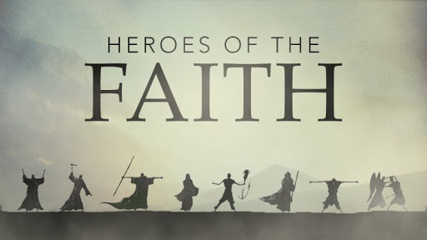
Chapter 11

Slide 3

Hebrews review
Chapter 1: Jesus, Better than Prophets and Angels (1:1-14)
Chapter 2: Jesus, Better than the Angels (2:1-18)
Chapter 3: Jesus, Better than Moses (3:1-19)
Chapter 4: Jesus, Better than Joshua (4:1-16)
Chapter 5: Jesus, Better than Aaron as Priest (5:1-14)
Chapter 6: Jesus, Press On To Maturity (6:1-20).
Chapter 7: Jesus, After the Order of Melchizedek (7:1-17).
Chapter 8: New Covenant Better than the Old (8:1-13).
Chapter 9: New Sanctuary and Sacrifice Better than the Old (9:1-28).
Chapter 10: New Sacrifice Settles Our Faith and Salvation (10:1-39).
this lesson . . .
Chapter 11: Superiority of Christ Gives Us a Working Faith (11:1-40).

Slide 4
Hebrews chapter 11
Overview of Chapter 11:
Having stressed the importance of faith for salvation (10:39), Paul defines faith (11:1-3), and then illustrates faith’s role in the lives of Old Testament saints (11:4-40).
The meaning of faith for New Testament Christians.
The examples of faith in Old Testament believers.

Slide 5
Hebrews chapter 11
Overview of Chapter 11:
Here, Paul transitions to the most practical portion of his letter, explaining how Christ is superior for pressing on (11:1 – 13:25).
The climax of the argument rests securely on the deep and broad doctrinal foundation established in chapters 1-10: The preeminent person of Christ deserves our whole hearted faithfulness.
The root of our response is faith. But it isn’t a hollow faith that fails to press on to the goal of maturity in Christ.

Slide 6
Hebrews chapter 11
Overview of Chapter 11:
It’s a full faith – a life motivated by Christ’s preeminent person and work, empowered by the Holy Spirit, and honoring to our heavenly Father.
Not only are we able to meet the truly great men and women of faithfulness in ages past, but we are also encouraged to follow their examples by walking today as they walked then.
These concluding chapters challenge us to put feet on our faith and to become thoroughly Christian in our attitudes and actions.

Slide 7
Hebrews chapter 11
Overview of Chapter 11:
We don’t do this alone, nor do we accomplish it in our own strength. The preeminent person of Christ is our superior Guide for pressing on in the walk of faith (Ch11).
By this faith that comes through Him, we have hope to endure every kind of trial (Ch12).
And this Christ-centered faith and hope are made complete in a lifestyle of love (Ch13).

Slide 8
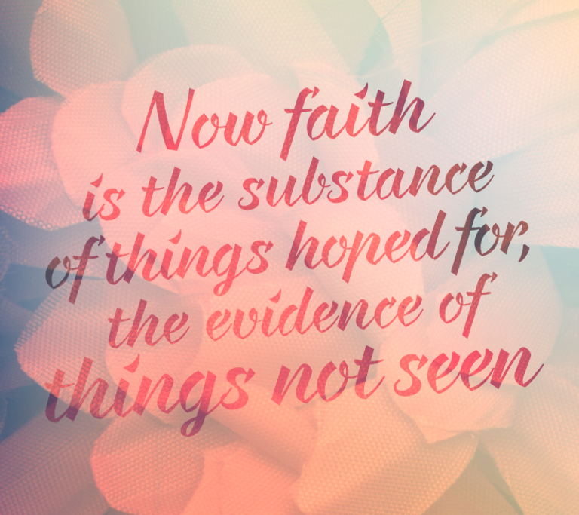

Slide 9
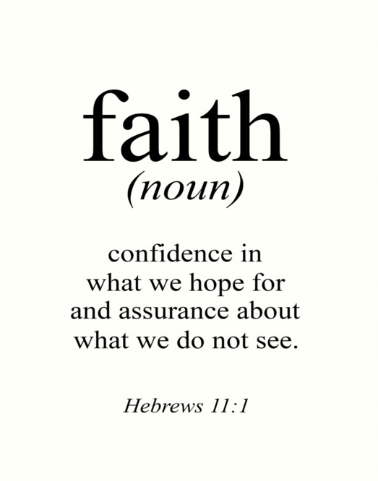

Slide 10
Hebrews chapter 11
Discussion:
It’s easy to think that perseverance in a life of faith is an honor reserved for an elite league of heroic saints with seemingly supernatural abilities to discern the invisible, believe the incredible, and stand against the inevitable.
Chapter 11 recounts biblical history through both the well-known and the lesser-known heroes of God’s epic story of redemption. Here we find common men and women who exhibited uncommon faith – faith that perplexed the people around them but pleased the God above them.

Slide 11
Hebrews 11:1 – 3, 6
¹Now faith is the substance of things hoped for, the evidence of things not seen.
²For by it the elders obtained a good report.
³Through faith we understand that the worlds were framed by the word of God, so that things which are seen were not made of things which do appear.
⁶But without faith it is impossible to please him: for he that cometh to God must believe that he is, and that he is a rewarder of them that diligently seek him.

Slide 12
Hebrews chapter 11
Discussion:
Before he documents the journey of the faithful throughout biblical history, Paul provides a simple but rich definition of faith (11:1-2).
Faith isn’t a blind shot in the dark, positive thinking, arrogant presumption, or gullible naïveté. Faith is confidence in God, a firm conviction that what He says is true and that what He promises He will do.
The words translated “assurance” and “reality” refers to the essence or substance of something which stands under it as its foundation or support.

Slide 13
Hebrews chapter 11
Discussion:
The word translated “conviction” or “evidence” refers to the test or trial which shows a thing as it really is.
These things constitute the grounds for holding as true the invisible reality of spiritual things and the trustworthiness of God’s future promises: “things hoped for . . . things not seen” (11:1).
Such faith isn’t simply limited to the things present but invisible, or to the things future and unknowable.

Slide 14
Hebrews chapter 11
Discussion:
Consider v6 . . .
FIRST – by faith we come to God: an acknowledgment that He is the great Source of everything here is. We simply go to God through faith.
SECOND – by faith we believe that God is: that we set aside the need to see with human eyes or touch with human hands.
THIRD – by faith we trust God to keep His word: God has promised to reward those who seek Him.

Slide 15
Hebrews 11:4-5
⁴Therefore, By faith Abel brought God a better offering than Cain did. By faith he was commended as righteous, when God spoke well of his offerings. And by faith Abel still speaks, even though he is dead. ⁵By faith Enoch was taken from this life, so that he did not experience death: “He could not be found, because God had taken him away.” For before he was taken, he was commended as one who pleased God.

Slide 16
Hebrews chapter 11
Discussion:
Paul introduces a shepherd named Abel, and his brother Cain who was a farmer. It’s implied that God had made known His requirement for an offering of blood. Abel did well, but Cain chose to offer the fruit of his labors. God approved of Abel’s sacrifice offered in faith, but disapproved of Cain’s.
In a fit of jealousy, Cain killed his brother for doing what was right in the eyes of God. Here, faithful obedience will often result in persecution – sometimes death.

Slide 17
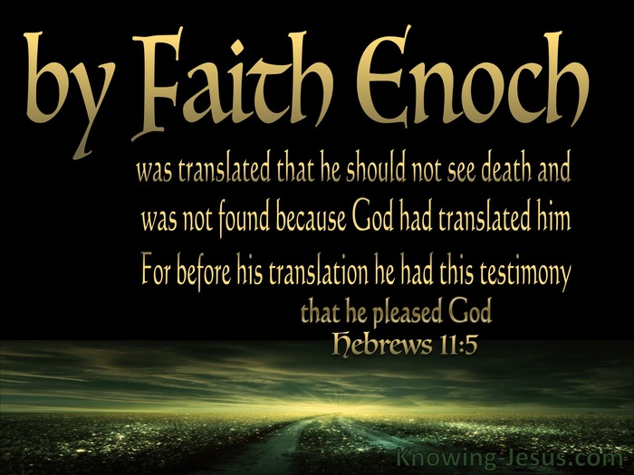

Slide 18
Hebrews chapter 11
Discussion:
The faith of Enoch (11:5) . . .
Exhibiting a life that was “pleasing to God,” this mysterious figure was taken up by God without experiencing death.
Living in the closing generations before Noah’s Flood, Enoch lived his life with righteousness and raised his children in the midst of an increasingly perverse and severely wicked world that would have viewed his life of faith with scorn.

Slide 19
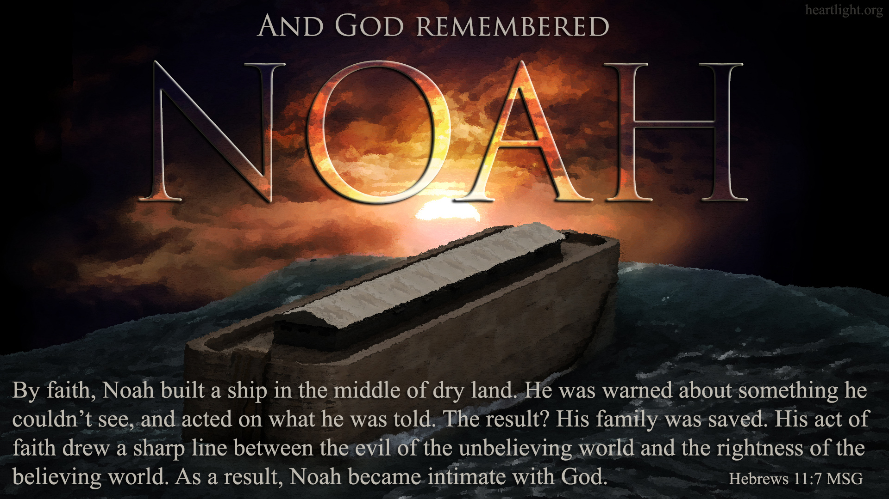

Slide 20
Hebrews chapter 11
Discussion:
The faith of Noah (11:7) . . .
Here, Paul distills the account of this giant of the faith to just one verse that focuses on his faithfulness in the midst of a condemned world.
Like Enoch, Noah walked with God and found favor in His eyes. Noah’s contemporaries – all of them – were wicked, with every intent of the thoughts of their hearts continually evil (Gen 6:5). Noah put his faith to work, believing God’s word over public opinion.

Slide 21
Hebrews chapter 11
Discussion:
Each of these men – Abel, Enoch, and Noah – exemplified with his life the very definition of faith. They lived in light of the invisible reality, in love with the invisible God, and in anticipation of an invisible future.
And each of them, like all people of faith, received the reward of those who please God – not by works, but by faith alone.

Slide 22
Hebrews 11:8 - 11
⁸By faith Abraham obeyed when he was called to set out for a place that he was to receive as an inheritance; and he set out, not knowing where he was going. ⁹By faith he stayed for a time in the land he had been promised, as in a foreign land, living in tents, as did Isaac and Jacob, who were heirs with him of the same promise. ¹⁰For he looked forward to the city that has foundations, whose architect and builder is God. ¹¹By faith he received power of procreation, even though he was too old—and Sarah herself was barren—because he considered him faithful who had promised.

Slide 23
Hebrews chapter 11
Discussion:
By faith Abraham (11:8-9) . . .
God’s calling to Abram was audible, objective, and specific. He responded with faithful obedience. He packed up his things and led his wife, Sarah, from the comfort and security of his homeland to head to God-knows-where.
Abraham was 75 years old and lived in tents like an unwanted foreigner. In the midst of this, Abraham walked by faith, not by sight.

Slide 24
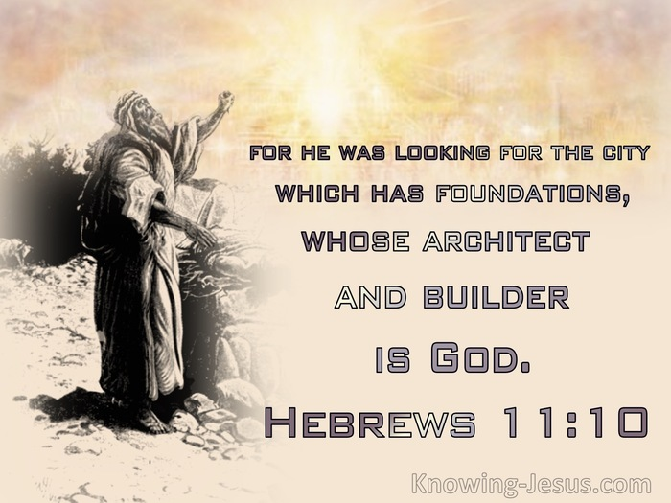

Slide 25
Hebrews chapter 11
Discussion:
Abraham was depending on God and yearning for a permanent, heavenly city designed and built by God (11:10).
Abraham’s focus wasn’t on the hardship of his journey through life, but on the reward at the eternal destination.
But what about Sarah?

Slide 26
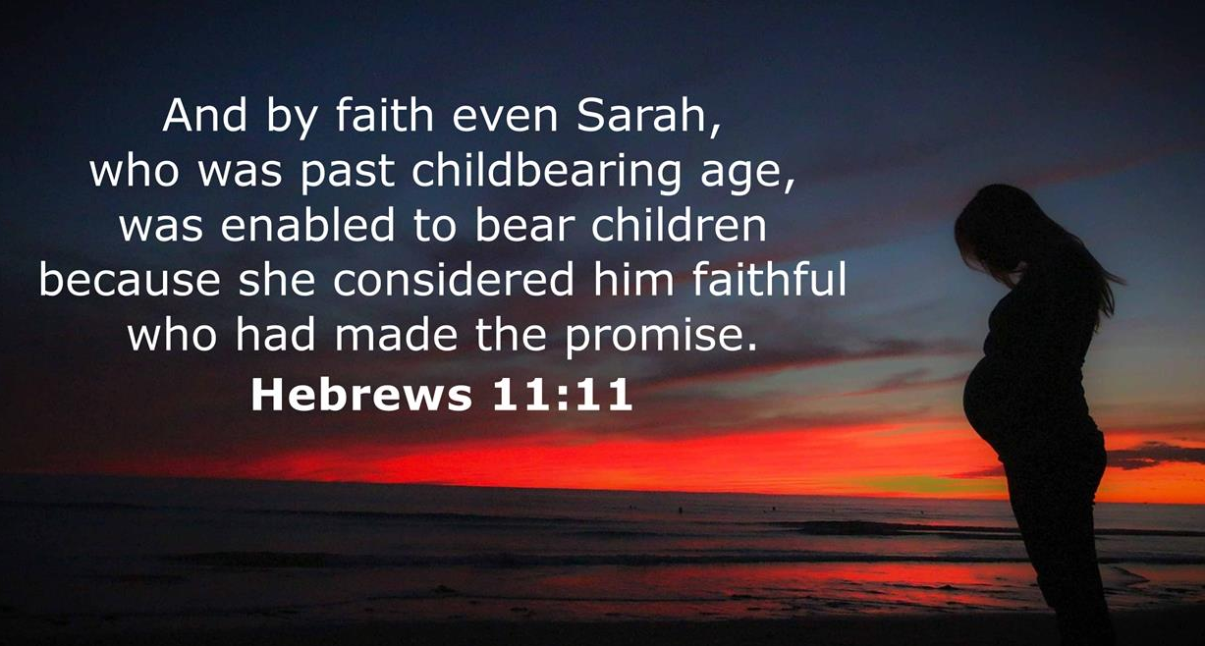

Slide 27
Hebrews chapter 11
Discussion:
Paul also points to Sarah’s faith-walk as worthy to be followed. By faith, Sarah considered God faithful “who promised one day they would have a child of their own (11:11).
Remember, in her old age, Sarah still hadn’t conceived and borne a son, even though that was part of the package of promises God had given to Abraham when they believed and left their homeland in obedience to God’s word (Gen. 12:1-3).

Slide 28
Hebrews chapter 11
Discussion:
And the going wasn’t easy. For 25 years after the initial call, Sarah had no child of her own. In fact, toward the end of their waiting, when God announced that within a year’s time Sarah would be pregnant, she laughed at the idea (Gen. 18:9-15).
When Abraham turned one hundred and Sarah was ninety, she conceive and brought forth the promised son. Though initially she laughed at the notion, she came to embrace with simple faith the clear words of God to Abraham (11:12).

Slide 29
Hebrews 11:13 - 16
¹³All of these died in faith without having received the promises, but from a distance they saw and greeted them. They confessed that they were strangers and foreigners on the earth, ¹⁴for people who speak in this way make it clear that they are seeking a homeland. ¹⁵If they had been thinking of the land that they had left behind, they would have had opportunity to return. ¹⁶But as it is, they desire a better country, that is, a heavenly one. Therefore God is not ashamed to be called their God; indeed, he has prepared a city for them.

Slide 30
Hebrews chapter 11
Discussion:
Paul states “all these died in faith, without receiving the promises.” Although each received that which was promised, what they experienced in this life was merely a foretaste, a shadow of thing to come. Abraham didn’t receive the full promise, just a down payment.
Abraham and Sarah had only one child – the promised was for descendants “innumerable as the sand which is by the seashore” (11:12). By faith, Abraham and Sarah were longing for a better country – a heavenly one (11:16).

Slide 31
Hebrews 11:17 - 19
¹⁷By faith Abraham, when put to the test, offered up Isaac. He who had received the promises was ready to offer up his only son, ¹⁸of whom he had been told, “It is through Isaac that descendants shall be named for you.” ¹⁹He considered the fact that God is able even to raise someone from the dead—and figuratively speaking, he did receive him back.

Slide 32
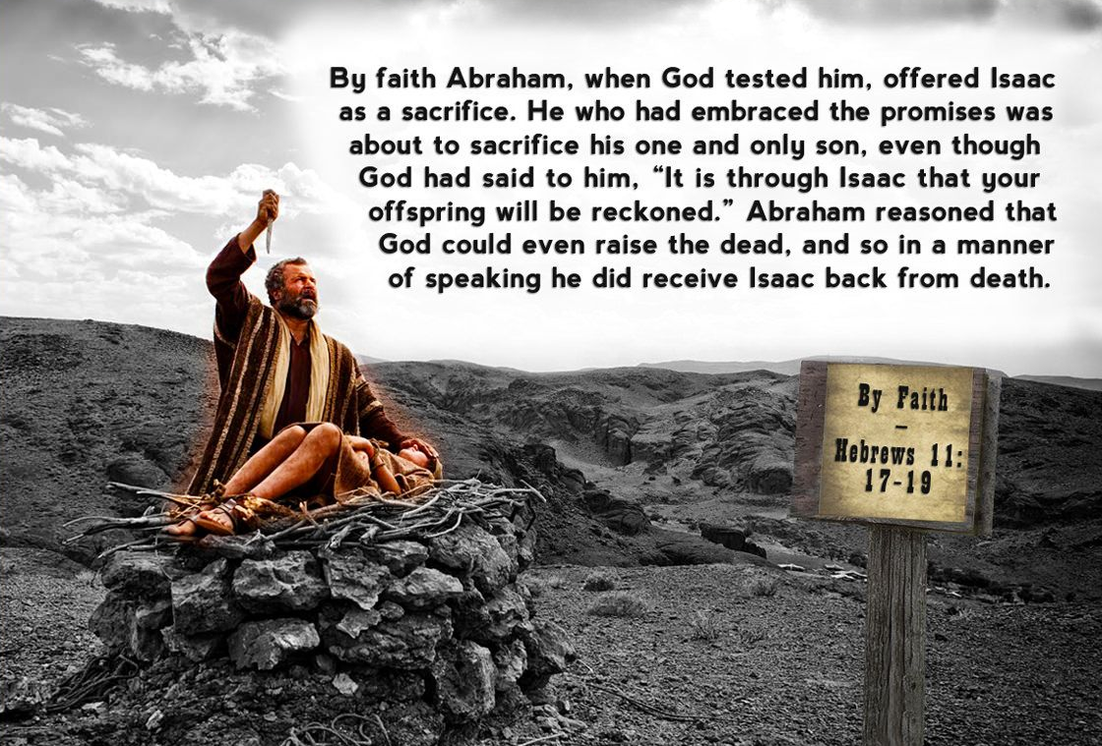

Slide 33
Hebrews chapter 11
Discussion:
After all that Abraham and Sarah had been through over the decades, God tested Abraham’s faith by instructing him to do the hardest thing he could be asked to do. Abraham was to surrender and sacrifice the promised son Isaac.
Abraham got up early, saddled up his donkey, and headed out in obedience (11:17). Paul speaks of the faith of Abraham who believed that “God is able to raise people even from the dead” (11:19).

Slide 34
Hebrews 11:20 - 22
²⁰By faith Isaac invoked blessings for the future on Jacob and Esau. ²¹By faith Jacob, when dying, blessed each of the sons of Joseph, “bowing in worship over the top of his staff.” ²²By faith Joseph, at the end of his life, made mention of the exodus of the Israelites and gave instructions about his burial.

Slide 35
Hebrews chapter 11
Discussion:
Considering the faith-walk of Abraham and Sarah, we see that same faith passed on to their son, Isaac, who in turn, passed it on to the next generation, Jacob and Esau by faith (11:20).
Jacob lived out a life of faith, receiving from God the new name “Israel.” Paul focuses on the legacy of faith passed on to Jacob’s grandchildren, Ephraim and Manasseh, the sons of Joseph (11:21). Joseph looked ahead prophetically to the Exodus from Egypt, requesting that his remains be returned to the Promised Land (11:22).

Slide 36
Hebrews 11:23 - 28
²³By faith Moses was hidden by his parents for three months after his birth, because they saw that the child was beautiful; and they were not afraid of the king’s edict. ²⁴By faith Moses, when he was grown up, refused to be called a son of Pharaoh’s daughter, ²⁵choosing rather to share ill-treatment with the people of God than to enjoy the fleeting pleasures of sin. ²⁶He considered abuse suffered for the Christ to be greater wealth than the treasures of Egypt, for he was looking ahead to the reward. ²⁷By faith he left Egypt, unafraid of the king’s anger; for he persevered as though he saw him who is invisible. ²⁸By faith he kept the Passover and the sprinkling of blood, so that the destroyer of the firstborn would not touch the firstborn of Israel.

Slide 37
Hebrews chapter 11
Discussion:
Paul notes that Moses’ life began with an act of faith. The unprovoked slaughter of male Hebrew infants prompted Moses’ parents to defied the king’s edict and hide their baby from death (11:23).
Paul states that the lawgiver himself was also a man who epitomized a life of faith – just like the patriarchs of old. Moses was a man who accomplished everything “by faith.”

Slide 38
Hebrews chapter 11
Discussion:
Moses is illustrated by three key decisions he made:
FIRST – refusing to be called the son of Pharaoh’s daughter. Choosing rather to suffer affliction with the people of God, than to enjoy the pleasures of sin for a season (11:24-25).
SECOND – leaving the familiar of Egypt to venture into the foreign, unfamiliar lands of Midian. Instead of backing down at the thought of Pharaoh’s wrath, Moses stood firm, trusting in God (11:27).

Slide 39
Hebrews chapter 11
Discussion:
Moses is illustrated by three key decisions he made:
THIRD – on the eve of the Exodus from their slavery in Egypt , God commanded Moses and the Israelites to do something unusual. They were to kill an unblemished male sheep or goat, apply its blood to the doorposts of their house, and eat its meat in haste. (11:27).
This was to be their “Passover” (11:27).

Slide 40
Hebrews 11:29 - 31
²⁹By faith the people passed through the Red Sea as if it were dry land, but when the Egyptians attempted to do so they were drowned. ³⁰By faith the walls of Jericho fell after they had been encircled for seven days. ³¹By faith Rahab the prostitute did not perish with those who were disobedient, because she had received the spies in peace.

Slide 41
Hebrews chapter 11
Discussion:
By faith the people of Israel walked through the Red Sea as though they were on dry land. When the Egyptians attempted to do this, they were drowned (11:29).
By faith the walls of Jericho fell down after they had been encircled for seven days by Joshua and the sons of Israel (11:30).
By faith Rahab the harlot was not killed along with those who were disobedient, because she had welcomed the spies in peace (11:31).

Slide 42
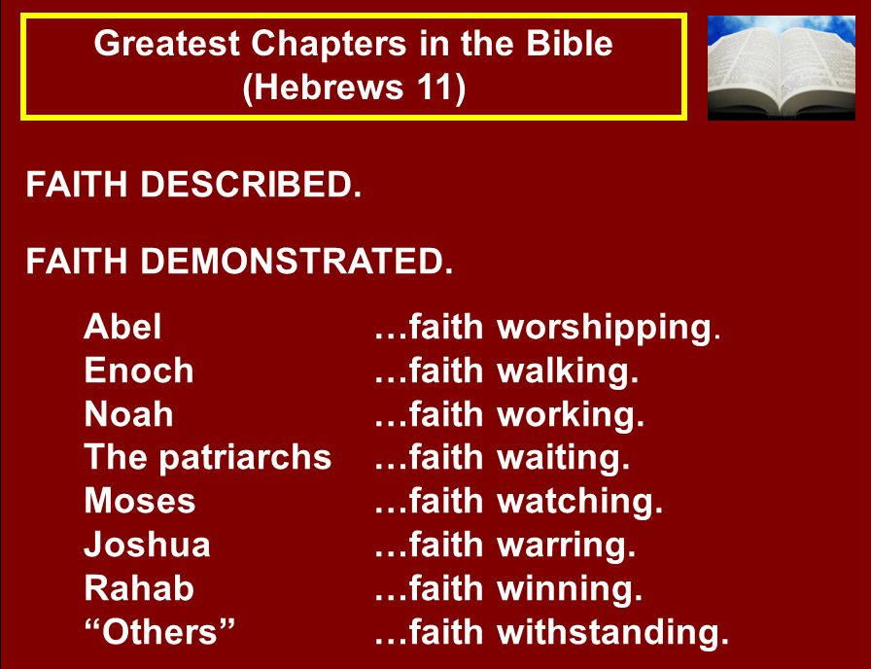

Slide 43
Hebrews 11:32 - 35
³²And what more shall I say? I do not have time to tell about Gideon, Barak, Samson and Jephthah, about David and Samuel and the prophets, ³³who through faith conquered kingdoms, administered justice, and gained what was promised; who shut the mouths of lions, ³⁴quenched the fury of the flames, and escaped the edge of the sword; whose weakness was turned to strength; and who became powerful in battle and routed foreign armies. ³⁵Women received back their dead, raised to life again. There were others who were tortured, refusing to be released so that they might gain an even better resurrection.

Slide 44
Hebrews chapter 11
Discussion:
Though Paul could have gone on with a long narrative of legacy-makers, he chose instead to finish out the rest of the faithful with a collage of tiny thumbnail sketches (11:32).
With an enduring trust in God and His promises, the faithful subdued kingdoms, administered justice, obtained promised blessings, closed the mouths of lions, extinguished the power of raging fire, escaped the edge of the sword, out of weakness were made strong, became mighty and unbeatable in battle, putting enemy forces to flight (11:33-34).

Slide 45
Hebrews 11:36 - 40
³⁶Some faced jeers and flogging, and even chains and imprisonment. ³⁷They were put to death by stoning; they were sawed in two; they were killed by the sword. They went about in sheepskins and goatskins, destitute, persecuted and mistreated— ³⁸the world was not worthy of them. They wandered in deserts and mountains, living in caves and in holes in the ground. ³⁹These were all commended for their faith, yet none of them received what had been promised, ⁴⁰since God had planned something better for us so that only together with us would they be made perfect.

Slide 46
Hebrews chapter 11
Discussion:
Some experienced the trial of mocking and scourging amid torture, and even chains and imprisonment (11:36).
Some were stoned to death, they were sawn in two, they were lured with tempting offers to renounce their faith, they were put to death by the sword; they went about wrapped in the skins of sheep and goats, utterly destitute, oppressed, cruelly treated people of whom the world was not worthy, wandering in deserts and mountains and living in caves and holes in the ground (11:37-38).

Slide 47
Hebrews chapter 11
Discussion:
Just as the sun shines on the just and the unjust, and rain falls on the wicked and the righteous (Matt 5:45), so also storms of tragedy sweep over the faithful and the faithless alike.
In this fallen world, everyone experiences a mixture of both triumphs and tragedies. However, neither astonishing victories nor demoralizing defeats represent the end of the story.
Faith is the assurance of things hoped for, the conviction of things not seen (11:1).

Slide 48
Hebrews chapter 11
Discussion:
Look at vv39-40, Paul clears up the varied experiences of the triumphant and the tragic. Having share a quick history of God’s people in the Old Testament, Paul summarizes their faith-walk:
“These were all commended for their faith, yet none of them received what had been promised, since God had planned something better for us so that only together with us would they be made perfect” (11:39-40).

Slide 49
Hebrews chapter 11
Discussion:
Those ancient saints framed in this portrait of faith represent our spiritual ancestry. But they aren’t merely relics of the past.
They are an ever-living presence to motivate us to do as they did: to look into the future by faith and to live faithful lives in the present.

Slide 50
Hebrews chapter 11
Discussion:
Those ancient saints framed in this portrait of faith represent our spiritual ancestry. But they aren’t merely relics of the past.
They are an ever-living presence to motivate us to do as they did: to look into the future by faith and to live faithful lives in the present.
Christians today are heirs of the promise through faith in Christ, since all of our spiritual blessings are the results of the promises God made to Abraham and David, now fulfilled spiritually in Christ (Gal. 3).

Slide 51
Hebrews chapter 11
Discussion:
The lessons of this chapter are many, but perhaps it would be helpful to mention just a few:
1) God works through faith and faith alone. Exercising faith is the only way to please Him and receive His blessing.
2) Faith is a gift from God through the Word and the Spirit. It is not something we “work up” ourselves.
3) Faith is always tested; at times it seems that trusting God is foolish, but faith always conquers in the end.

Slide 52


Slide 53
NEXT CLASS – 2 December 2020
Letter to the Hebrews
Before next class, read the below chapters in the KJV and in two other versions of the Bible, i.e., NKJV, NRSV, NIV, CEV, etc …
Chapter 12:1 – 28
Chapter 13:1 – 25

Slide 54



the end
Questions
Questions

