Slide 1

A Working Faith in Christ Gives Us Endurance, Direction and Discipline
Week 13
2 December 2020

Slide 2
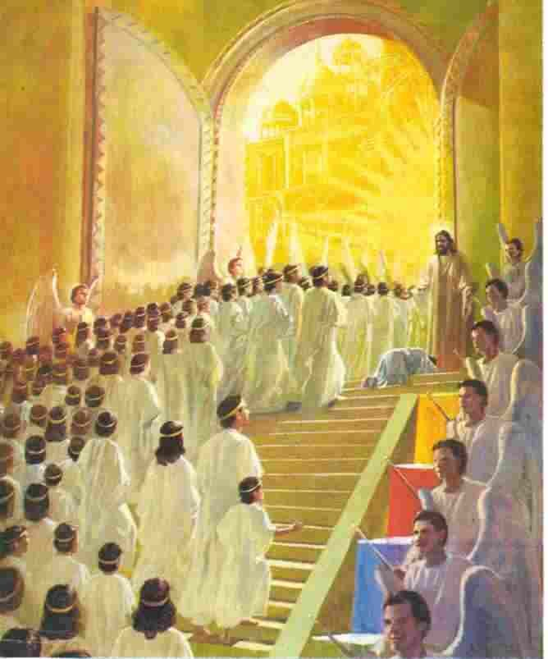
So great a cloud of witnesses

Slide 3

Hebrews review
Chapter 1: Jesus, Better than Prophets and Angels (1:1-14)
Chapter 2: Jesus, Better than the Angels (2:1-18)
Chapter 3: Jesus, Better than Moses (3:1-19)
Chapter 4: Jesus, Better than Joshua (4:1-16)
Chapter 5: Jesus, Better than Aaron as Priest (5:1-14)
Chapter 6: Jesus, Press On To Maturity (6:1-20).
Chapter 7: Jesus, After the Order of Melchizedek (7:1-17).
Chapter 8: New Covenant Better than the Old (8:1-13).
Chapter 9: New Sanctuary and Sacrifice Better than the Old (9:1-28).
Chapter 10: New Sacrifice Settles Our Faith and Salvation (10:1-39).
Chapter 11: Superiority of Christ Gives Us a Working Faith (11:1-40).
this lesson . . .
Chapter 12: A Working Faith in Christ Gives Us Endurance, Direction and Discipline (12:1-29).

Slide 4
Hebrews chapter 12
Overview of Chapter 12:
With the “heroes of faith” like a cloud of witness cheering us on, we are to run the race of faith, looking to Jesus’ example for endurance and to God’s loving discipline lest we fall short of His grace (1-17).
Coming not to Mt. Sinai but to glorious Mt. Zion (18-24), we are given the fifth warning: not to refuse or defy Him who speaks from heaven (25-29).

Slide 5
Hebrews chapter 12
Points to Ponder in Chapter 12:
How Jesus was able to endure the cross.
The role of discipline in the life of the Christian.
The danger of defying Him who speaks from heaven.

Slide 6
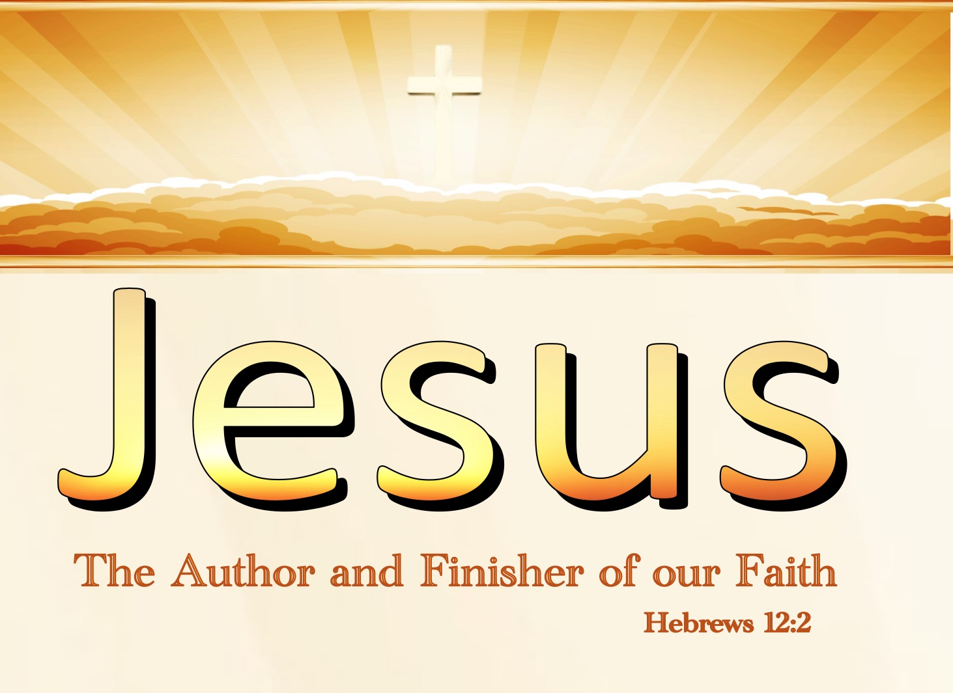

Slide 7
Hebrews chapter 12
Overview of Chapter 12:
Paul reminds us that when we enter the Christians life through faith, we enter a battleground. When we enter into a relationship with Christ and are initiated in to His body, the church, we’re thrust onto a spiritual battlefield.
The book of Hebrews was written to men and women in the thick of the battle against the flesh, the world, and the devil. Paul warns his readers of the cost of defecting in the midst of the battle.

Slide 8
Hebrews chapter 12
Overview of Chapter 12:
Here, Paul continues to urge them toward a life of enduring hope that responds positively to God’s hand of loving discipline with maturity. He doesn’t want them to be “flash in the pan” Christians. That type of Christian lack virtue of endurance, and they crumble under discipline.
The life of authentic Christian faith should lead to a Christian life of enduring hope. Such hope pushes through the persecution of a godless world.

Slide 9
Hebrews chapter 12
Overview of Chapter 12:
Hebrews 11 painted a brilliant picture of men and women of authentic faith who endured hardship, persevered through persecutions, and responded well to God’s discipline.
Hebrews 12 turns the attention on us believers, answering the question, “So what?”
In light of these examples of heroic faith, how should we live our own lives?

Slide 10
Hebrews 12:1 – 3
¹Therefore, since we are surrounded by such a great cloud of witnesses, let us throw off everything that hinders and the sin that so easily entangles. And let us run with perseverance the race marked out for us, ²fixing our eyes on Jesus, the pioneer and perfecter of faith. For the joy set before him he endured the cross, scorning its shame, and sat down at the right hand of the throne of God. ³Consider him who endured such opposition from sinners, so that you will not grow weary and lose heart.

Slide 11
Hebrews chapter 12
Discussion:
Although many may not relate to the metaphor of a battlefield, almost all of us have participated in some kind of sporting event . Here, Paul uses a foot race to encourage his readers to press on and finish their journey of faith.
The spiritual athletes showcased in chapter 11 are ushered off the track and into the grandstands in chapter 12, where Paul pictures them cheering us on as we take our places in the marathon.

Slide 12
Hebrews chapter 12
Discussion:
“Therefore” connects this passage with the last passage. Consequently, the “cloud of witnesses surrounding us” refer to the heroes mentioned in the Hall of Faith. Moreover, let us “lay aside every encumbrance and the sin which so easily entangle us.” (12:1).
All believers have been entered into the contest or “race” of faith. The Greek word for race can also be used in the sense of “struggle” or “fight.” To make it to the end of this faith struggle requires us to “set aside” anything that might hold us back.

Slide 13
Hebrews chapter 12
Discussion:
Notice, Paul has the specific sin of unbelief in mind when he declares “the sin,” not simply the sins (12:1). We are to set aside the unnecessary distractions and debilitating sin and instead “run with endurance the race that is set before us.”
While running this race, it is necessary both to be driven by faith and to be drawn by hope. Moreover, we are to be “fixing our eyes on Jesus.” Jesus – our divine focus – has gone before us in this marathon of faith (12:2).

Slide 14
Hebrews chapter 12
Discussion:
We must never stop looking to Jesus. Jesus is the author (leader) of our faith, and He is the one who makes our faith complete (finished) (12:2).
Jesus suffered death on a cross, but he accepted the shame of the cross as if it were nothing because of the joy he could see waiting for him. And now he is sitting at the right side of God’s throne (12:2).

Slide 15
Hebrews chapter 12
Discussion:
Hope drew Christ onward and upward, giving Him the endurance needed to persevere through the hostility of sinners.
Jesus patiently endured the angry insults that sinful people were shouting at him. Think about Him so that you won’t get discouraged and stop trying.
Jesus endured ruthless, unjust persecution from sinner. Yet these experiences were not outside his Father’s plan and purpose (12:3).

Slide 16
Hebrews 12:4-6
⁴In your struggle against sin, you have not yet resisted to the point of shedding your blood. ⁵And have you completely forgotten this word of encouragement that addresses you as a father addresses his son? It says, “My son, do not make light of the Lord’s discipline, and do not lose heart when he rebukes you, ⁶because the Lord disciplines the one he loves, and he chastens everyone he accepts as his son.

Slide 17
Hebrews chapter 12
Discussion:
Paul touches on a reality that often tries our faith more than anything else: the discipline of God.
We learn that in our struggles against sin and in our pursuit of righteousness, God permits people, events, and circumstances (experiences) that cause us pain – not to punish us, but to purify us.

Slide 18
Hebrews chapter 12
Discussion:
Unlike the Savior, these Jewish Christians had not yet suffered for their faith to the extent of shedding blood (12:4).
That is, they had not yet experienced martyrdom for their faith as did their Lord. The affliction they had experienced, however, was trying their faith.

Slide 19
Hebrews chapter 12
Discussion:
To answer the question of why things were happening to God’s people, Paul reminds them of a vital truth they had forgotten from Proverb 3:11-12
“My son, despise not thou the chastening of the Lord, nor faint when thou art rebuked of him: ⁶For whom the Lord loves, he chastens, and scourges every son whom he receives.”
Two extremes: first is to disregard the discipline God sends to train us. Secondly is faint when we face God’s correction.

Slide 20
Hebrews chapter 12
Discussion:
C. S. Lewis sums it up: “God whispers to us in our pleasures, speaks in our conscience, but shouts in our pains: it is His megaphone to rouse a deaf world.”
This is why faith is essential to help endure the painful trials in our lives. By faith we trust that God loves us, that He is all-powerful, and that he knows us completely.
By faith we grasp the significance of the next line of Solomon’s proverb: that God disciplines out of love, not anger or hatred. When He punishes, it is in love.

Slide 21
Hebrews 12:7 - 11
⁷Endure hardship as discipline; God is treating you as his children. For what children are not disciplined by their father? ⁸If you are not disciplined—and everyone undergoes discipline—then you are not legitimate, not true sons and daughters at all. ⁹Moreover, we have all had human fathers who disciplined us and we respected them for it. How much more should we submit to the Father of spirits and live! ¹⁰They disciplined us for a little while as they thought best; but God disciplines us for our good, in order that we may share in his holiness. ¹¹No discipline seems pleasant at the time, but painful. Later on, however, it produces a harvest of righteousness and peace for those who have been trained by it.

Slide 22
Hebrews chapter 12
Discussion:
Anybody who has parented knows that positive reinforcement through instruction and encouragement in never enough. We are fallen, sinful human beings who will always balk at instruction and buck the correction established for our growth.
However, positive discipline also involves a flip side – negative consequences for failing to progress and painful punishment for rebelliously transgressing the rules.

Slide 23
Hebrews chapter 12
Discussion:
In the midst of the discomfort and pain, Paul offers four principles > “God’s discipline . . .”
FIRST – Assures us that we are His children (7-8).
SECOND – Deepens and enhances our spiritual life (9).
THIRD – Continues for our benefit (10).
FOURTH – Though painful, is ultimately valuable (11).

Slide 24
Hebrews 12:12 - 13
¹²Therefore, strengthen your feeble arms and weak knees. ¹³“Make level paths for your feet,” so that the lame may not be disabled, but rather healed.

Slide 25
Hebrews chapter 12
Discussion:
In light of these principles of discipline, what should be our reaction? Paul calls for a practical response to these truths.
Believers should be strengthened in their faith and hope (12:12), and they should remain on a straight path toward the goal of faithfulness (12:13).

Slide 26
Hebrews chapter 12
Discussion:
Preparing for a marathon, people will go through days and weeks of pain. Their knees, feet, and joints will be sore. However, through continual, focused exercise under the direction of a careful coach, those aching limbs will eventually heal.
Therefore, God’s discipline is not something we should either resist or run from. Rather, we should prepare ourselves for it, expect it – even welcome it.

Slide 27
Hebrews 12:14 - 17
¹⁴Make every effort to live in peace with everyone and to be holy; without holiness no one will see the Lord. ¹⁵See to it that no one falls short of the grace of God and that no bitter root grows up to cause trouble and defile many. ¹⁶See that no one is sexually immoral, or is godless like Esau, who for a single meal sold his inheritance rights as the oldest son. ¹⁷Afterward, as you know, when he wanted to inherit this blessing, he was rejected. Even though he sought the blessing with tears, he could not change what he had done.

Slide 28
Hebrews chapter 12
Discussion:
In our marathon of faith, worldliness can ruin us. If we let it get the best of us, we’ll soon slow down, and fall aside.
Here, Paul gives us two positive commands (12:14), three negative warnings (12:15-16), and the serious consequences that result from a failure to overcome the temptation toward worldliness (12:17).

Slide 29
Hebrews chapter 12
Discussion:
Paul first urges his readers to “pursue peace with all people” and secondly, to “pursue sanctification” (14).
Next, Paul hits his audience with three negative warnings. The first warning is . . . Don’t let anyone come short of grace (15).
The second warning is . . . Don’t allow bitterness to take root (15).
The third warning is . . . Don’t tolerate the Esau syndrome (16).

Slide 30
Hebrews chapter 12
Discussion:
Now Paul describes serious consequences, illustrated by the horrifying fate of Esau after he traded the spiritual for the worldly (14).
The tragic story of Esau who literally traded the blessing of his birthright as the firstborn son of Isaac for a bowl of stew (Gen. 25:27-34).
The message to us is clear: Don’t trade your priceless spiritual inheritance for the paltry wares of this world.

Slide 31
Hebrews 12:18 - 24
¹⁸You have not come to a mountain that can be touched and that is burning with fire; to darkness, gloom and storm; ¹⁹to a trumpet blast or to such a voice speaking words that those who heard it begged that no further word be spoken to them, ²⁰because they could not bear what was commanded: “If even an animal touches the mountain, it must be stoned to death.” ²¹The sight was so terrifying that Moses said, “I am trembling with fear.” ²²But you have come to Mount Zion, to the city of the living God, the heavenly Jerusalem. You have come to thousands upon thousands of angels in joyful assembly, ²³to the church of the firstborn, whose names are written in heaven. You have come to God, the Judge of all, to the spirits of the righteous made perfect, ²⁴to Jesus the mediator of a new covenant, and to the sprinkled blood that speaks a better word than the blood of Abel.

Slide 32
Hebrews chapter 12
Discussion:
The spiritual marathon of faithfulness is rugged, long, painful, and exhausting, marked by trials and challenges that strengthen us and grow us throughout the journey (12:1-13).
Thankfully, our Trainer and Coach is more than just a Friend; he’s our heavenly Father (12:5-11). He wants the best for us. But just as in physical races, there are rules and warnings for participation in the spiritual race (12:14-16). These rules prevent us from ending up like worldly Esau (12:17).

Slide 33
Hebrews chapter 12
Discussion:
Here, Paul leads us down a path that passes by two mountains – Mt. Sinai and Mt. Zion. The first represents a worldly approach to the spiritual life, while the second represents the heavenly approach to the spiritual life.
Paul shows his audience a representation of the old covenant to create a stark contrast with the new covenant so that they can see where they stand before God.

Slide 34
Hebrews chapter 12
Discussion:
Paul describes the seriousness and even the terror that were involved in the giving of the Law. The people were afraid to hear God’s voice, and even Moses feared and trembled! God set boundaries around the mount, and even if an animal trespassed, it was stoned to death (12:20).
Of course, God had to impress on His people the seriousness of His Law, just as we must with our own children. This was the infancy of the nation, and children can understand reward and punishment.

Slide 35
Hebrews chapter 12
Discussion:
There are three groups of people in the heavenly city: (1) the host of angels, who minister to the saints; (2) the church of the firstborn ; and (3) the OT saints.
“Made perfect” means the OT saints have now a perfect standing before God because of the death and resurrection of Christ (12:23).
Anyone who believes God’s Word goes to heaven; but the perfection of God’s work did not come until Christ’s death on the cross.

Slide 36
Hebrews chapter 12
Discussion:
But above all, it is to God, the Judge of all men, that they have come—and there are some who can stand His searching scrutiny of their lives (12:23).
Jesus the Mediator of a New Covenant whose atoning blood does not cry for judgment as did Abel’s, but secures the acceptance of all new covenant persons.
If the readers would contemplate these things properly, they would be awed by them and more inclined to fulfill their call to the highest privileges that the new covenant can provide.

Slide 37
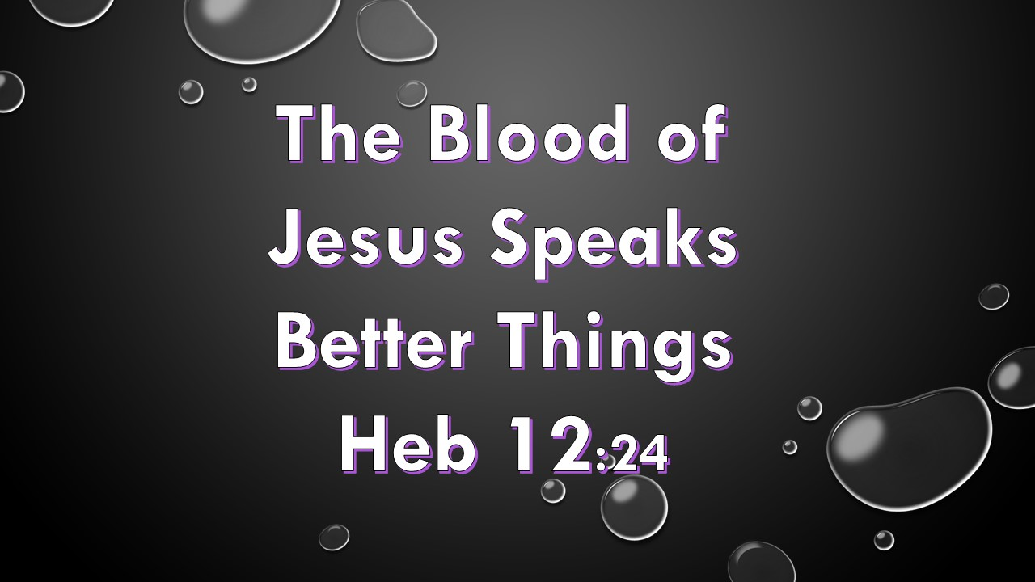

Slide 38
Hebrews 12:25 - 29
²⁵See to it that you do not refuse him who speaks. If they did not escape when they refused him who warned them on earth, how much less will we, if we turn away from him who warns us from heaven? ²⁶At that time his voice shook the earth, but now he has promised, “Once more I will shake not only the earth but also the heavens.” ²⁷The words “once more” indicate the removing of what can be shaken—that is, created things—so that what cannot be shaken may remain. ²⁸Therefore, since we are receiving a kingdom that cannot be shaken, let us be thankful, and so worship God acceptably with reverence and awe, ²⁹for our “God is a consuming fire.”

Slide 39
Hebrews chapter 12
Discussion:
Here, Paul offers the fifth and final warning:
Pay Attention lest you Drift Away (2:1-4).
Beware of a Harden Heart (3:7 – 4:13).
Don’t allow Dullness of Heart to Hinder Spiritual Growth (5:11-6:20).
Stand Firm in the Faith or Be Judged by God (10:19-39).
Don’t Turn Away from Christ (12:25-29).

Slide 40
Hebrews chapter 12
Discussion:
This fifth warning is a final call to those who had begun to stray from the path leading to Mt. Zion. “Do not refuse him who is speaking.” Paul reminds his readers that those who refused to listen to God’s voice under the old, inferior covenant established on earth “did not escape” judgment (12:25).
Now we have words from God the Father spoken directly from the lips of God the Son incarnate – Jesus Christ – and through the mouths of the apostles, whose message was given directly from God the Holy Spirit.

Slide 41
Hebrews chapter 12
Discussion:
The seriousness of neglecting the salvation spoken by Jesus and confirmed by the apostles is underscored by a reference to the coming judgment, which serves as a negative warning against the absolute futility of placing our hopes on worldliness.
Quoting from Haggai 2:6, Paul looks forward to a time when God will “shake not only the earth, but also the heaven” – that is, a final cataclysmic judgment of all creation (12:26-27).

Slide 42
Hebrews chapter 12
Discussion:
The positive side of the warning comes in 12:28 – “Let us show gratitude.” This is the opposite of refusing “Him who is speaking” (12:25).
Instead of neglecting the free gift of salvation, we respond with joyful, grace-oriented, reverential worship and service of God marked by awe (12:28), never forgetting that “our God is a consuming fire” (12:29). The basis of this proper response is the fact that we have received “a kingdom which cannot be shaken” (12:28).

Slide 43
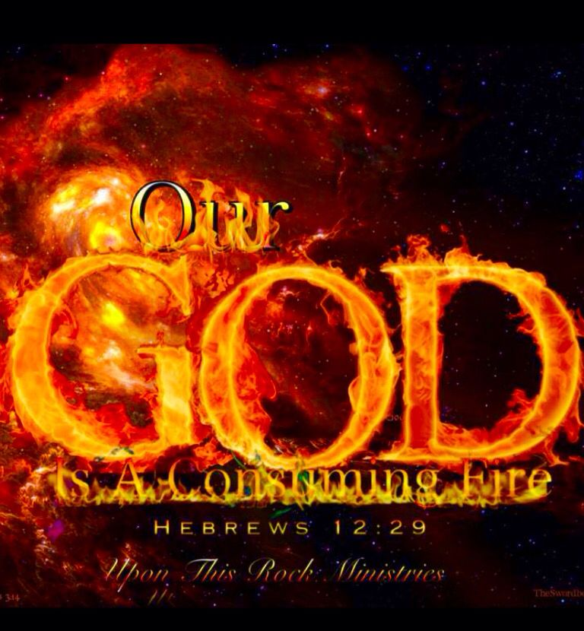

Slide 44



Slide 45
Hebrews chapter 12
Application of Chapter 12
[1] – Claim the grace to persevere through the race.
  When the winds of adversity blow you back, when your legs wobble with doubts, and when the worldly crowd boos your every step, call to God to give you grace to endure.
  His answer to this prayer may involve uncomfortable training or painful discipline, but you can be assured that you’re safe in God’s hands (cf. Isaiah 40:29-31).

Slide 46
Hebrews chapter 12
Application of Chapter 12
[2] – Remember that you are never alone in the race.
  Nothing will dampen your spirits and cut your stride in the spiritual marathon like the feeling that you’re alone. You are not! Thousands of faithful individuals have run the same path as you.
  When we look to Christ with hope and bear in mind the example of countless saints who ran before us, our strength will be renewed with each step. And when we recall that God is disciplining us for success, our confidence will be emboldened with every stride.

Slide 47
Hebrews chapter 12
Application of Chapter 12
[3] – Adjust your pace after starting the race.
  You’re in a marathon starting in time and ending in eternity. It’s a lifelong, day-by-day stretch over rough terrain. Consider how you can pat a fellow runner on the back, pick up a partner who has stumbled, and mend the injuries of those fallen.
  In this way, you’ll become an example of endurance to those who are yet to run the race. Keeping others as a priority in the race of faith will help you avoid putting yourself in a place of worldly competition and carnal ambition.

Slide 48
Hebrews chapter 12
Application of Chapter 12
[4] – Calculate the cost before you quit.
  Again, this is a marathon, not a fifty-yard dash. Much of it is uphill and over uneven ground. We get distracted when the scenery becomes frightening or boring. When we do this, we lose sight of Jesus.
  Our vision of God becomes clouded. We no longer see Him as an all-powerful, consuming fire. We no longer respond to His voice with reverence, but we reject His word as irrelevant.

Slide 49
Hebrews chapter 12
Application of Chapter 12
[5] – Get a firm grip in the gift of grace.
  Though it’s a harsh, grueling marathon, the Christian life is powered by grace, not law – by faith, not works – by love, not selfish ambition. How easy it is in our get-what-you-deserve world to come short of the grace of God.
  How easy it is to lose our grip on God’s grace and respond not with gratitude, but with contempt. How easy to forget the distant glories of the heavenly Jerusalem, falling prey instead to pleasures of worldly Babylon. Tragically, climbing Mt. Sinai and losing sight of beautiful Mt. Zion.

Slide 50
FINAL CLASS – 9 December 2020
Letter to the Hebrews
Before next class, read the below chapters in the KJV and in two other versions of the Bible, i.e., NKJV, NRSV, NIV, CEV, etc …
Chapter 13:1 – 25

Slide 51



the end
Questions
Questions

