Slide 1

The Supremacy of Christ
and Christianity
Week 3
16 September 2020

Slide 2

Hebrews
OUTLINE:
The Superiority of the Person of Christ
Jesus, Better than the Prophets (1:1-3).
Jesus, Better than the Angels (1:4 – 2:18).
Jesus, Better than Moses (3:1-19).
Jesus, Better than Joshua (4:1-16).
Jesus, Better than Aaron as Priest (5:1 – 8:5).

Slide 3
Hebrews
OUTLINE:
The Superiority of the New and Better Covenant
New Covenant Better than the Old (8:6-13).
New Covenant Opens a Better Tabernacle (9:1-15).
New Covenant is Sealed by a Better Sacrifice (9:16-28).
New Covenant Settles Forever Our Salvation (10:1-18).

Slide 4
Hebrews
OUTLINE:
The Superiority of the Life in Christ
It Gives Assurance of Faith (10:19-39).
It Gives Us a Working Faith (11:1-40).
It Gives us Patience and Direction (12:1-13).
It Gives Us Instruction in Our Walk and Worship (12:14 – 13:25).

Slide 5

HEBREWS 1:1 – 14
HEBREWS 2:1 – 18

Slide 6
Hebrews chapter 1
REVIEW OF CH 1:
Jesus is superior to prophets as spokesman (1:1-3) > “Who being the brightness of [God’s] glory, and the express image of his person ... ”
Jesus is superior tor angels by virtue of His deity (1:4-14) > Angels are messengers and ministering spirits – while Jesus is the Son, the Creator, and Ruler of the age to come.

Slide 7
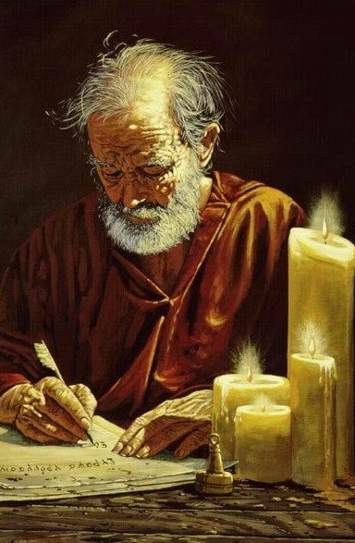
Hebrews chapter 2
POINTS TO PONDER IN CH2:
The very real danger of drifting and neglecting our salvation.
Man’s fall from his exalted position over creation.
Jesus' humanity and its impact on His role as Savior and High Priest.
Apostle Paul

Slide 8


Slide 9
Hebrews chapter 2
OVERVIEW:
Paul interrupts his comparison of Christ with angels with his first of five warnings in this epistle: a warning against drifting away from the faith (abandoning) by neglecting our great salvation (1-4).

Slide 10


Slide 11
Hebrews chapter 2
OVERVIEW:
Paul then illustrates Jesus’ superiority to angels by being made lower than the angels, whereby Jesus became the perfect captain of our salvation and a merciful and faithful High Priest (5-18).

Slide 12
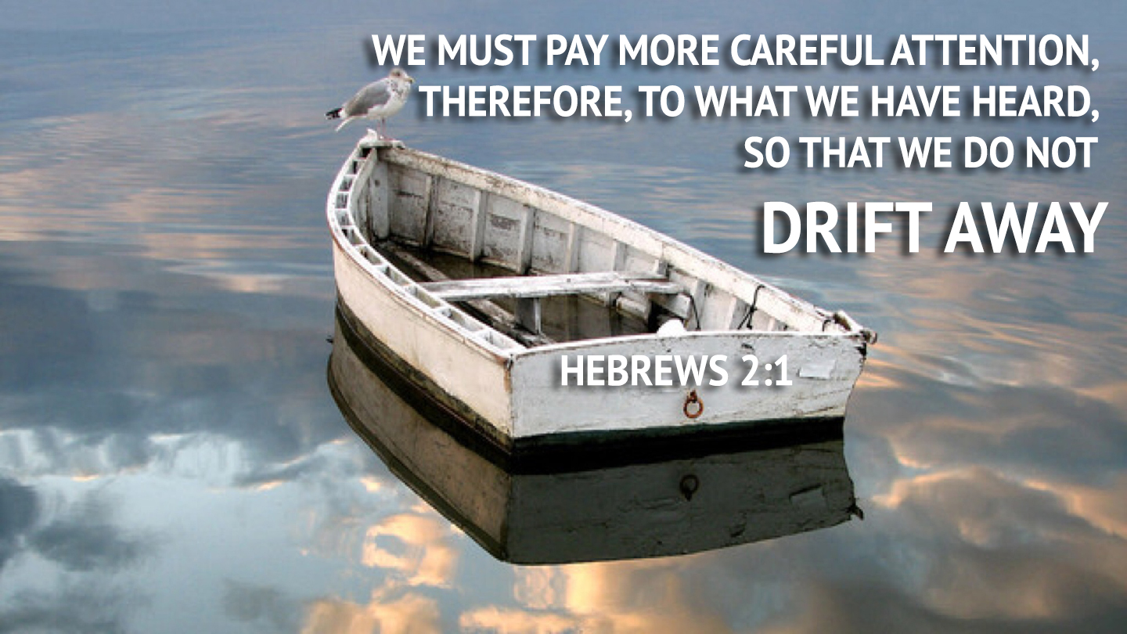
Hebrews chapter 2
WARNING #1:
Pay attention lest you drift (1-4).

Slide 13
Hebrews chapter 2
WARNING #1:
Pay attention lest you drift (1-4).
We can avoid drifting away by giving earnest heed to the things we have heard.
Absorbing what we have heard is more essential than seeking something new (1).
Overcoming the peril of drifting requires the discipline of application .
We cannot escape judgment if we neglect our great salvation; that disobedience to angels was punished, much more so if we neglect the Lord himself (2-3).

Slide 14
Hebrews chapter 2
WARNING #1:
This great salvation was revealed and confirmed to us first by the Lord himself, and by those who heard him (3).
Neglecting God’s salvation inevitably leads to inescapable consequences.
Further, God bore witness through signs, wonders, miracles, and gifts of the Holy Spirit (4).
Open your ears to hear God’s voice of correction. Be aware of the danger of spiritual drift.

Slide 15
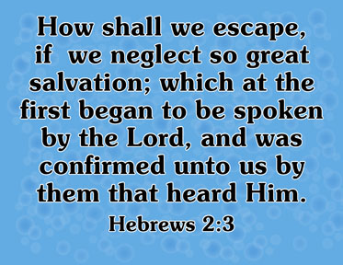

Slide 16


Slide 17
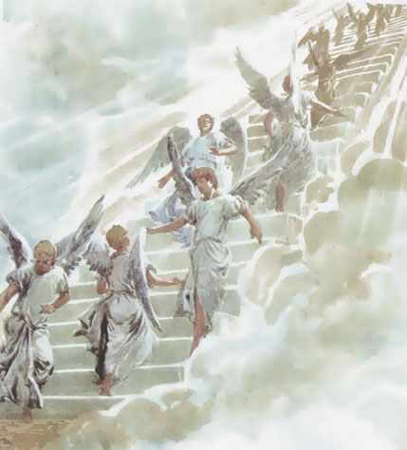
Hebrews chapter 2
SUPERIORITY:
Jesus is superior (better) than the angels (5).
Jesus was made lower than angels, but is placed over and above all of God’s works (6-9).

Slide 18
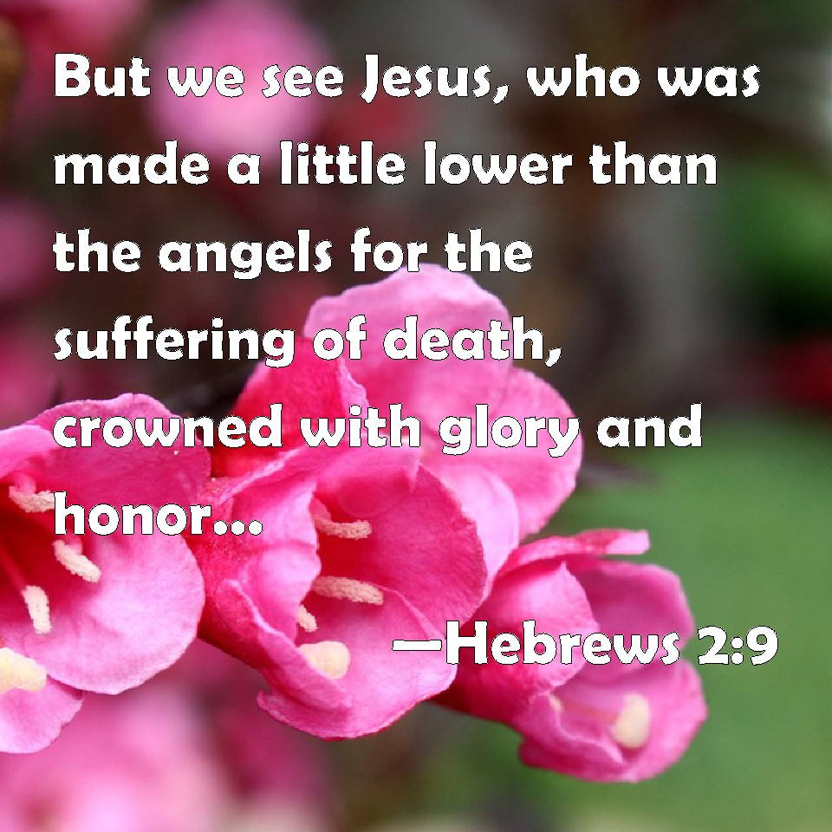
Hebrews chapter 2
Eight reasons Jesus was made lower than angels (9-18)
[1] To be made perfect through sufferings: “for the suffering of death” (9).

Slide 19
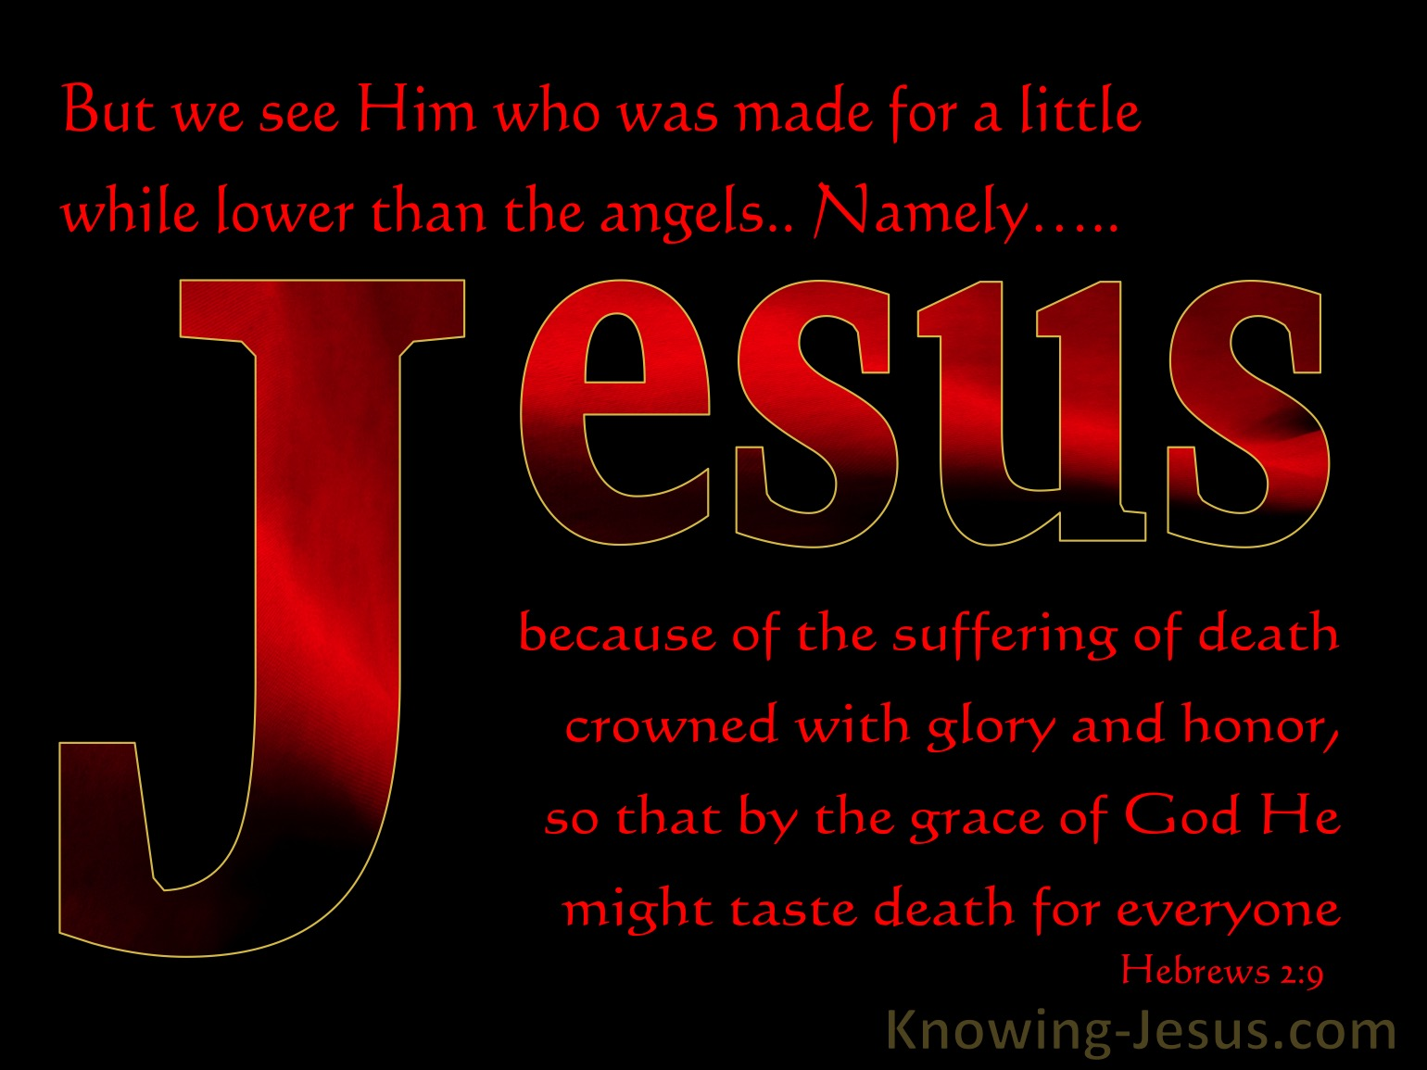
Hebrews chapter 2
Eight reasons Jesus was made lower than angels
[2] To taste death for every one: “that he by the grace of God should taste death for every man” (9).

Slide 20
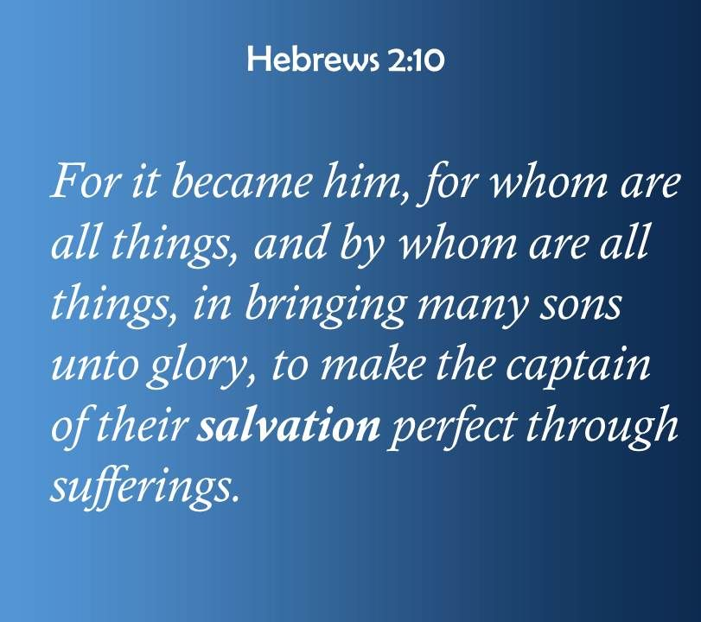
Hebrews chapter 2
Eight reasons Jesus was made lower than angels
[3] To bring many sons to glory: “in bringing many sons unto glory” (10).

Slide 21
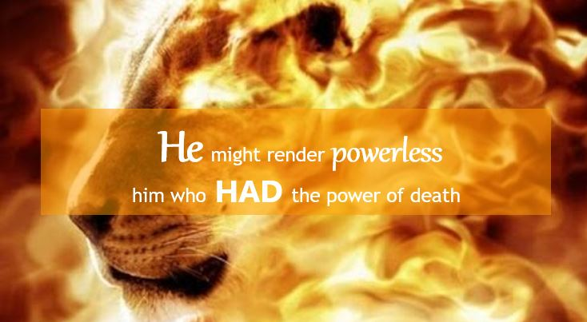
Hebrews chapter 2
Eight reasons Jesus was made lower than angels
[4] To destroy the devil who had the power of death: “that through death he might destroy him that had the power of death, that is, the devil” (14).

Slide 22
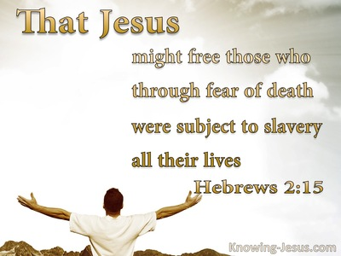
Hebrews chapter 2
Eight reasons Jesus was made lower than angels
[5] To release those subject to bondage through fear of death: “deliver them who through fear of death were all their lifetime subject to bondage” (15).

Slide 23
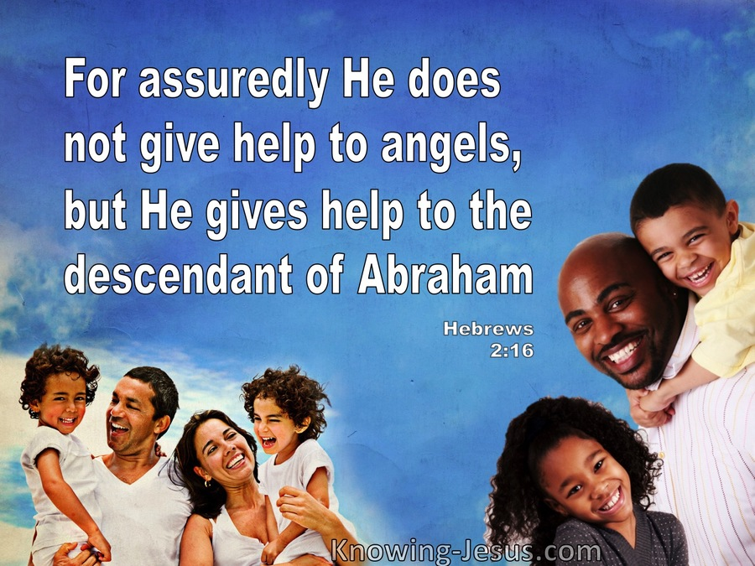
Hebrews chapter 2
Eight reasons Jesus was made lower than angels
[6] To give aid to the seed of Abraham: “he took on him the seed of Abraham” (16).

Slide 24
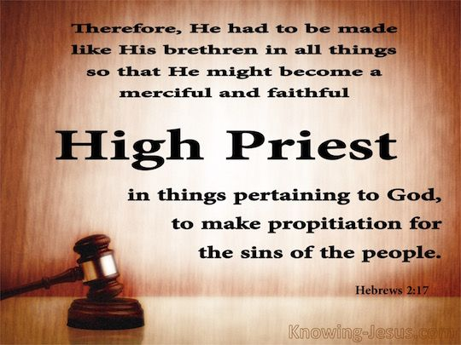
Hebrews chapter 2
Eight reasons Jesus was made lower than angels
[7] To be a merciful and faithful High Priest: “that he might be a merciful and faithful high priest” (17).

Slide 25
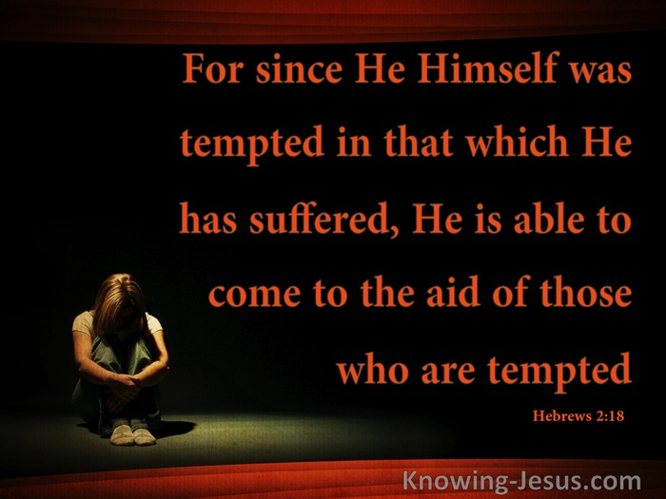
Hebrews chapter 2
Eight reasons Jesus was made lower than angels
[8] To aid those who are tempted, having suffered temptation Himself: “that he himself hath suffered being tempted” (18).

Slide 26


Slide 27
Hebrews chapter 2
Application of Chapter 2
[1] – We need to focus fully on Christ . . .
  Let us focus on Christ and the way things are going to be when He returns.
  We need to focus on Jesus in times of grief, loss, tragedy, doubt, disillusionment , loneliness, brokenness, and despair.
  Only then will we be able to look beyond the darkness of this world to see the rays of the sun on the horizon.

Slide 28
Hebrews chapter 2
Application of Chapter 2
[2] – We need to acknowledge Christ as Savior . . .
  Jesus alone is the Author of our salvation. He penned it with His very blood.
  Jesus defeated sin, death, and the devil. Jesus has conquered all those things that had once conquered us.
  Before we can partake of the hope of perfection, we must spiritual connect with the Pioneer of Perfection. We can only do that by faith.

Slide 29
Hebrews chapter 2
Application of Chapter 2
[3] – We need to walk with Christ toward perfection . . .
  After we have accepted Christ as Savior by faith alone, we begin walking the path of sanctification. This is the process of being set apart from sin and consecrated to a life of holiness.
  We are set on a path toward the perfection that Christ has already accomplished for us through His suffering.
  Christ has become what we hope to be one day, when we are resurrected in our own glorious bodies.

Slide 30


Slide 31
NEXT CLASS – 23 Sept 2020
Letter to the Hebrews
Read before the next class in the KJV and in two other versions of the Bible, NKJV, NRSV, NIV, CEV, etc …
Chapter 3

