Slide 1
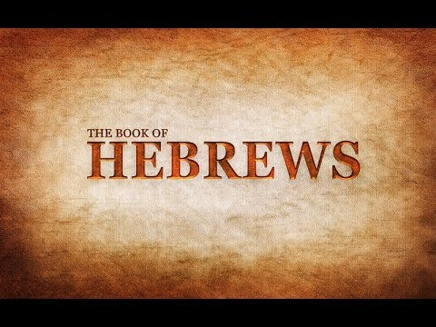
Jesus is Better Than Moses
Week 4
23 September 2020

Slide 2

Hebrews Introduction
Hebrew was written for Jewish believers who were torn between their new faith and their old ways.
The temptation was to slip back into familiar routines and rituals, settling for second best.
Paul skillful makes a case against such a digression. He argues that Jesus is better than every form of the old faith . . . prophets, angels, priest, etc.
When it comes to comparing the two, there is simply no comparison.

Slide 3
Hebrews
OUTLINE:
The Superiority of the Person of Christ
Jesus, Better than the Prophets (1:1-3).
Jesus, Better than the Angels (1:4 – 2:18).
Jesus, Better than Moses (3:1-19).

Slide 4
Hebrews chapter 1
REVIEW OF CH 1:
Jesus, Better than the Prophets (1:1-3).
Jesus is superior to prophets as spokesman >
“Who being the brightness of [God’s] glory, and the express image of his person . . . ” (1:1-3).

Slide 5
Hebrews chapter 1
REVIEW OF CH 1:
Jesus, Better than the Angels (1:4 – 2:18).
Jesus is superior to angels by virtue of His deity >
Angels are messengers and ministering spirits – while Jesus is the Son, the Creator, and Ruler of the age to come (1:4 – 2:18).

Slide 6
Hebrews chapter 2
REVIEW OF CH 2:
Jesus, Better than the Angels (1:4 – 2:18).
Paul interrupts his comparison of Christ with angels with his first of five warnings in this epistle >
a warning against drifting away (slipping back) from the faith by neglecting our great salvation (2:1-4).

Slide 7
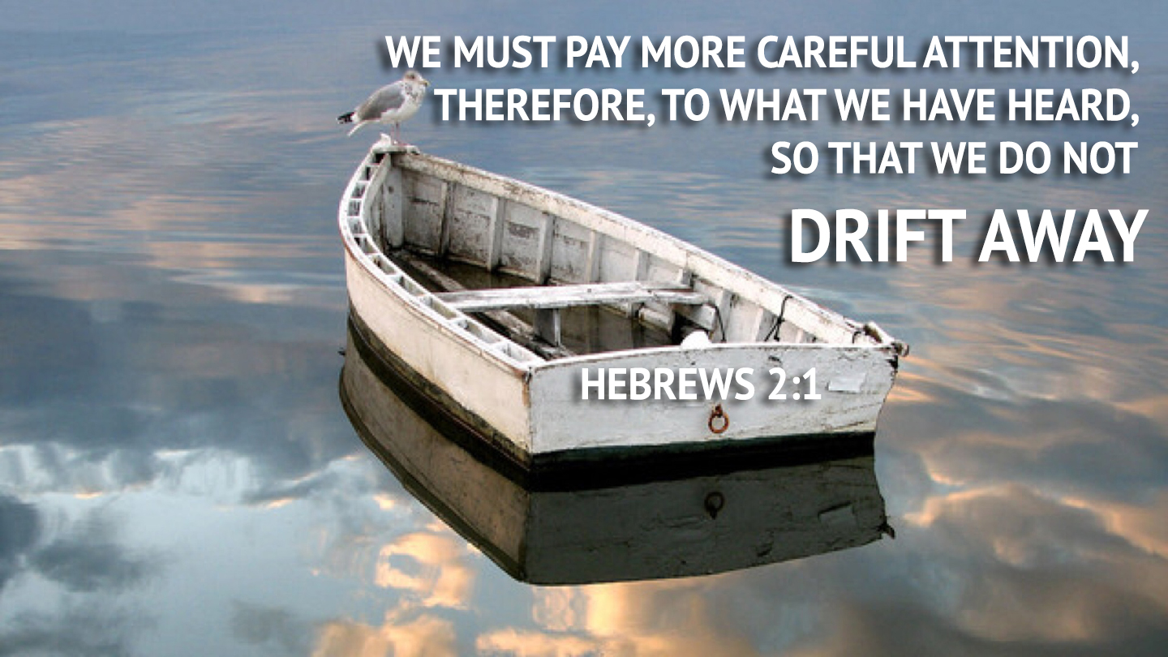
Hebrews chapter 2
REVIEW OF CH 2:
WARNING #1: Pay attention lest you drift away(2:1-4).

Slide 8
Hebrews chapter 2
REVIEW OF CH 2:
Jesus, Better than the Angels (1:4 – 2:18).
Paul then illustrates Jesus’ superiority to angels by being made lower than the angels, whereby Jesus became the perfect captain of our salvation and a merciful and faithful High Priest (2:5-18).

Slide 9

Moses

Slide 10
Hebrews chapter 3
OVERVIEW:
Having demonstrated Jesus’ superiority to prophets and angels, Paul now compares Jesus to Moses (1-6).
The comparison is followed with a reference to Israel’s unfaithfulness in the wilderness which leads to the second of six warnings in this epistle: a warning against developing a harden heart (evil) of unbelief against the living God (7-19).

Slide 11
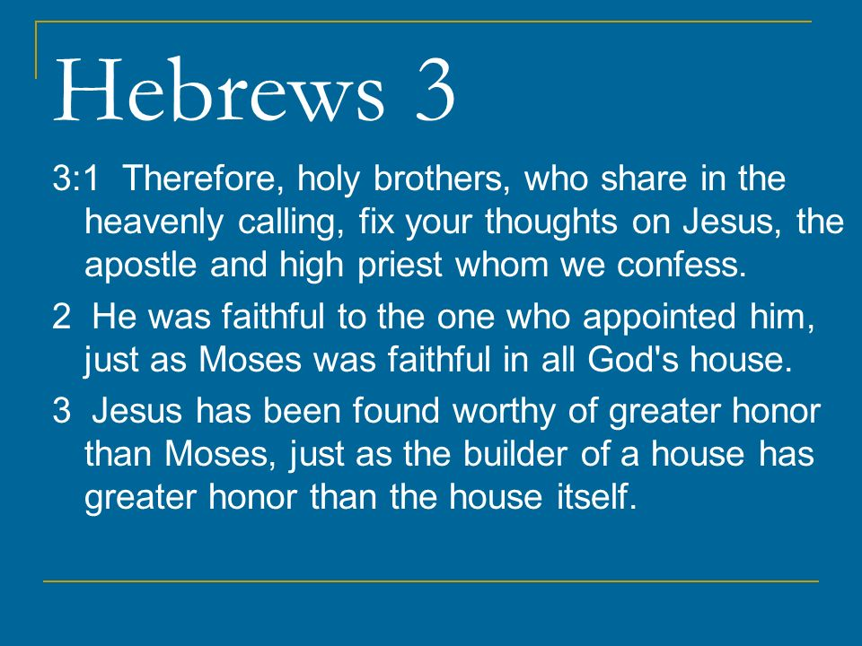

Slide 12
Hebrews chapter 3
REVIEW:
Paul declares that Jesus is superior to the kings, priests, leaders, and prophets of the OT . . . beginning with Moses.
Moses, the giver of God’s law – who, in the hierarchy of heroes in Israel’s history, had no equal.
To the Jewish people, Moses exhibited every aspect of strong spiritual and moral leadership.

Slide 13
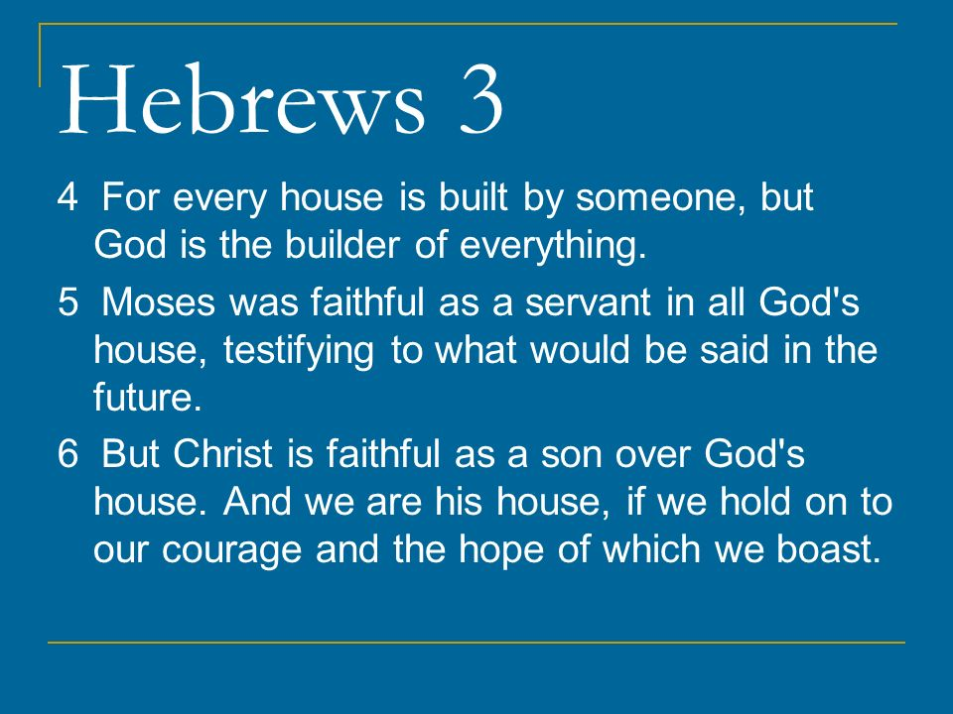

Slide 14
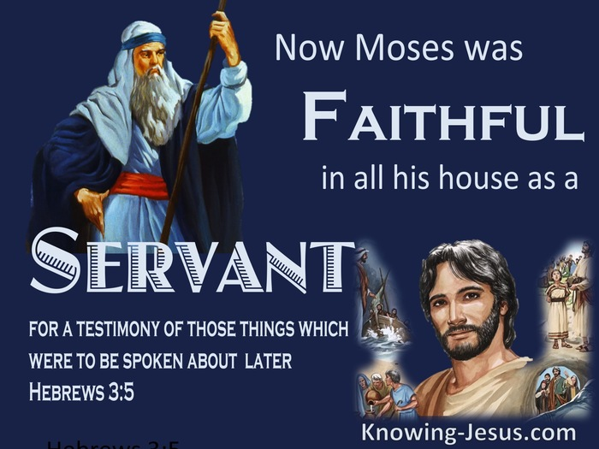

Slide 15
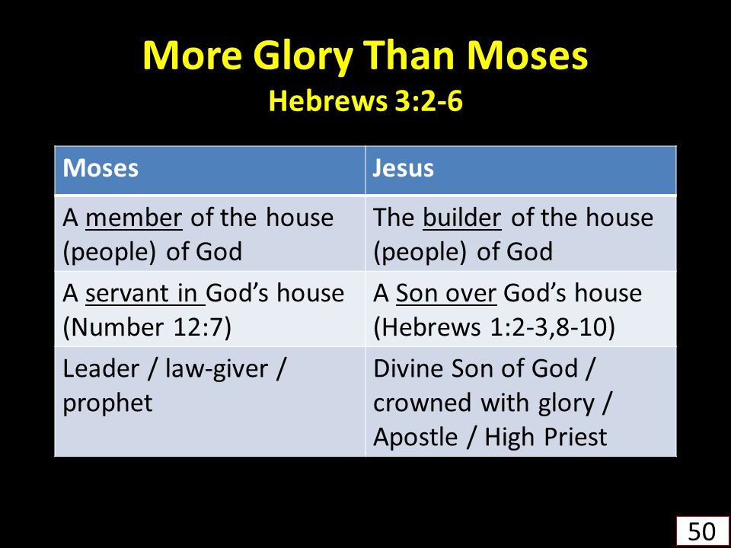

Slide 16
Hebrews chapter 3
REVIEW:
Moses had spoken face-to-face with God.
Moses had received the Law and passed it on to the nation of Israel.
Moses had revealed the plans for the tabernacle where sacrifices and offerings were to take place.
The Jewish mind was virtually incapable of imagining a person on earth equal to Moses.

Slide 17
Hebrews chapter 3
REVIEW:
Moses had led the people out of Egypt, provided guidance from God in the midst of their bickering and complaining, and had continued to lead them even after they rebelled against God and were forced to wander in the wilderness.
Moses had an impressive resume – and yet Paul says Moses was nothing compared to Jesus.
Just as Christ was faithful to God’s purpose, so should we – his followers – be faithful to the end.

Slide 18
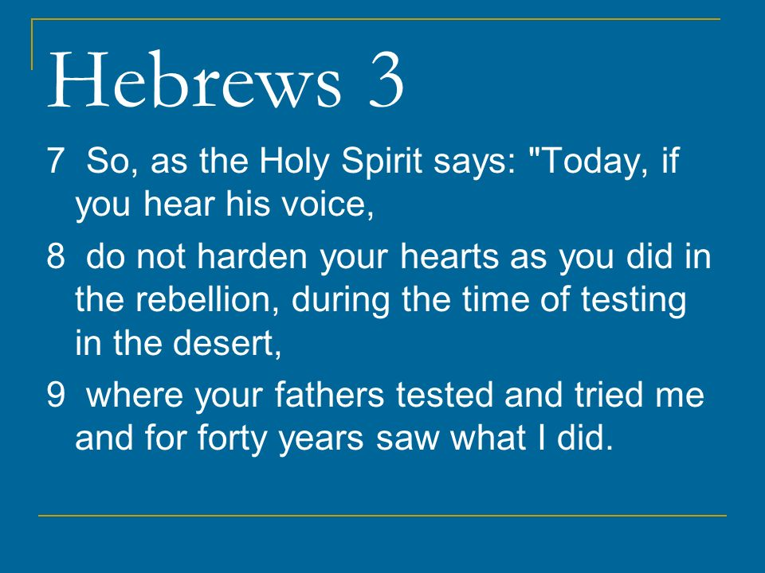

Slide 19
Hebrews chapter 3
WARNING #2:
Beware of a hard heart of disbelief against God (7-19).
Paul quotes from Psalm 95:8-11 > “Harden not your heart, as in the provocation, and as in the day of temptation in the wilderness: ⁹When your fathers tempted me, proved me, and saw my work. ¹⁰Forty years long was I grieved with this generation, and said, It is a people that do err in their heart, and they have not known my ways: ¹¹Unto whom I swore in my wrath that they should not enter into my rest.”

Slide 20
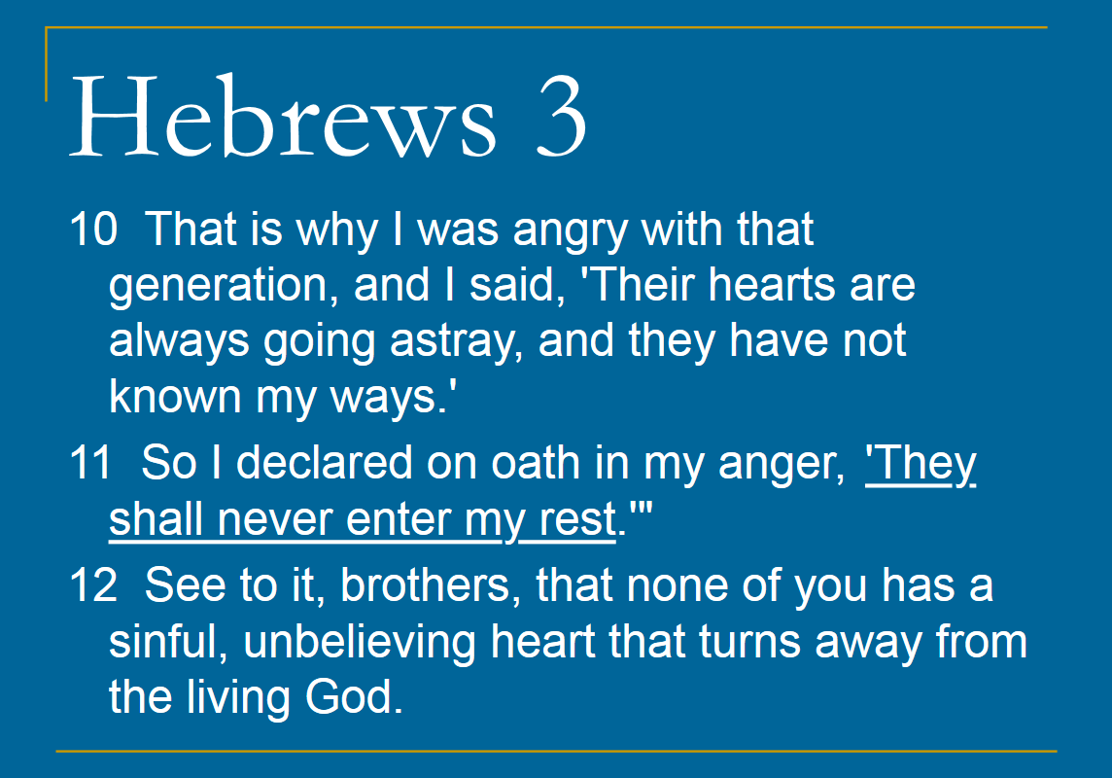

Slide 21
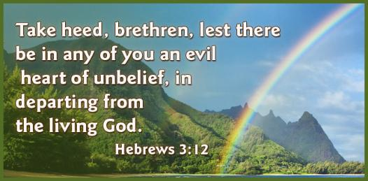

Slide 22
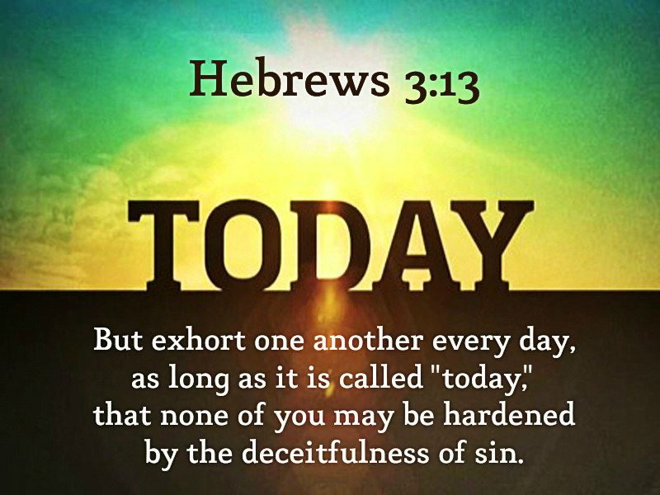

Slide 23
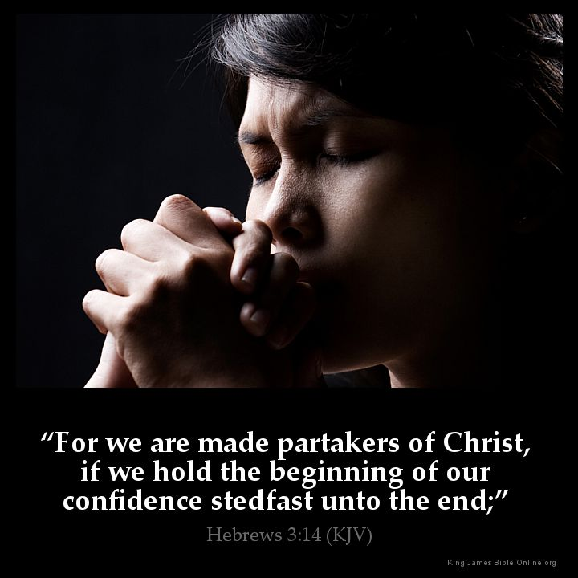

Slide 24
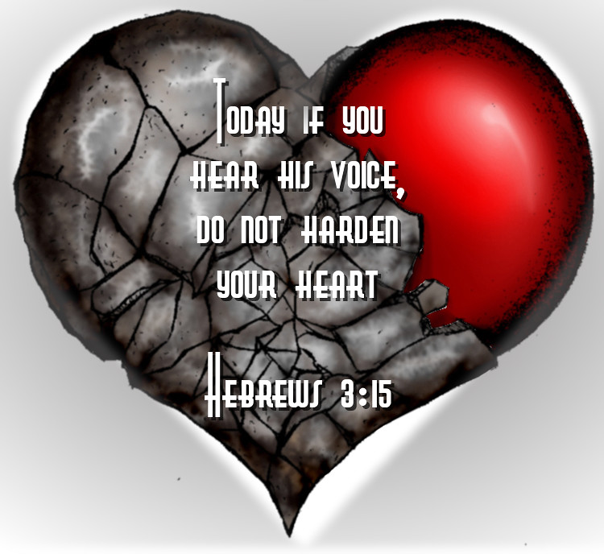

Slide 25
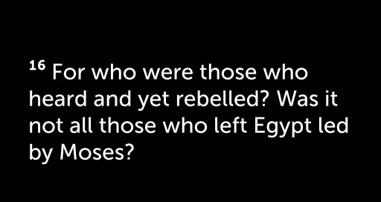

Slide 26
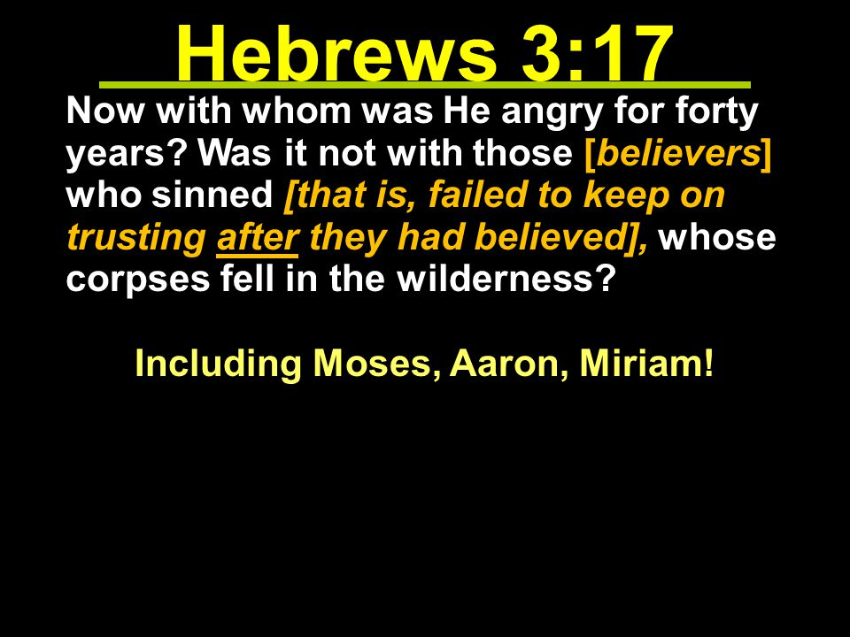

Slide 27
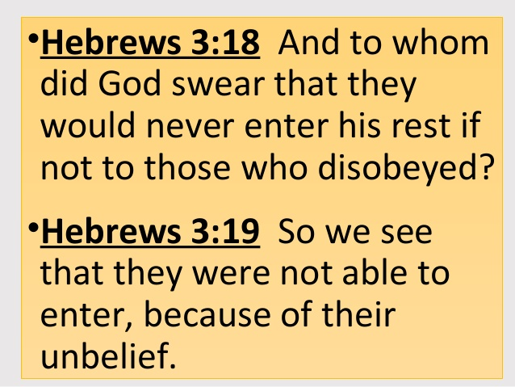

Slide 28
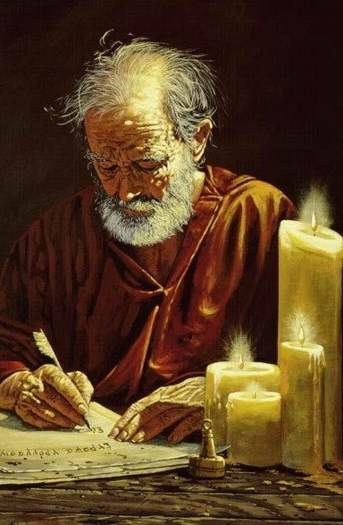
Hebrews chapter 3
POINTS TO PONDER IN CH 3:
How Jesus compares to Moses (1-6).
The very real danger of an evil and harden heart that leads to an unbelief in the living God (7-19).
Apostle Paul

Slide 29
Hebrews chapter 3
Application of Chapter 3
[1] – We need a daily dose of mutual encouragement
  We must exhort one another day after day so that none of us will be “hardened through the deceitfulness of sin” (v13).
  It involves spending time with one another, life-on-life – the kind of fellowship one finds in a close-knit church community.
  You get to know the struggles and temptations of others while they get to know yours. Only then can we exhort and encourage one another in this way.

Slide 30
Hebrews chapter 3
Application of Chapter 3
[2] – We need the daily discipline of personal perseverance
  We will show forth the evidence of our faith when we “holdfast the beginning of our assurance firm until the end” (v14).
  The perseverance of our faith in time of testing demonstrates our readiness to enter into God’s rest (18).

Slide 31
Hebrews chapter 3
Application of Chapter 3
[2] – We need the daily discipline of personal perseverance
  We need to seek refuge in God, He alone can give us “the peace” that will guard our hearts and minds.
  Only then will we begin to understand what it means to truly enter God’s rest (18).

Slide 32
Recap
of the
Warnings

Slide 33
Hebrews
WARNINGS:
Pay Attention lest you Drift Away (2:1-4)
Beware of a Hard Heart (3:7-4:13)

Slide 34



the end
Questions
Questions

Slide 35
NEXT CLASS – 23 Sept 2020
Letter to the Hebrews
Read before the next class in the KJV and in two other versions of the Bible, NKJV, NRSV, NIV, CEV, etc …
Chapter 4

Slide 36


