Slide 1

Jesus is Better Than Joshua
Week 5
30 September 2020

Slide 2

Hebrews Introduction
Paul wrote this letter to Jewish Christians who were torn between their new faith and their old ways . . . that is, abandoning the Christian faith in Jesus.
Their temptation was to slip back into familiar routines and rituals, settling for second best.
Paul skillfully argues that Jesus is better than every form of the old faith . . . prophets, angels, priest, etc.
When it comes to comparing the two, there is simply no comparison.

Slide 3
Hebrews review
Chapter 1: Jesus, Better than the Prophets (1:1-3)
Jesus is superior to prophets as spokesman > Who being the brightness of God’s glory, and the express image of his person.
Chapter 1: Jesus, Better than the Angels (1:4 – 14)
Jesus is superior to angels by virtue of His deity > Angels are messengers and ministering spirits – while Jesus is the Son, the Creator, and Ruler of the age to come.

Slide 4
Hebrews review
Chapter 2: Jesus, Better than the Angels (2:1-14)
Paul then illustrates Jesus’ superiority to angels by being made lower than the angels, whereby Jesus became the perfect captain of our salvation and a merciful and faithful High Priest.
Paul interrupts his comparison of Christ with angels with his first of five warnings in this epistle > a warning against drifting away (slipping back) from the faith by neglecting our great salvation (2:1-4).

Slide 5
Hebrews review
Chapter 3: Jesus, Better than Moses (3:1-19)
Having demonstrated Jesus’ superiority to prophets and angels, Paul now compares Jesus to the law-giver Moses (3:1-6).
The comparison is followed with a reference to Israel’s unfaithfulness in the wilderness which leads to the second of six warnings in this epistle > a warning against developing a harden heart (evil) of unbelief against the living God (3:7-19).

Slide 6
Hebrews warnings
#1 – Pay Attention lest you Drift Away (2:1-4)
#2 – Beware of a Harden Heart (3:7-4:13)

Slide 7
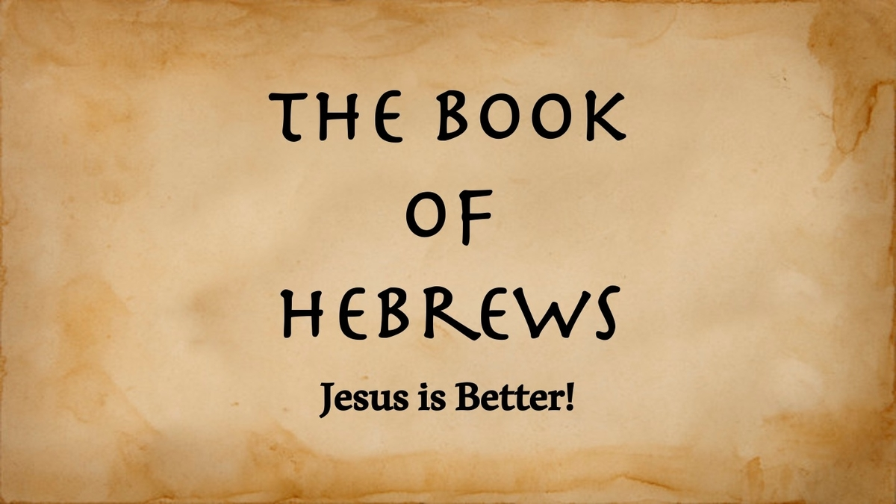
than . . . Joshua

Slide 8
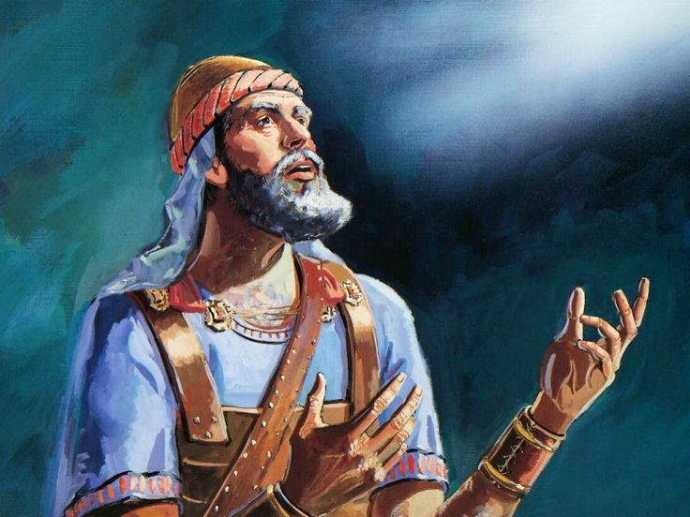
Joshua

Slide 9
Hebrews chapter 4
Points to Ponder:
In v8 (KJV): the name “Jesus” should be translated “Joshua” which means “savior” and “salvation”
Three Rest: the Sabbath rest (4), the Canaan rest (5), and the Heavenly rest (9).
Scriptures: God’s Word living, active, and sharper.
Prayer: the privilege of praying to Jesus Christ as our High Priest and Source of Help.

Slide 10
Hebrews chapter 4
Overview:
Since many Israelites failed to enter the Promise Land (Canaan Rest) because of unbelief, Paul says we should fear lest we come short of our promised Heavenly Rest (1-10).
Diligence is also required, and a restating of the second warnings > developing unbelief from a hard heart due to ignoring the Word of God (11-13).
A positive motivation is then given through our great High Priest, Jesus, who enables us to obtain mercy and find grace as help whenever needed (14-16).

Slide 11
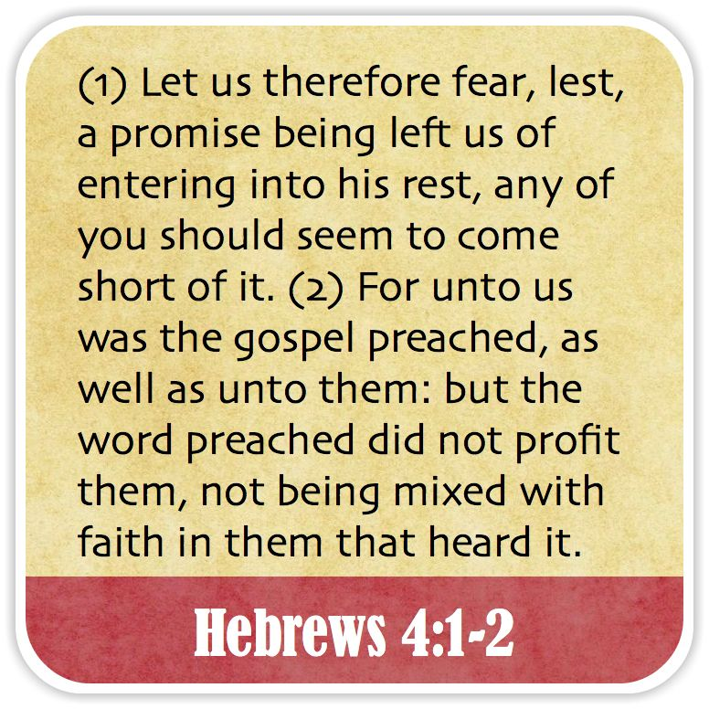

Slide 12
Hebrews chapter 4
Discussion:
Paul ties chapter 3 and chapter 4 together with the word “therefore” (1)
Jesus is better than Joshua, because Jesus’s rest is eternal, whereas Joshua’s rest was only temporary.
God promised Israel that they could enter and posses the land of Canaan and attain rest from their wanderings and their enemies.

Slide 13
Hebrews chapter 4
Discussion:
Instead of entering God’s rest, Israel resisted God in hardness of heart and unbelief. They exchanged abundant joy and refreshing rest for generation after generation of anxious, sadness and sorrow.
We must “fear” God with all honor, respect, and deference. We must not, like the ancient Hebrews, fear those worldly obstacles thrown in our paths (1).
Rather, we must fear and keep God’s commands in faith, in spite of distractions and obstructions.

Slide 14
Hebrews chapter 4
Discussion:
Paul makes it clear that simply hearing good preaching does not enable anybody to enter into spiritual rest > a rest from fear, melancholy, or stress.
HEARING + BELIEVING = RESTING (formula)
The Israelites who were with Moses had heard the promise of entering Canaan, but it did them no good because they failed to embrace that promise by faith.
Had they believed the gospel “good news” preached, they would have acted with confidence (2).

Slide 15
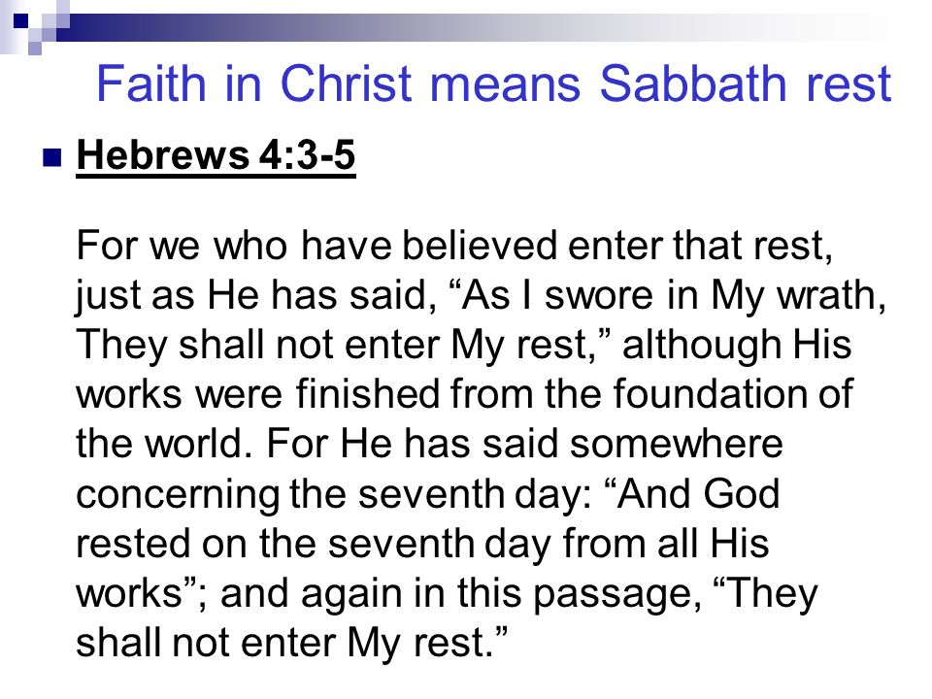

Slide 16
Hebrews chapter 4
Discussion:
Paul reminds his readers of God’s own work of creating the world in six days before resting on the seventh day (4).
God invited humanity to join Him in Sabbath Rest through fellowship and faith.
At Kadesh-barnea, God invited the ancient Israelites to join Him in promised rest, but they saw giants and not God. Therefore, God was disappointed with them and swore they would not enter “my rest” (5).

Slide 17
Hebrews chapter 4
Discussion:
HEARING + BELIEVING = RESTING . . .
If we ignore the “formula,” there will be no rest, only wandering.
Because the principle of faith undergirds everything God does in the lives of His people, failure to respond to His Word by faith, unbelief will result in God’s discipline rather than God’s blessings.
All we need is to trust God at His word and that God will act on His promises (6).

Slide 18
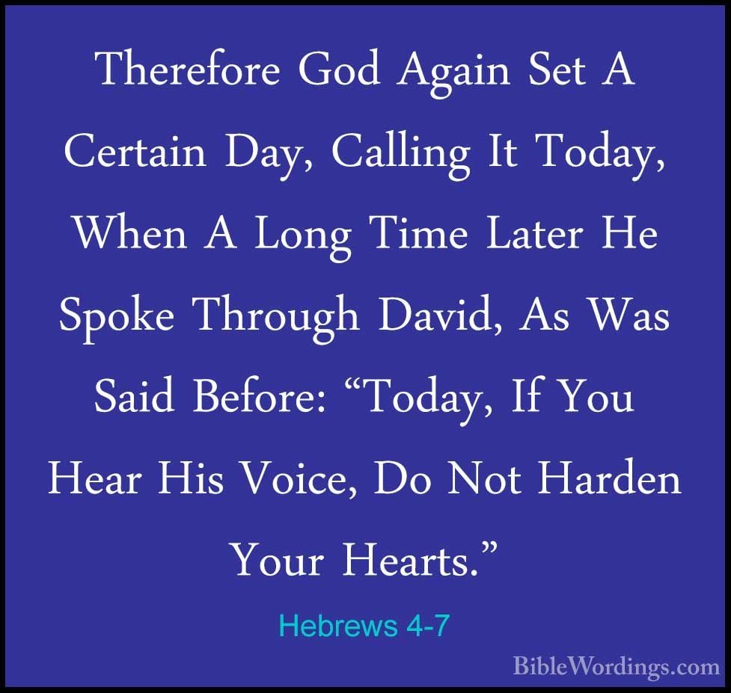

Slide 19
Hebrews chapter 4
Discussion:
Here, Paul quotes David from Psalm 95:7-8 > “For he is our God; and we are the people of his pasture, and the sheep of his hand. To day if ye will hear his voice, ⁸Harden not your heart, as in the provocation, and as in the day of temptation in the wilderness.”
A restating of the second warning > “harden not your heart” through unbelief (7).

Slide 20
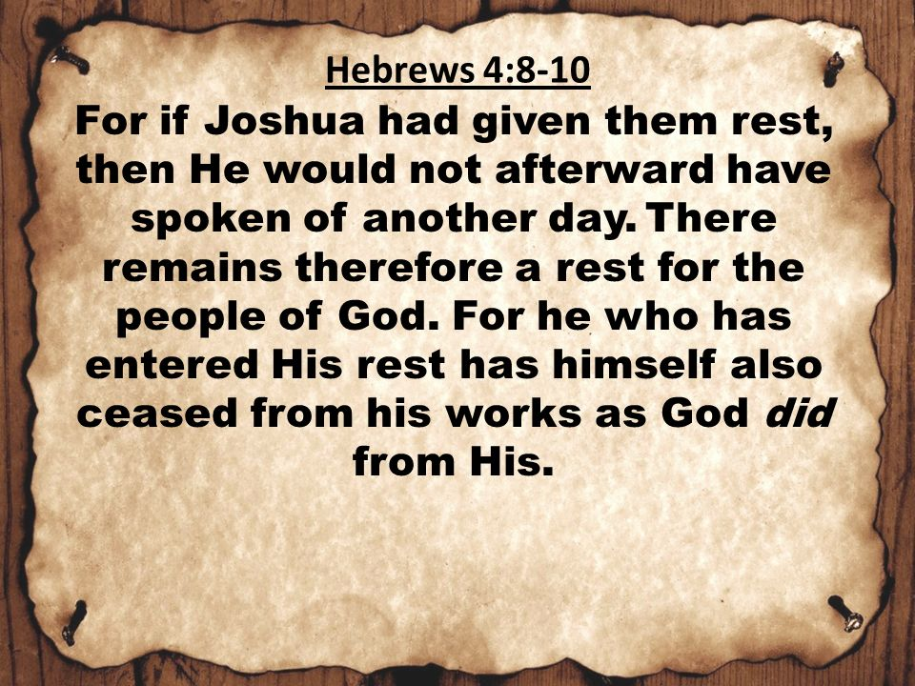

Slide 21
Hebrews chapter 4
Discussion:
The same kind of rest God entered into after His work of creation “remains” for us (9).
All we need to do to enter that rest is surrender our anxieties – and by faith – take God at His word.
God has purchased and prepared for us a reserved seat at the banquet table by sending His Son Jesus, who accomplished the work of salvation (10).
Our eternal rest is in Jesus Christ!

Slide 22
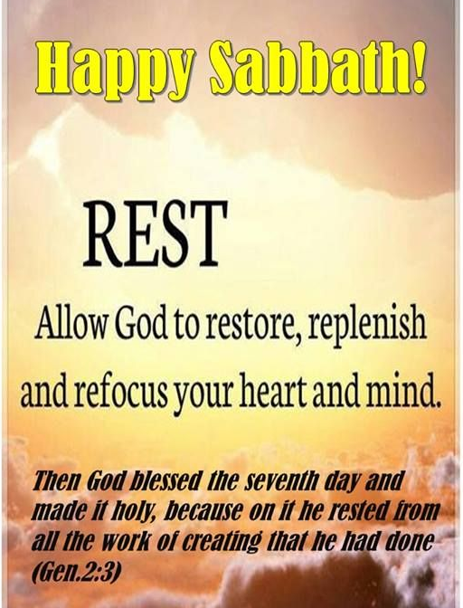

Slide 23
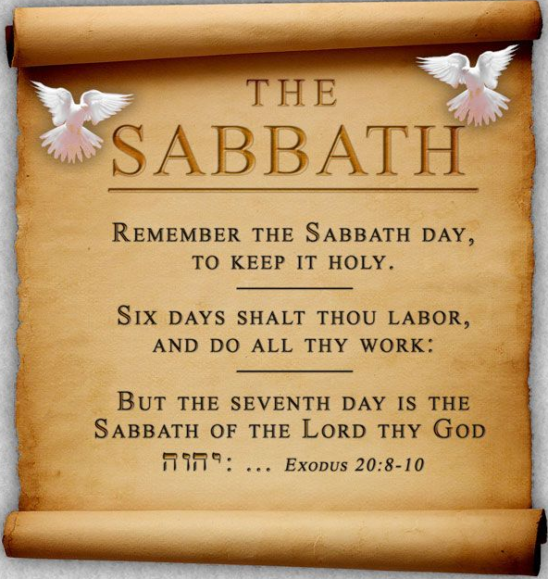

Slide 24
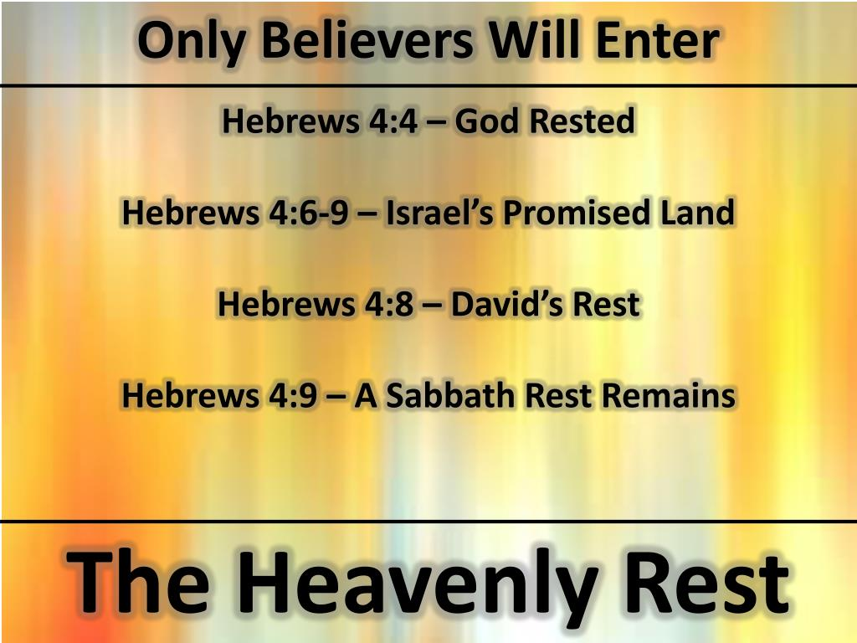

Slide 25
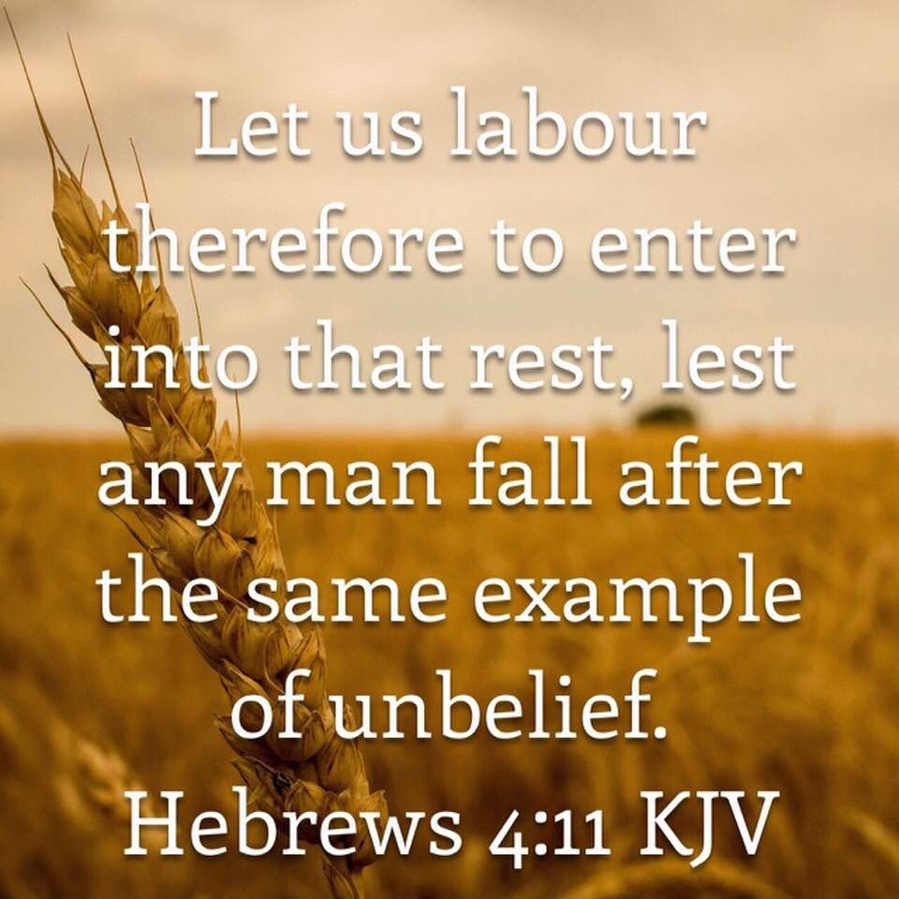

Slide 26
Hebrews chapter 4
Discussion:
Paul concludes this section where he began: warning his readers with the example of Israel’s failure to enter the “rest” of the Promise Land because of a harden heart of unbelief.
With all the labor accomplished on our behalf and nothing required of us but faith, no one should end up falling short of entering spiritual rest (11).
Common symptoms of a harden heart include the pride and panic that prevent believers from experiencing the healing rest of God (1-11).

Slide 27
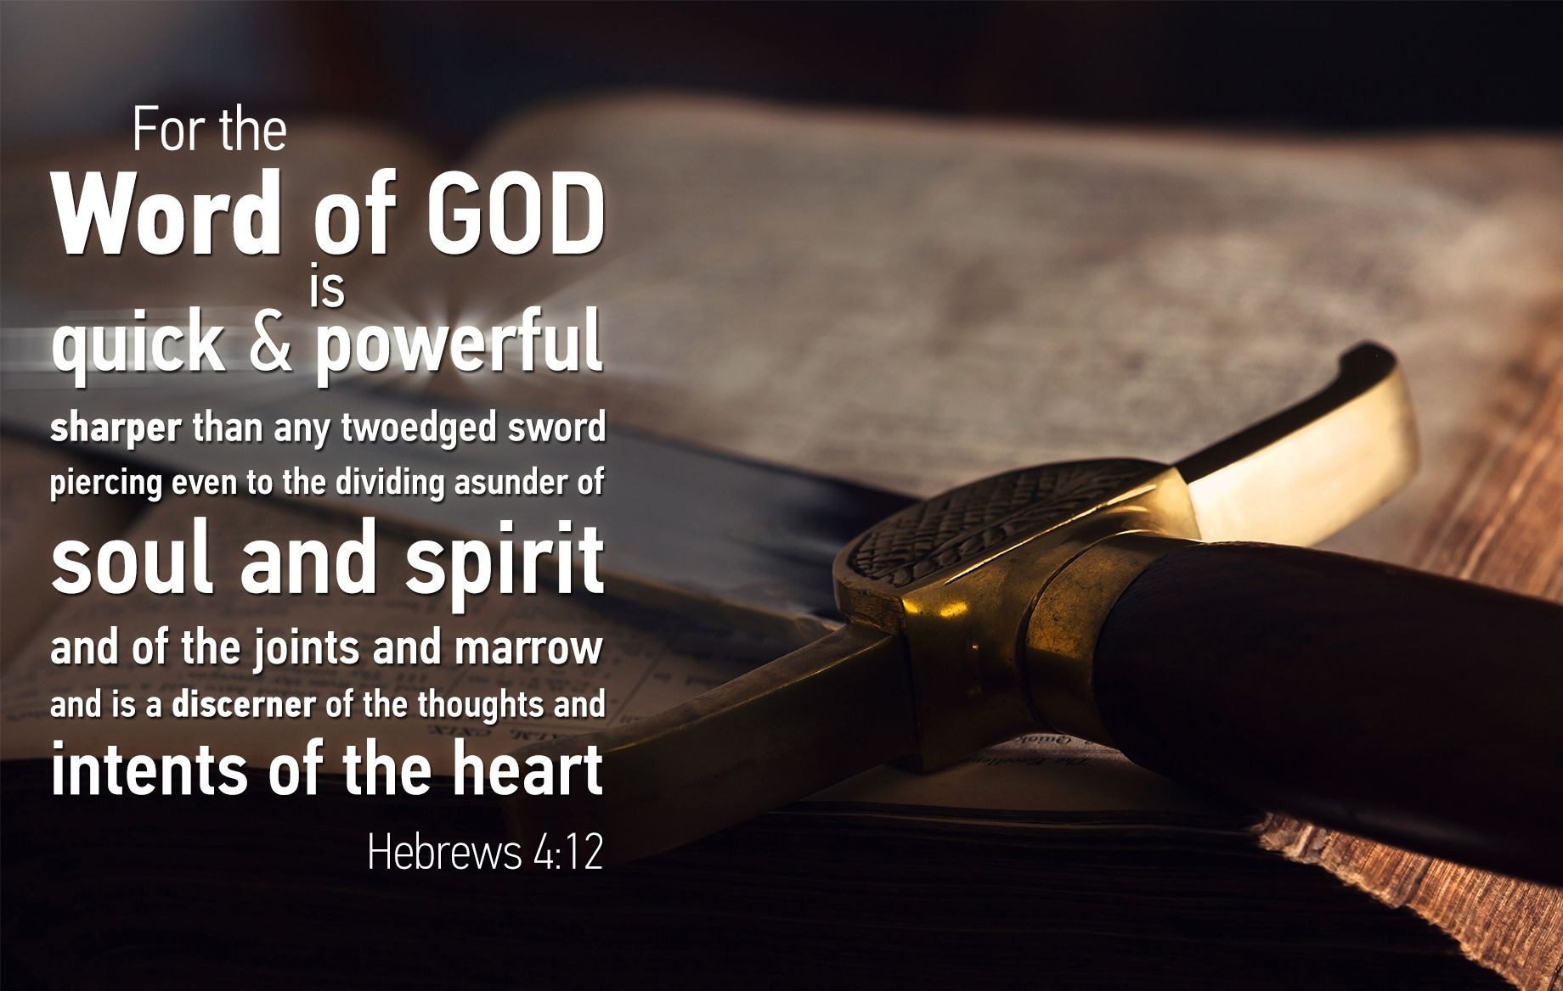

Slide 28
Hebrews chapter 4
Discussion:
With the notion of a “harden heart” occupying the previous section, Paul turns our attention to the Word of God.
The Word of God includes anything that communicates God’s revealed truth.
Scripture (the written Word) and Christ (the Word incarnate) reveals God’s truth with verbal infallibility.
God’s life-giving message nourishes, heals, and refreshes those who hear it in faith (12).

Slide 29
Hebrews chapter 4
Discussion:
Paul uses three words to describe what God’s word is like: LIVING, ACTIVE, and SHARP . . .
LIVING: it is alive.
The Bible is no dead book; the gospel message is no empty promise; and Jesus is no mere figure of history buried by centuries of myths and legends.
Jesus is alive! The gospel saves! And the Bible is always relevant to everyday life.

Slide 30
Hebrews chapter 4
Discussion:
Paul uses three words to describe what God’s word is like: LIVING, ACTIVE, and SHARP (cont)
ACTIVE: that is, it’s energizing.
The Bible is effective and powerful. It accomplishes what it sets out to do. It does what nothing else can do.
“The vigor and potency of His word are seen in its operation as his created word, sustaining word, and regenerating word” [Philip Hughes].

Slide 31
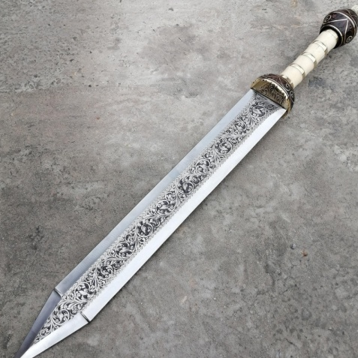
Hebrews chapter 4
Discussion:
Paul uses three words to describe what God’s word is like: LIVING, ACTIVE, and SHARP (cont)
SHARP: a modern-day scalpel.
The Bible is sharper than any two-edged sword.
That is, the Word of God isn’t a blunt instrument used to bludgeon God’s opposition. Rather, it has a razor-thin edge that can precisely cut through whatever it penetrates.

Slide 32
Hebrews chapter 4
Discussion:
Paul uses two words to describe what God’s word is capable of doing: PIERCING and JUDGING . . .
PIERCING: to move thru a three dimensional space.
The Bible penetrates deeply into the innermost life.
That is, the Word of God can probe so deeply that it can separate things not normally separated: soul from spirit and joints from marrow.

Slide 33
Hebrews chapter 4
Discussion:
Paul uses two words to describe what God’s word is capable of doing: PIERCING and JUDGING (cont)
JUDGING: a mental sense of discerning or analyzing.
The Bible is able to sift through or discern the thoughts and intentions of the heart.
That is, God’s probing truth functions like a CAT Scan that can show details like nothing else can, revealing our deepest feeling, desires, motives, and passions.

Slide 34
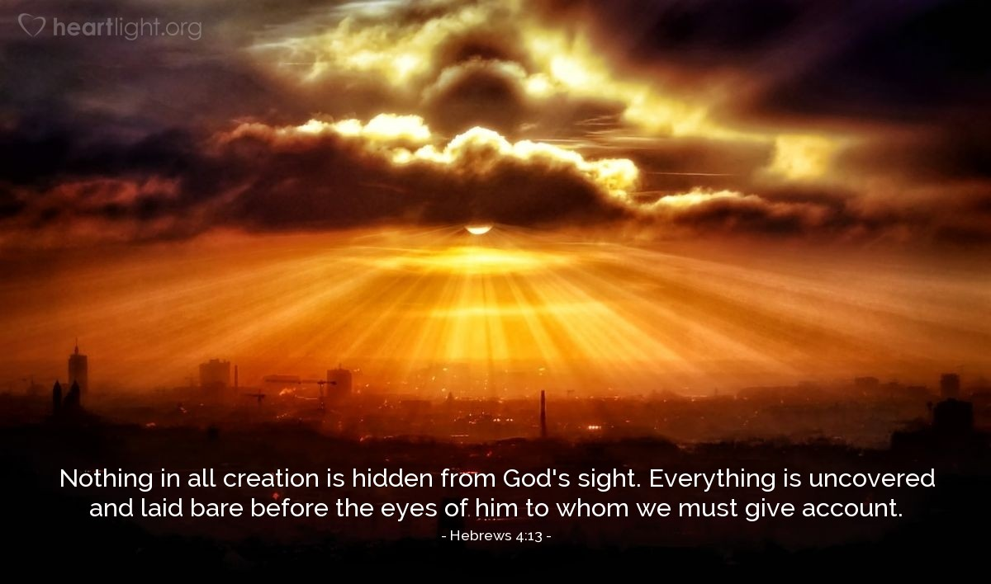
In the hands of a loving Master Surgeon, imagine what such a razor-sharp spiritual instrument can accomplish. This is Paul’s precise meaning in this verse.

Slide 35
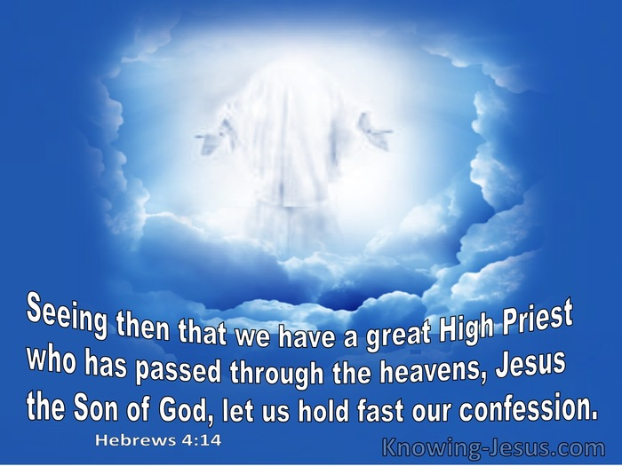

Slide 36
Hebrews chapter 4
Discussion:
Jesus, the Word of God incarnate, is the One who bears the blade of the inspired word of God – not as a sword to punish, but as a scalpel to heal (14).
By delving deeply into our lives to uncover the thoughts and intention of our hearts (13), Jesus can strengthen our confession of faith and lead us into the Spiritual Rest God has made available to His people (11).

Slide 37
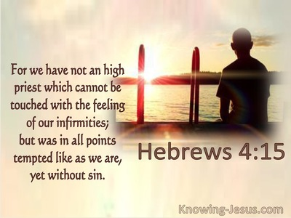

Slide 38
Hebrews chapter 4
Discussion:
The two natures of Christ – His full deity and full humanity – are clearly manifested in the juxtaposition of 4:14-16.
In v14 – we are reminded that Jesus is the “Son of God” who has passed through the heavens.
In v15 – we are reminded of Jesus’ humanity . . . that He was tempted throughout His earthly life.
Jesus didn’t float through life in a state of numbness, He saw, heard, and felt all the trials and temptations.

Slide 39
Hebrews chapter 4
Discussion:
But unlike us, Jesus did not sin – not in thought, nor in word, and not in deed.
Because of His humanity, Jesus can sympathize with our weaknesses and infirmities.
Jesus has been tested as we are tested, weak as we are weak, suffered as we suffer – yet coming through victoriously (15).

Slide 40
Hebrews chapter 4
Discussion:
DEBATE: whether or not Christ could have sinned.
That is, “Was Jesus able to not sin?” or “Was Jesus not able to sin?”
PECCABILITY > the term that Christ could have sinned but chose not to sin is termed “able not to sin.”
IMPECCABILITY > the term that Christ could not have sinned because He was incapable of sinning is referred to as “not able to sin.”

Slide 41
Hebrews chapter 4
Discussion:
PECCABILITY > the Arminians generally believe that Christ could have sinned but did not.
Those holding this view do so on the basis of Hebrews 4:15 > Jesus “was in all points tempted like as we are, yet without sin.”
If the temptation was genuine then Christ had to be able to sin, otherwise the temptation was not a genuine temptation.

Slide 42
Hebrews chapter 4
Discussion:
IMPECCABILITY > generally (not always), Calvinists believe that Christ could not have sinned because He was incapable of sinning or “not able to sin.”
Those who hold to this view suggest that Christ’s temptation by Satan was genuine, but it was impossible for Christ to sin.
In fact, the immutability of Christ (Heb. 13:8) states that Jesus is unchangeable and therefore could not sin. If He could have sinned on earth, then He could sin now because of His immutability.

Slide 43
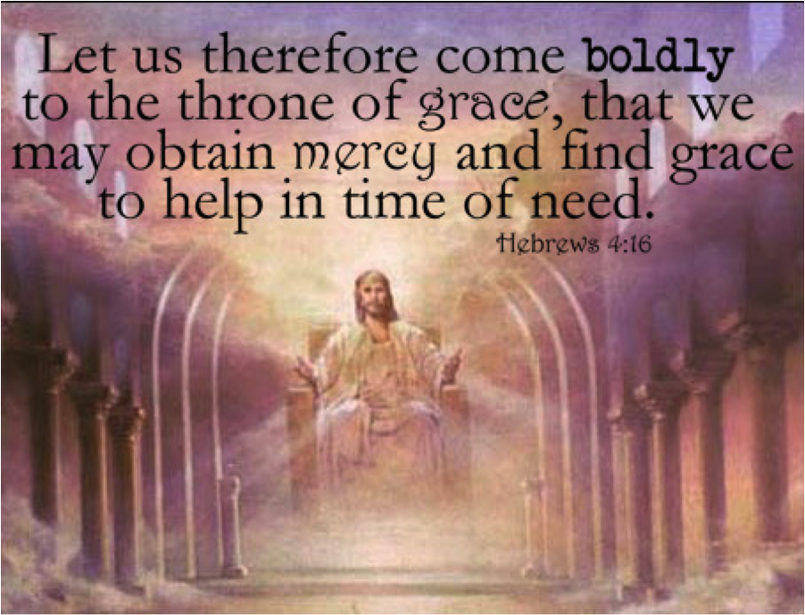

Slide 44
Hebrews chapter 4
Discussion:
Therefore, Jesus is able to offer us grace – if we draw boldly unto Him.
As the perfect man who has identified with humans fully, Jesus is a sympathetic High Priest for us (14).
As the perfect God who knows our weaknesses completely, He is an able Healer. As the incarnate God-man, Jesus is both willing and able to give us mercy “in time of need” (16).

Slide 45


Slide 46
Hebrews chapter 4
Points to Remember:
Salvation: Jesus our Savior is better than Joshua.
Three Rest: the Sabbath rest (4), the Canaan rest (5), and the Heavenly rest (9).
The Word of God: it’s living, active, and sharper.
Prayer: the privilege of prayer with Jesus as both our High Priest and Source of Help.

Slide 47
Hebrews chapter 4
Application of Chapter 4
[1] – We must overcome the enemies of rest.
  The first enemy is panic, which says, “You’re not going to make it.” When panic kicks in, we begin to see our problems as so big that not even God can handle them. Resist the panic, enter into His rest today.
  The second enemy is pride, which says, “You can handle your problems on your own.” When pride show up, it convinces us that we actually don’t need God’s help. We don’t need His rest.

Slide 48
Hebrews chapter 4
Application of Chapter 4
[2] – We must submit to God‘s healing touch.
  When Jesus finished his earthly work on the cross, He begun his heavenly work as our High Priest.
  Today, Jesus stands ready to hear our pleas and petitions. He is able to empathize with our pains and problems.
  Stop fighting the Great Physician. Let’s surrender our sins to Him. In prayer, let us confess our unwillingness and our unworthiness.

Slide 49
Hebrews chapter 4
Application of Chapter 4
[3] – We must draw near to Christ.
  Christ has invited us to come to Him so he can give us rest from our weariness and heavy burdens.
  Don’t resist, show up for His appointment and allow Him to probe and pierce with His living, active, and sharper word.
  That is, read you Bible, pray every day, and attend worship service on the Sabbath.

Slide 50
Hebrews warnings
Review of Warnings
#1 – Pay Attention lest you Drift Away (2:1-4)
#2 – Beware of a Harden Heart (3:7 – 4:13)

Slide 51
NEXT CLASS – 7 October 2020
Letter to the Hebrews
Read before the next class in the KJV and in two other versions of the Bible, NKJV, NRSV, NIV, CEV, etc …
Chapter 5

Slide 52



the end
Questions
Questions

Slide 53


