Slide 1

Jesus is Better Than
Aaron as High Priest
Week 6
7 October 2020

Slide 2

Hebrews Introduction
Paul writes this letter to Jewish Christians who were torn between their new faith in Christ and their desire to returning to the old ways of the Mosaic Law.
That is, abandoning the Christian faith in Jesus for the familiarity of the old lifestyle under the Law.
Paul skillfully argues how Jesus is superior (better) to prophets, angels, Moses, Joshua, Aaron, etc.

Slide 3
Hebrews introduction
Paul presents clear and compelling proof that Christ is superior in His person. Christ stands in a place of preeminence over the prophets (1:1-3) and shines brighter than the angels (Ch 1-2).
Christ stands out over Moses and Joshua (Ch 3-4).
In His ministry, Christ provides a greater spiritual rest than the Law, while His word reaches deep into our hearts to heal us (Ch 4).

Slide 4
Hebrews review
Chapter 1: Jesus, Better than the Prophets (1:1-3)
Chapter 1: Jesus, Better than the Angels (1:4 – 14)
Chapter 2: Jesus, Better than the Angels (2:1-14)
Chapter 3: Jesus, Better than Moses (3:1-19)
Chapter 4: Jesus, Better than Joshua (4:1-16)
this lesson . . .
Chapter 5: Jesus, Better than Aaron as Priest (5:1-14).

Slide 5
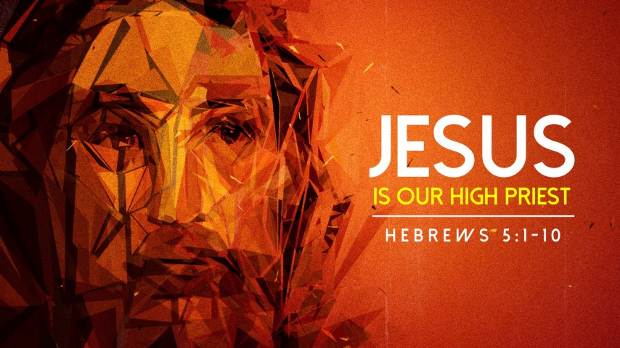

Slide 6
Hebrews chapter 5
Points to Ponder:
How Jesus qualifies to be our High Priest. Jesus is superior to Aaron as high priest (1-10).
Before proceeding further, Paul finds it necessary to extend the third of five warnings: The signs of being dull of spiritual hearing (11-14).
In this second part of Hebrews (5:1 – 8:5), Paul delves deeper into another side of the central theme of the book. Paul presents specific examples of how Jesus’ heavenly priesthood is superior to the earthly priesthood of the Aaron and the Levites.

Slide 7
Hebrews chapter 5
Discussion:
As both God and man, Jesus Christ is the great High Priest. As our perfect Advocate, Jesus Christ mediates between God and us, continually interceding on our behalf.
In 1Tim 2:5 – Paul states > “For there is one God, and one mediator between God and men, the man Christ Jesus.”
We no longer have a need for a frail, mortal human priest to present our cause before God, to offer sacrifices for us, or to represent God to us.

Slide 8
Hebrews chapter 5
Discussion:
Because of our personal relationship with the heavenly High Priest, we can “come boldly” and “draw near” to God through Him (4:16).
We can confess to Him our sins, bring to Him our needs, and present to Him our request.
Our High Priest is not some underling . . . He is the eternal Son who has added to His full divinity perfect humanity. He is superior as our High Priest.

Slide 9
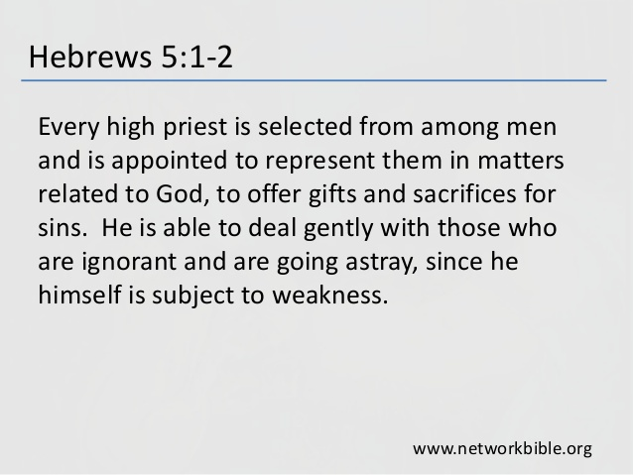

Slide 10
Hebrews chapter 5
Discussion:
The three qualifications of the earthly high priest:
FIRST, the earthly priest had to work on behalf of people “in things pertaining to God” (1).
  He was their stand-in, representing the people before God and God before the people.

Slide 11
Hebrews chapter 5
Discussion:
The three qualifications of the earthly high priest:
SECOND, he was responsible for offering sacrifices for sin . . . including his own (1-3). If people wanted to worship God by offering a gift, they had to do so through the priest (1).
  There were no stipulations for bypassing the priest in the worship of God. None of the people of God had the freedom to simply draw near to God apart from the priest.

Slide 12
Hebrews 5:3 – 4
This is why he has to offer sacrifices for his own sins, as well as for the sins of the people. ⁴ And no one takes this honor on himself, but he receives it when called by God, just as Aaron was.

Slide 13
Hebrews chapter 5
Discussion:
The three qualifications of the earthly high priest:
THIRD, he was called by God from among sinful, weak humans (1-4). Note the indications of the high priest deficiencies:
  He was a mere man from among men (1).
  He was beset with common weaknesses (2).
  He was also sinful, like people he represented (3).
  He had no honor in himself, but only from God (4).

Slide 14
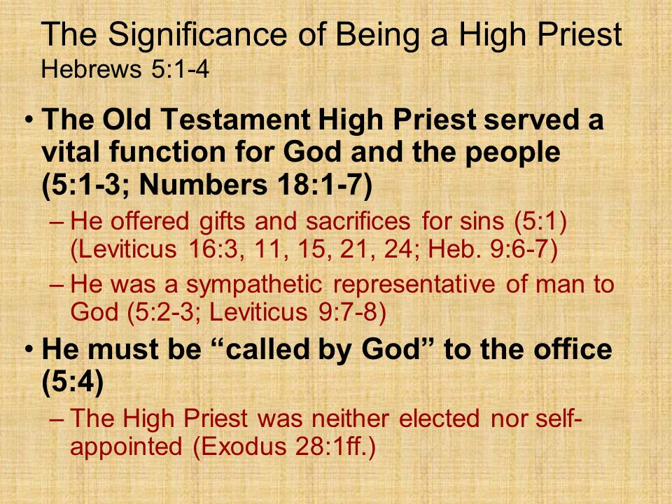

Slide 15
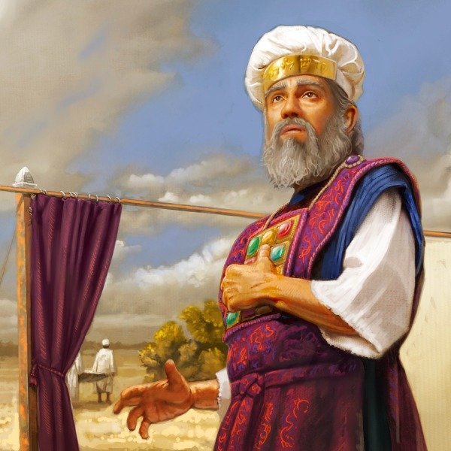
Aaron – High Priest

Slide 16
Hebrews chapter 5
Discussion:
Aaron is named as the primary exemplar for the office (4). Yet even Aaron, as great as he was, had no honor in himself. They could dress him in priestly garments, give him a grand title, and endow him with holy responsibilities; but at the end of the day, he was just a human like you and me.
Such an imperfect priesthood was never meant to be permanent. All along, God planned to one day pronounce “It is finished” and to establish a permanent priesthood with a Perfect Priest.

Slide 17
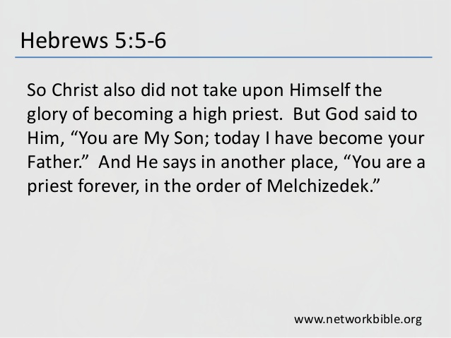

Slide 18
Hebrews chapter 5
Discussion:
Here, Paul begins to a comparison and contrast between the earthly priesthood typified by Aaron and the heavenly priesthood established in Christ.
By citing Psalm 2:7, Paul reminds us that Jesus is not merely qualified to be a priest, but also to be exalted as the Anointed King.
“I will declare the decree: the Lord hath said unto me, Thou art my Son; this day have I begotten thee” (Ps. 2:7).

Slide 19
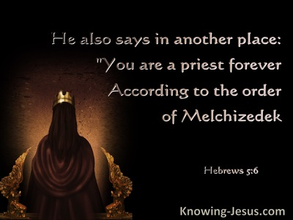

Slide 20
Hebrews chapter 5
Discussion:
Then, Paul quotes Psalm 110:4 to draw the two offices together, firming up this identification of the Messiah as both King and Priest – a priest in the order of Melchizedek rather than the order of Aaron.
“The Lord hath sworn, and will not repent, Thou art a priest for ever after the order of Melchizedek.” (Ps. 110:4).
In the order of Melchizedek, Christ is a “priest forever” (6). A host of distinction will be addressed in greater details in Hebrews 7.

Slide 21
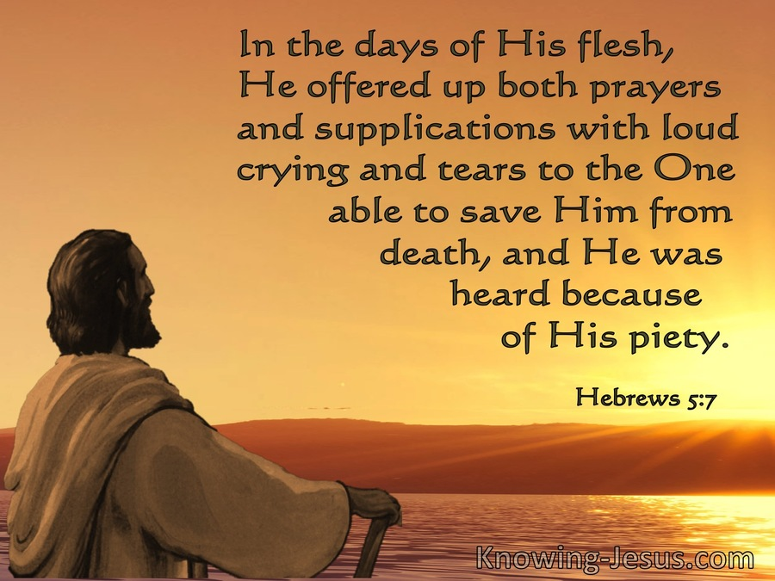

Slide 22
Hebrews chapter 5
Discussion:
Paul provides a brief glimpse into the life and character of Jesus as he functioned during his earthly ministry, that is, “in the days of his flesh” (7).
The Son of God submitted entirely to the Father’s will, offering prayers and supplications, crying with human tears as He faced suffering and death (7).
Of course, Jesus was without sin because of His impeccable divine nature (4:15), and God ultimately answered His prayers for salvation from death by raising Him from the dead.

Slide 23
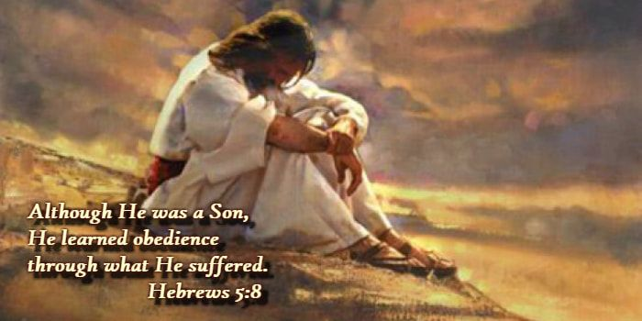

Slide 24
Hebrews chapter 5
Discussion:
In His submission as a true human who was subjected to the suffering of this world, Christ also “learned obedience from the things which He suffered” (8).
In this way, Paul can describe Christ as being made “perfect,” that is, complete. The Son’s continued life of obedience to the Father began at “Incarnation” and climaxed during the “Crucifixion.”

Slide 25
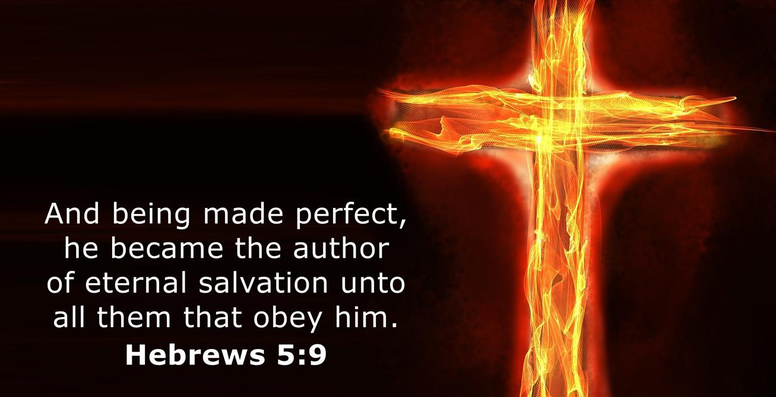

Slide 26
Hebrews chapter 5
Discussion:
It’s not that Christ was imperfect and needed to be made perfect or disobedient and needed to learn obedience. With His suffering and death, Jesus’ mission of total obedience was accomplished (8).
The earthly phase of His eternal priesthood was complete. As a result, He has become the source (author) of “eternal salvation” to believers who trust and obey Him (9).

Slide 27
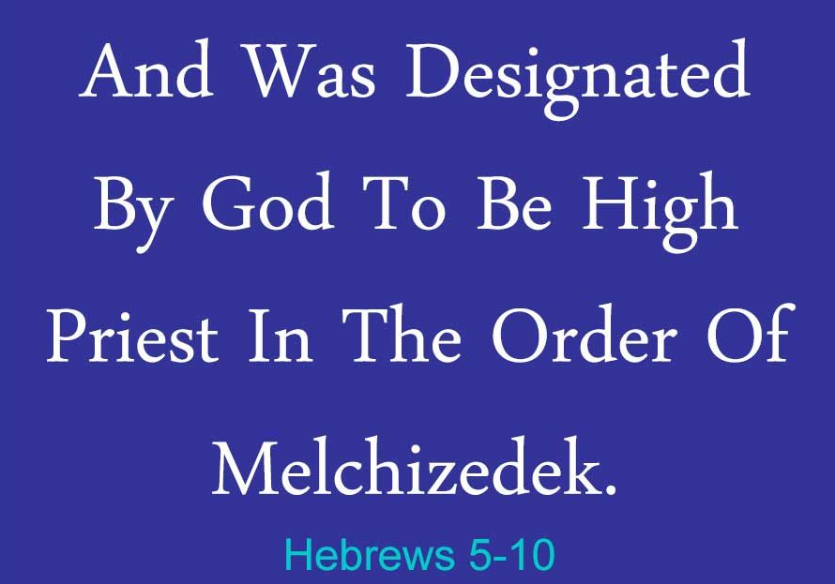

Slide 28
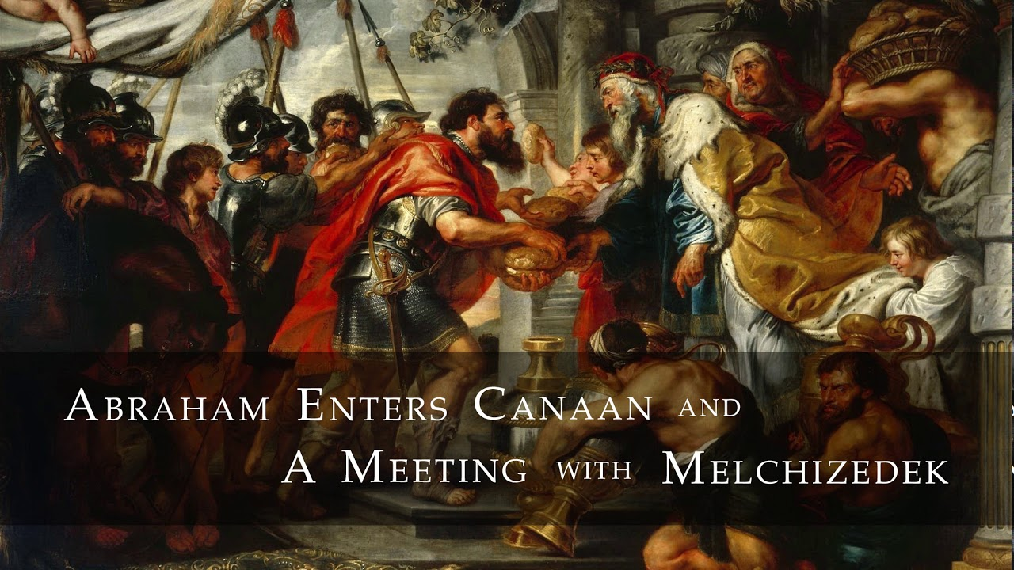
We shall discuss the person Melchizedek in greater details in Hebrew 7

Slide 29
Hebrews chapter 5
Discussion:
Melchizedek is first mentioned in Scripture in Genesis 14:17-18 >
    “And the king of Sodom went out to meet him after his return from the slaughter of Chedorlaomer, and of the kings that were with him, at the valley of Shaveh, which is the king's dale. ¹⁸And Melchizedek king of Salem brought forth bread and wine: and he was the priest of the most high God.”

Slide 30
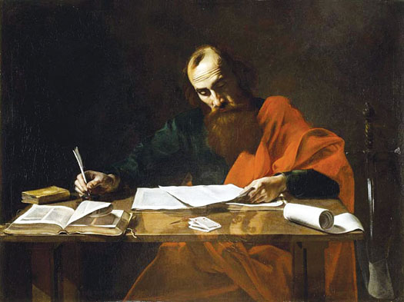
The Apostle Paul issues a third warning . . .

Slide 31
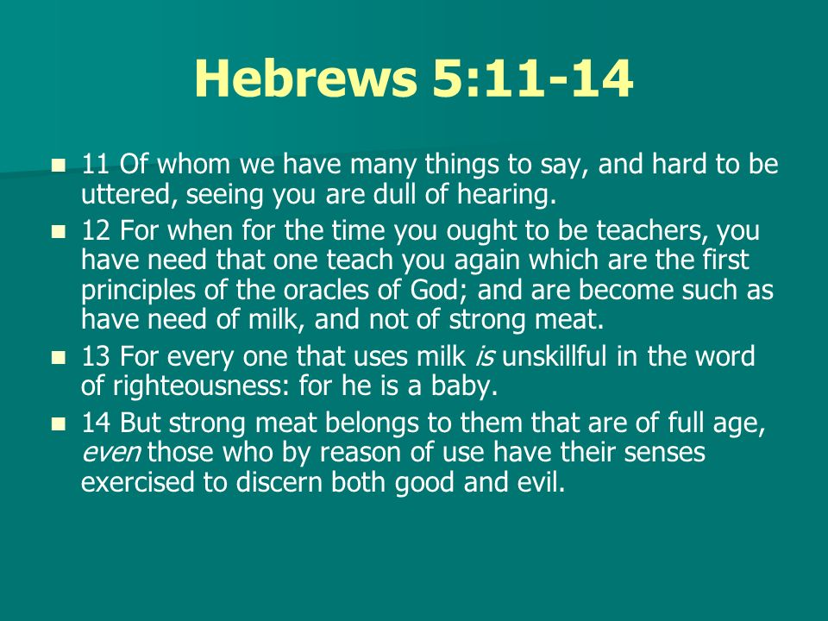

Slide 32
Hebrews
WARNING AGAINST
Drifting Away (2:1-4)
A Harden Heart (3:7 – 4:13)
  this lesson . . .
Dullness of Hearing Spiritually (5:11 – 6:20)

Slide 33
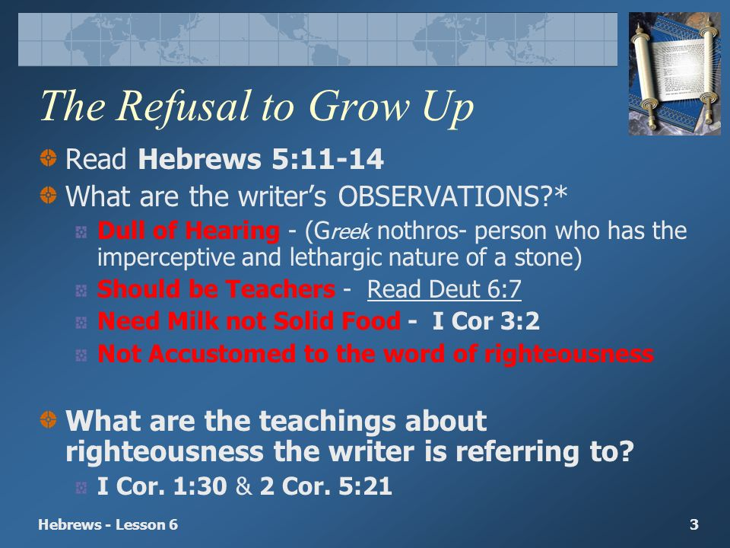

Slide 34
Hebrews chapter 5
Discussion:
Paul’s tone in this section (5:11-14), is one of disappointment. There is a lot to explain concerning Melchizedek and the desire to teach us about the Messiah, but his readers have become “dull of hearing” (11).
FIRST, we can become dull because we fail to grow up as we grow older . . . older does not mean wiser or more spiritual.
Age should be an indicator of spiritual maturity (12).

Slide 35
Hebrews chapter 5
Discussion:
SECOND, we can become dull because our bad habits prevent healthy development . . . continuing as students rather than growing into teachers (12).
They continued as students rather than growing into teachers.
They should be teachers: Deuteronomy 6:7 > “And thou shalt teach them diligently unto thy children, and shalt talk of them when thou sit in thine house, and when thou walk by the way, and when thou lie down, and when thou rise up.”

Slide 36
Hebrews chapter 5
Discussion:
Paul states that his readers have developed the bad habit of taking in spiritual food but not giving to or sharing it with others (12).
They prefer milk rather than solid food, just like an infant (13).
Just as a baby is unskilled, immature believers continue to dwell on the basic ABCs of the Christian faith. Their spiritual immaturity was threatening other aspects of their Christian life: i.e., discerning good and evil (14).

Slide 37
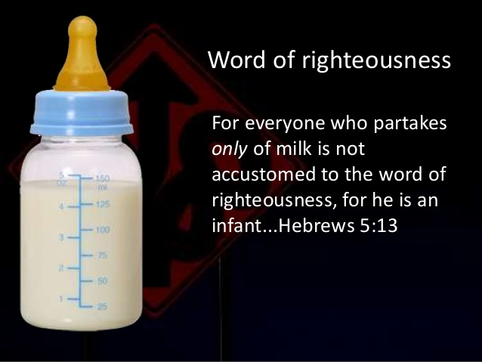
“I have fed you with milk, and not with meat: for hitherto ye were not able to bear it, neither yet now are ye able.” 1Cor. 3:2

Slide 38
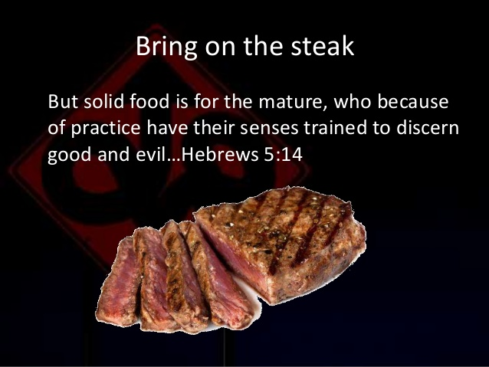
“But strong meat belongs to them that are of full age …” Heb 5:14

Slide 39
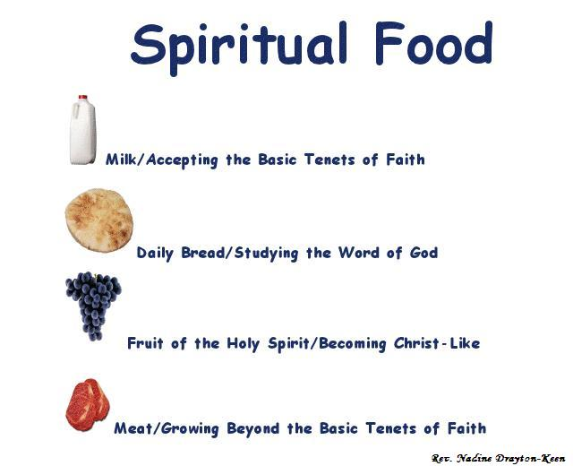
Feast upon spiritual food so as to grow to maturity

Slide 40
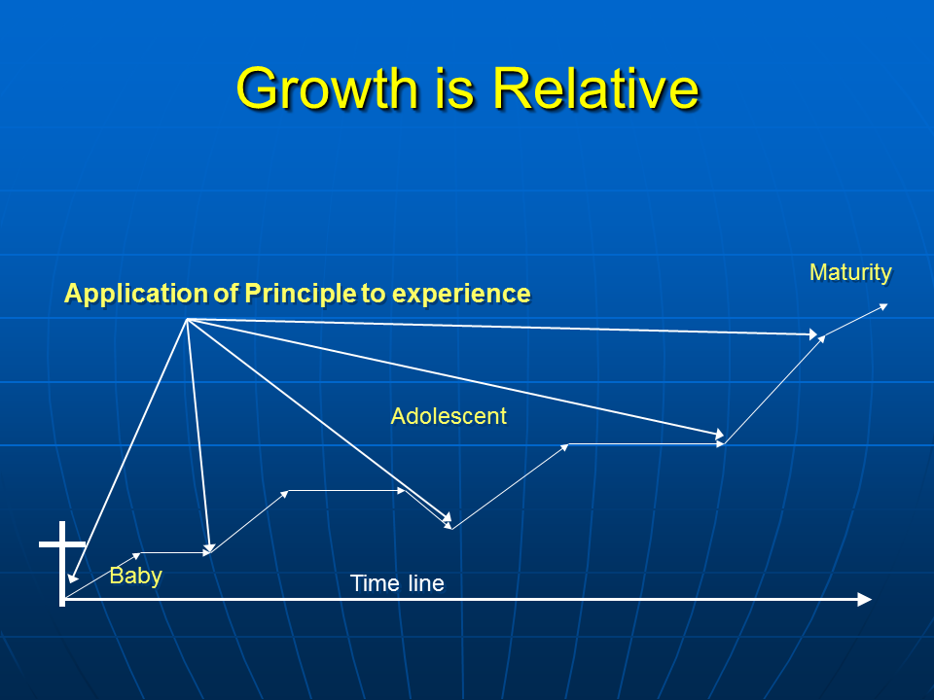
Let’s continue to apply spiritual principles so as to grow to maturity

Slide 41


Slide 42
Hebrews chapter 5
Review of the Points Pondered:
Jesus is well qualified to be our High Priest. Jesus is superior to Aaron as high priest (1-10).
Paul issues his third of five warnings: Avoid being dull of spiritual hearing (11-14).

Slide 43
Hebrews chapter 5
Application of Chapter 5
[1] – We need a priest who isn‘t prejudiced.
  Unlike the world’s corrupt leaders and crooked institutions, Christ’s perfect priesthood doesn’t arbitrarily and unjustly discriminate.
  On your knees before your perfect High Priest, it doesn’t matter whether you were born in privilege or poverty, whether you have a PhD or a GED, or whether they call you General or Private.

Slide 44
Hebrews chapter 5
Application of Chapter 5
[2] – We need a priest who is permanent.
  Because we’re full-time sinners, we need a full-time mediator. Because we face any-moment crises, we need an every-moment representative.
  Imagine if you could fellowship with God only by traveling hundreds of miles to a particular place, at a certain time of year, through a specific order of ministers.
  Our High Priest is everywhere present, always ready to listen to our prayers.

Slide 45
Hebrews chapter 5
Application of Chapter 5
[3] – We need a priest who assures us of our place.
  Only a priest who demonstrated perfect obedience and offered up a perfect sacrifice can give us the assurance that our place is secure in Him.
  If Jesus were only a really good priest rather than a perfect priest, or if He were only an above average sacrifice for most sins rather than the final sacrifice for all sin, then we would have room to worry about just how secure our salvation really is. But Christ is, and we can have confidence of our salvation in Him.

Slide 46
Hebrews chapter 5
Application of Chapter 5
[4] – We need to partake of solid spiritual food.
  Spiritually speaking, it the deeper doctrine, more serious devotion to righteousness, and more earnest dedication to the things of God.
  We need to avoid the junk food of weak, shallow biblical teaching, watered-down doctrine, and circus-style worship “experiences.”

Slide 47
Hebrews chapter 5
Application of Chapter 5
[5] – We need to maintain practice in righteous living.
  Practice is needed to effectively apply the Word to our daily lives. It means actually doing what we’re told—not once or twice, but repeatedly and continually. Practice, not just once a week, but 24/7.
  We have to participate in the right kind of spiritual activity day in and day out in order to build our spiritual muscles and strengthen our spiritual lives.

Slide 48
Hebrews chapter 5
Application of Chapter 5
[6] – We need to exhibit a trained sense of discerment.
  Senses trained to discern good and evil are a sure mark of spiritual maturity. Taking in solid spiritual food and turning it into good habits through continual, disciplined practice will result in a sharpening of our ability to distinguish between right and wrong – wise and foolish.
  These principles, given to us by God and applied to our lives by the power of the Holy Spirit, will keep us on the right path and train us for spiritual progress.

Slide 49
NEXT CLASS – 14 October 2020
Letter to the Hebrews
Read before the next class in the KJV and in two other versions of the Bible, NKJV, NRSV, NIV, CEV, etc …
Chapter 6:1 to 8:5

Slide 50



the end
Questions
Questions

Slide 51


