Slide 1
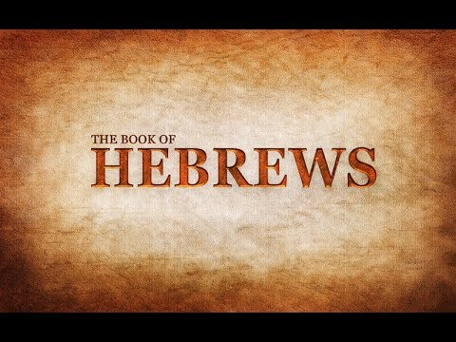
Press On To Maturity
Week 7
14 October 2020

Slide 2

Hebrews Introduction
Paul writes this letter to Jews who have become Christians, and because of persecution, are torn between their new faith in Christ and their desire to returning to the old ways under the Mosaic Law.
That is, they are willing to abandon the Christian faith in Jesus for the familiarity of the old lifestyle under the Law.
Paul skillfully argues how Jesus is superior (better) than prophets, angels, Moses, Joshua, Aaron, etc.

Slide 3
Hebrews introduction
Paul presents clear and compelling proof that Jesus Christ is superior in His personage.
In Ch 1 -2, Christ stands in a place of preeminence over the prophets (1:1-3) and shines brighter than the angels (Ch 1:4-2:18).
In Ch 3-4, Christ stands out over Moses and Joshua.
In Ch 4, Christ’s ministry provides a greater spiritual rest than the Mosaic Law, while Christ’s word reaches deep into our hearts to heal us.
In Ch5, Christ is superior to Aaron as our High Priest.

Slide 4
Hebrews review
Chapter 1: Jesus, Better than the Prophets (1:1-3)
Chapter 1: Jesus, Better than the Angels (1:4 – 14)
Chapter 2: Jesus, Better than the Angels (2:1-18)
Chapter 3: Jesus, Better than Moses (3:1-19)
Chapter 4: Jesus, Better than Joshua (4:1-16)
Chapter 5: Jesus, Better than Aaron as Priest (5:1-14).
this lesson . . .
Chapter 6: Jesus, Our Eternal Anchor (6:1-20).

Slide 5
Press On
To
Maturity

Slide 6
Hebrews chapter 6
Points to Ponder:
Elementary principles in the doctrine of Jesus Christ (1-10).
The very real danger of crucifying again the Son of God (11-15).
The basis of our hope that serves as an anchor of the soul (16-20).

Slide 7
Hebrews chapter 6
Overview of Chapter 6:
The interruption of the discussion regarding Jesus as High priest continues with a solemn warning regarding spiritual progress, and the need for diligence, faith and patience in order to inherit the promises (1-12).
The certainty of God’s promises upon which our hope is based serves as an anchor of the soul that reaches into heaven itself, where Christ is now our High Priest according the order of Melchizedek (13-20).

Slide 8
Hebrews chapter 6
Discussion:
In light of the disappointing and spiritually dangerous condition of the Hebrew Christians described in 5:11-14, Paul stops talking about the High Priest and transitions into the third (and probably the most well-know) warning in the book.
1st – Pay attention lest you drift away (2:1-4),
2nd – Beware of a harden heart (3:7-4:13), and now
3rd – Don’t allow dullness of heart to hinder spiritual growth (5:11-6:20).

Slide 9
Hebrews chapter 6
Discussion:
As we see, this warning began in 5:11 and continues through most of Chapter 6. Not only is it one of the hardest warning to hear, but it also contains some of the most difficult, disputed, controversial, “knottiest” verses in all of Scripture.
If we keep in mind that the larger context relates to a group of Christians who had failed to thrive in their spiritual growth—who had grown dull in their hearing and were wallowing in immaturity—we can begin to untie the “knot” of this difficult passage.

Slide 10
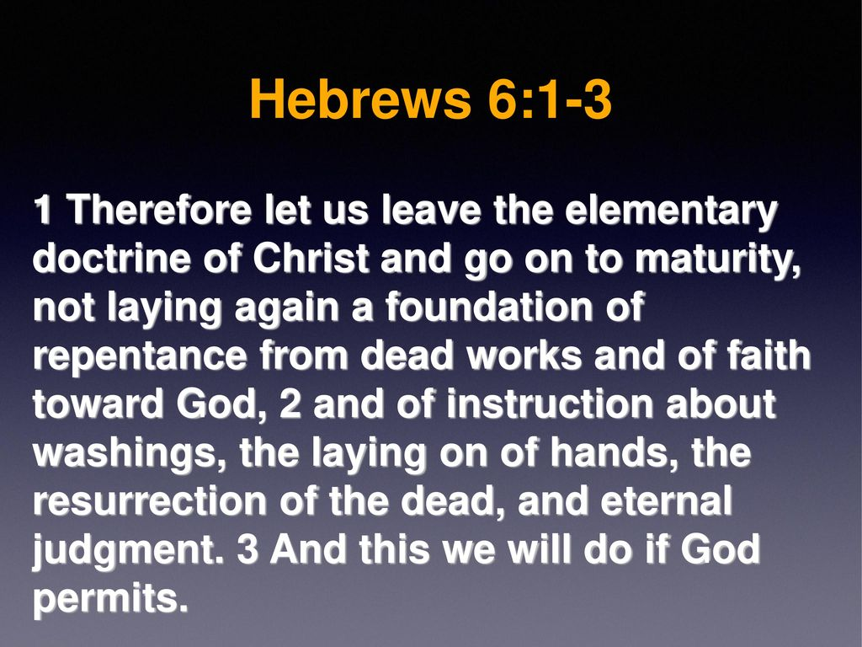

Slide 11
Hebrews chapter 6
Discussion:
Paul states in 6:1 – “leaving the elementary teaching about the Christ” and “pressing on to maturity.”
Paul refers back to the “oracles of God” mentioned in 5:12. And the reference to needing to move on to maturity would be in direct contrast to the readers’ current situation of partaking of only milk, like spiritual infants (5:13).

Slide 12
Hebrews chapter 6
Discussion:
Here, Paul accuses these Hebrew Christians of failing to grow out of the fundamentals of the Christian faith and life, instead repeating over and over again the subjects of Christianity 101.
Specifically, Paul mentions three categories of truths that constitute the “elementary principle” or “foundation” of the Christian faith.

Slide 13
Hebrews chapter 6
Discussion:
FIRST – Conversion: “a foundation of repentance from dead works, and of faith toward God.”
That is, the useless “dead works” of self-righteousness that can never bring salvation (Matthew 5:20).
Those who continue to focus only on what they have been save “from” and neglect the life of holiness they were saved “for” are like those who read Ephesians 2:8-9 and then forget v10 (created in Christ for good works).

Slide 14
Hebrews chapter 6
Discussion:
The spiritual immature never seem to grow out of their own conversion experience . . . or in the worst cast, they continue to “get saved,” or “pray the sinner’s prayer,” or “answer the altar call” over and over again, never growing beyond this very first step.

Slide 15
Hebrews chapter 6
Discussion:
SECOND – Church Practices and Procedure: “doctrine of baptisms, and of laying on of hands.”
That is, the instructions concerning water washing (rituals) and Christian (and Spiritual) baptism – which new converts in the faith would have experience (Acts 1:5; 10:47).
Also, “laying on of hands” brings to mind ordination – the rite of appointing a person to ministry (Acts 6:6; 13:3) or receiving spiritual blessings or healings (Acts 9:17).

Slide 16
Hebrews chapter 6
Discussion:
Third – Prophecy: “the resurrection of the dead, and of eternal judgment.”
That is, the resurrection of the dead, which is the basic hope of every Christian (Rom. 6:5), and eternal judgment, which Paul tied to the proclamation of the gospel (Rom. 1:16-18; 2:16).
If we’re getting hung up on basic experiences, practices, and doctrines, we are not going to graduate to the higher levels of spiritual maturity.

Slide 17
Hebrews chapter 6
Discussion:
We need to move beyond the basics, to “press on to maturity.” Paul is hopeful that, with God’s help, they will press on.
The phrase “if God permits” reminds us that even our spiritual growth depends on God’s provision.
God, and God alone, is able to grow us from infancy to maturity.

Slide 18


Slide 19
Hebrews chapter 6
Discussion:
Before we go farther, consider a couple of important observations:
FIRST – Paul switches from “first person plural” in 6:1-3 to the “third person” in 6:4-6.
Then after the stern admonition, Paul shifts back to language that includes his readers (6:9).
This change in grammar shows that Paul knew his readers had not yet fallen into the dreaded category of those for whom spiritual progress was impossible.

Slide 20
Hebrews chapter 6
Discussion:
There were still hope, but because of their current state of becoming slow of hearing and sluggish in their response to spiritual things, they faced a real danger of sliding even farther backward toward an irreversible condition.
That is, they were dull but not dead.

Slide 21
Hebrews chapter 6
Discussion:
SECOND – Paul uses a farming illustration to explain the contrast between those who fall under the dire condition that prevents them from pressing on to maturity (6:8) and those who, by His grace, respond to the means God has provided for spiritual growth (6:7).
Paul uses the ground (earth) to explain his admonition. Notice that the ground that is burned to clear it of its useless “thorns and thistle” may not be completely obliterated.

Slide 22
Hebrews chapter 6
Discussion:
The ground is burned so as to consume the worthless vegetation [thorns and briers] it has produced in spite of having received all the means necessary [sun and rain] to produce useful herbs and plants.
This would support the notion that those who fall under the condition that leads to a failure to thrive spiritually do not lose their salvation, but rather end up having no reward at the judgment seat of Christ.

Slide 23
Hebrews chapter 6
Discussion:
We see this sobering teaching confirmed in 1Cor. 3:12-15 in reference to a person’s labor for the body of Christ, the church, during this life >
“Now if any man build upon this foundation gold, silver, precious stones, wood, hay, stubble; ¹³Every man's work shall be made manifest: for the day shall declare it, because it shall be revealed by fire; and the fire shall try every man's work of what sort it is. ¹⁴If any man's work abide which he hath built thereupon, he shall receive a reward. ¹⁵If any man’s work shall be burned, he shall suffer loss: but he himself shall be saved; yet so as by fire. “

Slide 24
Hebrews chapter 6
Discussion:
The issues in Hebrew 6, then, as in 1Cor. 3, is not related to losing one’s eternal salvation, which has been irreversibly bought and paid for by the precious blood of Christ. The issue is related to losing one’s heavenly reward.
So how do we interpret these verses:
  They were once saved, but have lost their salvation, or
  They appear to be saved, but actually are not.

Slide 25
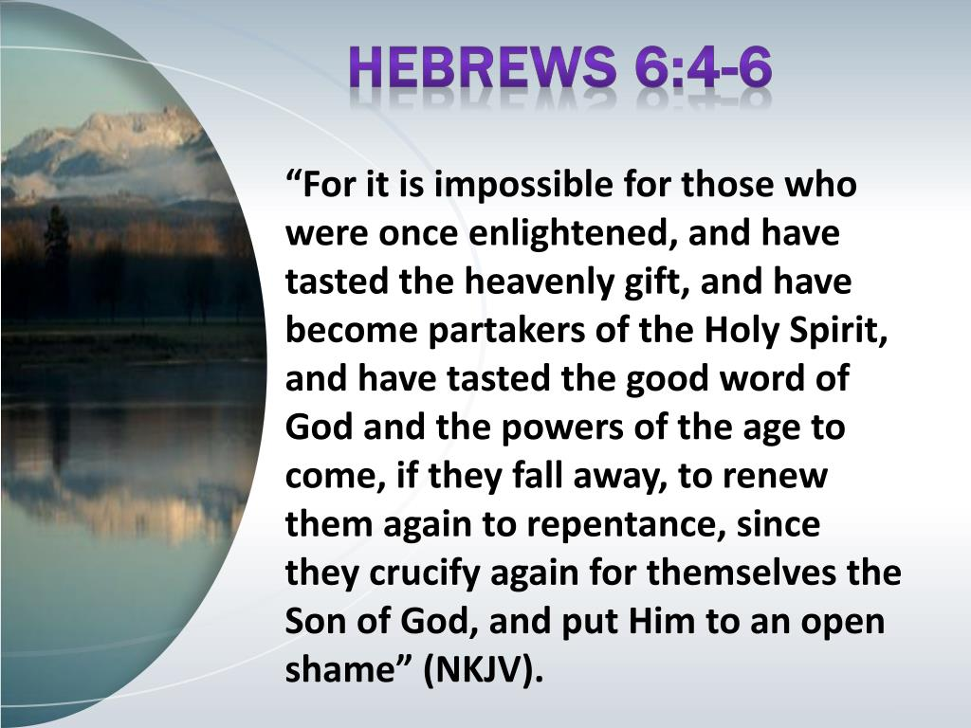

Slide 26
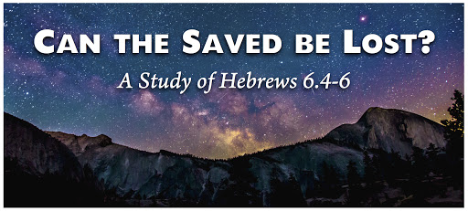

Slide 27
Hebrews chapter 6
Discussion:
  1 – They were once saved, but have lost their salvation
  They were born again having tasted the heavenly gifts.
  However, after experiencing all the blessings of genuine salvation, they have “fallen away” from Christ; losing their salvation, and therefore rendering themselves unable to be restored again to salvation (6:6).

Slide 28
Hebrews chapter 6
Discussion:
  1 – They were once saved, but have lost their salvation
  If this view is correct, then after abandoning their faith, there would be no way the person could ever be saved again.
  Impossible – to be renewed to repentance. Yet this position would contradict the many passages of Scripture that teach the eternal security of the believer’s salvation (Rom. 8:1, 27-29).

Slide 29
Hebrews chapter 6
Discussion:
  2 – They appear to be saved, but actually are not
  They profess Christ, but do not fully belong to Him [possess] . They have a head knowledge, but not a true heart conversion.
  As a result, the feigned faith of these “almost Christians” failed to take root and they “fell away” from the faith in appearance only.
  The truth is, “they were not really of us; for if they had been of us, they would have remained” (1Jn 2:19).

Slide 30
Hebrews chapter 6
Discussion:
2 – They appear to be saved, but actually are not
  If the second position is correct, then Paul has made the assurance of salvation difficult to affirm.
  How could someone “know” they have eternal life if the experience of a true believer is the same as that of the false believer.

Slide 31
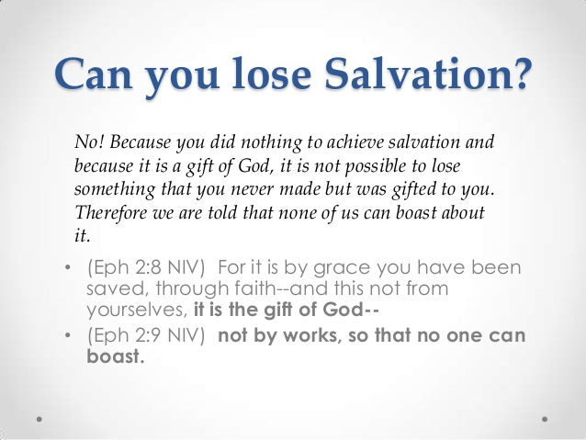

Slide 32
Hebrews chapter 6
Discussion:
  If both views are problematic, then we must remember the broader context: those wallowing in the basics of the faith, yet failing to grow spiritually.
  The encouragement to “press on to maturity” is written to those who have been truly born again, not to those on the outside of the family of God.
  The terminology “enlightened” (6:4) would refer to a Christian, not an unbeliever.

Slide 33
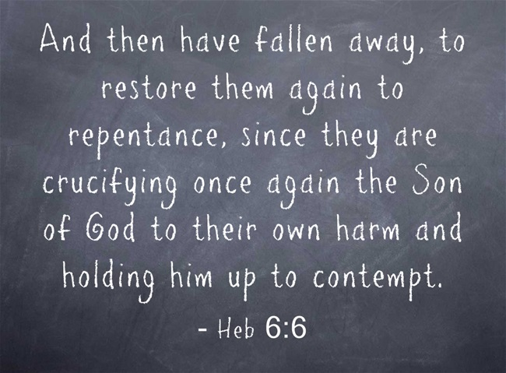

Slide 34
Hebrews chapter 6
Discussion:
  The phrase “It is impossible . . . to renew them again to repentance” (6:4-6) does not speak about salvation of the unsaved . . .
  Neither about those who have never been saved or those who have lost their salvation.
  Impossible – for men, but not for God.
  This passage is not talking about losing salvation, but repentance; therefore it would be possible for a believer to be set aside (rejected) or lose rewards.

Slide 35
Hebrews chapter 6
Discussion:
  However, “fallen away” means “apostasy” or to fall down or stumble. Peter fell down but he was not lost.
  Remember, Paul wanted to renew (restore) these Hebrew Christians through “repentance” – not salvation.
  These Hebrew Christians were dull but not dead.

Slide 36
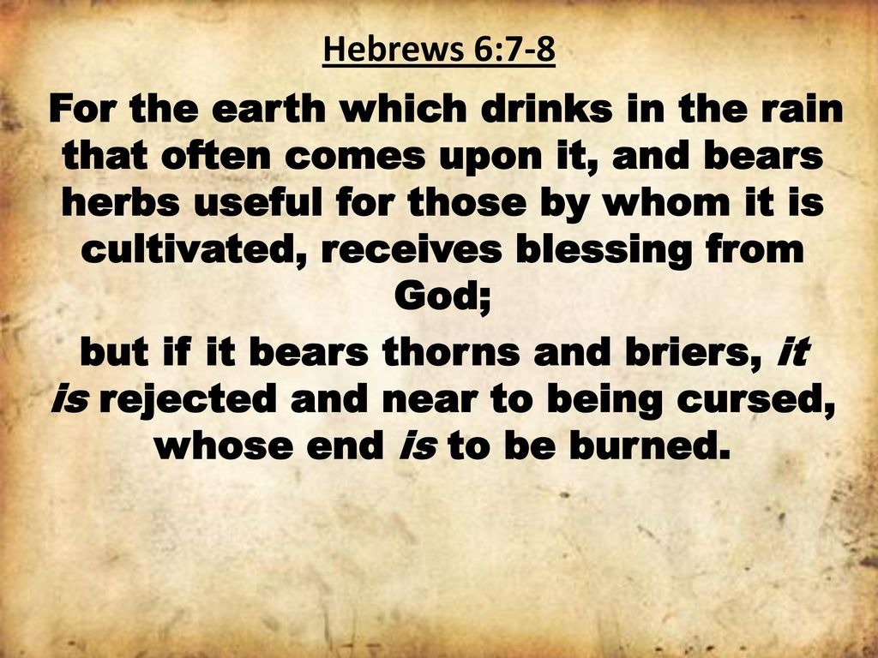

Slide 37
Hebrews chapter 6
Discussion:
Paul uses a farming illustration to explain this “falling down” condition: Some people are like land that gets plenty of rain and produces a good crop for those who farm it. That kind of land has God’s blessing (6:7).
But other people are like land that grows only thorns and weeds. It is worthless and in danger of being cursed by God. It will be destroyed by fire (6:8).

Slide 38
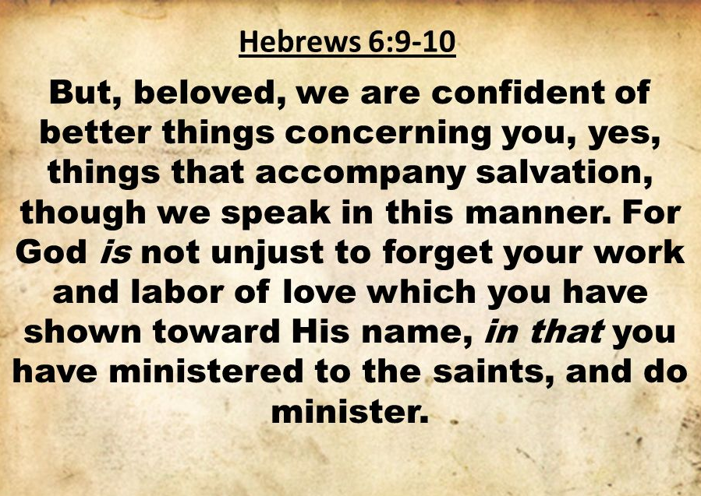

Slide 39
Hebrews chapter 6
Discussion:
  Notice Paul’s return to the first person plural (we) . . . proving once again that he is talking to Jewish believers (6:9).
  Paul stops blasting with commands and warnings and starts building with affirmations and encouragement.
  “Work and labor of love” is not salvation but the fruit of salvation. In the midst of their “dullness,” they were “still ministering to the saints.”

Slide 40
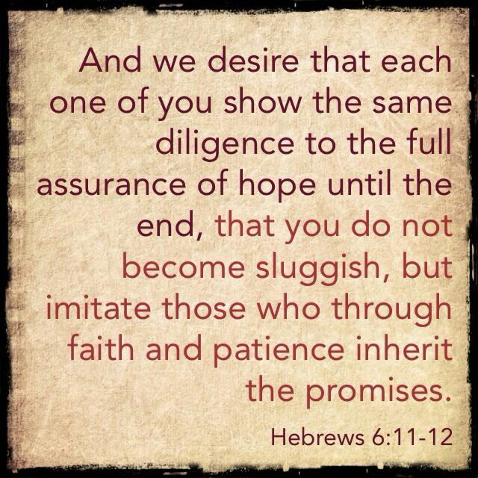

Slide 41
Hebrews chapter 6
Discussion:
  Paul urges with three exhortations:
  FIRST – he wanted them to show the same diligence to the end (6:11). They just needed to persevere – to maintain their “full assurance of hope until the end.”
  SECOND – he wanted them to not be sluggish in their spiritual progress (6:12). Paul brings them back to his original purpose: to snap them out of their spiritual dozing.

Slide 42
Hebrews chapter 6
Discussion:
  Paul urges with three exhortations:
  THIRD – he wanted them to be imitators of those who inherit the promises (6:12). Paul takes the final turn in his brief detour that constitutes this third warning passage of “dullness of heart.”
  Here, Paul is headed back to his original discussion of receiving the promised spiritual rest (4:1-11); echoing his desire for them to “press on to maturity.”

Slide 43
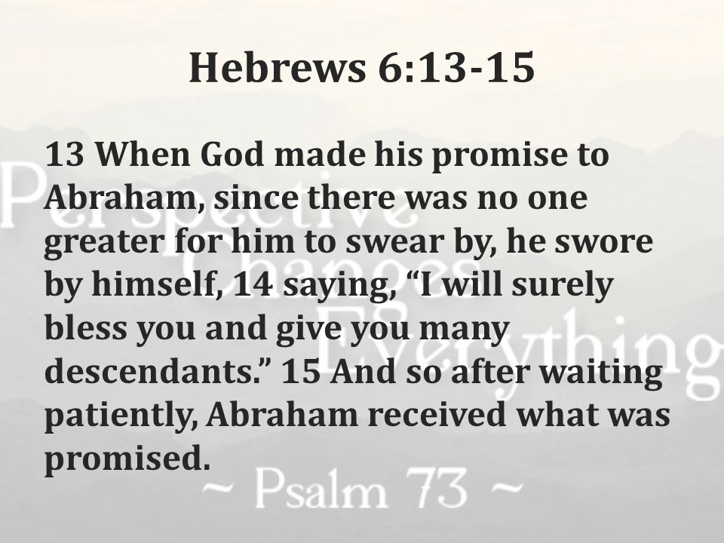

Slide 44
Hebrews chapter 6
Discussion:
  Paul uses Abraham as an example of persevering faith. Abraham who waited and waited for the “promised son” born to Sarah.
  But Abraham did wait . . . after 25 years, Sarah gave birth to Isaac (Gen. 17:17). Abraham had learned through a life lived by faith that God’s promises were sure.
  In fact, God had sworn by His own name. Abraham’s patient waiting and trust in God’s faithfulness to His promise can serve as a model for Christians.

Slide 45
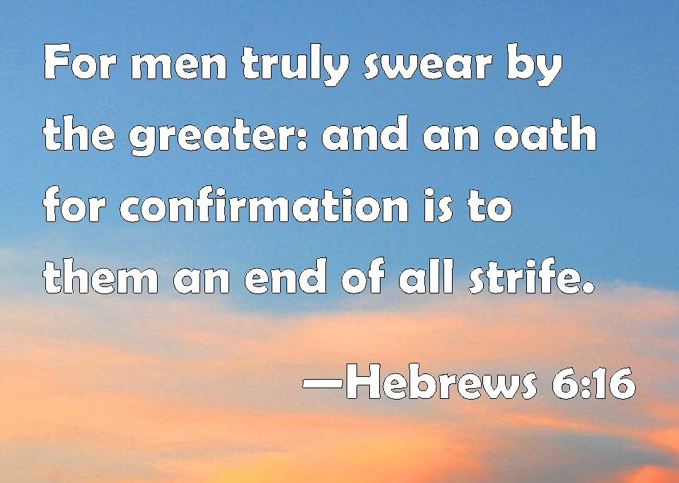

Slide 46
Hebrews chapter 6
Discussion:
  Paul offers encouragement for his readers to continue in their own steadfastness. That is, believers in Christ can lean on the same unchangeable nature of the promise-keeping God.
  In biblical times, when a person swore an oath by one greater than themselves, a dispute was considered settled (6:16).
  To break the oath would bring down consequences on the transgressor. God swore an oath – by Himself.

Slide 47
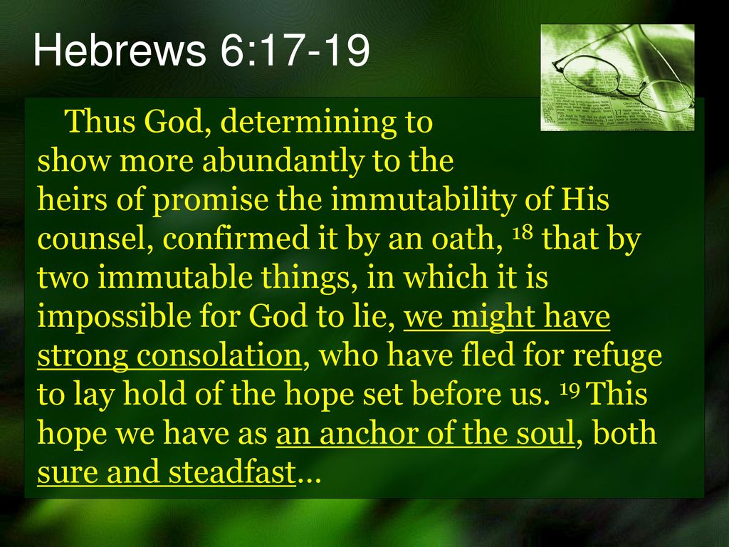

Slide 48
Hebrews chapter 6
Discussion:
  God’s purpose is unchangeable. It is His nature to remain steadfast, unchanging. God’s promise, expressed as an oath, is unchangeable (6:17).
  The moment His promise is spoken to His people, they can immediately begin to count on it without wavering. Why? “It is impossible for God to lie” (6:18).
  When the waves of doubts threaten to set their lives adrift, their expectant trust in God’s promises will keep them “firm and secure” like a mighty anchor (2:1).

Slide 49
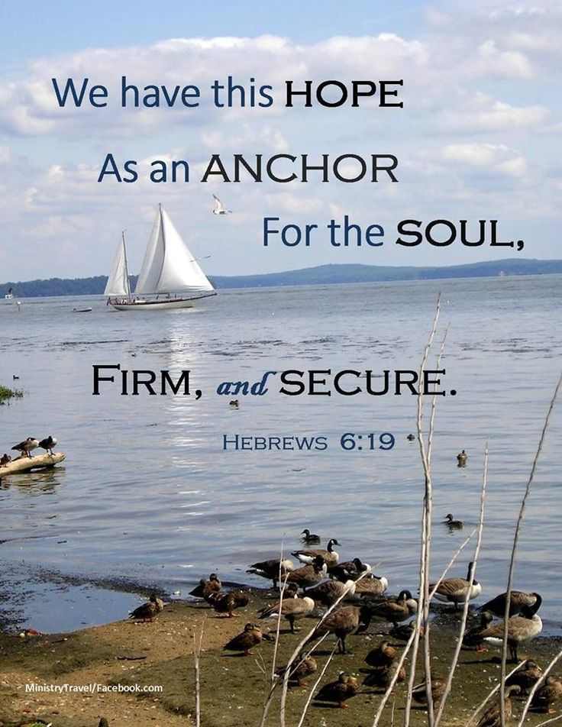

Slide 50
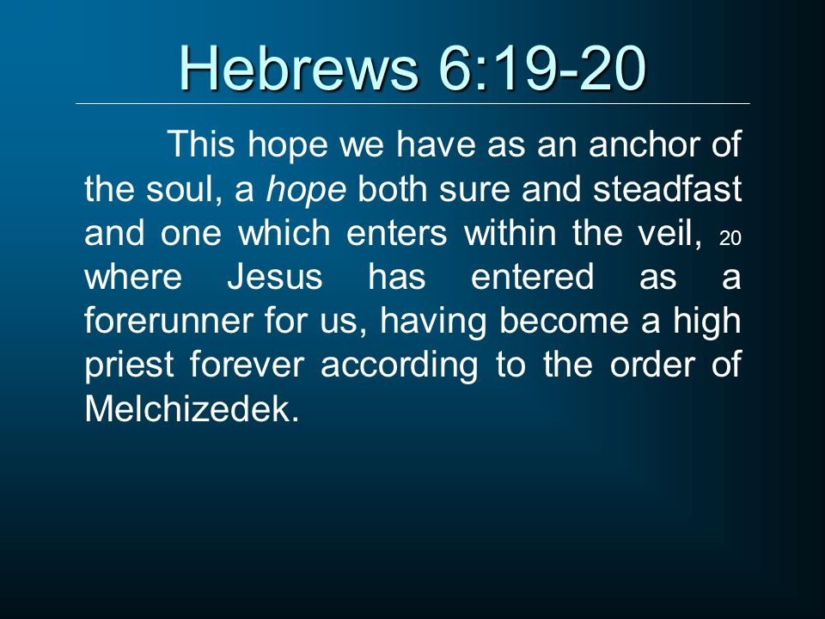

Slide 51
Hebrews chapter 6
Discussion:
  This anchor is not of this world. Keeping his focus on our heavenly longing, and returning our attention to the center and source of all hope, Jesus Christ, Paul says that this hope “enters within the veil” (6:19).
  Here we have come full circle, back to the high priesthood of Jesus and the discussion of the mysterious Melchizedek.
  Jesus Christ is in the heavenly sanctuary (behind the veil) as our forerunner and He is the guarantee that we shall one day enter heaven (rest) as well (6:20).

Slide 52
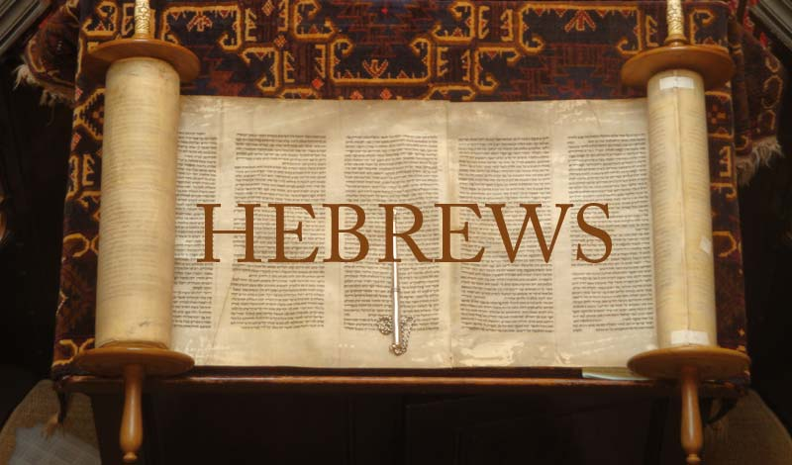

Slide 53
Hebrews chapter 6
Review of the Points Pondered:
Elementary principles in the doctrine of Jesus Christ (1-10).
The very real danger of crucifying again the Son of God (11-15).
The basis of our hope that serves as an anchor of the soul (16-20).

Slide 54
Hebrews chapter 6
Application of Chapter 6
[1] – Partake of solid spiritual food.
  The term “solid food” is contrasted with milk. It’s the knife-and-fork food of adults rather than the bottle-fed food of babies.
  It’s food that requires chewing, takes time to digest, and provides nutrients essential for building a strong body.
  We can’t expect to grow spiritually if we’re not partaking of solid spiritual food.

Slide 55
Hebrews chapter 6
Application of Chapter 6
[2] – maintain practice in righteous living.
  Practice is needed to effectively apply the Word to our daily lives. It goes beyond simply hearing and understanding.
  It means actually doing what we’re told—not once or twice, but repeatedly and continually. Practice takes time, energy, and commitment.
  We can’t “practice” by attending church once a week, then starving spiritually for six days straight.

Slide 56
Hebrews chapter 6
Application of Chapter 6
[3] – Exhibit a trained sense of discernment.
  The spiritually mature are able to respond with wisdom and skill to whatever comes their way. It is almost second nature to them.
  If we’re diligent in partaking solid spiritually food and maintain practice in righteous living – and if we continue these over the long haul – then we can expect to grow spiritually and to exhibit a trained sense of discernment.

Slide 57
Hebrews chapter 6
Application of Chapter 6
[4] – When dealing with doubts ... Remember.
  For those who are immature in their faith or who have grown sluggish in responding to spiritual things, doubts can drive them into despair. But they don’t need to!
  For those who are willing to remember the character and promises of God, doubts can serve as mere ellipses . . . pauses in the walk of faith that serve to turn our attention heavenward towards God.

Slide 58
Hebrews chapter 6
Application of Chapter 6
[4] – When dealing with doubts ... Remember (cont).
  Amid the storms of our own lives, God gives us an anchor for the soul (6:19).
  When doubt says, “Only a fool would believe these things.” Remember: “It is impossible for God to lie” (6:18).
  When doubt tells you, “God has abandoned me.” Remember: “The immutability of His purpose, interposed with an oath (6:17).

Slide 59
NEXT CLASS – 21 October 2020
Letter to the Hebrews
Read before the next class in the KJV and in two other versions of the Bible, i.e., NKJV, NRSV, NIV, CEV, etc …
Chapter 7:1 to 8:5

Slide 60



the end
Questions
Questions

Slide 61
