Slide 1

Jesus After the
Order of Melchizedek
Week 8
21 October 2020

Slide 2

Hebrews review
Chapter 1: Jesus, Better than Prophets and Angels (1:1-14)
Chapter 2: Jesus, Better than the Angels (2:1-18)
Chapter 3: Jesus, Better than Moses (3:1-19)
Chapter 4: Jesus, Better than Joshua (4:1-16)
Chapter 5: Jesus, Better than Aaron as Priest (5:1-14)
Chapter 6: Jesus, Press On To Maturity (6:1-20).
this lesson . . .
Chapter 7: Jesus, After the Order of Melchizedek (7:1-17).

Slide 3
Hebrews review
Warnings:
In light of the disappointing and spiritually dangerous condition of the Hebrew Christians described thus far, Paul has provide three of the five warning in this book.
1st – Pay attention lest you drift away (2:1-4),
2nd – Beware of a harden heart (3:7-4:13), and
3rd – Don’t allow dullness of heart to hinder spiritual growth (5:11-6:20).

Slide 4
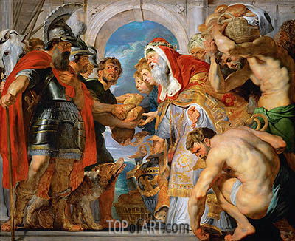
Chapter 7

Slide 5
Hebrews chapter 7
Overview of Chapter 7:
Resuming the discussion of Jesus as High Priest, the superiority of Melchizedek to Abraham and Levi is first demonstrated (1-10).
Reasons are then given as to why a new priest after the order of Melchizedek was necessary, which also required a change in the Law (11-19).
Finally, the greatness of Jesus as our new High Priest is explained (20-28).

Slide 6
Hebrews chapter 7
Discussion:
The Book of Hebrews argues that Christ is the center and goal of Old Testament revelation – whether in direct messianic prophecies, prophetic anticipation, or even foreshadowing figures, as in the case of the mysterious Melchizedek.
Paul declares that with the coming of the Messiah, a whole new era has dawned, leaving the old system of Judaism in the past.

Slide 7
Hebrews chapter 7
Discussion:
The mysterious figure Melchizedek is the point of reference for Paul’s exposition in the first seventeen verses. Paul’s key passage is Psalm 110:4 which he already quoted in Hebrews 5:6 to demonstrate that Christ is our heavenly High Priest.
“The Lord has sworn and will not change his mind,
‘You are a priest forever according to the order of Melchizedek’” (Ps 110:4).

Slide 8
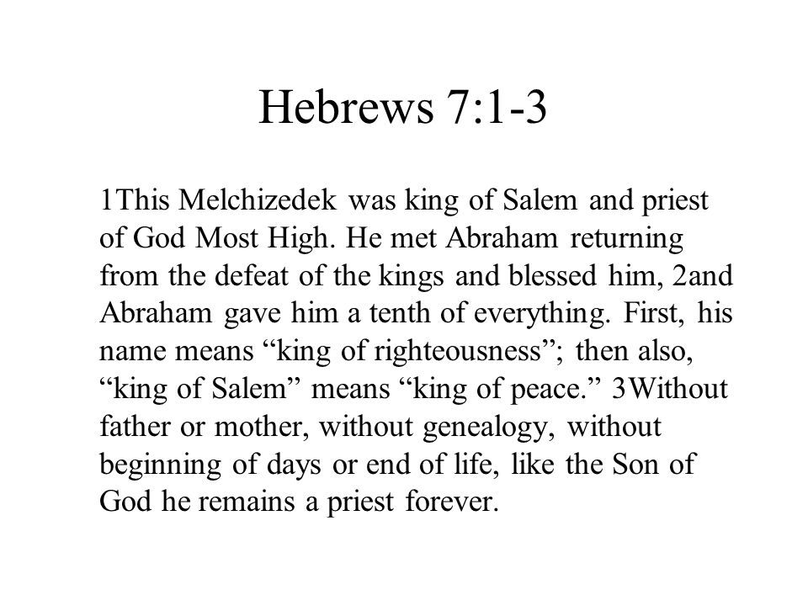

Slide 9
Hebrews chapter 7
Discussion:
Paul begins to point out some similarities between Melchizedek in Genesis 14 and the person of Christ.
What Melchizedek was in the biblical narrative, Christ is in His very nature. It’s states that Melchizedek was “made like the Son of God.”
That is, to make something resemble another thing. This doesn’t mean that Melchizedek was in his nature the Son of God or that he was in his nature eternal, divine, angelic, or heavenly.

Slide 10
Hebrews chapter 7
Discussion:
Rather, it means that Melchizedek displays some striking similarities that serve as a “type,” “foreshadowing,” or “illustration” of the true eternal high priest, Jesus Christ.
Paul explains how it is that Christ’s Melchizedekian priesthood is superior to that of Aaron, which came later.
Remember, this is the very same subject that Paul said was “hard to explain” to his “dull to hear” readers.

Slide 11
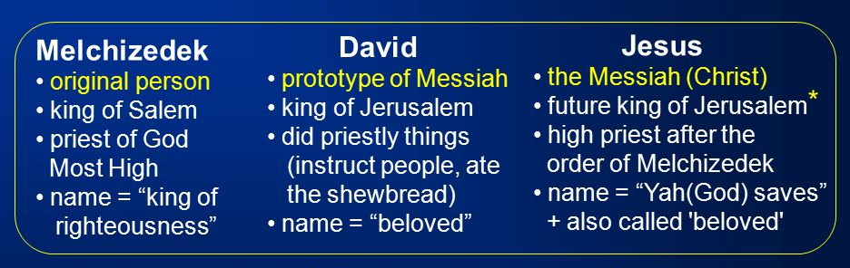
FIRST – similarly, they are kings. The place called Salem later called Jerusalem.
SECOND – the name Melchizedek means “king” and “righteousness.” The name Salem means “shalom,” translated “peace.”
THIRD – Melchizedek is introduced without mention of his parentage, ancestry, birth or death. He pronounced a priestly blessing over Abraham, who responded by giving Melchizedek a tenth of the spoils of his recent battle.

Slide 12
Hebrews chapter 7
Discussion:
Here, Paul argues that Melchizedek foreshadowed the coming of the Son of God. As such, David can later declare of the future Messiah, “You are a priest forever according to the order of Melchizedek” (Ps 110:4).
Jesus was of the tribe of Judah – ineligible to serve as priest on earth. Jesus’ priesthood was different.
What Melchizedek was in the narrative, the Messiah is in the His nature – Jesus is Priest and King, Righteousness and Peace incarnate, eternal in His deity, and ever able to serve as High Priest in heaven.

Slide 13
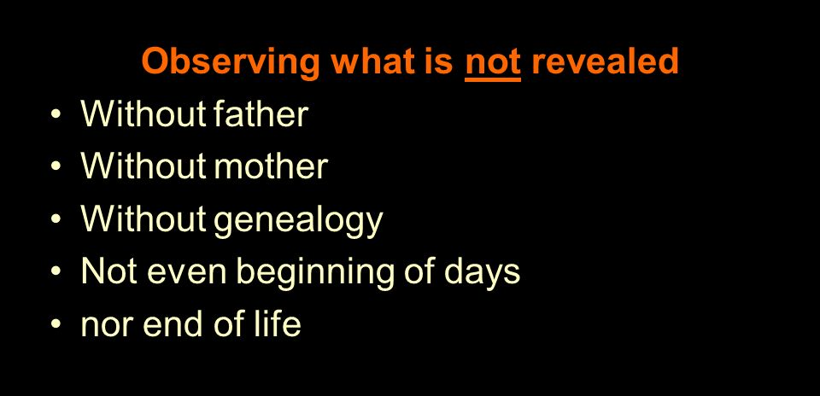

Slide 14
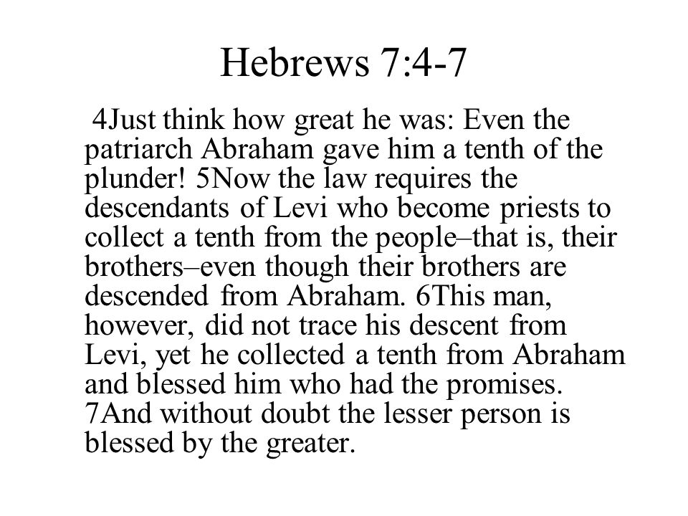

Slide 15
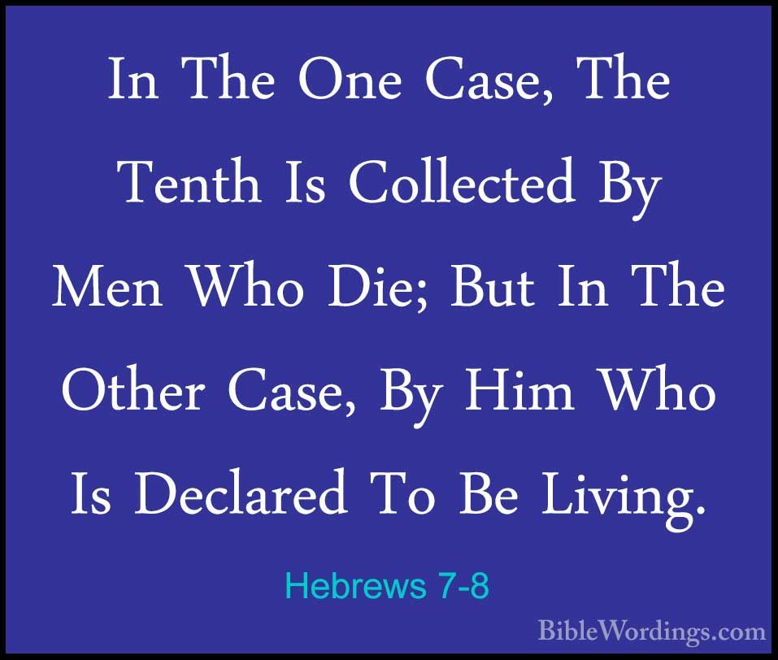

Slide 16
Hebrews chapter 7
Discussion:
Here, Paul demonstrates that Melchizedek himself was greater even than Abraham, the founding father of the Hebrew people and original recipient of the foundational covenant (7:4).
FIRST – Abraham gave the priest one tenth (“tithe”) of all his spoils of war (Gen. 14:20). In the Law of Moses, the Levitical priesthood received tithes from the people of Israel – the descendants of Abraham (7:5).
Note: tithing predates the Mosaic Law.

Slide 17
Hebrews chapter 7
Discussion:
SECOND – Melchizedek blessed Abraham, the one who possessed the promises of God (7:6). In a formal Biblical blessing, the superior (greater)always blesses the inferior (lesser).
Paul notes that such order of rank and propriety of blessing is “without any dispute” (7:7). The priest-king of Salem occupied a place of greater spiritual authority than Abraham: “greater indicates a person of greater status, prominence, or rank.”

Slide 18
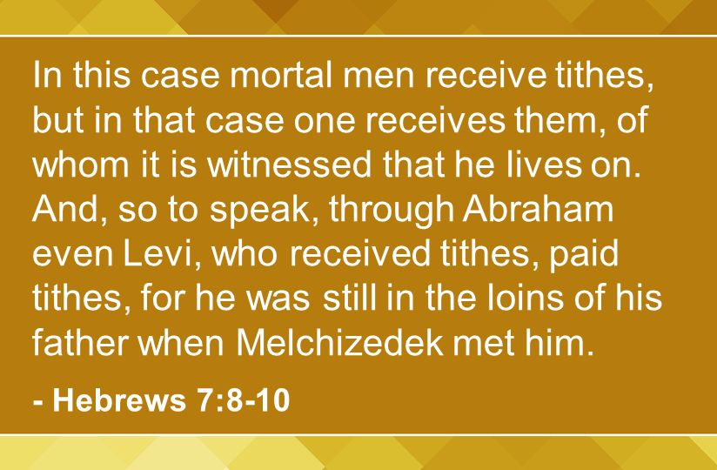

Slide 19
Hebrews chapter 7
Discussion:
By implication then, Melchizedek’s priesthood was superior to the priesthood of the Levites, who were still “in the loins” of Abraham (7:10).
Because Melchizedek is greater than the Levitical priests, Melchizedek’s priesthood – which existed long before the Law of Moses – is greater than the Levitical priesthood established under Moses.
Because the Messiah’s priesthood is of the “order of Melchizedek, ” the Messiah’s priesthood is greater than the priesthood of the Levites under Mosaic Law.

Slide 20
Hebrews chapter 7
Discussion:
What a powerful argument!
Remember, the readers had been tempted to back away from their complete trust in the Messiah as their great High Priest and find significance again in the Levitical priesthood with its continual sacrifices and rituals.
Paul states there is another priestly order superior to the Levitical line of Aaron. It was the order of Melchizedek, a king-priest who foreshadowed a still greater future King and Priest, Jesus Christ.

Slide 21
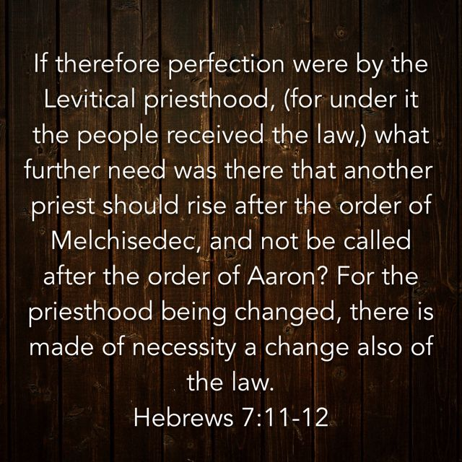

Slide 22
Hebrews chapter 7
Discussion:
Paul quotes David that another priest was to rise who was not part of the order of Aaron (7:11), but shall be after the order of Melchizedek (Ps 110:4).
There was obviously something the priesthood of Aaron couldn’t accomplish – perfection (7:11).
Paul makes the obvious point that with the changing of the priesthood from Aaron to Melchizedek, there must also be changes regarding the Law of Moses (7:12).

Slide 23
Hebrews chapter 7
Discussion:
The Levitical priesthood failed to give the believer direct access to God. The Law failed to bring maturity into the life of the believer. But where the old covenant failed, the new covenant succeeded.
With Jesus Christ – the promised Priest according to the order of Melchizedek – came the assurance both of unhindered access to God (4:14-16) and growth toward real spiritual maturity (12:1-2).

Slide 24
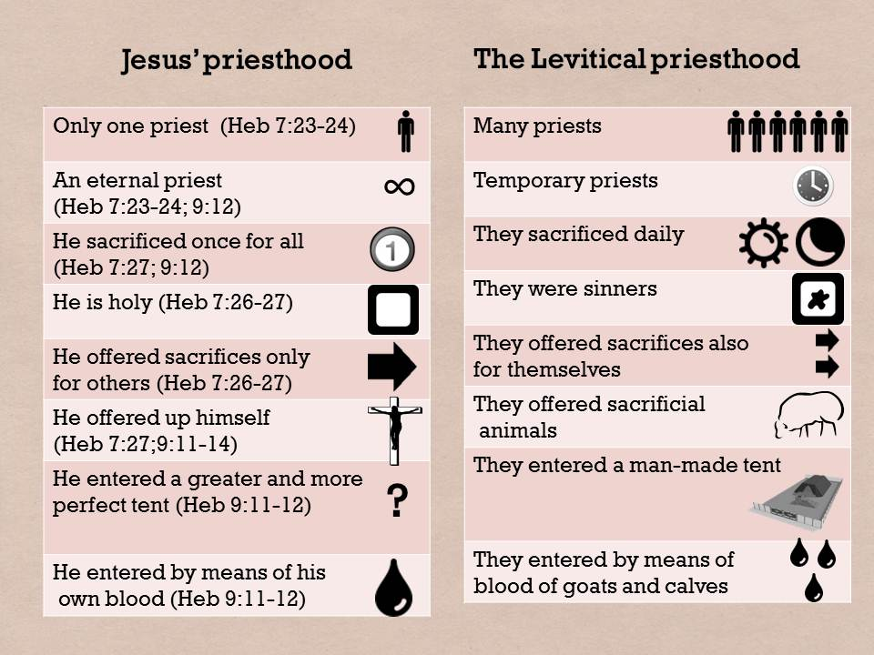

Slide 25
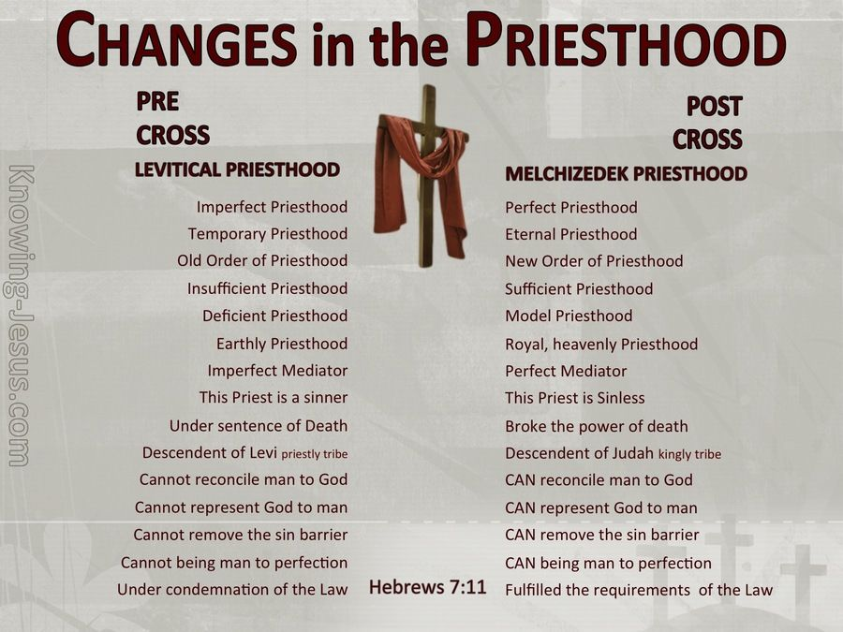

Slide 26
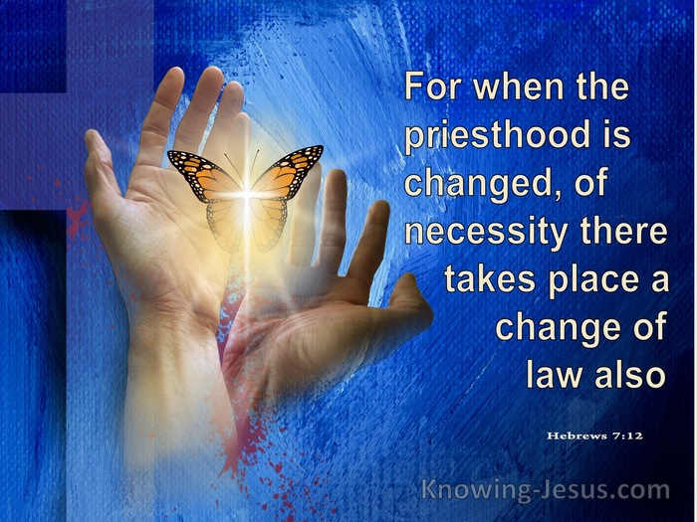

Slide 27
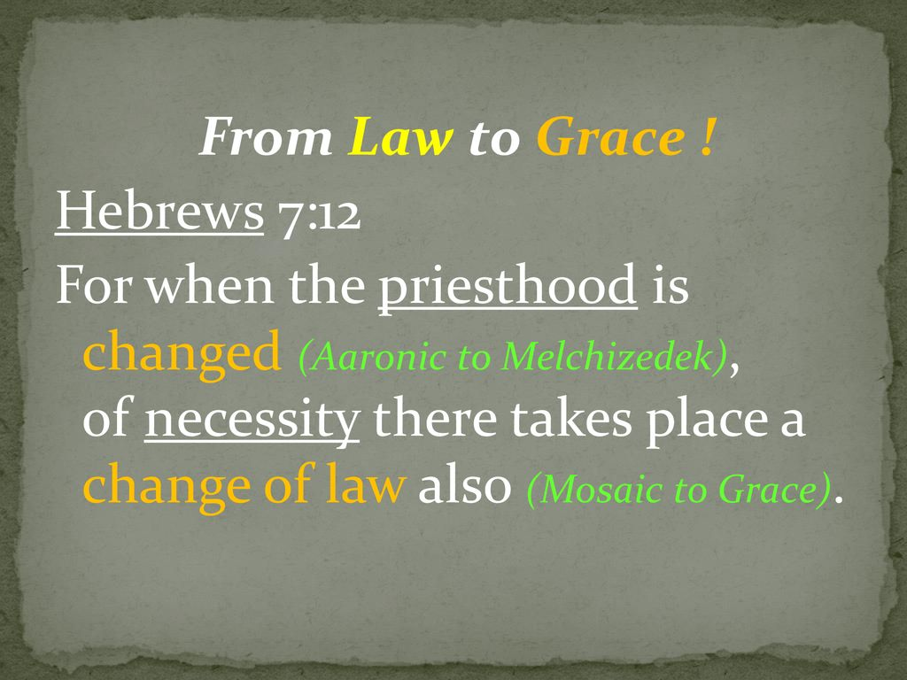

Slide 28
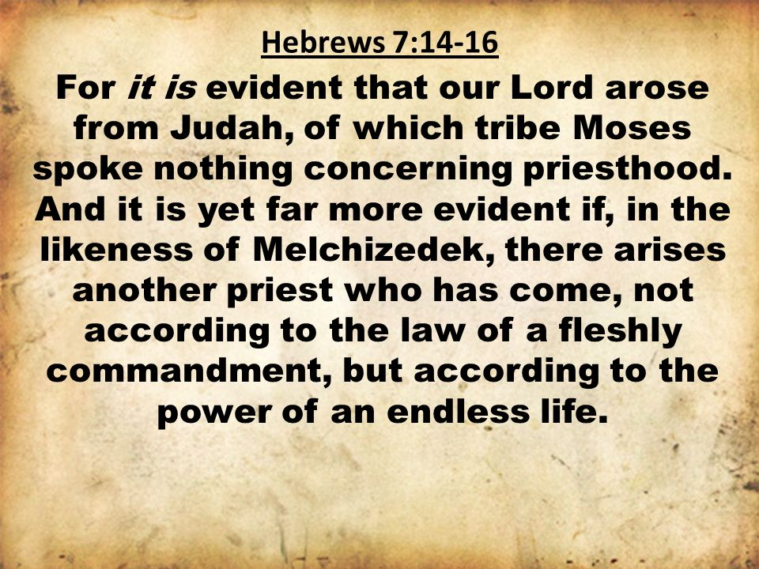

Slide 29
Hebrews chapter 7
Discussion:
  Paul explains that Jesus Christ descended from the tribe of Judah rather than from the tribe of Levi. As such, Jesus stood outside the legal lineage for a priest under the Law of Moses (7:14).
  Jesus priesthood was of a completely different order. It was an eternal priesthood based on “an indestructible (endless) life,” foreshadowed by the mysterious Melchizedek (7:15-16).

Slide 30
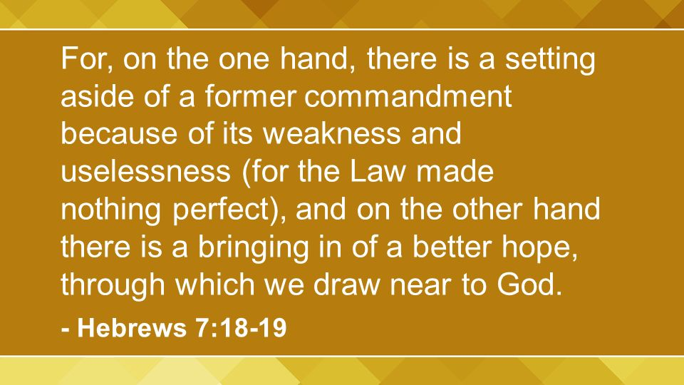

Slide 31
Hebrews chapter 7
Discussion:
  Paul argues that “on the other hand,” the Law was set aside because of its weakness and uselessness at providing genuine access to God and means of spiritual growth . . . for the Law made nothing perfect (7:18-19).
  Knowing God and having personal access to Him are the hallmarks of true religion. Fallen humanity needs a reliable bridge to span the chasm that separates sinful humans from a holy, righteous God – that bridge is Jesus Christ (1Tim. 2:5; John 14:6).

Slide 32
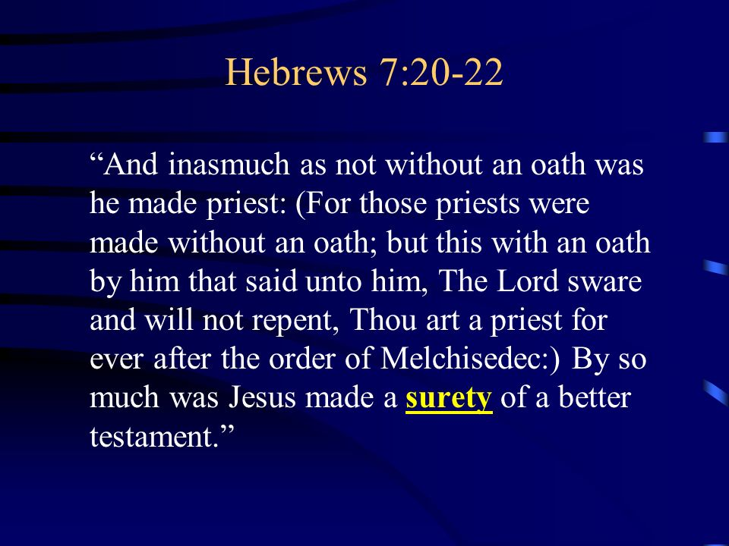

Slide 33
Hebrews chapter 7
Discussion:
Note the following four comparisons . . .
  ONE – Paul emphasizes the fact that Christ’s Melchizedekian priesthood was established by a divine oath, as found in Psalm 110:4, (7:21).
  Because Christ is superior in His priesthood, those who place their trust in Him are guaranteed a better kind of salvation. Because Jesus lives forever, we will live forever (7:22).

Slide 34
Hebrews chapter 7
Discussion:
Note the following four comparisons . . .
  TWO – Paul declares that Jesus was the personal guarantee of a better covenant that could never expire (7:22).
  Jesus has become the guarantee of a covenantal arrangement superior to that of Moses (7:22).

Slide 35
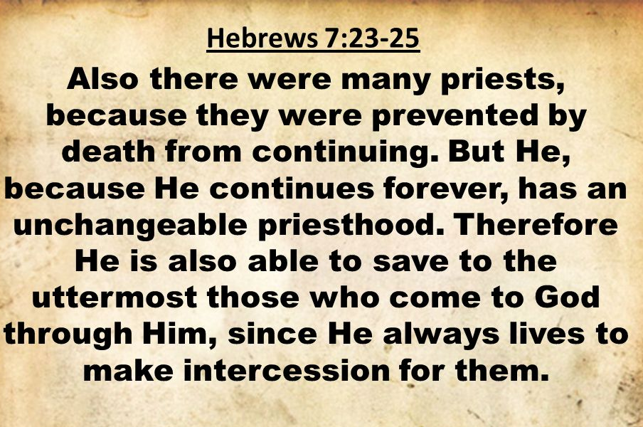

Slide 36
Hebrews chapter 7
Discussion:
Note the following four comparisons . . .
  THREE – Paul declares that Jesus’ priestly ministry is permanent, because He conquered death and lives forever (7:24).
  We sinful mortals are in perpetual need of a mediating high priest; Christ is a perpetual, perfect High Priest (7:24).

Slide 37
Hebrews chapter 7
Discussion:
Note the following four comparisons . . .
  FOUR – Paul declares that Jesus’ ministry of heavenly intercession enables Him to provide eternal salvation to those who come to God through Him (7:25).
  What a great reminder of our eternal security in Jesus Christ. He is able “to save totally, completely, and forever” those who have placed their faith in Him (7:25).

Slide 38
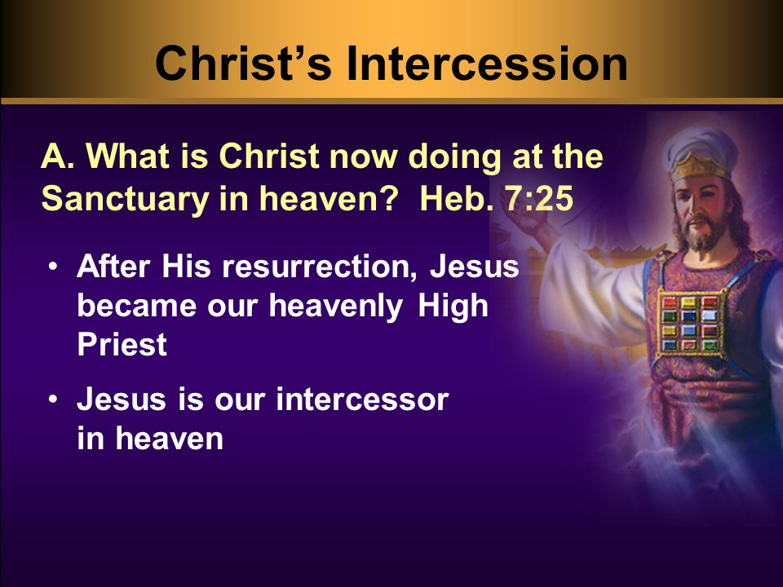

Slide 39
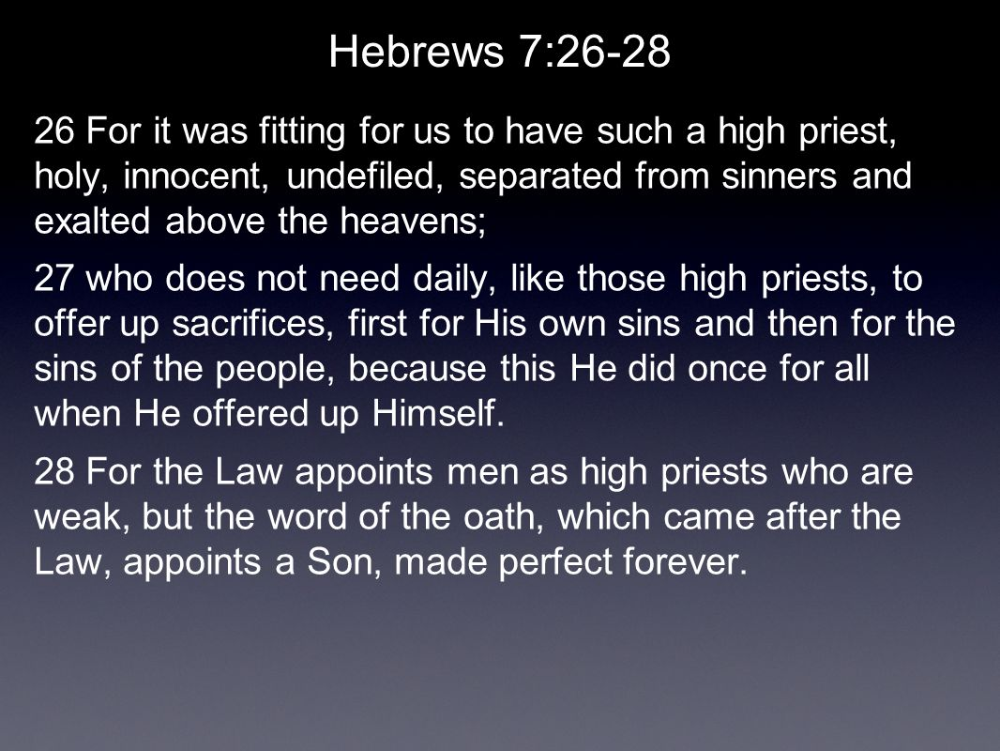

Slide 40
Hebrews chapter 7
Discussion:
Three additional reasons for Christ’s superiority
  FIRST – Jesus is superior because He is sinless (7:26).
  SECOND – Jesus is superior because His sacrifice was offered once for all (7:27).
  THIRD – Jesus is superior because He is the perfect, powerful Son of God (7:28).

Slide 41
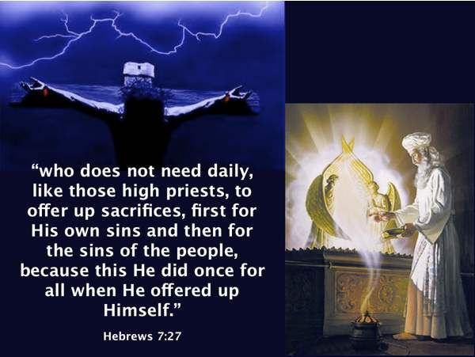

Slide 42
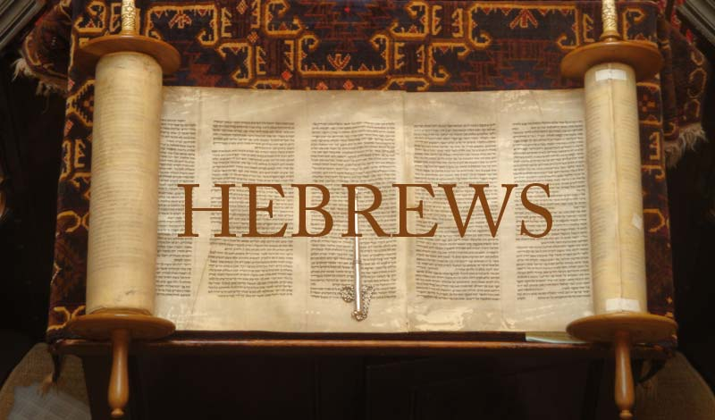

Slide 43
Hebrews chapter 7
Points to Remember:
The superiority of Melchizedek to Abraham and Levi (1-10).
The change in the priesthood and the annulment of the law (11-19).
The superiority of Jesus’ priesthood to the Levitical priesthood (20-28).

Slide 44
Hebrews chapter 7
Application of Chapter 7
[1] – Change in the priesthood, change in the Law.
  When Christ took His position at the right hand of the Father to function in the role of the great High Priest, He came not to continue the OT Levitical priesthood, but He came as a priest according to the order of Melchizedek.
  Jesus uprooted the Law, which produced no fruit in the life of the believer. Whereas the Law was both weak and ineffective, grace is both effective and filled with assurance.

Slide 45
Hebrews chapter 7
Application of Chapter 7
[2] – Grace vs Law.
  We must never forget that it is grace, not Law, which enables us to draw near to God. Rigid rules provide no access to God; legalistic principles provide no security. Our security is in a Savior who has fulfilled the Law for us.
  Having fulfilled the Law – including its need for perfect obedience and a perfect sacrifice for sin – Christ has ushered in a new order based on the principle of grace.

Slide 46
Hebrews chapter 7
Application of Chapter 7
[3] – Grace through faith, no works.
  Being right with God doesn’t require us to work through a daunting list of dos and don’ts … or to turn to a priest (who is also sinful) for mediation.
  Rather, we turn to the great High Priest who is after the order of Melchizedek. Our High Priest is indestructible, lives permanently, and is able to do what no earthly priest could ever do.

Slide 47
Hebrews chapter 7
Application of Chapter 7
[4] – A change for the better.
  Unlike the OT priesthood with its endless sacrifices, our High Priest (Jesus Christ), not only tells us we’re weak and empty and in need of saving; He actually saves us, strengthens us, and fills us with His power to trust and obey Him.
  Apart from Christ, we can do nothing, but with Him, we can do all things. Thank God that with the changing of the priesthood, there has been a changing of the Law as well.

Slide 48
Hebrews chapter 7
Application of Chapter 7
[5] – Christ, our permanent Bridge-maker.
  The idea of Christ as the Bridge – between sinful humanity and our holy God – has become a helpful way of thinking about the gospel of salvation.
  As a reminder for us as well as a motivator to share this simple good news with others, continue to view Christ as our permanent “Bridge-maker.”

Slide 49
Hebrews chapter 7
Application of Chapter 7
[6] – Christ, our access to God.
  Since you have cross the “chasm of sin” over the Bridge of Christ, have you shared the good news with others?
  Have you taken the hand of an unbeliever who was stuck on the wrong side of the chasm and carefully walked them through God’s plan of salvation through Jesus Christ (John 14:6).

Slide 50
NEXT CLASS – 21 October 2020
Letter to the Hebrews
Read before the next class in the KJV and in two other versions of the Bible, i.e., NKJV, NRSV, NIV, CEV, etc …
Chapter 8:1 – 13

Slide 51



the end
Questions
Questions

Slide 52


