Slide 1

Jesus the High Priest
of a
New Covenant
Week 9
28 October 2020

Slide 2
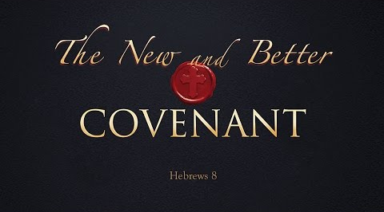
Chapter 8

Slide 3

Hebrews review
Chapter 1: Jesus, Better than Prophets and Angels (1:1-14)
Chapter 2: Jesus, Better than the Angels (2:1-18)
Chapter 3: Jesus, Better than Moses (3:1-19)
Chapter 4: Jesus, Better than Joshua (4:1-16)
Chapter 5: Jesus, Better than Aaron as Priest (5:1-14)
Chapter 6: Jesus, Press On To Maturity (6:1-20).
Chapter 7: Jesus, After the Order of Melchizedek (7:1-17).
this lesson . . .
Chapter 8: New Covenant Better than the Old (8:1-13).

Slide 4
Hebrews chapter 8
Overview of Chapter 8:
Having demonstrated Jesus’ superiority to prophets, angels, Moses, and Levi, the author summarizes: we have a High Priest at God’s right hand who is Minister and Mediator of a better covenant established on better promises (1-6).
Our attention is then directed toward that New Covenant which has replaced the Old Covenant (7-13).

Slide 5
Hebrews chapter 8
Discussion:
The Book of Hebrews argues that the Mosaic covenant—established under specific conditions—was never meant to last forever.
Paul quotes an OT prophecy (Jeremiah) that anticipates the replacement of the old covenant with the new, proving to his Jewish readers that the one has become obsolete, replaced by another that will never pass away.

Slide 6
Hebrews chapter 8
Discussion:
This chapter of Hebrews ties in beautifully with the things that have been said about Christ’s superiority in His person and work.
Jesus “has become the guarantee of a better covenant” (7:22), which assures us that whatever the new covenant includes, it is superior to everything that has come before it.

Slide 7
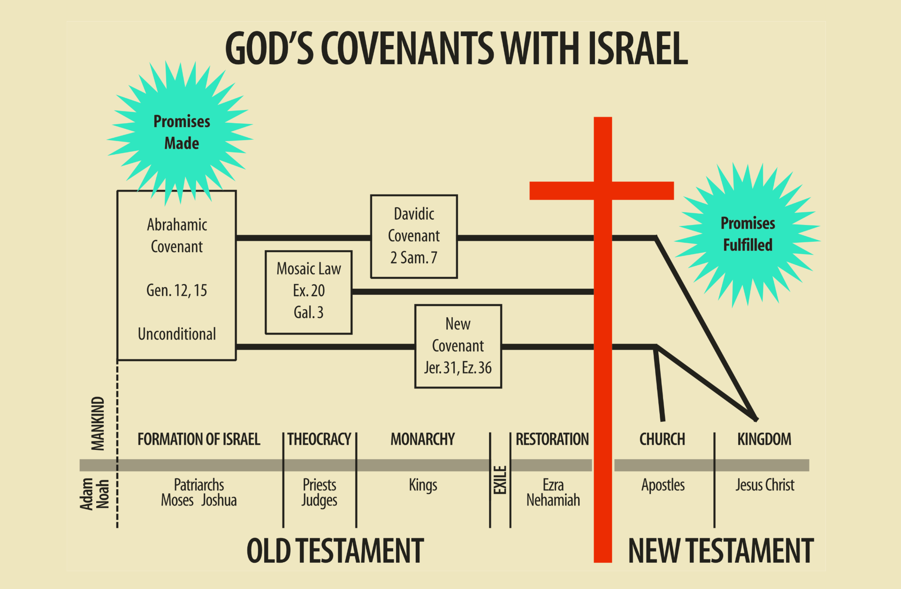

Slide 8
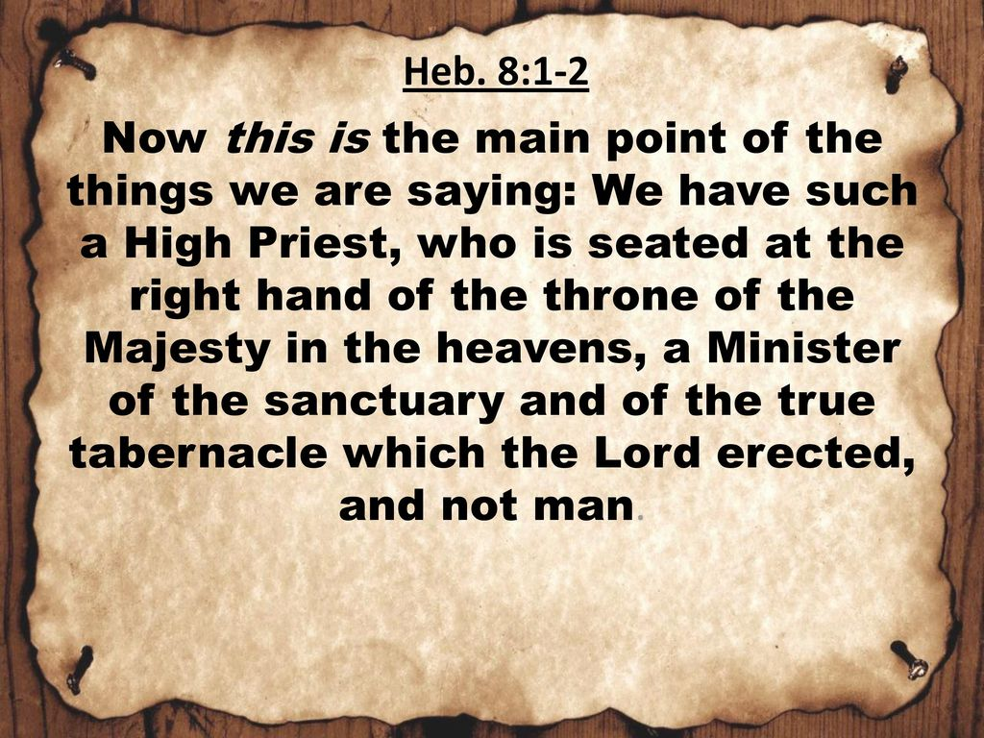

Slide 9
Hebrews chapter 8
Discussion:
Paul summarizes his argument, thus far in bullet-point fashion, “Now the main point in what has been said is this . . .”
We have a high priest who is greater that those of the old covenant (8:1)
Our High Priest sits in the heavens at the right of God (8:1)
He ministers in the true tabernacle made by God, not by man (8:2).

Slide 10
Hebrews chapter 8
Discussion:
Paul says the Lord Himself “pitched” that tabernacle. Like the earthly realm, the heavenly realm is a creation of God.
Whereas the earthly tabernacle – the holy tent of meeting, which originally hosted Levitical priest and their sacrificial worship – was put up and take down by human hands (Exod. 33:7; Josh. 18:1), the heavenly tabernacle was erected by God Himself.
That is, the heavenly tabernacle is permanent.

Slide 11
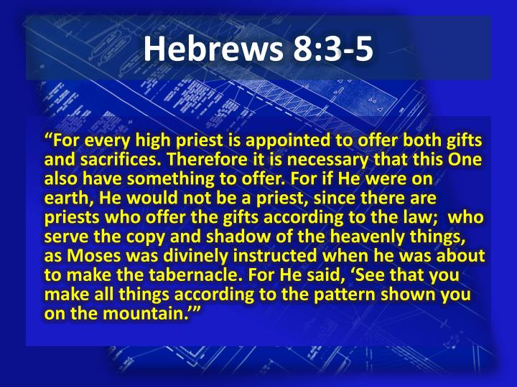

Slide 12
Hebrews chapter 8
Discussion:
Paul states that the Aaronic Levitical priesthood served in the sphere of a copy and shadow of the heavenly things (8:5).
Moses commanded that the earthly tabernacle be built as a symbolic representation of the heavenly sanctuary which he saw on Mt. Sinai (Exod 25:40).
Just as a shadow is cast by something of real substance, so the rituals of the old covenant are representative of a greater reality that stands behind them.

Slide 13

Pattern as seen on Mt. Sinai

Slide 14
Hebrews chapter 8
Discussion:
Had Jesus’ priestly ministry been established in the earthly copy rather than in the heavenly original, He wouldn’t even have qualified to be a priest (8:4).
Jesus wasn’t from the tribe of Levi and therefore couldn’t offer gifts in that old covenant system “according to the Law” (8:4).

Slide 15
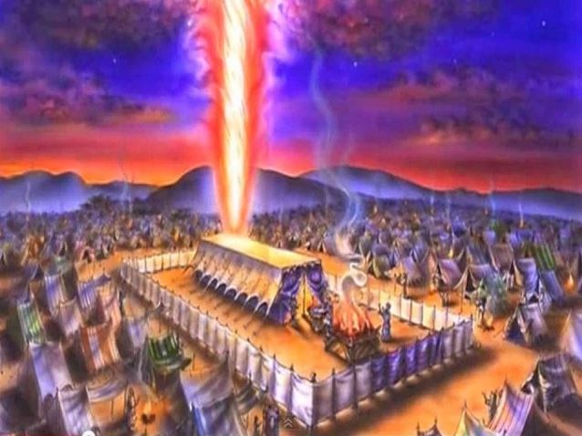

Slide 16
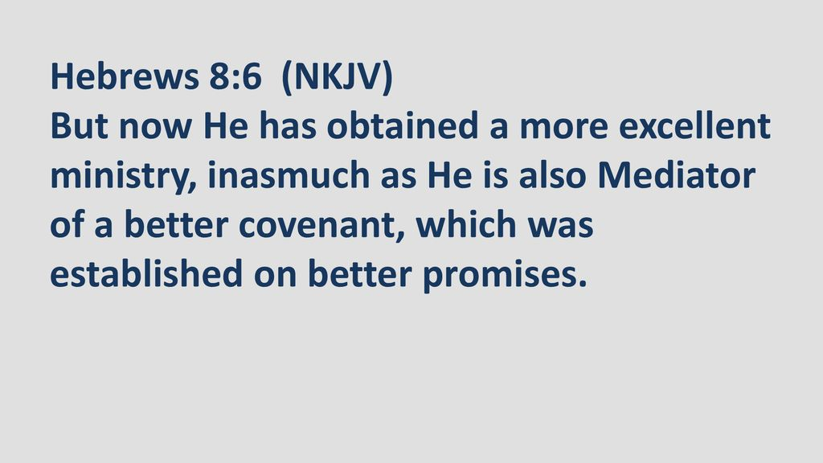

Slide 17
Hebrews chapter 8
Discussion:
Thank God, Christ is a high priest and offers “both gifts and sacrifices,” but not in the earthly tabernacle according to the old covenant Mosaic Law.
Rather, Christ has a “more excellent ministry” as the eternal High Priest in a heavenly tabernacle. Logically, then, Christ must be the “the mediator of a better covenant” based on “better promises” (8:6).

Slide 18
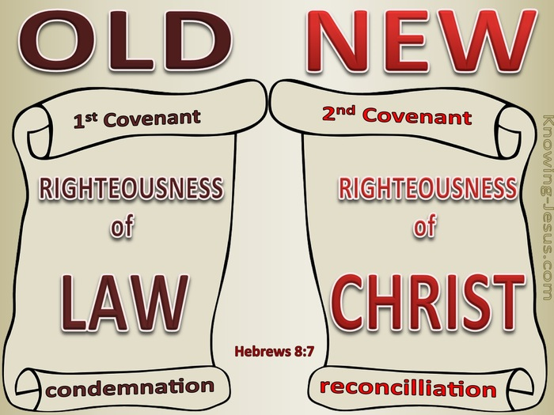

Slide 19
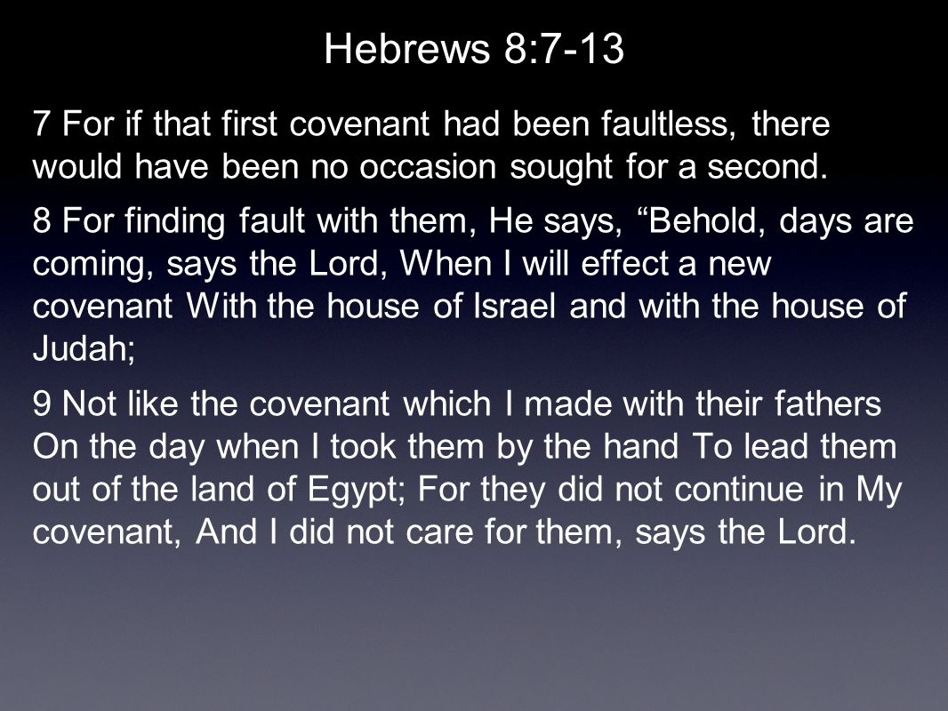
9

Slide 20
Hebrews chapter 8
Discussion:
The Jewish Christians who were the original audience of this letter were likely being influenced by unbelieving Jews who were completely loyal to their rabbis’ teaching and committed to preserving the Mosaic covenant.
Any challenge to this system would be the target of criticism and attack; therefore, Paul has to back up his assertions with solid Scripture in order to prove his point.

Slide 21
Hebrews chapter 8
Discussion:
This is why Paul quotes extensively from Jeremiah 31:31-34. Paul demonstrates from the OT Scriptures themselves that the covenant under Moses was imperfect and required replacement by a new covenant that was faultless (8:7).
That is, the OT covenant was insufficient. It could not accomplish eternal salvation nor bring about perfect righteousness.
The new covenant would not be like the old covenant established at Sinai after the Exodus (8:8-9).

Slide 22
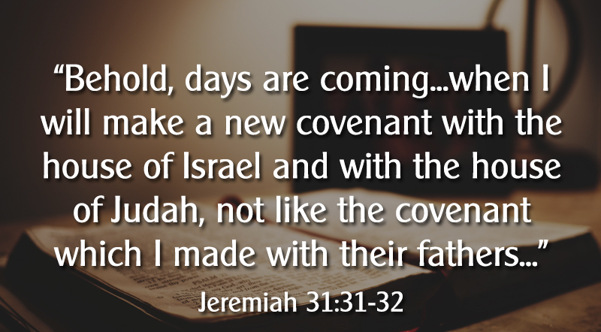

Slide 23
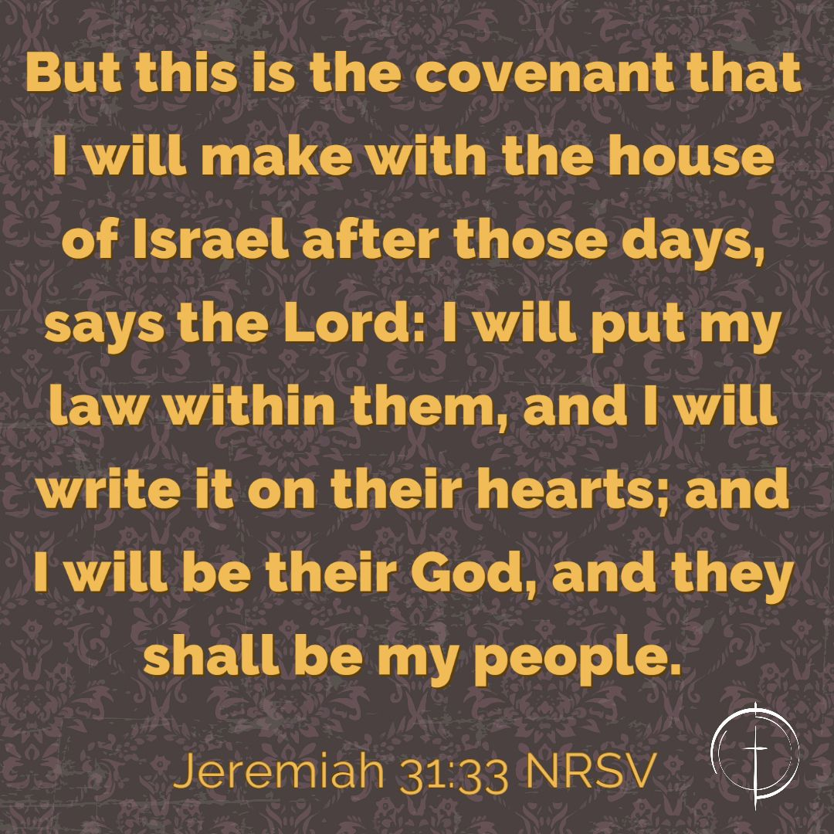

Slide 24
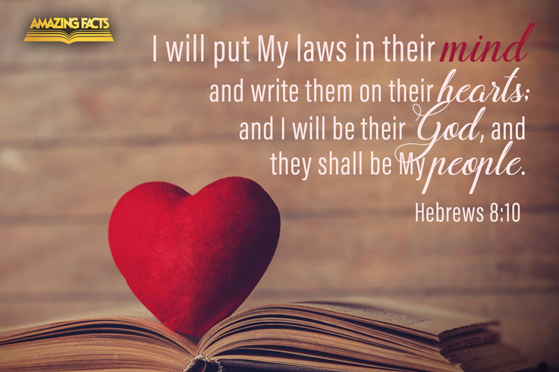

Slide 25
Hebrews chapter 8
Discussion:
The new covenant would have its laws written in people’s hearts, not on tablets of stone. The old covenant failed because the urgings of the flesh superseded the urgings of the spirit in man (8:10).
The new covenant is based on God making us new creations (2Cor. 5:17), so that we are Spirit-controlled rather than body-controlled.
God makes His will the desire of our hearts: Psalm 40:8 > “I delight to do thy will, O my God: yea, thy law is within my heart.”

Slide 26
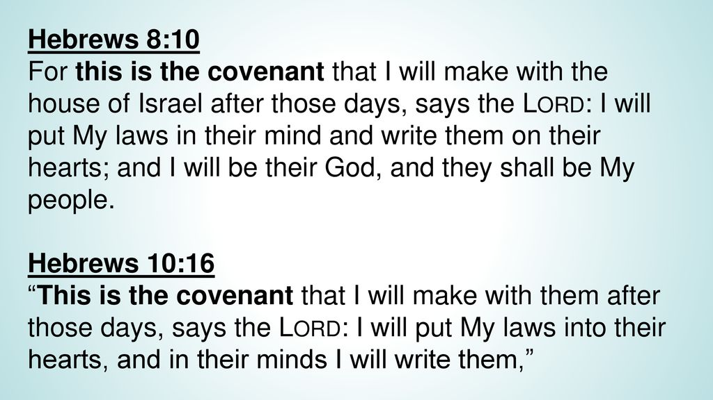
Restated in Hebrews 10:16

Slide 27
Hebrews chapter 8
Discussion:
Paul offers four ways in which the new covenant is superior to the old – rendering it obsolete:
FIRST – the new covenant offers internal motivation and power instead of external lists (8:10). The old covenant was addressed to a people with hard, unregenerate hearts.
In stark contrast, the new covenant involves an internal transformation by which the laws are written on people’s hearts. Submission comes from faith and love, not fear of judgment.

Slide 28
Hebrews chapter 8
Discussion:
Paul offers four ways in which the new covenant is superior to the old – rendering it obsolete:
SECOND – the new covenant is based on a close relationship instead of a distant fear (8:10). God gave commandments to the people from a place of remote distance, from Mt. Sinai, through Moses.
In contrast, the new covenant involves a new relationship of intimacy and fellowship – similar to Moses’ unique “face-to-face” with God (Exod 33:11).

Slide 29
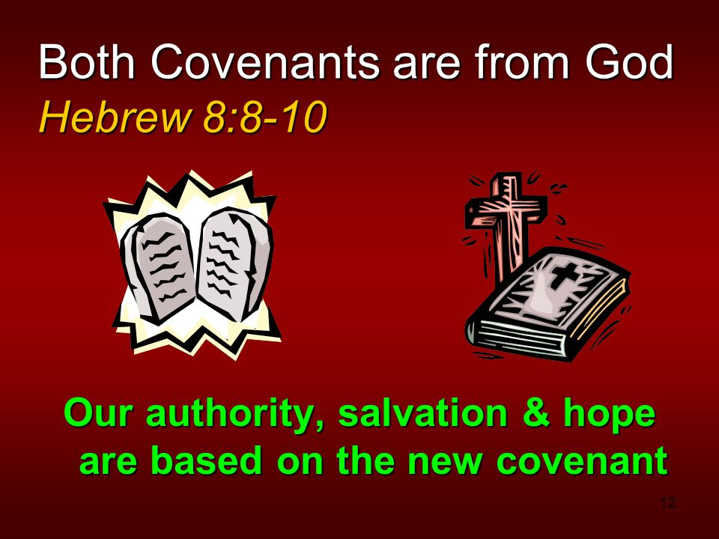

Slide 30
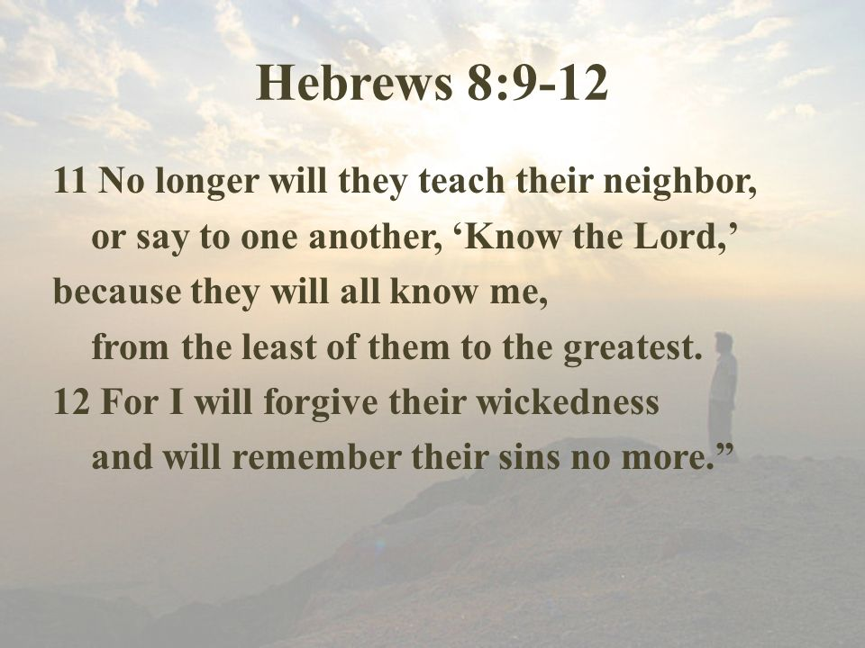

Slide 31
Hebrews chapter 8
Discussion:
THIRD – the new covenant provides confidence and assurance instead of insecurity and uncertainty (8:11). In the old covenant, there were a mixed company of both believers and unbelievers – all marked by the external sign of circumcision, but not all having experienced the “circumcision of the heart” (Deut. 10:16; Jer. 4:4).
In contrast, people enter into the new covenant by the inner transformation of the new birth as children of God with one heavenly Father.

Slide 32
Hebrews chapter 8
Discussion:
FINALLY – the new covenant emphasizes forgiveness and mercy instead of failure and wrongdoing (8:12). The iniquities and sins that separated an unholy, guilty people from a holy, perfect God were no basis for an eternal relationship.
In contrast, the new covenant erases the sin and guilt of God’s people once for all time. Through the work of Christ, they are the recipients of His mercy and grace . . . and their sins will never be brought to mind (8:12).

Slide 33
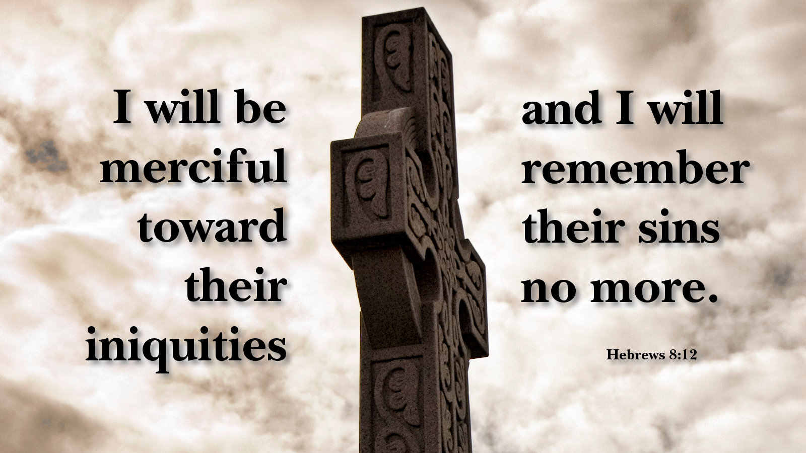

Slide 34
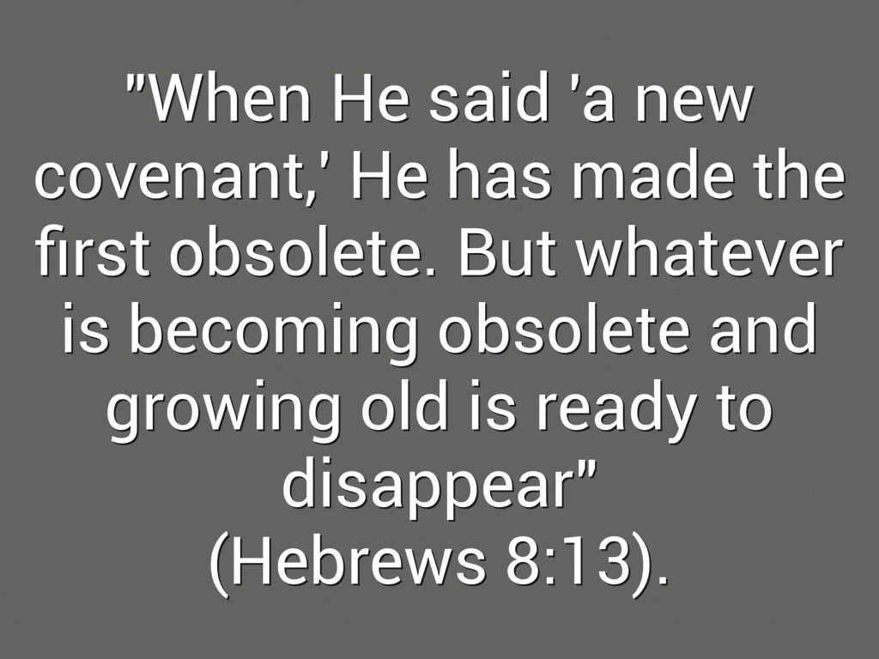

Slide 35
Hebrews chapter 8
Discussion:
All of these striking marks of the superiority of the new covenant over the old send a clear and compelling message: The new covenant renders the old covenant “obsolete” (8:13).
Though the priesthood was still in operation at the time this letter was written, the inauguration of the new covenant through the coming of the Messiah meant that the old covenant was “growing old” and was “ready to disappear.” Thus ending with the destruction of the Temple in AD 70.

Slide 36
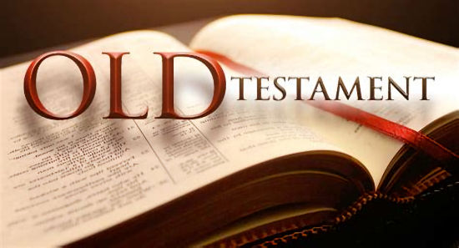
Obsolete
Growing old
Ready to disappear
Vanishing away

Slide 37
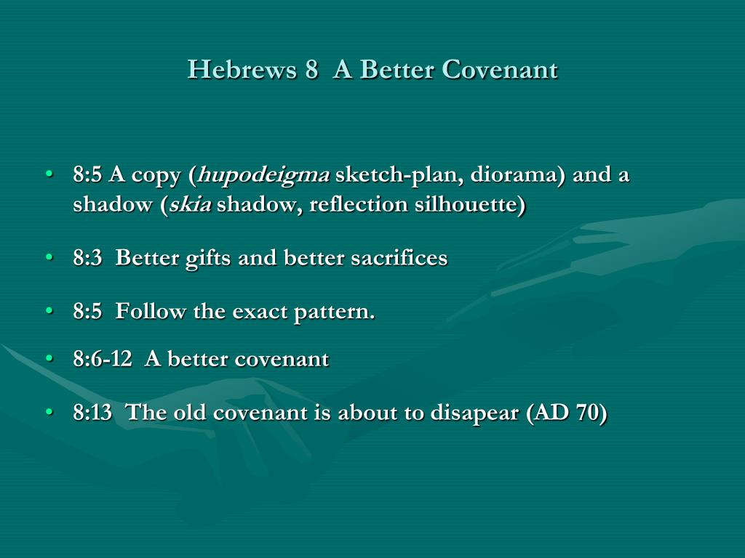
Review

Slide 38
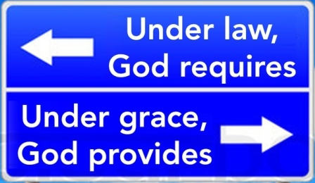
Which do you prefer?

Slide 39
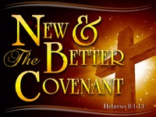

Slide 40
Hebrews chapter 8
Application of Chapter 8
[1] – The new covenant provides motivation and power.
  We have confidence that God’s Spirit within us can overcome our weaknesses and inadequacies. We remember that trusting and obeying Him isn’t done in our own fleshly strength.
  God works in us to shape our desires and accomplish what He wills (Phil. 2:12-13). We’re not asked to conjure up halfhearted obedience performed with a begrudging grin, but God himself produces spiritual fruit through His abiding Spirit (love, joy, peace).

Slide 41
Hebrews chapter 8
Application of Chapter 8
[2] – The new convenant is based on a close relationship with Him.
  We can embrace God as our heavenly Father and fellowship with Him as our ever-present friend. If you’ve ever felt afraid of God and kept your distance from Him, remember that He’s your Father and you are His child.
  Even when we stumble and fall, He wants to take us under His wing, restore us and discipline us, but He doesn’t smite us.

Slide 42
Hebrews chapter 8
Application of Chapter 8
[3] – The new covenant provides confidence and assurance.
  We can cast aside our doubts and uncertainties regarding assurance of salvation and our place in His
  family. If you’ve doubt, with trembling knees, whether you’re worthy enough to be His, stop.
  None of us is worthy, but he has invited us into His family forever—not based on our worthiness, but on the worthiness of His Son. We’re joint-heirs with Jesus Christ.

Slide 43
Hebrews chapter 8
Application of Chapter 8
[4] – The new covenant emphasizes forgiveness and mercy.
  We can always turn to Him for both forgiveness and mercy. If you’re in a prison of guilt, God’s promise of forgiveness provides the key to freedom.
  If you’re stuck in the ups and downs of a cycle of sin and repentance, know that God’s mercy is always there to pick you up.

Slide 44
Hebrews chapter 8
Application of Chapter 8
[4] – The new covenant emphasizes forgiveness and mercy.
  Mercy means God withholds the punishment we deserve.
  Forgiveness means he sets us free from the guilt and consequences of sin.
  Grace means He gives us what we don’t deserve: spiritual blessings now and the promise of eternal life with Him.

Slide 45
NEXT CLASS – 4 November 2020
Letter to the Hebrews
Read before the next class in the KJV and in two other versions of the Bible, i.e., NKJV, NRSV, NIV, CEV, etc …
Chapter 9:1 – 28

Slide 46



the end
Questions
Questions

