Slide 1

Jesus the High Priest
in a
New Sanctuary
Week 10
4 November 2020

Slide 2
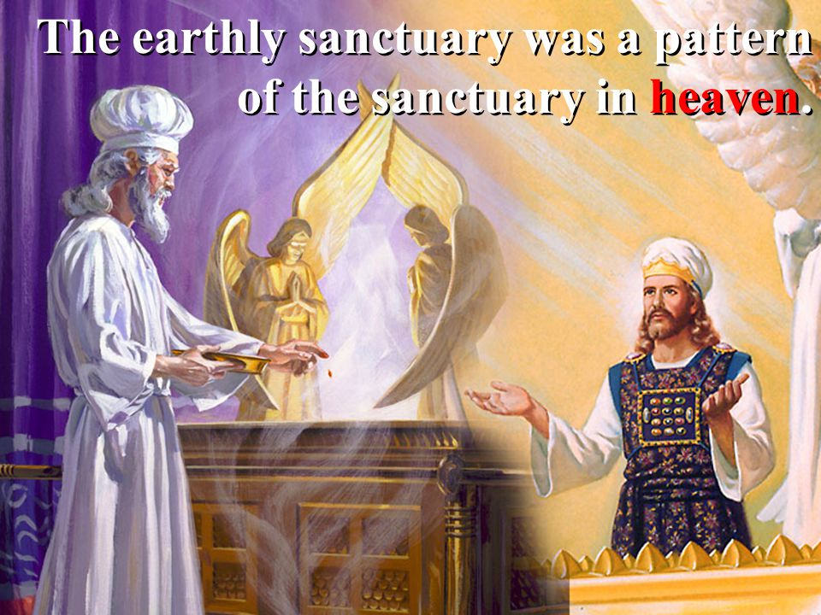
Chapter 9

Slide 3

Hebrews review
Chapter 1: Jesus, Better than Prophets and Angels (1:1-14)
Chapter 2: Jesus, Better than the Angels (2:1-18)
Chapter 3: Jesus, Better than Moses (3:1-19)
Chapter 4: Jesus, Better than Joshua (4:1-16)
Chapter 5: Jesus, Better than Aaron as Priest (5:1-14)
Chapter 6: Jesus, Press On To Maturity (6:1-20).
Chapter 7: Jesus, After the Order of Melchizedek (7:1-17).
Chapter 8: New Covenant Better than the Old (8:1-13).
this lesson . . .
Chapter 9: New Sanctuary and New Sacrifice Better than the Old (9:1-28).

Slide 4
Hebrews chapter 9
Overview of Chapter 9:
To appreciate the difference between the two covenants, their respective sanctuaries and divine services are compared. First, the earthly sanctuary and the limitations of its divine services are reviewed (1-10).
Then, the greater and more perfect heavenly sanctuary with emphasis on its better sacrifice, the blood of Christ Himself (11-28).

Slide 5
Hebrews chapter 9
Points to Ponder:
The symbolism of the earthly tabernacle and its divine service (1-10).
The superiority of the heavenly High Priest and His sacrifice (11-28).

Slide 6
Hebrews chapter 9
Discussion:
Throughout the book of Hebrews, Paul has been declaring a biblical argument for the superiority of Christ’s person and work over the Old Testament priests and their ministry.
Back in Hebrew 8, Paul briefly mentioned the earthly tabernacle and its temporary ministry (8:4-5), asserting that Jesus’ high priestly ministry in the true, heavenly tabernacle is superior.

Slide 7
Hebrews chapter 9
Discussion:
Though Paul mentions details of the furnishings of the physical tabernacle and the ministry of the priests, his primary purpose is spiritual, drawing attention from external, tangible thins to internal, spiritual matters of the heart.
But how easy it is to get wrapped up in the external – those things we can see and touch with our bodies and the inner voice of our conscience. The conscience isn’t a fail-safe. It can be damaged making us feel good about our wickedness or guilty when innocent.

Slide 8
Hebrews chapter 9
Discussion:
The problem with the original, Jewish Christian recipients of this letter was that they were tempted to address the internal, spiritual concerns of the conscience with external, physical forms of worship that were never intended to cleanse the inner person.
Such efforts were futile. They belonged to a temporary stage in God’s plan of redemption – an age that pointed to a future time of reformation that would address not merely the external aspects of a person, but, more importantly, the internal conscience.

Slide 9
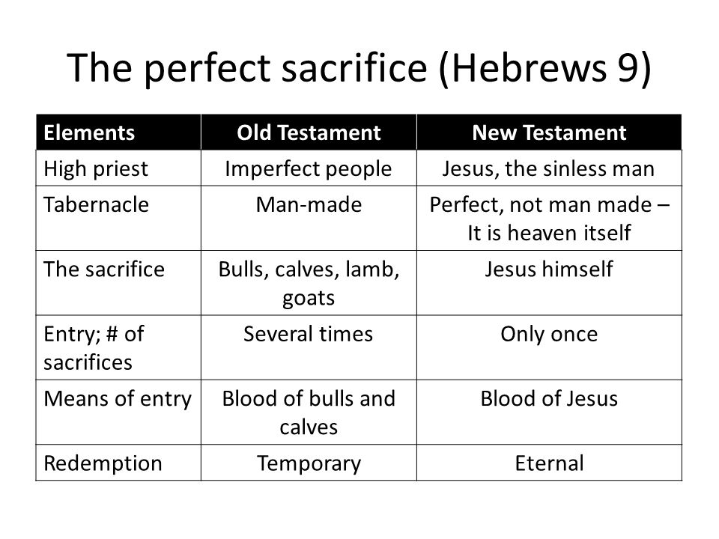

Slide 10
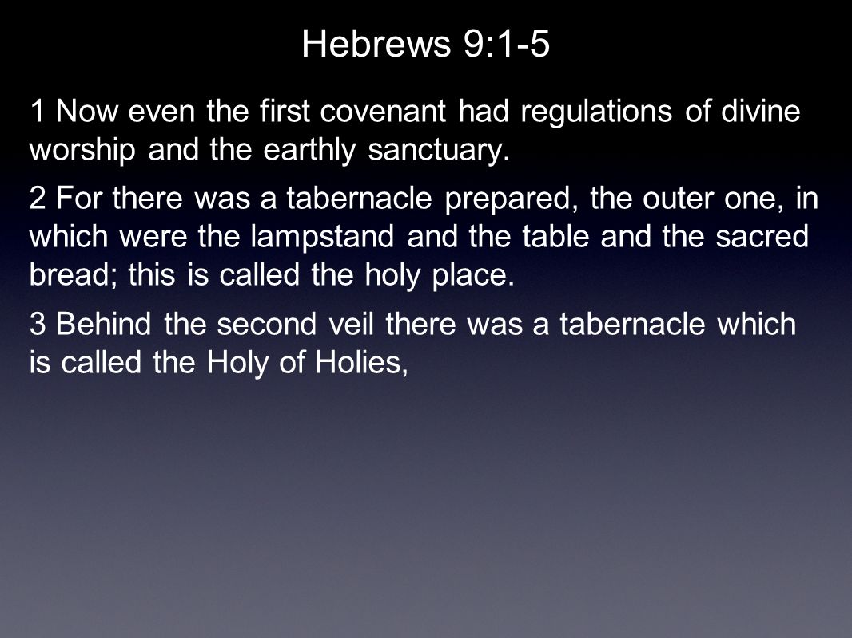
Hebrews 9:1 - 5
4 Having a golden altar of incense and the ark of the covenant covered on all sides with gold, in which was a golden jar holding the manna, and Aaron’s rod which budded, and the tables of the covenant;
5 and above it were the cherubim of glory overshadowing the mercy seat; but of these things we cannot now speak in detail.

Slide 11
Hebrews chapter 9
Discussion:
The tabernacle was a tent the Levites carried with them during their wilderness wanderings. When they stopped somewhere, the priests would reassemble the elements of the tent and thus erect the portable place of worship (cf. Exod. 25:25-40).
This temporary structure then housed a variety of implements of worship necessary for carrying out the sacrifices and rituals – all strictly prescribed by God in the regulations of the old covenant sacrificial system (9:1).

Slide 12
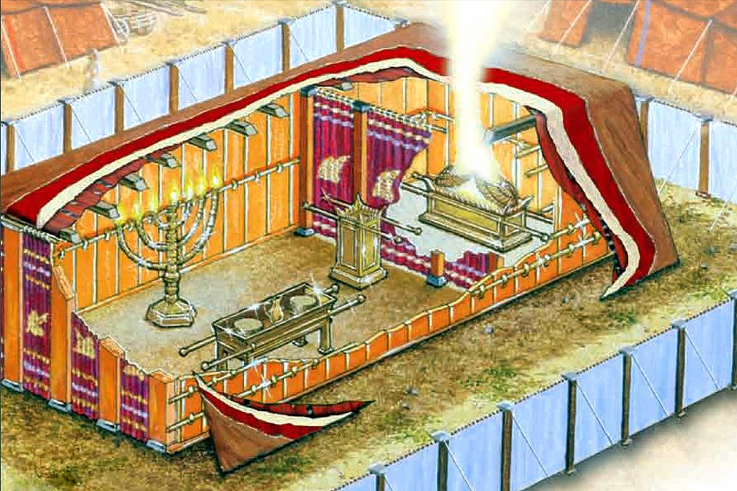

Slide 13
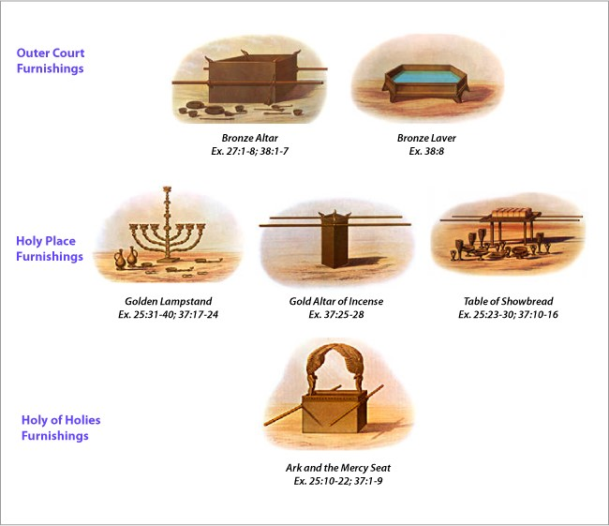

Slide 14
Hebrews chapter 9
Discussion:
FIRST – the main court of the sanctuary was the large, outermost court that fenced in the tabernacle itself and set it apart from the Israelite encampment, establishing the space for conducting the work of the priesthood (Exod. 27:9-19).
In this outer court stood the brazen altar for presenting the various offerings to the Lord. Between that altar and the tabernacle stood the bronze laver (or “wash basin”) for ritual washings conducted prior to entering the tabernacle itself.

Slide 15
Hebrews chapter 9
Discussion:
SECOND – the holy place or main tabernacle was situated behind a thick veil beyond the bronze laver. The priests would enter the holy place through the veil, where the golden lampstand and table of showbread stood opposite each other to the left and right, respectively (Exod. 25:23-40).
Just outside the veil to the holy of holies, stood the golden altar of incense used to obscure with thick smoke the glory of God above the ark of covenant (9:7).

Slide 16
Hebrews chapter 9
Discussion:
THIRD – the holy of holies was a small space behind a second veil, in which rested the ark of the covenant, containing the original tablets of the Ten Commandment, the rod of Aaron (which budded), and a golden jar of manna from the wilderness (Exod. 25:10-22).

Slide 17
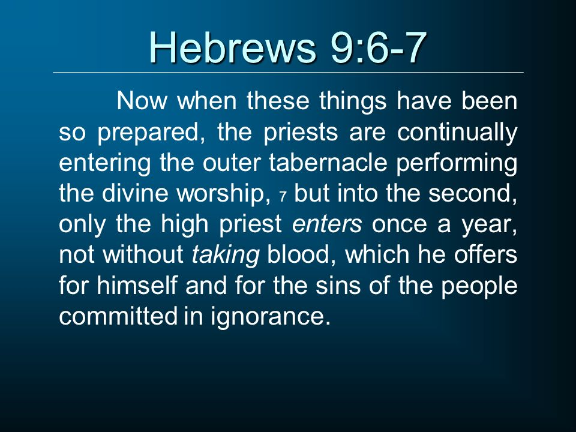

Slide 18
Hebrews chapter 9
Discussion:
Only the high priest was permitted to pull back the veil and enter the holy of holies – and only once a year during the special rituals related to the great Day of Atonement (Yom Kippur – Lev. 16:1-34).
This annual offering of blood was “for himself and for the sins of the people committed in ignorance” (9:7).

Slide 19


Slide 20
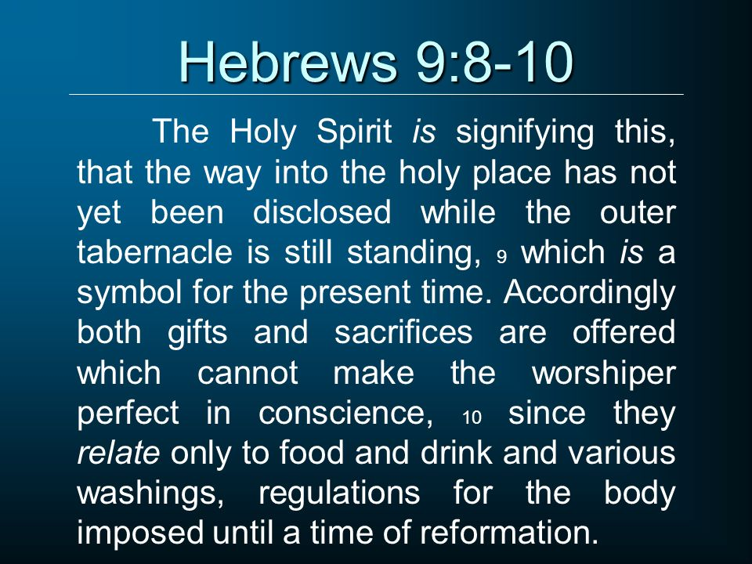

Slide 21
Hebrews chapter 9
Discussion:
The entire system of worship in the tabernacle was prescribed in painstaking detail by God. Yet, these rituals addressed only the outer person and revolved around material things and physical actions.
These gifts and offerings “relate only to food and drink and various washings, regulations for the body” (9:10). Unless the outer tabernacle were taken down, there could be no access to God apart from the high priests and the continual sacrifices (9:8).

Slide 22
Hebrews chapter 8
Discussion:
In an attempt to sooth an uneasy conscience, ease doubts about personal worthiness, or make up for too many missteps, people turn their backs on grace to embrace a life of legalism. These Jewish Christians probably thought that if they could just get back to a secure routine or a certain religious ritual, somehow they could find rest for their souls and relief for their consciences.
Remember, they had already become dull of hearing (5:11) and were stalling out in their spiritual growth (5:12).

Slide 23
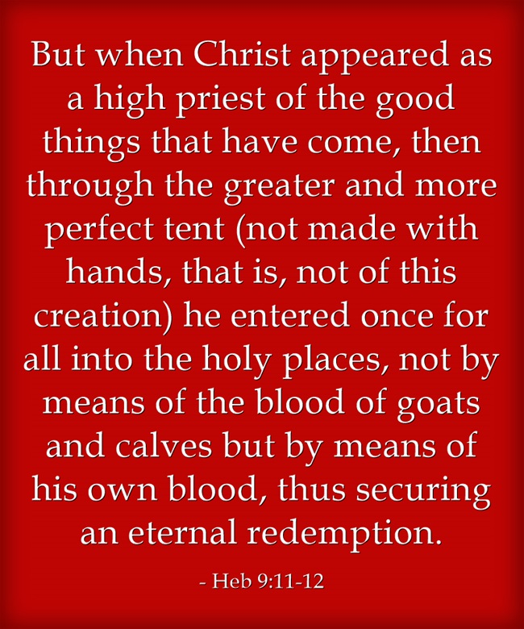

Slide 24
Hebrews chapter 9
Discussion:
Paul puts an end to this kind of thinking with the words: “But when Christ appeared” (9:11). With this, Paul turns the spotlight from the external to the internal, from rituals to righteousness, from imperfect priests to the perfect High Priest. An issue that can only be solved by Jesus Christ.
When Jesus died for our sins, rose victorious over death, and ascended into heaven, He replaced the temporary symbol of the sacrificial system with a permanent reality to which it had always been pointing.

Slide 25
Hebrews chapter 9
Discussion:
His was a “greater and more perfect tabernacle” (9:11), not fashioned by human hands, but created in the heavens by God himself. His offering for sin was not another in an endless slaughter of animals whose blood could never cleanse spiritually or eternally . . .
Jesus offered His own blood “once for all” and thus accomplished for us “eternal redemption (9:12).

Slide 26
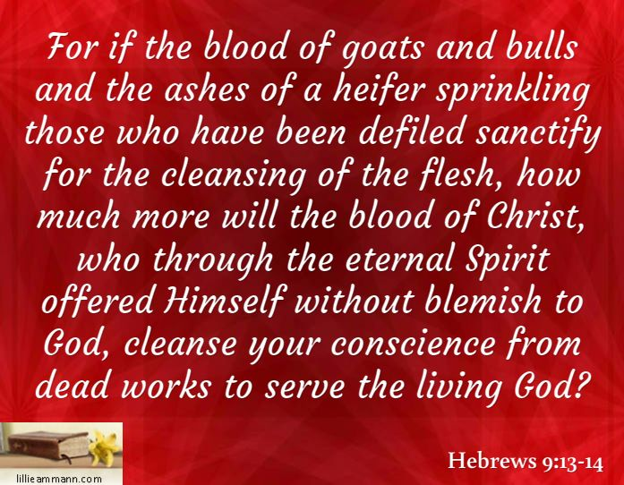
Hebrews 9:13 - 14

Slide 27
Hebrews chapter 9
Discussion:
The old covenant sacrificial system had its time, place, and specific purpose. It was established for the nation of Israel until the coming of the Messiah, and it kept them centered on the reality of their sin and their need for salvation.
However, the kind of cleansing accomplished through the sacrifice of animals was only useful for ceremonial “cleansing of the flesh” (9:13).

Slide 28
Hebrews chapter 9
Discussion:
Christ is superior as our High Priest. He offered himself to the Father by the power of the Holy Spirit, and His priceless blood has the infinite power to cleanse the internal conscience “from dead works” that we might serve God (9:14).
As in the old, blood plays a central role in the new, as a vivid symbol of sacrificial death – not the bloody sacrifices of goats and bulls, but the blood of Christ who “offered Himself without blemish to God” to cleanse our conscience from dead works (9:14).

Slide 29
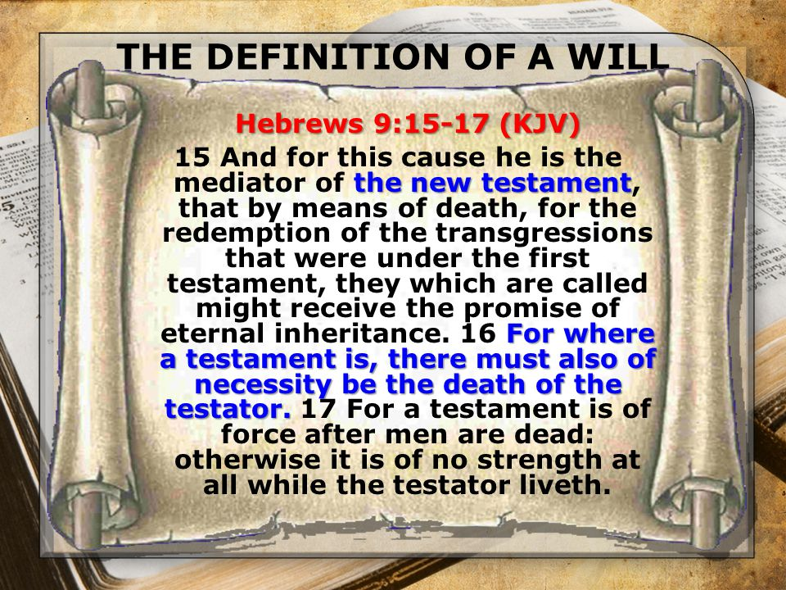

Slide 30
Hebrews chapter 9
Discussion:
Here, Paul clearly establishes the overarching theme of the rest of the chapter – Christ is the Mediator of a new covenant.
His death served to pay for the sins that could not be paid by the old covenant arrangement, thus enabling those who partake of the new covenant to inherit eternal life (9:15).

Slide 31
Hebrews chapter 9
Discussion:
With this illustration, Paul demonstrates the legal appropriateness that Christ should die in order to inaugurate the new covenant and grant the inheritance of eternal life to God’s people (9:16-17).
The word “covenant” also means testament – as in, “last will and testament.” As long as the person who had executed the will was still alive, the stipulations of the will would not be in effect, and the heirs would not receive their inheritance (9:17).

Slide 32
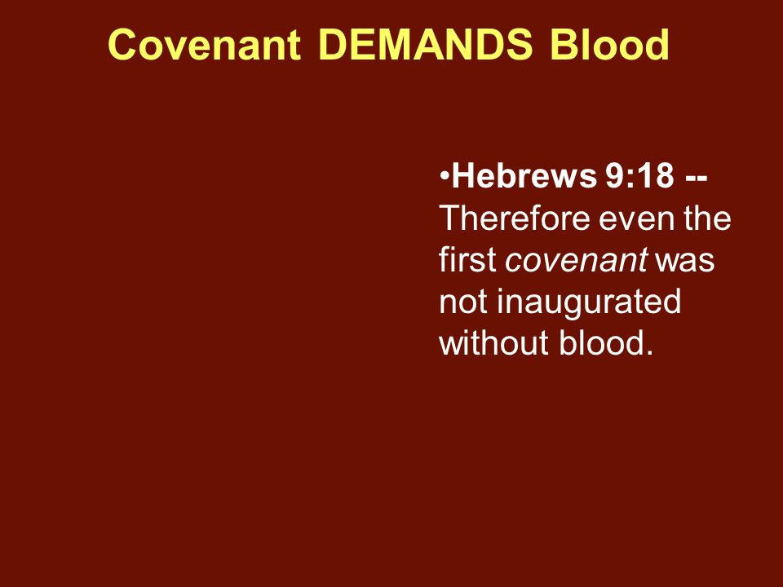

Slide 33
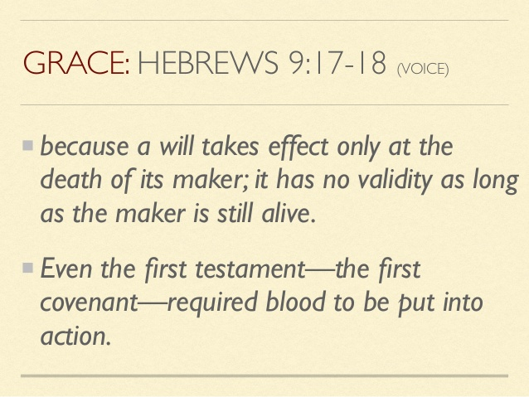

Slide 34
Hebrews chapter 9
Discussion:
The same illustration applies to the first covenant. Paul notes that even the first arrangement “was not inaugurated without blood” (9:18).
The old covenant was instituted by the death of calves and goats. Their blood was then sprinkled on the physical copy of the covenant and on the people as a sign of their obligation to keep the law, under penalty of death (9:19-20; see Exod. 24).

Slide 35
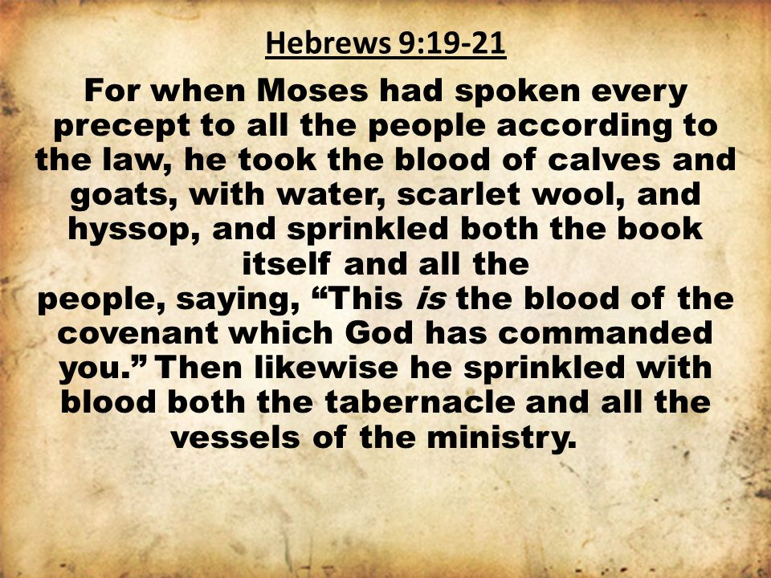

Slide 36
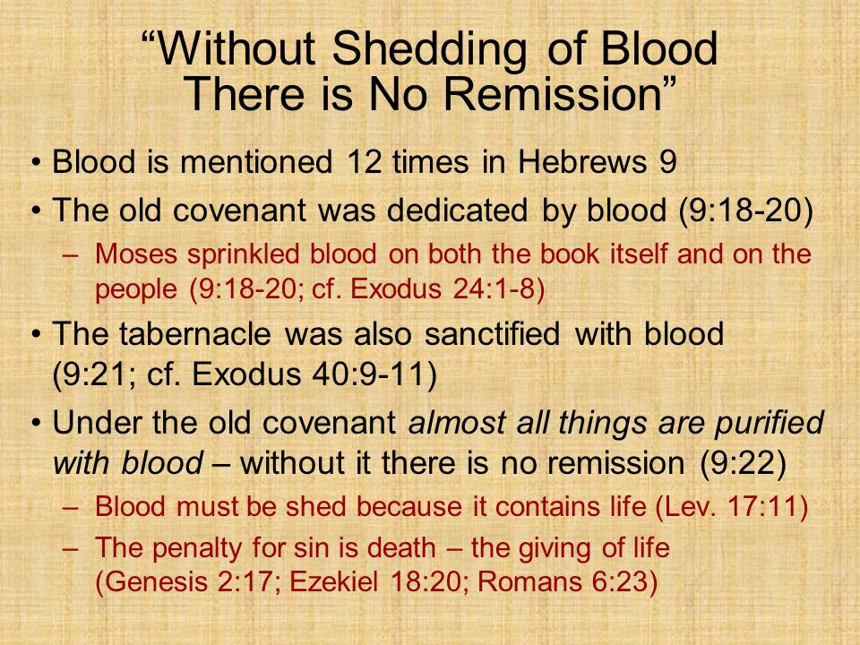

Slide 37
Hebrews chapter 9
Discussion:
Paul states that not only were the people sprinkled with the blood of the old covenant, so were the tabernacle and implements of worship (9:21).
Note the idea of “sprinkling” that the inauguration of the covenant was at once a glorious but bloody affair. On its inauguration day of worship, the gorgeous tabernacle as well as its tapestries, golden appointments, and priestly vestments were all soon dripping with blood (9:21).

Slide 38
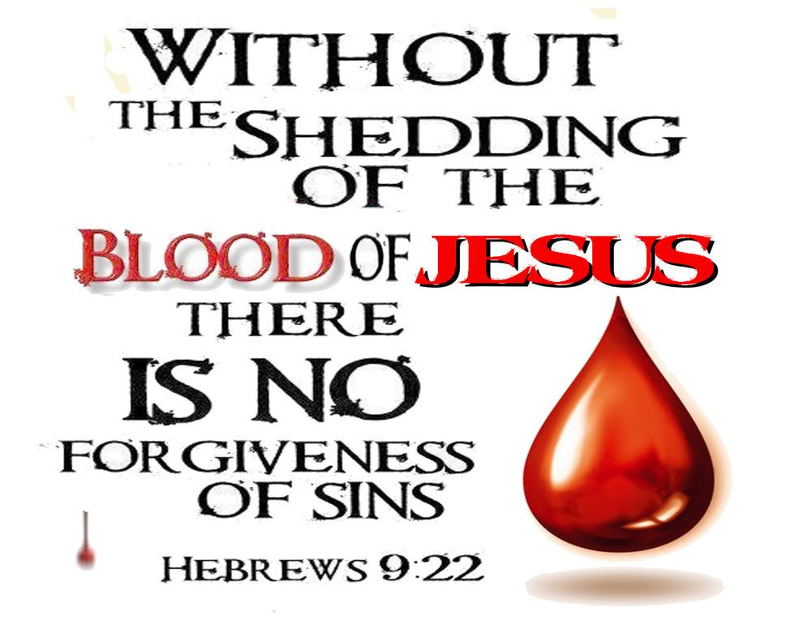

Slide 39
Hebrews chapter 8
Discussion:
According to the law of Moses, nearly everything was purified (purged) with blood. Blood was essential for ritual cleansing and for setting something apart for worship.
“… For without the shedding of blood, there is no forgiveness” (9:22).
“For the life of the flesh is in the blood, and I have given it to you upon the altar to make atonement for your souls; for it is the blood that makes atonement for the soul” (Lev. 17:11).

Slide 40
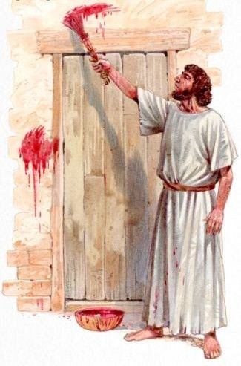
The first Passover in Egypt

Slide 41
Hebrews chapter 9
Discussion:
Two critical points of theology rest on 9:22 . . .
FIRST – sin is shown to be a terrible offense. Sin is a heinous transgression against a holy God who deserves our absolute obedience.
SECOND – atonement for sin is costly. God doesn’t wink at sin. To do so would be to compromise His perfect, holy character. The costliest thing in God’s creation is life. And an animal’s life is in the blood. Therefore, without shedding blood, there is no forgiveness (9:22).

Slide 42
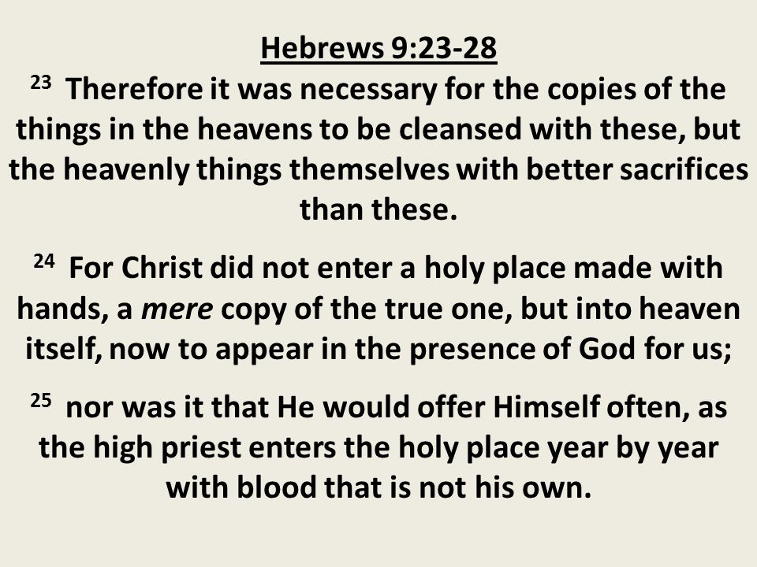
Hebrews 9:23-25

Slide 43
Hebrews chapter 9
Discussion:
Paul presents three strong contrasts:
FIRST – Christ didn’t enter a holy place made with hands but rather heaven itself (9:24).
This underscores the fact that the earthly tabernacle was an old covenant copy and an anticipation of the new covenant reality and fulfillment.

Slide 44
Hebrews chapter 9
Discussion:
Paul presents three strong contrasts:
SECOND – Christ didn’t offer up sacrifices repeatedly, as did the high priests (9:25).
Christ sacrificed himself “once for all.” In fact, so profoundly powerful was this atoning sacrifice of God’s Son that it effectively paid for all sin – past, present, and future.

Slide 45
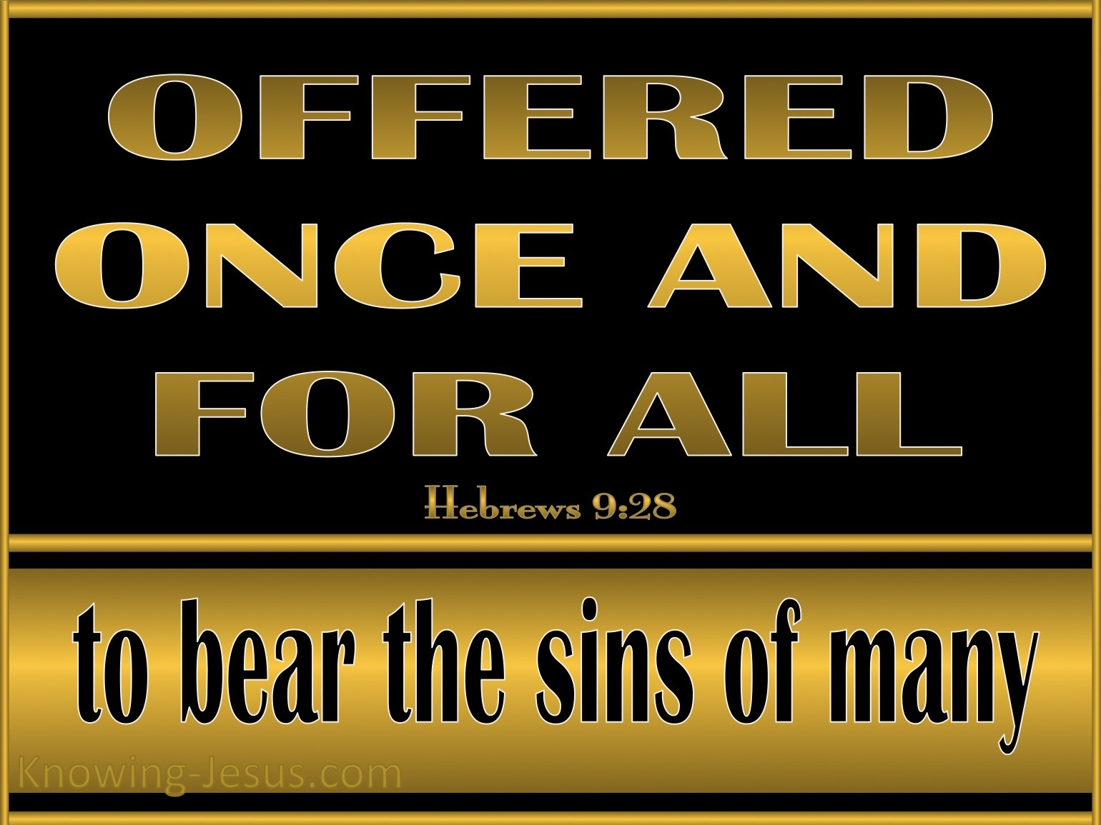

Slide 46
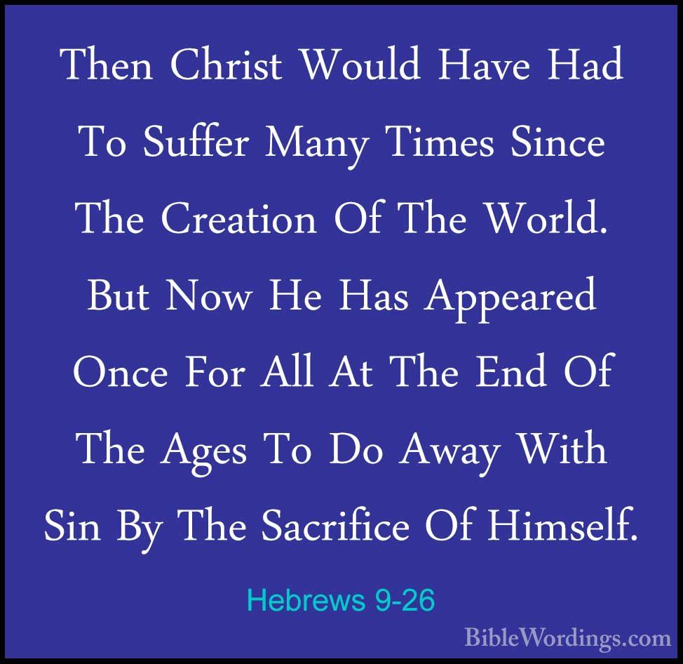

Slide 47
Hebrews chapter 9
Discussion:
Paul presents three strong contrasts:
THIRD – Christ death was qualitatively different from the sacrifices of the old covenant, which had to be repeated (9:26).
Paul states that if Christ’s single death had not been sufficient, He would have had to die “often since the foundation of the world.” While the old system might be said to have covered over sin, Christ’s blood “put away sin.”

Slide 48
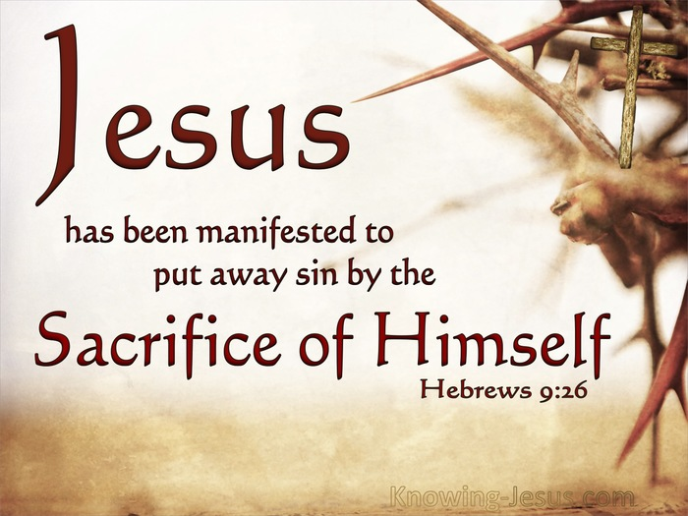

Slide 49
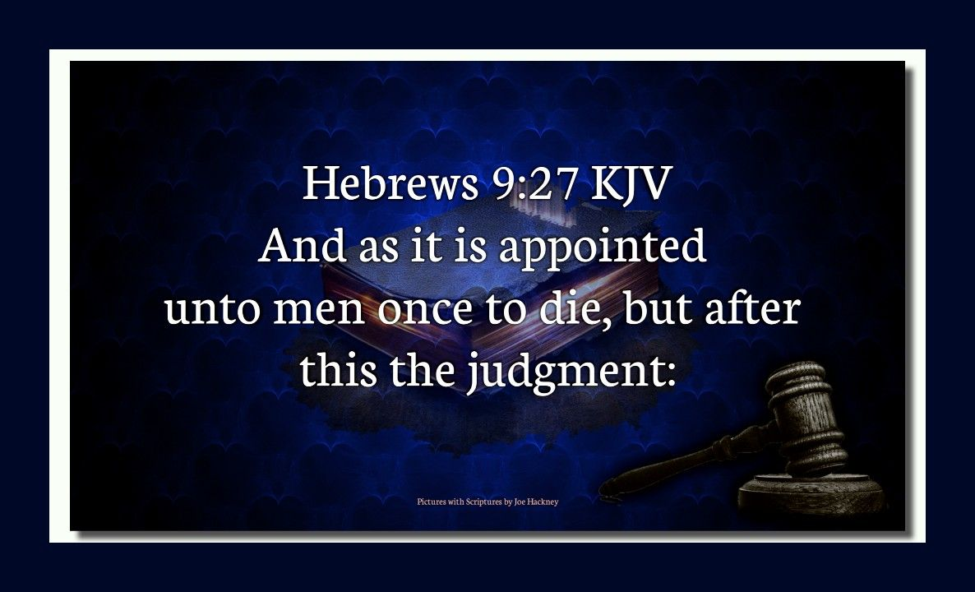

Slide 50
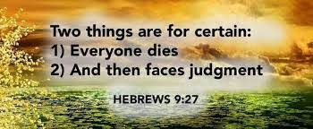

Slide 51
Hebrews chapter 9
Discussion:
Paul concludes with a word of warning to those who shrug at the superiority of Christ’s person and work to implement the new covenant. It is appointed for people to die once (9:27). After this, there is no second chance.
After this, there is judgment. This warning is leveled at those who might foolishly put off a decision to trust Christ as Savior. Paul ends with a word of hope and encouragement for those who are believers in Christ that “He will appear a second time for salvation” (9:28).

Slide 52
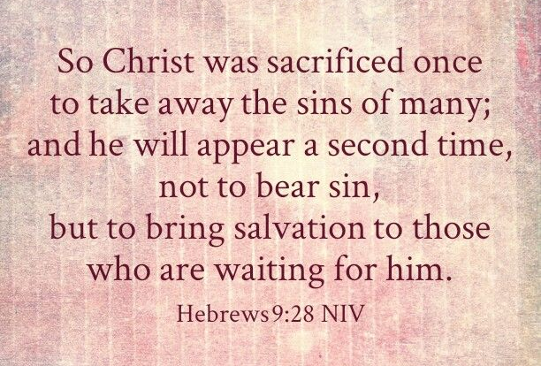

Slide 53
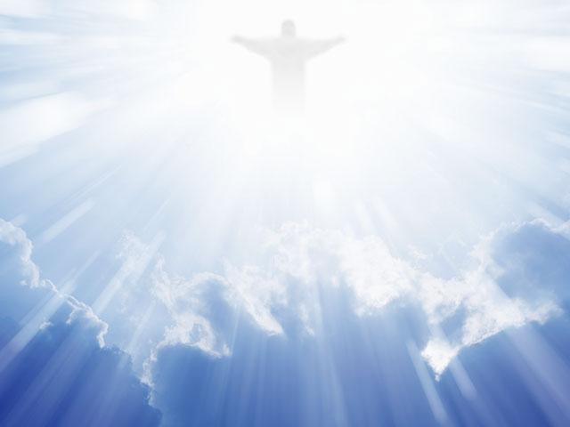

Slide 54
Hebrews chapter 9
Application of Chapter 9
[1] – We need to stop overemphasizing the externals.
  We need to de-emphasize ritualistic religion, stop simply going through the motions, and avoid over-cluttering our lives with more and more superficial religious stuff.
  Simply clearing the clutter of Christian crutches will allow us to move on to the essential second step.

Slide 55
Hebrews chapter 9
Application of Chapter 9
[2] – We need to refocus on the internals.
  Look beyond the shadow of the symbols to the substance to which they point. Whether it’s hymns and choruses, daily devotions, or weekly sermons – any one of these means a spiritual discipline can become an end in itself.
  Let these things move you to the reality. Focus on what God focuses on – the inside. Look to Christ; fix your eyes on Him. When we do, we will experience a reformation of conscience.

Slide 56
Hebrews chapter 9
Application of Chapter 9
[3] – The bible looks at life and the afterlife differently.
  There’s more than life than food and drink. There’s more to death than the grave. Beyond the grave there is God – our Creator and Judge.
  The real root of our human problems is not physical or psychological, but spiritual. The problem is sin, with its prospect of judgment.
  Hebrews teaches us that our problem of sin can only be solved by forgiveness.

Slide 57
Hebrews chapter 9
Application of Chapter 9
[4] – Tomorrow‘s judgment is escapable because today‘s sin is forgivable.
  Just as nobody can escape the reality of death, nobody can escape that day when we must face our God. However, we can escape the eternal judgment that comes as a just penalty for our sin against a holy God.
  The weight of our sin, which causes us to fall farther and farther from our heavenly Father, can be completely removed by the blood of Christ.

Slide 58
Hebrews chapter 9
Application of Chapter 9
[5] – The blood still works.
  Those who have been freed from sin and guilt have reason to rejoice. We have been washed by the blood of the Lamb; the blood still works.
  We can look forward with eagerness to that great homecoming, when Christ Himself will come to bring salvation – not judgment – to those who have accepted Him as Savior and received forgiveness of sin. For all of them, the blood still worked.

Slide 59
NEXT CLASS – 11 November 2020
Letter to the Hebrews
Read before the next class in the KJV and in two other versions of the Bible, i.e., NKJV, NRSV, NIV, CEV, etc …
Chapter 10:1 – 39
Chapter 11:1 – 40

Slide 60



the end
Questions
Questions

Slide 61


Slide 64
Hebrews
OUTLINE:
The Superiority of the Person of Christ
Jesus, Better than the Prophets (1:1-3).
Jesus, Better than the Angels (1:4 – 2:18).
Jesus, Better than Moses (3:1-19).
Jesus, Better than Joshua (4:1-16).
Jesus, Better than Aaron as Priest (5:1 – 8:5).

Slide 65
Hebrews
OUTLINE:
The Superiority of the New and Better Covenant
New Covenant Better than the Old (8:6-13).
New Covenant Opens a Better Tabernacle (9:1-15).
New Covenant is Sealed by a Better Sacrifice (9:16-28).
New Covenant Settles Forever Our Salvation (10:1-18).

Slide 66
Hebrews
OUTLINE:
The Superiority of the Life in Christ
It Gives Assurance of Faith (10:19-39).
It Gives Us a Working Faith (11:1-40).
It Gives us Patience and Direction (12:1-13).
It Gives Us Instruction in Our Walk and Worship (12:14 – 13:25).

Slide 67
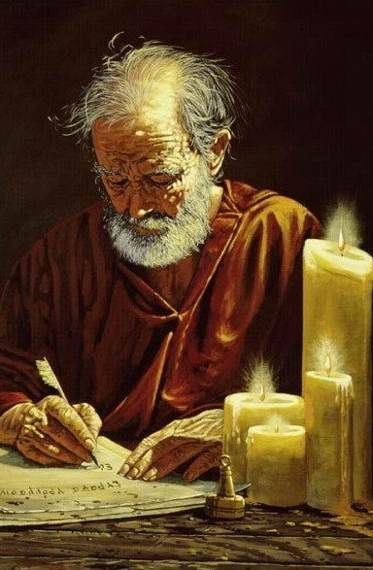
Hebrews chapter 4
POINTS TO REMEMBER IN CH 4:
How Jesus compares to Joshua (1-6).
The very real danger of an evil and harden heart that leads to an unbelief in the living God (7-19).
Apostle Paul

Slide 68
Recap
of the
Warnings

Slide 69
Hebrews
WARNINGS:
Pay Attention lest you Drift Away (2:1-4)
Beware of a Harden Heart (3:7 – 4:13)
Don’t allow Dullness of Heart to Hinder Spiritual Growth (5:11-6:20).
Stand Firm in the Faith or Be Judged by God (10:19-39)
Don’t Turn Away from Christ (12:25-29)

Slide 70
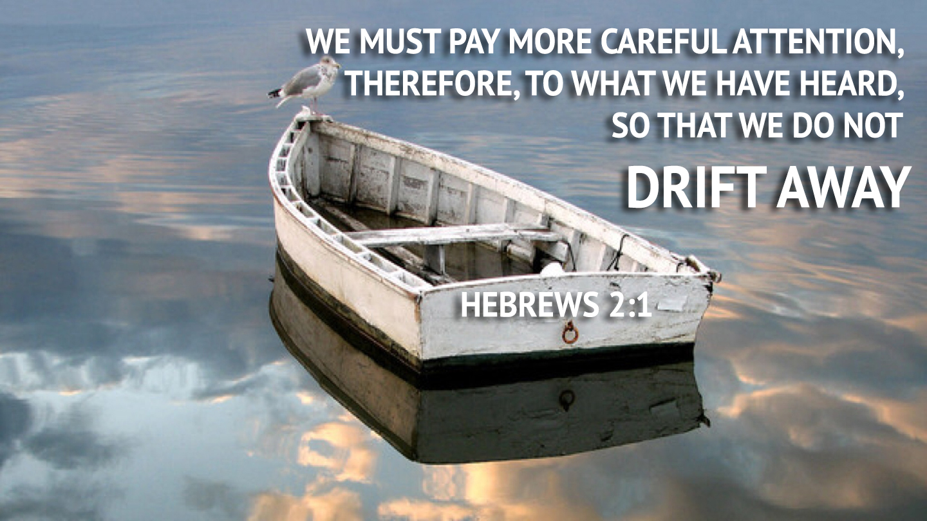
Hebrews chapter 2
REVIEW OF CH 2:
WARNING #1: Pay attention lest you drift away(2:1-4).

Slide 71
Hebrews chapter 3
WARNING #2:
Beware of a hard heart of disbelief against God (7-19).
Paul quotes from Psalm 95:8-11 > “Harden not your heart, as in the provocation, and as in the day of temptation in the wilderness: ⁹When your fathers tempted me, proved me, and saw my work. ¹⁰Forty years long was I grieved with this generation, and said, It is a people that do err in their heart, and they have not known my ways: ¹¹Unto whom I swore in my wrath that they should not enter into my rest.”

Slide 72
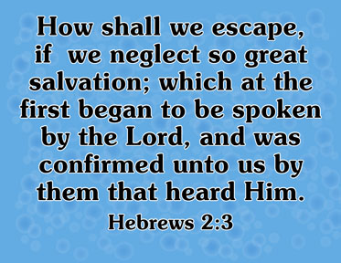
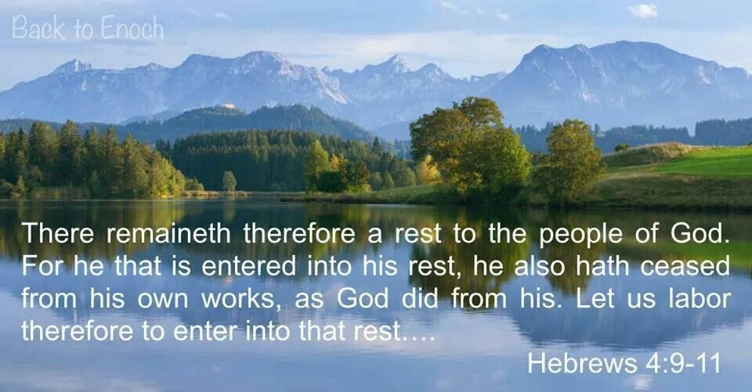
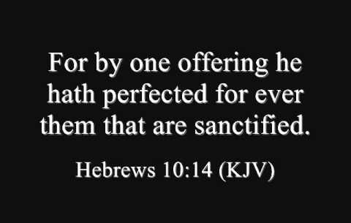
Hebrews

Slide 73
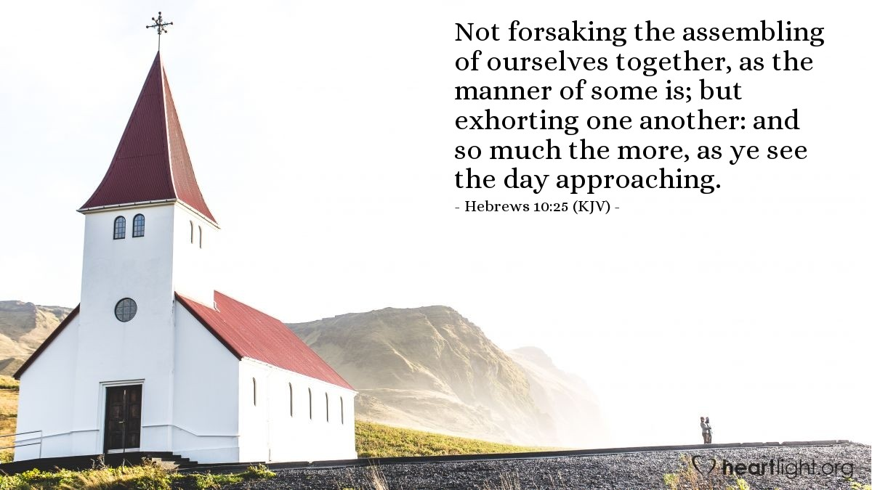
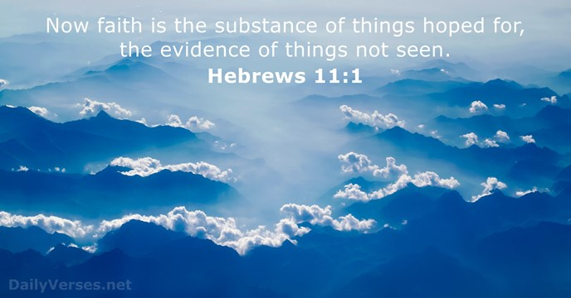
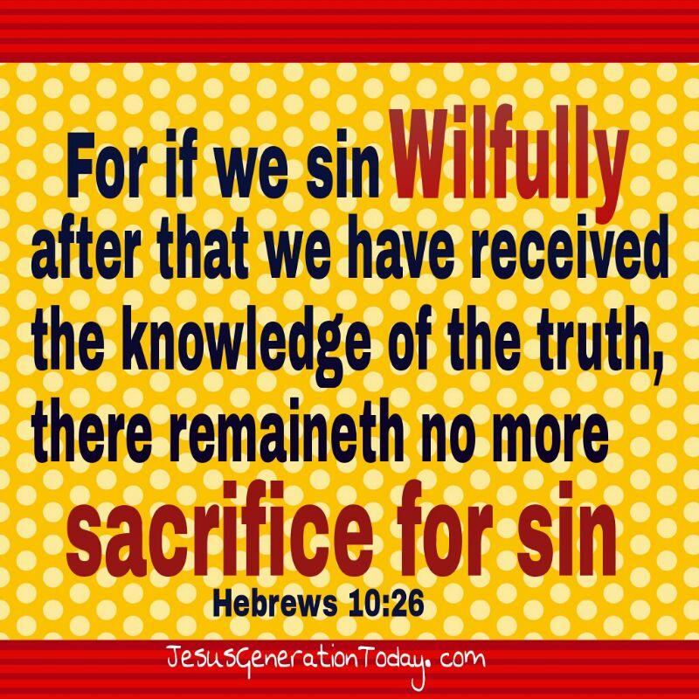
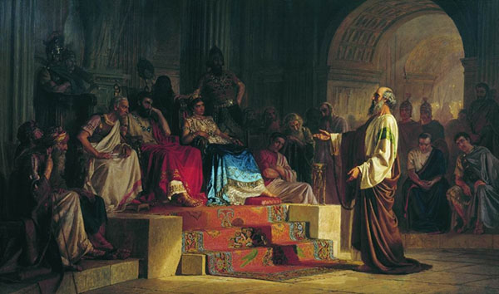
Hebrews
Paul Defending His Faith

Slide 74
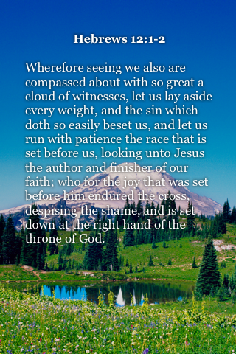
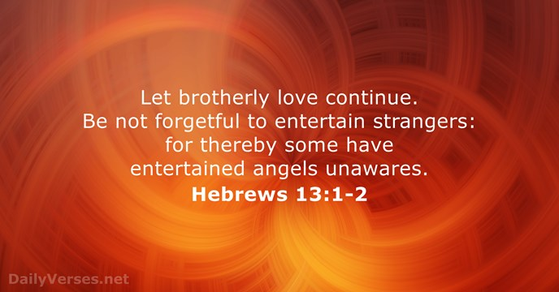
Hebrews

Slide 75
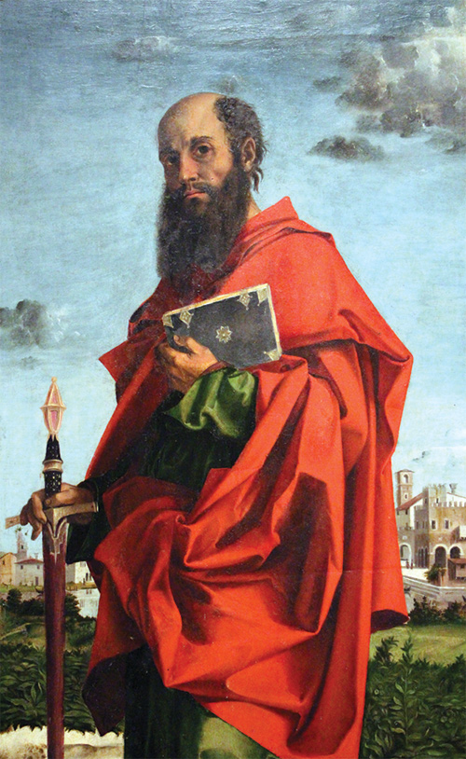
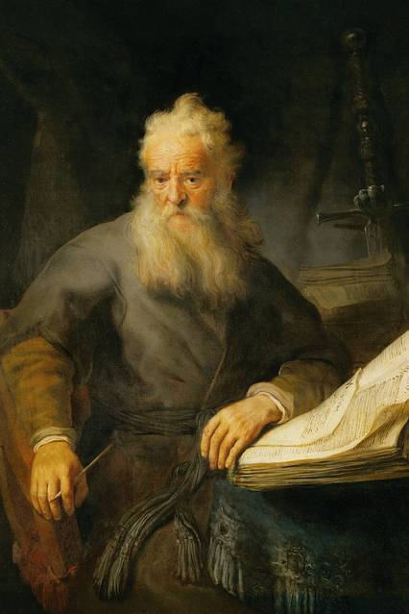
Philemon
Apostle Paul
Apostle Paul
Apostle Paul

Slide 76
Hebrews
Outline (Chapter):
Jesus greater than Angels (1 – 2)
Jesus higher than Moses (3 – 4)
Jesus superior to Aaron (5 – 10)
Hall of Faith in Christ (11)
Living faithfully for Christ (12 – 13)
Apostle Paul

Slide 77
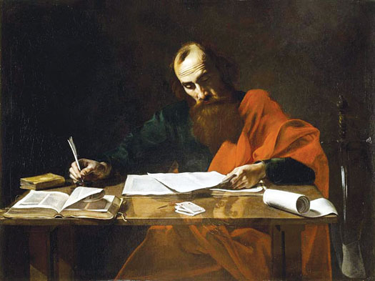
The Apostle Paul at his writing desk

Slide 78
Hebrews chapter 9
Discussion:
Thank God, Christ is a high priest and offers “both gifts and sacrifices,” but not in the earthly tabernacle according to the old covenant Mosaic Law.
Rather, Christ has a “more excellent ministry” as the eternal High Priest in a heavenly tabernacle. Logically, then, Christ must be the “the mediator of a better covenant” based on “better promises” (8:6).

