Slide 1

Introduction
and
Overview
Week 1
13 January 2021

Slide 2
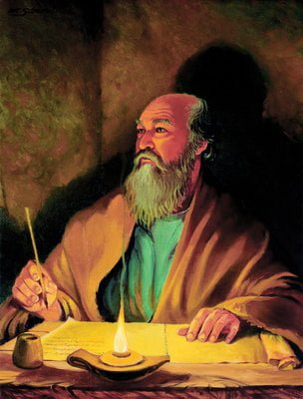
The Apostle Paul at his writing desk

Slide 3
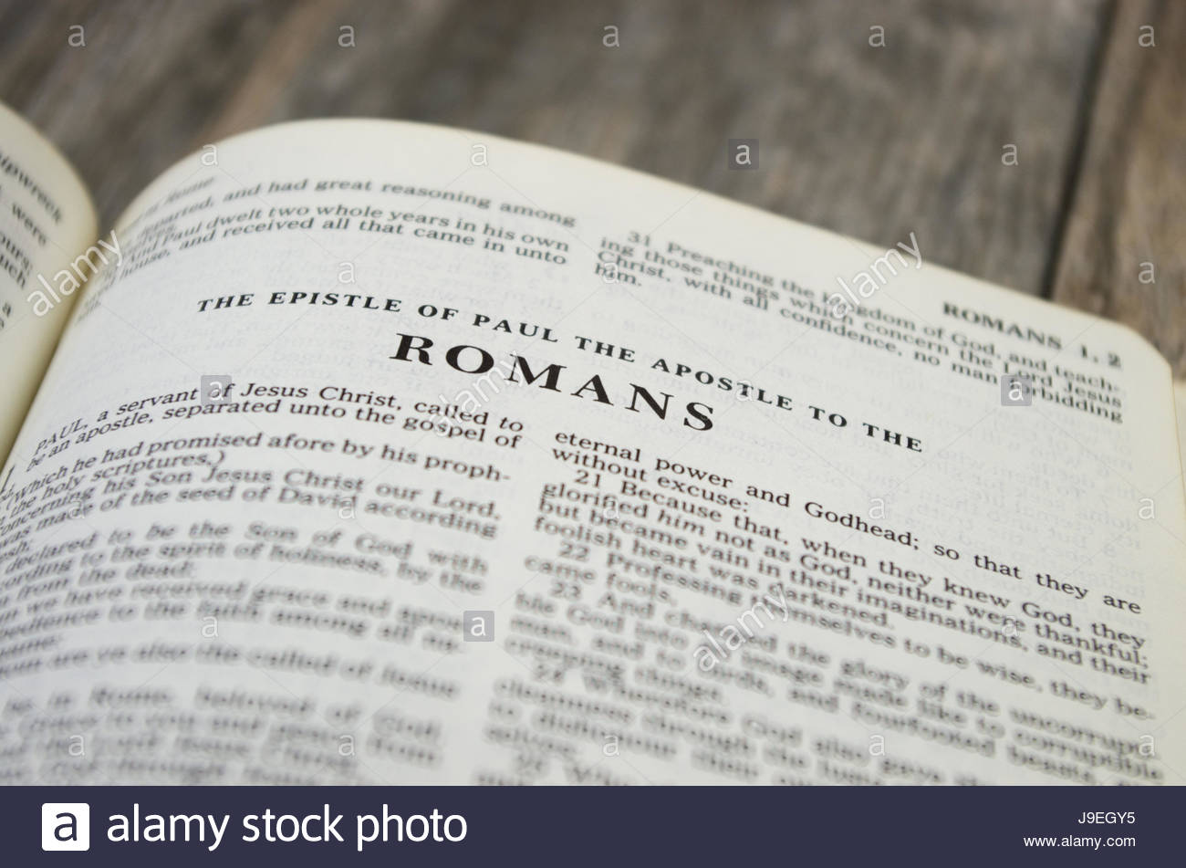

Slide 4

The Pauline Epistles
First Missionary Journey:
Galatians (ad 48-49)
Second Missionary Journey:
1 Thessalonians (ad 50-52)
2 Thessalonians (ad 50-52)
Third Missionary Journey:
1 Corinthians (ad 55-56)
2 Corinthians (ad 56)
Romans (ad 57) – from Corinth

Slide 5
The Pauline Epistles
First Roman Imprisonment:
Ephesians (ad 60)
Philippians (ad 62)
Colossians (ad 62)
Philemon (ad 62)
While in Macedonia
1 Timothy (ad 63 – 66)
Titus (ad 63 – 66)
Second Roman Imprisonment:
2 Timothy (ad 67)
Hebrews (ad 68 – 69)

Slide 6
The Pauline Epistles
“Religions are man’s search for God; the Gospel is God’s search for man. There are many religions, but one Gospel.”
E. Stanly Jones

Slide 7


Slide 8
Romans
Who: Paul
What: Letter to Roman Christians
Where: Corinth
When: c. ad 57
Why: To illustrate law, faith, salvation, and righteous living.
Synopsis: Jesus is God’s Son, a suffering servant of all people.

Slide 9
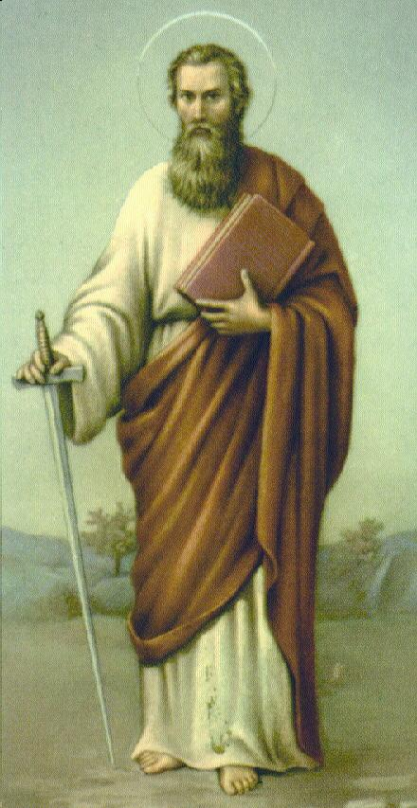
Romans
Outline (Chapter):
God’s righteousness and salvation: Christian Gospel: (doctrinal) (1 – 8)
God’s righteousness and Israel: (historical) (9 – 11)
God’s righteousness and application: Christian Life (practical) (12 – 16)
Apostle Paul

Slide 10
Romans
Overview:
The Epistle to the Romans was written by Paul from Corinth during his third missionary journey to that city. He had long planned to visit the believers in Rome, many of whom he knew (Ch16), and this letter prepared the way. When Paul wrote it, the Gospel had been preached through the Roman world for about a quarter of a century and many groups of Christians had come into existence.
Many questions had come out of these groups such as – “God’s grace – the Gospel and the Law – the Abrahamic Covenant” – and many other such questions, Paul had not yet been to Rome when he wrote this Epistle. Yet, Paul knew many of the believers in Rome and this letter was to prepare the way for his visit.

Slide 11
Romans
Overview:
Some call Romans a “theology textbook” for its thorough explanation of the Christian life. Paul gives the grandest presentation of Christian doctrine found anywhere in Scripture. Paul begins by describing God’s righteous anger against human sin (Ch1-2), noting that everyone falls short of God’s standard (3:23). But God Himself provides the only way to overcome that sin, “the righteousness of God which is by faith of Jesus Christ unto all and upon all them that believe” (3:22).
Being justified (made right) through faith in Jesus, we can consider ourselves “to be dead indeed unto sin, but alive unto God through Jesus Christ our Lord” (6:11).

Slide 12
Romans
Overview:
God’s Spirit will “quicken” (give life to, 8:11) all who believe in Jesus, allowing us to “present [our] bodies a living sacrifice, holy, acceptable unto God” (12:1).
It is possible, with God’s help, to “be not overcome of evil, but [to] overcome evil with good” (12:21).
The Book of Romans may be defined as:
  How the Gospel Saves (Ch 1 thru 8).
  How the Gospel Relates to Israel (Ch 9 thru 11).
  How the Gospel Affects Conduct (Ch 12 thru 16).

Slide 13
Romans
Overview:
Romans is one of the three books written to explain Habakkuk 2:4: “The just shall live by his faith” (Rom. 1:17; Gal. 3:11; Heb. 10:38).
The basic theme is “the just,” what it means to be justified and to live a righteous life. Righteousness is used in one form or another over forty times.
Romans is a closely knit argument that defends the righteousness of God. You can summarize the argument by noting the verses containing “therefore” (3:20, 28; 5:1; 8:1; 12:1).

Slide 14
Romans
Overview:
Unlike Paul’s other letters to churches, Romans was addressed to a congregation he’d never met. The great missionary was hoping to see the Roman Christians personally while traveling westward to Spain (15:23-24).
It’s unclear if Paul ever actually reached Spain or if he was executed in Rome after the end of the Book of Acts.
The Book is applicable in our day because the human heart has not changed. This is the Book that shook Martin Luther (1:17) which started the Reformation or Protestant Movement and started the Lutheran faith.

Slide 15
Romans: Vocabulary
Overview:
Righteousness = the word takes on both an ethnical and judicial flavor. Righteousness is both an attribute of God that He renders to those who have faith in His Son, Jesus, and a characteristic of the behavior of those who maintain a right relationship with God.
Moreover, only God can defines what is right or declare a person righteous. Christ has shown us the proper path to becoming the righteousness of God.
Gospel = a favorable report from the battlefield or the proclamation that an heir to the king has been born. The “good news story” about Christ’s person and work … Jesus’ death and resurrection forgives sin and gives eternal life.

Slide 16
Romans: Vocabulary
Overview:
Justification = God’s gracious act by which He declares the believing sinner righteous in Jesus Christ because of the work of Christ on the cross. The act of God seeing us just as if we never sinned. Through Christ, we are justified by our faith in Him. When you believe, Christ’s righteous-ness is imputed.
Imputation = to put to your account. Christ’s righteous-ness is imputed to the believer as an act of grace.
Righteousness = only God can defines what is right or declare a person righteous. Christ has shown us the proper path to become the righteousness of God.

Slide 17
Romans: Vocabulary
Overview:
Propitiation = to satisfy, a satisfactory sacrifice. Christ is our propitiation (perfect, sinless sacrifice).
Sanctification = God’s work in the believer whereby we are set apart for God’s plan and purpose. The work of the Holy Ghost in the believer imparting righteousness to develop a holy character and conduct. A righteous standing before God leads to a holy life before men. We are not saved by works or by faith plus work; we are saved by a faith that works (James 2:14-26).

Slide 18
Romans: Vocabulary
Overview:
Salvation = to save (rescue) from condemnation. Through Christ, we are not saved by works or by faith plus work; we are saved by a faith that works. Salvation conveys not only the idea of spiritual salvation (going to heaven when we die), but also an eschatological perspective of looking forward to the ultimate salvation found in Christ’s second coming, including resurrection and glorification.
Redemption = to deliver, or save, by paying a price. Christ paid the price for our salvation with His blood on the cross of Calvary.

Slide 19
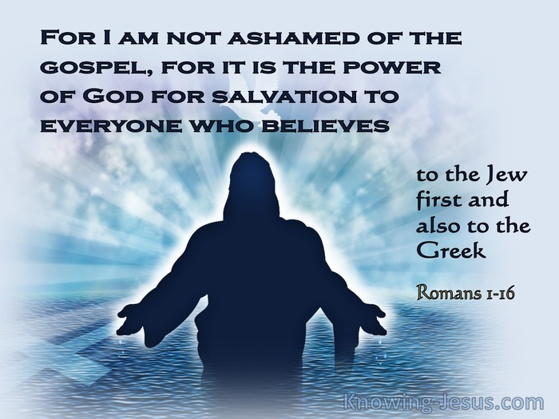
Romans: Theme of the Book

Slide 20


Slide 21
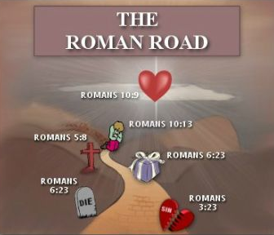

Slide 22

Roman road 3:10

Slide 23
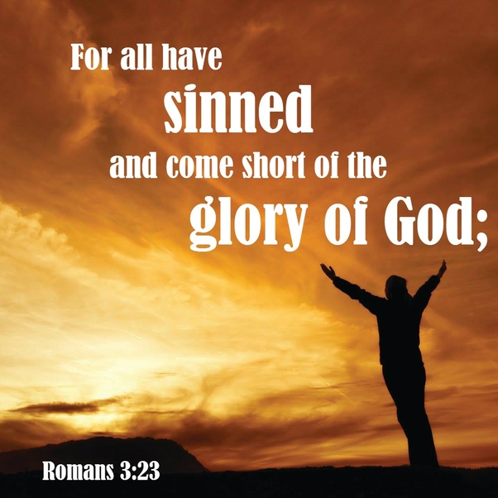
Roman road 3:23

Slide 24
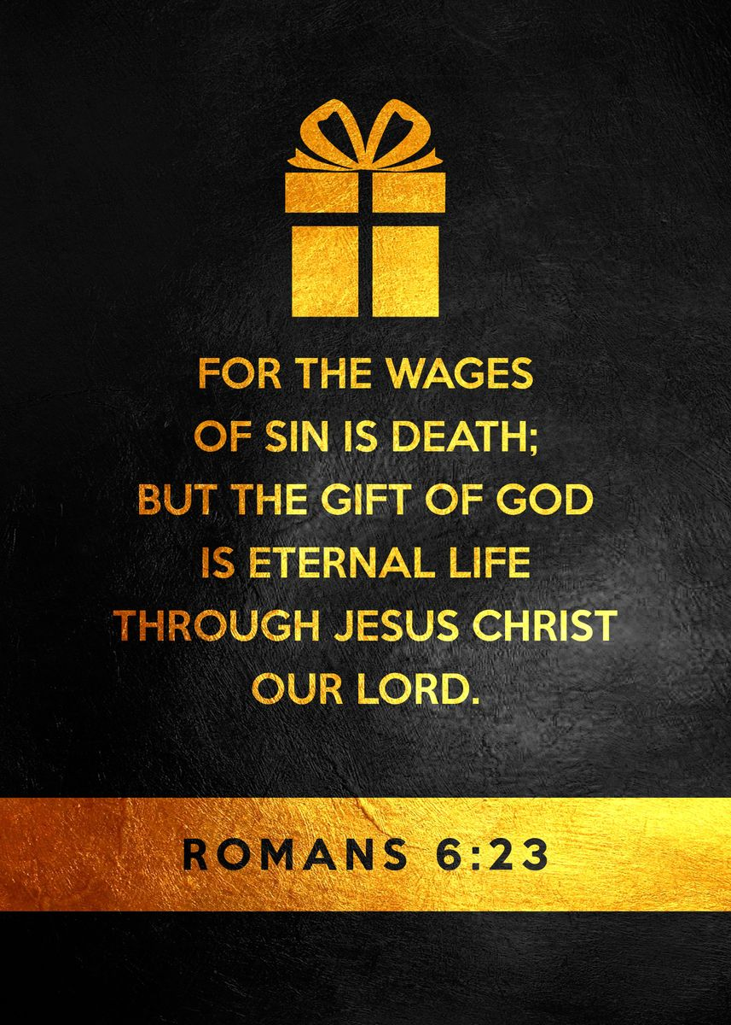
Roman road 6:23

Slide 25
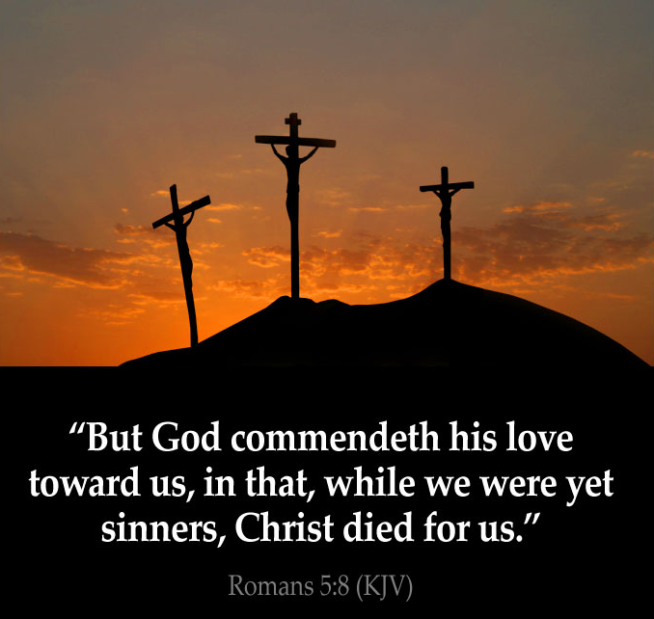
Roman road 5:8

Slide 26
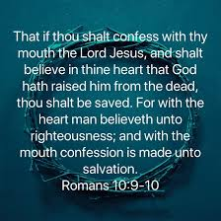
Roman road 10:9 – 10

Slide 27
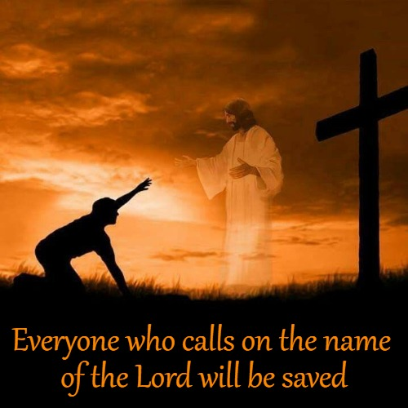
Roman road 10:13

Slide 28
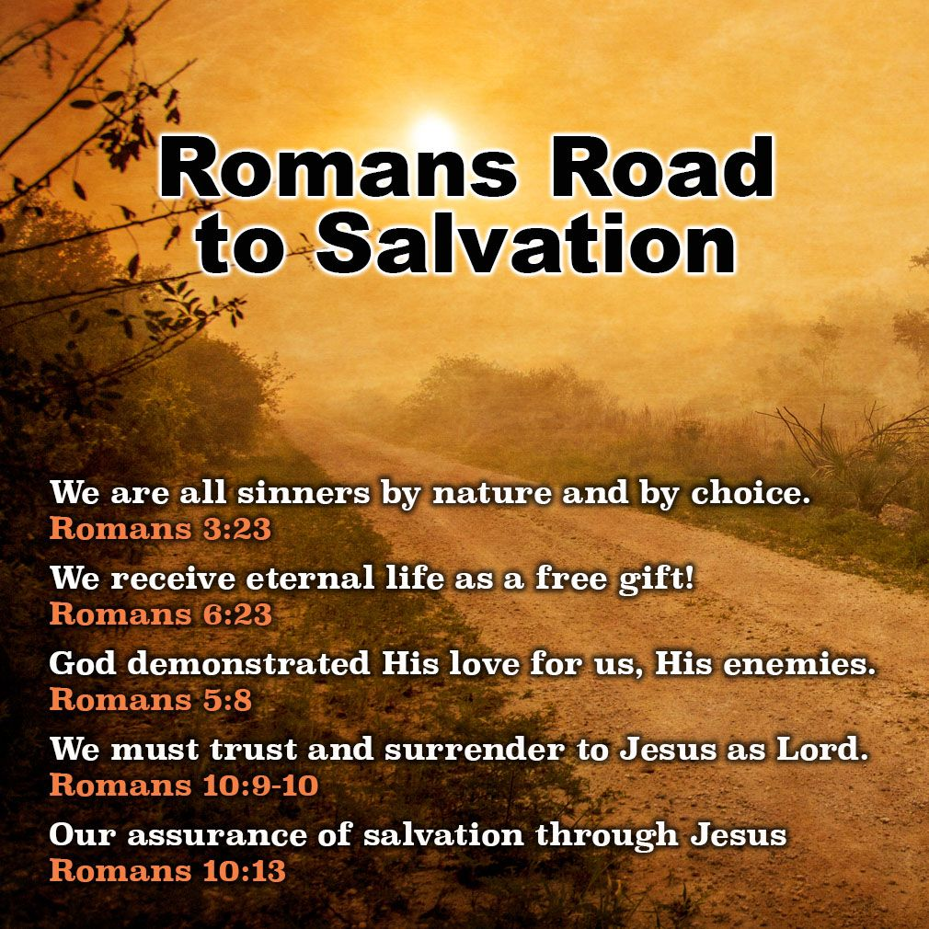

Slide 29
Romans (Introd.)
Paul provides his readers with some pretrial introductory material . . .
A. Paul’s credentials (1:1, 5)
Paul relates four facts about himself:
1. He is a servant of Jesus (1:1a).
2. He is an apostle (1:1b).
3. He has been set apart to preach the gospel (1:1c).
4. He is a missionary to the Gentiles (1:5).

Slide 30
Romans (Introd.)
Paul provides his readers with some pretrial introductory material . . .
B. Paul’s Christ (1:2 – 4)
1. The Messiah was prophesied in the OT (1:2) .
2. The Messiah is now proclaimed in the NT (1:3–4).
a. In regard to his human nature (1:3): He is a descendant of David.
b. In regard to his divine nature (1:4): His resurrection proves his deity.

Slide 31
Romans (Introd.)
Paul provides his readers with some pretrial introductory material . . .
C. Paul’s Congregation (1:6 – 15)
Paul writes to a local church assembly:
1. The identity of this church is in Rome (1:6 – 7).
2. The intercession for this church (1:8 – 10).
a. His praise of them (1:8): Paul praises them for their universally know faith.
b. His prayers for them (1:9-10): Paul prays for the church and asks God that he be allowed to visit them.

Slide 32
Romans (Introd.)
Paul provides his readers with some pretrial introductory material . . .
C. Paul’s Congregation (1:6 – 15)
Paul writes to a local church assembly [cont.]:
3. The interest in this church (1:11 – 13).
a. Paul desires to see them (1:11 – 12).
b. Paul desires to serve them (1:13). Paul desires to sow seed among them.
4. The indebtedness to the church (1:14 – 15). Paul feels an obligation to minister to them.

Slide 33
Romans (Introd.)
Paul provides his readers with some pretrial introductory material . . .
D. Paul’s Confidence (1:16 – 17)
Paul expresses his full assurance in the power of the gospel to accomplish two things:
1. To bring about saving faith for sinners (1:16): Through faith a sinner may be saved.
2. To bring about sanctifying faith for saints (1:17): Through faith a righteous person may have life.

Slide 34



Slide 35
Romans
Application of Chapter 1:1 – 17
[1] – You Accept the Gospel.
  You don’t rewrite it, reshape it, or revise it. You accept it as an invitation. You’re invited to a new life of faith in Christ – forgiven of all your sins, cleansed by the work of Christ on your behalf, and set free to live a new life by the power of the Spirit.
  Paul will expand on all of these effects throughout his letter to the Romans. But in order for the good news of Jesus Christ to be great news for us, we need to first accept the invitation.

Slide 36
Romans
Application of Chapter 1:1 – 17
[2] – You Live the Gospel.
  Living the gospel means being set apart for the gospel for “obedience of faith” (1:5). Anyone who genuinely comprehends the magnitude of God’s gift won’t be able to remain idle.
  Their priorities, passions, and pursuits will necessarily change. They’ll begin to praise and thank God for what He’s done. They’ll worship and obey the one who saved them. They’ll set their hope on things above, love God, and live a life of service rather than selfishness.

Slide 37
Romans
Application of Chapter 1:1 – 17
[3] – You Share the Gospel.
  Paul considered himself indebted to all of humanity because he had been entrusted with a priceless gift, the only cure for the deadly disease of sin(1:14-15). Like Paul, whose who have accepted the free gift of eternal life have an obligation to share it.
  Share the fact that God has extended the offer of salvation to everyone, whether privileged or poor. Sharing the gospel will mean facing the same kinds of rejections Paul faced, but we must remain steadfast, even if it means sacrificing our lives.

Slide 38
NEXT CLASS – 20 Jan 2021
Book of Romans
Before next class, read the below chapters in the KJV and in one other versions of the Bible, i.e., NKJV, NRSV, NIV, CEV, etc …
Chapter 1:1 – 32

Slide 39


