Slide 1

Chapter 1
The Wrath of God
Week 2
27 January 2021

Slide 2
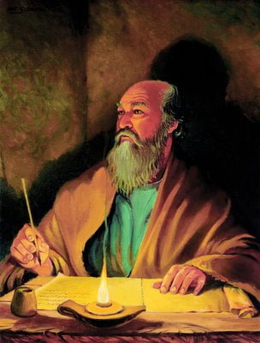
The Apostle Paul at his writing desk

Slide 3

The Pauline Epistles
“The greatest judgment God can inflict on us is to let us have our own way.”
Warren W. Wiersbe

Slide 4
Romans
Overview:
We now begin the first section of the letter, which discusses sin: Paul records the evidence presented at this trial (1:18-32).
In these closing verses of chapter 1, Paul explains how the Gentiles got into the awful darkness that engulfs them and how God’s wrath was revealed against them.
God’s wrath is a righteous and holy response to humanity’s sinful, rebellious nature.

Slide 5
Romans
Overview:
Note that in Romans 1:18, the Gentiles “held down the truth,” and now they “exchange the truth” for a lie.
The truth believed and obeyed grants us knowledge and sets us free (John 8:31–32).
The truth rejected and disobeyed turns us into deceivers and makes us slaves (1John 1:8).

Slide 6
Romans
Overview:
Note the steps downward in Gentile history . . .
They knew God (18–20) . . .
God had given them a twofold revelation of Himself “in them” (conscience) and “unto them” (creation).
“Because that which may be known of God is manifest in them; for God hath showed it unto them” (19).

Slide 7
Romans
Overview:
Man did not begin with ignorance and gradually work his way up to intelligence; he began with a blazing revelation of the power and wisdom of God and turned his back on it.
God had revealed Himself from the very time of creation, so that people who have never heard the Gospel are still without excuse.
They glorified Him not as God (21–23). Vain thinking and foolish reasoning turned men from the truth to lies.

Slide 8
Romans
Overview:
When we choose to sin, we express contempt for God’s character, calling bad things good.
Sin suppresses the will of God; sin keeps the world from working as God originally intended it to.
Humanity has a stubborn habit of looking to the gift rather than the Giver for fulfillment.

Slide 9
Romans
Overview:
It has long been the habit of humankind to trade the one true God for one of their own making.
God will hold us accountable for sin, whether we acknowledge His presence or not. And the consequences of our rejecting Him in favor of sin are far graver than we can imagine.
The Court Scence . . . Paul records the evidence presented at this trial as six indictments (18–32):

Slide 10

Romans
First indictment – inexcusable ignorance (1:20): God has always revealed his existence and power to mankind.

Slide 11
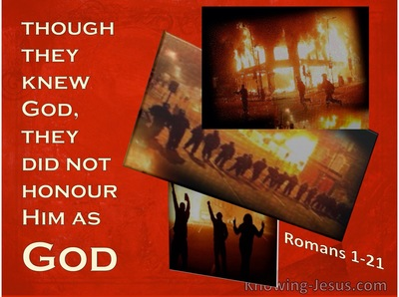
Romans
Second indictment – ingratitude (21): People are thankless, refusing to worship their Creator.

Slide 12

Romans
Third indictment – insolence (22): Claiming themselves to be wise without God, they become fools instead.

Slide 13
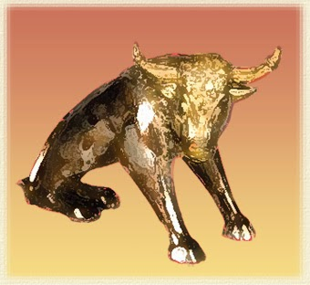
Romans
We see indifference leading to ingratitude, resulting in ignorance.
Fourth indictment – idolatry (23): They exchange God’s glory for idols resembling mere people, birds, animals, and snakes.

Slide 14

Romans
Fifth indictment – immorality (24–27): They are guilty of lesbianism and homosexuality.

Slide 15
Romans
Overview:
Paul uses the phrase “God gave them over” three times, describing increasingly graver implications.
1] God gave them over to impurity (24).
2] God gave them over to degrading passion (26).
3] God gave them over to a reprobate mind (28).

Slide 16
Romans
Overview:
They changed the truth of God (24–25). This word “changed” should really read “exchanged.” People replaced God’s truth with Satan’s lie.
What is Satan’s lie?
Worshipping the creature and not the Creator; worshipping man instead of God; worshipping things instead of Christ. Satan tempted Christ to do this during the Temptation (Matt. 4:8–11).

Slide 17
Romans
Overview:
People today bow before the Greek and Roman philosophers and honor their words above the Word of God; but Paul calls all of these philosophies “empty imaginations” and “times of ignorance” (Acts 17:30).
The next step was idolatry, honoring the creature (including man) rather than the Creator.

Slide 18
Romans
Overview:
They rejected the knowledge of God (26–32) . . .
These people had begun with a clear knowledge of God (19, 21) and His judgment against sin (32); but now they reached the lowest level of their downward fall: they did not even want to have knowledge of God.
“The fool has said in his heart, ‘There is no God’” (Psalm 14:1).

Slide 19

Romans
Sixth indictment – incorrigibility (28–32)
a) They embrace their wicked deeds (28–31)
b) They endorse their wicked deeds (32)

Slide 20
Romans
Overview:
God gave them up (over) to a reprobate or debased mind . . .
REPROBATION: the inability to distinguish good from evil.
This is the revelation of the wrath of God (18).

Slide 21
Romans
Overview:
Note the three judgments of God:
1] God gave them up to uncleanness and idolatry, (24–25).
2] God gave them over to vile passions, (26–27).
3] God gave them over to a reprobate mind, (28) and the evil results of reprobation (29-32).

Slide 22
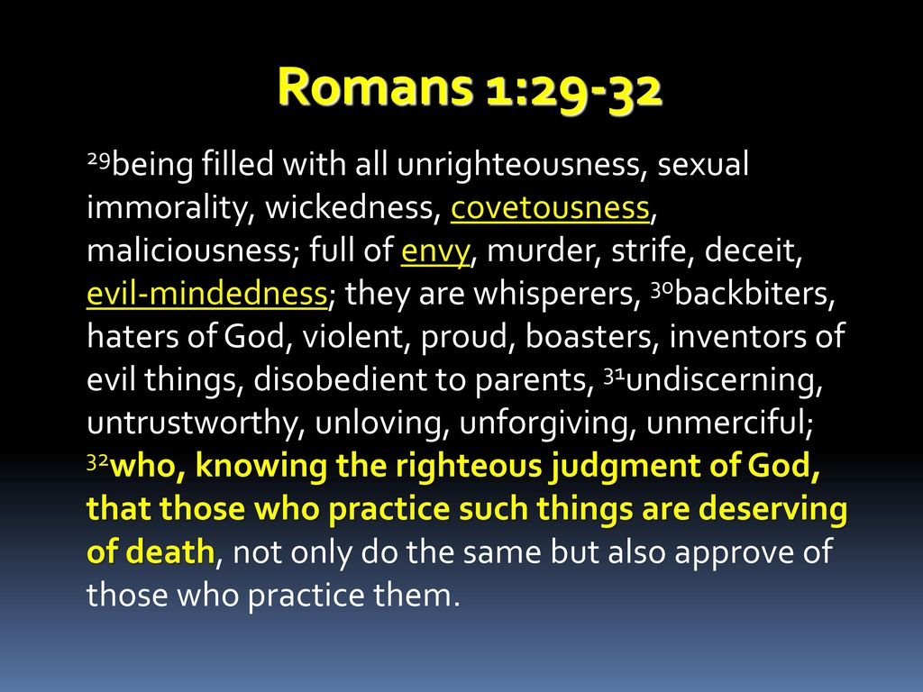

Slide 23
Romans
Overview:
The sins listed here are vile, yet commonplace among humanity. They are still practiced today around the world with the approval of society.
People know that sin will be judged, yet they take pleasure in it anyway.
Were it not for the Gospel of Christ, we would be in this slavery to sin ourselves. “Thanks be unto God for His unspeakable gift” (2 Cor. 9:15).

Slide 24
Romans
Overview:
It is sad to see the tragic results of this decline. Evolutionists want us to believe that humans have “evolved” from primitive, ignorant, beast-like forms into the marvelous creature they are today.
Paul says just the opposite: man began as the highest of God’s creatures, but he made himself into a beast.

Slide 25
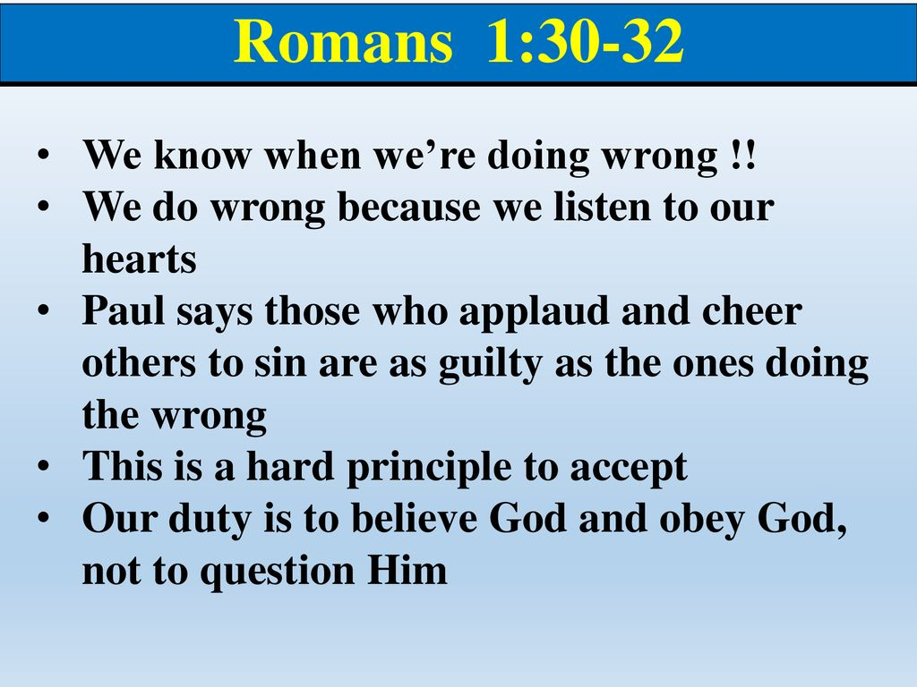

Slide 26
Romans
Overview:
If someone stubbornly refuses to repent of sin, we may discover that person is not a believer.
Upon such discovery, it would be appropriate to make every attempt to lead the individual to Christ.
Then, upon repentance and belief in Jesus Christ, embrace him or her as God’s child and a member of the Household of Faith.

Slide 27
Romans
Overview:
On the other hand, if we continue to embrace someone who is guilty of unrepentant sin as a fellow believer, we deny that person the opportunity to hear the good news and turn to the Savior for deliverance.
May such a thing never occur!

Slide 28


“Come unto Me”

Slide 29
NEXT CLASS – 3 Feb 2021
Book of Romans
Before next class, read the below chapter in the KJV and in one other versions of the Bible, i.e., NKJV, NRSV, NIV, CEV, etc …
Read the entire Chapter 2:1 – 29
Focus on Chapter 2:1 – 16

