Slide 1

Human Responsibility
Part One
Chapter 10:1 – 12
9 June 2021
Week 21

Slide 2

“Human Responsibility”
Part One

Slide 3

Romans
Background:
In chapter 9, we encountered the “Sovereignty of God” and wrestled with its implications and ultimately learned to rest in its truth.
Here in chapter 10, we will consider the “Justice of God” and learn to accept that God does not submit to our notion of fair play; God has all the power, so He is the Judge. Yet, humanity has a responsibility to respond to the gospel of Jesus Christ.

Slide 4
Romans
Background:
And then in chapter 11, we will find comfort in the “Faithfulness of God.” Where answers fail, we can trust in the unfailing goodness of our Creator and His unsurpassed love for His creatures.
Remember, Paul’s letter to the Romans is not about our salvation. His primary subject is the righteousness of God, of which our salvation is a part. The Lord is pursuing His own agenda.

Slide 5
Romans 10
Background:
Remember in chapter 9, Paul confirmed that salvation is the work of God. He has “elected” some and He has “hardened” (or not chosen) others.
Naturally, this doctrine of election or predestination prompted a reasonable question from the Jews in Rome: “How can God justly condemn those who did not choose to believe if their choosing was not the will of God?” In 9:19, Paul writes > “... Then why does God still blame us? For who is able to resist his will?”

Slide 6
Romans 10
Background:
After defending the Lord’s absolute sovereignty, upholding His perfect righteousness, showing us His mercy, and defending His fairness, Paul appropriately turned his attention to the responsibility of humanity.
Putting Ch9 and Ch10 together, we see two sides of this issue. Truth be told, we must uphold each without diminishing the other:

Slide 7
Romans 10
Background:
SIDE A: God rejects rebellious people because they have rejected him (1:28-32).
SIDE B: We love God because God first loved us (5:8; 8:28-30).
In Romans 10:1-7, Paul laments the failure of his unsaved Jewish brethren to see personal righteousness in its proper context. In trying to obtain righteousness through personal willpower, they missed the mark [sin] and failed to recognize their Messiah.

Slide 8
Romans 10
Background:
By contrast, a person whose righteousness comes through faith will admit his or her own helplessness and readily receive the redeeming Savior.
Then, as the apostle confronts humanity with the truth of the gospel, he closes off four possible routes of escape:

Slide 9
Romans 10
Background:
1 – The gospel is available; therefore, those who hear are accountable (10:8-10).
2 – The gospel is universal; therefore, no one is exempt (10:11-15).
3 – The gospel is plain; therefore, the unsaved are responsible (10:16-19).
4 – God is faithful and immutable; therefore, the crisis of responsibility remains (10:20-21).

Slide 10
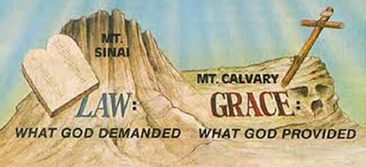
Human Responsibility

Slide 11
Romans 10
Objectives of Ch10:
1) To see the importance of combining zeal with knowledge and 2) To understand that Israel had plenty of opportunity to heed the gospel of Christ, but for the most part they had rejected it.
Summary:
As Paul continues to explain God’s dealings with the nation of Israel, Paul repeats his expression of love towards them (1). Though as a nation they had plenty of zeal (fervor), unfortunately their zeal was not according to knowledge (2).

Slide 12
Romans 10
Summary:
Thus they rejected the righteousness of God while trying to establish their own righteousness through the Law of Moses. But Paul explains that Christ is the fulfillment of the Law and has brought it to an end (3-4).
The righteousness God now offers is based upon faith in Christ, not keeping the Law. It involves not the accomplishment of some great feat (like ascending to heaven or descending to hell), but confessing Jesus as Lord and believing that God raised Him from the dead (5-10).

Slide 13
Romans 10
Summary:
As foretold by Scripture, it is offered to all, both Jew and Gentile (11-13). And it is offered through the act of preaching the Word (14-15).
The problem with the nation of Israel, then, is that not all of them received the gospel message, even when they had ample opportunity (16-18). But as Moses predicted, the day would come when God would provoke Israel to jealousy by another people, who Isaiah said did not seek God yet found Him, while Israel was constantly rebelling against Him (19-21).

Slide 14
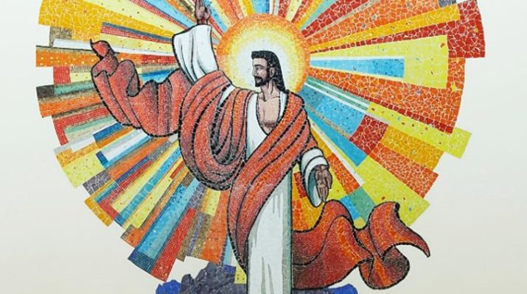

Slide 15
Romans 10:1 – 4
¹Brethren, my heart’s desire and prayer to God for Israel is, that they might be saved. ²For I bear them record that they have a zeal of God, but not according to knowledge. ³For they being ignorant of God’s righteousness, and going about to establish their own righteousness, have not submitted themselves unto the righteousness of God. ⁴For Christ is the end of the law for righteousness to every one that believeth.

Slide 16
Romans 10:1 – 4
Having stated the fact of Israel’s stumbling in the preceding verses, Paul now explained the reason for that stumbling. But first, in words reminiscent of the opening verses of Chapter 9, the apostle expressed his deep personal spiritual burden for the salvation of the people of Israel.
Paul shares his deep desire that Israel come to know and accept Jesus. Perhaps with his own experience in mind, Paul affirmed, For I can testify (bear witness) about them that they are zealous for God, but without knowledge of God.

Slide 17
Romans 10:1 – 4
Israel was called “the God-intoxicated people.” Paul had to acknowledge, however, that their zeal is not based on “full knowledge.” The Jews obviously had knowledge of God but not full knowledge.
Otherwise they would not have stumbled over Christ by disregarding the “righteousness that comes from God and seeking to establish their own,” refusing to “submit to God’s righteousness. That is , establishing their own righteousness on the basis of works.

Slide 18
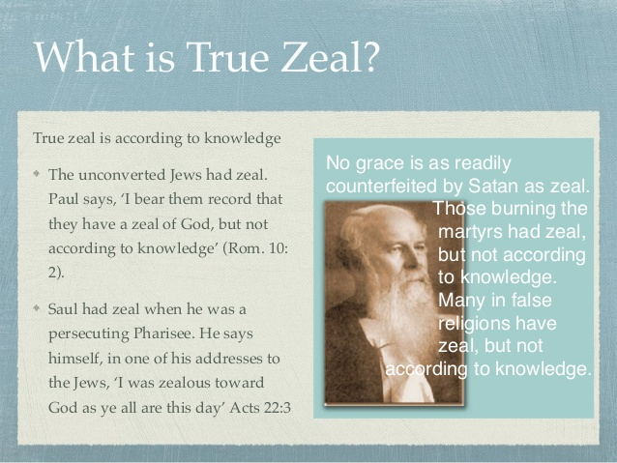

Slide 19
Romans 10:1 – 4
Paul continued his explanation of Israel’s failure and their misguided zeal. Since they did not know (“being ignorant” as to not understanding) the righteousness that comes from God.
The people of Israel did not understand the God-provided righteousness expounded in this letter (cf. Rom 1:17), even though they should have known from their own Scriptures (cf. Gen. 15:6 > “And he [Abraham] believed in the LORD; and he counted it to him for righteousness.”

Slide 20
Romans 10:1 – 4
But here preferably the righteousness in view is the righteousness God requires for people to be accepted by Him, which is God’s own infinite righteousness. The Jews did not really understand God’s own infinite righteousness, which is why they were continuing to seek to establish their own.
Little wonder then that they did not submit to (“place themselves under”) God’s righteousness, that is, the righteousness God provides through Christ by faith.

Slide 21
Romans 10:1 – 4
In v4, Paul introduces a statement that is crucial to his explanation of Israel’s stumbling > “Christ is the end of the Law so that there may be righteousness for everyone who believes.”
The word translated “end” means that Christ is the designed end (termination) or Purpose-Goal of the Law, the Object to which the Law pointed (cf. Gal. 3:24 > “Wherefore the law was our schoolmaster to bring us unto Christ, that we might be justified by faith”).

Slide 22
Romans 10:1 – 4
The Law did not and could not of itself provide God’s righteousness for individuals. But Christ fulfilled the Law by keeping it perfectly during His sinless life and then gave His life in payment for the penalty of sin and the broken Law.
The Law then pointed to Christ as the source of the God-provided righteousness that the Law could not supply.

Slide 23
Romans 10:1 – 4
A godly Jew who trusted Yahweh and followed the Levitical system, including the sin offering and the trespass offering, would most likely be inclined to respond to Christ by faith and would receive God’s righteousness.
He then could meet the requirements of the Law by the indwelling Holy Spirit (8:4). Conversely, a Jew who sought by works to establish his own righteousness would not recognize Christ as “the end of the Law” and would stumble over Him.

Slide 24
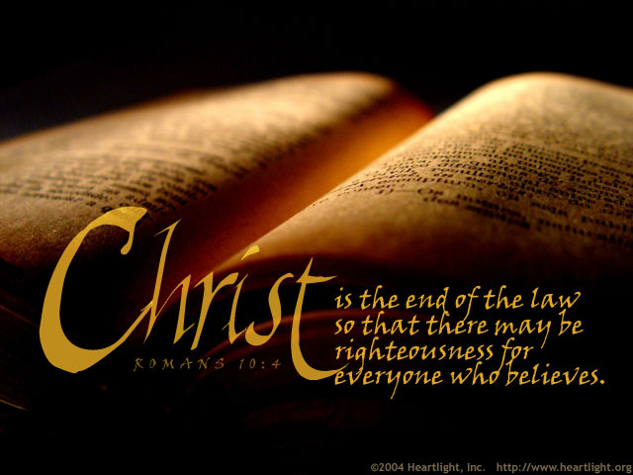

Slide 25
Romans 10:5 – 8
⁵For Moses describes the righteousness which is of the law, That the man which does those things shall live by them. ⁶But the righteousness which is of faith speaks on this wise, Say not in thine heart, Who shall ascend into heaven? (that is, to bring Christ down from above:) ⁷Or, Who shall descend into the deep? (that is, to bring up Christ again from the dead.) ⁸But what saith it? The word is nigh thee, even in thy mouth, and in thy heart: that is, the word of faith, which we preach.

Slide 26
Romans 10:5 – 8
In presenting God’s gracious offer of salvation in Christ and the provision of righteousness “by faith,” Paul first states the contrast of the “by-works” approach to achieving righteousness.
Paul states that Moses describes the righteousness that is by the Law. Then Paul quoted Leviticus 18:5 > “The man who does these things will live by [in] them” (10:5).
If a Jew were to receive righteousness by keeping the demands of the Law, that would be human achievement; it would not be from God.

Slide 27
Romans 10:5 – 8
That is to say, if a person is able to perform all that the Law requires, it will lead to life.﻿ The problem lies in the fact that no one is able to live up to the requirements of the law. Although law points us in the right direction, it provides no power to achieve its demands. It was never meant as a way to merit God’s favor.
Its role was to reflect the character of God in terms of ethical goals. The Jewish legalists had perverted the divine intention of the Law and made it into a way to gain God’s favor based on personal merit.

Slide 28
Romans 10:5 – 8
However, a Jew would need to keep the entire Law perfectly all his life – an impossible task (cf. James 2:10 > “For whosoever shall keep the whole law, and yet offend in one point, he is guilty of all.”).
But then Paul also quoted Moses in support of his righteousness “by-faith” position centered in Christ as “the end of the Law” and the means by which righteousness is available for everyone who believes. Paul uses of Moses’ words suggest that righteousness “by faith” is not a new concept, but had been proclaimed to Israel by Moses.

Slide 29
Romans 10:5 – 8
The material Paul quotes here is taken somewhat freely from Deuteronomy 30:12-14. The material in Deuteronomy was part of Moses’ charge to the generation of Israel about to enter the land of Canaan.
Blessing was promised for faith and obedience, and chastisement would result from rejection and disobedience. If Israel forsook God, Moses said, they would face worldwide dispersion and affliction. When the people then finally do turn to God in faith, He will restore them to blessing, prosperity, and prominence among the nations.

Slide 30
Romans 10:5 – 8
The point of Moses’ exhortation is that the generation to whom he was speaking had the message (cf. Deut. 30:14 > “But the word is very near you and in your mouth, and in thy heart, that thou may do it.”)
They could respond by faith and walk with God in obedience. Since the Israelites in Moses’ day had the message, they did not need to ask that it be brought down from heaven or that someone “cross the sea to get it (Deut. 30:13).” Instead, the words that Moses gave them was “near” them.

Slide 31
Romans 10:5 – 8
In effect, Paul indicated that the same truth applied to his generation, with the added fact that Christ has come “down from above” in the flesh and has been “brought up from the dead” by the resurrecting power of God (10:6).
Therefore ,there was no need for anyone to ask to bring Christ down (Incarnation) or to bring Christ up from the dead; He has already come and has been resurrected (10:7).

Slide 32
Romans 10:5 – 8
In Paul’s day, the message of righteousness by faith was “near” his readers (available to them) and this was “the word (rhēma) of faith” he was preaching and proclaiming.
Thus the gospel, “the word of faith,” is still available and accessible (10:8).

Slide 33
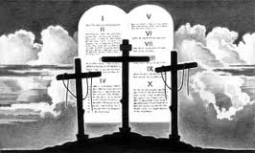

Slide 34
Romans 10:9 – 12
⁹That if thou shalt confess with thy mouth the Lord Jesus, and shalt believe in thine heart that God hath raised him from the dead, thou shalt be saved. ¹⁰For with the heart man believeth unto righteousness; and with the mouth confession is made unto salvation. ¹¹For the scripture saith, Whosoever believes on him shall not be ashamed. ¹²For there is no difference between the Jew and the Greek: for the same Lord over all is rich unto all that call upon him.

Slide 35
Romans 10:9 – 12
In these verses Paul states the content of that message concerning faith.
Confessing with the mouth that Jesus is Lord is mentioned first to conform to the order of the quotation from Deuteronomy 30:14 (in thy mouth and in thy heart) would be the same in Romans 10:8.
The confession is an acknowledgement that God has been incarnated in Jesus, and that Jesus Christ is God.

Slide 36
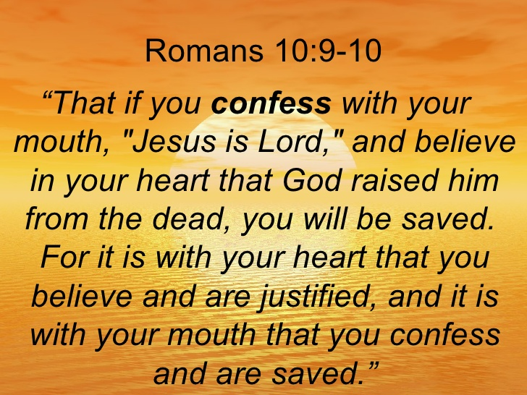

Slide 37
Romans 10:9 – 12
Romans 10:9-10 (part of the Roman Road), has long served as one of the most helpful portions of Scripture for pointing out the way of salvation. In an A-B-B-A format it lays out both the necessity of believing from the heart and the role of public confession.
A-Mouth – B-Heart = B-Heart – A-Mouth
Outward confession stems from a profound inward conviction. Those who come to Christ must believe in their hearts that Jesus was raised from the dead by God. The resurrection of Jesus Christ is the very center of the Christian faith.

Slide 38
Romans 10:9 – 12
Apart from the resurrection, Christianity would be little more than a well-intentioned ethical system. It is a fact that within history, God did something that defies all the laws of nature as we know them. He raised Jesus from the dead.
It is the reality of this resurrection that lends credence to all that Jesus did and taught throughout his earthly life. It is God’s way of authenticating to us that Jesus is the Son of God (cf. 1:4). The truth of the resurrection was at the very center of the apostolic preaching.

Slide 39
Romans 10:9 – 12
Also essential is heart-faith that God raised Him from the dead. The result is salvation. The true order is given in 10:10 > For it is with your heart that you believe and are justified (“it is believed unto righteousness”), and it is with your mouth that you confess and are saved (“it is confessed unto salvation”).
Yet these are not two separate steps to salvation. They are chronologically together. Salvation comes through acknowledging to God that Christ is God and believing in Him.

Slide 40
Romans 10:9 – 12
Paul then supports his position by restating part of Isaiah 28:16 (cf. 9:33), adding the Greek word “everyone” translated as “whosoever.” God responds with the gift of provided righteousness to each individual who believes.
This quotation not only demonstrates that salvation by grace through faith alone has always been God’s salvation plan, but that no one – including Gentiles – was ever to be excluded (10:11).

Slide 41


Slide 42
Romans 10:9 – 12
Paul reminds his readers of God’s impartiality, as he did when discussing human sinfulness (3:22). Just as all who sin will be judged, so all who believe (whosoever) will be saved and richly blessed, both Jew and Gentile alike (10:11).
Finally in v12, Paul states there is no distinction between Jew and Gentile. This conclusion is also supported in v13 by a quotation from Joel 2:32 > “Everyone who calls on the name of the Lord will be deliverance (saved).” To call on the Lord means to pray in faith for salvation.

Slide 43
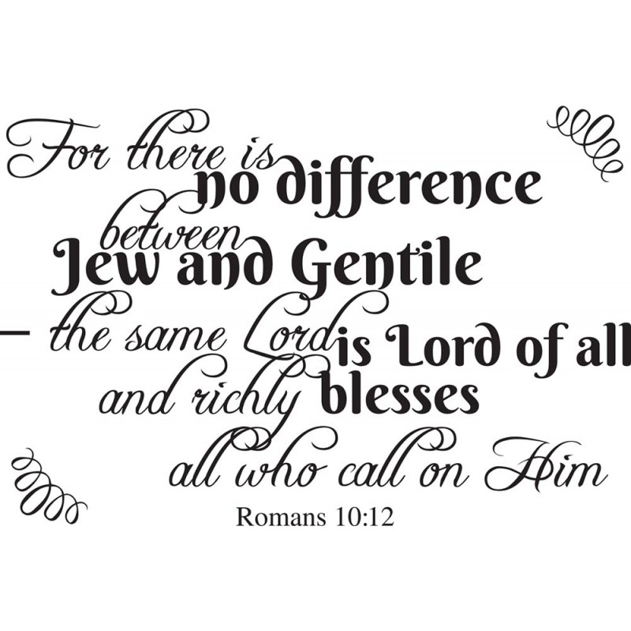

Slide 44



“ … I will richly bless all who call upon ME ”

Slide 45
NEXT CLASS – 16 June 2021
Book of Romans
Before next class, read the below chapter in the KJV and in one other versions of the Bible, i.e., NKJV, NRSV, NIV, CEV, etc …
Read the entire Chapter 10 again
2nd lesson: 10:13 – 21

