Slide 1

Human Responsibility
Part Two
Chapter 10:13 – 21
16 June 2021
Week 22

Slide 2

“Human Responsibility”
Part Two

Slide 3

Romans 10
Background:
In Ch9, after defending the Lord’s absolute sovereignty, upholding His perfect righteousness, showing us His mercy, and defending His fairness, Paul appropriately turned his attention to the responsibility of humanity.
In Ch10, Paul laments the failure of his unsaved Jewish brethren to see personal righteousness in its proper context. In trying to obtain righteousness through personal willpower, they missed the mark [sin] and failed to recognize their Messiah.

Slide 4
Romans 10
Background:
1 – The gospel is available; therefore, those who hear are accountable (10:8-10).
2 – The gospel is universal; therefore, no one is exempt (10:11-15).
3 – The gospel is plain; therefore, the unsaved are responsible (10:16-19).
4 – God is faithful and immutable; therefore, the crisis of responsibility remains (10:20-21).

Slide 5
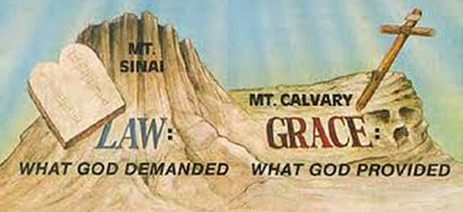
Human Responsibility

Slide 6
Romans 10
Objectives of Ch10:
1) To see the importance of combining zeal with knowledge and 2) To understand that Israel had plenty of opportunity to heed the gospel of Christ, but for the most part they had rejected it.
Summary:
As Paul continues to explain God’s dealings with the nation of Israel, Paul repeats his expression of love towards them (1). Though as a nation they had plenty of zeal (fervor), unfortunately their zeal was not according to knowledge (2).

Slide 7
Romans 10
Summary:
Thus they rejected the righteousness of God while trying to establish their own righteousness through the Law of Moses. But Paul explains that Christ is the fulfillment of the Law and has brought it to an end (3-4).
The righteousness God now offers is based upon faith in Christ, not keeping the Law. It involves not the accomplishment of some great feat (like ascending to heaven or descending to hell), but confessing Jesus as Lord and believing that God raised Him from the dead (5-10).

Slide 8
Romans 10
Summary:
As foretold by Scripture, it is offered to all, both Jew and Gentile (11-13). And it is offered through the act of preaching the Word (14-15).
The problem with the nation of Israel, then, is that not all of them received the gospel message, even when they had ample opportunity (16-18). But as Moses predicted, the day would come when God would provoke Israel to jealousy by another people, who Isaiah said did not seek God yet found Him, while Israel was constantly rebelling against Him (19-21).

Slide 9
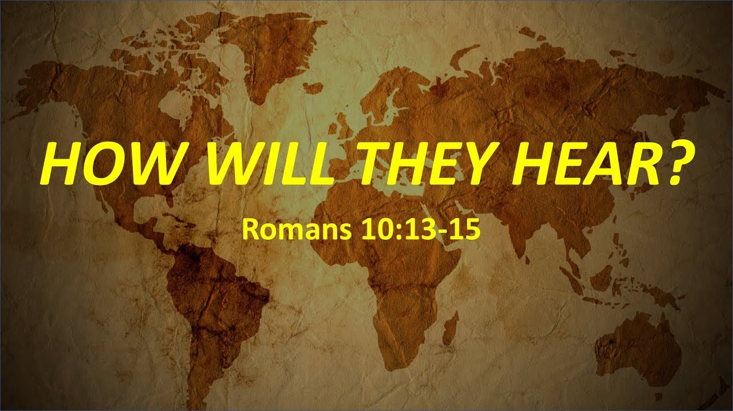

Slide 10
Romans 10:13 – 15
¹³For whosoever shall call upon the name of the Lord shall be saved. ¹⁴How then shall they call on him in whom they have not believed? and how shall they believe in him of whom they have not heard? and how shall they hear without a preacher? ¹⁵And how shall they preach, except they be sent? as it is written, How beautiful are the feet of them that preach the gospel of peace, and bring glad tidings of good things!

Slide 11
Romans 10:13 – 15
Just as all who sin will be judged, so all who believe will be saved and richly blessed. This conclusion also is supported by a quotation from Joel 2:32 > “Everyone who calls on the name of the Lord will be saved.”
To call on the Lord means to pray in faith for salvation.

Slide 12
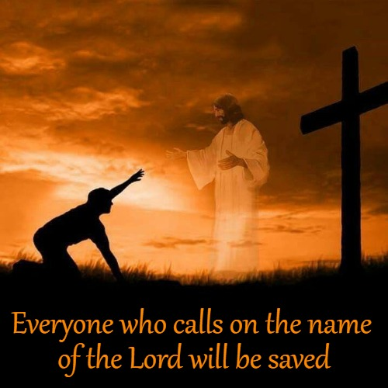

Slide 13
Romans 10:13 – 15
After proclaiming God’s gracious offer in Christ, Paul confronted the natural questions that arise, each additional question building on the key verb from the preceding question.
God’s promise of salvation to “everyone who calls” on Him (10:13) begins the process.
How, then, can they call on the One they have not believed in? Previously, to call on the Lord was equated with trusting Him or believing in Him (cf. 11 and 13), but here “calling” follows the believing.

Slide 14
Romans 10:13 – 15
When one believes in Christ, he “calls” on Him. Believing, in turn, is based on hearing, and hearing is based on someone preaching . . . and how can they preach unless they are sent?
Since the Greek word “preach” means “to be a herald, to announce,” it is not limited to proclamation from a pulpit.
Carrying God’s gracious offer involves human beings whom God has brought to Himself and then uses as His heralds. They share God’s message of salvation because God will save everyone who “calls” on His name.

Slide 15
Romans 10:13 – 15
With simple, progressive logic, Paul establishes that only those who call upon the name of the Lord can be saved . . . only those who have believed in Him can call upon Him . . .
Only those who have heard of Him can believe in Him . . . only those who have a preacher can rightly hear of Him . . .
And finally, no preacher can preach the true gospel who has not been sent by God.

Slide 16
Romans 10:13 – 15
Viewed from the other direction, Paul is saying that if God did not send preachers no one could hear . . .
If no one could hear; no one could believe . . .
If no one could believe; no one could call on the Lord . . .
And if no one could call on Him; no one could be saved.

Slide 17
Romans 10:13 – 15
In v15, Paul quotes from Isaiah 52:7 concerning the eagerness of the bearers of good news. Those who bear it have beautiful feet. That is, their message is both peaceful and welcoming.
In Isaiah 52:7 the messenger announced to Judah that God had ended their Exile in Babylon. Isaiah 52:7 > “How beautiful upon the mountains are the feet of him that brings good tidings . . .”
It is not the physical feet of God’s preachers that are beautiful, but the wondrous glad tidings of good things that those feet carry to the ends of the earth.

Slide 18


Slide 19



Slide 20
Romans 10:16 – 18
¹⁶But they have not all obeyed the gospel. For Isaiah saith, Lord, who hath believed our report? ¹⁷So then faith cometh by hearing, and hearing by the word of God. ¹⁸But I say, Have they not heard? Yes verily, their sound went into all the earth, and their words unto the ends of the world.

Slide 21
Romans 10:16 – 18
Paul had made it clear that God’s gracious offer of righteousness by faith was given to all, Jews and Gentiles alike (10:12). Paul’s focus is on the people of Israel and their response to that offer.
Not all of Israel accepted the good news of Christ and their failure to accept and to hear with a positive response. Truth of the matter, Israel heard, but did not heed. Some disbelieve now (3:3) as they did then. Yet, no everyone is believing the “report” (10:16).

Slide 22
Romans 10:16 – 18
This failure of the Jews to respond to the good news was true in Jesus’ days on earth (John 12:37-41) and in Paul’s day as well. Here, Paul reminds his Jewish readers that they did not all heed the glad tidings; for Isaiah 53:1 says, “﻿Lord, who has believed our report?﻿”
﻿The report of which Isaiah and Paul speak is the glad tidings of the gospel, the good news of Christ’s dying that we might live, the glorious truth that “﻿God so loved the world, that He gave His only begotten Son, that whoever believes in Him should not perish, but have eternal life.”

Slide 23
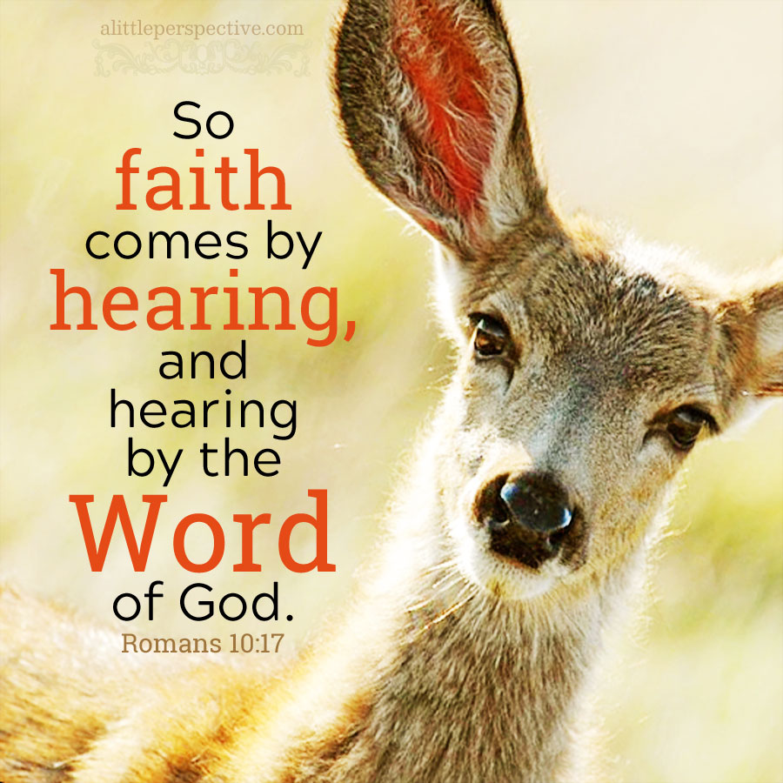

Slide 24
Romans 10:16 – 18
Salvation does not come by intuition, mystical experience, meditation, speculation, philosophizing, or consensus but by hearing and having faith in the word of Christ.
To proclaim the saving word of Christ is therefore the central and essential purpose of evangelism to “﻿go therefore into all the world.”
The purpose of evangelism is not to use human persuasion and clever devices to manipulate confessions of faith in Christ but to faithfully proclaim the gospel of Christ (10:17).

Slide 25
Romans 10:16 – 18
That is, the faithfully proclaim the gospel of Christ, through which the Holy Spirit will bring conviction and salvation to those who hear and “by faith” accept the word of Christ.
Someone, however, might insist that the Jews were not given adequate opportunity to hear the message. So Paul writes, “But I say, did Israel not hear? Paul quotes Psalm 19:4, concerning God’s general revelation in the cosmic heavens.

Slide 26
Romans 10:16 – 18
However, that psalm also discusses God’s special revelation in the Old Testament . . .
Ps. 19:7-11 > “The law of the Lord is perfect, converting the soul: the testimony of the Lord is sure, making wise the simple . . .”
Paul’s obvious answer to his question is that Israel had ample opportunity by both general and special revelation to respond to God. Certainly Israel heard!

Slide 27
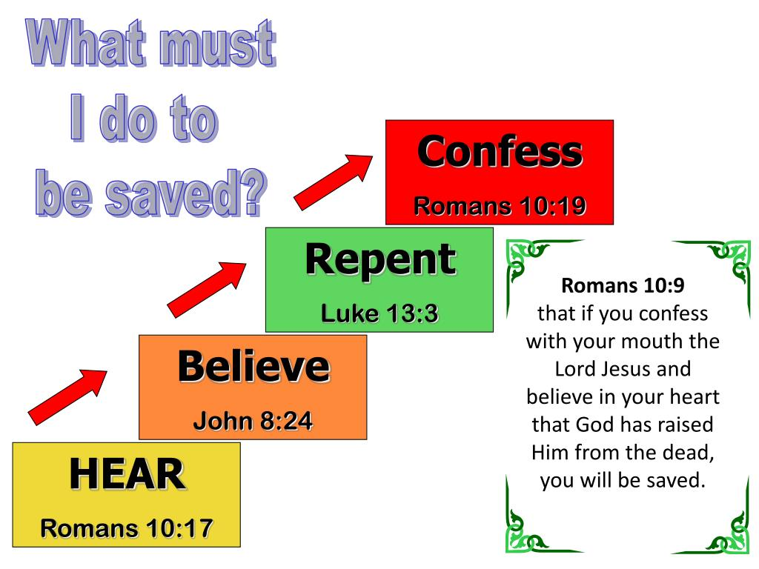

Slide 28
Romans 10:19 – 21
¹⁹But I say, Did not Israel know? First Moses saith, I will provoke you to jealousy by them that are no people, and by a foolish nation I will anger you. ²⁰Isaiah is very bold, and saith, I was found of them that sought me not; I was made manifest unto them that asked not after me. ²¹But to Israel he saith, All day long I have stretched forth my hands unto a disobedient and gainsaying people.

Slide 29
Romans 10:19 – 21
Starting with v19, the argument takes a turn. The apostle anticipated another objection. Someone might argue, “Yes, Israel heard but she did not understand that God purposed to offer righteousness by faith to all mankind, including Gentiles.”
Both Old Testament leaders wrote about God’s turning to the Gentiles, whom the Jews thought had no understanding. And yet concerning Israel, God has been gracious in spite of her disobedience. “Did not Israel know?” (10:19)

Slide 30
Romans 10:19 – 21
Paul’s obvious answer to his question is that Israel had ample opportunity by both general and special revelation to respond to God. Israel had a human responsibility to heard the gospel and to accept Jesus as Messiah.
God told Israel that He would “provoke them to jealousy (against) them that are not a nation, and against a nation without understanding will I anger you” (Deut 32:21).

Slide 31
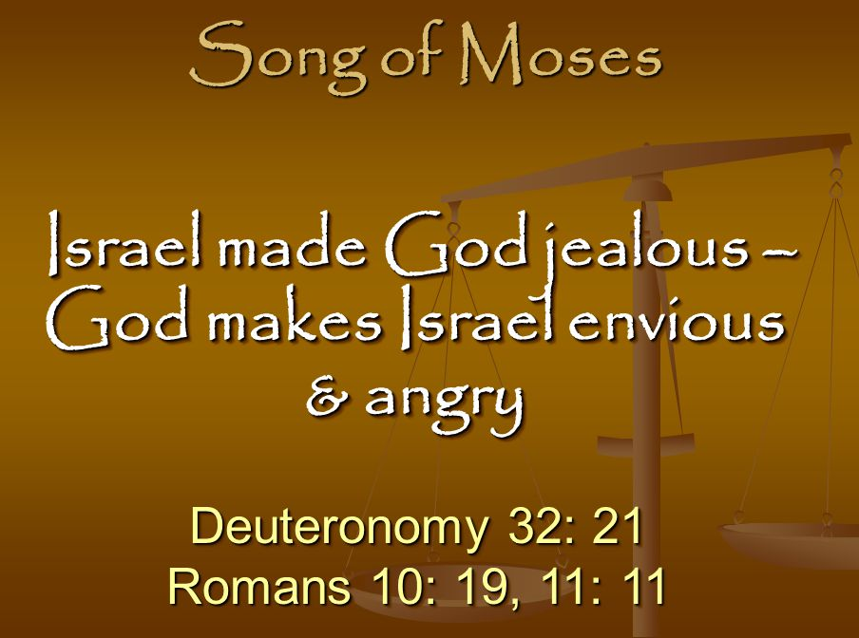

Slide 32
Romans 10:19 – 21
Israel’s continuing rebellious and unbelieving disobedience was judged by God’s turning to the Gentiles (10:20). At the same time God has not withheld salvation from the Jews. He has held out His hands, imploring them to return to Him.
Although Paul was probably speaking here only of the part of “﻿the world﻿” to which the full gospel had been proclaimed, the benefit of the gospel was available to all the earth, extending unto the ends of the world.

Slide 33
Romans 10:19 – 21
In this verse, God warns His ancient people that because they had moved Him to jealousy with their “no-gods” (idolatry) and provoked Him to anger with their vanities, God in requital would move them to jealousy by receiving into His favor a “no-people” and will use them to provoke Israel to anger by adopting a Gentile nation void of understanding.
Israel’s continuing rebellious and unbelieving disobedience was judged by God’s turning to the Gentiles (10:20).

Slide 34
Romans 10:19 – 21
At the same time God has not withheld salvation from the Jews. He has held out His hands, imploring them to return to Him.
God is stretching forth His hands all day long to a disobedient (stubborn) and gainsaying (defiant) people. The good news is God’s invitation is still open. God continues to offer salvation to the lost (10:21).

Slide 35
Romans
Application of Chapter 10:1 – 21
  God is sovereign in the choosing of His people: Abraham out of all the Chaldeans; Isaac, not Ishmael; Jacob over Esau; a believing remnant out of a non-believing majority. Nevertheless, each person is responsible to respond to God’s offer of grace and is blameworthy for refusing it.
  Those who suffer the penalty of eternal torment for sin will do so without excuse. The gospel is within reach of all people (10:8-10), no one is exempt from the offer of eternal life (10:11-15), receiving the gift requires no human effort (10:16-20), and this free gift of eternal life remains available (10:21).

Slide 36
Romans
Application of Chapter 10:1 – 21
  God is sovereign; people are responsible. These two truth must be held simultaneously or evangelism suffers. The Lord’s sovereignty gives me great comfort in two respects.
  FIRST – I rest secure in the fact that my relationship with Him cannot be severed by my unfaithfulness. That’s because God has chosen me and will faithfully equip me to enjoy eternal life with Him.
  SECOND – I rest secure in the fact that the salvation of others is His accomplishment, not mine. I can only image the unbearable pressure of holding the . . .

Slide 37
Romans
Application of Chapter 10:1 – 21
  . . . eternal destiny of another in my feeble hands. I would continually worry that a slip of the tongue or something would push someone closer to the edge of damnation.
  Because the sovereign control of God determines the destiny of another, I can boldly proclaim the truth without fear. I am not responsible for the salvation of people; however, my responsibilities are considerable (as are yours), if you are a believer. And those responsibilities are vital to the success of God’s plan.

Slide 38
Romans
Application of Chapter 10:1 – 21
  While God does not need us, He has given us a genuine stake in His redeeming the world. He is omnipotent, but we have three fundamental tasks:
  [1] We must care enough for the souls of others to go out of our way, to leave our comfort zones, to lay aside our desires in order to proclaim the gospel where it would not otherwise be heard.

Slide 39
Romans
Application of Chapter 10:1 – 21
  [2] We must share the good news faithfully, freely, and often. Preferably with competence; even better, within the context of an obedient life.
  [3] We must pray that the gospel willpenetrate the guarded minds and then resonate in the hollows of empty souls. As we faithfully and competently offer them the free gift of justification by grace alone through faith alone in Christ alone, we must submit their destinies to the loving care of their Creator. Pray that blind minds will see and deaf souls will hear.

Slide 40
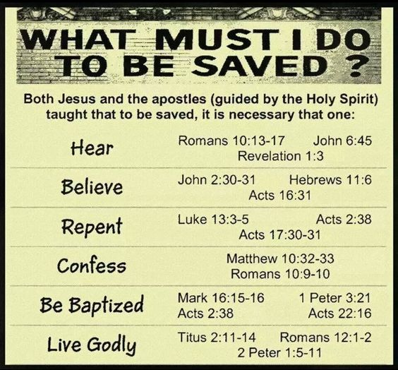

Slide 41



“ … whosoever shall call upon MY name shall be saved”

Slide 42
NEXT CLASS – 23 June 2021
Book of Romans
Before next class, read the below chapter in the KJV and in one other versions of the Bible, i.e., NKJV, NRSV, NIV, CEV, etc …
Read the entire Chapter 11
1st lesson: 11:1-21 (Horticultural Ethnics)
2nd lesson: 11:22-36 (Unfathomable)

