Slide 1

The Wild Olive Tree
Part One
Chapter 11:1 – 24
23 June 2021
Week 23

Slide 2

“The Wild Olive Tree”
Part One

Slide 3

Romans 9
Background:
In Chapter 9, Paul gives us an overview of the sovereignty of God and Israel’s selection in the past. Paul wants his readers to appreciate why and how God could choose to reject the nation of Israel (except for a remnant) and accept people from among the Gentiles.
Paul defends the God’s absolute sovereignty by upholding His perfect righteousness, showing us His mercy, and defending His fairness.

Slide 4
Romans 10
Background:
In Chapter 10, Paul turns his attention to the responsibility of humanity. Here, Paul laments at the failure of his unsaved Jewish brethren to see personal righteousness in its proper context. In trying to obtain righteousness through personal willpower, they missed the mark [sin] and failed to recognize their Messiah.
Paul wants us to see the importance of combining zeal with knowledge and to understand that Israel had plenty of opportunity to heed the gospel of Christ, but instead they rejected it.

Slide 5
Romans 11
Background:
In Chapter 11, Paul turns his attention back to the people of Israel and answers the question if God has forgotten or just set them aside. Paul gives several examples to show that despite this rebellion, God has not totally rejected His people.
Paul wants us to understand the wisdom of God and Israel’s future restoration. Here, Paul wants us to see the possibility of apostasy for us today.

Slide 6
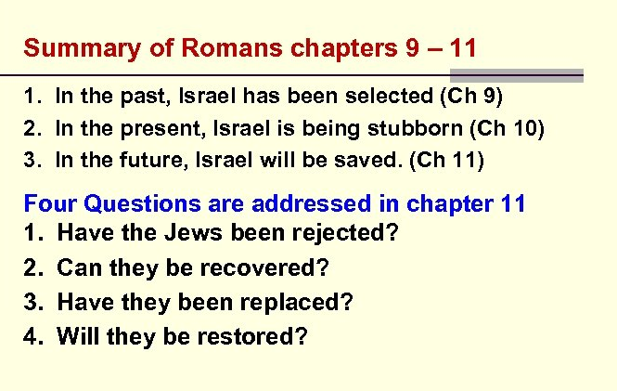

Slide 7


Slide 8
Romans 11
Summary:
Paul concluded chapter ten with a quotation from Isaiah describing the nation of Israel as “a disobedient and contrary people.” Paul begins chapter eleven by giving several examples to show that despite this rebellion God has not totally rejected His people (1-6).
What God has done, however, is harden the hearts of the rebellious Israelites (7-10).

Slide 9
Romans 11
Summary:
But the outcome of this “hardening” led to salvation coming to the Gentiles, which in turn God was using to provoke Israel to jealousy in an attempt to win them back to Him.
This is also why Paul magnified his ministry to the Gentiles, hoping to save some of his people by provoking them to jealousy (11-15).

Slide 10
Romans 11
Summary:
Paul then directs his attention to the Gentile believers, explaining that their obedience allowed them to be “grafted” into Israel to replace those removed by their own disobedience.
However, this “grafting” is permanent only as long as they remain faithful. In addition, if any Israelites repent of their unbelief, they too can be grafted back in (16-24).

Slide 11
Romans 11
Summary:
Paul explains that this is how “all Israel” will be saved. Through a “hardening in part” mercy can now be shown to the Gentiles, and by showing mercy to the Gentiles, mercy will be available to disobedient Israel. In this way Paul can say that “God has committed them all to disobedience, that He might have mercy on all,” proving that God is no respecter of persons and makes His plan of salvation available to all (25-32).
Paul ends this section with a doxology praising the wisdom and knowledge of God (33-36).

Slide 12
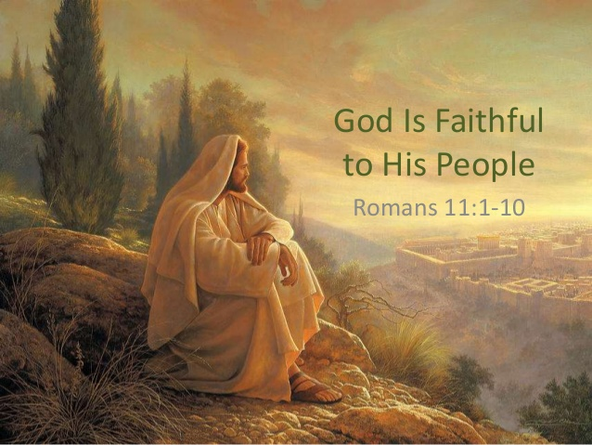

Slide 13
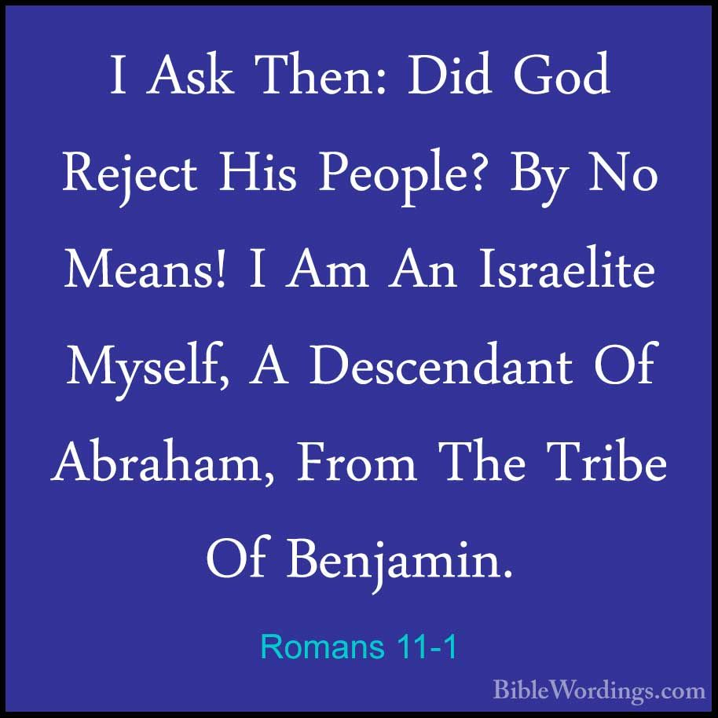
Romans 11:1

Slide 14
Romans 11:1
The Jews are not permanently rejected, but, through the calling of the Gentiles, they will be brought into the Church at last.
Painfully recognizing the fact of the present exclusion of Israel as a nation from the inheritance of the promises made to their fathers, Paul accounts for and justifies such exclusion, and proceeds now to the question: “Did God reject his people?”
Paul answers – No; impossible; by no means!

Slide 15
Romans 11:1
Paul provides “personal proof” that God has not permanently cast His people aside. Paul states that “I am an Israelite and my salvation is proof that God is not through with Israel.”
Paul’s conversion is a pattern for other Jewish believers. That is, Paul’s experience is a picture of the way the people of Israel will be converted at the coming of Christ in glory. Like Paul, they will be in rebellion and unbelief. They will see Him whom they pierced (Zech. 12:10 and Rev. 1:7) and will repent and be saved.

Slide 16
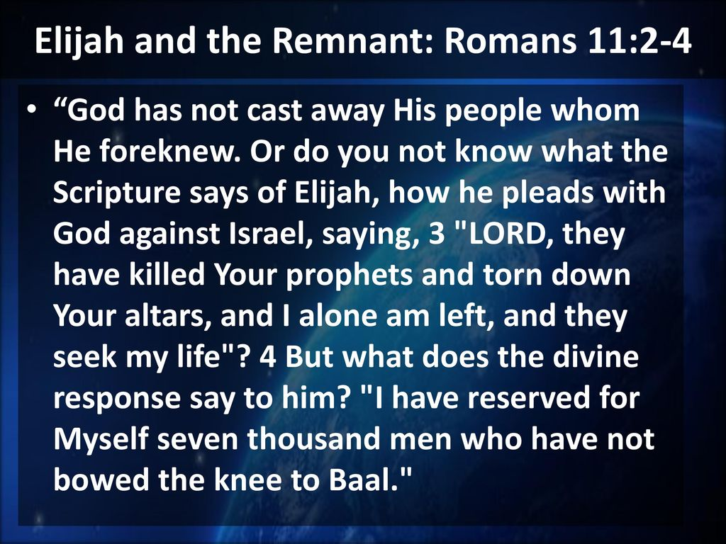
Romans 11:2 – 4

Slide 17
Romans 11:2 – 4
God’s ancient covenant with his people stands; the remnant of believers even now is a sign of His continued favor to His ancient people. From Pentecost to the present day, Christ’s church has never been without believing Jews.
As was in the time of Elijah, the remnant never bowed their knees to Baal. When his life was threatened by Jezebel, even the godly and normally fearless Elijah became fearful and despondent, thinking in self pity that he was the only believer left on earth.

Slide 18
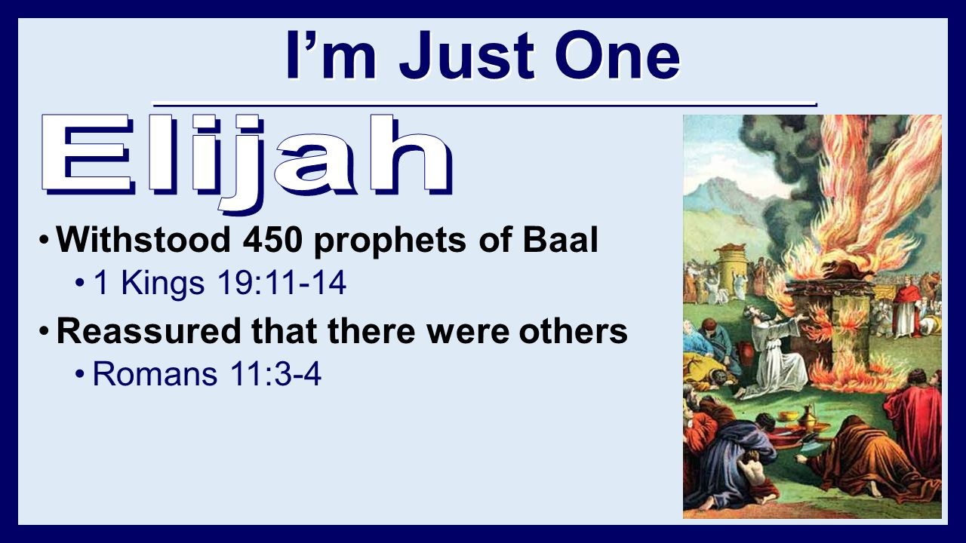

Slide 19
Romans 11:2 – 4
Through His direct word, God reassured Elijah that seven thousand others (remnant) remained faithful to the true God and had not bowed the knee to the pagan god Baal, whom the wicked Jezebel and her priests had led most of Israel to worship (cf. ﻿1Kings 19:9–18﻿).
When Jesus Christ, came to earth, the apostate nation rejected and crucified Him. But there was a godly remnant in Israel before Jesus was born – including Simeon, Anna, and the Bethlehem shepherds – who received and worshiped Jesus when He was but an infant.

Slide 20
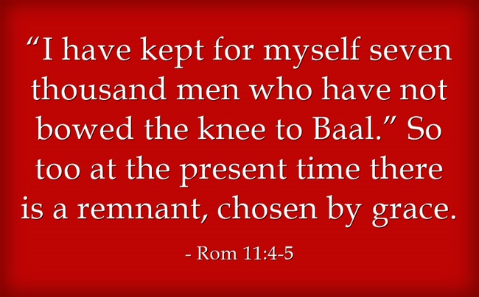
Romans 11:4 – 5

Slide 21
Romans 11:4 – 5
After the Elijah illustration, Paul drew a conclusion for his day: So too, at the present time there is “a remnant according to the election of grace has come to be.”
Paul was only one of many in his generation elected to faith from the people of Israel. In every generation of the church “a remnant chosen by grace” has been called from among the Jews.
Paul adds that this choice is totally by God’s grace (cf. Eph. 2:8-9) and Paul emphasized the difference between grace and works (cf. Rom. 4:4-5; 9:30-32).

Slide 22
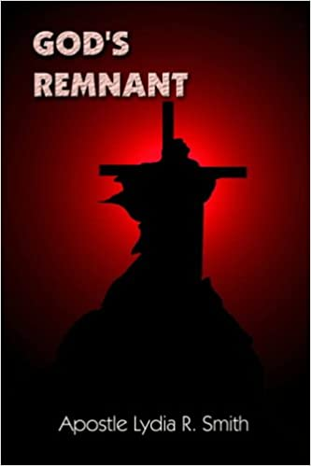
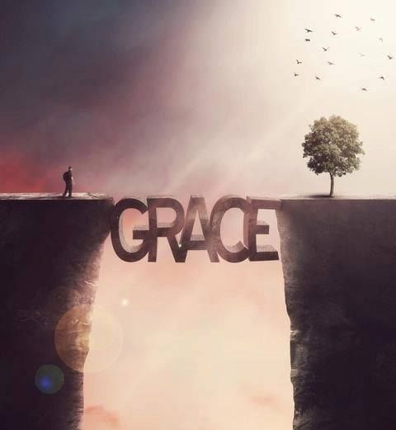

Slide 23
Romans 11:6 – 8
⁶And if by grace, then it cannot be based on works; if it were, grace would no longer be grace. ⁷What then? What the people of Israel sought so earnestly they did not obtain. The elect among them did, but the others were hardened, ⁸as it is written: “God gave them a spirit of stupor, eyes that could not see and ears that could not hear, to this very day.”

Slide 24
Romans 11:6 – 8
Human effort (work) and God’s grace are mutually exclusive ways to salvation. Our salvation is by God’s grace only, completely devoid of our work (11:6).
In spite of the Jews of Paul’s day intense religious zeal, they failed to obtain God’s righteousness. Yet, the elect, those whom God graciously had chosen (predestinate) sought by faith and found God’s righteousness (11:7).

Slide 25
Romans 11:6 – 8
The rest of Israel were hardened (callous) or “grew deaf” and were made spiritually blind. Paul uses both Deuteronomy 29:3-4 (law) and Isaiah 29:10 (prophets) to explain that hardening involves spiritual drowsiness (stupor = “a numbness resulting from a sting”), (11:8).
Both the law and the prophets testify to God’s sovereign and predetermined hardening of hearts. But that hardening is neither capricious nor unjust. God hardens only those hearts who, in rejecting His gracious offer of righteousness, harden themselves to His grace.

Slide 26
Romans 11:6 – 8
God judicially hardened Pharaoh’s heart because Pharaoh willingly “﻿hardened his [own] heart﻿” against God.
During the Lord’s Supper, Jesus said, “﻿Behold, the hand of the one betraying Me is with Me on the table.﻿ For indeed, the Son of Man is going as it has been determined; but woe to that man by whom He is betrayed!﻿” (﻿Luke 22:21–22﻿).
God’s righteous predetermination of Judas’s betrayal was inextricably connected to Judas’s own unrighteous intentions, for which he was held eternally accountable.

Slide 27
Romans 11:6 – 8
One of the great mysteries of Scripture is the coexistence of God’s sovereign preordination and man’s personal accountability.
God’s judicial hardening of a man’s heart is never separate from that man’s hardening of his own heart.

Slide 28
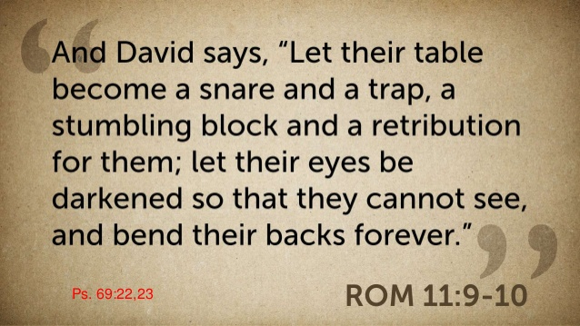
Romans 11:9 – 10

Slide 29
Romans 10:9 – 10
Spiritual hardening is a terminal disorder for which, there is no remedy. In the same way, David spoke of their feasts (table) becoming snares and traps (Psalm 69:22–23).﻿
The very things which should have been the source of nourishment and blessing to Israel (table means their blessings from the hand of God, which should have led them to Christ) became the occasion for their rejection of God (a snare and a trap, a stumbling block (9:32) and God’s judgment (retribution) on them.

Slide 30
Romans 10:9 – 10
When the Lord Jesus Christ came as their Messiah, He really was bringing all the benefits of a banquet. He was their “table” and their table became a stumbling block to them. Paul asks, “Did they stumble that they might fall and never be brought back?” God forbid!
Because they refused to receive God’s truth and Jesus as Christ, Israel’s backs will be bent under the weight of guilt and punishment forever (11:10).

Slide 31
Romans 10:9 – 10
Here, Paul strengthens his argument with these three OT quotations (Deut., Isaiah, and Psalm) that God’s people should be liable to the state of stupefaction described, without ceasing to be His people.
Israel’s very religious practices and observances became substitutes for the real experience of salvation. Sadly, this same mistake is made today when people depend on religious rituals and practices instead of trusting in Jesus Christ who is pictured in these activities.

Slide 32
Romans 10:9 – 10
Paul makes it clear that the hardening of Israel is neither total nor final, and this is proof that God has a future for the nation. “Hardness in part is happened to Israel, until the fullness of the Gentiles be come in” (11:25).
The existence of the believing Jewish remnant today, as in Elijah’s day, is evidence that God still has a plan for His people. Therefore, the present hardening of Israel as a notion was never intended to be permanent.

Slide 33
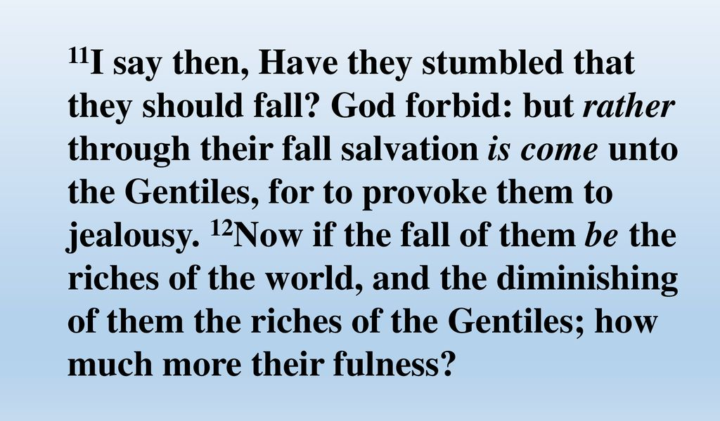
Romans 10:11 – 12

Slide 34
Romans 11:11 – 12
Israel is experiencing not a permanent fall, but a stumbling. It serves at least two divine purposes: (a) to offer salvation to the Gentiles, and (b) to make or provoke Israel to jealousy (cf. Deut. 32:21).
In turning away from unbelieving Jews to the Gentiles, Paul was fulfilling these two divine purposes of God. But Paul is convinced that Israel’s transgression (misstep, or “stumble”) is temporary.

Slide 35
Romans 11:11 – 12
So Paul looks beyond its immediate results (riches for the world and Gentiles) to the possibility of its removal (how much greater riches will their fullness bring). Israel’s “fullness” suggests a large-scale conversion of the Gentiles (cf. 11:25).
Certainly the world (Gentiles) has been enriched spiritually because of so many Gentiles coming to Christ. But even greater riches will be enjoyed by Gentiles after the conversion of Israel at the Lord’s return (cf. 11:26).

Slide 36
Romans 11:13 – 16
¹³I am talking to you Gentiles; inasmuch as I am the apostle to the Gentiles, I take pride in my ministry ¹⁴in the hope that I may somehow arouse [provoke] my own people to envy [jealousy] and save some of them. ¹⁵For if their rejection brought reconciliation to the world, what will their acceptance be but life from the dead? ¹⁶If the part of the dough offered as firstfruits is holy, then the whole batch is holy; if the root is holy, so are the branches.

Slide 37
Romans 11:13 – 16
Paul singles out the Gentile Christians in the church at Rome and tells them that he is the “apostle to the Gentiles” (11:13). Part of Paul’s purpose for magnifying his service to the Gentiles is to provoke to jealousy his fellow Jews (11:11), resulting in the salvation of some of them. Any such Jews won to Christ would be part of the “remnant chosen by grace.”
Paul reminds his Gentiles readers that Israel’s rejection meant the reconciliation of the world in the purpose of God. Because Israel rejected Christ, the gospel was taken to these Gentiles.

Slide 38
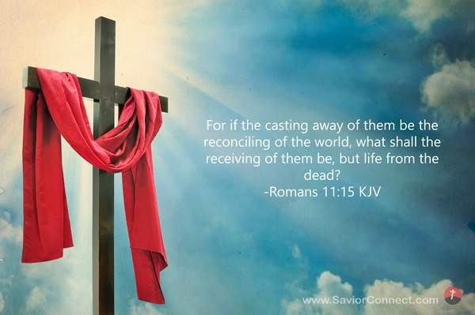

Slide 39
Romans 11:13 – 16
Because Paul was convinced that Israel’s stumbling is temporary, he asked, What will their acceptance be but life from the dead? Israel’s “acceptance” of Christ is related to “the first resurrection,” the resurrection of life (John 5:29).
The first resurrection includes dead saints at the Rapture (1Thes. 4:13-18), martyred Great Tribulation saints raised at Christ’s second coming (Rev. 20:4), and believing OT saints (Dan. 12:1-2). The second resurrection will include all the wicked dead to be judged at the great white throne judgment (Rev. 20:5, 12-13).

Slide 40
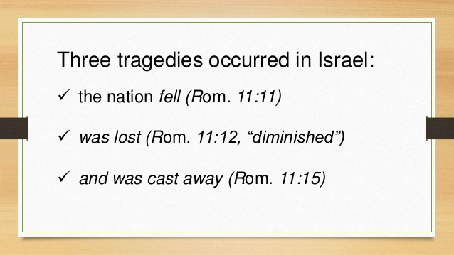

Slide 41
Romans 11:13 – 16
Paul uses two illustrations to show that Israel’s stumbling is temporary rather than permanent. His first illustration is taken from God’s instructions to Israel to take “a cake from the first of [their] ground meal and present it as an offering” (Num. 15:20) after they entered the land of Canaan and reaped their first wheat harvest.
This offering was to be repeated each year at their harvests. The cake made from the first ground meal of the wheat harvest was sanctified or made holy by being offered to God.

Slide 42
Romans 11:13 – 16
As Paul explained, If [since] the part of the dough offered as firstfruits is holy, then the whole batch [lump] is holy also.
Paul’s second illustration is that of an Old Olive Tree, If [since] the root is holy, so are all of the branches.
In both illustrations the principle is the same: what is considered first contributes its character to what is related to it.

Slide 43
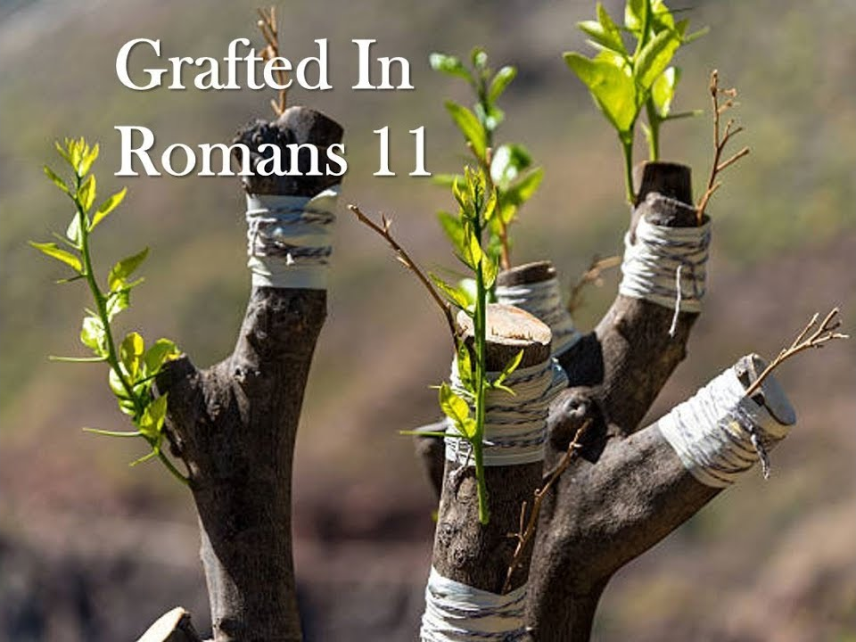
The Wild Olive Tree

Slide 44
Romans 11:13 – 16
With the olive tree, the root obviously comes first and contributes the nature of that type of tree to the branches that come later.
With the cake, the flour is taken from the ground meal, but that cake is formed and baked first and presented as a firstfruit. Since it is set apart to the Lord first, it sanctifies the whole harvest.

Slide 45
Romans 11:13 – 16
The firstfruits and the root represent the patriarchs of Israel or Abraham personally, and the lump and the branches represent the people of Israel.
As a result Israel is set apart (holy) to God, and her “stumbling” (rejection of Christ) is therefore temporary.

Slide 46
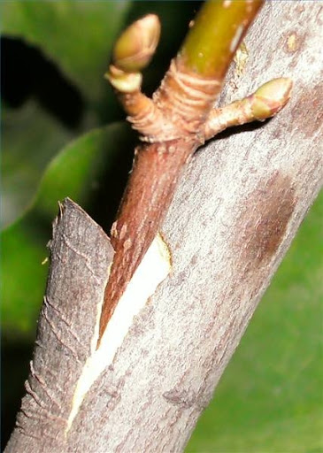
In this section, Paul sternly warns the Gentiles against pride and arrogance because of Israel’s rejection and their being grafted in.

Slide 47
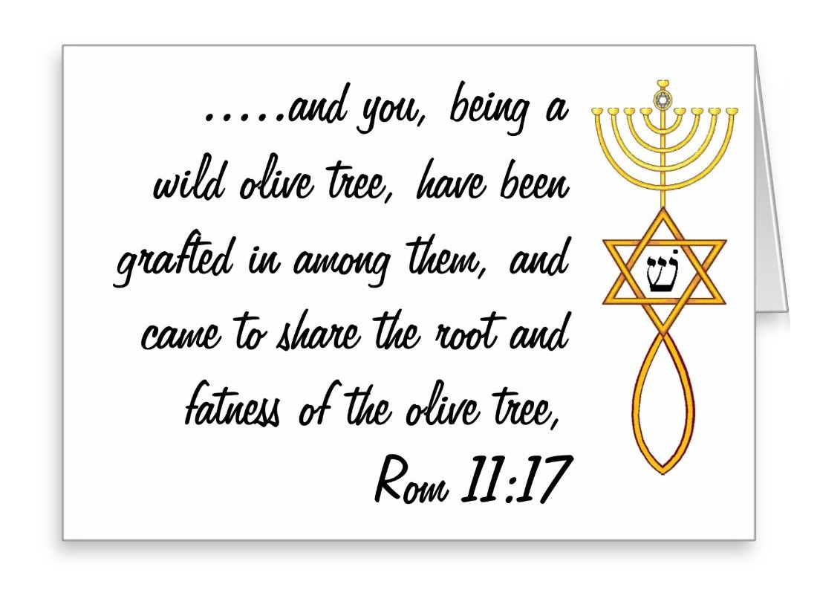
Romans 11:17

Slide 48
Romans 11:17
Some, but not all, of the branches of Israel were removed; God always preserved a believing remnant (cf. 11:3, 4), a wild olive tree grafted in.
Olives were an important crop in the ancient world. Although trees often lived for hundreds of years, individual branches eventually stopped producing olives. When that happened, branches from younger trees were grafted in to restore productivity.

Slide 49
Romans 11:17
Paul’s point is that the old, unproductive branches (Israel) were broken off and branches from a wild olive tree (Gentiles) were grafted in; the root and fatness.
Once grafted in, Gentiles partake of the richness of God’s covenant blessings as the spiritual heirs of Abraham (the olive tree); the place of divine blessing – God’s covenant of salvation made with Abraham (cf. Gen. 12:1–3).

Slide 50
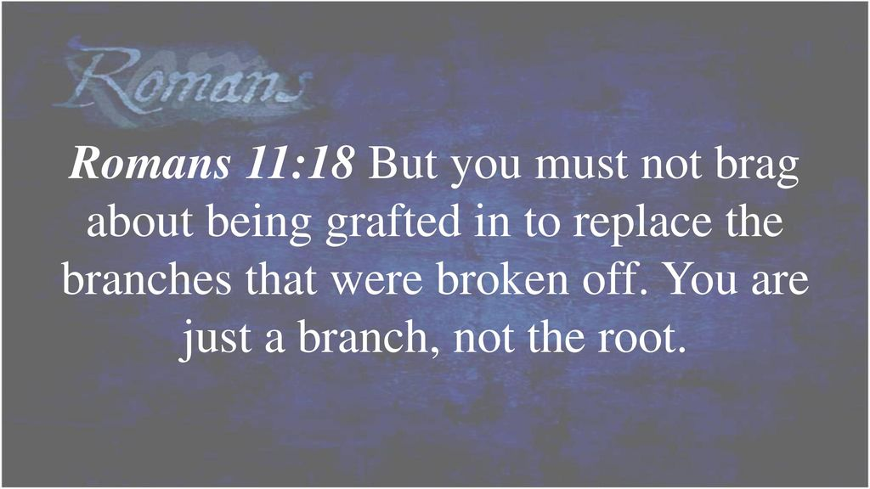
Romans 11:18

Slide 51
Romans 11:18
Paul admonishes the Gentiles not to boast or brag. There is no place in the church for spiritual pride or superiority, still less for anti-Semitism.
We are the spiritual offspring of Abraham (4:11 – the branches). The unbelieving Jews who had been broken off so that Gentiles might be grafted in.
Gentiles are not the source of blessing – the root supports (nourishes) them. Remember, Gentiles have been grafted into the covenant of salvation that God made with Abraham (cf. Gal. 3:6–9).

Slide 52
Romans 11:18
Normally a branch of a cultivated olive tree is grafted into a wild olive tree, the opposite of what Paul spoke of here. But Paul knew that grafting the wild into the cultivated was not the norm (though it was done), for later he said it was “contrary to nature” (11:24).
To reinforce his warning, Paul declared, You do not support the root, but the root supports you. The root of the tree is the source of life and nourishment to all the branches, and Abraham is “the father of all who believe.” So Gentile believers are linked to Abraham; in one sense they owe their salvation to him, not vice versa.

Slide 53
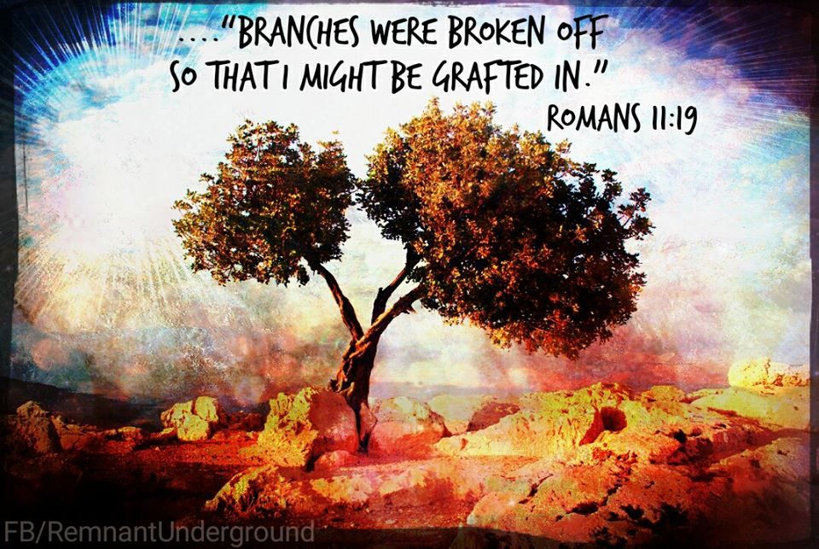
Romans 11:19

Slide 54
Romans 11:19
The apostle anticipates the rebuttal a Gentile believer might make: Branches were broken off (to make room for me) so that I could be grafted in. Though that was not the real reason the branches were broken off, Paul accepts the statement for the sake of argument.
Israel is the olive tree that failed to bear fruit for God. Therefore, God then broke off some of the Jewish branches and grafted into the olive tree the Gentiles branches from “a wild olive tree.”

Slide 55
Romans 11:20 – 22
²⁰Granted. But they were broken off because of unbelief, and you stand by faith. Do not be arrogant, but tremble. ²¹For if God did not spare the natural branches, he will not spare you either. ²²Consider therefore the kindness and sternness of God: sternness to those who fell, but kindness to you, provided that you continue in his kindness. Otherwise, you also will be cut off.

Slide 56
Romans 11:20 – 22
Here Paul points out that the real reason the branches were broken off was Israel’s unbelief and that any Gentile as a grafted-in branch stands (cf. 5:2) by faith.
Therefore Paul warns Gentile Christians individually again, Do not be arrogant (“Do not think high” of yourself”), but be afraid, have a proper fear of God.
Paul reminded them, For if God did not spare the natural branches (Israel), He will not spare you (Gentiles) either.

Slide 57
Romans 11:20 – 22
If God is righteous in temporarily putting aside Israel as a whole for unbelief, God certainly could put aside the Gentiles for pride and arrogance.
Now Paul summarizes his whole discussion of God’s sovereign choice in temporarily putting Israel aside corporately and proclaiming righteousness by faith to all mankind.
Therefore, consider the kindness (benevolence in action) and the sternness (harshness) of God.

Slide 58
Romans 11:20 – 22
God’s sovereign choice involved severity toward the Jews who stumbled (fell) in unbelief and were hardened, but that same decision displayed the goodness of God toward individual Gentiles.
God’s continuing His goodness to the Gentiles depends on their continuing in His kindness. If Gentiles do not continue in God’s kindness, they also will be cut off.
This does not suggest that a Christian can lose his salvation; it refers to Gentiles as a whole (suggested by the singular you) turning from the gospel much as Israel as a nation had done.

Slide 59
Romans 11:23 – 24
²³And if they do not persist in unbelief, they will be grafted in, for God is able to graft them in again. ²⁴After all, if you were cut out of an olive tree that is wild by nature, and contrary to nature were grafted into a cultivated olive tree, how much more readily will these, the natural branches, be grafted into their own olive tree!

Slide 60
Romans 11:23 – 24
Paul reminds the people of Israel, if they do not persist (continue) in unbelief, they will be grafted in, for God is able to graft them in again.
At issue is not God’s ability but God’s decision. God sovereignly chose to put Israel aside corporately because of unbelief and to extend righteousness by faith to everyone.
This demonstrates God’s decision to graft Gentiles into the spiritual stock of Abraham.

Slide 61
Romans 11:23 – 24
Therefore, if the unbelief which caused Israel’s rejection by God is removed, God is able and will graft the people of Israel (the natural branches) back into the spiritual stock to which they belong (their own olive tree).
After all, as Paul wrote earlier, “Everyone who calls on the name of the Lord will be saved” (10:13).

Slide 62
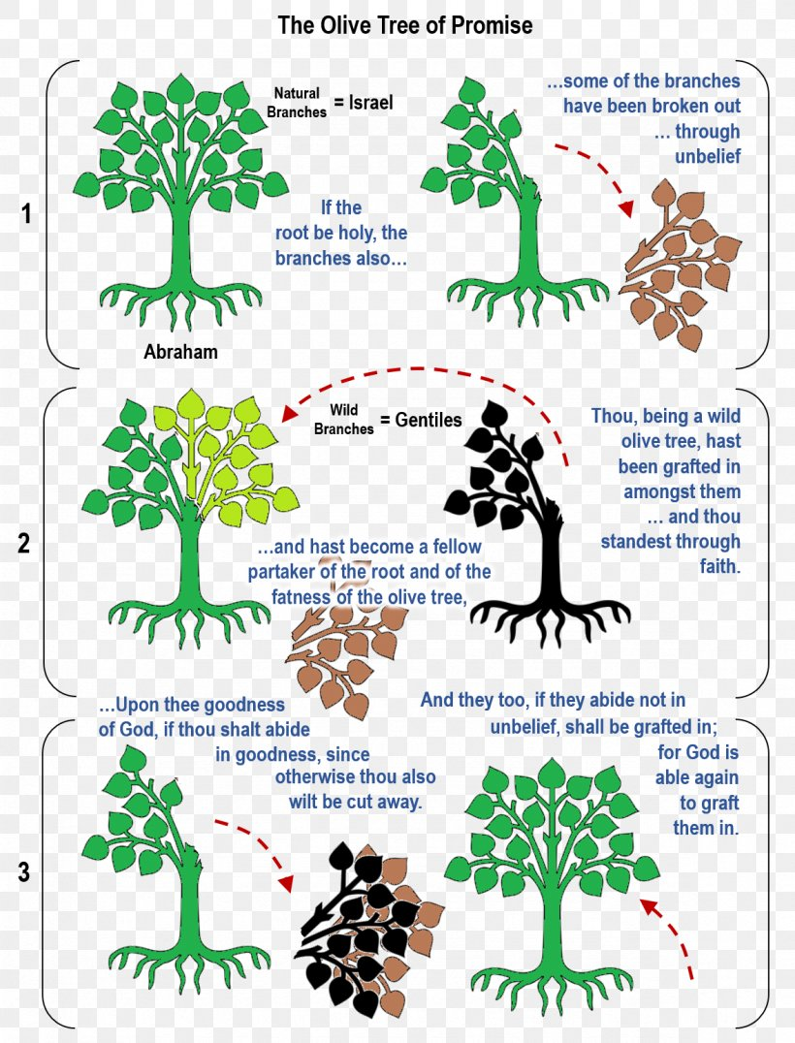

Slide 63
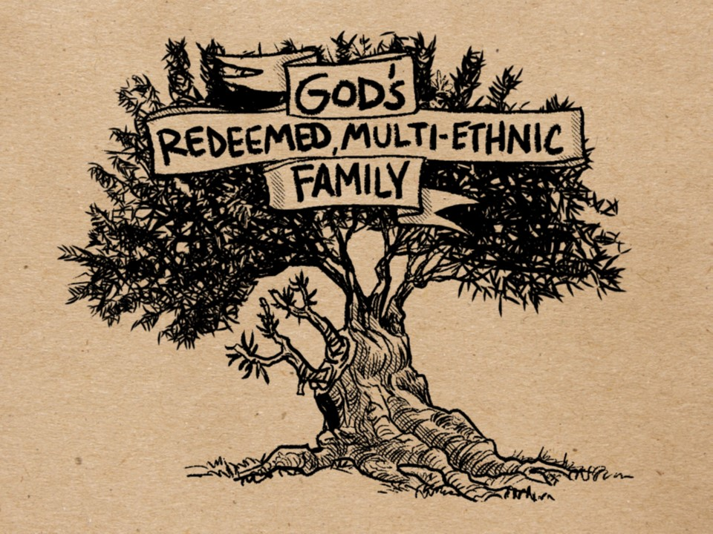

Slide 64
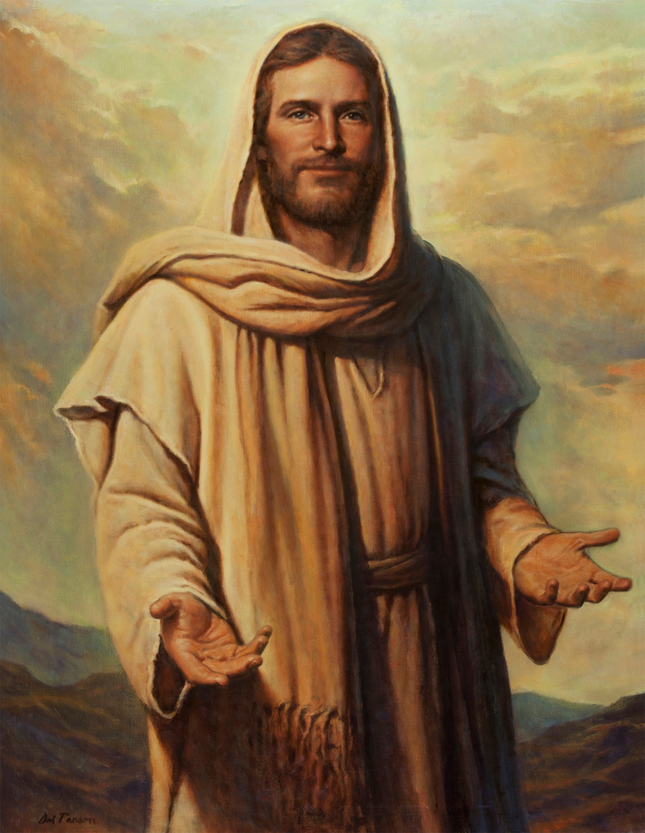


“I am the Savior of all, Jew and Gentile . . .”

Slide 65
NEXT CLASS – 30 June 2021
Book of Romans
Before next class, read the below chapter in the KJV and in one other versions of the Bible, i.e., NKJV, NRSV, NIV, CEV, etc …
Read the entire Chapter 11
1st lesson: 11:1-24 (The Wild Olive Tree)
2nd lesson: 11:25-36 (The Salvation of Israel)

