Slide 1

The Salvation of Israel
Part Two
Chapter 11:25 – 36
30 June 2021
Week 24

Slide 2

“The Salvation of Israel”
Part Two

Slide 3
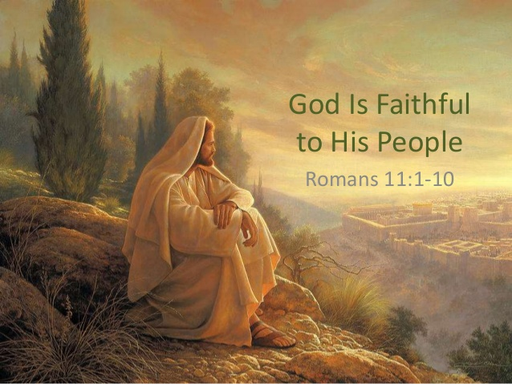

Slide 4

Romans 11
Summary:
After concluding chapter ten with a quotation from Isaiah describing the nation of Israel as “a disobedient and contrary people,” Paul begins chapter eleven by giving several examples to show that despite this rebellion God has not totally rejected His people (1-6).
What God has done, however, is harden the hearts of the rebellious Israelites (7-10).

Slide 5
Romans 11
Summary:
But the outcome of this “hardening” led to salvation coming to the Gentiles, which in turn God was using to provoke Israel to jealousy in an attempt to win them back to Him.
This is also why Paul magnified his ministry to the Gentiles, hoping to save some of his people (remnant) by provoking them to jealousy (11-15).

Slide 6
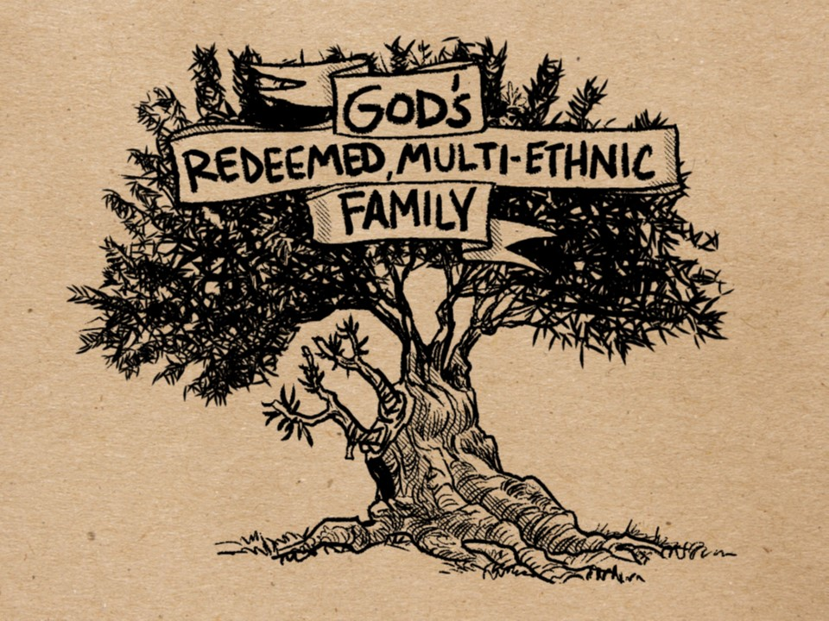
The Olive Tree of Divine Favor (Privilege)

Slide 7
Romans 11
Summary:
Paul turns his attention to the Gentile believers, explaining that their obedience allowed them to be “grafted” into DIVINE FAVOR (olive tree) to replace those Israelites removed by their own disobedience and/or unbelief.
However, this “grafting” is permanent only as long as they remain faithful. In addition, if any Israelites repent of their unbelief, they too can be grafted back in (16-23).

Slide 8
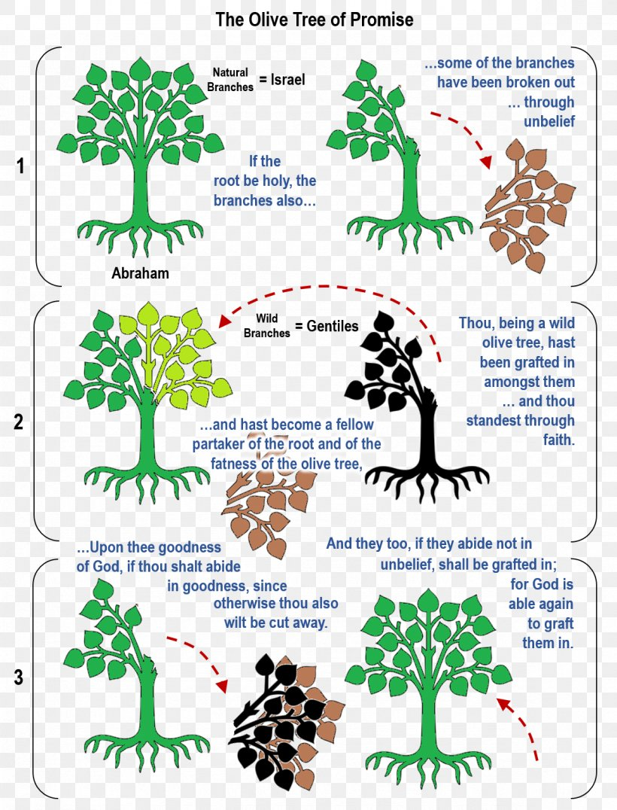
v17
v16
v19
v17
v23
v22

Slide 9
Romans 11
Summary:
Paul is careful to maintain a distinction between the church and Israel in this illustration. Here, Paul stresses the unity of Jew and Gentile Christians, declaring them to be a new, single species of humanity unlike any before (Eph. 2:14ff > “For he is our peace, who hath made both one, and hath broken down the middle wall of partition between us”).
Some have concluded that God set aside the literal nation of Israel and superseded it by establishing a “spiritual Israel” called the church, which is made up of this new race of humankind.

Slide 10
Romans 11
Summary:
Furthermore, some claim that the church will inherit the promises of Abraham’s covenant, not literally, but “spiritually” – which can mean just about anything you care to read into it. Not true!
Paul stresses Jew and Gentile unity, but he also stresses their distinction in terms of how God will carry out His salvation plan for the world. Gentiles do not replace Israel, but they coexist together in salvation and fellowship (22-24).

Slide 11

The wild olive branches grafted into divine favor

Slide 12


Slide 13
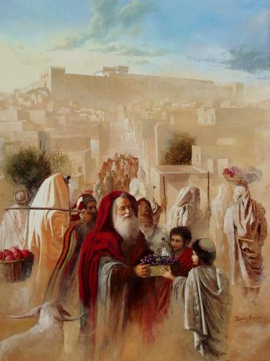
Tonight’s focus . . .
“The Salvation of Israel”

Slide 14
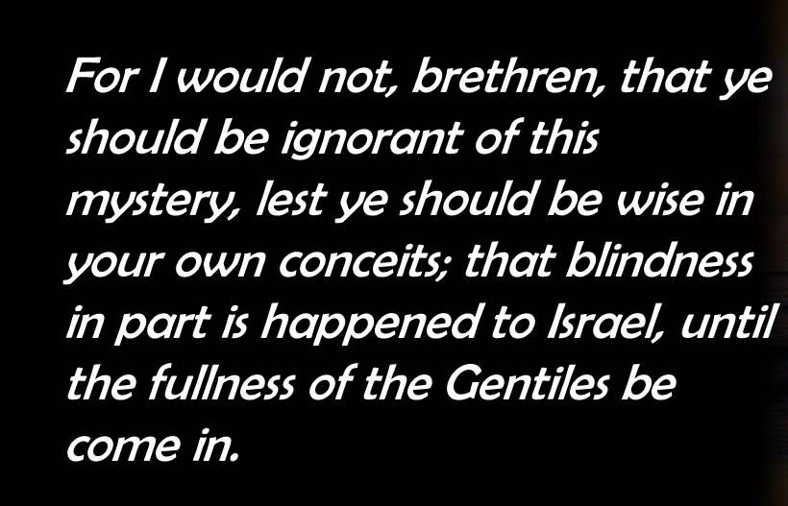
Romans 11:25

Slide 15
Romans 11:25
Paul reveals that Israel’s corporate stumbling, which is temporary, not permanent, is called a mystery. In Scripture a mystery is not a truth difficult to understand, but a truth previously concealed, but now revealed and publicly proclaimed . . .
Eph. 3:4-6 > “In reading this, then, you will be able to understand my insight into the mystery of Christ, ⁵which was not made known to people in other generations as it has now been revealed by the Spirit to God’s holy apostles and prophets. ⁶that through the gospel the Gentiles are heirs together with Israel, members together of one body, and sharers together in the promise in Christ Jesus.”

Slide 16
Romans 11:25
Paul wants to make sure his Gentile readers knew about the mystery concerning Israel in God’s sovereign choice. God’s purpose was so that you may not be conceited.
God’s sovereign plan to put Israel aside temporarily in order to show grace to Gentiles is no basis for conceit on the part of the Gentiles.
God purpose is that some from all nations should by faith receive the righteousness provided by grace. Thus, displaying further the glory of God.

Slide 17
Romans 11:25
Israel’s relationship as God’s Chosen People was rescinded for a time as they now experience a hardening in part until the full number of the Gentiles has come in. There is a fullness for Israel (11:12) and a fullness for the Gentiles (11:25).
Here, Paul gives two specific facts about Israel’s hardening: a) it is partial because throughout this time there is a remnant chosen by grace (11:5), and b) it is temporary because it will end when God’s sovereignly chosen number of Gentiles has been saved.

Slide 18
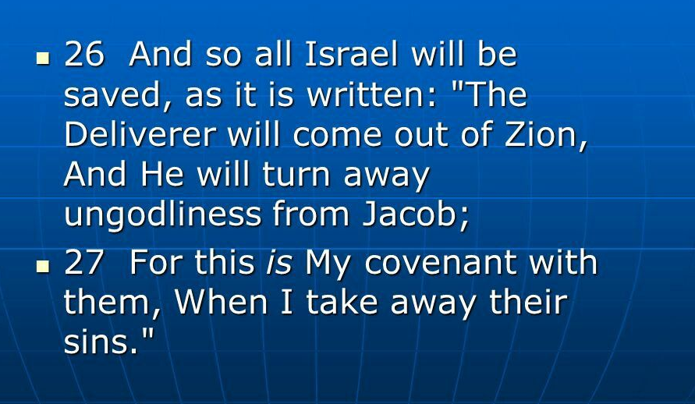
Romans 11:26 – 27

Slide 19
Romans 11:26 – 27
Paul explains that when the era of the Gentiles has ended, “all Israel will be saved.” This may or may not include the majority of Jewish individuals. Remember, “all Israel,” or the true Israel, is not determined by numbers but by belief (faith).
Therefore, “all Israel” and “the fullness of the Gentiles” represent the sum total of God’s elect. When all of God’s chosen individuals have believed, the next age will begin. Paul alludes to this coming era by quoting from Isaiah 59.

Slide 20
Romans 11:26 – 27
In this prophetic song, Isaiah laments the sorrowful condition of Israel, in which there is no justice or righteousness. And because Israel is supposed to be God’s example of righteousness for the rest of the world, all of creation is corrupt.
Moreover, “there was no one to intercede” (Isa. 59:16), no one to make things right. So, God Himself dons His armor to invade and conquer this hostile territory, to bring evildoers to justice and to redeem “those who turn from transgression.” Isaiah 59:20 > “And the Redeemer shall come to Zion, and unto them that turn from transgression in Jacob, saith the LORD.”

Slide 21
Romans 11:26 – 27
At this future time, Jesus Christ will come to this earth, claim the throne of Israel, and establish a nation that is obedient to Him. Christ will come to earth like a mighty, rushing river and flood the whole world with His righteousness.
Furthermore, Christ will put into effect the full provisions of the new covenant . That new era will be glorious! At that time, the Hebrew children of Israel will finally receive all of their covenant blessings. They will have their Promised Land – all of it! They will have their King – a perfectly righteous, obedient King.

Slide 22
Romans 11:26 – 27
Following this judgment God will then remove godlessness and sins from the nation as He establishes His New Covenant with regenerate Israel (Jer. 31:31-34).
The salvation of all Israel will take place only as individual Israelites of that day place their faith in Christ (cf. 11:23 > “if they do not persist in unbelief”).
Faith in Christ is the only means of salvation, for Jew as well as Gentile (cf. 1:16–17; 10:11–13).

Slide 23
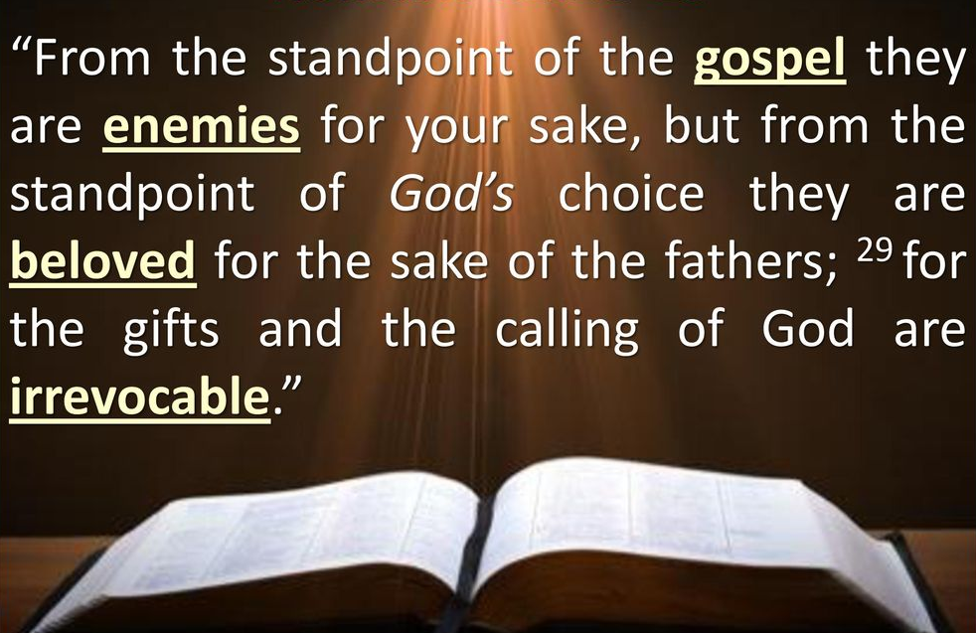
Romans 11:28 – 29

Slide 24
Romans 11:28 – 29
Here Paul summarized God’s dealings with Israel and with the Gentiles. In order for God to bring the gospel to Gentiles He had to deal with Israel corporately as enemies. Unfortunately, the great majority of Jews are enemies of the gospel and have rejected God’s grace.
But rather than judge them by their present condition, we Gentiles should first be thankful for the blessings we currently enjoy at their expense. In fact, we should honor them for their future role in God’s plan to redeem His creation.

Slide 25
Romans 11:28 – 29
But in relation to God’s choice (election) of Abraham and His covenant with him and the patriarchs, Israel is beloved. Because God chose Abraham, Isaac, and Jacob (cf. 9:6-13), He loves the nation and will carry through on His promises.
Israel must finally be saved corporately: God chose her. And the gifts and the calling of God are irrevocable (not repented of ). God does not revoke what He has given or whom He has chosen (“call” means election and salvation; cf. 8:30).

Slide 26
Romans 11:30 – 32
³⁰Just as you who were at one time disobedient to God have now received mercy as a result of their disobedience, ³¹so they too have now become disobedient in order that they too may now receive mercy as a result of God’s mercy to you. ³²For God has bound [concluded] everyone over to disobedience so that he may have mercy on them all.

Slide 27
Romans 11:30 – 32
Paul summarizes his teaching on the current disposition of the Jews in God’s plan using the word group translated “mercy” four times in three verses (11:30-32). The apostle rarely repeated himself, so this is remarkable.
The Greek noun “mercy” describes the unrelenting, inexplicable, overwhelming grace of God for His covenant people. The term is filled with emotion, referring to God’s inclination to relieve our misery.

Slide 28
Romans 11:30 – 32
Paul uses another word group four times in the same space. The Greek noun is translated “disobedience.” The literal meaning is “the condition of being un-persuadable” or “obstinate.”
Paul then alternates between these two terms to show how God used the disobedience of one group as a means of showing mercy to the other.

Slide 29
Romans 11:30 – 32
God will extend His grace to unbelieving Israel, just as He did to unbelieving Gentiles (cf. 5:8). Salvation, whether of Jews or Gentiles, flows from God’s mercy.
Though not the author of sin, God allowed man to pursue his sinful inclinations so that He could receive glory by demonstrating His grace and mercy to disobedient sinners (cf. Eph. 2:2 > “Wherein in time past ye walked according to the course of this world, according to the prince of the power of the air, the spirit that now works in the children of disobedience.”

Slide 30
Romans 11:30 – 32
God is surrounding us with our own sin and drawing the net closed to cut off any means of escape. Why? To give us grace!
Why would a holy God go to such great lengths to show such unmerited kindness to creatures who have not only rebelled but are resistant to grace? That is as nonsensical as grafting fruitless branches into a perfectly good olive tree. But such is the nature of grace. It cannot be explained, only received with gratitude as one in great need.

Slide 31
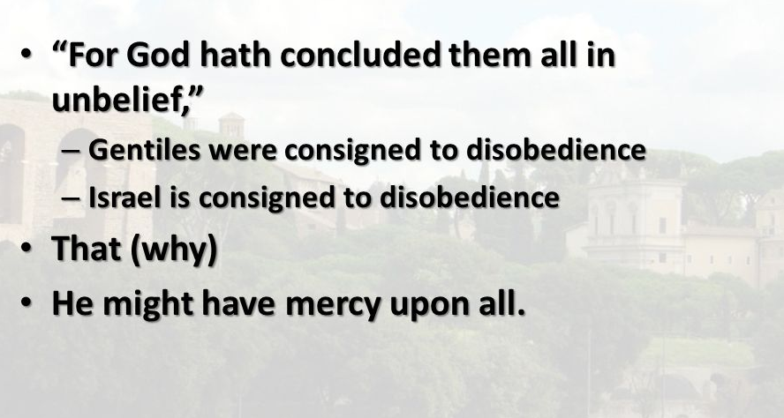
Romans 11:32

Slide 32
Romans 11:32
Man’s sin, manifested in his willful disobedience, provides a means for God to demonstrate the magnitude and graciousness of His mercy. Were there no disobedience, there would be no need for and there could be no expression of God’s mercy.
To reveal Himself as merciful, God permitted sin. He has shut up all—the whole world, Jew and Gentile—in disobedience and unbelief in order that He might show mercy to all who repent of their sin and turn to Him for gracious salvation.

Slide 33
Romans 11:32
In His sovereign omnipotence, God has allowed man intellectually, morally, and spiritually to fall into a state of sin to the extent that, on his own, man is unable to be convinced of God’s truth, specifically the truth that he is lost and condemned and that he is powerless in himself to change his condition.
God allowed man to fall into sin in order that his only hope would be divine mercy. It must be noted that this saving mercy is shown to all.

Slide 34
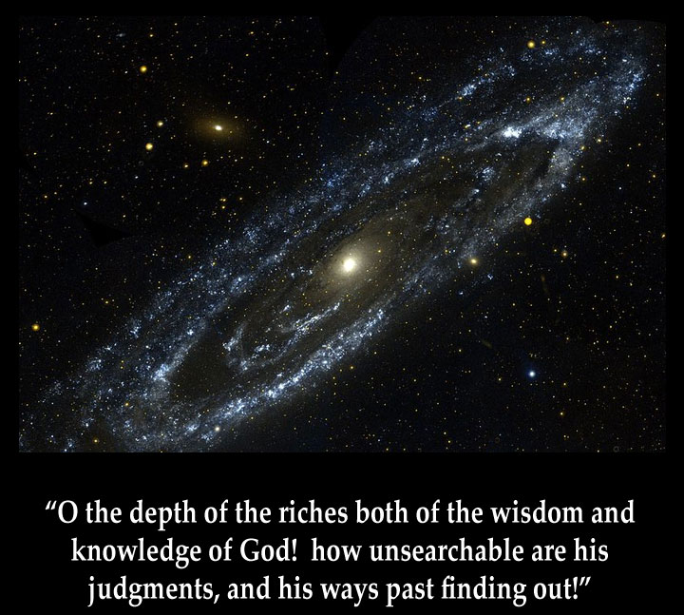
Romans 11:33

Slide 35
Romans 11:33
Reflecting on the unsearchable mercy of God prompted Paul to break forth in a doxology. Such inexplicable grace can only come from a God of infinitely deep goodness.
To praise his Creator, Paul searches his extensive vocabulary to find the right words. It was as if he were stringing verbal pearls onto a magnificent necklace of praise, selecting each one ever so carefully . . .

Slide 36
Romans 11:33
Paul bursts out with a marvelous doxology, in which he rejoices that God’s temporarily setting Israel aside glorifies His incomprehensibility. The full wonder of God’s gracious omnipotence is wholly beyond human understanding. It staggers even the most mature Christian mind, including Paul’s own mind . . . blown!
Having completed his argument and affirmed God’s sovereignty, integrity, and generosity, Paul has nothing more to add but a hymn of praise for the depth of the riches of God’s wisdom and knowledge.

Slide 37
Romans 11:33
This doxology is a fitting response not only to God’s future plans for Israel (chaps. 9–11), but to Paul’s entire discussion of justification by faith (chaps. 1–11).
As someone has remarked, “Theology becomes doxology!” Only a God as wise as our God could take the fall of Israel and turn it into salvation for the world! His plans will not be aborted nor will His purposes lack fulfillment. No human being can fully know the mind of the Lord; and the more we study His ways, the more we offer Him songs of praise.

Slide 38

Romans 11:34 – 35

Slide 39
Romans 11:34 – 35
Are we to conclude that God does not know what He is doing, and that the nation of Israel completely ruined His plans? Of course not! God is too wise to make plans that will not be fulfilled. Israel did not allow Him to rule, so He overruled!
The apostle then quoted Isaiah 40:13, which shows that God is the sole Designer of His wise plan. God has all knowledge and no one knows His mind or gives Him advice (counsel).

Slide 40
Romans 11:34 – 35
This is followed by a quotation from Job 41:11, which testifies to God’s sole responsibility for His acts.
God is indeed the Sovereign of all things, the One to whom all creatures are accountable and whom all should glorify.
God is under no obligation to repay anyone, for no one has ever given Him anything.

Slide 41
Romans 11:34 – 35
God is sovereign, self-sufficient, and free from any obligation except those He places on Himself. He owes the Jew nothing and the Gentile nothing
Therefore, to Him be the glory forever. Amen! God is the only proper One to magnify and glorify (1Cor. 1:31 > “He who glories, let him glory in the Lord.” ).
The all-sovereign God deserves the praise of all His creatures.

Slide 42

Romans 11:36

Slide 43
Romans 11:36
Paul concludes, for from Him and through Him and to Him are all things. God is the first Cause, the effective Cause, and the final Cause of everything. God’s deep ways are beyond man’s discovering (v33); beyond man’s knowing (v34a), beyond man’s counseling (v34b), and beyond man’s giving (v35).
After traversing all the great realities of salvation, Paul ends with an ascription of glory to his Lord. This simple doxology draws a clear line between the Christian doctrinal section and the final five chapters on Christian duty.

Slide 44
Review
of
Romans 9 – 11

Slide 45
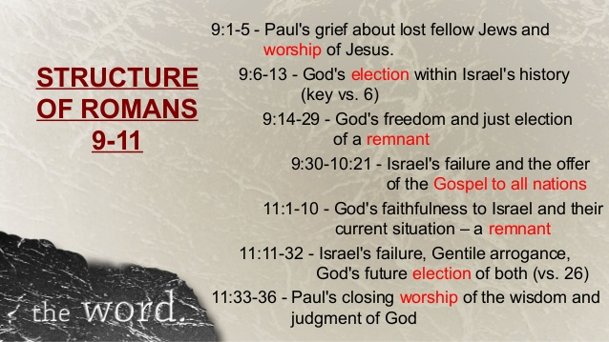

Slide 46



“I am the Savior of all, Jew and Gentile . . .”

Slide 47
NEXT CLASS – 8 September 2021
Book of Romans
Before next class, read the below chapter in the KJV and in one other versions of the Bible, i.e., NKJV, NRSV, NIV, CEV, etc …
Read the entire Book of Romans again.
Read Chapter 12 twice.
1st lesson: 12:1-8 “A Compelling Commitment”
2nd lesson: 12:9-21 “Christianity 101”

