Slide 1

A Compelling Commitment
Chapter 12:1 – 8
8 September 2021
Week 25

Slide 2


Slide 3
A Quick Review
of the
Book of Romans

Slide 4

Romans
Who wrote the book: Paul
Paul had never been to Rome when he wrote the letter to the Romans, though he had clearly expressed his desire to travel there in the near future.
The apostle greeted twenty-six different people by name, personalizing a letter from a man who would have been a personal stranger to most of the recipients.
No doubt they had heard of Paul and would have been honored by the letter, but Paul always took opportunities to personally connect with his audience so that the message of the gospel might be better received.

Slide 5
Romans
Where was Paul: Corinth
Paul wrote to the Romans from the Greek city of Corinth in AD 57, just three years after the 16-year-old Nero had ascended to the throne as Emperor of Rome.
The political situation in the capital had not yet deteriorated for the Roman Christians, as Nero wouldn’t begin his persecution of them until he made them scapegoats after the great Roman fire in AD 64.
Therefore, Paul wrote to a church that was experiencing a time of relative peace, but a church that he felt needed a strong dose of basic gospel doctrine.

Slide 6
Romans
Where was Paul: Corinth (cont.)
Writing from Corinth, Paul likely encountered a diverse array of people and practices—from grumpy sailors and meticulous tradesmen to wealthy idolaters and enslaved Christians.
The prominent Greek city was also a hotbed of sexual immorality and idol worship. So when Paul wrote in Romans about the sinfulness of humanity or the power of God’s grace to miraculously and completely change lives, he knew that of which he spoke.
Immorality and idolatry were played out before Paul’s eyes every day.

Slide 7
Romans
Why is Romans so important?
The letter to the Romans stands as the clearest and most systematic presentation of Christian doctrine in all the Scriptures. Paul began by discussing that which is most easily observable in the world—the sinfulness of all humanity.
All people have been condemned due to our rebellion against God. However, God in His grace offers us justification by faith in His Son, Jesus Christ.
When we are justified by God, we receive redemption, or salvation, because Christ’s blood covers our sin.

Slide 8
Romans
Why is Romans so important? (cont.)
But Paul made it clear that the believer’s pursuit of God doesn’t stop with salvation; it continues as each of us is sanctified—made holy—as we persist in following Him.
Paul’s treatment of these issues offers a logical and complete presentation of how a person can be saved from the penalty and power of his or her sin.

Slide 9
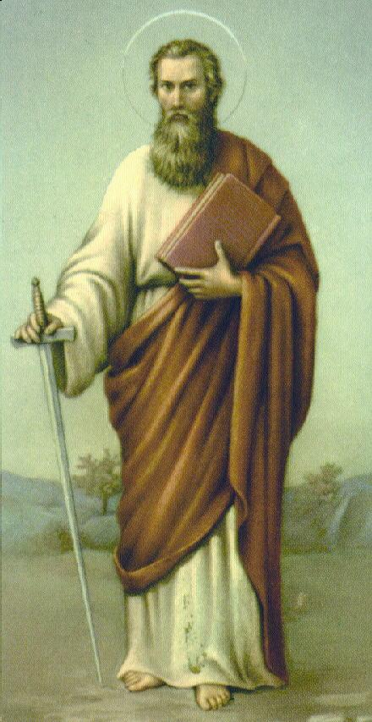
Romans
Outline (Chapter):
God’s righteousness and salvation: Christian Gospel (1 – 8): (doctrinal)
God’s righteousness and Israel: Christian Engrafted (9 – 11): (historical)
God’s righteousness and application: Christian Life (12 – 16): (practical)
Apostle Paul

Slide 10
Romans
Practical Application:
The Book of Romans makes it clear that there is nothing we can do to save ourselves. Every “good deed” we have ever done is as a filthy rag before God. So dead in our trespasses and sins are we that only the grace and mercy of God can save us.
God expressed that grace and mercy by sending His Son, Jesus Christ, to die on the cross in our place. When we turn our lives over to Christ, we are no longer controlled by our sin nature, but we are controlled by the Spirit.

Slide 11
Romans
Practical Application: (cont.)
If we make confession that Jesus is Lord, and believe that He is raised from the dead, we are saved, born again. We need to live our lives offered to God as a living sacrifice to Him.
Worship of the God who saved us should be our highest desire. Perhaps the best application of Romans would be to apply Romans 1:16-17 (Paul’s theme) and not be ashamed of the gospel.
Instead, let us all be faithful in proclaiming it!

Slide 12
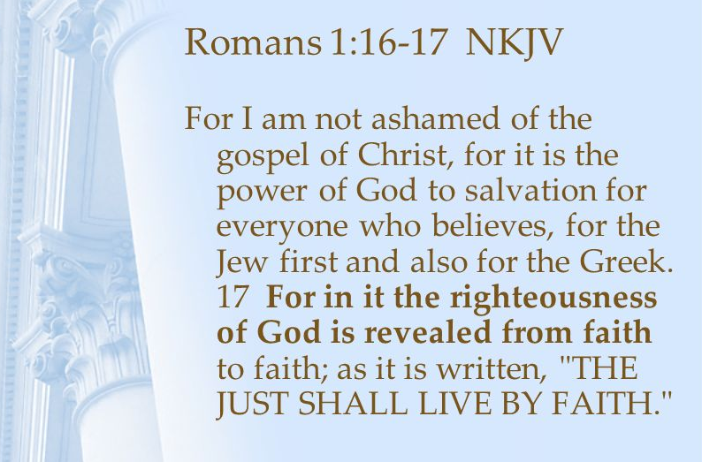
Paul’s primary theme running through the Book of Romans is the revelation of God’s righteousness in His plan for salvation, what the Bible calls the gospel:

Slide 13
Romans
Overview:
God’s Spirit will “quicken” (give life to) all who believe in Jesus, allowing us to “present [our] bodies a living sacrifice, holy, acceptable unto God” (12:1).
It is possible, with God’s help, to “be not overcome of evil, but [to] overcome evil with good” (12:21).
The Book of Romans may further be defined as:
  How the Gospel Saves (Ch 1 thru 8).
  How the Gospel Relates to Israel (Ch 9 thru 11).
  How the Gospel Affects Conduct (Ch 12 thru 16).

Slide 14
A Quick Review
of
Chapters 1 – 11

Slide 15
Romans
Overview: Paul shows . . .
How humanity lacks God’s righteousness because of our sin (1–3) . . .
How humanity receives God’s righteousness when God justifies us by faith (4–5) . . .
How humanity demonstrates God’s righteousness by being transformed from rebels to followers (6–8) . . .
How humanity confirms His righteousness when God saves the Jews and engrafts the Gentiles (9–11), and
How humanity applies His righteousness in practical ways throughout our daily lives (12–16).

Slide 16


Slide 17

Tonight’s focus . . .
“A Compelling Commitment”

Slide 18
Romans 12:1 – 8
From chapter 12 through the first part of chapter 15, Paul outlines how the Gospel transforms believers and the behavior that results from such a transformation.
This transformation is described as a “renewing of your mind” (12:2).
It is a transformation so radical that it amounts to “a transfiguration of the brain” . . . a “metanoia” or a mental revolution.

Slide 19
Romans 12:1 – 8
Before Paul started talking about the future fate of Israel (Ch 9-11), Paul was describing the “righteous stand of the believer.”
In Ch8, the believer discovers that his or her eternal destiny is secure: “There is therefore now no condemnation to them which are in Christ Jesus, who walk not after the flesh, but after the Spirit. ²For the law of the Spirit of life in Christ Jesus hath made me free from the law of sin and death” (8:1-2).

Slide 20
Romans 12:1 – 8
Each believer stands at a pivotal moment in his or her own history, at the intersection of grace.
There we are confronted with a compelling call in Paul’s incredible words: “I beseech you therefore, brethren, by the mercies of God, that ye present your bodies a living sacrifice, holy, acceptable unto God, which is your reasonable service. ²And be not conformed to this world: but be ye transformed by the renewing of your mind, that ye may prove what is that good, and acceptable, and perfect, will of God” (12:1-2).

Slide 21
Romans 12:1 – 8
These two verses represent God’s all-important call to consecration and transformation.
The first (8:1-2) is about the body, and the second (12:1-2) is about the mind.
The first concerns our surroundings and how we live in them; the second looks within to discover what goes on in our mind.

Slide 22
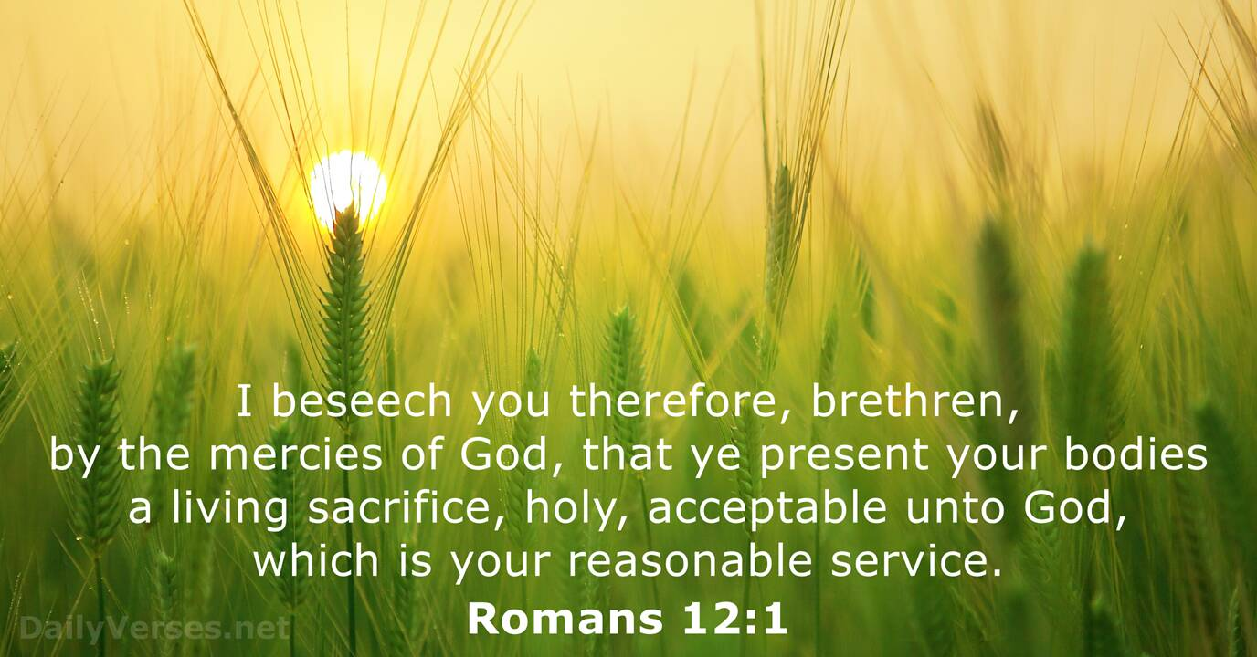
Romans 12:1

Slide 23
Romans 12:1
Paul begins this section with the idea that the Holy Spirit (The Paraclete) is standing alongside of us to provide counsel, courage, comfort, hope, and positive perspective.
Like a great encourager, the Holy Spirit challenges without condemning, instructs without lecturing, inspires without condescending, and helps us towards excellence.
Like a coach encouraging and challenging an athlete, Paul urges believers to consecrate themselves.

Slide 24
Romans 12:1
Consecration is a radical separation from a secular world view to adopt instead a Christ-like purpose and way of life.
This doesn’t automatically happen when someone becomes a believer in Christ. Good news, God has not left us alone. “By the mercies of God,” we learn that God is “merciful” above all.
That is, God stands ready to help us when we respond to His call of salvation.
Paul teaches that a consecrated life must be presented as a living sacrifice.

Slide 25
Romans 12:1
We can only present a consecrated physical body to God’s service. Keep in mind, anything presented to God must be “first-rate.” All sacrifices have to be without blemish or defect.
The believer’s consecrated body is to be . . .
  LIVING – a deliberate ongoing sacrifice given again and again over a lifetime.
  HOLY – an undefiled offering dedicated to the Lord and His purpose.
  ACCEPTABLE – a well-pleasing sacrifice in that it honors God’s character.

Slide 26
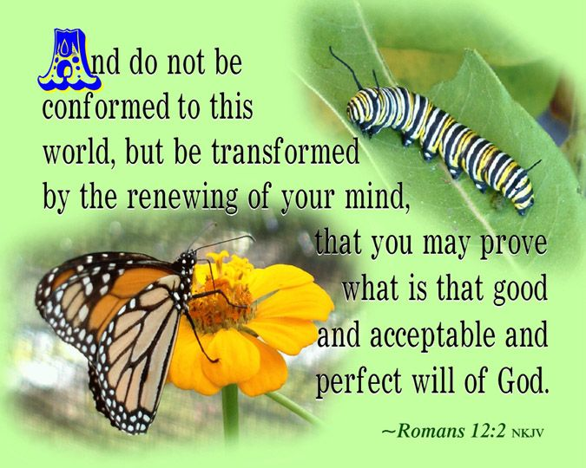
Romans 12:2

Slide 27
Romans 12:2
Paul then states general implications of a believer’s offering his or her life to God as a sacrifice. Such an offering represents a complete change in lifestyle, involving both a negative and a positive aspect.
FIRST [negative] – Paul commands, “Do not be conformed any longer to the pattern of this world (Age).”
Living according to the lifestyle of “the present evil Age” must now be put aside.

Slide 28
Romans 12:2
SECONDLY [positive] – Paul commands, “Keep on being transformed” by the renewing of your mind.” The Greek verb translated “transformed” is the English word “metamorphosis.” A total change from inside out.
The key to this change is the “mind.” The control center of one’s attitudes, thoughts, feelings, and actions.
As one’s mind keeps on being made new by the spiritual input of God’s Word, prayer, and Christian fellowship, his or her lifestyle keeps on being transformed.

Slide 29
Romans 12:2
That kind of transformation can occur only as the Holy Spirit changes our thinking through consistent study and meditation of Scripture.
The renewed mind is one saturated with and controlled by the Word of God. Then our life is “prove by testing” what God’s will is. For God’s will is good . . . acceptable . . . perfect.
As believers, who are transformed in mind and are made more like Christ, we comes to approve and desire God’s will, not our own will for our lives.

Slide 30
Romans 12:2
As believers, we will discover that God’s will is what is good for us, and that it pleases God, and is complete (acceptable and perfect) in every way.
Receiving the Will of God is all we need; it’s good for us. But only by being renewed spiritually can we ascertain, do, and enjoy the Will of God.

Slide 31
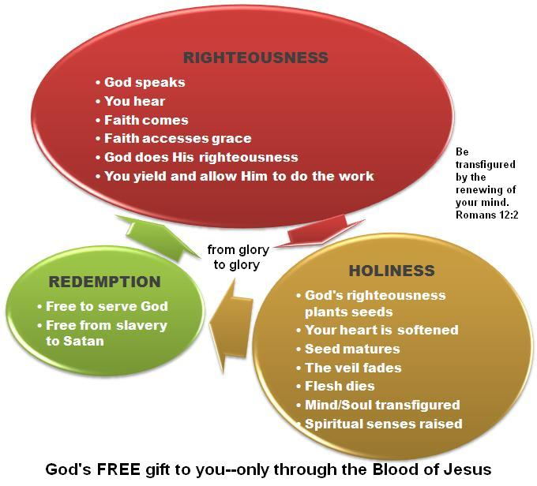

Slide 32
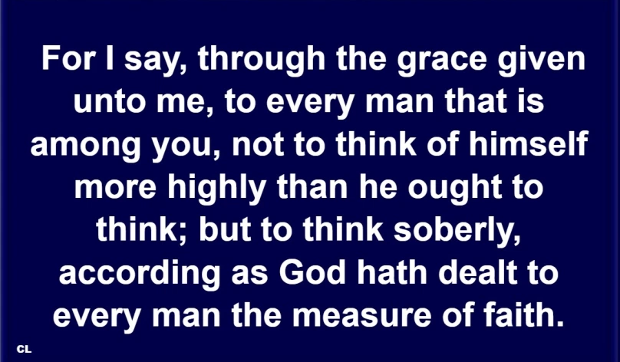
Romans 12:3

Slide 33
Romans 12:3
GRACE – Paul states, “through the grace given to me,” as a way of softening his confrontation with his readers. It also hint at transparency, suggesting that Paul considered himself to have been arrogant at one time in his life.
He was saying, in effect, “As one who once nurtured an exalted view of myself, let me give you some humble advice.”
MORE HIGHLY – As believers, we are to avoid thinking “too highly of ourselves,” and instead, we are to “exercise sound judgment.”

Slide 34
Romans 12:3
SOBERLY – The exercise of sound judgment, which will lead believers to recognize that in themselves they are nothing, and will yield the fruit of humility.
MEASURE OF FAITH – The correct proportion of the spiritual gift—or supernatural endowment and ability—the Holy Spirit gives each believer so they may fulfill their role in the body of Christ.
FAITH – This is not saving faith, but rather faithful stewardship, the kind and quantity required to use one’s own particular gift. Every believer receives the exact gift and resources needed.

Slide 35
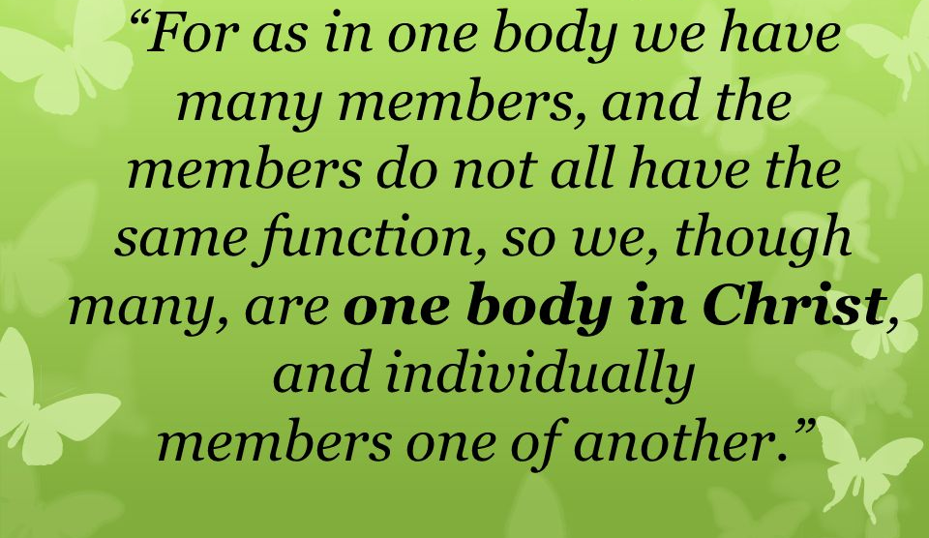
Romans 12:4 – 5

Slide 36
Romans 12:4 – 5
Here – Paul gives one of two NT passages (cf. 1Cor. 12:12–14) listing the general categories of spiritual gifts.
The emphasis in each list is not on believers’ identifying their gift perfectly, but on faithfully using the unique enablement God has given each.
Consider the phrase “many members … one body.” Just as in the natural body, God has sovereignly given the body of Christ a unified diversity.

Slide 37
Romans 12:4 – 5
The point is that each member functions to serve the body, not the body to serve the members. The diversity of the many accompanies the unity of the body.
Therefore it is important to think soundly about oneself and to evaluate properly God’s gifts and their uses.
Like the human body, each organ (member) must function properly. So it is with the body of Christ. There is no such thing as an unimportant or worthless believer (member), even though some functions are more public than others.

Slide 38


Slide 39
Romans 12:6 – 8
⁶Having then gifts differing according to the grace that is given to us, whether prophecy, let us prophesy according to the proportion of faith; ⁷Or ministry [serving], let us wait on our ministering: or he that teaches, on teaching; ⁸Or he that exhorts [encouraging], on exhortation: he that gives, let him do it with simplicity; he that rules, with diligence; he that shows mercy, with cheerfulness.

Slide 40
Romans 12:6 – 8
Now that we have a sensible view of ourselves in relation to God and fellow believers, we must consider our respective roles within the body – specifically, spiritual gifts (charisma).
These are supernatural abilities given by God to individuals that enable them to perform a function with ease and effectiveness.
Here – Paul list seven spiritual gifts . . .
1] prophecy, 2] service, 3] teaching, 4] exhortation, 5] giving, 6] leading, and 7] mercy.

Slide 41
Romans 12:6 – 8
PROPHECY
Prophesy with faith: In the NT, as in the Old, the prominent idea of prophecy is not prediction, but the inspired delivery of warning, exhortation, instruction, judging, and making manifest the secrets of the heart.
That is, prophesying – communicating God’s message, to strengthen, encourage, and comfort – is to be in right relationship to the body of truth already revealed. They speak as God’s “mouthpiece.”

Slide 42
Romans 12:6 – 8
MINISTRY
Be occupied with serving: Pau admonishes believers to “wait on” or “be occupied” by their gift, no matter the kind of service.
The idea of the word “diakonia” or servant is from the same Greek word as “deacon” and “deaconess.” It refers to those who serve.
This gift, similar to the gift of helps in 1Cor 12:28, has broad application to include every kind of practical help. Those with this gift rarely have to be told what is needed.

Slide 43
Romans 12:6 – 8
TEACHING
Be occupied with teaching: The ability to interpret, clarify, systematize, and explain God’s truth clearly.
Pastors must have the gift of teaching (1Tim. 3:2), but many mature, qualified laymen also have this gift.
This differs from preaching (prophecy), not in content, but in the unique skill for public proclamation.

Slide 44
Romans 12:6 – 8
EXHORTATION
Be occupied with encouraging: The gift which enables a believer to effectively call (urge) others to obey and follow God’s truth.
It may be used negatively to admonish and correct regarding sin (2Tim. 4:2 > “Preach the word; be instant in season, out of season; reprove, rebuke, exhort with all long suffering and doctrine.”
Or positively, to encourage, comfort, and unite believers behind a common endeavor – and to strengthen struggling believers.

Slide 45
Romans 12:6 – 8
GIVING
Give with simplicity (liberality): While all believers are instructed to be generous, these people look for opportunities to give, offering what they have beyond normal measure. This gift denotes the sacrificial sharing and giving of one’s resources and self to meet the needs of others.
Giving as simplicity (liberality), single-mindedness, and openhearted generosity. The believer who gives with a proper attitude of liberality does not do so for thanks and personal recognition, but to glorify God.

Slide 46
Romans 12:6 – 8
LEADING
Leading (ruling) with diligence: The word literally means “standing before.” Paul calls this gift “administrations” in 1Cor 12:28, a word that means “to guide” and is used of the person who steers a ship.
In the NT, this word “to lead” or “to care for” is used to describe leadership in the home and in the church with diligence or earnest purpose.
Again, the church’s leaders must exercise this gift, but it is certainly not limited to them.

Slide 47
Romans 12:6 – 8
MERCY
Show mercy with cheerfulness: Those with the gift of mercy exercise the extraordinary ability to sense the needs of those who are hurting and to know what to say, how to say it, and when to remain silent.
Frequently, this gift accompanies the gift of exhortation. The attitude of cheerfully showing mercy is crucial to ensure that the gift of mercy becomes a genuine help, not a discouraging pity with those who are suffering.

Slide 48
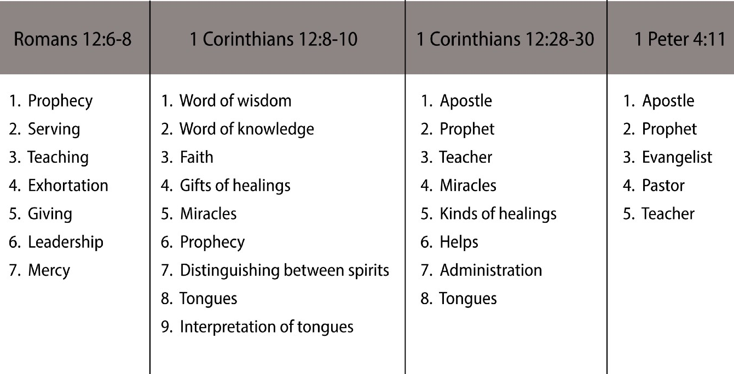
Eph. 4:11

Slide 49
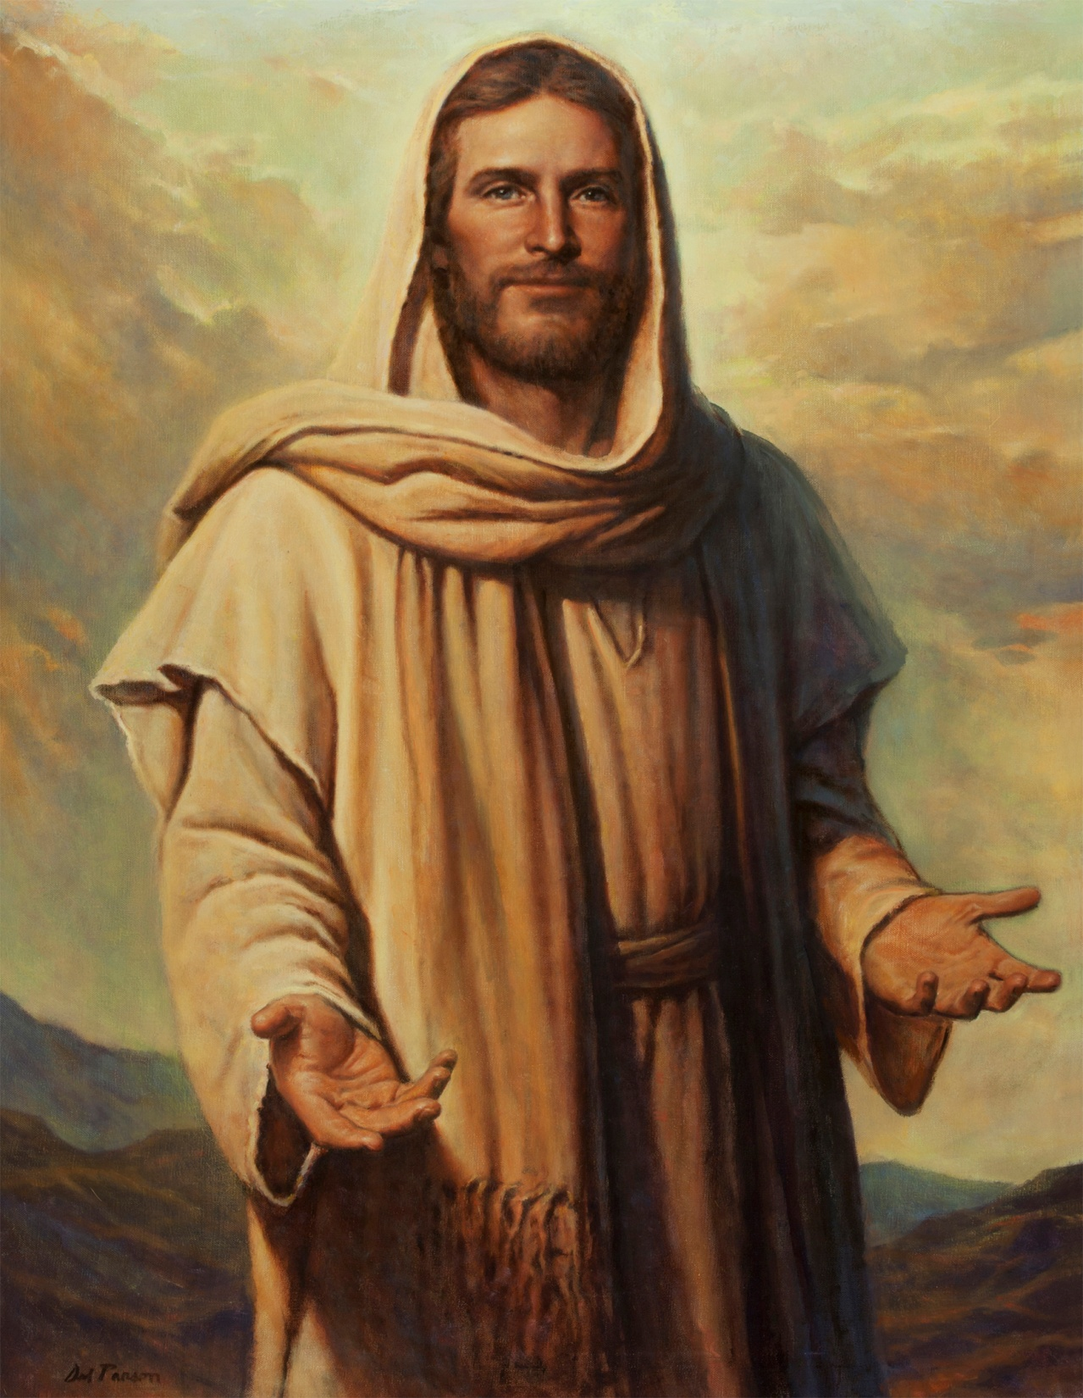
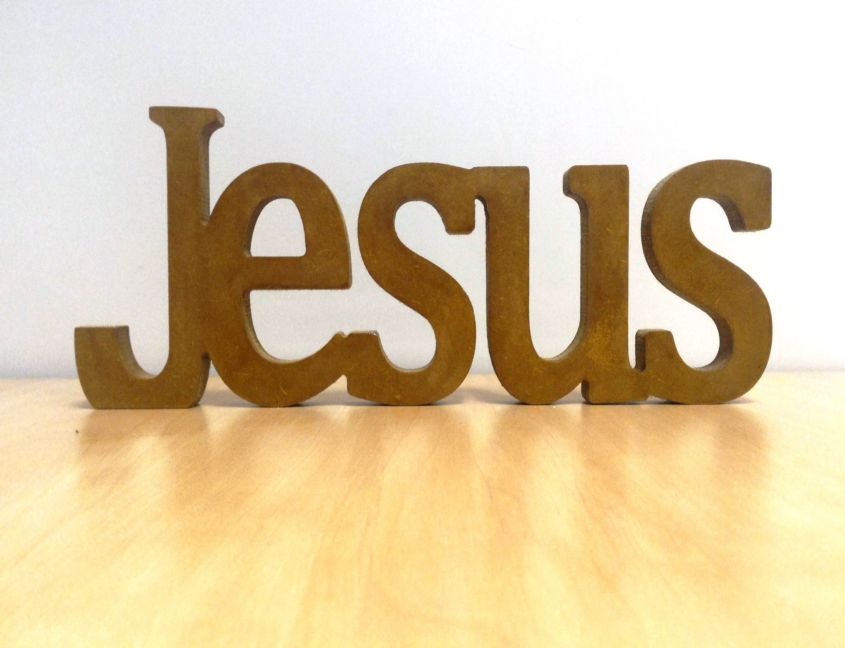

A Call to a Compelling Commitment

Slide 50
NEXT CLASS – 15 September 2021
Book of Romans
Before next class, read the below chapter in the KJV and in one other versions of the Bible, i.e., NKJV, NRSV, NIV, CEV, etc …
Read through Chapter 12 again.
2nd lesson: 12:9-21 “Christianity 101”

