Slide 1

Christianity 101
Chapter 12:9 – 21
15 September 2021
Week 26

Slide 2

Romans
Overview:
Ch12 – Paul urges his readers to make their bodies living sacrifices for the glory of God and the believer’s service.
Ch13 – Paul discusses the believer’s responsibilities toward society: to the rulers and the state.
Ch14 – Paul discusses the believer’s responsibilities toward those Christians who are weak in the faith.
Ch15 – Paul talks about how Christians should live in relation to others. He writes about his travel plans and prayers for his Roman audience.
Ch16 – In closing, Paul greets a few specific friends and gives some final instructions.

Slide 3
A Quick Overview
of
Chapters 12 – 16

Slide 4

Tonight’s focus . . .
“Christianity 101”

Slide 5
Romans 12:9 – 10
While 1Corinthians 13 is the most beautiful and most eloquent treaties on love, Romans 12:9-21 is the most succinct.
Here – Paul teaches us how to love others in practical, tangible ways that will fill the memories of those we love and teach them how to live well – hopefully even better than we have.

Slide 6


Slide 7
Romans 12:9 – 10
Paul began these specific exhortations with the key ingredient for success: Love must be sincere. “Sincere” translates the Greek word to mean “without hypocrisy.”
This is God’s love, which has been ministered to believers by the Holy Spirit (5:5) and must be ministered by them to others in the Holy Spirit’s power.
Paul provides the solution for dealing with others in a social relationship. As believers, we are to love and honor them with unhypocritical love (12:9–10).

Slide 8
Romans 12:9 – 10
Genuine love has two primary qualities: sincerity, the opposite of hypocrisy, and discernment, the opposite of gullibility.
That is, “love is unhypocritical.” If hypocrisy creeps in, love ceases to be love and becomes something grotesque – manipulation, quid pro quo, competition, pretense.
There’s no place for a mask; there’s no play acting; there’s no room to think one way and act another. That’s because love and truth go hand in hand.

Slide 9
Romans 12:9 – 10
This first command is followed by a pair of related basic commands—hate what is evil; cling to what is good. Turning from evil is to accompany adhering to the good.
EVIL is the antithesis of holiness and therefore the antithesis of godliness. The child of God abhors evil because God abhors evil.
EVIL is the enemy of God and the enemy of love, and it is to be as fervently abhorred as love is to be fervently coveted.

Slide 10
Romans 12:9 – 10
To “cling” means to be glued or bond together. As servants of Christ, we are to bind ourselves to what is good, that which is right and worthy.
GOOD: Paul proclaims, “Whatever is true, honorable, right, pure, lovely, whatever is of good repute. If there is any excellence and if anything worthy of praise, ﻿let your mind dwell on [cling to] these things﻿” (﻿Phil. 4:8﻿).
GOOD: As we separate ourselves from the things of the world and saturate ourselves with the Word of God, the things that are good will more and more replace the things that are evil.

Slide 11
Romans 12:9 – 10
Divine love is to be exercised with other believers. The Greek word translated devoted, suggests family affection. As in v9, the second clause in v10 can be understood as explaining the first command.
That is, v10 may be translated, “With brotherly love have family affection for one another, in honor giving place to one another.”
To show genuine appreciation and admiration for fellow believers by putting them first (cf. Phil. 2:3, “consider others better than yourselves”).

Slide 12
Romans 12:9 – 10
To be devoted to other Christians with a family sort of love, not based on personal attraction or desirability (cf. 1 Thess. 4:9, “But as touching brotherly love ye need not that I write unto you: for ye yourselves are taught of God to love one another”).
This quality is the primary way the world can recognize us as followers of Christ (cf. John 13:35, “By this shall all men know that ye are my disciples, if ye have love one to another”).

Slide 13
Romans 12:11 – 16
¹¹Not slothful in business; fervent in spirit; serving the Lord; ¹²Rejoicing in hope; patient in tribulation; continuing instant in prayer; ¹³Distributing to the necessity of saints; given to hospitality. ¹⁴Bless them which persecute you: bless, and curse not. ¹⁵Rejoice with them that do rejoice, and weep with them that weep.
¹⁶Be of the same mind one toward another. Mind not high things, but condescend to men of low estate. Be not wise in your own conceits.

Slide 14
Romans 12:11 – 16
In the rest of the chapter, Paul talks about a “life of love” and explains how love should manifest itself. It’s a tragic thing that the greatest grace of the Christian life is sometimes made a cloak for hypocrisy.
First, Paul tells believers how to love within the church (12:11-16), and
Secondly, Paul tells believers how to love outside the church (12:17-21).

Slide 15
Romans 12:11 – 16
Paul tells believers how to love in the church . . .
Show them your zeal and joy (12:11–12).
Share with them (12:13).
Mourn and weep with them (12:15).
Live in harmony with them (12:16).

Slide 16
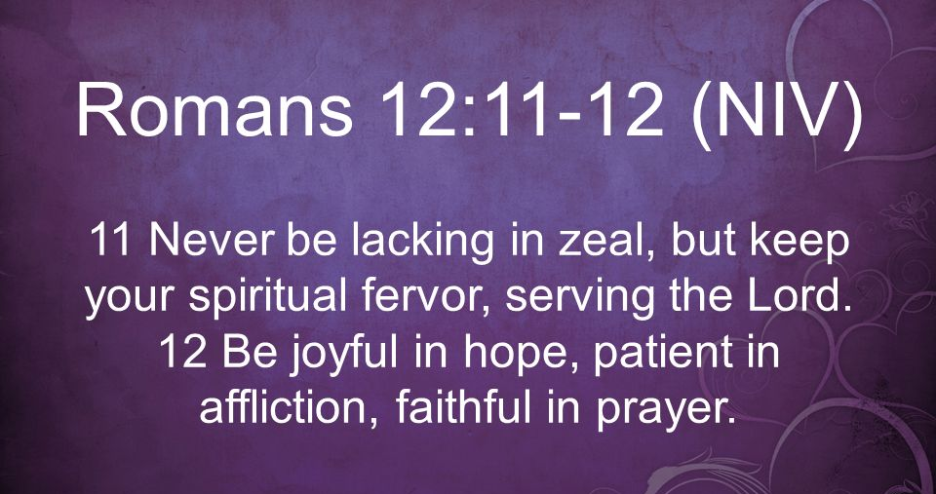

Slide 17
Romans 12:11 – 12
Paul tells believers how to love in the church . . .
Show them your zeal and joy (12:11–12).
Whatever is worth doing in the Christian life is valuable enough to be done with enthusiasm and care. Sloth and indifference not only prevent good, but allow evil to prosper.
Fervent in spirit means “to boil in spirit.” This phrase suggests having plenty of heat to produce adequate, productive energy, but not so much heat that one goes out of control.

Slide 18


Slide 19
Romans 12:11 – 12
Paul tells believers how to love in the church . . .
Show them your zeal and joy (12:11–12).
Believers are to be joyful in hope, because their hope in Christ is the basis of their rejoicing.
In affliction (distress, trouble, pressure), believers are to be patient which means, “being steadfast, having endurance.”
Believers should continue steadfastly in prayer to God for wisdom, guidance, and strength.

Slide 20


Slide 21
Romans 12:13
Paul tells believers how to love in the church . . .
Share with them (12:13).
Distributing – from a word that means commonality, partnership, or mutual sharing, which is often translated fellowship, and communion.
Hospitality – In NT times, travel was dangerous and inns were evil, scarce, and expensive. So the early believers often opened their homes to travelers, especially to fellow believers.

Slide 22


Slide 23
Romans 12:15
Paul tells believers how to love in the church . . .
Mourn and weep with them (12:15).
Christians are to be glad in the blessings, honor, and welfare of others—no matter what one’s own situation, and to be sensitive or compassionate to the hardships and sorrows of others.
Sympathetic involvement with the joys and sorrows of fellow-believers is a hallmark of sincere love for the brothers and sisters of Christ.

Slide 24
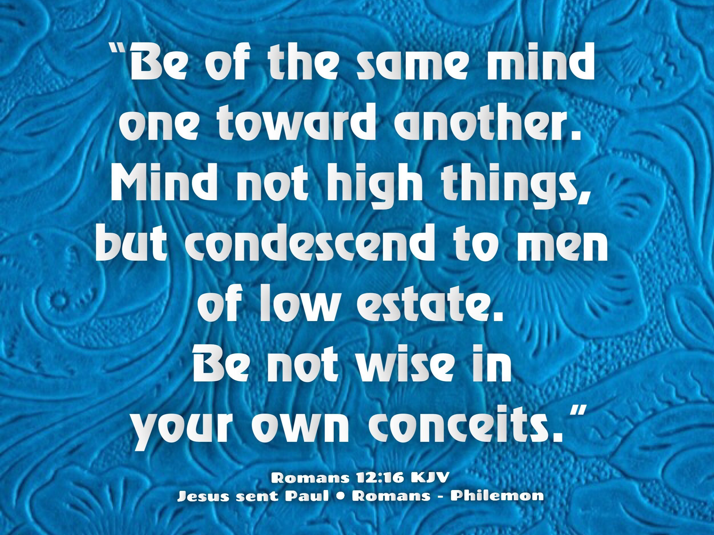

Slide 25
Romans 12:16
Paul tells believers how to love in the church . . .
Live in harmony with them (12:16) means, “having the same attitude toward one another.” That is, to be impartial. Being in harmony with other Christians is basic to being able to empathize with them. Christians are not to have conceit or feelings of superiority toward fellow believers.
Do not become wise concerning yourselves, an attitude that makes empathy impossible. Love will not manifest itself in refusing to associate with those of a lower estate.

Slide 26
Romans 12:17 – 21
¹⁷Recompense to no man evil for evil. Provide things honest in the sight of all men. ¹⁸If it be possible, as much as lies in you, live peaceably with all men. ¹⁹Dearly beloved, avenge not yourselves, but rather give place unto wrath: for it is written, Vengeance is mine; I will repay, saith the Lord. ²⁰Therefore if thine enemy hunger, feed him; if he thirst, give him drink: for in so doing thou shalt heap coals of fire on his head. ²¹Be not overcome of evil, but overcome evil with good.

Slide 27
Romans 12:17 – 21
Paul tells us how to love outside the church . . .
In this section, Paul’s exhortations relate to a believer’s reactions to the actions and emotions of others, whether Christians or not.
Bless them when they persecute you (12:14).
Let God repay them for the evil done to you (12:17–19).
Give them food when they are hungry and water when they are thirsty (12:20–21).

Slide 28
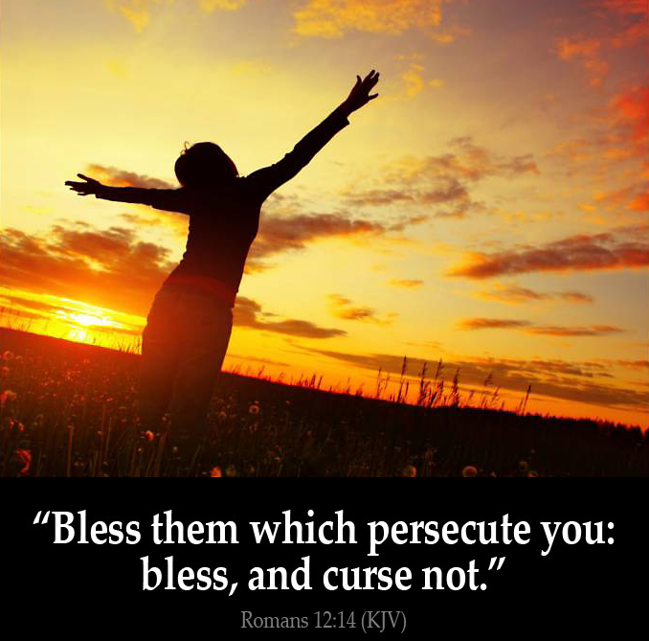

Slide 29
Romans 12:14
Paul tells us how to love outside the church . . .
Bless them when they persecute you (12:14).
The hatred displayed in persecution usually evokes response in kind, but Paul commanded, “Bless those who persecute you; bless and do not curse.” This is taken from the Sermon on the Mount (cf. Matt. 5:44).
That is, as Christians, we should refrain from asking God to curse those who persecute us. Instead, we are commanded to treat our enemies as if they were our friends.

Slide 30
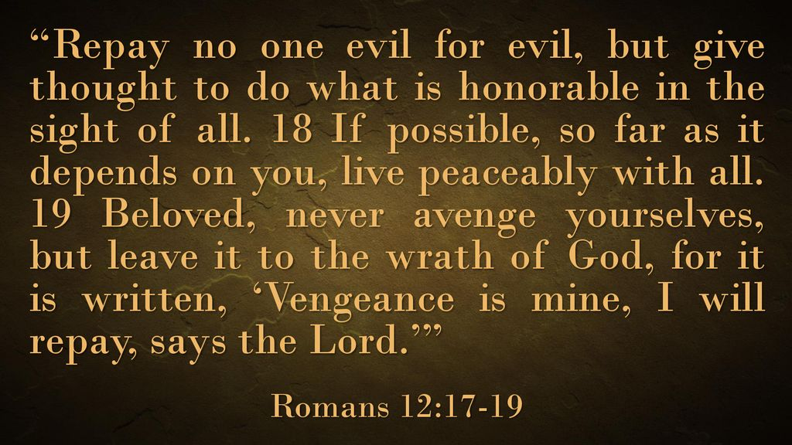

Slide 31
Romans 12:17 – 19
Paul tells us how to love outside the church . . .
Let God repay them for the evil done to you (12:17–19).
The OT principle of justice was “eye for eye” (Exodus 21:24), but Paul commanded, Do not repay anyone evil for evil.
Christians are to respect what is intrinsically proper and honest. “Good, noble, and honorable” also carries the idea of visibly and obviously having the right behavior when they are around others, especially unbelievers.

Slide 32


Slide 33
Romans 12:17 – 19
Paul tells us how to love outside the church . . .
If it is possible. Although we should do everything possible to be at peace with others, it will not always come, because it also depends on others’ attitudes and responses.
Harmony with others may not always be achievable, but believers should not be responsible for that lack of peace (cf. Matt. 5:9).

Slide 34

Romans 12:19

Slide 35
Romans 12:17 – 19
Paul tells us how to love outside the church . . .
Paul then exhorted believers not to take revenge after they are misused. Instead they should leave room for God’s wrath, because God has promised to avenge His people: “It is Mine to avenge, I will repay” (Deut. 32:35).
In the Bible “vengeance” [divine retribution] is a judicial function. It is justice, not revenge. It is punishment of sin. But don’t suppose vengeance is ours to mete out. It is God’s prerogative alone.

Slide 36


Slide 37
Romans 12:20 – 21
Paul tells us how to love outside the church . . .
Give them food when they are hungry and water when they are thirsty (12:20–21).
Here, Paul reminds us of Christ’s words from the Sermon on the Mount. These words are easy to read but difficult to practice. Surely we need to pray and ask God for love as we try to show kindness to our enemies.
As Christians, we should feed our enemy and quench his thirst—in short, respond to his evil with Christian love.

Slide 38
Romans 12:20 – 21
Paul tells us how to love outside the church . . .
Paul referred to Proverbs 25:21–22 as he urged us to return good for evil in the name of the Lord.
The “coals of fire” refer to an ancient Egyptian custom in which a person who wanted to show public contrition carried a pan of burning coals on his head. The coals represented the burning pain of his shame and guilt our enemies will experience when we return good for evil.

Slide 39


Slide 40
Romans 12:20 – 21
Paul tells us how to love outside the church . . .
A children of God, we must live on the highest level—returning good for evil.
Anyone can return good for good and evil for evil. The only way to overcome evil is with good. If we return evil for evil, we only add fuel to the fire.
And even if our enemy is not converted, we have still experienced the love of God in our own hearts and have grown in grace.

Slide 41
Romans 12:20 – 21
Paul tells us how to love outside the church . . .
A climate of love is absolutely basic to the church of Jesus Christ. Without such caring, and reaching out to touch one another’s lives, the church will fall tragically short of God’s intended experience of His “good, and acceptable (pleasing), and perfect will” (12:2).
Here, Paul’s summary statement on the issue of retaliation could be a mission statement for what we might call “the master plan of salvation.”

Slide 42
Romans 12:20 – 21
Paul tells us how to love outside the church . . .
God’s ultimate purpose is to reclaim His creation from the control of evil, supernaturally transform it, and bring it back under the control of His righteousness.
In other words, God will overcome the world’s evil with His good. In following the command of Christ to “bless and not curse” (Matt 5:44) and by returning good for evil, we do as God does, and we become active participants in His great plan for the world.

Slide 43



A Call to Authentic Love

Slide 44
NEXT CLASS – 22 September 2021
Book of Romans
Before next class, read the below chapter in the KJV and in one other versions of the Bible, i.e., NKJV, NRSV, NIV, CEV, etc …
Read Chapter 13 again.
1st lesson: 13:1 – 7 “How to be a Godly Rebel”
2nd lesson: 13:8 –14 “Wake Up and Get Dressed”

