Slide 1

How to be a Godly Rebel
Chapter 13:1 – 7
22 September 2021
Week 27

Slide 2


Slide 3

Romans 13:1
Christians have been called out of this world, (John 15:18 > “If the world hate you, ye know that it hated me before it hated you”), but they still have responsibilities to the state.
The best citizen ought to be the Christian citizen. Though the church is not to get involved in party politics, individual believers certainly should use their God-given privileges as citizens to see to it that the best leaders are elected and the best laws are enacted and enforced justly.

Slide 4
Romans 13:1
When we think of godly leaders like Joseph, Daniel, and Esther, who were able to exercise spiritual ministries in pagan governments, we can see what the Spirit can do through the dedicated believer.
In this chapter, Paul gives us four motives for obeying human government:
For Wrath’s Sake (1 – 4)
For Conscience’s Sake (5 – 7)
For Love’s Sake (8 – 10)
For the Savior’s Sake (11 – 14)

Slide 5

Tonight’s focus . . .
“How to be a Godly Rebel”

Slide 6
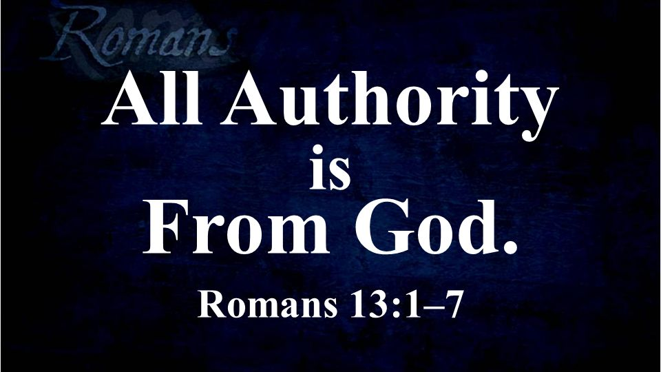

Slide 7
Romans 13:1 – 7
Rome was the imperial capital, the seat of the empire’s civil government. As residents in Rome, Paul’s initial readers were aware of both the glory and the shame of that city in the days of Nero, who reigned from A.D. 54 to 68.
But they were also citizens of Christ’s kingdom (cf. Phil. 3:20; Col. 1:13). Appropriately, Paul discusses a Christian’s relationship to his government and civil rulers.
In its length and specific details, this Chapter 13 discussion is the key NT passage on the subject.

Slide 8
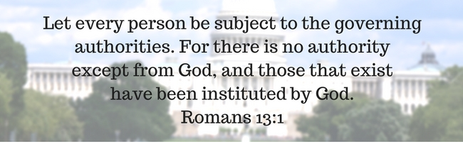
Romans 13:1

Slide 9
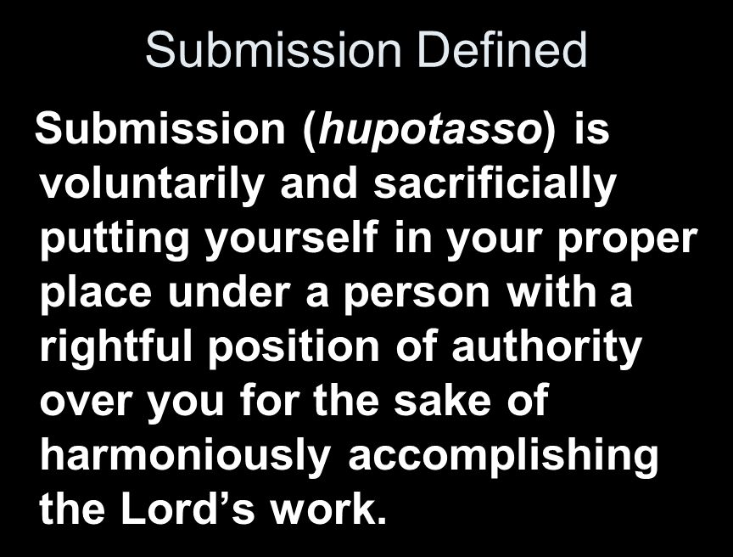

Slide 10
Romans 13:1
An important aspect of what Swindoll calls “horizontal grace” is responsible citizenship. Paul commands the Roman church (and every believer) to subject themselves to governing authorities. The word “subject” means submission to the wishes of another.
Furthermore, submitting to these authorities are part and parcel of a world system that rewards evil and opposes the righteousness of God.
So, isn’t obeying them tantamount to opposing God’s order?

Slide 11
Romans 13:1
Not necessarily. Paul explains further that while the world has rebelled and an evil world system reigns over us, God remains in control.
All earthly authorities are given a limited amount of autonomy and, while they frequently behave poorly, the Lord uses them to “establish” or
accomplish His purpose nonetheless.
Therefore, as a general rule, we should not subvert these governing authorities.

Slide 12
Romans 13:1
Paul then gives three reasons:
  Earthly authorities are agents of law and order (13:1).
  Civil obedience allows us to fear God, not people (13:2-4).
  Civil obedience allows us to live above reproach (13:5-6).

Slide 13
Romans 13:1
Earthly authorities are agents of law and order:
After God created the world, He filled it, organized it, and gave purpose to each created thing.
When governments establish laws and prosecute justice, they honor God’s created order, even when they don’t do it perfectly.
Anarchy, on the other hand, is bad for everyone.

Slide 14
Romans 13:1
Earthly authorities are agents of law and order:
Therefore, governments serve the purposes of God, whether they mean to or not.
They form and thrive with God’s permission, and they cease to exist when they no longer serve His plan.

Slide 15


Slide 16
Romans 13:2 – 4
²Consequently, whoever rebels against the authority is rebelling against what God has instituted, and those who do so will bring judgment on themselves. ³For rulers hold no terror for those who do right, but for those who do wrong. Do you want to be free from fear of the one in authority? Then do what is right and you will be commended. ⁴For the one in authority is God’s servant for your good. But if you do wrong, be afraid, for rulers do not bear the sword for no reason. They are God’s servants, agents of wrath to bring punishment on the wrongdoer.

Slide 17
Romans 13:2 – 4
Civil obedience allow us to fear God, not people:
To put ourselves at odds with a government is to oppose God’s instrument of justice – generally speaking. (There are rare exceptions to this rule.)
All governments, even cruel totalitarian regimes, want their citizens to live peacefully, remain productive, and cause no trouble.
The only people who really need to fear are those who are doing something wrong. If you want to live without fear, then do what is good.

Slide 18
Romans 13:2 – 4
Civil obedience allow us to fear God, not people:
Obey the laws, pay your taxes, stop at red lights, don’t take advantage of your neighbor’s property, don’t invade their privacy, don’t rob banks.
In addition, if we do what is right, we will gain a good reputation with those in authority.
The benefit of living without fear of the government is twofold. First, it frees us to fear God – that is , to respect His authority and to do right because it pleases Him. Second, it frees us to serve God more freely than if we are in prison.

Slide 19


Slide 20
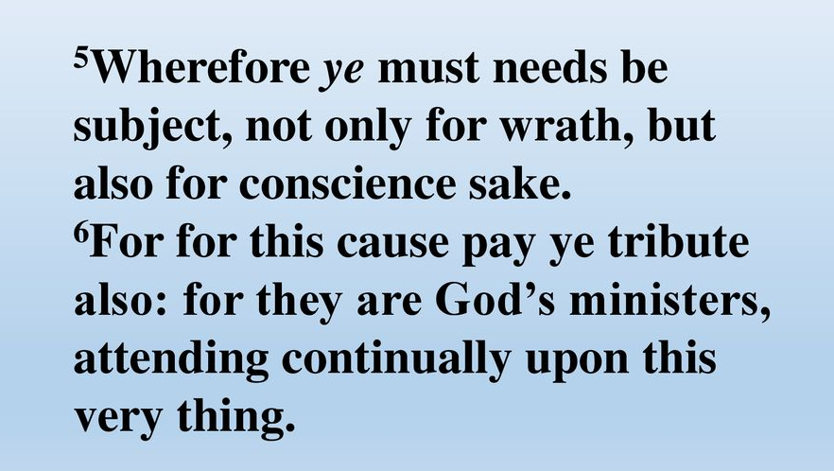
Romans 13:5 – 6

Slide 21
Romans 13:5 – 6
Civil obedience allow us to live above reproach:
The motivation for Christians to behave well and obey laws is not merely to avoid being caught and punished, but to satisfy our own conscience.
Presumably, the Christian conscience is the product of the Holy Spirit’s transformation.
So, again, to obey civil law is to submit to God.

Slide 22
Romans 13:5 – 6
Civil obedience allow us to live above reproach:
Jewish Christians would have struggled with the issue of paying taxes to a pagan government not because of greed but from a desire to remain holy.
Jews commonly understood taxes paid to Caesar as money taken from God (cf. Matt. 22:17-22).

Slide 23
Romans 13:5 – 6
Civil obedience allow us to live above reproach:
Paul merely regards paying taxes to be a contribution to the common good, which God encouraged even during the Exile: “Seek the welfare of the city where I have sent you into exile, and pray to the Lord on its behalf; for in its welfare you will have welfare” (Jer. 29:7).
Furthermore, because the magistrates serve with God’s permission, paying their salaries serves God’s interests.

Slide 24

Romans 13:7

Slide 25
Romans 13:7
Paul’s summary statement encourages Christians to live respectfully and honorably in the eyes of the government, fulfilling all requirements and meeting all obligations.
Note that our debt to government includes more than mere taxes and tolls (money); we also owe respect, which Paul describes as “fear” and “honor.”
The apostle is simply applying an earlier principle to our relationship with government: “So far as it depends on you, be at peace with all men” (12:18)

Slide 26
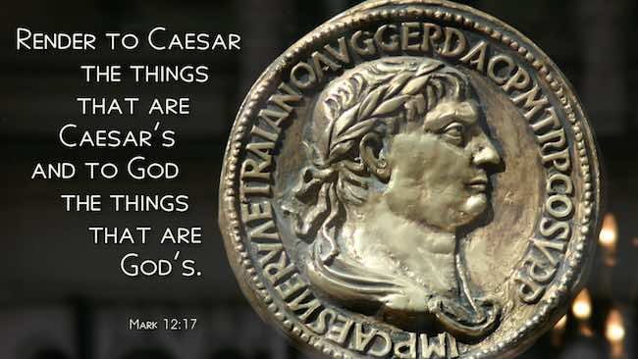
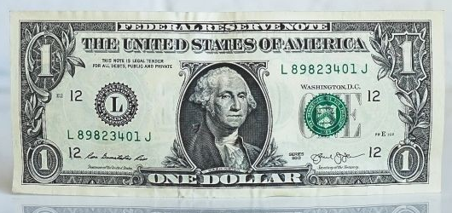
Romans 13:7
As we fulfill all the requirements of good citizenship, we cast Jesus Christ in a positive light and, perhaps, create opportunities to share the good news with greater freedom.

Slide 27
Romans 13:7
Paul understood that the question of obedience to worldly authorities can be thorny for the Christian. He sympathized with the fact that we obey a heavenly King—which most governments do not recognize and frequently oppose—yet we must “be at peace with all men” (12:18), including those in authority.
We must cooperate with the demands of government while peacefully trying to infiltrate it with the Good News.
Put simply, we must learn how to become godly rebels.

Slide 28



A Call to Authentic Love

Slide 29
NEXT CLASS – 29 September 2021
Book of Romans
Before next class, read the below chapter in the KJV and in one other versions of the Bible, i.e., NKJV, NRSV, NIV, CEV, etc …
Read Chapter 13 again.
2nd lesson: 13:8 –14 “Wake Up and Get Dressed”

