Slide 1

Putting Grace into Action
Chapter 14:1 – 12
6 October 2021
Week 29

Slide 2

Romans 14:1 – 23
On the eve of His crucifixion, Jesus bowed His head and prayed for His followers. Clearly, our unity was on Christ’s mind as he offered up His prayer. However, “unity” does not mean “uniformity.” People often confuse them. While we are called to be one—to work together, to serve together—we cannot ignore the fact that we are all different.
Each one of us bears unique DNA. Furthermore, each one of us has been shaped by utterly unique circumstances. We have different viewpoints, different opinions, different preference, and different ways of solving problems.

Slide 3
Romans 14:1 – 23
We each come to the community of faith with our own set of convictions and prejudices, some of which we are willing to defend to the death. Nevertheless, God expects us to coexist in unity and harmony. But that has rarely occurred.
Turn to any page in the chronicles of the church and you will find conflict. Yes, even the first-century Christians struggled to maintain unity the same as we do today.
Paul wrote to the believers in Corinth because the congregation was on the verge of imploding. Open sin scandalized the church.

Slide 4
Romans 14:1 – 23
While in other gatherings, legalism put a stranglehold on the body of believers. False accusations from outside the congregation fueled false teaching from within.
Some factions favored Paul, while others favored Peter or Apollos (1Cor 1:12), and theological debates between the groups kept the church in continual turmoil.
In other churches, Alexander the coppersmith relentlessly opposed Paul (2Tim 4:14), Diotrephes usurped John’s apostolic authority (3John 1:9-10).

Slide 5
Romans 14:1 – 23
Paul had to oppose Peter for his hypocritical treatment of Gentile Christians in the presence of others Jews (Gal 2:11-14).
The apostle even found himself in angry disagreement with Barnabas, of all people, so that the two had to part ways, never to work together again (Acts 15:39).
If the apostle struggled with conflict, certainly we will too. That’s not to say that all disagreement is necessarily evil. In fact, differences of opinion can become a great advantage to the body.

Slide 6
Romans 14:1 – 23
The same can be said of most differences. It’s all a matter of how they are handled. With patience, the right perspective, good communication, and plenty of grace to keep all the moving parts well-oiled, unity isn’t difficult to achieve.
In fact, achieving unity happens because, through the Holy Spirit, we are “putting grace into action.” And it is grace that has taught us how to “disagree without being disagreeable.”

Slide 7
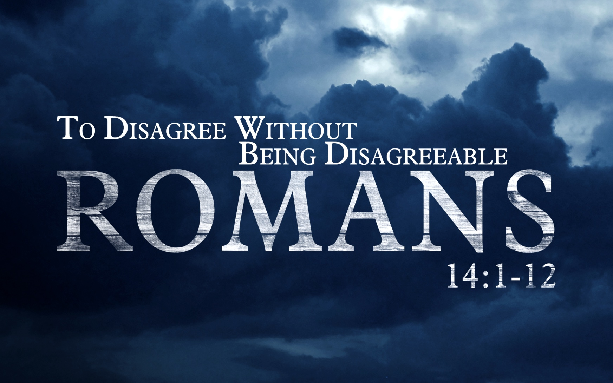

Slide 8

Tonight’s focus . . .
“Putting Grace into Action”

Slide 9
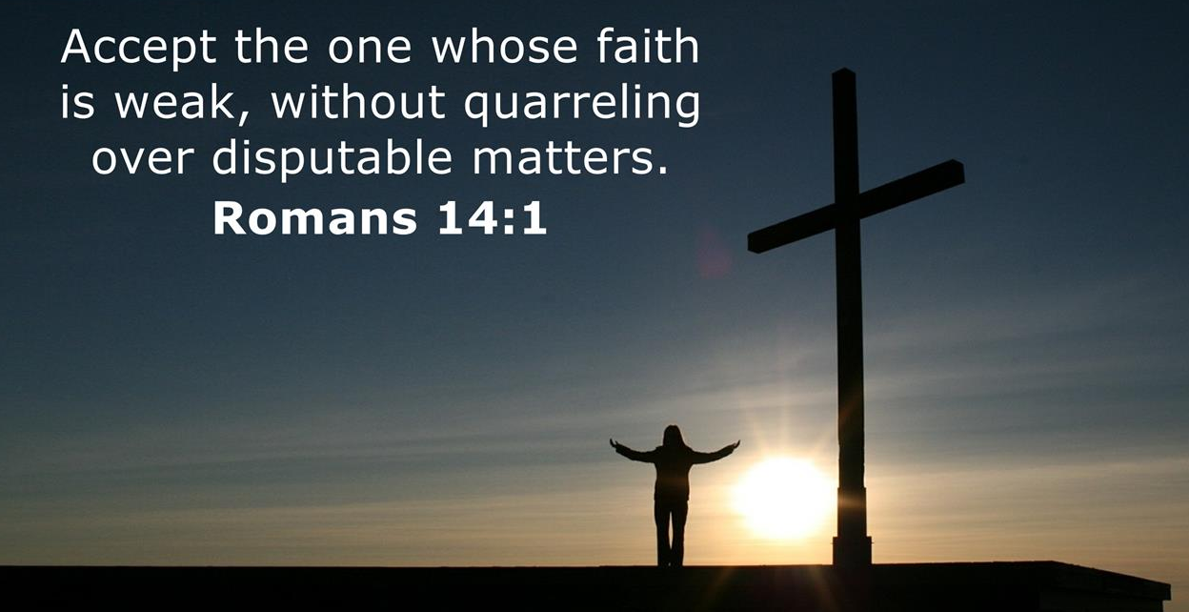
Romans 14:1

Slide 10
Romans 14:1
Paul recognized that differences can lead to disunity and disharmony if not addressed. So, he chose to focus on two hot-button issues in the Roman church: diet and days.
Initially, he noted that some issues had the capacity to divide people into two groups. Some people he called “weak in faith.” The idea behind the term “weak” is “feeble or frail.”
The “strong” (15:1) are to accept (welcome) or “receive to themselves” those who struggle to walk on wobbly legs of faith.

Slide 11
Romans 14:1
The purpose for receiving them is to make them welcome, to accept them without changing them or their opinions. The word translated “quarreling, arguing, or passing judgment” means “to judge.”
The idea of the word “judge” means “to distinguish between person” or “to discern the relative value of someone. In other words, the weak in faith must be accepted unconditionally, just as they are; without passing judgment or quarreling with him.

Slide 12
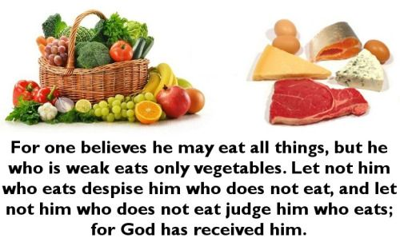
Romans 14:2 – 3

Slide 13

Romans 14:2 – 3

Slide 14
Romans 14:2 – 3
The church in Rome experienced many of the same tensions that nagged Corinth, Ephesus, and other cosmopolitan cities. Jews traditionally kept to themselves, and Gentile pagans didn’t much like Jews.
As fellow Christians, believers from both cultures had a lot of history and long-standing preferences to overcome in order to live in harmony. Jewish believers did not cease to be ethnically and culturally Hebrew, and they saw no reason to set aside their dietary customs.

Slide 15
Romans 14:2 – 3
Jesus had declared all foods “clean” (Mark 7:19) and had removed the restrictions on Jew-Gentile relations (Acts 10), but Jews were free to continue their special diet.
Nevertheless, Paul warned that dietary preferences offer no justification for feeling superior to others who eat freely.
Without identifying any specific group, Paul described meat-avoiders as “weak in faith.” Strong faith realizes that spirituality is not a matter of do’s and don’ts, but of loving and serving God while enjoying His good gifts.

Slide 16
Romans 14:2 – 3
We would be wrong to see the term as derogatory, however. We are all “weak”—feeble and frail—in one way or another.
Therefore, Paul commands each side to treat the other with understanding, compassion, and tenderness. It is our relationships, not whether we eat meat or only vegetables, that God cares about.
The “weak” needed to be strengthened, and the strong needed to be considerate in the exercise of their freedom. The same is true today!

Slide 17
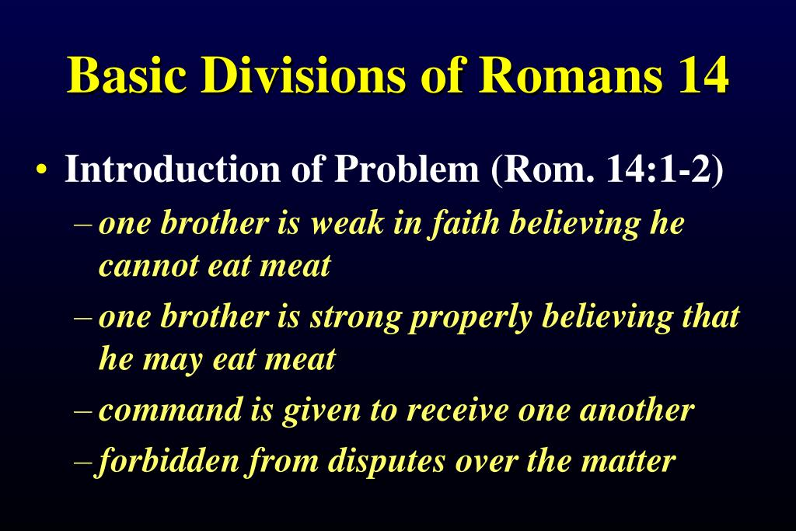
Romans 14:2 – 3

Slide 18
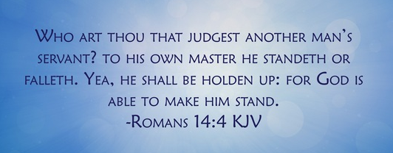
Romans 14:4

Slide 19
Romans 14:4
Paul quickly points to the core issue: accountability. To put Paul’s question in modern terms, “Who are you to review the performance of someone else’s employee?”
It’s important to note that Paul’s question is asked in the context of nonessential matters. Paul expresses his outrage with the believers in Corinth because they tolerated the outright sin of a man who had been sleeping with his father’s wife. He commanded them, “Remove the wicked man from among yourselves” (1Cor 5:13).

Slide 20
Romans 14:4
Matters about which there is no clear scriptural teaching are morally neutral. They might be unwise, but they are not sin.
Paul’s use of the verb “stand” is one of his favorite expressions. It means to be in good standing, confidently and resolutely doing as one should and receiving favor as a reward (1Cor16:13).
Obviously, to “fall” is to do the opposite. This has nothing to do with the final judgment; it has everything to do with God’s favor and whether one deserves chastisement.

Slide 21
Romans 14:4
When it comes to morally neutral matters, only God has the right to evaluate the soul and judge the deeds of another believer.
If God is not pleased with the conduct of His servant, He will address the issue in such a way as to continue the believer’s transformation.

Slide 22
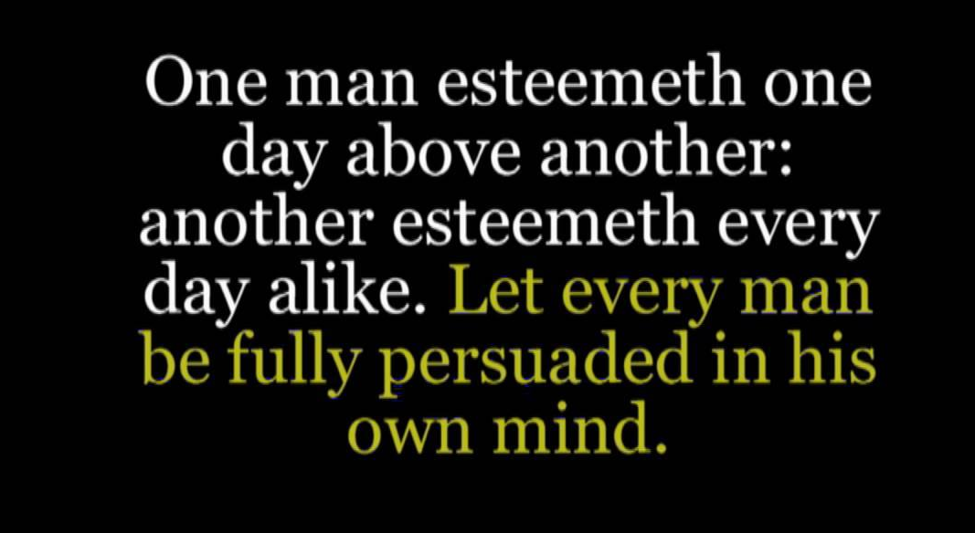
Romans 14:5

Slide 23
Romans 14:5
Another issue in the first-century church was the observation of holidays, pagan or otherwise. Jewish and Gentile believers were already divided over the question of whether to eat meat; the veneration of certain days would have further divided them.
Jewish identity rested on three pillars: Father Abraham, the Promised Land, and the Sabbath. The Gentile could barely appreciate the significance of the Sabbath in the life of godly Jews. The Sabbath went beyond the seventh day, the Sabbath ran through Israel’s many festivals.

Slide 24
Romans 14:5
Gentiles, on the other hand, had a calendar full of pagan holidays and festivals. Not all were celebrated with drunken revelry and sexual immorality. But they honored fictitious gods and treated the earth as though it was divine.
These holidays “exchanged the truth of God for a lie, and worshiped and served the creature rather than the Creator” (1:25). To the converted Gentile, observing specific days as holy smacked of idolatry.

Slide 25
Romans 14:5
So, the time of Passover rolls around. Imagine the tension mounting in the church as Jews joyfully sweep their houses clean of yeast and dust. The Passover celebration was instituted to be a perpetual custom for them (Exod 12:24), and there is no indication that the new covenant should necessarily end it.
Though released from the burden of obedience to the Law, why wouldn’t Christian Jews want to continue celebrating God’s freeing them from slavery and bringing them into the Promise Land?

Slide 26
Romans 14:5
According to Paul, the veneration of certain days, like dietary preferences, is a matter of conscience. It is a morally neutral issue. Is there benefit in observing holidays? If done in the right spirit and for the right motives, absolutely!
Should we continue to set aside one day per week for spiritual refreshment and physical rest? Clearly, this is wise. God established the Sabbath for our good. However, we have been released from the command to do so. Under the new covenant, observing Saturday or Sunday or whatever day is a matter of conscience.

Slide 27
Romans 14:5
Matters of conscience are those issues that involve no clear command of Scripture and therefore result in no sin. We are encouraged to hold one another accountable and to encourage one another to be morally pure.
However, we are to be guided by our own conscience for other decisions. That’s what it means to be “fully convinced in [one’s] own mind.”
Swindoll says that he is not suggesting that truth is relative or that morality is now defined by whatever each person’s conscience can tolerate.

Slide 28
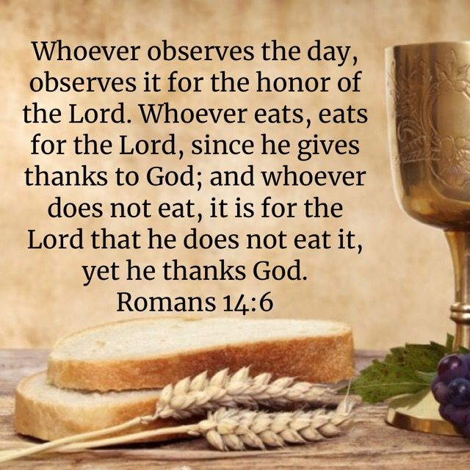
Romans 14:6

Slide 29
Romans 14:6
Paul took two things for granted as he loosened up the restrictions believers place on one another.
FIRST – some matters are absolutely and categorically wrong and must be corrected through mutual accountability. However, the morality of some matters is relative to the individual. For matters of conscience, the individual’s motivation determines its morality.
Paul highlighted this fact with the repeated phrases “for the Lord” and “thanks to God.”

Slide 30
Romans 14:6
SECOND – the Christian’s conscience is gradually being transformed by the Holy Spirit to reflect the mind of Christ.
Before the Holy Spirit took up residence in the heart of the believer, the conscience was like a broken compass, pulled this way and that by popular opinion, personal lusts, upside-down morality, and ignorance.
Now, that compass is able to find true north with increasing accuracy as the Holy Spirit retrains and guides the needle.

Slide 31
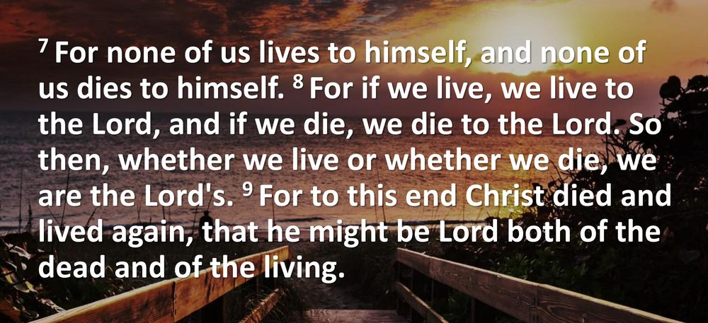
Romans 14:7 – 9

Slide 32
Romans 14:7 – 9
We belong to God, not to one another. We are His prized possessions. He is responsible for the renewing of minds, not us.
Therefore, we must allow Him opportunity to do His transforming work without distracting one another with attempts to control or coerce behavior based on what pleases us.
Christ is the only one who died and rose again to accomplish this transformation. We are His “workmanship” (Eph 2:10).

Slide 33
Romans 14:7 – 9
In our eagerness to see our new brothers and sisters grow, we mature believers frequently rob them of their joy by laying burdens on them right away . . .
“Stop smoking.” “Start reading your Bible.”
“Get out of debt and give more money to the needy.” “Dress more appropriately.”
“Eat less fat.” And on, and on, and on . . .

Slide 34
Romans 14:7 – 9
All of those life changes are good. We should dedicate our lives to helping people see the wisdom of applying the principles of Scripture and encouraging them to follow the example of Christ.
However, it’s foolish to expect them to behave like mature Christians overnight. Furthermore, their motivation must come from a transformed conscience, a renovated spirit that wants to please God as an expression of love, not a misguided need to meet the expectation of their peers.

Slide 35
Romans 14:7 – 9
This vital passage affirms the essential truth that we are all personally responsible (accountable) to Jesus Christ for the choices we make. We are accountable to Him for He is Lord.
Too many Christians—leaders and laypeople—act as if fellow believers were accountable to them rather than to Jesus.
When we pass judgment on others, we usurp Jesus’ role as Lord and deny Him the place that is rightfully His in our fellow believer’s life. What a terrible sin this is.

Slide 36
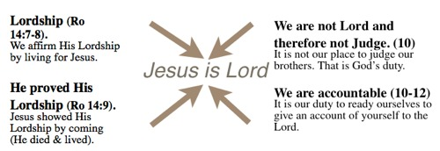

Slide 37
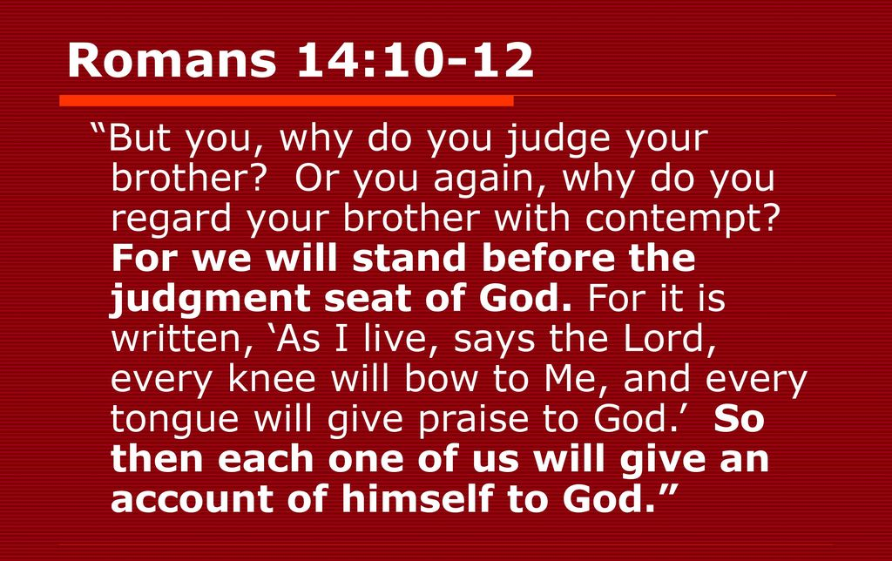
Romans 14:10 – 12

Slide 38
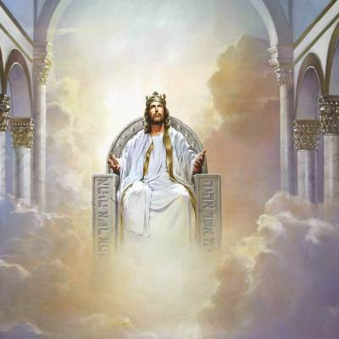
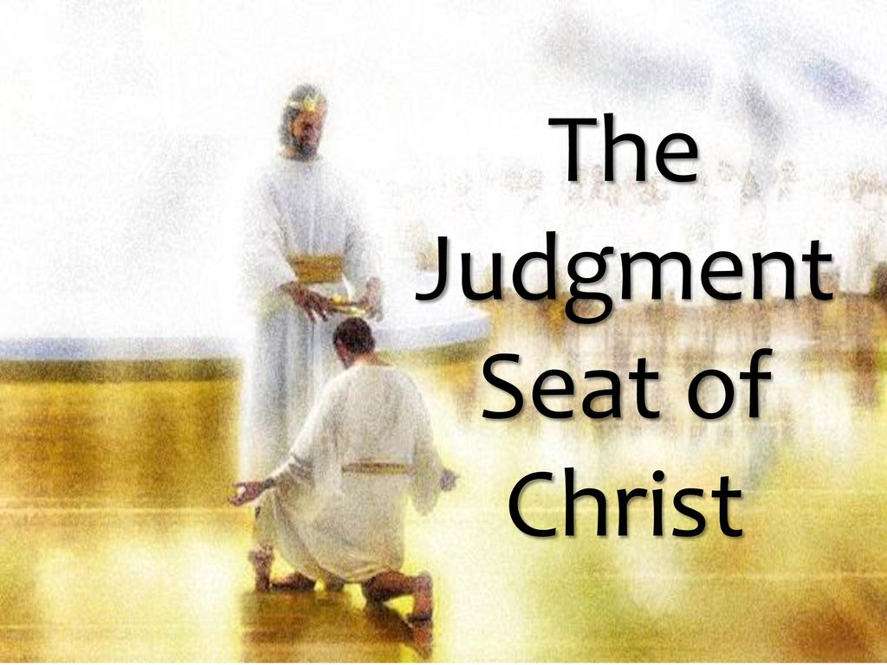

Slide 39
Romans 14:10 – 12
Paul brings the issue around to its origin—that of accountability—by asking two rhetorical questions. By placing them in parallel, we are able to discern exactly what the apostle meant by “judging.”
Clearly, we are to have standards of conduct, and we have been commanded to hold one another accountable. Remember, Paul counseled the Corinthian believers to put a sinning man out their congregation until he repented of his evil (1Cor 5:1-5, 13).

Slide 40
Romans 14:10 – 12
Paul’s purpose was to protect the integrity of the congregation until the man repented and could be restored. This act of tough love was also for the benefit of the man. This is not “judging” as Paul defines it here in Romans.
“Judging,” in this sense of the word, has no positive element. It can only be negative and cruel. This kind of judging presumes to appraise the value of another person based on a flawed, human standard.

Slide 41
Romans 14:10 – 12
  Our ability to judge has several shortcomings:
We are not omniscient, so our judgment doesn’t have all the facts.
We are not objective, so our judgment is tainted by self-interest.
We are not perfect, so our judgment is hypocritical.
We are not God, so our judgment has no jurisdiction.

Slide 42
Romans 14:10 – 12
Only God has the right to assess the value of people, because He alone owns them. He made people, He redeemed them, He knows them, and He cares for them.
Paul opens his argument by describing the issues that sharply divided believers in his day, and he closes his argument by reminding them of what they share in common.
Despite whatever differences keep believers from uniting, we will all stand before the same Judge and will be measured against the same standard.

Slide 43
Romans 14:10 – 12
To prove that this has always been the plan, Paul quotes a verse from the pen of the OT prophet Isaiah, who described the day when the Lord will visibly rule over His creation (Isa 45:23).
When we see the true Judge, we will all assume the same posture: bowed before Him in humble submission.

Slide 44
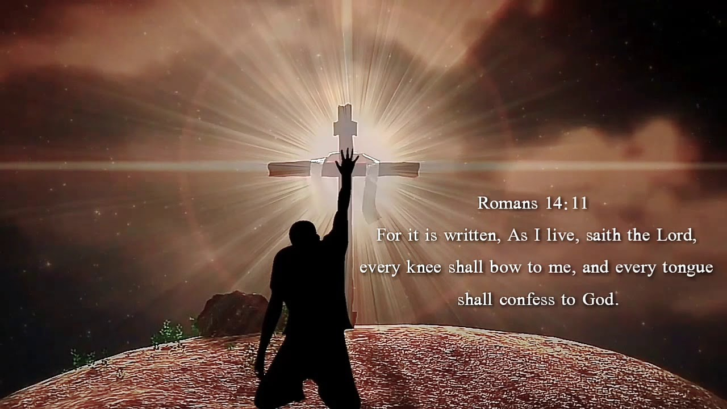

Slide 45
Romans 14:10 – 12
Paul’s teaching on how to put grace into action can be summed up this way: Just let one another be! Christians don’t need others to lecture them or to become their self-appointed life coaches.
Most believers already have a long list of changes they would like to see in their own behavior. So, having someone add a few more doesn’t help. In fact, it hurts. Most new believers already feel overwhelmed as it is.

Slide 46
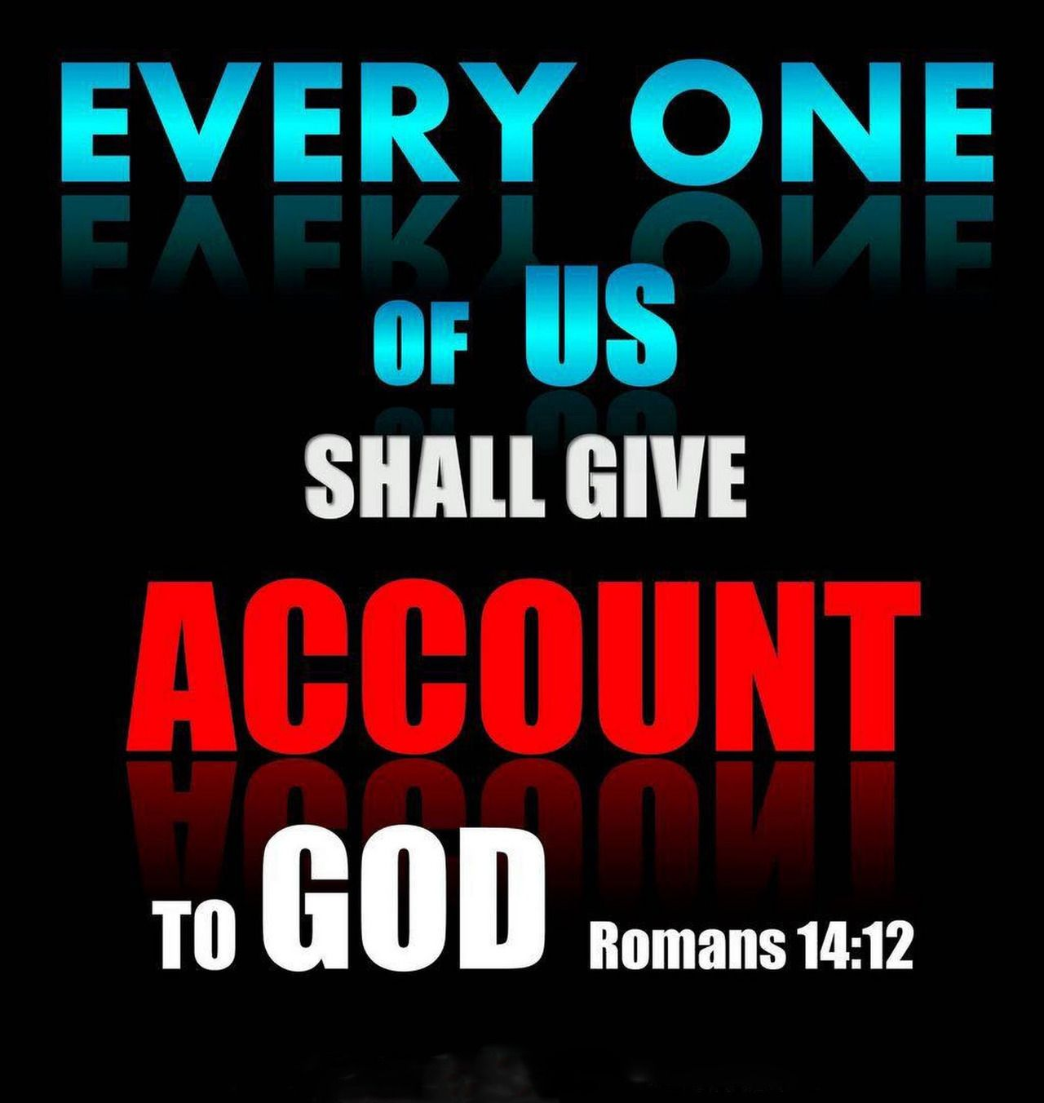

Slide 47



Keep Putting Grace into Action

Slide 48
NEXT CLASS – 13 October 2021
Book of Romans
Before next class, read the below chapter in the KJV and in one other versions of the Bible, i.e., NKJV, NRSV, NIV, CEV, etc . . .
Read Chapter 14:1 – 23 again . . .
2nd lesson: 14:13 –23 “Liberty on a Tightrope”

