Slide 1

Liberty on a Tightrope
Chapter 14:13 – 23
13 October 2021
Week 30

Slide 2

Romans 14:1 – 23
In Rome, the Christian church is a new community. Christians of Jewish and Gentile backgrounds are going into one another’s houses and sharing the same meals — for the first time in their lives.
Paul knows that some Christian Jews will still want to keep their food laws and observe their holy days. Paul describes their faith as “weak.”
They don’t realize that Jesus has done everything for their salvation. Theses “weak” Christians feel they still have to add some details themselves.

Slide 3
Romans 14:1 – 23
In Ch14 – Paul deals with the issue which often creates conflict in churches: convictions. These are not matters which Scripture identifies as “sin.” However, they are issues which seem “wrong” to some believers and “right” to others.
As Christians, we have different opinions about what a believer should and shouldn’t do. In Paul’s day, some thought it was “Christian” to be vegetarian, while others liked a good steak. Some then felt Christians should observe special “holy” days, and others felt all days are alike.

Slide 4
Romans 14:1 – 23
On the other hand, Gentile Christians may know they can eat anything, and regard every day as holy. If so, their faith is “strong” — but they must not be prideful.
Paul tells Christians of different backgrounds to respect one another’s consciences. Everyone should take their lead from the Lord. Those who hold to a strict diet, avoid certain foods or refuse meat that has been killed in pagan temples do this to honor the Lord.
Others thank God for everything and eat with grateful hearts.

Slide 5
Romans 14:1 – 23
They, too, honor the Lord in their way. Each group should accept the other, as Christ has accepted both.
Paul knows all about food laws. He used to be a Pharisee. Now he can eat anything! But he is careful not to offend anyone with his new-found freedom.
If someone will be misled or upset by what Paul eats, then Paul won’t eat it. Why should he distress his fellow Christian just to show off his liberty?

Slide 6
Romans 14:1 – 23
Often the differences that do exist between us will trouble an entire fellowship. Some, who have the freedom to do what others question, may in the exercise of that freedom, cause their fellow Christians harm.
Paul is very clear here. Nothing (that is not identified in Scripture as sin) is unclean or wrong in itself. But neither is it more important than our brother or sister. So we Christians walk a fine line.

Slide 7
Romans 14:1 – 23
We affirm our freedom and responsibility to live by our own convictions. Yet we are careful not to flaunt them, so that others may follow our example despite personal doubts, or may condemn us for what we ourselves believe to be good and right.
The goal toward which we are to work, giving it priority rather than convictions, is “that with one heart and mouth you may [together] glorify the God and Father of our Lord Jesus Christ” (15:6).

Slide 8
Romans 14:1 – 23
Romans 14:1-12 describes an analogy to an acrobat on a wire, experiencing the rapture of the heights and enjoying complete freedom.
The next eleven verses explain the balance he or she must maintain while traveling along the tightrope of liberty.
To stabilize that delicate walk, the believer must hold in her or his hands a balance pole. On one end, self-control.
On the other, love for others. Neither should tip much higher than the other.

Slide 9

Tonight’s focus . . .
“Liberty on a Tightrope”

Slide 10
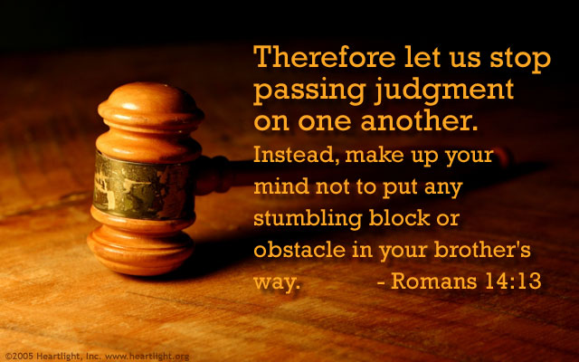
Romans 14:13

Slide 11
Romans 14:13
Paul addresses both the “weak in faith,” whose excessive caution might make them fearful and legalistic, and the “strong,” whose love of liberty might make them callous and careless.
Paul exhorts believers of both persuasions to avoid “judging,” that is, despising one another as “worthless” based on how we conduct ourselves in matters of conscience.
The legalist might question the genuine faith of someone who doesn’t share his or her convictions on a certain matter.

Slide 12
Romans 14:13
The libertine might question the genuine faith of someone who cannot stop quoting the Law. Put them together in the same congregation and the environment can become toxic for everyone.
Paul’s primary concern was to avoid two specific dangers. First, the legalist might cause the free-flying strong Christian to crash to the ground.
Second, the libertine might cause the careful, weak Christian to fall into sin.
Paul gives these two dangers names: “OBSTACLE” and “STUMBLING BLOCK.”

Slide 13
Romans 14:13
An “OBSTACLE” can be the result of a tumble, such as a bruised knee or a knot on the forehead, or it can refer to the trip hazard itself, such as a “tripping stone.”
Picture a Christian running with his head thrown back and wearing a giant smile, enjoying his freedom in Christ without a worry in the world. Then imagine a legalist sticking his foot out.

Slide 14
Romans 14:13
A “STUMBLING BLOCK” is a trap. Picture a baited cage with a spring-loaded door, like a rabbit trap.
Picture a brand-new Christian carefully trying to discern what is appropriate for a believer and what is not, perhaps taking her cues from the example of mature Christians.
Now picture a reckless believer who frequently drinks to the point of intoxication and defends his choices as “his freedom in Christ.” His reckless example has set a trap for his new sister in Christ.

Slide 15
Romans 14:13
The balance between enjoying one’s liberty and exercising self-control is not mastered overnight. To help everyone find that balance and keep it, Paul offers three principles to live by:
Nothing is clean or unclean by itself (14:14-16).
The essence of Christianity in not found in external matters (14:17-19).
When liberty hinders the work of God, it must yield (14:20-23).

Slide 16
Romans 14:14 – 16
¹⁴I am convinced, being fully persuaded in the Lord Jesus, that nothing is unclean in itself. But if anyone regards something as unclean, then for that person it is unclean. ¹⁵If your brother or sister is distressed because of what you eat, you are no longer acting in love. Do not by your eating destroy someone for whom Christ died. ¹⁶Therefore do not let what you know is good be spoken of as evil.

Slide 17
Romans 14:14 – 16
NOTHING IS CLEAN OR UNCLEAN BY ITSELF
Inanimate objects can be neither good nor evil because they do not have a mind or a will. They lack the capacity to do anything on their own. Idols are nothing until someone ascribes significance to them.
The piece of polished wood or stone are not evil; the worship of them is evil. Similarly, dates on a calendar have no significance other than what we choose to assign them.

Slide 18
Romans 14:14 – 16
NOTHING IS CLEAN OR UNCLEAN BY ITSELF
However, perception can be a powerful thing, especially to an untransformed mind. The sights, sounds, and symbols associated with someone’s sinful past can pose a genuine threat to spiritual progress.
SWINDOLL – for example, alcohol is not evil, and bars are not evil places. Alcohol abuse is evil and evil people may frequent bars. But neither of these should concern a mature Christian whose conduct isn’t easily influenced.

Slide 19
Romans 14:14 – 16
NOTHING IS CLEAN OR UNCLEAN BY ITSELF
A recovering alcoholic, just days after his or her fresh start in rehab, however, has very good reason to fear. Only a callous Christian would chastise him or her for wanting to avoid temptation. To that person, alcohol and bars are evil.
When someone who stands on feeble legs of faith recoils from a perceived danger, the mature believer has a choice: love for pleasure or love for the other believer.

Slide 20
Romans 14:14 – 16
NOTHING IS CLEAN OR UNCLEAN BY ITSELF
How should a Christian whose convictions allow him to eat everything respond to one with scruples against certain foods?
In Christian love, he ought to forgo his liberty in Christ to avoid being a spiritual hindrance to his spiritual brother.
If he persists in exercising his liberty so that his brother is distressed (“grieved or hurt”), Paul concludes, then the Christian exercising his liberty is no longer acting (“walking”) in love.

Slide 21
Romans 14:14 – 16
NOTHING IS CLEAN OR UNCLEAN BY ITSELF
Such persistence could cause the spiritual destruction of a brother for whom Christ died. Here, “destroy” mean temporal ruin; a Christian forced to act contrary to his scruples.
Persisting in one’s freedom could also result in his Christian liberty (what you consider good) being blasphemed (spoken of as evil).
When unbelievers see a strong Christian abusing his freedom in Christ and harming a weaker brother, they will conclude that Christianity is filled with unloving people; reflecting on God.

Slide 22
Romans 14:17 – 19
¹⁷For the kingdom of God is not a matter of eating and drinking, but of righteousness, peace, and joy in the Holy Spirit, ¹⁸because anyone who serves Christ in this way is pleasing to God and receives human approval. ¹⁹Let us therefore make every effort to do what leads to peace and to mutual edification.

Slide 23
Romans 14:17 – 19
THE ESSENCE OF CHRISTIANITY IS NOT FOUND IN EXTERNAL MATTERS
Jesus said, “it is not what enters into the mouth that defiles the man, but what proceeds out of the mouth, this defiles the man” (Matt. 15:11).
How easy to get hung up on tangible things such as foods, habits, clothing, recreation, music, and even decorations. The organ of life’s richest delights is not the stomach; it’s the heart. At the end of the day, we will answer not for what we put into our stomachs but for the attitudes we nurtured in our hearts.

Slide 24
Romans 14:17 – 19
THE ESSENCE OF CHRISTIANITY IS NOT FOUND IN EXTERNAL MATTERS
After all, food is not that important an issue; it is not the sum and substance of the kingdom of God.
But the kingdom is righteousness (upright living), peace (unity) and joy in (the authority of) the Holy Spirit. These are the essentials of Christian fellowship and harmony.
A “strong” believer insists on right conduct, harmony, and joy rather than forcing his own lifestyle on others.

Slide 25
Romans 14:17 – 19
THE ESSENCE OF CHRISTIANITY IS NOT FOUND IN EXTERNAL MATTERS
What is our focus? Are we more concerned with people’s preferences than the true products of Christian growth: righteousness, peace and joy?
When the outside world peeks through the window of our churches, what do we want them to see? List-makers dashing about and enforcing rules . . . while others defiantly ignore them.
What a chaotic scene! Who would want that?

Slide 26
Romans 14:17 – 19
THE ESSENCE OF CHRISTIANITY IS NOT FOUND IN EXTERNAL MATTERS
Instead, let’s serve Christ by giving one another space to breathe and respecting the sensibilities of others.
Paul put it best when he wrote, “You were called to freedom, brethren; only do not turn your freedom into an opportunity for the flesh, but through love serve one another” (Gal. 5:13).

Slide 27
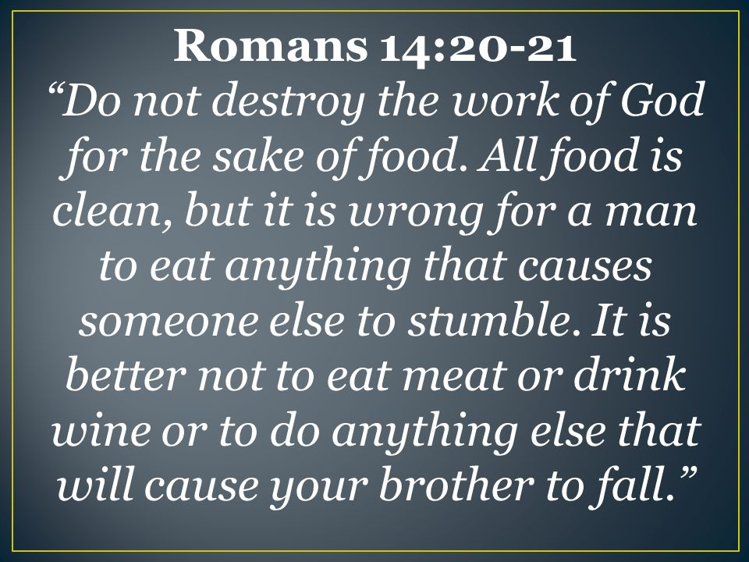
Romans 14:20 – 21

Slide 28
Romans 14:20 – 21
WHEN LIBERTY HINDERS GOD’S WORK, IT MUST YIELD
Meat or drink or anything else should be put aside if it causes a brother to fall (either “obstacle” or “stumblingblock”). At times one’s Christian liberty must be relinquished for the sake of others.
Paul wrote to the believers in Corinth, “All things are lawful, but all are not profitable; all things are lawful, but all do not edify. Let no one seek his own good, but that of his neighbor” (1Cor. 10:23-24).

Slide 29
Romans 14:20 – 21
WHEN LIBERTY HINDERS GOD’S WORK, IT MUST YIELD
Nothing should hinder “the work of God,” which is nothing short of bringing salvation to the world, reclaiming His creation, and washing away evil with His righteousness.
We must keep our focus on what’s important. It’s silly to quibble about petty differences in nonessential matters. One who uses those God-given liberties carelessly and selfishly, offending his weaker brother (14:21).

Slide 30
Romans 14:20 – 21
WHEN LIBERTY HINDERS GOD’S WORK, IT MUST YIELD
We must remember that some are stronger in their faith than others, but there is always someone stronger that we are.
While we are compassionately limiting our freedom for the sake of someone else’s weakness, another Christian is doing the same for us! Or do you think you’re the most mature person in your community? I hope not. That’s a sure sign of spiritual weakness.

Slide 31
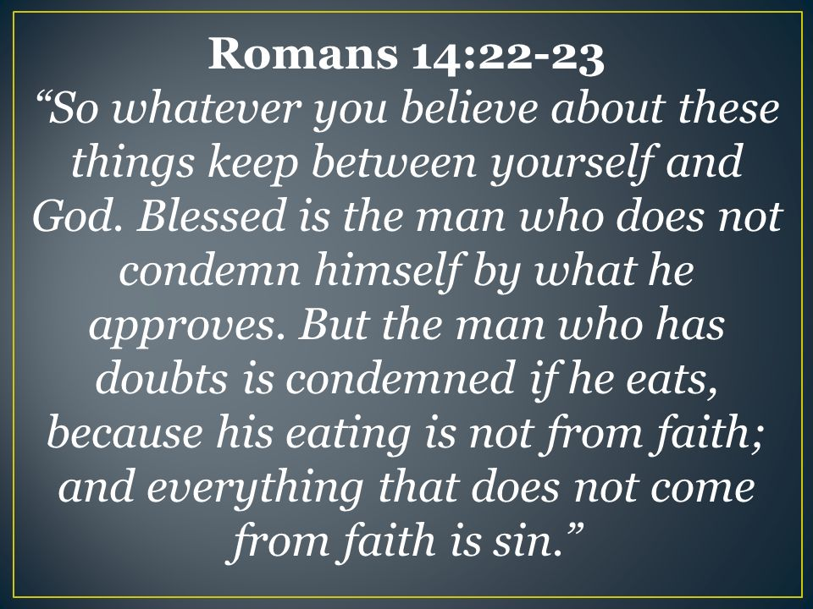
Romans 14:22 – 23

Slide 32
Romans 14:22 – 23
WHEN LIBERTY HINDERS GOD’S WORK, IT MUST YIELD
Paul, ever practical in his teaching, offers three simple reminders to help us maintain our own balance on the tightrope of freedom and to help others gain theirs:
  1 – Be Considerate (14:21).
  2 – Be Convinced (14:22).
  3 – Be Consistent (14:23).

Slide 33
Romans 14:22 – 23
BE CONSIDERATE
SWINDOLL – what you enjoy in the privacy of your home is entirely between you and the Lord. All things are lawful; not all things are constructive. Know the difference, and thank God for all the wonderful things He created for you to enjoy.
When you are in public, don’t restrict yourself unnecessarily, but be aware of the potential effect your actions have on others. Be sensitive to reactions, and graciously adjust your behavior accordingly.

Slide 34
Romans 14:22 – 23
BE CONVINCED
SWINDOLL – many Christians are not clear within themselves what they believe, so they live in perpetual frustration trying to please everyone around them. But everyone is different and their convictions are contradictory.
Please one and you’re likely to displease another. Instead, carefully examine your matters of conscience to be certain they are not indeed clear moral issues. Determine what Scripture has to say. Discuss them with trusted, mature believers.

Slide 35
Romans 14:22 – 23
BE CONVINCED
SWINDOLL – consider the impact they have on others and yourself, both positively and negatively. Then, once you have settled the issue, you can enjoy your freedom with complete confidence.
You won’t need to react defensively, you won’t have to convince anyone else, and you won’t even second-guess yourself.
Furthermore, that quiet confidence will allow you to let others be.

Slide 36
Romans 14:22 – 23
BE CONSISTENT
SWINDOLL – consistently match your actions to your conscience. But don’t be surprised to find that your conscience gradually changes over time. Some things that caused you no problem years ago irritate your conscience today. This is to be expected. Your conscience should never stop growing.
As our consciences are transformed by the Holy Spirit and become more mature, we are wise to heed them. That’s not to say our developing consciences need to become anyone else’s.

Slide 37
Romans 14:22 – 23
The conscience is strengthened by knowledge. But knowledge must be balanced by love; otherwise it tears down instead of building up.
When this truth is taught in an atmosphere of love, then the “weaker” Christian can grow and develop a strong conscience. Believers may hold different convictions about many matters, but they must hold them in love.
When the “weak” brother violates his conscience, he sins. That is, whatever is not from faith is sin. Here, sin is the thoughts and actions that our conscience condemns.

Slide 38
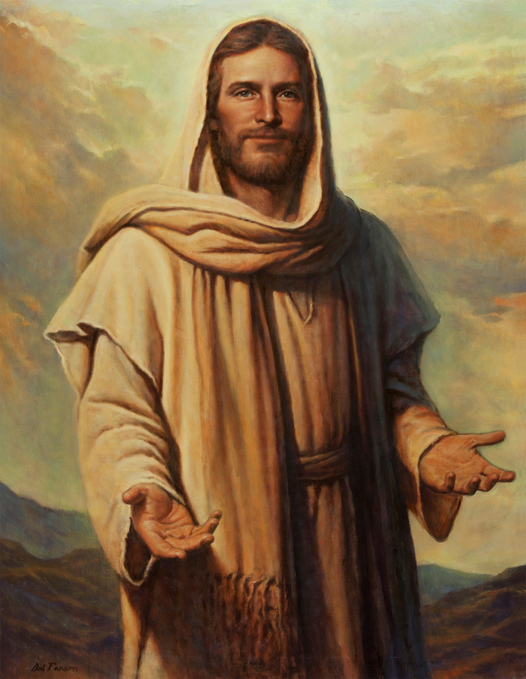


Maintain Your Liberty

Slide 39
NEXT CLASS – 20 October 2021
Book of Romans
Before next class, read the below chapter in the KJV and in one other versions of the Bible, i.e., NKJV, NRSV, NIV, CEV, etc . . .
Read Chapter 15:1 – 33
1st lesson: v1 – 13 “We Are One … Or Are We?
2nd lesson: v14 – 33 “Partners, Plans, and Prayer”

