Slide 1

We Are One … Or Are We?
Chapter 15:1 – 13
20 October 2021
Week 31

Slide 2

Romans 15:1 – 33
In Ch14 – Paul wrote that Christians should not despise or condemn others but to “put grace into action” (14:1-12), nor should they hinder the conduct of other Christians as they exercise their “liberty on a tightrope” (14:13-23).
Here in Ch15 – Paul gives a third principle to observe when a believer is dealing with fellow Christians: he is to follow the example of Christ.
Christ Jesus was supremely the Person who ministered on behalf of others, not for Himself. It is fitting, therefore, that those who take His name should imitate Christ.

Slide 3
Romans 15:1 – 33
Overview . . .
Paul continues his discussion on how those who are strong are to receive and bear with the infirmities of the weak. Encouraging the strong to be concerned with uplifting the weak, he reminds them of Christ and His unselfishness (15:1-3).
Reminding them of the value of the Old Testament Scriptures, he pleads for patience so that with one mind and one mouth they may glorify God (15:4-6).

Slide 4
Romans 15:1 – 33
Overview . . .
Finally, he calls for them to receive one another to the glory of God, just as Christ served both Jews and Gentiles in fulfilling the prophets of old (15:7-12).
Paul then offers a prayer that God might fill them with joy and peace in believing, so that they may abound in hope with the help of the Holy Spirit (15:13).

Slide 5
Romans 15:1 – 33
Overview . . .
At this point, Paul begins to draw this epistle to a close by making remarks concerning his apostleship and plans to see them. Recognizing their own abilities in the faith, he still felt it appropriate to write to them as he did (15:14-16).
Speaking of his design not to preach where Christ had already been received (15:17-21), Paul tells of his plan to come to Rome on his way to Spain (15:22-24).

Slide 6
Romans 15:1 – 33
Overview . . .
But first, Paul is going to the poor saints in Jerusalem with a contribution from the saints in Macedonia and Achaia (15:25-29).
Realizing the danger such a trip entails, he asks to be remembered in their prayers (15:30-33).

Slide 7

Tonight’s focus . . .
“We Are One … Or Are We?”

Slide 8
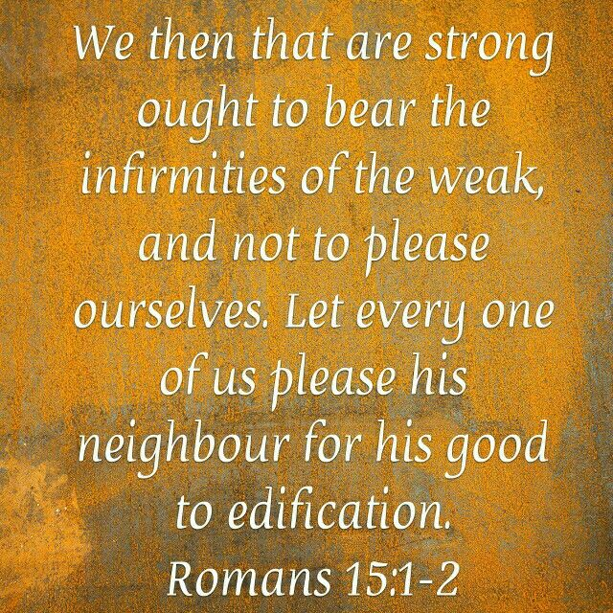
Romans 15:1 – 2

Slide 9
Romans 15:1 – 2
Paul summarized the discussion of Ch14 by saying, We who are strong (in convictions and conscience) ought (are obligated) to bear with the failings (infirmities or weaknesses) of the non-strong. The strong ought not despise the weak; they ought to bear (carry) with them.
The strong are to lighten the burden in the packs of the weak and add it to their own. The strong are people who have risen above the drag of lists, people pleasing, and performance-based righteousness.

Slide 10
Romans 15:1 – 2
The strong know deep down they are righteous because of the Father’s grace, the Son’s gift of eternal life, and the Spirit’s indwelling presence. The strong rest confidently in their eternal security, knowing they have nothing to prove and everything to give.
Also the strong should not seek to please themselves. A Christian should not be self-centered, but should be concerned about the spiritual welfare of others. However, pleasing others is not the end in itself, but is for their good, to build them up (cf. “edification” in 14:19).

Slide 11
Romans 15:1 – 2
Rather than please themselves, mature believers must encourage unity by accepting the burden of others’ legalism. If eating meat compromises unity with another believer, get a “to go” box or stick to the salad bar. It is a sad and difficult gift to give, but nothing more than what Jesus Christ gave each of us.
Paul earlier stated, in effect, “If Christ considered a fellow believer worth dying for, certainly you can forgo eating meat” (14:15).

Slide 12
Romans 15:1 – 2
Paul’s phrase “please his neighbor” (15:2) does not encourage pleasing others at the expense of doing what is right. Neither does it suggest that our motive is to gain the favor of others.
Paul did not encourage “people pleasing” as we understand it. The apostle merely wanted believers to value the welfare and comfort of others above their own.

Slide 13
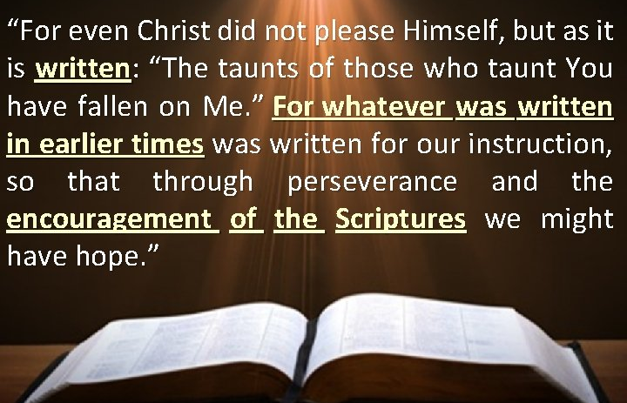
Romans 15:3 – 4

Slide 14
Romans 15:3 – 4
Whenever Paul wanted to illustrate the quality of selflessness, he pointed to the example of Jesus
Christ. This is the example the Lord Jesus Christ left.
Even He did not please Himself. Jesus came “to do the will” of the Father who sent Him (John 4:34) and to please the Father (John 5:30; 8:29).

Slide 15
Romans 15:3 – 4
What a perfect example of someone voluntarily climbing down from a place of high honor to bear the weakness of weak people. Jesus condescended from the highest place of glory in the universe to suffer the most humiliating of deaths in order to lift us up.
To highlight Christ’s setting aside His own comfort for the sake of the weak, Paul quotes a part of a verse from a messianic psalm (Ps. 69:9), which is the lament of a righteous sufferer: “The reproaches of those who reproached You fell on Me” (15:3).

Slide 16
Romans 15:3 – 4
The Scriptures serve to give believers endurance (“steadfastness in the face of adversities”) and encouragement so that they might have hope (cf. Rom. 5:3-5 “hope maketh not ashamed”).
As Christians learn from the OT past about who did not please themselves, they are motivated to endure and be comforted in the present, looking ahead in hope (confidence) to the future.

Slide 17
Romans 15:3 – 4
Christ was insulted by others because of His associations with God the Father. Paul states a significant principle concerning the purpose and ministry of the Scriptures: “For everything that was written in the past was written to teach us” (15:4).
This, in turn, reminds Paul of Scripture’s enduring value as a source of hope.
Note three benefits he stressed:

Slide 18
Romans 15:3 – 4
The comprehensive value of Scripture: All of God’s Word, from cover to cover, is equally beneficial for instruction.
The contemporary relevance of Scripture: Although written long ago to cultures long extinct, God’s Word teaches timeless principles that apply to all of humanity throughout all time.
The practical application of Scripture: Diligence to apply the principles taught in the Bible helps us to overcome challenges and to cultivate a spirit of confident assurance.

Slide 19
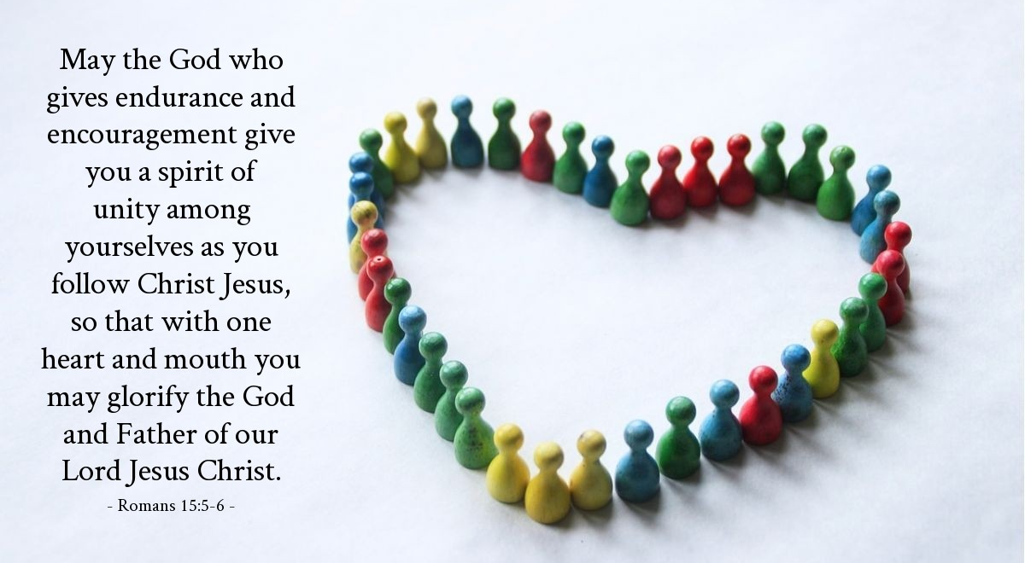
Romans 14:5 – 6

Slide 20
Romans 15:5 – 6
The steadfast endurance and encouragement a Christian receives from the Scriptures (v4) come ultimately from God (v5), the Author of the Scriptures.
Paul prays that God would give his readers a spirit of unity (“to think the same” and “live in harmony”) as they follow according to Christ Jesus.
Paul urges believers to be of the same mind “according to Christ Jesus.” That is, “in the manner” of God’s son. This is not the same as trying to imitate one another, which is futile.

Slide 21
Romans 15:5 – 6
The ultimate purpose of this unity was that with one heart and mouth (a unity of inward feeling and outward expression) they would “keep on glorifying” the God and Father of our Lord Jesus Christ. This is the final purpose of Christians individually and of the church corporately (cf. Rom. 15:7).
Like an orchestra, we are crafted by the Eternal Artist – Christ. We play a score written for us by the Master Composer, which allows our individual notes to create harmonies. Being tuned to perfect pitch, we play with passion and precision to the glory of God.

Slide 22
Romans 15:7 – 12
⁷Accept one another, then, just as Christ accepted you, in order to bring praise to God. ⁸For I tell you that Christ has become a servant of the Jews on behalf of God’s truth, so that the promises made to the patriarchs might be confirmed ⁹and, moreover, that the Gentiles might glorify God for his mercy. As it is written: “Therefore I will praise you among the Gentiles; I will sing the praises of your name.” ¹⁰Again, it says, “Rejoice, you Gentiles, with his people.” ¹¹And again, “Praise the Lord, all you Gentiles; let all the peoples extol him.” ¹²And again, Isaiah says, “The Root of Jesse will spring up, one who will arise to rule over the nations; in him the Gentiles will hope.”

Slide 23
Romans 15:7 – 12
Paul again turns to Christ as our example and, again, encouraged “acceptance.” Christ’s ministry of acceptance took two forms, one to the Jews and one to the Gentiles.
Jesus was born a Jew and followed the rites and customs of the Jews. He as circumcised to identify with God’s covenant with Abraham and then He fulfilled the requirement of Gods covenant with Israel by living as they should have lived. He claimed the blessings of that covenant as a sinless representative. And He fulfilled the covenant of David by claiming the throne of Israel as his descendant.

Slide 24
Romans 15:7 – 12
Paul quotes four OT passages to show that Gentiles were a part of God’s redemptive plan from the beginning:
Psalm 18:49 > “Therefore will I give thanks unto thee, O Lord, among the heathen, and sing praises unto thy name.”
Deut. 32:43 > “Rejoice, O ye nations, with his people...”
Psalm 117:1 > “O praise the Lord, all ye nations: praise him, all ye people.”
Isaiah 11:10 > “And in that day there shall be a root of Jesse, which shall stand for an ensign of the people; to it shall the Gentiles seek …”

Slide 25
Romans 15:7 – 12
The Lord originally planned for His blessing to Abraham to become the means of His extending grace to the whole world (Gentiles).
The Israelites were to settle in the Promised Land and become a living example of God’s government, one so steeped in grace that sojourners would never want to leave.
And the kings of Israel were to remain perfectly obedient to God, leading all of their follower in worship and eventually bringing Gentiles under His worldwide theocracy.

Slide 26
Romans 15:7 – 12
Where the descendants of Abraham failed, the Israelites disappointed, and the kings disobeyed, Jesus Christ succeeded.
The righteousness of God was ultimately revealed in the person of His Son, Jesus Christ. When He returns, the world will be re-created all the way down to the atom to reflect that righteousness.
So, if we want to know what the new kingdom will look like, we need only look to its King. And during His earthly ministry, the King was a servant.

Slide 27
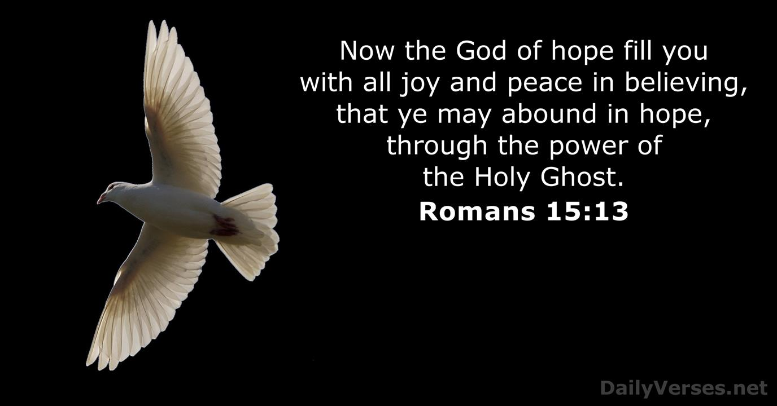
Romans 15:13

Slide 28
Romans 15:13
Paul concludes the final section of his teaching with a benediction.
“Hope” is not a tentative wish that may or may not come true. Christian hope is an assured expectation based on a promise of God.
Because God always keeps His promises, we have a guaranteed future that awaits us. Therefore, we can endure trials with joy and peace. Our believing will keep us moving when we might otherwise become discouraged and quit.

Slide 29
Romans 15:13
“So that” indicates a cause-effect relationship. Note that God does the filling with joy and hope; our only responsibility is to believe.
Paul desires that this process of believing and receiving would result in believers overflowing with hope – perhaps enough to flood the world and produce change, if only a little.
This benediction marks the end of Paul’s teaching to the Romans. The balance of his letter addresses several personal matters and outlines his future plans.

Slide 30



We are ONE . . . In the Spirit

Slide 31
NEXT CLASS – 3November 2021
Book of Romans
Before next class, read the below chapter in the KJV and in one other versions of the Bible, i.e., NKJV, NRSV, NIV, CEV, etc . . .
Read Chapter 15:1 – 33
2nd lesson: v14 – 33 “Partners, Plans, and Prayer”

