Slide 1

The Indictment of Conscience
Chapter 2:1-16
Week 3
3 February 2021

Slide 2
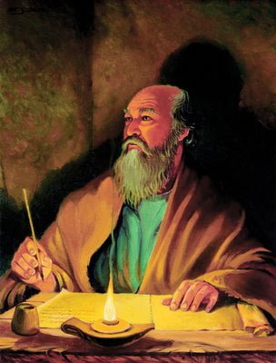
The Apostle Paul at his writing desk

Slide 3

The Pauline Epistles
“How rarely we weigh our neighbor in the same balance in which we weigh ourselves.”
Thomas Kempis

Slide 4


Slide 5
Romans 2
Overview:
Throughout the first chapter, Paul consistently referred to sinful humanity as “they” and “them,” a nice, safe, third-person pronoun that keeps the accusing finger pointed elsewhere.
They are without excuse (1:20); they became futile (1:21); they became fools (1:22) etc.
God gave them over (1:24, 26, 28).

Slide 6
Romans 2
Overview:
Then, having cataloged the depravity of humanity in agonizing detail, Paul suddenly spun the pronoun a full 180 degrees from the outward third person to the inward-pointing second person: you.
At this point, Paul turns his attention from the Gentile to the Jew. The Hebrew Christians in the congregation undoubtedly felt affirmed by their Jewish brother’s diagnosis of Gentile depravity.

Slide 7
Romans 2
Overview:
God created all of humanity to worship Him, yet He intentionally and specifically called the offspring of Abraham, Isaac, and Jacob – the Jewish people – to be His instrument of righteousness in the world.
And while God gave the Gentiles over to their degrading passions, He held the Jewish people accountable and chastised them like sons.

Slide 8
Romans 2
Overview:
Of all the people of the world, the Jews received the blessing of the Law to steward for the sake of all, which gave many Jews not only a sense of high calling but also an exalted sense of superior worth.
In fact, many smugly believed that their heritage as “God’s chosen people” exempted them from judgment.

Slide 9
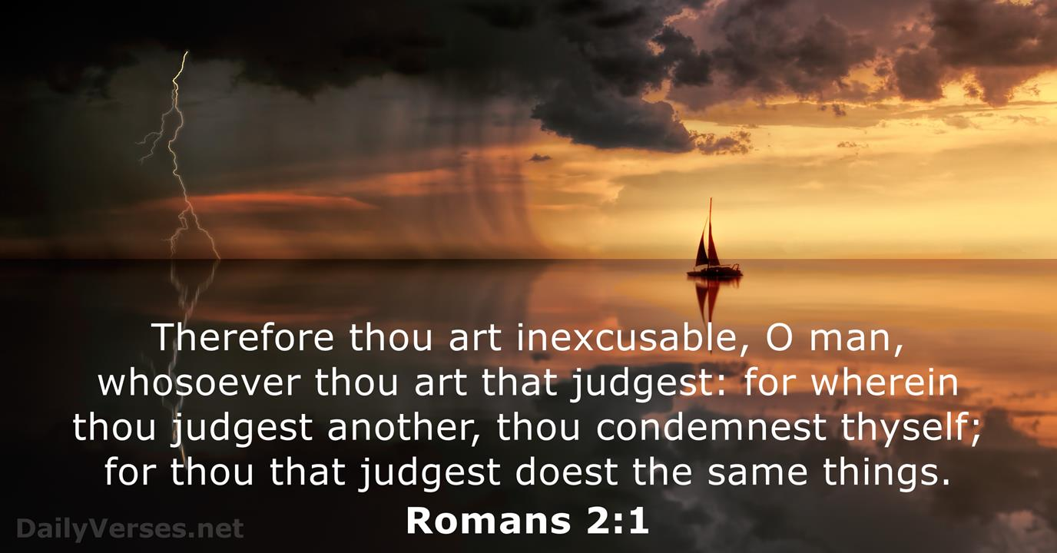
Romans 2

Slide 10
Romans 2
Overview:
While the Jew-Gentile tension that characterized other churches may have plagued the church in Rome, nothing in Paul’s language suggests that he specifically had this divide in mind.
More likely, the shift from “they” to “you” was not from Gentile to Jew, but from “humanity” in general to “O man” [whoever you are] when you judge someone else, you condemn yourself, you who judge are practicing the same things.

Slide 11
Romans 2
Consider:
The two divisions of people:
JEWS – the chosen people of God.
Gentiles – the fallen humanity of the world.
The four types of people:
Jews who believe in Jehovah God (Judaism).
Jews who believe in Jehovah & Jesus (Christians).
Gentiles who believe Jesus as Savior (Christians).
Gentiles who are the fallen humanity of this world (unbelievers).

Slide 12
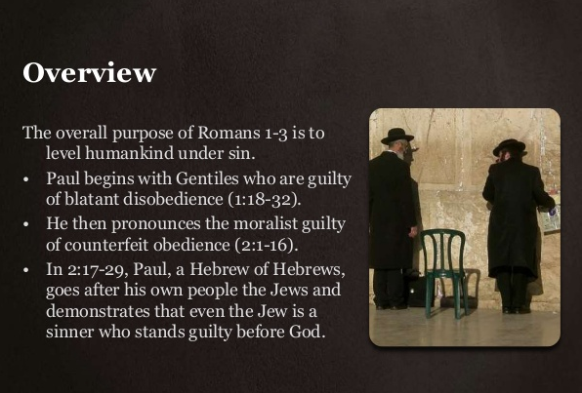
Romans 2

Slide 13
Romans 2
Overview:
Having condemned the world, Paul places his readers on trial.
In this segment, three truths become clear:
  God’s judgment is inescapable (2:1-4);
  God’s judgment is impartial (2:5-11); and
  God’s judgment is universal (2:12-16).

Slide 14
Romans 2
God’s judgment is inescapable (2:1-4):
How do you determine who is “good” and who is “bad”? We each have in our unconscious mind at least three moral categories into which we place people.
Some are without questions undeniably “bad.” Adolf Hitler, Joseph Stalin, Charles Manson, Judas Iscariot, Nero . . . nearly everyone would agree these people are clearly evil.

Slide 15
Romans 2
God’s judgment is inescapable (2:1-4):
Then there are a few undeniably “good” people, like the late Mother Teresa. She’s often held up as the modern standard of “good.”
Another would be Rev. Dr. Martin Luther King, Jr. Some might say, “Well, I’m no Mother Teresa or Dr. King, but I’m a pretty decent person.”

Slide 16
Romans 2
God’s judgment is inescapable (2:1-4):
Then there’s a broad middle category containing the masses of somewhat-good-yet-sometimes bad and other, yet-to-be-determined people.
This is where we usually place ourselves. Within this category, we mentally rank people in order of observable goodness.
Some are clearly better than others. Who do you suppose is the measuring rod? Right: ourselves!

Slide 17
Romans 2
God’s judgment is inescapable (2:1-4):
When people are asked whether they are going to heaven or hell, many will answer, “Well, I’m not perfect, but I’ve never killed anyone, so I guess I’m a pretty good person.”
Alcoholics often look down on “dope addicts,” while drug heads ridicule “drunks.” Even in prison, murderers, rapists, and thieves have no tolerance for child molesters and have no compunction about mistreating or even killing them.

Slide 18
Romans 2
God’s judgment is inescapable (2:1-4):
With Paul, we all agree that “the judgment of God rightly falls upon those who practice [evil]” (2:2).
But he reminds us that the same judgment we call down upon others falls upon us as well. That’s the part that makes us squirm. We all want justice for the world, but we each carry within us a standard of righteousness based on our own perceived goodness.

Slide 19
Romans 2
God’s judgment is inescapable (2:1-4):
Furthermore, we will tolerate only as much evil in the world as we can accept within ourselves.
When we feel resentment toward God for not eradicating evil in the world, we forget that eliminating all evil would mean the end of us too!
So, from now on we’ll have to say what we really mean: “Lord, get rid of all evil that’s worse than what’s inside of me.”

Slide 20
Romans 2
God’s judgment is inescapable (2:1-4):
The judgment of God falls upon every person because the standard of righteousness is perfection.
So why are any of us alive? Why have we not been reduced to a cinder by God’s wrath?
“The riches of His kindness and tolerance and patience” (2:4). In a word: grace.

Slide 21

Romans 2

Slide 22
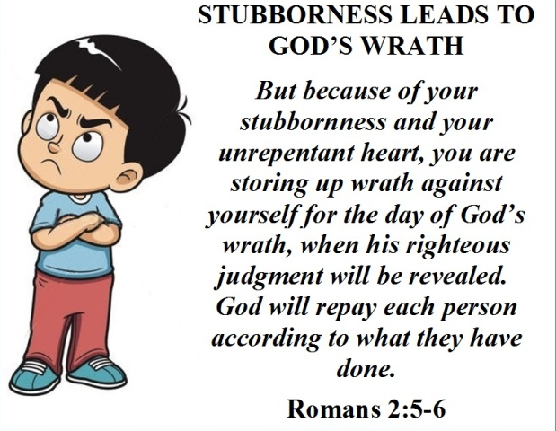
Romans 2

Slide 23
Romans 2
God’s judgment is impartial (2:5-11):
At the end of days, there will be a terrifying courtroom scene involving every human being who ever took a breath on earth.
The deeds of each man and woman will be laid on a scale and weighed against the holy character of God – the very definition of righteousness (2:5-6).
Wealth, power, position, race, color, heritage, and philosophy will count for nothing. Religion will count for nothing.

Slide 24
Romans 2
God’s judgment is impartial (2:5-11):
The standard will be the same for all – those who had access to the Law and those who did not.
God “will render to each person according to his [or her] deeds,” according to a promise of the OT (2:6; quoting Ps. 62:12; Prov 24:12) repeated by Jesus (Matt 16:27) and described in detail by John in the book of Revelation.
The reward of righteousness is eternal life (2:7), the penalty for unrighteousness is wrath (2:8).

Slide 25
Romans 2
God’s judgment is impartial (2:5-11):
Paul has not contradicted himself. He earlier wrote that the gospel “is the power of God for salvation to everyone who believers” (1:16), and he quoted the OT prophet’s declaration that “the righteous will live by his faith” (Hab. 2:4).
He merely meant to clarify that each person will be judged by his or her deeds, not saved by them. At the end of days, each will lay his or her deeds on the scale and they will be found wanting.

Slide 26
Romans 2
God’s judgment is impartial (2:5-11):
No number of good deeds will balance the righteousness of God on the other side – not even close.
Paul’s point is simple: “There is no partiality with God” (2:11). All have equal opportunity to stand before the Judge to present evidence of their own righteousness.

Slide 27
Romans 2
God’s judgment is impartial (2:5-11):
And the standard will be the same for all. But, Paul warned, “because of your stubbornness and unrepentant heart yo are storing up wrath for yourself” (2:5).
Anyone daring to presume that his or her deeds are sufficiently good for eternal life or that God, who sees all, will overlook sin has chosen a bleak future.

Slide 28
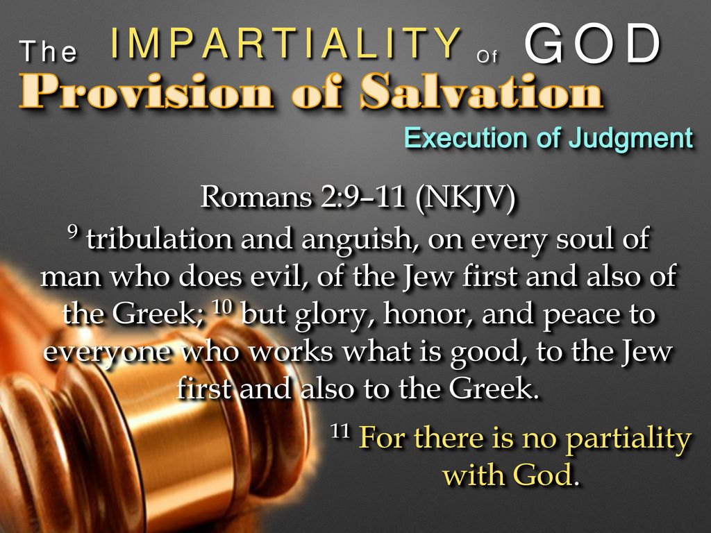
Romans 2

Slide 29
Romans 2
God’s judgment is universal (2:12-16):
The old saying “The road to hell is paved with good intentions” seems especially appropriate in light of Paul’s words. We all intend to do well. The question is, do we act on that knowledge? And when we do act, are our actions righteous?
Some might take issue with the Paul’s statement, “All who have sinned without [having heard] the Law, will also perish [not having heard] the Law (2:12).

Slide 30
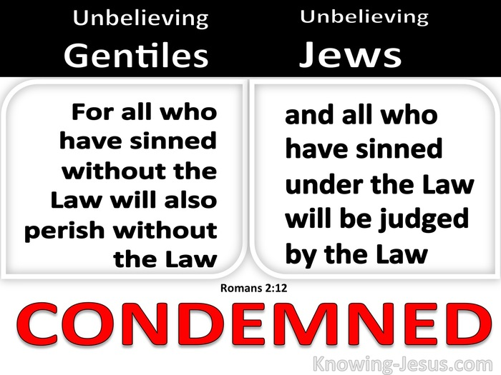
Romans 2

Slide 31
Romans 2
God’s judgment is universal (2:12-16):
That hardly seems fair. How can someone be justly punished for breaking rules he or she knew nothing about? But that’s Paul’s point entirely.
Gentiles living in places far removed from the Promised Land may have never known a single Hebrew or the Law he kept, but every man and woman bears the image of God – an image smudged by sin, but God’s image nonetheless.

Slide 32
Romans 2
God’s judgment is universal (2:12-16):
And part of that image includes an innate sense that some actions are good and some are bad.
The details may not be accurate. One’s understanding of “good” may be flawed. Nevertheless, even by this imperfect standard, no one lives righteously. No one has ever perfectly obeyed his or her own conscience.
Guilt is a universal reaction to doing something one’s personal ethic forbids.

Slide 33
Romans 2
God’s judgment is universal (2:12-16):
At the end of days, when the final verdict is rendered, the deeds of each person will have been weighed and found lacking.
And ignorance of the Law is no excuse. Each person will be judged according to his or her knowledge of right and wrong.
And by any standard – the Law of Moses or the Gentile’s own conscience – each person will be found guilty.

Slide 34


Slide 35
Romans 2
Overview:
If you know Jesus Christ as your Savior, your sins have already been judged on the cross (8:1).
But are you ready for the judgment seat of Christ where your deeds will be judge (14:10-12; 2Cor. 5:10)? Ask yourself the following questions:
Do I judge myself or others (2:1-3)?
How easy it is to cover up my own failures by criticizing others.

Slide 36
Romans 2
Overview:
am I grateful for god’s goodness (2:4)?
It is not the badness of man, but the goodness of God that brings us to repentance. Do I take God’s many blessings for granted?
Is my faith proved by works (2:5-11)?
Paul was not teaching salvation by works, but works that prove salvation. Do I obey God’s truth and persist in holy living? Do I have a hard heart or a tender heart?

Slide 37

Romans 2

Slide 38
Romans 2
Overview:
am I hiding behind religion (2:12-16)?
The Jews boasted of their law, but it could not save them. God searches the heart. What does He see in your heart?

Slide 39

Romans 2

Slide 40


“Come unto Me”

Slide 41
NEXT CLASS – 10 Feb 2021
Book of Romans
Before next class, read the below chapter in the KJV and in one other versions of the Bible, i.e., NKJV, NRSV, NIV, CEV, etc …
Read the entire Chapter 2:1 – 29
Focus on Chapter 2:17 – 29

