Slide 1

The Dark Side of Religion
Chapter 2:17 – 29
Week 4
10 February 2021

Slide 2
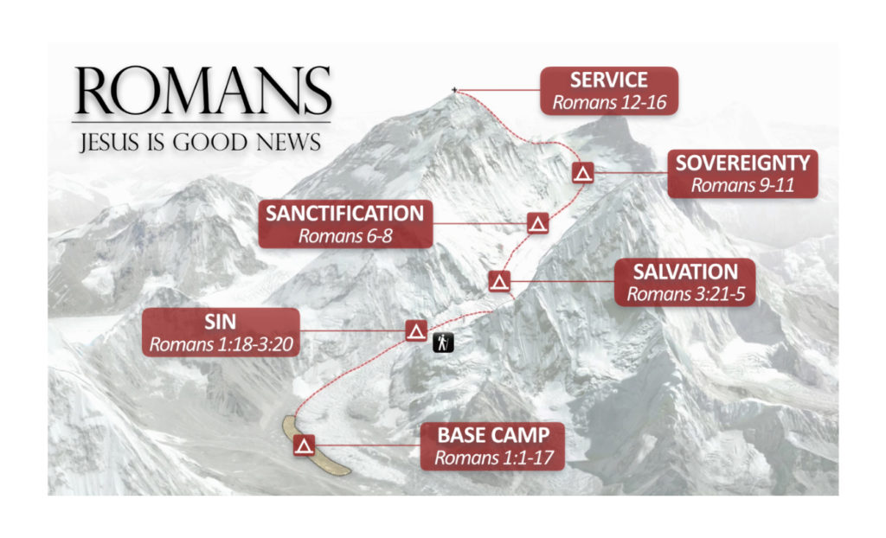

Slide 3


Slide 4
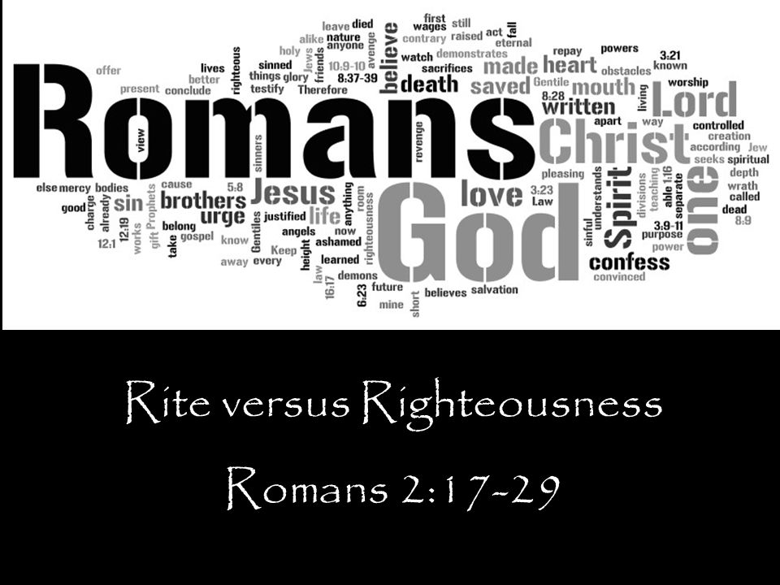
Religion versus Righteousness
Romans 2:17 – 29

Slide 5

Romans 2
Overview:
Depending on how you look at it, religion can be either good or bad. We generally look upon religious people favorably, even when we don’t agree with their religion.
Many who know almost nothing about Christianity revere Billy Graham and Martin Luther King as preeminent men of God.
Statesmen have long understood the crucial role of religion in maintaining a peaceful society.

Slide 6
Romans 2
Overview:
When people believe in something greater than themselves, they generally behave better.
But religion has a dark side. It has caused dissension, sustained wars, and inspired atrocities.
Consequently, some atheists have declared intellectual and political war on all belief in the supernatural, hoping that this will rid the world of its most prolific evil, religion.

Slide 7
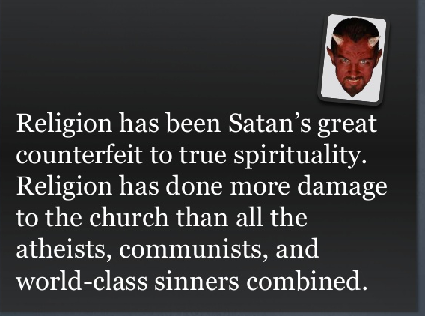

Slide 8
Romans 2
RELIGION = a set of beliefs concerning the cause, nature, and purpose of the universe, especially when considered as the creation of a superhuman agency or agencies, usually involving devotional and ritual observances, and often containing a moral code governing the conduct of human affairs.
A specific fundamental set of beliefs and practices generally agreed upon by a number of persons or sects: the Christian religion; the Jewish religion; etc.
SALVATION = the act of saving or protecting from harm, risk, loss, death; the state of being saved and delivered from sin and eternal death.

Slide 9
Romans 2
Overview:
How to be a Christian without becoming religious might sound like a contradiction. Isn’t being a Christian the same as being religious?
As most people understand the term “Christian,” YES. But according to Paul’s letter to the Romans, NO.
Christianity is not a treadmill. Daily, most Christians climb onto the religious demands of their leaders and peers, and they start running.

Slide 10
Romans 2
Overview:
Working, striving, hoping, pleading , and praying they might please God, or win His favor, or maybe just cause Him to smile on them for a moment or two.
With so much distance between the perfection God demands and where we stand, certainly we will have to work hard to close the gap.
That’s religion . . . all pain, no gain.

Slide 11
Romans 2
Overview:
Fortunately, genuine Christian practice has nothing to do with religion. For one to become a Christian, he or she must first accept that no amount of effort on the treadmill will put distance between us and our sin, nor will religious effort bring us any closer to God.
Only the grace of God will do that. God’s grace provides salvation we cannot earn, favor we do not deserve, and kindness we cannot repay.

Slide 12
Romans 2
Overview:
In this world, “there ain’t no such thing as a free lunch.” You get what you pay for. Justice demands restitution in exchange for sin.
So, finding themselves trapped between the awful vision of damnation and the impossible demands of religion, people delude themselves into thinking that the “right something” will somehow transform them within.

Slide 13
Romans 2
Overview:
They search for the right ritual, the right talisman, the right tradition, the right church – but it’s all in vain.
Religion is all wrong! Jesus offers salvation.
By the end of Chapter 1, Paul had demonstrated that Gentiles have condemned themselves by chasing false gods.

Slide 14
Romans 2
Overview:
And in 2:1-16, Paul proved that pursuing the one true God on one’s own terms is no better. We cannot satisfy our own self-defined standard of righteousness, to say nothing of His.
Now in 2:17-29, Paul turns his attention to the most religious people of all, the Jews. As Paul indicts God’s covenant people, keep in mind that these words are coming from the pen of a Jew. Moreover, everything Paul writes to his kinsmen also applies to present-day Christians.

Slide 15


Slide 16
Romans 2:17 – 29
Overview:
Remember, Paul is the prosecuting attorney. In 1:19-32, he points his finger at the Gentile world and says, “You are guilty as charged.”
In Ch2, Paul addresses the Jewish world, the pious, religious people who hid behind their pedigree and profession, and says the same thing, “Guilty as charged.” The Jew is without excuse.
Then in Ch3, Paul says, “For all have sinned and come short of the glory of God.”

Slide 17
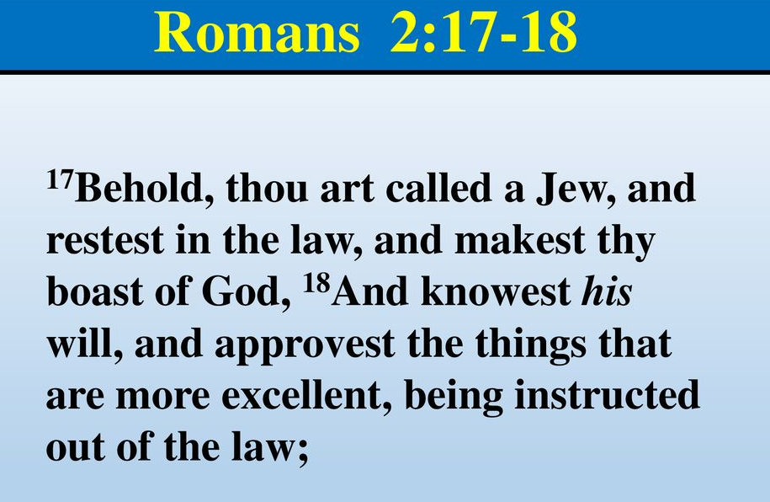
Romans 2:17 – 18

Slide 18
Romans 2:17 – 18
Overview:
Paul begins by identifying five sources of religious pride and arrogance for Jews:
[1] THEIR TITLE: The very name Jew came from Judah, meaning “Yahweh be praised.”
This wonderful reminder of the covenant also became their source of smugness and stubbornness. In 2:1, Paul indicted the Jew for passing judgment on others, thereby condemning themselves. This was their “hypocrisy.”

Slide 19
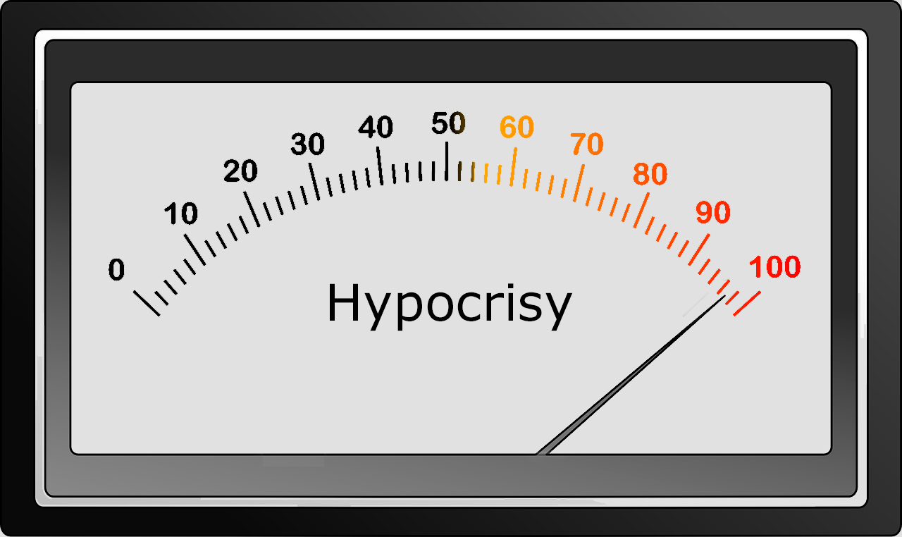
Romans 2:17 – 18
What’s the reading on your hypocrisy meter?

Slide 20
Romans 2:17 – 18
Overview:
Paul’s five sources of religious pride:
[2] THEIR POSSESSION OF THE LAW: God chose the Hebrew people, as the seed of Abraham, to bear His word to the rest of the world.
Many thought this responsibility exempted them from God’s judgment and guaranteed them the kingdom of God. They were falsely secure.

Slide 21
Romans 2:17 – 18
Overview:
Paul’s five sources of religious pride:
[3] THEIR UNIQUE RELATIONSHIP WITH GOD: To “boast in” meant to claim superior standing because of someone or something and to express a high degree of confidence because of it.
The words have the idea that you are boasting in a braggart sense. You are boasting that in God you have God, the Law, and the name Jew. Regrettably, their lives were not backing it up.

Slide 22
Romans 2:17 – 18
Overview:
Paul’s five sources of religious pride:
[4] THEIR KNOWLEDGE OF GOD’S WILL: As recipients of divine instructions, they were capable of discerning God’s plan for the ages.
In addition to the Law, they carefully preserved the writings of the prophets, knowledge of the future that undoubtedly fed their elitist national pride. Although they have God’s knowledge, they are not living according to it.

Slide 23
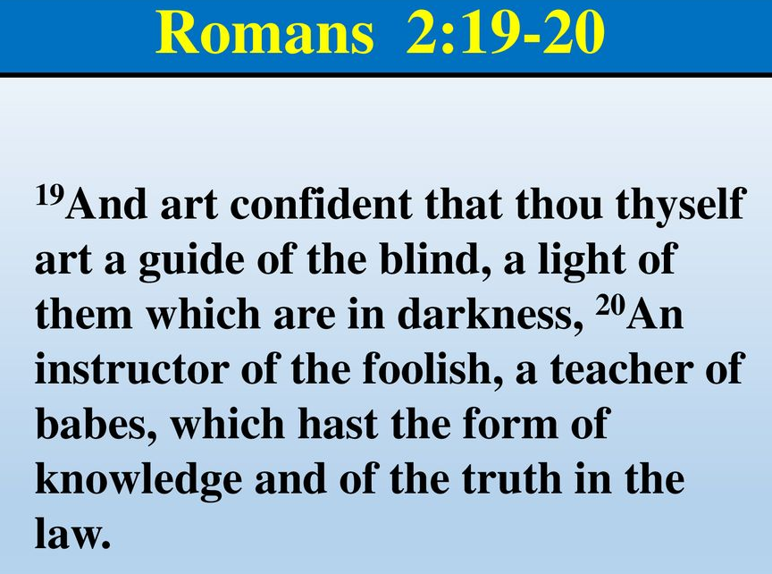
Romans 2:19 – 20

Slide 24
Romans 2:19 – 20
Overview:
Paul’s five sources of religious pride:
[5] THEIR RESPONSIBILITY TO INSTRUCT THE NATIONS: God charged the Jews with the responsibility to teach the rest of the world about Him, a duty that was as old as the covenant with Abraham.
They were to be a guide to the blind, a light to those who are in darkness, a corrector of the foolish, a teacher of the immature. Many thought mere possession gave them success and victory.

Slide 25
Romans 2:19 – 20
Overview:
The dark side of all these blessings was pride, such arrogance that many Jews referred to Gentiles as “dogs.”
Paul’s purpose was not to bash his fellow Jews or to suggest that their unique privilege as God’s chosen people was bad but to help his Jewish readers understand that their religion did nothing to cleanse the inside. That’s the definition of religion. The disparity between inner and outer righteousness leads to hypocrisy.

Slide 26
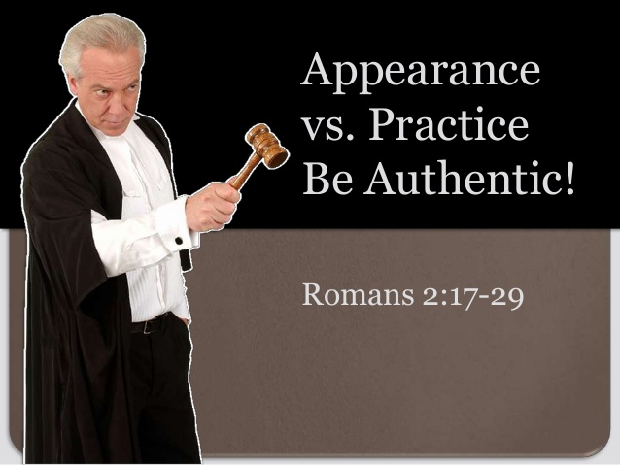
Romans

Slide 27
Romans 2:21 – 23
Overview:
Next, Paul dons the robes of a barrister to cross-examine the self-righteous Jew, first by probing his integrity and then by bringing irrefutable evidence of guilt against the source of his religious pride: his heritage.
Paul asks five pointed questions:

Slide 28
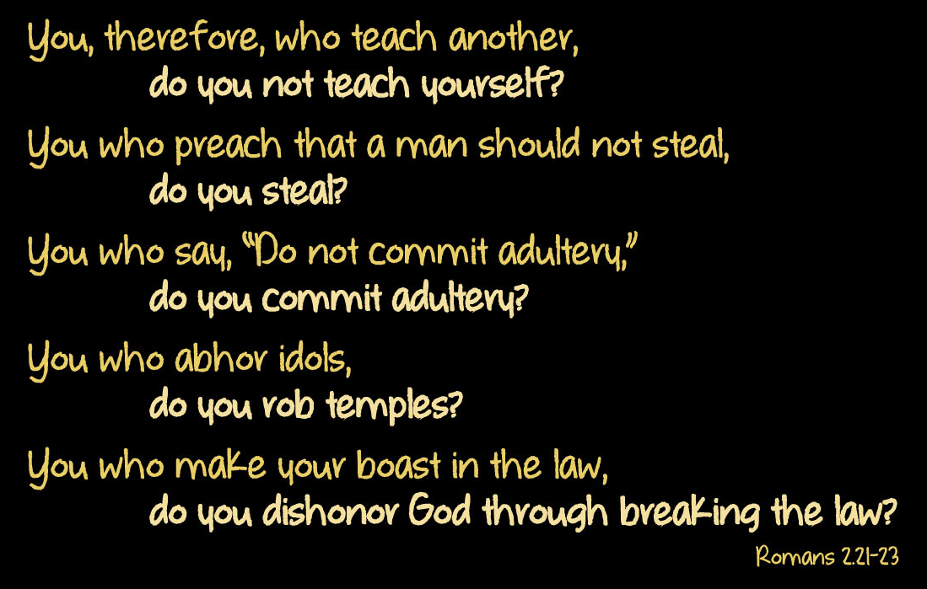
Romans 2:21 – 23

Slide 29
Romans 2:21 – 23
Overview:
Next, Paul dons the robes of a barrister to cross-examine the self-righteous Jew, first by probing his integrity and then by bringing irrefutable evidence of guilt against the source of his religious pride: his heritage.
Paul asks five pointed questions: “Do you …”
  teach yourself – steal –
  commit adultery – rob temples
  dishonor God.

Slide 30
Romans 2:21 – 23
Overview:
If by chance the individual could answer “no” to the first four and dared to deny the fifth, he still could not escape the indictment of the prophets Isaiah and Ezekiel (Isa. 52:5; Ezek. 36:20-22).
The Jew could not – any more than the Gentile – claim exemption from God’s judgment on the basis of personal holiness or religious heritage.

Slide 31
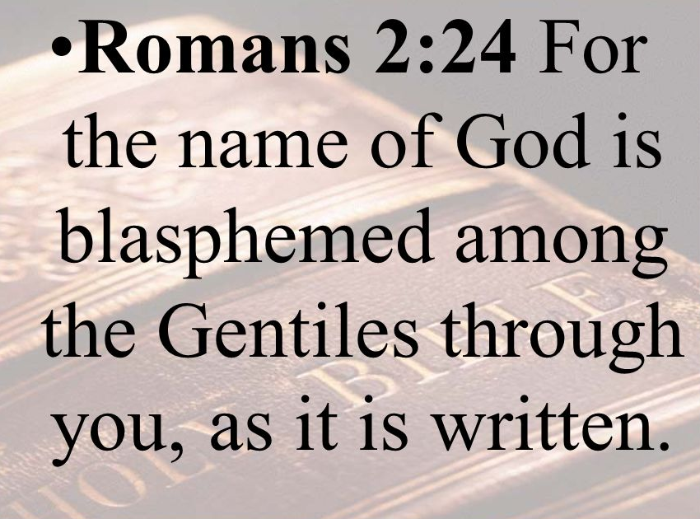
Romans 2:24

Slide 32
Romans 2:24
Overview:
The term “blaspheme” means to hurt the reputation of someone, to slander someone, to ruin the proper estimate of someone. Notice they didn’t ruin the proper estimate of Judaism.
They ruined the Gentiles’ estimate of God. The problem in our world is not unbelievers. It is a fact that people who claim to be Christians are not living a righteous lifestyle. This doesn’t disgrace our name. It disgraces God’s name.

Slide 33
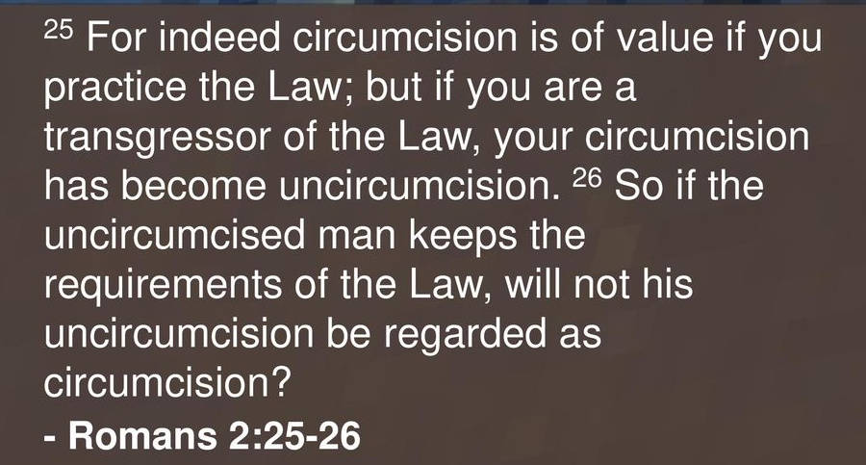
Romans 2:25 – 26

Slide 34
Romans 2:25 – 26
Overview:
Because the Jews had circumcision, they thought that marked them and set them apart unto God and guaranteed the Kingdom of God.
The first thing that would happen to a male Jewish boy would be that he was circumcised eight days after he was born. That circumcision would mark him.
The thing the Jew did not understand was that circumcision had no spiritual power at all. None.

Slide 35
Romans 2:25 – 26
Overview:
Circumcision was simply a reminder that they were set apart unto God. If they did not live obedient to God, their circumcision was of no value at all. Certainly, it never had any spiritual value.
Circumcision was to point the Jew to obedience and if he is obeying, he doesn’t even need circumcision, because he already has the point: he is living as he is supposed to live.

Slide 36
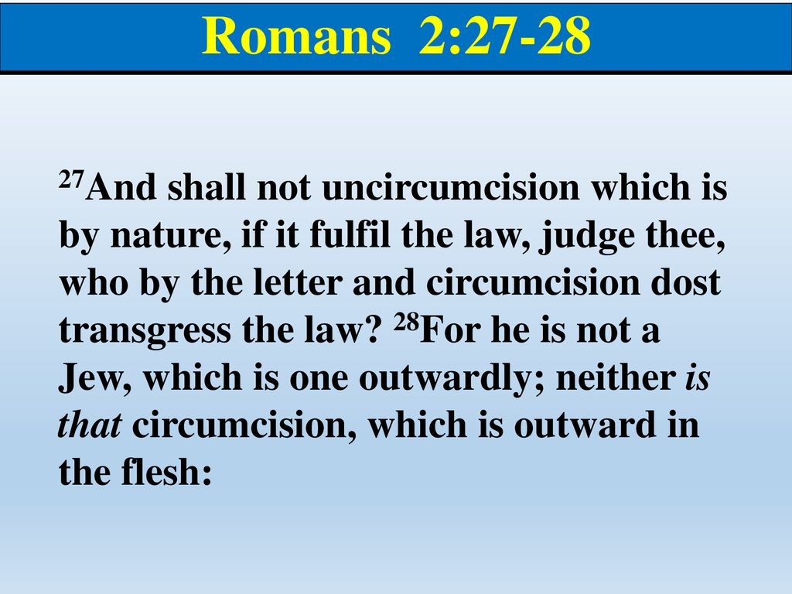
Romans 2:27 – 28

Slide 37
Romans 2:27 – 28
Overview:
Paul was saying, “Hey, you guys. You may have the Law. You may have the mark of circumcision on you, but if you are not obeying and a Gentile receives the Good News of God and obeys God, then the Gentile will turn right around and stand in judgment of you!”
All those rites, all of those external things, were to remind people as to whose they were and who they were. If there was no obedient lifestyle, none of that was of any value at all.

Slide 38
Romans 2:27 – 28
Overview:
Baptism is an outward symbol of an inward change that has taken place in your heart. It has no spiritual value at all if there is no life to back it up. It becomes a living testimony if there is a life behind it.
There has to be a change of heart, a heart that desires to please God, and then a lifestyle that grows and grows and gets better and better. It starts at a significant, spiritual rebirth experience when a person receives Jesus Christ.

Slide 39
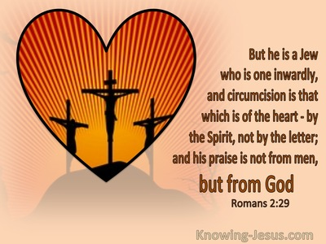
Romans 2:29

Slide 40
Romans 2:29
Overview:
Every time Paul speaks, he speaks of the Jew, not of Israel. A Jew is an individual. Israel is a nation.
God made a covenant with Abraham that concerned a land, a nation, and a seed. God is going to be faithful to keep it.
In Romans 9, 10, and 11 Paul shows us that God is not through with Israel yet. The whole plan of Israel was to point people to what it meant to be a believer in God.

Slide 41
Romans 2:29
Overview:
The outward symbol of true circumcision is obedience. Paul emphatically states that God prefers a Gentile with a circumcised heart over a disobedient Jew bearing the outward symbol of a broken covenant.
Which would you prefer: an unfaithful spouse who proudly wears you wedding ring or a mate who guard your shared intimacy with his or her life, but doesn’t wear a ring?

Slide 42
Romans 2:29
Overview:
If you were on trial for being a Christian, would there be enough evidence to convict you.
That is the indictment to the church today. We talk about it and use it to judge others with it, but are we living it ourselves?
The righteous lifestyle is what is going to be judged one day by God Himself.

Slide 43


“Come unto Me”

Slide 44
NEXT CLASS – 17 Feb 2021
Book of Romans
Before next class, read the below chapter in the KJV and in one other versions of the Bible, i.e., NKJV, NRSV, NIV, CEV, etc …
Read the entire Chapter 3:1 – 31
Focus on Chapter 2:17 – 29

Slide 45



the end
Questions
Questions

Slide 46


