Slide 1

An Autopsy of Depravity
Chapter 3:1 – 20
Week 5
17 February 2021

Slide 2


Slide 3
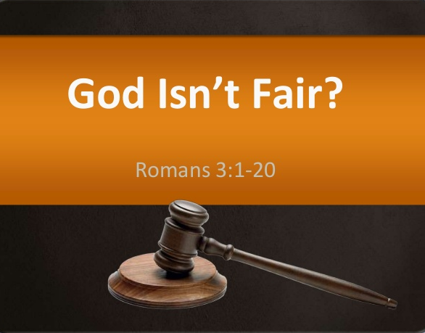

Slide 4

Autopsy of Depravity

Slide 5

Romans 3
Overview:
The central theme of Paul’s letter to the Romans is the gospel – the good news (1:16). He began, however, with the bad news , the universal problem of human depravity.
For how can anyone understand the need for a Savior who does not first acknowledge the evil lurking in the shadows of his public self?

Slide 6
Romans 3
Overview:
The term “depraved” doesn’t mean that we are as bad as we can possibly be. People can accomplish good things, including great deeds of kindness to others.
Furthermore, we could always be much worse than we are. However, we deserve none of the credit for whatever good we may have accomplished.

Slide 7
Romans 3
Overview:
We have a nature that is enslaved to evil and, were it not for the fear of being caught and the inevitable consequences of wrongdoing, nothing would prevent any one of us from falling headlong into abject corruption.
In the absence of external restraint, the depraved human nature lurking within each of us would express itself with astonishing acts of selfishness, cruelty, lust, and murder.

Slide 8
Romans 3
Overview:
The term “depravity” has more to do with the vertical plane of existence – our relationship with God – than our horizontal dealings on earth.
We are not as bad as we can possibly be, however, our sinful deeds prove that we are as bad off as we can possible be. Our good deeds do nothing to overcome our separation from God, legally or relationally. We stand condemned, not only because of what we have done, but because of what we are.

Slide 9
Romans 3
Overview:
And to prove that the rule applies to everyone, Paul systematically turned from one person to the next, peeling off whatever mask he or she might be wearing.
Paul stripped the upright intellectual Gentile of his disguise to reveal a simpering fool who merely professes to be wise, worships creation over the Creator, and exchange the natural for the unnatural (1:18-32).

Slide 10
Romans 3
Overview:
Consequently, God has given such people over to impurity, to degrading passions, and to a depraved mind. That is, a mind proven to be worthless by its deeds.
Paul then sliced through the armor of the self-satisfied crusader, the self-righteous moralist, who presumes to be above judgment by virtue of his or her rituals and traditions. Yet beneath the armor of religion beats a corrupt heart (2:1-16).

Slide 11
Romans 3
Overview:
Lastly, Paul defrocks his fellow brothers of the covenant. Clearly, God chose the Hebrew people to receive his Word and to share it with the world, yet they were not exempt from divine judgment.
In fact, they deserved a greater portion. Gentiles sinned in ignorance and would reap the wages of sin, but Jews rebelled against God with a greater knowledge of what they were rejecting, knowing fully who they offended and the consequences their sin would reap.

Slide 12
Romans 3
Overview:
By this point in his letter, Paul had sufficiently demonstrated that everyone is guilty: the willfully ignorant (1:18-32), the self-righteous (2:1-16), and the super-religious (2:17-19).
They all deserve the wrath of God.
As Paul taught this truth in the synagogues, he undoubtedly encountered a number of objections.

Slide 13
Romans 3
Overview:
To anticipate rebuttals among his readers, the apostle restates each of the four most common objections in the form of a question.
The question of . . .
  1] racial advantages
  2] divine faithfulness
  3] confused righteousness
  4] twisted logic

Slide 14
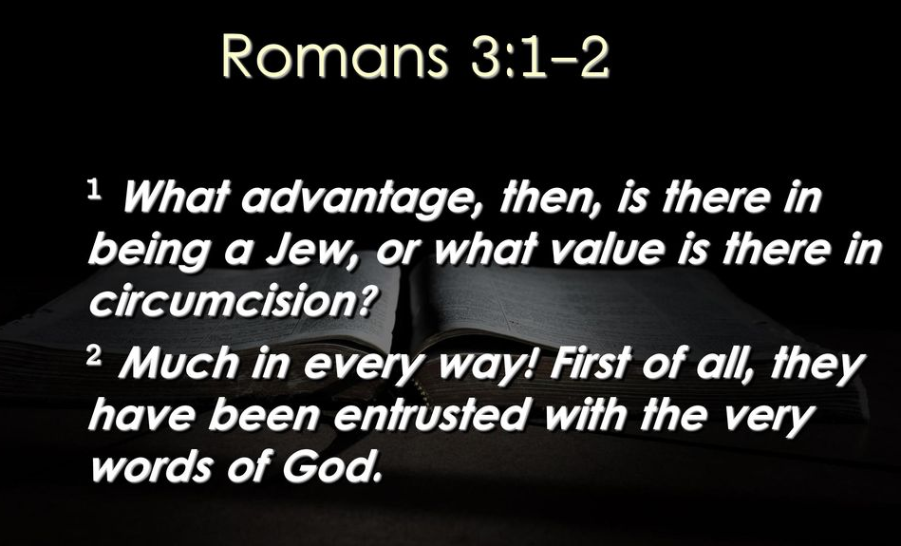
Romans 3:1 – 2

Slide 15
Romans 3:1 – 2
The question of racial advantage: “What’s the advantage of being a Jew or what value is there in circumcision?” (3:1).
In other words, if God’s covenant with the descendants of Abraham (and those Gentiles who enter the same covenant by choice [Gen. 17:12-13]) doesn’t make them righteous, what was the point. How are we “greater than” the Gentiles? What are the “benefits” of our privilege?
Paul explains that God’s covenant does not exempt anyone from judgment.

Slide 16
Romans 3:1 – 2
Paul tells the Jew they benefit “in every respect.” It is an unequaled privilege. The descendants of Abraham, Isaac, and Jacob received more truth (the Oracles of God) than any other group of people on earth.
To the Jew the Scriptures were given. Through them the Scriptures were shared. From them the whole world would receive God’s invitation to receive grace and salvation.
The Jew knew the will and knowledge of God spoken through prophets and sung in psalms.

Slide 17
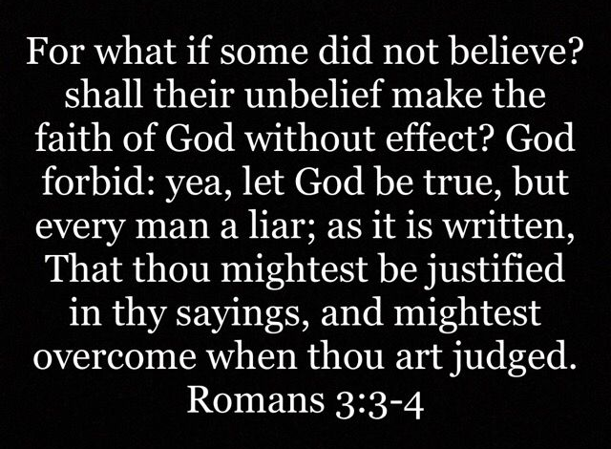
Romans 3:3 – 4

Slide 18
Romans 3:3 – 4
The question of divine faithfulness: “What if some were unfaithful, will their lack of faith nullify the faithfulness of God?” (3:3-4).
In other words, “Does the failure of the Hebrew people to keep their end of the bargain prevent God from accomplishing His plan to save the world?”
The answer is obvious – NO! The unbelief of the entire Jewish race would never in any way prevent God from accomplishing His will.

Slide 19
Romans 3:3 – 4
God keeps His promises, and He will remain faithful despite the failure of humanity.
In fact, His light only shines brighter against the inky-black backdrop of humanity’s darkness. To illustrate, Paul draws upon King David’s (you are the man) prayer of repentance in Psalm 51:4
    “Against you, you alone, have I sinned,
    and done what is evil in your sight,
    so that you are justified in your sentence
    and blameless when you pass judgment.”

Slide 20
Romans 3:3 – 4
What God is saying is, “I’ll honor My covenant with Israel. But you, as individuals, will be judged for the sin in your own life, even David your hero knew that.”
Because they knew God would be faithful to all of Israel, they built their hopes upon it, culled out all the other verses and built a false theology that allowed them to sin and get away with it.
When you don’t allow God’s Word to lead you to repentance, this is exactly what you will do.

Slide 21
Romans 3:5 – 6
⁵ But if our injustice serves to confirm the justice of God, what should we say? That God is unjust to inflict wrath on us? (I speak in a human way.) ⁶ By no means! For then how could God judge the world?

Slide 22
Romans 3:5 – 6
The question of confused righteousness: “But if our unrighteousness demonstrates the righteousness of God, what shall we say? The God who inflicts wrath is not unrighteous, is He?” (3:5).
In other words, “Because God made these moral demands knowing humanity would fail, does that make His wrath unjustified?”
After all, weren’t we doomed to failure from the beginning?

Slide 23
Romans 3:5 – 6
But the giving of the Law didn’t suddenly make humanity guilty of wrongdoing. God didn’t arbitrarily paint a target somewhere other than when we had already shot the arrow and then call it a miss. The target has always been present.
God’s utterly righteous character is – and always has been – the standard. The Law merely illuminates and magnifies the target, leaving humanity with even less of an excuse for missing it. Paul will explain this in greater detain in the next major section of his letter (4:15; 5:13).

Slide 24
Romans 3:5 – 6
The Lord did not give the Law to humanity in order to justify His wrath. On the contrary, he established clear lines between right and wrong as a means of grace, to confront humankind with our offenses and to lead us to repentance.
The giving of the Law was a first step in His plan to redeem us. Rather than simply discard us or abandon us to our own self-destructive end, God cared enough to confront us, to identify the source of our estrangement from Him. God did this so that we might see our wrongdoing, repent of our sins, and seek a means of reconciliation.

Slide 25
Romans 3:5 – 6
When you are not being led to repentance, you are going to do something. You will take the Word and make it mean what you want it to mean and provide you a license to sin.
You think God’s grace in your life means you can just do whatever you want to do. How is that working for you?
God’s Word says there is no way you can live unrighteous and claim to know Him. How can folks ever justify that?

Slide 26
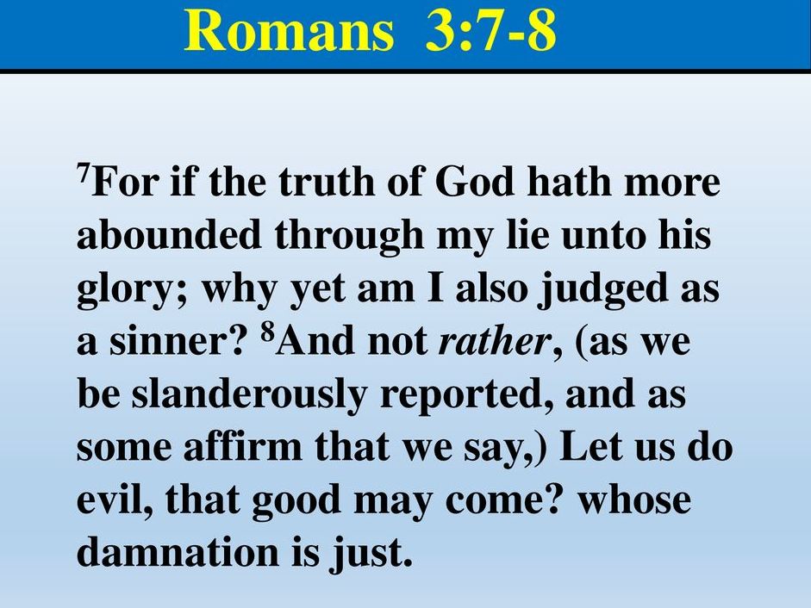
Romans 3:7 – 8

Slide 27
Romans 3:7 – 8
⁷ But if through my falsehood God’s truthfulness abounds to his glory, why am I still being condemned as a sinner? ⁸ And why not say (as some people slander us by saying that we say), “Let us do evil so that good may come?” Their condemnation is deserved!

Slide 28
Romans 3:7 – 8
The question of twisted logic: “But if through my lie the truth of God abounded to His glory, why am I also still being judged as a sinner? And why not say . . . Let us do evil that good may come?” (3:7-8).
In other words, “If God’s light shines brighter because of our darkness, haven’t we glorified God all the more by our wrongdoing? Let’s sin like crazy so we’ll know grace like never before!”
What bizarre thinking and twisted logic!

Slide 29
Romans 3:7 – 8
On the other side of this argument was Paul accused of preaching the message that grace is a license to sin.
The Jews didn’t like it when they found out the Gentiles could be saved and not be circumcised. So they turned on Paul, the very man God was using and tried to make him look like he was preaching license when all Paul was doing was preaching the message of grace.

Slide 30
Romans 3:7 – 8
It fails to comprehend the destructive nature of sin. That kind of logic is no better than saying, “If fires and disasters give rescue workers an opportunity to display their skills and bravery, why not set more fires and cause more disasters so they will have greater opportunity to show their courage?”
Sounds great until you consider the victims. There are no victimless sins. Every choice to do wrong harms someone – if not right away, inevitably; and if not directly, indirectly.

Slide 31
Romans 3:7 – 8
At some level, all of humanity suffers. And far from glorifying God, sin grieves God. It’s an affront to His character – all that He is and everything He desires. Sin separates the Creator from the creation He loves so dearly.
Note Paul’s final remark, referring to those who would justify their willful sin with such twisted logic, he declared simply, “Their condemnation is just” (3:8).

Slide 32
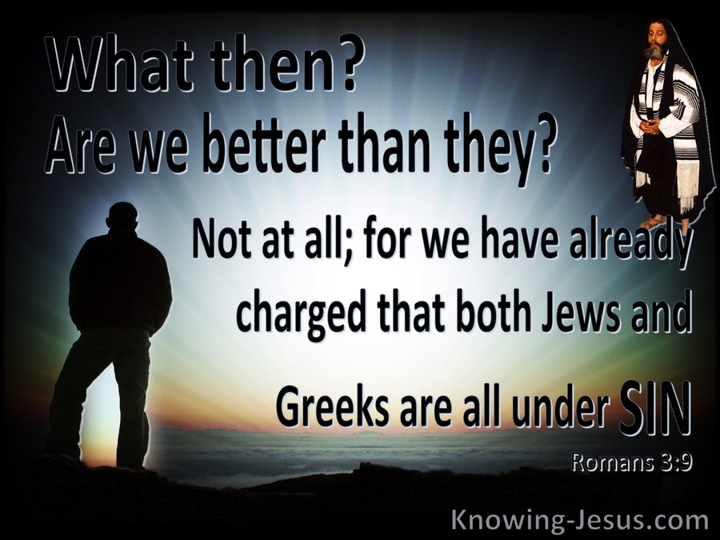
Romans 3:9

Slide 33
Romans 3:9
Here, the question in 3:9 is similar to the one asked in 3:1, “Do Jews have an advantage over Gentiles?”
Paul says that the charge has been leveled and it is clear that all men, Gentiles and Jews, are under sin. They are all guilty as charged. The Jew and the pagan are no different. Within each beats the same sin-sick heart.
Paul sums up what he has been saying now for two chapters: every man is desperate for the good news of Jesus Christ (3:9).

Slide 34
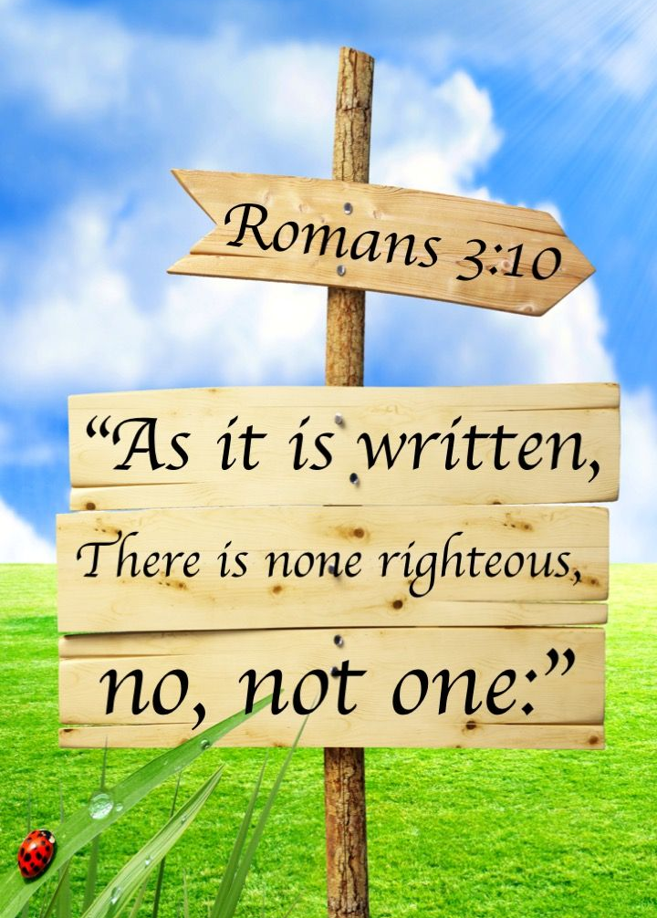
Romans 3:10

Slide 35
Romans 3:10
In a final, dramatic flourish, Paul settles the issue of universal human depravity, leaving no room for argument or objection.
Note Paul’s direct quotations and clear allusions from the Old Testament. Paul lays humanity on the examining table and cut through all outward appearance to expose what lies within . . .
Throat – tongue – lips – mouth – feet and eyes.

Slide 36
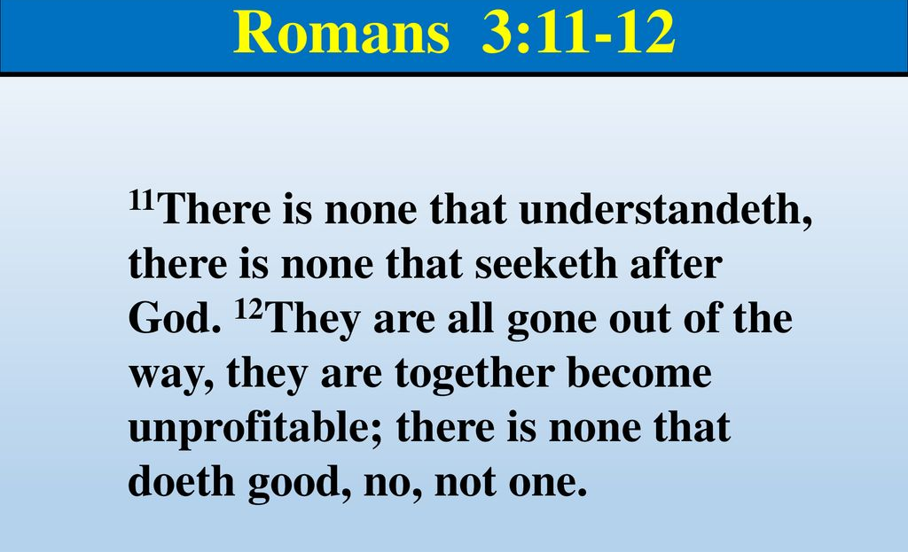
Romans 3:11 – 12

Slide 37
Romans 3:11 – 12
Paul says, “There is not a single man, Jew or Gentile on this earth, who has any kind of spiritual understanding whatsoever.”
There is none who understands, there is none who seeks for God." The word "none" means absolutely no one.
The term "understands“ means the ability to take all the different facts, put them together and come to a conclusion that would give them understanding about God and divine things.

Slide 38
Romans 3:11 – 12
Paul says, “All have turned aside ...”
The Jew has intentionally turned aside to avoid God and to establish their own standards.
In his heart a man knows that what he does is wrong. He knows that there is a standard God is going to require. Even the Gentiles knew that what they were doing was worthy of death, but they didn’t want God because they didn’t want to stop what they were doing.

Slide 39
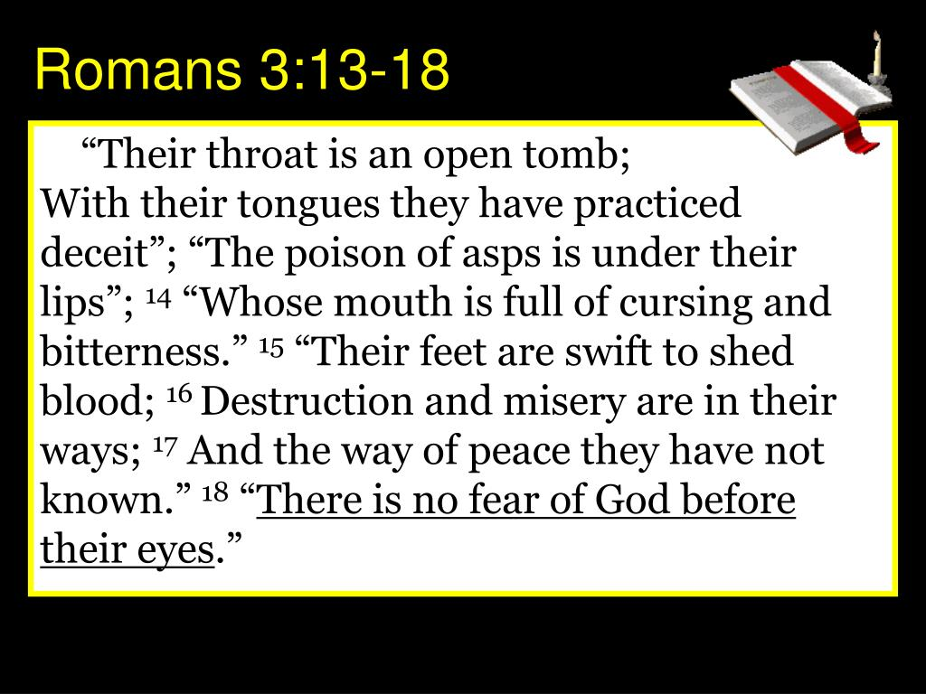
Romans 3:13 – 18

Slide 40
Romans 3:13 – 18
Paul uses the Old Testament to perform his autopsy on humanity . . .
  Throat and tongues – Ps. 5:9
  Lips – Ps. 140:3
  Mouth – Ps. 10:7
  Feet – Isa. 59:7-8
  Eyes – Ps. 36:1
The veil between savagery and civility is only as thick as our sincere belief that our actions have consequences.

Slide 41
Romans 3:13 – 18
Paul says, “There is no fear of God before their eyes.” This fear can take two forms . . .
First, those who oppose the goodness of God should tremble in terror of His power. At some point, everyone should experience such fear.
Secondly, the right kind of fear leads to repentance and a restored relationship with God.
Unfortunately, many will not acknowledge their Creator and will continue to ignore the anger stored up against them (2:4-5).

Slide 42
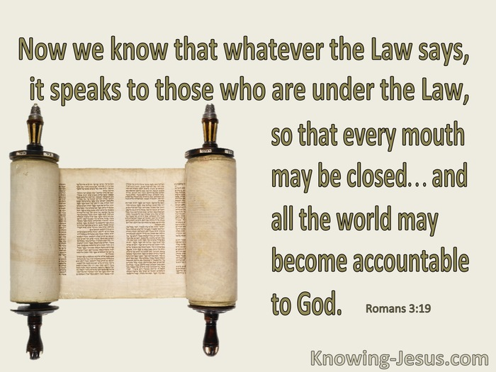
Romans 3:19

Slide 43
Romans 3:19
Do you know what it means to be under the Law? All men are under the Law. The Law that God wrote on a Gentile’s heart; the law that He gave to the Jews.
The law that He gave to the Jews condemns all men, not just the Jews. Paul is saying all men are under the law, which means you are subject to it.
Moreover, “that every mouth may be closed.” In other words, if you have ever broken one of them, you are guilty of the whole law.

Slide 44
Romans 3:19
Every man living on the face of this earth has broken that law.
Paul is saying, “You Jews are guilty. Now shut up. You Gentiles are guilty. Now shut up. The law has condemned you so be quite.”

Slide 45
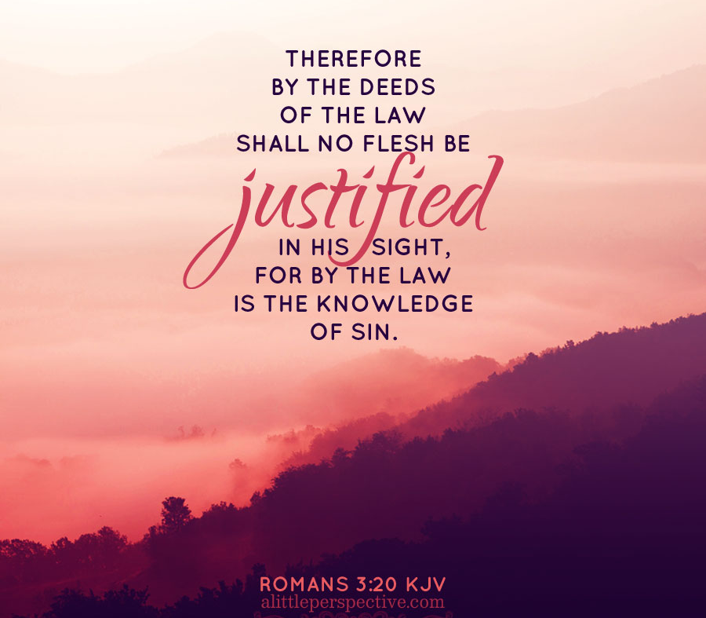
Romans 3:20

Slide 46
Romans 3:20
God’s law, whether on tablets of stone given by Moses or written on the pagan man’s heart shows the sinfulness of man. It is the standard that no man can reach but to which every man is accountable.
So Paul says, “Okay, Law, have you spoken? Psalms, have you spoken? Prophets, have you spoken? I rest my case. God has a case against every man, Gentile, Jew, pagan, pious. Every man is guilty before God.”

Slide 47
Romans 3:20
You may think to yourself, “My goodness, this is the worst news I have ever had in my life. Paul, do you know what he is doing?”
Under the inspiration of the Holy Spirit of God, Paul is bringing us full circle, right back around to the good news of Jesus Christ.
Until you realize how bad it is, you haven’t got a clue how good it is.
Paul is going to come around in our next lesson.

Slide 48
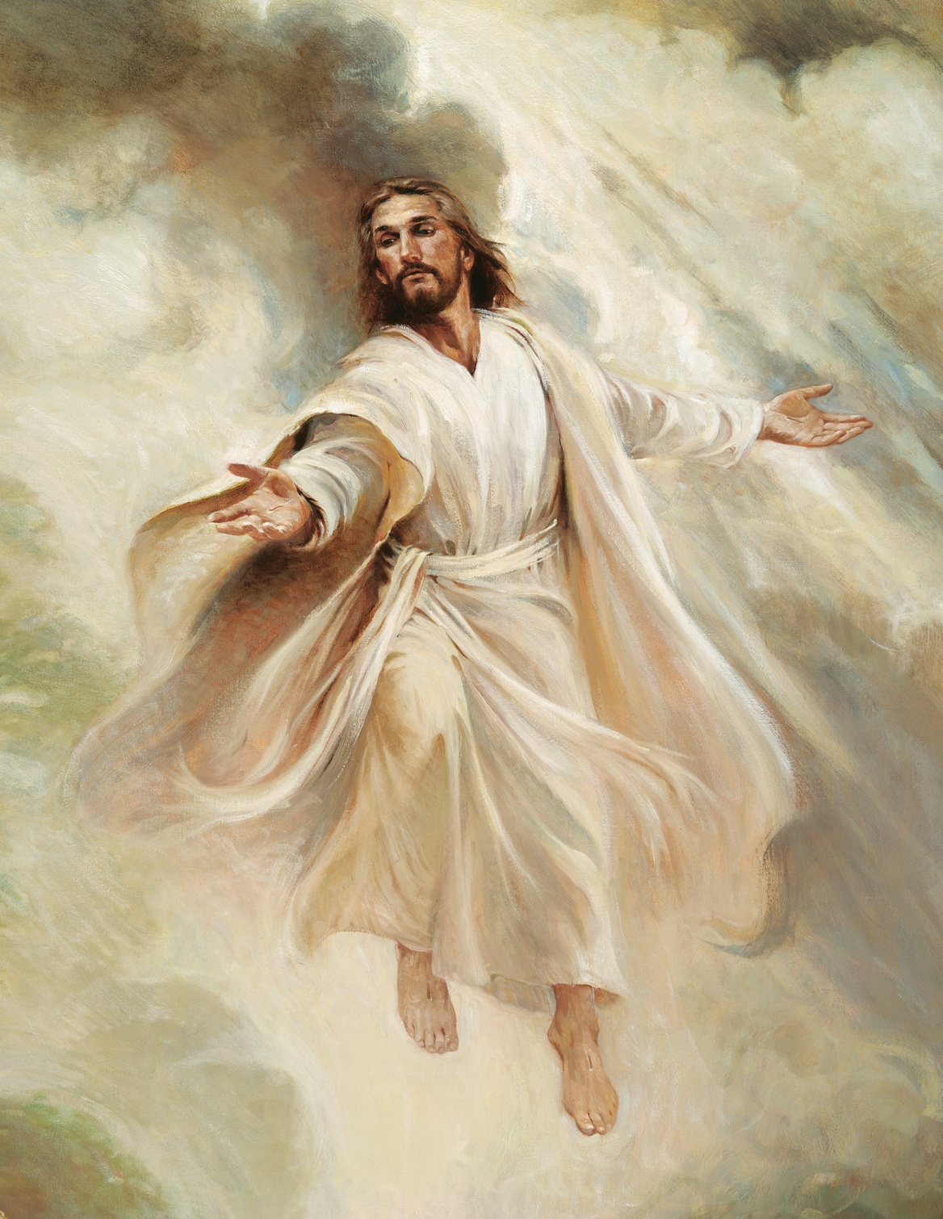

“Come unto Me”

Slide 49
NEXT CLASS – 24 Feb 2021
Book of Romans
Before next class, read the below chapter in the KJV and in one other versions of the Bible, i.e., NKJV, NRSV, NIV, CEV, etc …
Read the entire Chapter 3:1 – 4:25
Focus on Chapter 3:21 – 31

Slide 50



the end
Questions
Questions

