Slide 1

Unwrapping the Gift of Grace
Chapter 3:21 – 31
Week 6
24 February 2021

Slide 2

The Grace of God

Slide 3
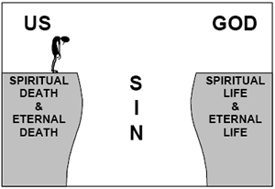
The Gift of Grace

Slide 4

Romans 3:21 – 31
Overview: Right with God through faith in Christ
Paul declares that it is possible to be right with God in a way that is quite different from keeping the Jewish law. It sounds scandalous, but the OT always knew of it.
This righteousness is open to all. Just as Jews and Gentiles are together in sin, so they can be together in salvation.

Slide 5
Romans 3:21 – 31
Overview: Right with God through faith in Christ
The means by which human sin can be forgiven is the sacrifice of Jesus on the cross. A sacrifice is the payment of an innocent life for a guilty life.
Animals and birds are killed in the temple so that the lives of their owners can be spared. But all these sacrifices are inadequate and have to be constantly repeated.

Slide 6
Romans 3:21 – 31
Overview: Right with God through faith in Christ
Now Jesus has become the perfect sacrifice — not an animal, bird or human hero, but the Son of God. His perfect life has been freely offered for the sins of the whole world and for all time.
His righteousness has been credited to us.

Slide 7
Romans 3:21 – 31
Overview: Right with God through faith in Christ
Paul says that through the sacrifice of Jesus we are “justified.” Our punishment has been borne by Christ, and now it is “just as if we had never sinned” (justification).
The sacrifice of Jesus is an “atonement” (to cover) bringing God and human beings together and making everlasting peace.

Slide 8
Romans 3:21 – 31
Overview: No boasting!
So Jews have nothing to boast about. They haven’t worked out their own salvation by keeping the law.
They are saved by faith in Jesus, just as the Gentiles are. The law is still immensely valuable, but only as a guide to living, not as a way of being saved.

Slide 9
Romans 3:21 – 31
Overview: A Whole New Life
Human beings are born with a sinful nature. We are dead to God, and driven by selfish and decadent desires. Because of this, God is angry.
God is holy and just in his anger. If he is to be true to himself, then he can only condemn us to his judgment.
But God loves us. He hates our sin, but he loves us. What can he do, to be true to both his judgment and his love?

Slide 10
Romans 3
Overview: A Whole New Life
God’s answer is to send Jesus, his own dear Son, into the world. Jesus is God in human life, taking on our sinful nature, temptations and circumstances.
In living the perfect life, and dying for the sin of the world, Jesus makes peace between God and humankind.

Slide 11
Romans 3:21 – 31
Overview: A Whole New Life
Here is a sensational free gift! Jesus Christ has paid his life for our sin and secured our forgiveness from God. He has also broken the stranglehold of Satan on our lives — although the struggle with our old nature continues for the time being.
Jesus has enabled us to become God’s children — the beginning of a whole new creation, free of all evil, fear, sin and death.

Slide 12

Romans 3:21 – 31

Slide 13
Romans 3:21 – 31
Overview: Unwrapping The Gift of Grace
The following verses outline no less than four significant truths about the gospel:
Salvation is a transfer of righteousness.
Salvation is a gift of grace.
Salvation is a declaration of faith.
Salvation is a display of love.

Slide 14
Romans 3:21 – 22
Paul has been arguing . . .
²¹ But now the righteousness of God apart from the law is revealed, being witnessed by the Law and the Prophets, ²² even the righteousness of God, through faith in Jesus Christ, to all and on all who believe. For there is no difference:

Slide 15
Romans 3:21 – 22
Salvation is a transfer of righteousness . . .
In the darkest gloom of human history, grace dawned with the rising of the gospel. And it produces genuine righteousness in three ways:
FIRST – genuine righteousness cannot be obtained through obedience of the Law. No once can purge the body of cancer by eating healthful food. Shunning cancerous toxins is a good way to avoid contracting the disease, but once you have it, a cure demand radical action. Unfortunately, we were born with the disease of sin.

Slide 16
Romans 3:21 – 22
Salvation is a transfer of righteousness . . .
SECOND – genuine righteousness is not a new concept. It was witnessed, declared, and made available to humankind from the beginning of time. The Law and the Prophets described this righteousness and demonstrated it to be a part of God’s redemptive plan throughout the ages.
THIRD – genuine righteousness does not come from somewhere within us; it comes solely through faith in Jesus Christ.

Slide 17

Romans 3:23
Salvation is a transfer of righteousness . . .

Slide 18
Romans 3:23
Salvation is a transfer of righteousness . . .
Humanity and God does not measure the standards of righteousness the same. If the standard of righteousness were measured by one’s vertical leap, professional athletes would put most of us to shame. How absurd to suggest that anyone could obtain God’s righteousness through human effort.
God’s character is the moral standard, which sets the bar far beyond human effort, and all have fallen absurdly short of his glory.

Slide 19
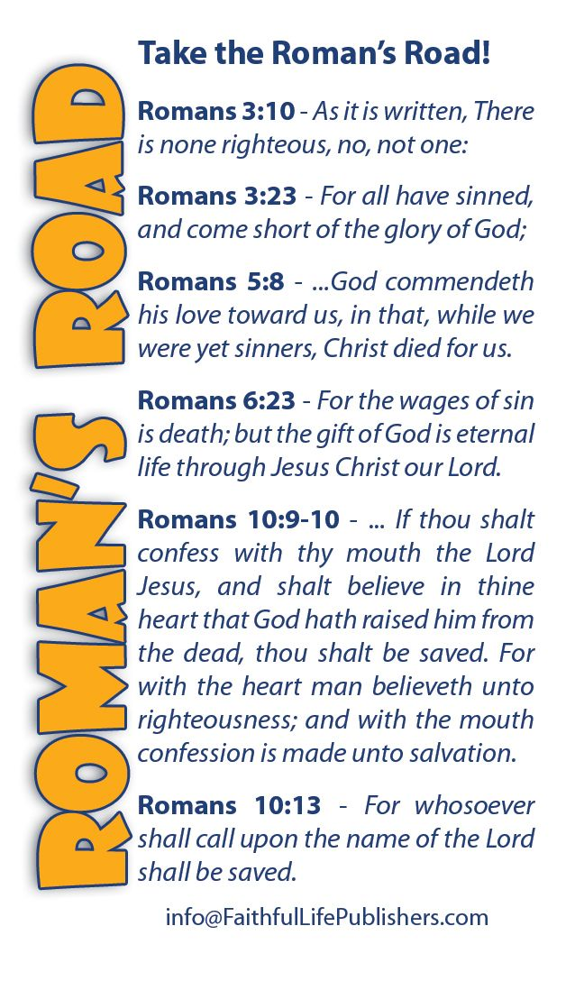

Slide 20
Romans 3:24
Salvation is a gift of grace . . .
²⁴ Being justified freely by His grace through the redemption that is in Christ Jesus,

Slide 21
Romans 3:24
Salvation is a gift of grace . . .
The term “justified” describes the legal status of a defendant before a judge. If a person is considered “just,” he or she will not receive punishment. If, on the other hand, a person is considered “unjust,” he or she faces fines, imprisonment, or worse.
In human courts, one must prove his or her innocence in order to be declared just by the judge.

Slide 22
Romans 3:24
Salvation is a gift of grace . . .
According to Paul’s earlier argument (1:18-3:20), everyone stands irrefutably guilty before our Creator and Judge. All of humanity has fallen absurdly short of God’s standard of righteousness. Therefore, we must be justified by some other means.
We are justified – declared just – as a gift, by His grace, through the redemption which is in Christ Jesus.

Slide 23
Romans 3:24
Salvation is a gift of grace . . .
Though we stand guilty, completely devoid of righteousness before God, we are declared just by means of a transfer of righteousness to our account from that of Jesus Christ. How? “By His grace.” A free gift given not because we are good but because He is good.
All of humanity has been enslaved to sin. The Law of God demands payment for us to be considered “righteous” or “just,” but we are hopeless unable to pay – we need a Redeemer.

Slide 24
Romans 3:25
Salvation is a gift of grace . . .
²⁵Whom God set forth as a propitiation by His blood, through faith, to demonstrate His righteousness, because in His forbearance God had passed over the sins that were previously committed,

Slide 25
Romans 3:25
Salvation is a gift of grace . . .
Propitiation in the OT means “sacrifice of atonement” and is related to “Yom Kippur” or the “Day of Atonement.” On that day, the high priest would take the blood of a goat and sprinkled it upon the “mercy seat” as a ransom for Israel’s sins.
The high priest then laid hands on the head of the other goat symbolically transferring Israel’s sins onto it. The goat was allowed to escape into the wilderness, thus the animal was the “scapegoat.”

Slide 26
Romans 3:25
Salvation is a gift of grace . . .
This sacrificial rite symbolized the satisfaction of God’s holy wrath against sin by means of death.
Paul declares the crucifixion of Jesus to be a public sprinkling of blood – a Day of Atonement rite of Propitiation – that fulfilled two important requirements . . .
FIRST – the atonement of Christ satisfied the wrath of God, which demanded justice for humanity’s sin.

Slide 27
Romans 3:25
Salvation is a gift of grace . . .
SECOND – this atonement silenced the slander against God. Throughout the OT, God delayed judgment, which caused some to suggest that He was not entirely good.
Christ’s public atonement was to demonstrate His righteousness, because in the forbearance of God He passed over the sins previously committed. Our only hope is to be declared righteous by the gracious gift of God.

Slide 28
Romans 3:26
Salvation is a gift of grace . . .
²⁶To demonstrate at the present time His righteousness, that He might be just and the justifier of the one who has faith in Jesus.

Slide 29
Romans 3:26
Salvation is a gift of grace . . .
The wrath of God called for the just penalty of sin to be paid, and His wrath was satisfied in the atoning death of His Son.
Therefore, God is “just,” because sin does not go unpunished, and He is the “justifier,” because the death of His Son clears the way for Him to declare believers righteous without contradicting His own nature.
And we accept this gift of grace through faith.

Slide 30
Romans 3:27 – 28
Salvation is a declaration of faith . . .
²⁷Where is boasting then? It is excluded. By what law? Of works? No, but by the law of faith.
²⁸ Therefore we conclude that a man is justified by faith apart from the deeds of the law.

Slide 31
Romans 3:27 – 28
Salvation is a declaration of faith . . .
Where then is boasting? The grace of God cancels everyone’s right to boast. The truth of the gospel is offensive to human pride.
Pride suggests that enough goodness can substitute for belief in the Son of God.
Faith requires a humble admission that we are helpless to redeem ourselves. A person is justified by faith apart from works of the Law.

Slide 32
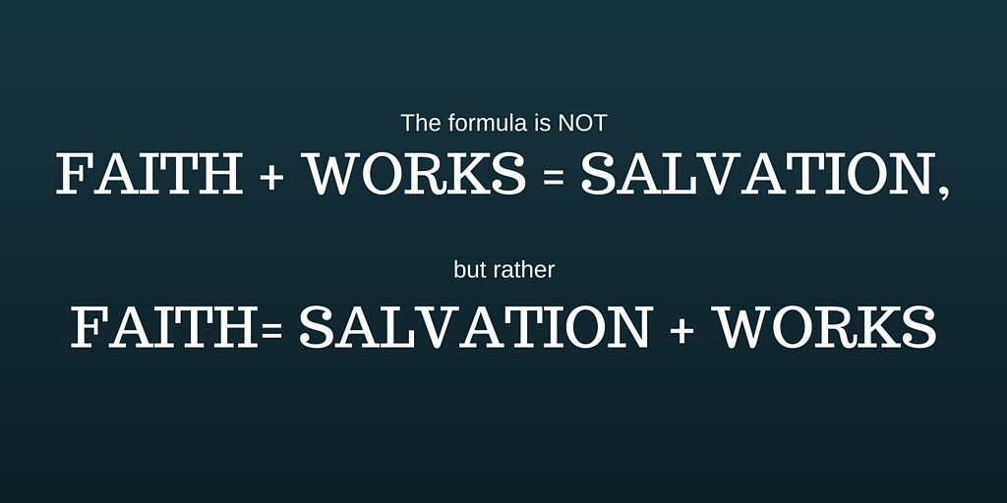
Romans 3:27 – 28
Salvation is a declaration of faith . . .

Slide 33
Romans 3:29 – 30
Salvation is a declaration of faith . . .
²⁹ Or is He the God of the Jews only? Is He not also the God of the Gentiles? Yes, of the Gentiles also, ³⁰Since there is one God who will justify the circumcised by faith and the uncircumcised through faith.

Slide 34
Romans 3:29 – 30
Salvation is a declaration of faith . . .
Paul questions the notion could God be somehow partial. If justification comes by obedience to the Law of God and He gave the Law exclusively to Israel, this would suggest that God only wants Israelites to be saved.
Paul answers simply and directly, stating, “No, because one is justified through faith and not by obedience to the Law, and because everyone is invited to believe, God is the God of all.”

Slide 35
Romans 3:29 – 30
Salvation is a declaration of faith . . .
Some trust in His grace and demonstrate their belief through the rite of circumcision . . .
Some trust in His grace apart from this Hebrew ritual. The common denominator is faith.

Slide 36

Romans 3:29 – 30
Salvation is a declaration of faith . . .

Slide 37
Romans 3:31
Salvation is a display of love . . .
³¹ Do we then make void the law through faith? Certainly not! On the contrary, we establish the law.

Slide 38
Romans 3:29 – 30
Salvation is a display of love . . .
Does this suggest that the Law given to Israel is irrelevant, nullified, or to be render useless?
Paul states, “May it never be!” God is one and he does not change. God gave the Law to expose our sin and to prove our guilt.
Because the Law reflects the character of God, we can never say that the Law is bad.

Slide 39
Romans 3:29 – 30
Salvation is a display of love . . .
Disobedience is nothing less than objective proof of disbelief in the goodness and power of God. One then receives the grace of God apart from good deeds through faith.
Salvation – being declared righteous before our Creator and Judge – is a gift to be received, not a wage to be earned.
Since God is impartial, God’s offer of salvation is a display of love.

Slide 40


“Come unto Me”

Slide 41
NEXT CLASS – 24 Feb 2021
Book of Romans
Before next class, read the below chapter in the KJV and in one other versions of the Bible, i.e., NKJV, NRSV, NIV, CEV, etc …
Read the entire Chapter 4:1 – 25
Focus on verses 4:1 – 15

