Slide 1

Hoping against Hope
Chapter 4:16 – 25
Week 8
10 March 2021

Slide 2

Hoping Against Hope

Slide 3

Romans 4:1 – 25
Overview of Ch 4:
In chapter 4, Paul presented several irrefutable reasons why justification is by faith:
[1] Since justification is a gift, it cannot be earned by works (1-8).
[2] Since Abraham was justified before he was circumcised, circumcision has no relationship to justification (9-12).

Slide 4
Romans 4:1 – 25
Overview of Ch 4:
[3] Since Abraham was justified centuries before the Law, justification is not based on the Law (13-17).
[4] Abraham was justified because of his faith in God, not because of his works (18-25).

Slide 5
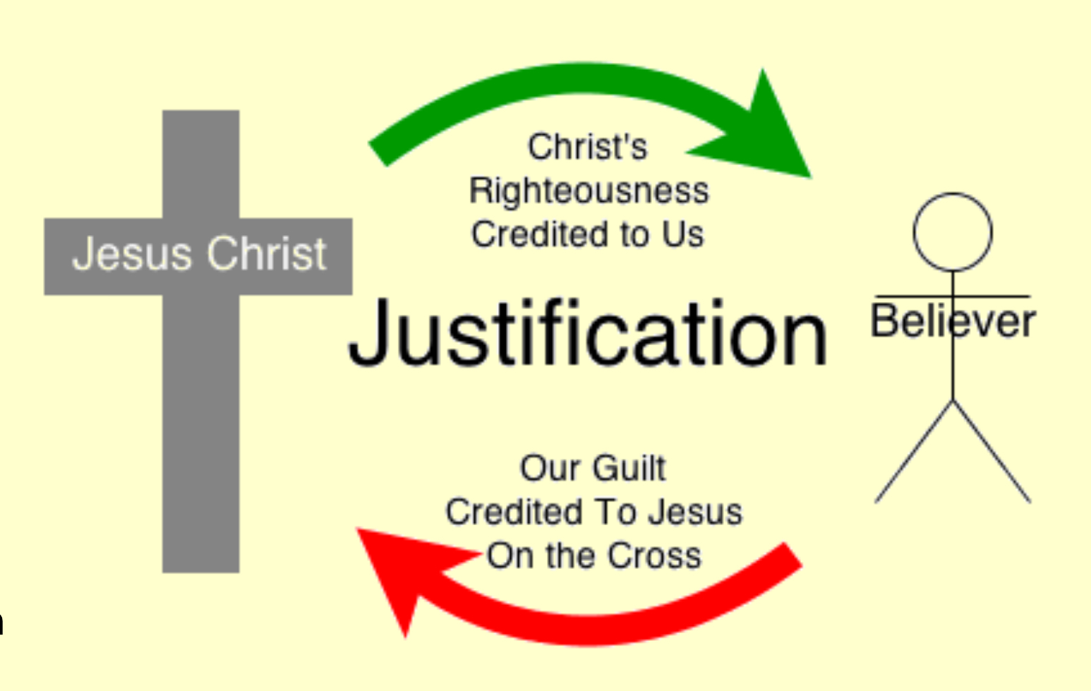
The Doctrine of Imputation

Slide 6
Romans 4:16 – 25
Overview This Lesson:
Having nailed down the truth that human beings can’t earn the righteousness of God by works (4:1-15), Paul then illustrated how God can credit His righteousness to us. It is by our “faith,” a term which has gone through many changes of meaning over time.
Webster defines faith as the “firm belief in something for which there is no proof.”

Slide 7
Romans 4:16 – 25
Overview This Lesson:
Having reasonable expectation that the aircraft is designed and built correctly and the crew is competent to operate it, you climb aboard with every expectation to land safely at your destination. The same holds true for your doctor visits.
No one can prove that your travel will end safely or that you will be healed from your surgery. However, what you have seen allows you to trust what you cannot yet see.

Slide 8
Romans 4:16 – 25
Overview This Lesson:
In time, experience reinforces the decision to trust. Eventually, repeated experience allows faith in air travel or medicine to grow strong.
Faith – or trust – allows us to move beyond what we see in order to experience what cannot yet be seen. Nevertheless, faith is not a leap … and faith is never blind.
Paul illustrated this truth in Abraham’s relationship with God.

Slide 9
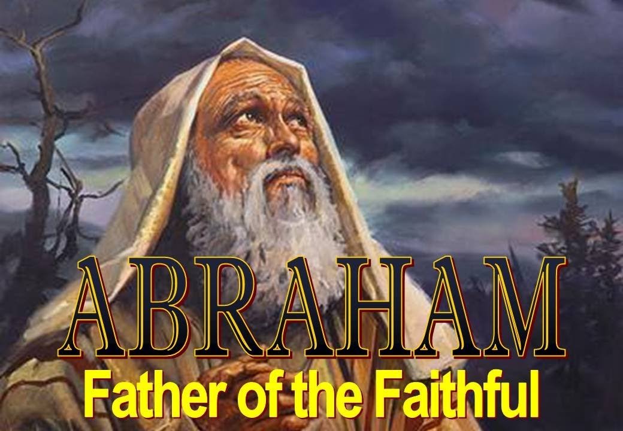

Slide 10
Romans 4:16 – 17
¹⁶ Therefore, the promise comes by faith, so that it may be by grace and may be guaranteed to all Abraham’s offspring—not only to those who are of the law but also to those who have the faith of Abraham. He is the father of us all. ¹⁷As it is written: “I have made you a father of many nations.” He is our father in the sight of God, in whom he believed—the God who gives life to the dead and calls into being things that were not.

Slide 11
Romans 4:16 – 17
Paul establishes a logical connection between what he had just written and what he will declare next. Just as wages are obtained through work (4:4), and failure to obey the Law reaps God’s wrath (4:15), grace is received through faith (4:16).
Grace and faith must go together because grace is utterly alien to our world. It’s a miraculous act of God – not unlike parting seas (Exod 14:13-31) and raining bread from heaven (Exod 16:1-7) – in which divine power supersedes all other forces.

Slide 12
Romans 4:16 – 17
In the same way that Abraham is the father of the Hebrews and their covenant with God, he is the father of all who would be joined to God through trust in Him.
Responding in faith to God’s promise is not meritorious, since the promise springs from His grace, His disposition of favor toward those who deserve His wrath. The human exercise of faith is simply the prerequisite response of trust in God and His promise.

Slide 13
Romans 4:16 – 17
Since faith and grace go together, and since the promise is by grace, the promise can be received only by faith, not by the Law.
Another reason the promise is by faith is so that it may be guaranteed to all Abraham’s offspring, not only the Jews (those . . . of the Law) but to all who exercise faith in God.
If the promise were fulfilled for those who keep the Law, then no Gentiles (or Jews either) could be saved! But this cannot be, because Abraham is the father of us all, that is, all who believe.

Slide 14
Romans 4:16 – 17
Since faith and grace go together, and since the promise is by grace, the promise can be received only by faith, not by the Law.
Another reason the promise is by faith is so that it may be guaranteed to all Abraham’s offspring, not only the Jews (those . . . of the Law) but to all who exercise faith in God.
If the promise were fulfilled for those who keep the Law, then no Gentiles (or Jews either) could be saved! But this cannot be, because Abraham is the father of us all, that is, all who believe.

Slide 15
Romans 4:16 – 17
The term “father” here is used as “founder of a line or family.” That which makes a person one of Abraham’s offspring is not physical descent, but rather faith in God.
Those who are physically Abraham’s descendants and those who are not must alike become members of his spiritual family.
This is possible only by believing in the God in whom Abraham believed.

Slide 16
Romans 4:18
¹⁸Against all hope, Abraham in hope believed and so became the father of many nations, just as it had been said to him, “So shall your offspring be.”

Slide 17
Romans 4:18
The wording “against hope believed in hope” is a paradoxical turn of phrase that some use to support their “leap of faith” approach to Christian belief.
Paul meant by this expression to separate natural hope from supernatural hope. In other words, Abraham placed his hope in the supernatural power of God to accomplish what is hopeless by any natural means.

Slide 18
Romans 4:18
Though humanly there was no hope of ever having a child, the old patriarch believed God’s Word.
Against all hope, Abraham in hope believed. God honored his faith, and he became the father (ancestor) of many nations. This was in accord with God’s promise, So shall your seed (offspring) be (Gen. 15:5).

Slide 19
Romans 4:19 – 21
¹⁹And being not weak in faith, he considered not his own body now dead, when he was about an hundred years old, neither yet the deadness of Sarah's womb: ²⁰He staggered not at the promise of God through unbelief; but was strong in faith, giving glory to God; ²¹And being fully persuaded that, what he had promised, he was able also to perform.

Slide 20
Romans 4:19 – 21
In spite of the humanly impossible situation, Abraham did not waver or “staggered” (hesitated) under the weight of unbelief. On the contrary, Abraham was strengthened in his faith.
God, responding to Abraham’s faith, empowered him and Sarah physically to generate the child of promise. Also Abraham gave glory to God, that is, he praised God by exalting or exclaiming His attributes.

Slide 21
Romans 4:19 – 21
Here, Paul restates specific details of v18 about Abraham’s hope. Abraham without weakening in his faith . . . faced the fact (lit., “considered carefully”) that his body was as good as dead.
Abraham also considered carefully that Sarah’s womb was also dead. She was unable to conceive a child, as had been demonstrated through their life together (cf. Gen. 16:1-2; 18:11) and as was certainly true for her at age 90 (Gen. 17:17).

Slide 22
Romans 4:19 – 21
Abraham was fully persuaded that God had power (“spiritual ability”) to do what He had promised. What confidence in God this spiritual forefather possessed!
Abraham “in hope believed” (4:18); he was not weak in faith despite overwhelming odds (4:19); he was not divided in his thinking by unbelief (4:20a); he was empowered by faith (4:20b); and he was fully persuaded God has the ability to do what He had said (4:21).

Slide 23
Romans 4:19 – 21
Abraham was fully persuaded that God had power (“spiritual ability”) to do what He had promised. What confidence in God this spiritual forefather possessed!
Abraham “in hope believed” (4:18); he was not weak in faith despite overwhelming odds (4:19); he was not divided in his thinking by unbelief (4:20a); he was empowered by faith (4:20b); and he was fully persuaded God has the ability to do what He had said (4:21).

Slide 24
Romans 4:22 – 25
²²This is why “it was credited to him as righteousness.” ²³The words “it was credited to him” were written not for him alone, ²⁴but also for us, to whom God will credit righteousness—for us who believe in him who raised Jesus our Lord from the dead. ²⁵He was delivered over to death for our sins and was raised to life for our justification.

Slide 25
Romans 4:22 – 25
From a natural, human perspective, one might think that Abraham’s obedience to the command of God earned him the covenant blessing.
But Paul’s illustration from Mount Moriah proves that Abraham’s obedience was simply a visible manifestation of his faith, and that it was his faith that allowed him to receive God’s gift of righteousness.

Slide 26
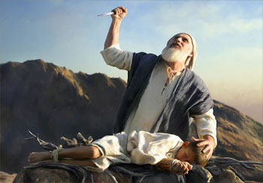
Abraham sacrificing Isaac

Slide 27
Romans 4:22 – 25
Paul belabored the point in order to make an important connection. Abraham is the father of the Hebrews, but not of them only. He is the father of all who receive God’s grace through faith and are declared righteous through no merit of their own.
The only difference between Abraham and us is what, specifically, we are to believe. Abraham was called to obey the command of God to sacrifice his only son, Isaac, with the under-standing that “God will provide” (Gen 22:8).

Slide 28
Romans 4:22 – 25
We are called to “believe in Him who raised Jesus our Lord from the dead, he who was delivered up because of our transgressions, and he was raised up because of our justification (4:24-25). This righteousness of grace is “imputed” to every believer.
This is the gospel in its most straightforward terms. Christ died for our sins according to the Scriptures and He was buried. Then Christ was raised from the dead and was seen by His disciples, including a meeting with more than five hundred followers (1Cor 15:3-6).

Slide 29
Romans 4:22 – 25
Christ’s death as God’s sacrificial Lamb was to pay the redemptive price for the sins of all people (3:23) so that God might be free to forgive those who respond by faith to that provision. Christ’s resurrection was the proof of God’s acceptance of Jesus’ sacrifice (cf. 1:4). Thus because He lives, God can credit (impute) His provided righteous-ness to the account of every person who responds by faith to that offer.
And by trusting in God’s provision despite the apparent finality of death, we “hope against hope” and receive the gift of eternal life.

Slide 30
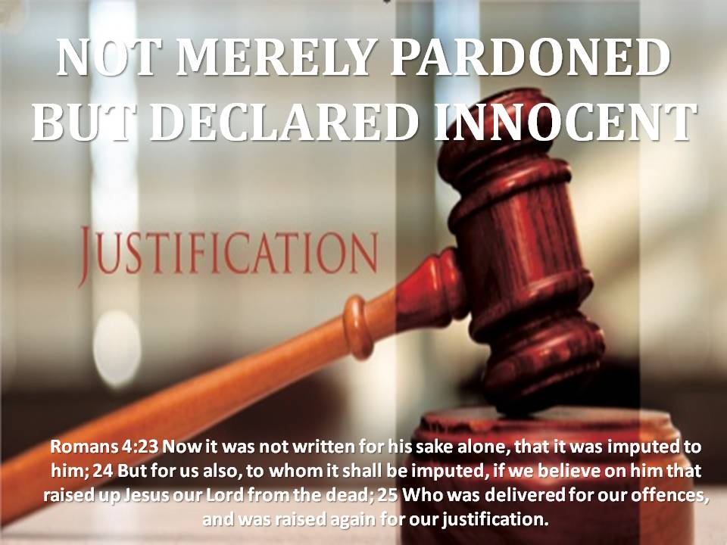
Jesus was raised for our justification

Slide 31


“Justification: Hoping Against Hope”

Slide 32
NEXT CLASS – 17 March 2021
Book of Romans
Before next class, read the below chapter in the KJV and in one other versions of the Bible, i.e., NKJV, NRSV, NIV, CEV, etc …
Read Chapter 5 and 6
Focus on verses 5:1 – 11

