Slide 1

Peace With God
Chapter 5:1 – 11
Week 9
17 March 2021

Slide 2

“Peace With God”

Slide 3

Romans
Background:
In presenting his case, Paul has proved that the whole world is guilty before God, and that no one can be saved by religious deeds, such as keeping the Law.
Paul has explained that God’s way of salvation has always been “by grace, through faith” (Eph. 2:8–9), and he has used Abraham as his illustration.

Slide 4
Romans
Background:
If the reader stopped here, he would know that he needed to and could be saved. But there is much more the sinner needs to know about justification by faith. Can he be sure that it will last? How is it possible for God to save a sinner through the death of Christ on the cross?
Romans 5 is Paul’s explanation of the last two words in Romans 4: “our justification.” Here in Ch5, Paul explained two basic truths: the blessings of our justification (1–11), and the basis for our justification (12–21).

Slide 5
Romans 5:1 – 11
Overview of Ch 5
In chapter 5, Paul talks about the joy that comes from faith. He lists five results of divine justification:
The believer has peace with God (5:1)
The believer has access to God (5:2)
The believer has assurance from God (5:3–4)
The believer is indwelt by God (5:5)
The believer is preserved in God (5:6–11)

Slide 6
Romans 5:1 – 11
Overview of Ch 5
Keep in mind that justification is God’s declaration that the believing sinner is righteous in Christ. It is righteousness imputed, put to our account.
Sanctification is righteousness imparted, worked out in and through our lives by the Spirit.

Slide 7
Romans 5:1 – 11
Overview of Ch 5
Justification is our standing before God; sanctification is our state here on earth before others.
Justification never changes; sanctification does.

Slide 8
Romans 5:1 – 2
¹Therefore, being justified by faith, we have peace with God through our Lord Jesus Christ: ²By whom also we have access by faith into this grace wherein we stand, and rejoice in hope of the glory of God.

Slide 9
Romans 5:1 – 2
To prepare his readers for the rest of the journey, Paul directs us to stop for a moment to consider where we are. We have now believed! This step is monumental in the life of a believer, and if we don’t pause to appreciate its significance, the rest of our journey will remain a mystery.
Paul takes us by the shoulders, as it were, turns us around to look back down the road we traveled, and says, “Therefore, having been justified by faith, we have peace with God through our Lord Jesus Christ” (5:1).

Slide 10
Romans 5:1 – 2
“Peace with God.” There’s move relief in those three words than any others. The more we comprehends the danger of God’s fearsome wrath, the more we experience the incredible relief of having peace with God.
“Peace” does not refer to inner tranquility, although that’s part of the relief we feel.
“Peace” refers to our no longer being subject to God’s wrath because of sin.

Slide 11
Romans 5:1 – 2
The death of Jesus satisfied our debt of sin and set aside the resulting hostility so that God and people are no longer divided by rebellion, but reconcile in peace.
And the resulting relief is indescribable. Anyone who has spent his or her life trying to earn God’s pleasure or trying to accumulate enough good deeds to escape hell understands the joy of the words “Peace with God.”

Slide 12
Romans 5:1 – 2
The problem with trying to earn one’s way out of debt to God is that we can never know how much is enough. Ask most people, “Are you going to heaven after you die?” and most will answer, “I hope so.”
Those who trust religion to save them, if they take it seriously, must remain in a constant state of terror, knowing that only death will solve the mystery of their eternal destiny and that their fate might be eternal suffering.

Slide 13
Romans 5:1 – 2
Paul called the experience of receiving God’s grace through faith and the resulting peace an “introduction.” The Greek word is rendered “access” or “admission.”
That is, the process of being ushered into the court of a king and then announced and given the right or opportunity to address the ruler. Paul used the same term to describe prayer for the Christian > “According to the eternal purpose which he purposed in Christ Jesus our Lord: ¹²In whom we have boldness and access with confidence by the faith of him” (Eph. 3:11-12).

Slide 14
Romans 5:1 – 2
Paul concludes this introductory sentence with the phrase, “and we exult [rejoice] in hope of the glory of God,” which uses three important terms worth studying …
“Exult” is best rendered to mean “to boast.” Not a negative behavior. But the “boasting” of believers is inherently humble because they do not have any confidence in their own goodness; instead, they express complete confidence in the free gift of grace.

Slide 15
Romans 5:1 – 2
“Hope” is best rendered to mean “an assured expectation.” Paul uses this term in a very specific way to describe the future day when Jesus returns to rule the world and renovate it to His liking.
“Glory” is best rendered to mean “appearance or manifestation.” Glory refers to the state of things as God desire them. God triumphs over evil, justice prevails, sin has no place, and everything exists in harmony with His holy character.

Slide 16
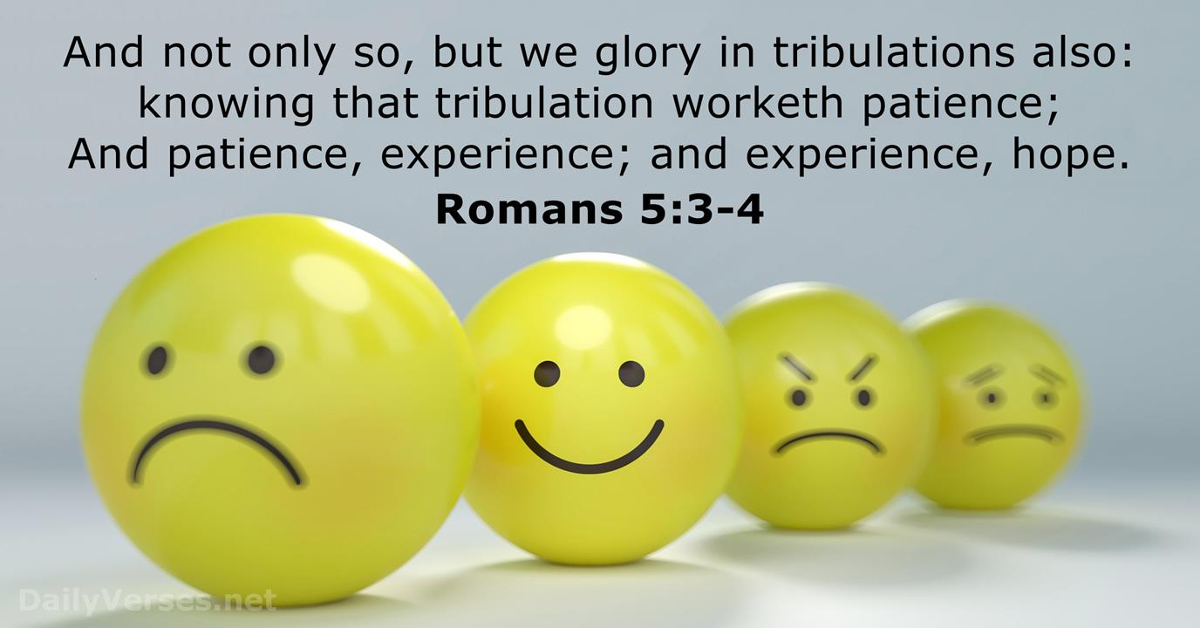
Romans 5:3 – 4

Slide 17
Romans 5:3 – 4
Justification is no escape from the trials of life. “In this world ye shall have tribulation” (John 16:33). But for the believer, trials work for him and not against him.
No amount of suffering can separate us from the Lord (Rom. 8:35–39); instead, trials bring us closer to the Lord and make us more like the Lord.
Suffering builds Christian character. The word “experience” means “character that has been proved.”

Slide 18
Romans 5:3 – 4
The sequence is: tribulation – patience – experience (proven character) – hope.
Our English word “tribulation” comes from a Latin word tribulum. In Paul’s day, a tribulum was a heavy piece of timber with spikes in it, used for threshing the grain. The tribulum was drawn over the grain and it separated the wheat from the chaff.
As we go through tribulations, and depend on God’s grace, the trials only purify us and help to get rid of the chaff.

Slide 19
Romans 5:3 – 4
The word for “tribulation” is often translated to “pressure” or “suffering.” Such suffering comes in all shapes and sizes. Nevertheless, because we have been ushered into a completely new manner of life, we can live with joyful confidence in “suffering under pressure,” through tribulation.
How do we come by this supernatural ability? We gain the ability to rejoice under pressure through a carefully monitored training program directed by the Lord Himself. Paul described this program a “chain reaction” in which one phase leads to another, giving us joy despite our circumstances.

Slide 20
Romans 5:3 – 4
Tribulation brings patience. That is, perseverance. Naturally, when the pressure builds, we should take reasonable measures to relieve the discomfort. When we cannot avoid the suffering, choose to endure and to do so with graceful and calm dignity.
Patience works experience. That is, perseverance brings about proven character or “tested worth.” This can also be thought of as “triumphant fortitude” which comes as the trials of life become instruments in the hand of Holy Spirit.

Slide 21
Romans 5:3 – 4
Experience works hope. That is, “assured expectation,” the certainty of a promised outcome. We experience this kind of hope when we overcome insurmountable odds to achieve victory and success.
Throughout the ordeal, we observe without anxiety; we endure setbacks without panic. This is a kind of hope that cannot disappoint, because we have an assured outcome.

Slide 22
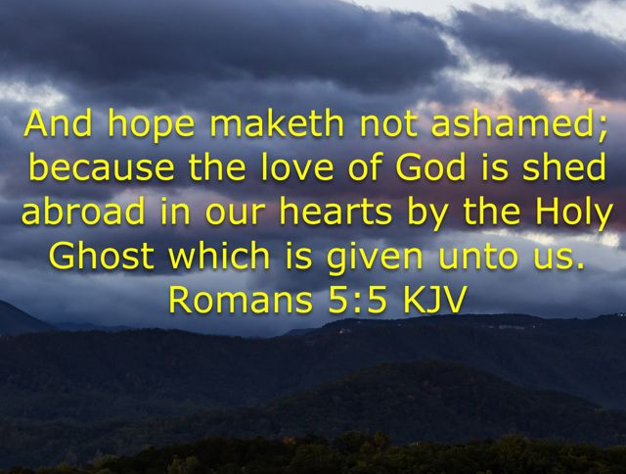

Slide 23
Romans 5:5
To provide the assurance we need, Paul introduces two great truths for the first time in the letter to the Romans: the great love of God and the indwelling of the Holy Spirit.
We learned of God’s wrath in 1:18-32; here we discover that those who now have peace with God can experience His love. His Spirit fills, transforms, and empowers us. He provides strength in our weakness, wisdom in our foolishness, love in our doubt, and evidence in our despair. The Holy Spirit living within us is our ever-present guarantee of future victory.

Slide 24
Romans 5:5
A believer’s hope, since it is centered in God and His promises, does not disappoint him. “Disappoint” means “put to shame because of disappointment” in unfulfilled promises.
The reason this hope (resulting finally from affliction) does not disappoint is that God has poured out His love into our hearts.
God’s love, so abundant in believer’s hearts, encourages them on in their hope.

Slide 25
Romans 5:5
And this love is poured out by (or through) the Holy Spirit, whom He has given us. The Holy Spirit is the divine Agent who expresses to a believer the love of God.
That is, God’s love for him. The reality of God’s love in a believer’s heart gives the assurance, even the guarantee, that the believer’s hope in God and His promise of glory is not misplaced and will not fail.

Slide 26
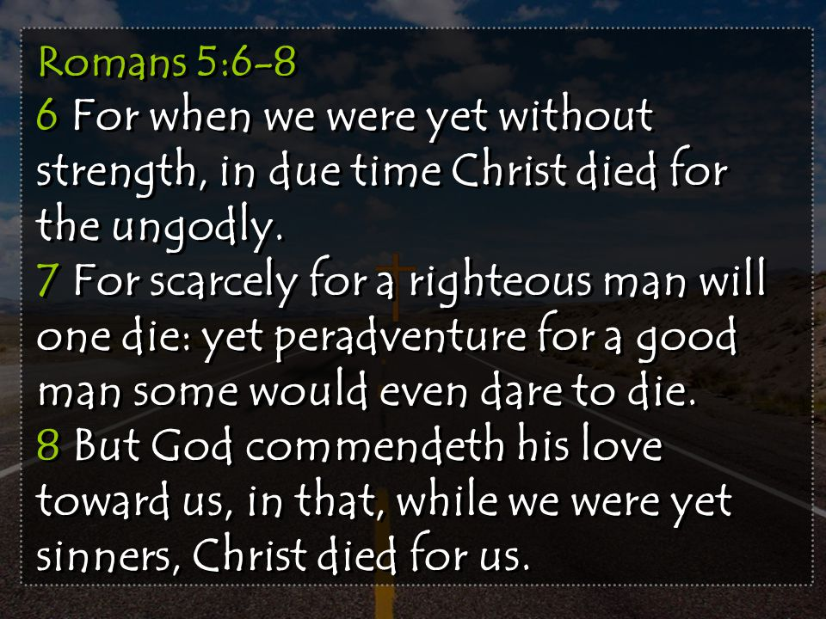
Romans 5:6 – 8

Slide 27
Romans 5:6 – 8
To illustrate our continuing need for grace and God’s faithfulness in providing it, Paul retraced the steps of the gospel. In doing so, he stresses the fact that nothing in us deserved saving, yet Christ died for us.
How remarkable it is when one good person sacrifices his or her own life to save that of another good person. Most of us can identify with that kind of selflessness and hope to have similar courage if called upon to do the same.

Slide 28
Romans 5:6 – 8
But who would volunteer to take the place of a serial killer on death row? Who would give his or her own life to save that of a Hitler or Stalin?.
Jesus Christ did.
Note the verbs “demonstrates” and “died.” Normally, we would expect both verbs to be past tense . . . Paul uses this unexpected turn of tenses to make an important point. We weren’t what we should have been before we were saved, and we aren’t what we should be now.

Slide 29
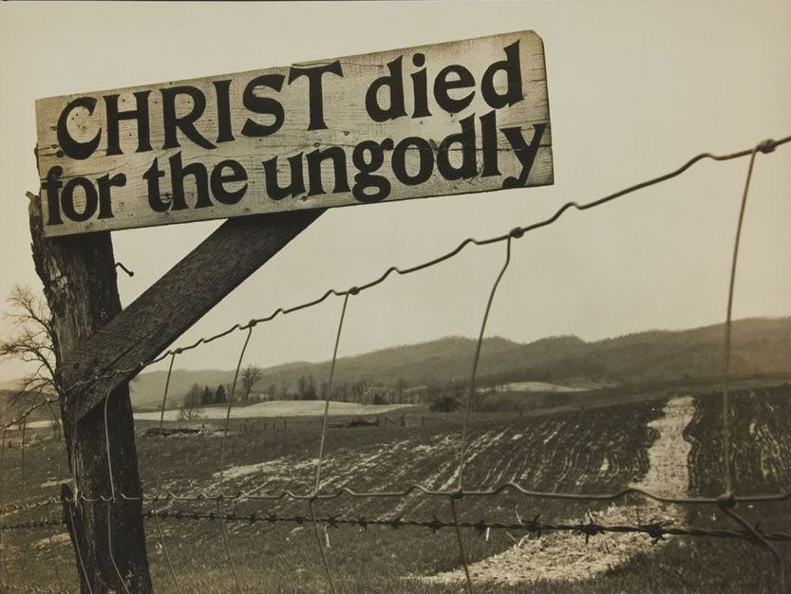

Slide 30
Romans 5:6 – 8
The gospel affirms that God demonstrates (“keeps on showing”) His own love for us in this: While we were still sinners, Christ died for us (“in our place”).
Though a few people might possibly be willing to die to save the lives of good people, though that is rare, Christ went well beyond that. Christ died in the place of the powerless (“feeble,” v6), the ungodly (v6), sinners (v8), and even His enemies (5:10).

Slide 31
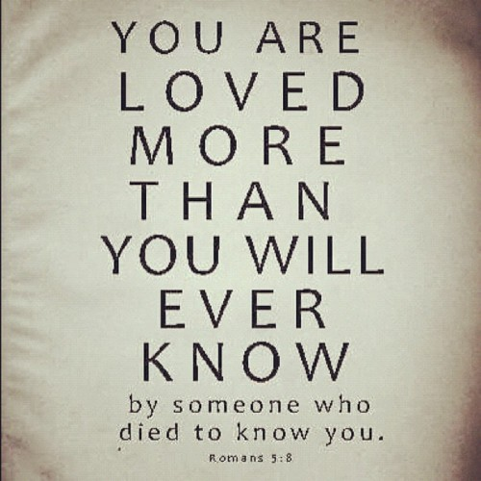

Slide 32
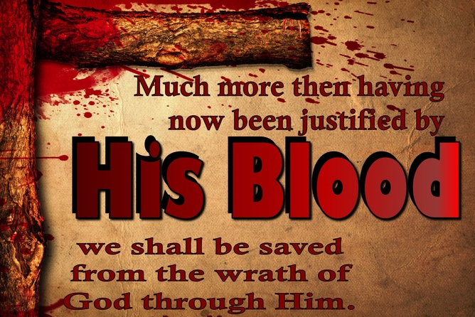
Romans 5:9

Slide 33
Romans 5:9
The phrase “much more then” indicates that what follows is even more overwhelming and significant than what has preceded, astounding and wonderful as that is.
Having been justified by His blood refers to the initial aspect of salvation, which for believers is past. In light of the fact that we already have been justified, Paul is saying, we are assured of being saved from the wrath of God through Jesus Christ.

Slide 34
Romans 5:9
Because of Christ’s death, we (by grace, through faith) have been declared “just” by the Judge of heaven. We no longer have to fear His wrath.
We are no longer subject to punishment. Christ’s sacrifice paid our debt for sin – not only our sins in the past but also those we will certainly commit in the future.
We have not only escaped God’s wrath at the final judgment after death; we are not subject to His wrath during our lifetime.

Slide 35
Romans 5:9
Paul wrote all of this to support his opening statement in 5:1 > “Therefore being justified by faith, we have peace with God through our Lord Jesus Christ.”
The death and resurrection of Jesus Christ has ushered us into a completely new territory called “grace,” in which we have the opportunity to thrive according to a completely different perspective.

Slide 36
Romans 5:10 – 11
¹⁰For if, when we were enemies, we were reconciled to God by the death of his Son, much more, being reconciled, we shall be saved by his life. ¹¹And not only so, but we also joy in God through our Lord Jesus Christ, by whom we have now received the atonement.

Slide 37
Romans 5:10 – 11
But that’s not all. As if peace with God – freedom from His wrath – were not enough, there’s more. Much more. The death of God’s Son on behalf of humankind is only part of the story.
Christ not only died, he rose again! His death stripped away the condemnation of death; His resurrection gives us abundant, eternal life.
The work of reconciliation is complete! The gaping chasm that stood between God and us has been permanently bridged by Jesus Christ.

Slide 38
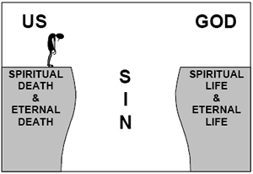
Jesus Christ
The Work of Reconciliation

Slide 39
Romans 5:10 – 11
Paul’s use of the term “saved” includes far more than preservation from the torments of hell. It means preservation from all things that are opposed to God, including any future sin that threatens to keep us from enjoying our new life in the territory called “grace.”
Christ not only died, he rose again! His death stripped away the condemnation of death; His resurrection gives us abundant, eternal life.

Slide 40
Romans 5:10 – 11
Mature believers experience a kind of joy that transcends all other considerations because it is anchored in their “peace with God” (5:1), their reconciled relationship with the Almighty.
They live with joyful confidence despite the afflictions of a fallen world, despite the physical consequences of past sin, even despite their failure to live as they ought.
Things are not yet as they should be.

Slide 41
Romans 5:10 – 11
Not “if,” but since . . . we were God’s enemies, Christ was able by His death to reconcile us to God. Certainly now that we are God’s children, the Savior can keep us by His living power (5:10).
The assurance and guarantee of it all is the fact that through Christ, we have now received “the reconciliation” or “the atonement” (5:11).
Since God has reconciled godless enemies to Himself, we should also rejoice in God and enjoy that peace with God.

Slide 42


“Justification: Hoping Against Hope”

Slide 43
NEXT CLASS – 24 March 2021
Book of Romans
Before next class, read the below chapter in the KJV and in one other versions of the Bible, i.e., NKJV, NRSV, NIV, CEV, etc …
Read Chapter 5 and 6
Focus on verses 5:12 – 21

