Slide 1

Guilt vs. Grace
Chapter 5:12 – 21
Week 10
24 March 2021

Slide 2

“Guilt vs. Grace”

Slide 3

Romans
Background:
Paul has now finished his description of how God has revealed and applied to humans His provided righteousness on the basis of the sacrificial death of Jesus Christ, which is received by faith.
One thing remains to be done – to present the contrastive parallelism between the work of Jesus Christ (and its results in justification and reconciliation) -AND- the work of another man, Adam (and its results in sin and death).

Slide 4
Romans
Background:
That is, the work of Adam (the sinful father of all people) with the work of Christ (the sinless Savior of all people).
As great a cosmic battle as that between “good and evil,” there is a greater battle between “guilt and grace.”
And you can’t remain neutral . . . either guilt or grace. Which one will you allow to shape your perspective on the other great conflict (the one between good and evil)?

Slide 5
Romans
Background:
The term “guilt” can be confusing. There is “objective guilt,” which has nothing to do with feelings but describes the moral state of a person who has done something wrong.
Whether or not a person experiences negative emotion after doing an evil deed is irrelevant; that person is objectively guilty no matter how he or she feels.

Slide 6
Romans
Background:
On the other hand, “subjective guilt” can produce feelings of sorrow or remorse and usually causes a person to struggle with self-condemning thoughts.
This subjective feeling is called “shame.” When a person is guilty – that is, objectively blameworthy for wrongdoing – feelings of shame should follow. Parents used to say to their misbehaving child, “Shame on you for that!” Or, “The fact that you are guilty should make you feel ashamed.

Slide 7
Romans
Background:
Shame is a God-given emotion, and its purpose is to bring us to repentance. Unfortunately, people are reluctant to repent, even when overwhelmed with shame.
If the shame becomes intense and repentance doesn’t follow, they invariably make irrational and destructive choices. Adam and Eve sewed fig-leaf underwear rather than repent, and this shame-induced behavior has only grown more and more bizarre.

Slide 8
Romans
Background:
The struggle between these two great forces (good & evil -AND- guilty & grace) began in the Garden of Eden, not long after the creation of humanity. The Creator fashioned the first people and placed them in a pristine environment, which He created specifically with their physical needs in mind.
Surrounded by such plenty, all the man and woman had to do was tend the garden, savor its delights, love one another, and enjoy intimate fellowship with God forever.

Slide 9
Romans
Background:
Furthermore, the Lord delegated authority (dominion) to the couple, empowering them and charging them to be His vice-regents over the earth (Gen 1:26-28; 2:15). Having been cradled in this lavish abundance of good, they were to avoid one solitary tree.
Adam, having a nature unpolluted by sin, had the freedom to choose between obedience and disobedience, good and evil. And we all know which he chose.

Slide 10
Romans
Background:
Whereas, “the man and his wife were both naked and were not ashamed” before his disobedience (Gen 2:25), but after their “shame,” they “hid themselves” (Gen 3:8).
This was Adam’s second tragic choice. He covered himself in guilt and ran from grace. Certainly he must have know that God’s love fueled His wrath.

Slide 11
Romans
Background:
This is the first man’s legacy. He chose evil over good, and in so doing, doomed us all to follow in his sinful steps. In the same sense that a monarch or president acts on behalf of the people, who then reap the consequences of his or her policies, Adam chose this path for all of humanity.
Moreover, we have inherited his mutated nature so that we are incapable of choosing only good and avoiding all evil. This doesn’t seem fair – Adam chose my fate.

Slide 12
Romans
Background:
But wait! Don’t forget that we ratify our representative’s inaugural sin by adding sins of our own.
Our sinful choices place us squarely behind Adam in the rebellion against God’s goodness.
Like Adam, our head, we must come out of hiding and face our Creator. We will never find grace hiding in the bushes.

Slide 13
Romans
Background:
King David describes our sin connection to Adam in Psalm 51:5 > “Behold, I was shapen in iniquity; and in sin did my mother conceive me.”
Adam typifies the sinful condition of all humans (1:18–3:20). Jesus stands for the justification received by faith (3:21–5:11). Redemption is the story of two men.

Slide 14
Romans 5:12 – 21
Overview of Chapter:
Paul describes how the death of Christ has been the answer to the sin of Adam. Adam was the first human being, and his sin infected the entire human race. The penalty for that sin was death – even before the law was given, so that people knew what sin was.
Now, through the righteousness of one perfect man, Jesus Christ, life is spreading to the whole human race. Grace wins!

Slide 15
Romans 5:12 – 21
Overview of Chapter:
How is it possible for God to save sinners in the person of Jesus Christ? We understand that somehow Christ took our place on the cross, but how was such a substitution possible?
Paul answered the question in this section, and these verses are the very heart of the letter. To understand these verses, a few general truths about this section need to be understood . . .

Slide 16
Romans 5:12 – 21
Overview of Chapter:
FIRST – note the repetition of the little word one. It is used eleven times. The key idea here is our identification with Adam and with Christ.
SECOND – note the repetition of the word reign which is used five times. Paul saw two men—Adam and Christ – each of them reigning over a kingdom.

Slide 17
Romans 5:12 – 21
Overview of Chapter:
FINALLY – note that the phrase much more is repeated five times. This means that in Jesus Christ we have gained much more than we ever lost in Adam!
Christ not only undid all the damage that Adam’s sin effected, but He accomplished much more by making us the very sons of God.
By condemning the human race through one man (Adam), God was then able to save the human race through one Man (Jesus Christ).

Slide 18
Romans 5:12 – 14
¹²Therefore, just as sin entered the world through one man, and death through sin, and in this way death came to all people, because all sinned – ¹³To be sure, sin was in the world before the law was given, but sin is not charged against anyone’s account where there is no law. ¹⁴Nevertheless, death reigned from the time of Adam to the time of Moses, even over those who did not sin by breaking a command, as did Adam, who is a pattern of the one to come.

Slide 19
Romans 5:12 – 14
Therefore, which says, in effect, “because the preceding information is true, the following is also true.”
Paul starts his comparison: sin brings death. In fact, sin and death rules together. Death includes the curses God pronounced in Genesis and eternal separation from Him in eternity.
And like a caronavirus, sin infects all of humanity, dooming us all to a death-like existence.

Slide 20
Romans 5:12 – 14
God did not specify and codify His standard for human conduct until the time of Moses. Thus, sin was not “imputed” until then, which doesn’t suggest that humankind was any less guilty of sin.
The “Law” is nothing less than a particular expression of God’s holy character preserved for us in written form. Even without the written Law, they were “without excuse” (1:18-2:16).
The Law is a moral ledger sheet that brings to our attention the truth about our moral debt.

Slide 21
Romans 5:15 – 17
¹⁵But the gift is not like the trespass. For if the many died by the trespass of the one man, how much more did God’s grace and the gift that came by the grace of the one man, Jesus Christ, overflow to the many! ¹⁶Nor can the gift of God be compared with the result of one man’s sin: The judgment followed one sin and brought condemnation, but the gift followed many trespasses and brought justification. ¹⁷For if, by the trespass of the one man, death reigned through that one man, how much more will those who receive God’s abundant provision of grace and of the gift of righteousness reign in life through the one man, Jesus Christ!

Slide 22
Romans 5:15 – 17
Paul makes clear the contrastive nature of the parallelism by stating, But the gift (“charisma” or “grace-gift”) is not like the trespass. What Christ gives contrasts with what Adam did, his “trespass” or “false step”).
The offense vs. the free gift: Adam’s offense brought condemnation and death, while the free gift of God’s grace brings justification and life.
Death vs. life: Death reigned as king because of Adam, but now believers reign in life (today) through Christ, and have abundant life.

Slide 23
Romans 5:15 – 17
Sin entered the world through Adam, and all descending from him have been sinners. Spiritual death, as God had clearly warned struck humankind.
While no one was charged with “sin” (in the technical sense of a violation of divine law) until the Law was given, all were spiritually dead.
Thus death reigned, bringing all humankind under necessary condemnation.

Slide 24
Romans 5:15 – 17
But then Jesus Christ came into the world, bringing a grace-gift to us. What flows from Jesus is not death, but life.
What relationship with Adam meant was death; what relationship with Jesus means is eternal life and righteousness.
For just as sin is associated with and expresses spiritual death, so righteousness is associated with and expresses spiritual life.

Slide 25
Romans 5:18 – 19
¹⁸Consequently, just as one trespass resulted in condemnation for all people, so also one righteous act resulted in justification and life for all people. ¹⁹For just as through the disobedience of the one man the many were made sinners, so also through the obedience of the one man the many will be made righteous.

Slide 26


Slide 27
Romans 5:18 – 19
Paul reduced the contrast to the briefest possible statement: Adam’s one act of trespass / disobedience has brought condemnation and sinfulness in the same way in which Christ’s one act of righteousness / obedience has brought justification and righteousness.
All people, without exception, belong to Adam (5:12); but only those who come to faith, who “receive the gift,” belong to Christ (cf. 1Cor. 15:22 > “For as in Adam all die, even so in Christ shall all be made alive”).

Slide 28
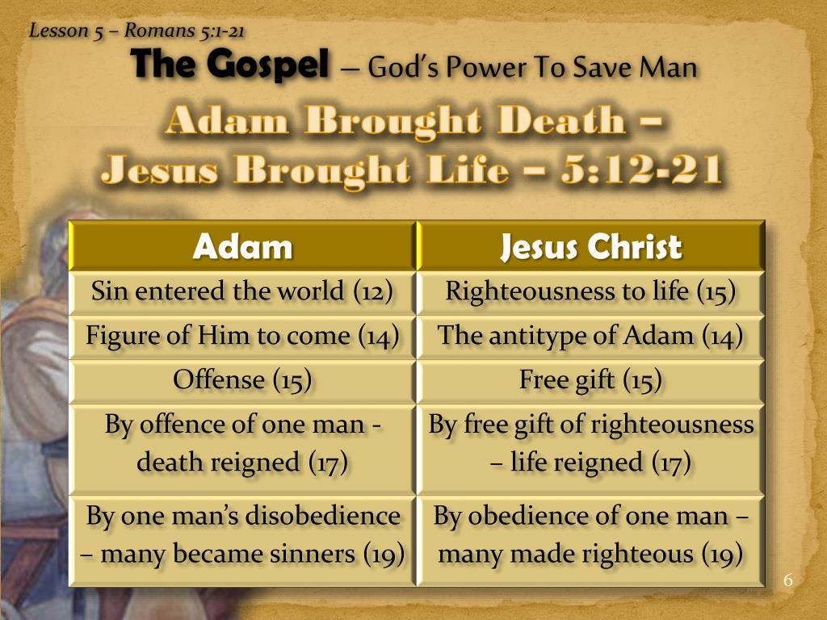

Slide 29
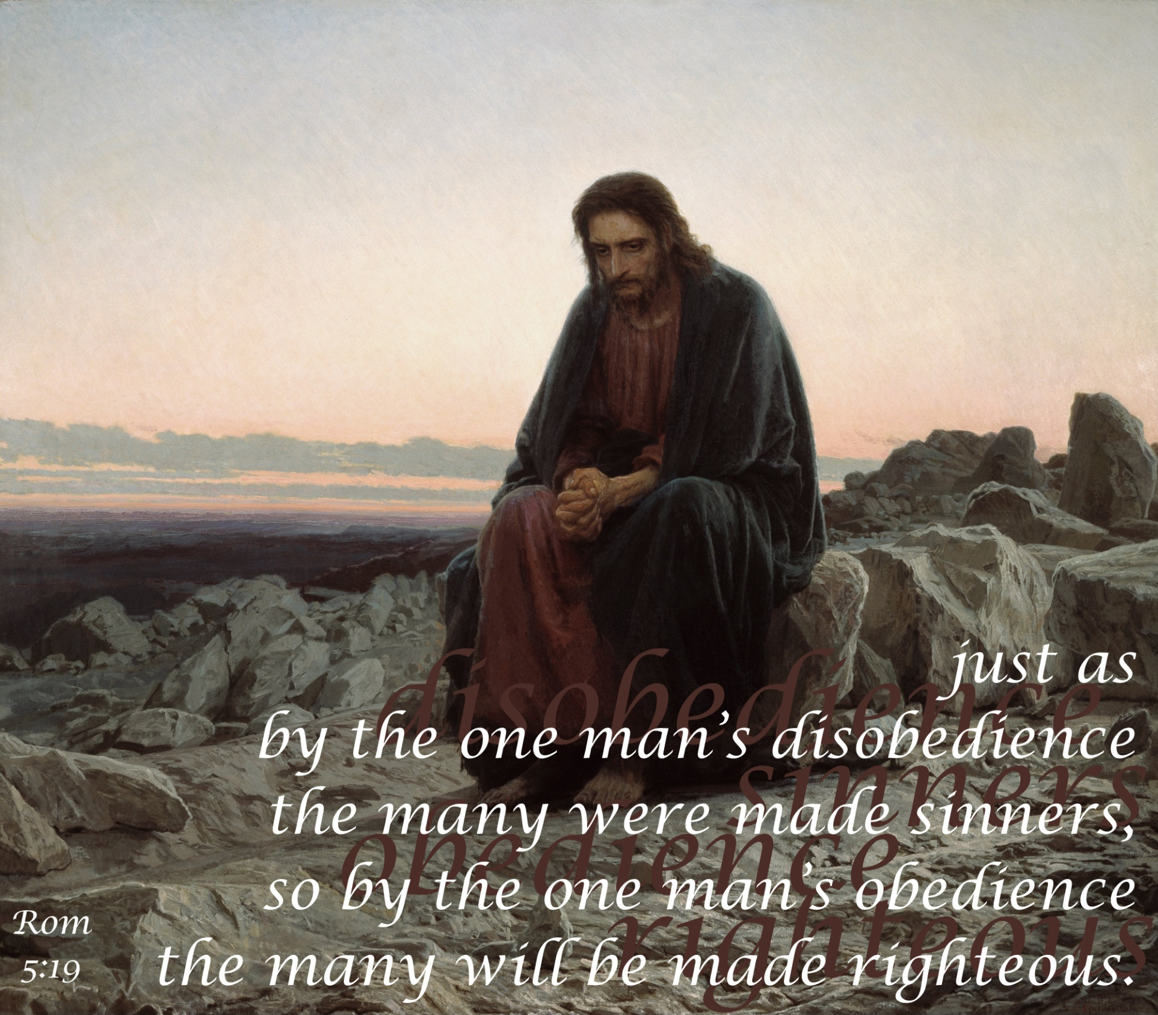

Slide 30
Romans 5:20 – 21
²⁰The law was brought in so that the trespass might increase. But where sin increased, grace increased all the more, ²¹so that, just as sin reigned in death, so also grace might reign through righteousness to bring eternal life through Jesus Christ our Lord.

Slide 31
Romans 5:20 – 21
To say that the transgression “increased” as a result of the Law can be interpreted in two ways:
FIRST – sin “abounded” in the sense that we now see what had been invisible before the Law clearly defined what was right and wrong.
SECOND – the presence of the Law stimulates the rebellious heart to do the very opposite of what it commands.
Both interpretations are valid.

Slide 32
Romans 5:20 – 21
The Mosaic Law came in “so that” (purpose) abounding sin might be recognized as abounding trespasses. The result was that where sin increased (“abounded”) grace increased all the more (“overflowed abundantly”).
What a contrast! No matter how great human sin becomes, God’s grace overflows beyond it and abundantly exceeds it. No wonder Paul wrote that God’s grace “is sufficient” (cf. 2Cor. 12:9 > “My grace is sufficient for thee: for my strength is made perfect in weakness”).

Slide 33
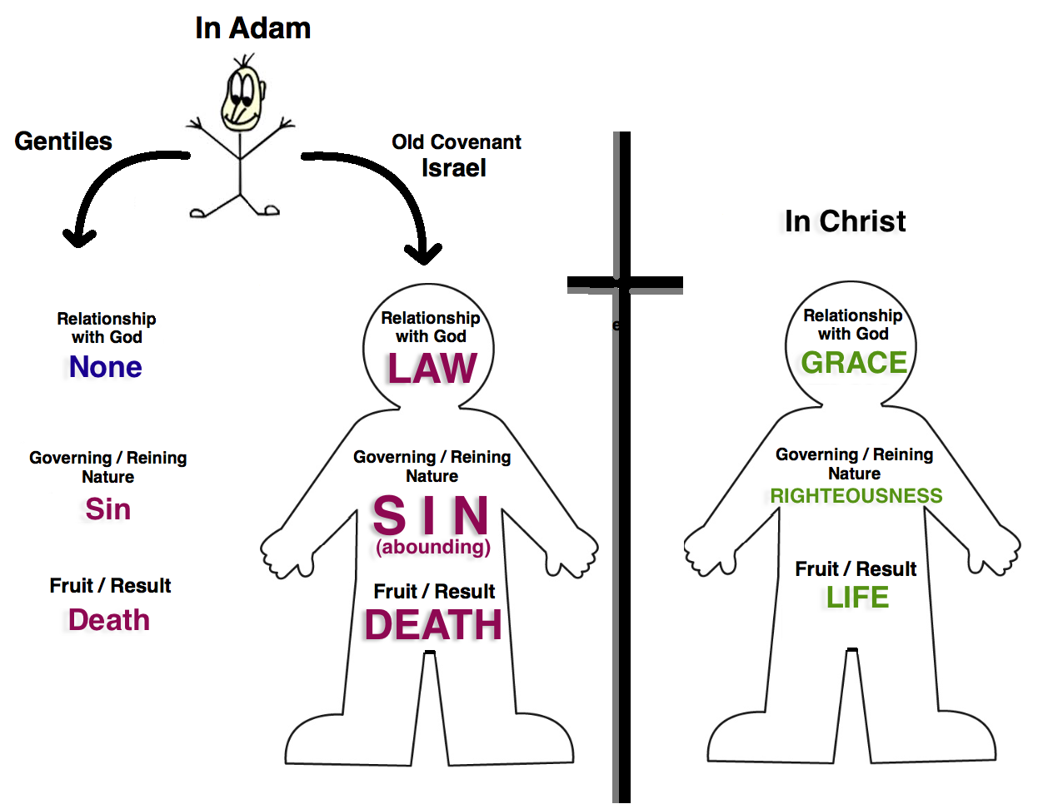
In Christ
Saved Gentiles
and
Believing Jews

Slide 34
Romans 5:20 – 21
Paul brings this section of his letter to a close by summarizing his primary point: Salvation cannot be gained through obedience to the Law; salvation is a gift of grace (5:20).
The final sentence in this section then foreshadows the topic of the next: the rise of grace over sin in the life of the believer and its eventual conquest of the world (5:21).

Slide 35


“The Grace of God”

Slide 36
NEXT CLASS – 31 March 2021
Book of Romans
Before next class, read the below chapter in the KJV and in one other versions of the Bible, i.e., NKJV, NRSV, NIV, CEV, etc …
Read Chapter 6 and 7
Focus on verses 6:1 – 14

