Slide 1

Dying To Live
Chapter 6:1 – 14
Week 11
31 March 2021

Slide 2

“Dying To Live”

Slide 3

Romans
Background:
What passes for worldly wisdom is usually bad theology. That’s because the world stopped working the way God intended soon after Adam’s disobedience dragged the rest of creation into rebellion with him.
Consequently, the order and beauty that once graced God’s creation, while not completely obliterated, became twisted and grotesque.

Slide 4
Romans
Background:
Now, the world operates according to a different system, one that leaves little or no room for such heavenly qualities as humility, selflessness, faith, or, the most alien of all, grace.
As Paul concluded the last section, he boldly declared that, whereas sin reigned over the earth and death through sin, Jesus Christ had initiated a takeover . . .

Slide 5
Romans
Background:
“Grace multiplied . . . so that just as sin reigned in death, so also grace will reign through righteousness to eternal life through Christ our Lord” (5:20-21). This summarizes what he will explain in Chapter 6-8.
To begin his explanation, the apostle asked two questions that illustrate how alien grace is to a world dominated by death and to minds given over to depravity.

Slide 6
Romans
Background:
These were two questions for which he already had answers:
“Are we to continue in sin so that grace may increase?” (6:1) AND “Shall we sin because we are not under law but under grace?” (6:15)
Paul undoubtedly encountered these challenges to grace in every synagogue between Jerusalem and Rome.

Slide 7
Romans
Background:
“Sanctification” is Paul’s focus for Ch 6 thru 8. Sanctification is the theological term given to the gradual, internal transformation of a newly freed slave of sin into a fully mature and completely free individual.
In Ch 6, Paul introduces God’s threefold method that leads to sanctification:
STEP ONE – Know (6:1-10).
STEP TWO – Reckon (6:11).
STEP THREE – Yield (6:12-23).

Slide 8
Romans
Background:
In Ch 7, Paul discusses how the law of God applies to and affects three kind of people:
TYPE ONE – Spiritual people and the Law (7:1-6).
TYPE TWO – Natural people and the Law (7:7-13).
TYPE THREE – Carnal people and the Law (6:14-26).

Slide 9
Romans
Background:
In Ch 8, Paul outlines seven new assurances accompanying salvation: (The believer has …)
ONE – A New Position (8:1-8).
TWO – A New Guest (8:9-14).
THREE – A New Adoption (8:15-17).
FOUR – A New Hope (8:18-25).
FIVE – A New Prayer Helper (8:26-27).
SIX – A New Confidence (8:28).
SEVEN – A New Destiny (8:29-39).

Slide 10
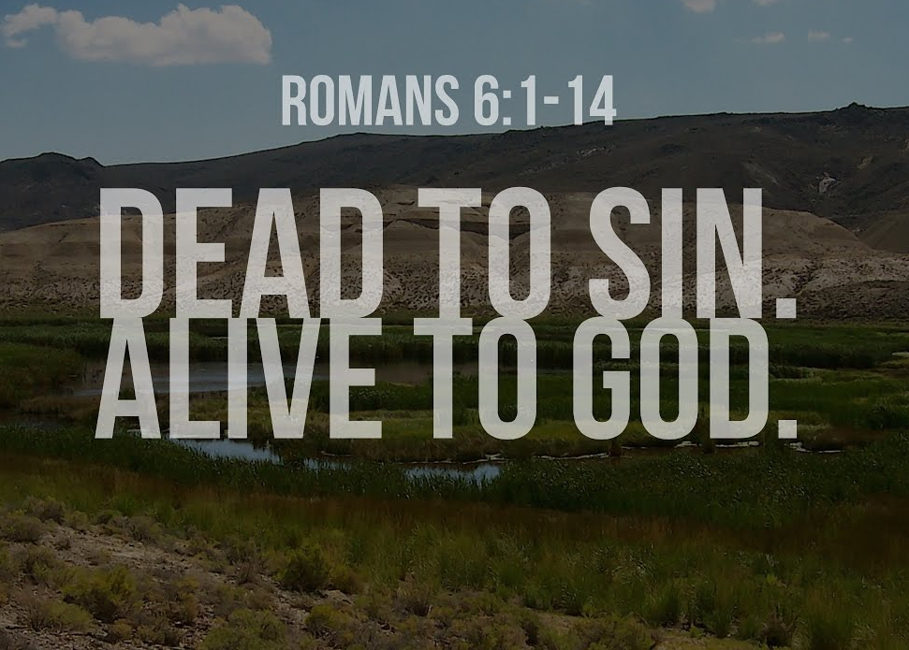

Slide 11
Romans 6:1
¹What shall we say then? Shall we continue in sin, that grace may abound?
The salvation God gives us is complex and complete. Romans 6 is about “present tense” salvation. We are being saved by Christ as He releases us from the grip of sin and enables us to live a righteous life . . . now.

Slide 12
Romans 6:1
Paul took his opponents’ rhetorical question, a challenge to the doctrine of grace, and put it on display: “If sin brings grace, and lost of sin brings a lot more grace, shouldn’t we sin as much as possible in order to keep grace flowing from heaven?”
The opponents’ response would naturally follow: “We know that can’t be true, so the doctrine of grace must be false.”

Slide 13
Romans 6:1
Paul’s opponents made a valid point. A depraved mind will certainly see grace from a twisted perspective. But Paul turned the attack to his advantage.
His opponents demonstrated all too clearly by their distorted point of view that God cannot allow those who receive His grace to remain in their depraved state of mind or they will mangle grace as Paul’s detractors did
Therefore, believers must receive a new nature, a new mind.

Slide 14
Romans 6:2 – 3
²God forbid. How shall we, that are dead to sin, live any longer therein? ³Know ye not, that so many of us as were baptized into Jesus Christ were baptized into his death?

Slide 15
Romans 6:2 – 3
Some may have reasoned that since grace increases “all the more” when sin abounds, then believers ought to sin more so they could experience more grace.
Paul voiced this idea only to reject it vehemently: By no means! In no way is the abundance of God’s grace designed to encourage sin.
Paul explained why such a thought cannot be entertained. The fact is, Christians died to sin, which suggests a specific point when the action occurred, at salvation.

Slide 16
Romans 6:2 – 3
Death, whether physical or spiritual, means separation, not extinction (cf. 6:6-7, 14). Death to sin is separation from sin’s power, not the extinction of sin. Being dead to sin means being “set free from sin.”
That being true, Paul asked, How can they live in it any longer? Obviously believers cannot live in sin if they died to it.
The word “baptize” is a transliteration of the Greek term baptizo, which means “to immerse” or “to submerge.”

Slide 17
Romans 6:2 – 3
All who have placed their faith in Christ have been “baptized into” Him. Water baptism does not save, it’s an outward expression of an inward change (cf. circumcision).
That is, the believer is “baptized” (placed into) Christ and also into the body of Christ, and both are done by the Holy Spirit.
The spiritual reality is that “by faith” believers are baptized into Christ and thereby are united and identified with Him. Christ died and we died with Him. Christ rose to new life, and so shall we.

Slide 18
Romans 6:2 – 3
By virtue of our identification with Jesus Christ, His death, and His resurrection, we have been emancipated from bondage to sin.
Identity with Christ begins with belief, but it has ongoing consequences. We were identified with Jesus when He suffered punishment on the cross on our behalf and He paid the legal penalty for sin in our place.
God then credited His Son’s righteousness to our moral accounts, and we receive this grace through faith. But grace doesn’t stop there.

Slide 19
Romans 6:2 – 3
Identification allows the believer to partake of everything the Son of God enjoys.
To help believers make the most of this gift, Paul first explains the intricacies of this vital Christian truth (6:4-10),
Explains the significance of identification (6:11-12), and then
Concludes with an explanation of how to apply it (6:12).

Slide 20
Romans 6:4
⁴Therefore we are buried with him by baptism into death: that like as Christ was raised up from the dead by the glory of the Father, even so we also should walk in newness of life.

Slide 21
Romans 6:4
Therefore indicates a logical continuation of what he has just written, it further explains the truth of the prior verse (6:3).
The baptism of 6:4 is the same as that in 6:3 – spiritual, not water. Keep in mind, salvation is not through a pool of water, but by faith alone.
In 1Cor. 12:13, the Holy Spirit “baptizes” (unites) believers into the Body of Christ (church) and with one another. In Romans 6, “baptism” is our union with Jesus Christ Himself.

Slide 22
Romans 6:4
The concept of identification explains our union with Christ. Paul’s point is that this union with Jesus is not merely “legal” but is real.
Because we who believe are now “in Christ,” His death is our death, and His resurrection is our resurrection.
Being “in Christ” is the very root and essence of the new life of the Christian. We have passed from death to life. We are not “in the flesh,” or “in sin” anymore. It is as if we were citizens of a new country – in Christ.

Slide 23


Slide 24
Romans 6:5 – 7
⁵For if we have been planted together (united) in the likeness of his death, we shall be also in the likeness of his resurrection: ⁶Knowing this, that our old man (self) is crucified with him, that the body of sin might be destroyed, that henceforth we should not serve sin. ⁷For he that is dead is freed from sin.

Slide 25
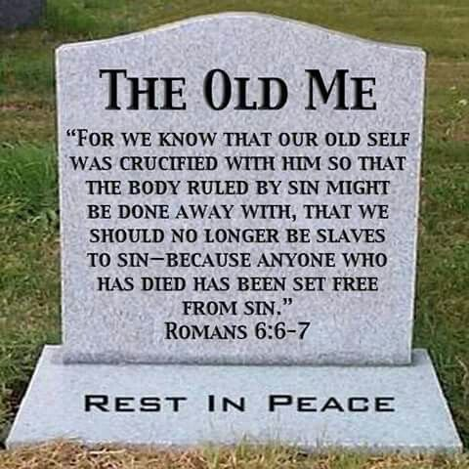

Slide 26
Romans 6:5 – 7
Sanctification begins with regeneration, the implanting of spiritual life in a believer. From there, sanctification progressively separates a believer from sinner to saint and transforms his total life experience toward holiness and purity.
“Since (not if) we have become united in the likeness of His death,” because this statement is true . . . it affirms the certainty of the second clause of the sentence, which promises that believers are united with Christ in the likeness of His resurrection.

Slide 27
Romans 6:5 – 7
A believer’s “old man” is that person as he or she was before he or she trusted Christ, when still under sin (3:9), powerless and ungodly (5:6), a sinner (5:8), and an enemy of God (5:10).
Our “old self” was crucified with Christ (6:5). The crucifixion of the “sin nature” did not eradicate the old desires or motives. This crucifixion did not remove the pull of temptation.
Instead, what happened was that the “body of sin” (the old and warped responses) was rendered powerless or inoperative (6:6).

Slide 28
Romans 6:5 – 7
In his unregenerate state a believer was enslaved to sin. But his “old man” was crucified (identified) with Christ, and that is the basis for deliverance from enslavement to sin.
The words “has been freed” are literally, “has been justified or declared righteous.” The perfect tense of this verb describes a past action with a continuing effect or force.
Sin no longer has the legal right to force its mastery and control on a believer, for she or he has died with Christ.

Slide 29
Romans 6:5 – 7
What happened to our sin nature?
Paul’s teaching is the key to understanding the victory over sin which Christ has won for us.
Historically, there have been many different approaches to the “victorious Christian life.” Each of them is related to a particular idea of what has happened to the Christian’s sin nature:
  Eradication.
  Suppression.
  Self-crucifixion.
  Penalism.

Slide 30
Romans 6:5 – 7
What happened to our sin nature?
ERADICATION: According to this theory, when a person becomes a Christian the sin nature itself dies.
This means that the very capacity to sin is removed; whatever a Christian desires or chooses must flow from the new in him and not the old.
Our common experience as well as the Bible’s promise of continued forgiveness makes it plain that this theory does not fit the facts.

Slide 31
Romans 6:5 – 7
What happened to our sin nature?
SUPPRESSION: Here, the Christian is given the power to control the sin nature. The capacity and the desire for sin are still present, but the Christian is responsible to hold down that desire.
In this approach a great deal of emphasis is placed on the Law as a tool for suppression. Guided by the Law’s demands, and always aware of his or her own personal responsibility, the individual fights for mastery over this old self. This grim struggle is something Paul described in Romans 7. The apostle himself apparently once took this route – and failed.

Slide 32
Romans 6:5 – 7
What happened to our sin nature?
SELF-CRUCIFIXION: Noting that we were crucified with Christ, this approach to the Christian life visualizes our sin nature as something that struggles to get off the cross again. It is the believer’s responsibility, then, to live the “crucified life.” Each temptation calls for a renewed surrender to God.
This approach has led individuals to see every human desire and pleasure as an indication of sin. When this happens, they have been led into a joyless life of denying themselves those very things which God gives us “richly … to enjoy” (1Tim 6:17).

Slide 33
Romans 6:5 – 7
What happened to our sin nature?
PENALISM: This approach views all temptations as attacks of Satan. The problem is never located within us; it’s always the fault of Satan.
The right response to Satan’s attack is rejection. We are to resist Satan on the authority of Jesus (xx),
It was Jesus, who at the cross won final victory over His enemy and ours, the devil.

Slide 34
Romans 6:5 – 7
What happened to our sin nature?
UNION: What Paul teaches in Romans 6 is different from each of these four ideas. Paul’s argument rests on a unique understanding of what did happen at the cross.
Paul teaches us a unique way to respond when we sense sin’s inner pull; a way that promises a freedom such as we have never known. Through Christ’s work on the cross, our “sin nature” is rendered powerless. Oh, it still exists. And it still pulls us toward evil. But we do not have to respond. We are no longer slaves to sin!

Slide 35
Romans 6:8 – 11
⁸Now if we be dead with Christ, we believe that we shall also live with him: ⁹Knowing that Christ being raised from the dead dies no more; death hath no more dominion over him. ¹⁰For in that he died, he died unto sin once: but in that he liveth, he liveth unto God. ¹¹Likewise reckon ye also yourselves to be dead indeed unto sin, but alive unto God through Jesus Christ our Lord.

Slide 36
Romans 6:8 – 11
Once we know that God’s gift is available, we must claim it. Here in v8, Paul again stated the basic proposition that those who have “died with Christ” will also live with him. This is not a promise of life after death with Christ in heaven but of a life to be lived out here and now.﻿﻿
Death, far from being simply a negative concept, is in fact the gateway to life. Elsewhere Paul paradoxically stated, “I have been crucified with Christ … but … I live by faith” (Gal 2:20).
Put simply, to live one must die.

Slide 37
Romans 6:8 – 11
In v9, Jesus was raised to a new kind of life. His physical body not only awakened from death, it was transformed into a kind of body that was no longer subject to disease, disaster, or aging.﻿﻿
It was no longer a body that the world could abuse. This will be true of us when our bodies have died and we are raised to this new kind of life.
That’s a marvelous future we can anticipate with confident assurance. However, we don’t have to wait. We can begin enjoying this gift – now!

Slide 38
Romans 6:8 – 11
The resurrected life has God as both its source and its purpose. And to claim this gift, we must “consider” or “reckon” it to be true and then act upon it.﻿﻿
Paul, based on his authority as an agent of the good news, commanded believers, “Consider yourselves to be dead to sin.”
Reckon it as true. Claim this truth as a reality. Count on it and live it out.

Slide 39
Romans 6:12 – 13
¹²Let not sin therefore reign in your mortal body, that ye should obey it in the lusts thereof. ¹³Neither yield ye your members as instruments of unrighteousness unto sin: but yield yourselves unto God, as those that are alive from the dead, and your members as instruments of righteousness unto God.

Slide 40
Romans 6:12 – 13
Once we know about our emancipation from slavery and have considered ourselves to be freed from the old bondage, we must present ourselves to our new Master to enjoy the benefits of new life.﻿﻿
Slaves do the bidding of their master. They are the master’s instruments, utilized by him to accomplish his desires. Before emancipation, we could not refuse sin’s authority, but now we do not have to obey its commands.

Slide 41
Romans 6:12 – 13
Rather than allowing our physical bodies to be instruments of sin’s desire, “unrighteousness,” we must now present our bodies to our new Master, God, to accomplish His desire, “righteousness” (6:13).
The Greek word translated “instrument” frequently refers to weapons of war. We are no longer to present our bodies as weapons to be used by sin to accomplish evil ends, but to become foot soldiers in the interest of righteousness.

Slide 42
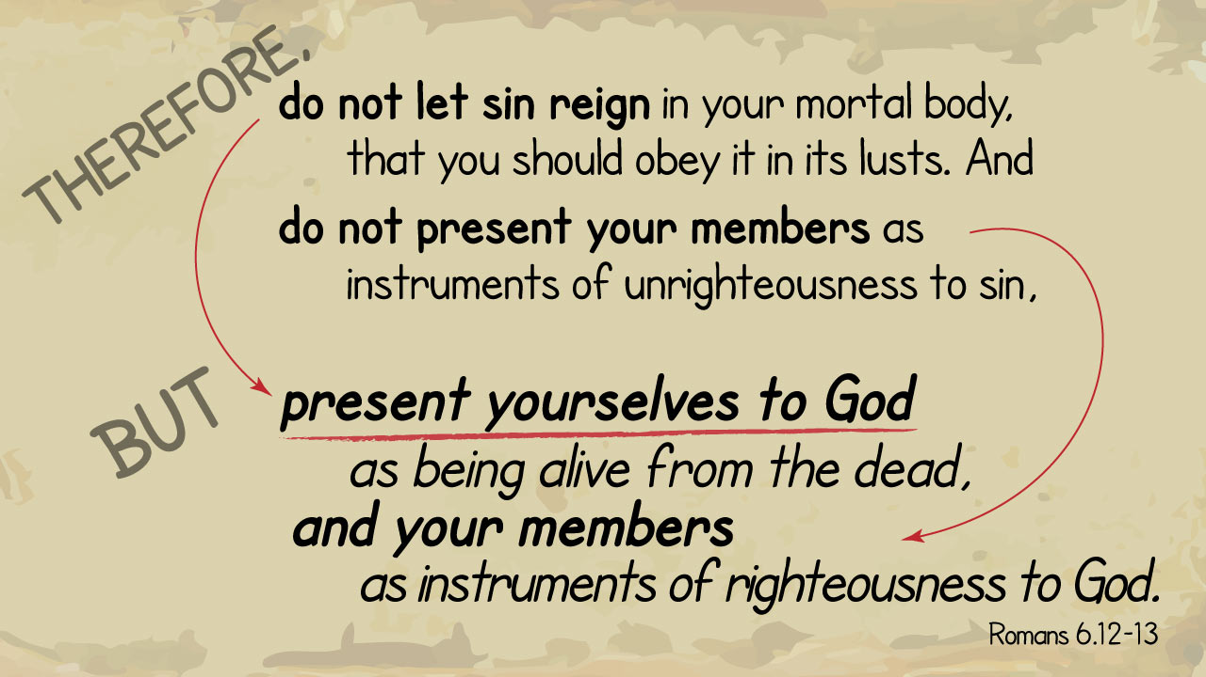

Slide 43
Romans 6:14
¹⁴For sin shall not have dominion over you: for ye are not under the law, but under grace.

Slide 44
Romans 6:14
Paul concludes his point with a summary statement: “Sin shall not be master over you.” Then he introduces his next point: “You are not under the law but under grace.”
Because we have been freed from the bondage of sin, laws have no application. The purpose of the Law is to point out transgression; therefore, those who have no involvement in sin are not subject to laws.

Slide 45
Romans 6:14
God’s design is that sin shall not be our master (“shall not rule as lord”). The reason this should not happen is that we are not under Law, but under grace.
Paul had already explained that “the Law was added so that the trespass might increase” (5:20).
If believers were still under the Law, it would be impossible to keep sin from exercising mastery. But since believers are “under grace,” this can be done by following the instructions in Paul’s letter.

Slide 46
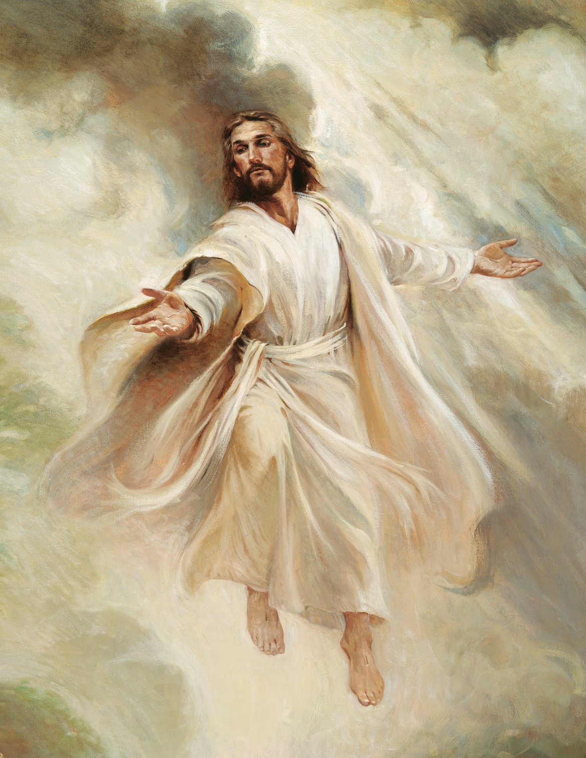

“Alive Forevermore”

Slide 47
NEXT CLASS – 7 April 2021
Book of Romans
Before next class, read the below chapter in the KJV and in one other versions of the Bible, i.e., NKJV, NRSV, NIV, CEV, etc …
Read Chapter 6 thru 8
Focus on verses 6:15 – 23

