Slide 1

Whose Slave Are You?
Chapter 6:15 – 23
Week 12
7 April 2021

Slide 2

“Whose Slave Are You?”

Slide 3

Romans
Background:
“Sanctification” is Paul’s focus for Ch 6 thru 8. Sanctification is the theological term given to the gradual, internal transformation of a newly freed slave of sin into a fully mature and completely free individual.
In Ch 6, Paul introduces God’s threefold method that leads to sanctification:
  STEP ONE – Know (6:1-10).
  STEP TWO – Reckon (6:11).
  STEP THREE – Yield (6:12-23).

Slide 4
Romans
Overview:
In the second half of Ch 6, Paul describes two kinds of yielding:
THE WRONG KIND (6:12–13a) – Paul does not say, let not the body live or act, but, let not sin reign in your body; neither yield your members to sin.
THE RIGHT KIND (6:13b–23) – The body is indifferent between vice and virtue, for Christ came not to destroy your nature, but to transform your ability for freely yield your members to God.

Slide 5
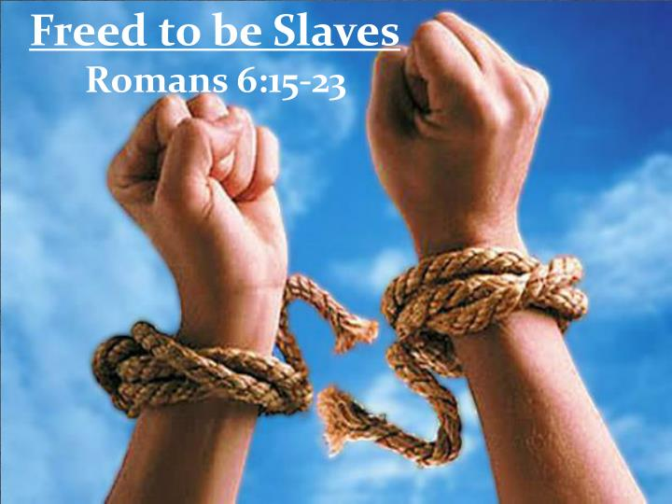

Slide 6
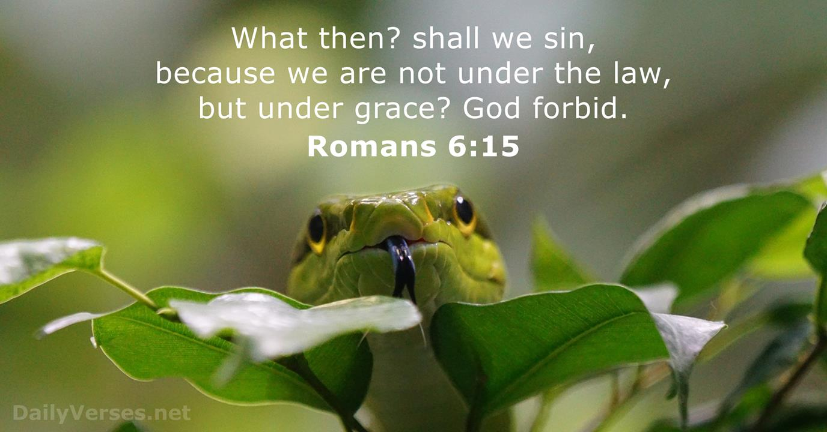
Romans 6:1

Slide 7
Romans 6:15
Paul concludes his response to the question, “Are we to continue in sin so that grace my abound?” (6:1) with the statement “Sin shall not be master over you, for you are not under law but under grace” (6:14).
In other words, because believers can now choose not to sin, they have the freedom to rise above the Law. This prompted a second rhetorical question, again, one Paul likely heard often in response to the gospel: “Shall we sin because we are not under law but under grace?” (6:15).

Slide 8
Romans 6:15
In other words, “Since God’s grace has set us free from the law, does this mean we can go on sinning?”
Paul response was the same as before: “God forbid” or by no means or may such a thing never occur!
Again, Paul proceeds to explain why that idea cannot be accepted. That is, believers are now free to choose not to sin; they have the freedom to rise above the Law.

Slide 9
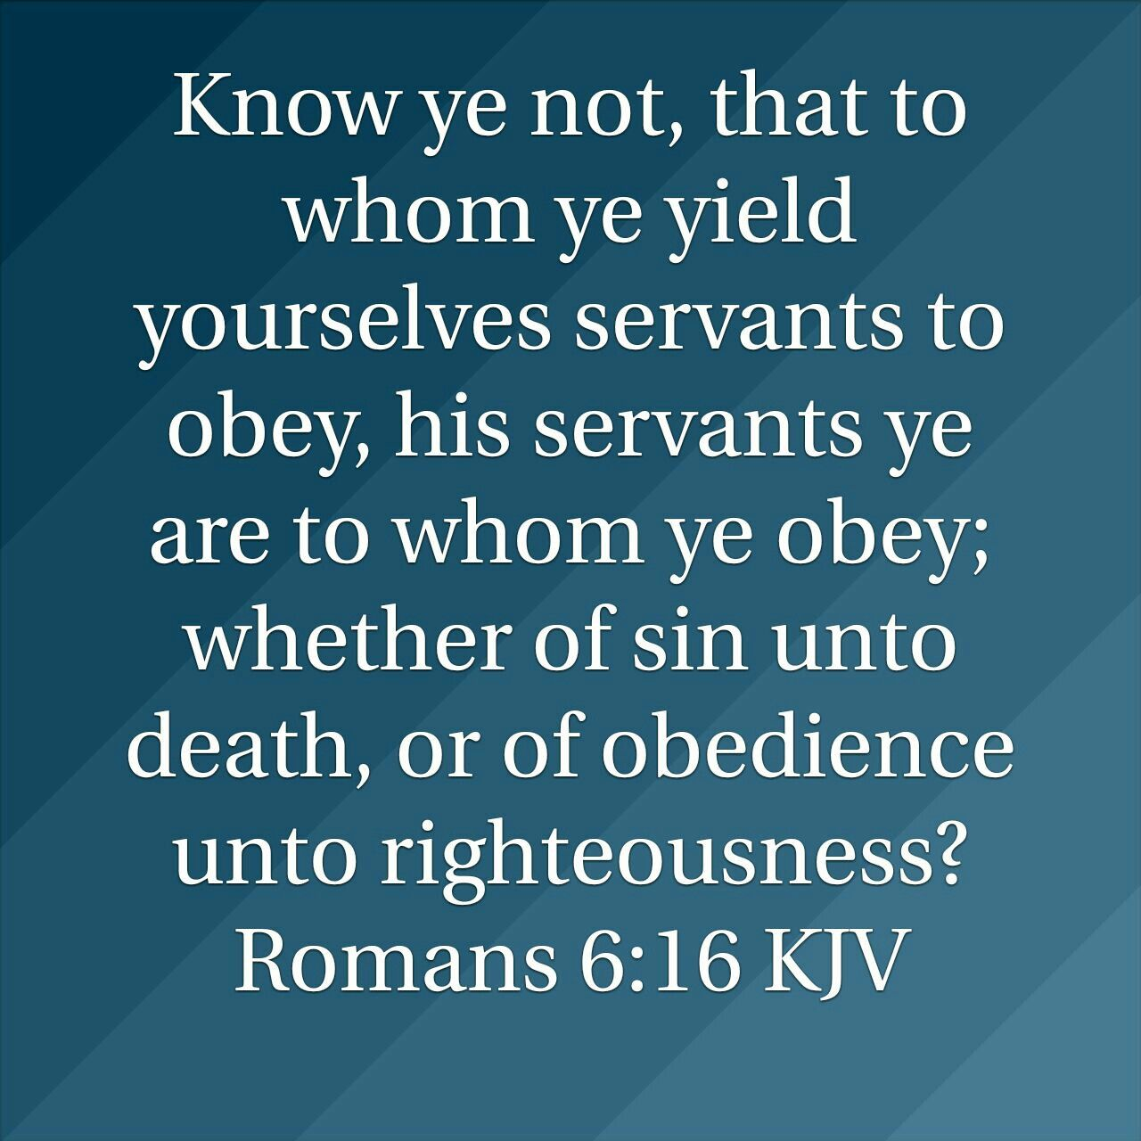

Slide 10
Romans 6:16
Paul asks a rhetorical question of his own: “Do you not know that when you present yourselves to someone as slaves for obedience, you are slaves of the one whom you obey, either of sin resulting in death, or of obedience resulting in righteousness?” (6:16).
Paul is asking, “Who you gonna serve?” because there is no middle ground.
As the Lord Jesus said, “No one can serve two masters … You cannot serve both God and money” (Matt. 6:24; Luke 16:13).

Slide 11
Romans 6:16
Paul is asking, in effect, “Why would you choose a master whose dedicated purpose is to keep you enslaved and ultimately kill you?”
Paul uses the word “doulos,” the most abject, servile term for a slave in the Greek language.
Paul also points out that being a slave to sin leads to death (cf. 6:21, 23). This is not physical death only or even spiritual death only, but death (separation) in general as the natural consequence and inevitable result of sin (cf. Gen. 2:17).

Slide 12
Romans 6:16
Paul uses the word death in at least three senses in his writings:
(1) The biological fact of “physical death” as the judgment of God upon all human life (Romans 5:12–14);
(2) The “spiritual death” of all men in their pre-Christian state (Ephesians 2.1; Colossians 2.13);
(3) The “eternal death” as the final judgment of God on the life of sin (6:16).

Slide 13
Romans 6:16
Being a slave to obedience (to God and His gospel obviously) leads to righteousness (righteousness in the sense to eternal life or glorification).
One can choose sin, which leads to death, or one can choose to obey God and receive his approval and righteousness.
Death is the normal consequence of sin (which is disobeying God) . . .
Righteousness is the normal consequence of obeying God and living for Him.

Slide 14
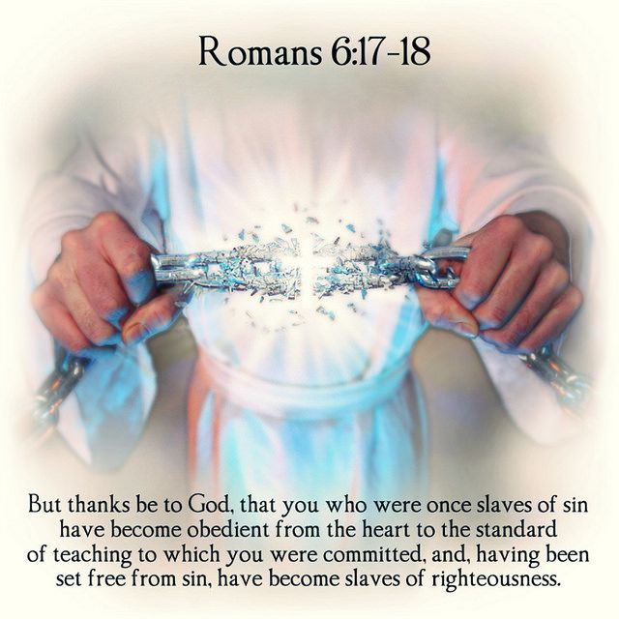
Romans 6:17 – 18

Slide 15
Romans 6:17 – 18
This discussion reminds Paul of what the grace of God has already accomplished in his readers’ lives and Paul burst forth in praise: “But thanks be to God.”
Through grace, something happens immediately when a person receives the grace of God through faith. She or he is instantly given a new heart, a new nature that hates sin and desires to obey its new master: righteousness.

Slide 16
Romans 6:17 – 18
To obey “whole-heartedly” requires a willing abandonment from sin to the truth of the message. Christian obedience is never coercive; it is always voluntary.
The teaching (doctrine) was not entrusted to the converts but the converts to the teaching.
The gospel message with all its ethical implications represents an existing body of truth into which new believers are brought by faith. The gospel (doctrine) is not brought to the sinner but the sinner is brought to the message.

Slide 17
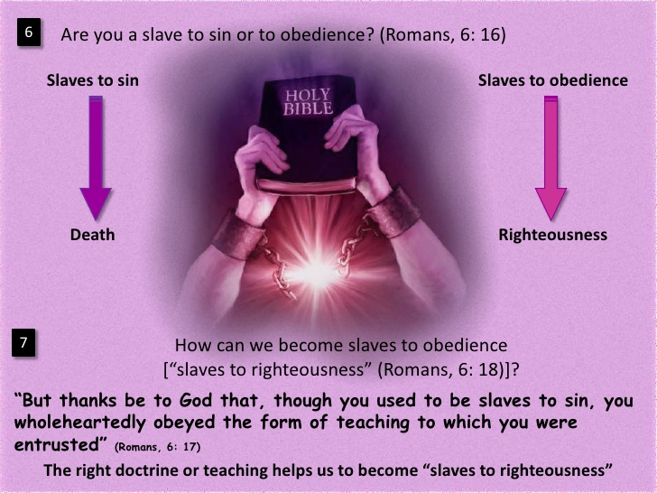

Slide 18
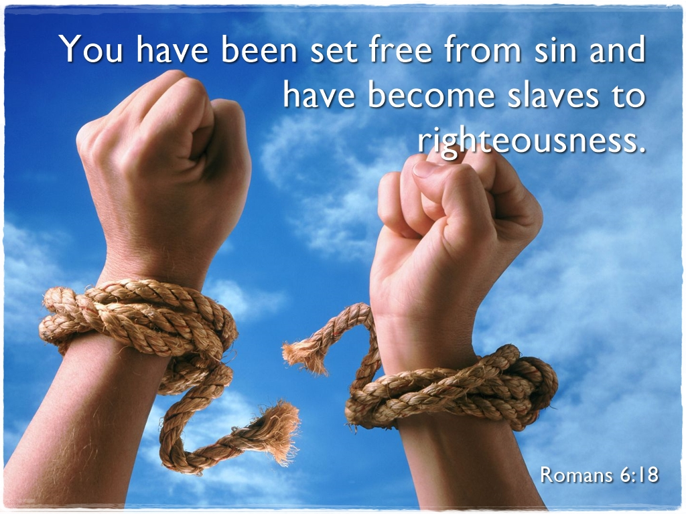

Slide 19
Romans 6:19
¹⁹I speak after the manner of men because of the infirmity of your flesh: for as ye have yielded your members servants to uncleanness and to iniquity unto iniquity; even so now yield your members servants to righteousness unto holiness.

Slide 20
Romans 6:19
While the illustration of slavery is powerful, it is flawed in one important respect. The truth Paul labors to teach is really a paradox. Slavery to God is the greatest freedom a human can ever know.
When God created Adam and Eve, they perfectly bore their Creator’s image. They lived in perfect harmony with their created purpose, which was to live in limitless communion with Him, to enjoy uninhibited intimacy with one another, and to rule over the rest of creation as His vice-regents.

Slide 21
Romans 6:19
Never was humankind so free as when they lived in harmony with their created purpose, or as Paul chose to put it, “as slave to righteousness.”
When we serve righteousness, we not only please God, we do what is best for ourselves. That’s how the Lord created the universe to work before it was corrupted through disobedience.
But humanity exchanged truth for a lie and looked to sin rather than their Creator to meet their basic needs.

Slide 22
Romans 6:19
That decision only perpetuated sin and intensified the accompanying bondage. This is the downward cycle of sin. The grace of God changed all of that. Christ’s sacrificial death creates the potential for us to recapture some of the innocence and freedom of Eden.
Just as service to sin binds us closer to sin, service to righteousness frees us to live in harmony with our created purpose, which is to live in limitless communion with God, to enjoy uninhibited intimacy with one another, and to rule over the rest of creation as His vice-regents.

Slide 23
Romans 6:19
This is what Paul calls “sanctification,” “holiness,” “consecration,” or “purity.”
For Paul, sanctification is both a state of being and a process. While this Greek word appears only twice in his letter (6:19 and 6:22), it is nevertheless the central theme of this larger section chapters 6 – 8.

Slide 24
Romans 6:20 – 22
²⁰For when ye were the servants of sin, ye were free from [in regard to] righteousness. ²¹What fruit [advantage] had ye then in those things whereof ye are now ashamed? for the end of those things is death. ²²But now being made free from sin, and become servants to God, ye have your fruit unto holiness [sanctification], and the end [is] everlasting life.

Slide 25
Romans 6:20 – 22
Again, Paul clarifies the believer’s choice. Sin and righteousness are mutually exclusive. Again, Jesus states, “No once can serve two masters …”
God created humanity with certain needs. In the beginning, those physical, emotional, and spiritual needs were filled as humankind enjoyed peace with God. After the Fall, we looked to sin instead.
Paul asks another rhetorical question to prompt the reader to look within (6:21) . . .

Slide 26
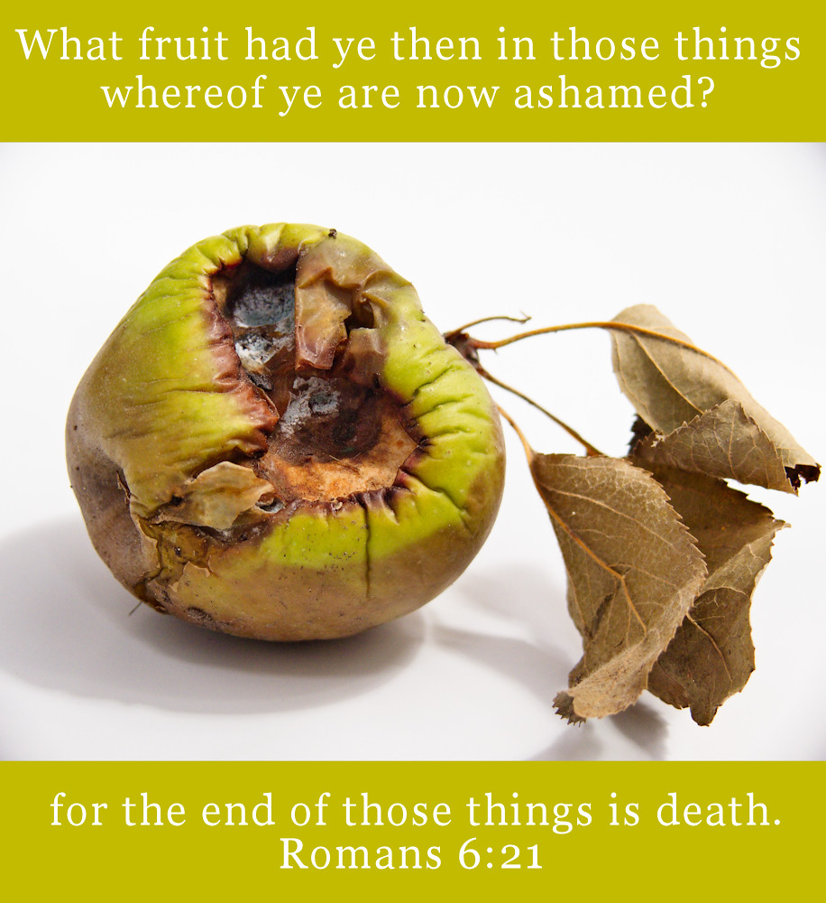

Slide 27
Romans 6:20 – 22
Paul asks, “When you were trying to meet those God-given needs by pursuing sin, what did you gain.”
Consider the taking of mind-altering drug. Medical experts tell us that these drugs have a double impact in the long term: They increase the user’s need for the drug while decreasing his or her body’s response.
In other words, the drug gradually creates a greater need for more, and it takes larger and larger doses to achieve the same satisfying effect.

Slide 28
Romans 6:20 – 22
The same is true of sin. Sin is usually the result of someone trying to fill a legitimate, God-given need in an illegitimate way.
Paul states that once we have been freed from bondage to sin, we still have needs that must be filled. And we will look to something to fill them. We all serve something; it’s just a matter of what.
While the pull of sin might be lessen, the cycle of sanctification draws the believer closer to God. Rather than leading to death, slavery to God ultimately leads to eternal life.

Slide 29
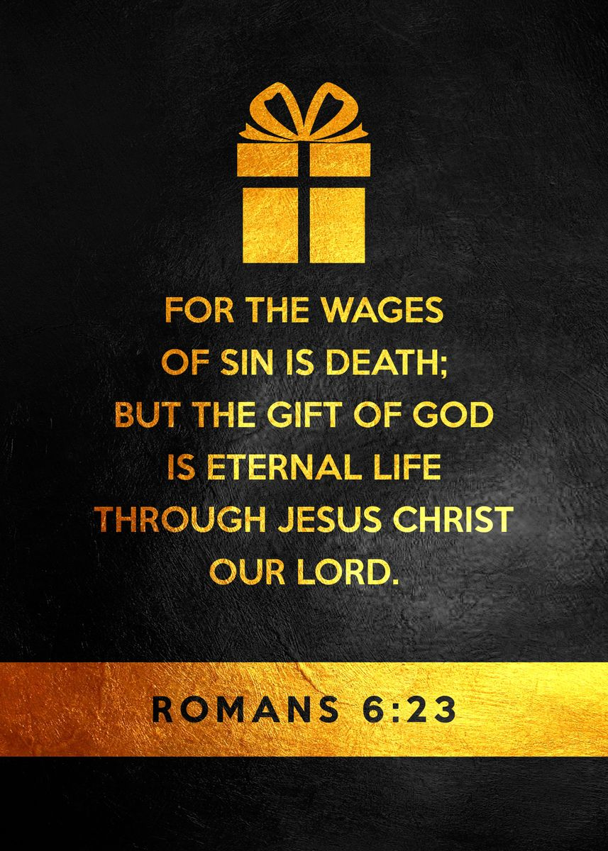

Slide 30
Romans 6:23
Paul masterfully concludes his answer to the charge that grace encourages sin.
This verse is commonly used to explain the gospel to those who have yet to believe as a part of the “Roman Road to Salvation.”
But, Paul wrote this verse to encourage believers in sanctification. In this concluding statement, Paul introduces a new concept, being “in Christ,” which he will take great care to explain in the next chapter.

Slide 31
Romans 6:23
We have everything by virtue of our being “in Christ.” We are “dead to sin, but alive to God in Christ” (6:11). Moreover, we receive eternal life by being “in Christ” (6:23).
This “in Christ” concept becomes the key to understanding everything Paul tells his readers in the following chapters. The believer’s life derives from being in Christ, his or her joy must be found in Christ, our success depends upon resting in Christ, and we have fellowship with others who are in Christ.

Slide 32
Romans 6:23
As we will see, our being “in Christ” provides the opportunity to escape the downward drag of sin and to enjoy freedom like we never thought possible.
However, it’s no guarantee that we will experience that kind of joy in this lifetime. Like emancipation, we must “KNOW” (understand its truth), “RECKON” (claim its truth), and “YIELD” (apply its truth). Unfortunately, our old master refuses to release its grip.
Whose slave are you?

Slide 33


“In Christ”

Slide 34
NEXT CLASS – 14 April 2021
Book of Romans
Before next class, read the below chapter in the KJV and in one other versions of the Bible, i.e., NKJV, NRSV, NIV, CEV, etc …
Read Chapter 7 thru 8
Focus on verses 7:1 – 13

