Slide 1

Portrait of a Struggling Christian
Chapter 7:1 – 13
Week 13
14 April 2021

Slide 2

“Portrait of a Struggling Christian”

Slide 3

Romans
Background:
In Chapter 6, Paul has just completed discussing how being baptized into Christ makes us dead to sin and free to present our bodies as instruments of righteousness unto holiness.
For the benefit of his Jewish readers (those who know the Law), he now carries the concept of death and freedom one step further: the Jewish believers become dead to the Law that they might be joined in newness to Christ.

Slide 4
Romans
Background:
He illustrates his point by referring to the marital relationship (7:1-4).
The result of being freed from the Law is that they might “serve in the newness of the Spirit and not in the oldness of the letter” (7:5-6).

Slide 5
Romans
Overview:
Lest his Jewish readers think he is implying that the Law was sinful, Paul is quick to dispel that notion (7:7).
The Law, he says, is “holy and just and good.” The problem is that the Law only makes known that which is sinful, but sin took opportunity by the commandment to produce evil desire and deceived him, resulting in death (7:8-12).

Slide 6
Romans
Overview:
To further illustrate his point, Paul pictures himself as man under the Law who finds himself in a terrible dilemma (7:13-14).
With his mind he knows that which good and wants to do it. He also knows that which is evil and wants to avoid that. But he finds a “law” (or principle) in his flesh which wins over the desire of the mind (7:15-23).

Slide 7
Romans
Overview:
As a prisoner, he cries out for freedom. Is there no hope?
Yes! God provides the solution through His Son Jesus Christ, upon which Paul will elaborate in chapter eight (7:24-25).

Slide 8
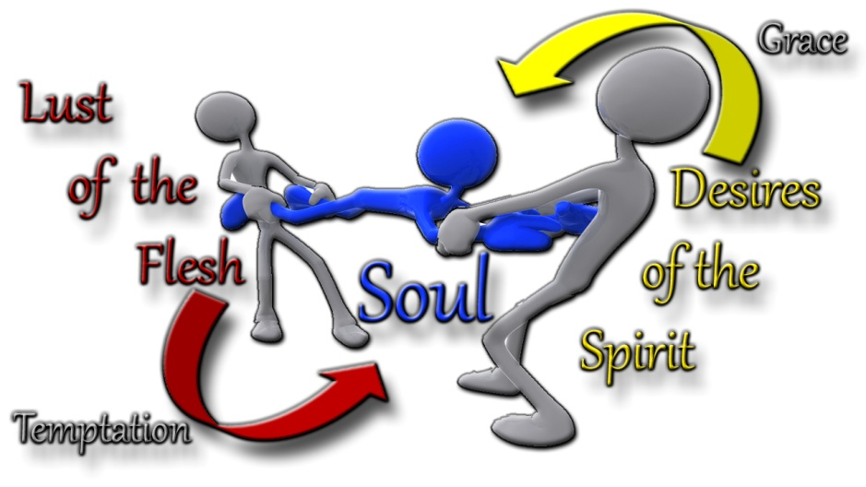
Portrait of a Struggling Christian

Slide 9
Romans
Paul concludes his response to the question, “Are we to continue in sin so that grace my abound?” (6:1) with the statement “Sin shall not be master over you, for you are not under law but under grace” (6:14).
In other words, because believers can now choose not to sin, they have the freedom to rise above the Law. This prompted a second rhetorical question, again, one Paul likely heard often in response to the gospel: “Shall we sin because we are not under law but under grace?” (6:15).

Slide 10
Romans
Responding to the gospel by faith and accepting Jesus Christ completely reverses things for an individual. He or she is now set free from sin (6:18) and has been enslaved to God with the result that she or he has the benefit of holiness (6:19).
The believers can now choose not to sin, no longer subject to the “wages of sin” being death, but now are the recipients of eternal life, which is the “gift of God” (6:23).

Slide 11
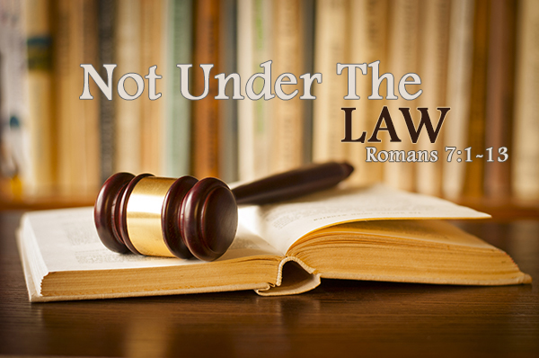

Slide 12
Romans 7
Chapter 7 is Paul’s self-portrait, in which he used the first-person singular pronoun, “I,” almost thirty times. Near the end of his verbal self-portrait, he exclaims, “Wretched man that I am!” (7:24).
Paul describes himself as feeling like something had “wrenched” the life out of him. This portrait begins with “lost” and rises to “victory.” Why, after escaping the tyranny of sin, does the next portrait depict a suffering, afflicted, miserable man?

Slide 13
Romans 7:1 – 3
¹Do you not know, brothers and sisters—for I am speaking to those who know the law—that the law has authority over someone only as long as that person lives? ²For example, by law a married woman is bound to her husband as long as he is alive, but if her husband dies, she is released from the law that binds her to him. ³So then, if she has sexual relations with another man while her husband is still alive, she is called an adulteress. But if her husband dies, she is released from that law and is not an adulteress if she marries another man.

Slide 14
Romans 7:1 – 3
In this passage, Paul uses the illustration of a husband and wife to show that the believer has a new relationship to the Law because of his union with Jesus Christ. When a man and woman marry, they are united for life. Marriage is a physical union and can only be broken by a physical cause. One such cause is death.
However, Matthew 5:31–34; 19:1–12 indicate that unfaithfulness also breaks the marriage bond, but Paul does not bring this up. He is not discussing marriage and divorce; he is using marriage to illustrate his point.

Slide 15
Romans 7:1 – 3
As long as they live, the husband and wife are under the authority of the law of marriage. If the woman leaves the man and marries another man, she commits adultery.
But the death of the husband frees both, and she is now free to remarry because she is no longer a wife. It is death that has broken the marriage relationship and set her free.
Our union with Jesus is a real union too, so when He died we were legally released from any obligation to the Law.

Slide 16
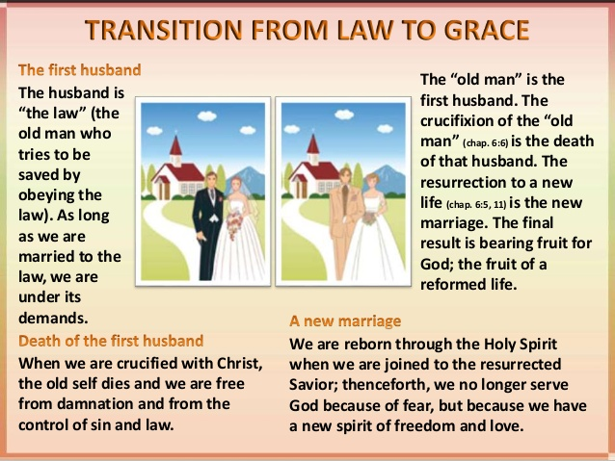

Slide 17
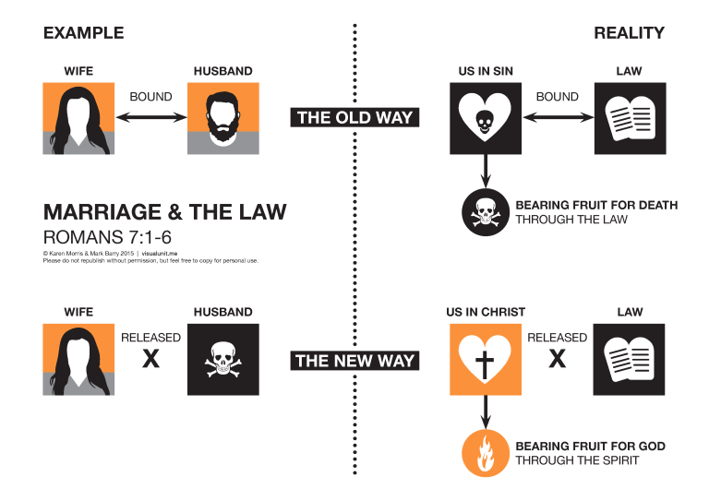

Slide 18
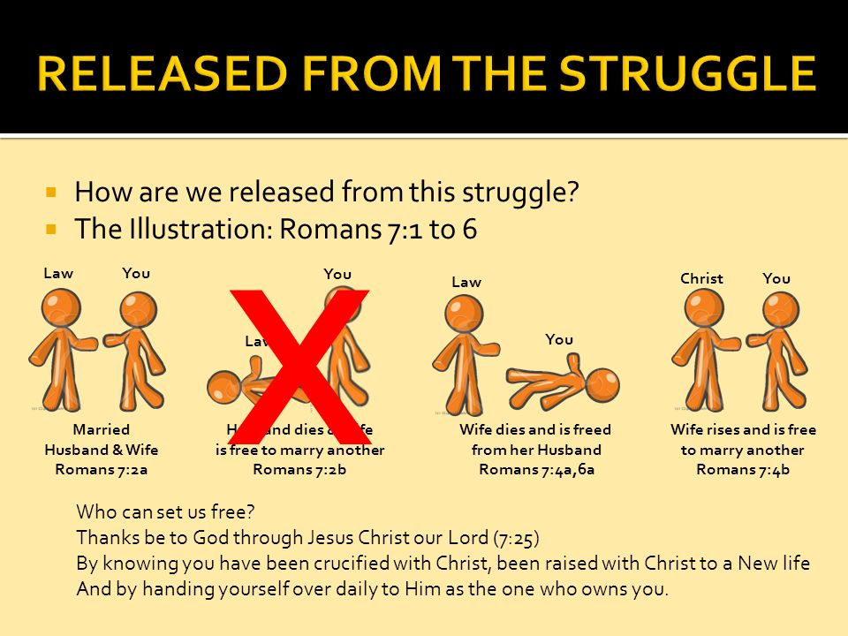

Slide 19
Romans 7:4 – 6
⁴So, my brothers and sisters, you also died to the law through the body of Christ, that you might belong to another, to him who was raised from the dead, in order that we might bear fruit for God. ⁵For when we were in the realm of the flesh, the sinful passions aroused by the law were at work in us, so that we bore fruit for death. ⁶But now, by dying to what once bound us, we have been released from the law so that we serve in the new way of the Spirit, and not in the old way of the written code.

Slide 20
Romans 7:4 – 6
Paul says that the old nature (our “sinful passions”) is aroused (stimulated or energized) by the Law! And the result of this stimulation is that we produce sin’s deadly fruit.
But since we are “not under Law,” we can relate to God in a new way. This new way is by the Spirit, who speaks to us directly from within. And, while the Law energized the old nature, the Spirit energizes the new nature!

Slide 21
Romans 7:4 – 6
When we approach life as interpreted through the Law, all marked off by “do’s” and “don’ts,” our old sinful nature is charged with energy.
But when we approach life in God’s new way, seeing each challenge as an opportunity to let God express Himself through us, we are on the way to victory.

Slide 22
Romans 7:4 – 6
The result of the Spirit’s ministry is that we produce the fruit of righteousness. We see the energizing principle at work everywhere.
The child who is told, “Don’t touch the cookies, they’re for company,” finds his hunger for a cookie increased! The forbidden seems far more desirable.
Released or delivered from the law: not freedom to do what God’s law forbids (6:1), but freedom from the spiritual liabilities and penalties of God’s law.

Slide 23
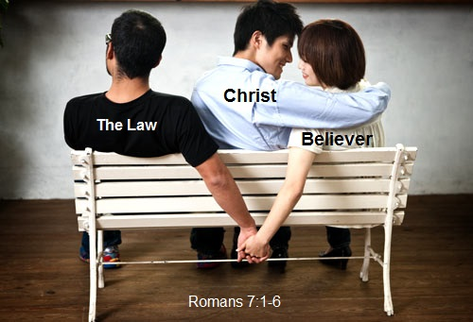

Slide 24


Slide 25
Romans 7:7 – 8
⁷What shall we say then? Is the law sin? Certainly not! On the contrary, I would not have known sin except through the law. For I would not have known covetousness (lust) unless the law had said, “You shall not covet.” ⁸But sin, taking opportunity by the commandment, produced in me all manner of evil desire. For apart from the law sin was dead.

Slide 26
Romans 7:7 – 8
Starting here in v7, and continuing through this chapter, Paul turned to the first person singular, presenting his personal Christian struggles.
Paul is saying, “I did not know that I was dying from the disease of sin until the Law revealed my terminal condition.”
Paul continues, “The Law showed me that I loved my disease and that I would do anything to keep it. I was like a living dead man! By pointing out my problem, the Law demonstrated that I was living under a death sentence.”

Slide 27
Romans 7:7 – 8
The Law excites lust, in the sense that I should not have lusted as I do had not the Law forbidden me to lust.
Without the Law, I might not have been aware of the sinfulness of desires, as well as of deeds, and thus, been unacquainted with the essence of sin.
The Law is God’s diagnostic tool. Its purpose is to expose the disease of sin and to confront us with the prognosis: The disease is deadly if not treated, but it’s completely curable.

Slide 28
Romans 7:7 – 8
Does the Law cause death? No more than the MRI causes cancer. The Law is not the cause of the act of sin; the principle or nature of sin within an individual is.
But the Law’s specific commandments stimulate the sin principle into acts that violate the commandments and give those acts the character of transgression.

Slide 29
Romans 7:9 – 11
⁹I was alive once without the law, but when the commandment came, sin revived and I died. ¹⁰And the commandment, which was to bring life, I found to bring death. ¹¹For sin, taking occasion by the commandment, deceived me, and by it killed me.

Slide 30
Romans 7:9 – 11
Paul’s focus in these verses was not on whether the person is regenerate or unregenerate. The power of sin is present in any person who tries to keep the law on his own.
Evidently Paul was speaking of his personal experience as a child and perhaps even a youth prior to his awareness and understanding of the full impact of God’s commandments.
The result was that the principle of sin within made its presence and power known (it sprang to life) in Paul’s violations of the commandment.

Slide 31
Romans 7:9 – 11
As a result Paul died spiritually (cf. 6:23a) under the sentence of judgment by the Law he had broken. The commandment not to covet was given to help people see how to live, but it actually produced death because of the sin in human hearts.
The view of the origin of human sin presented to us in Genesis 3 is that man at first lived at peace with God; but that the commandment, “Thou shalt not eat of it, lest thou die,” was taken advantage of by the “serpent” inspiring sinful lust.

Slide 32
Romans 7:9 – 11
The thing [fruit] desired was not really good for man; but inspired by the “tempter” caused it to seem so. One great purpose of regenerating grace is to dispel this delusion; to bring us back to the true view of things as they are, and so to peace with God.
Note: Paul’s words about the flesh and Spirit are also in Galatians 5:17-18 > “For the flesh lusts against the Spirit, and the Spirit against the flesh: and these are contrary the one to the other: so that you cannot do the things that you would. ¹⁸But if you be led of the Spirit, you are not under the law.”

Slide 33
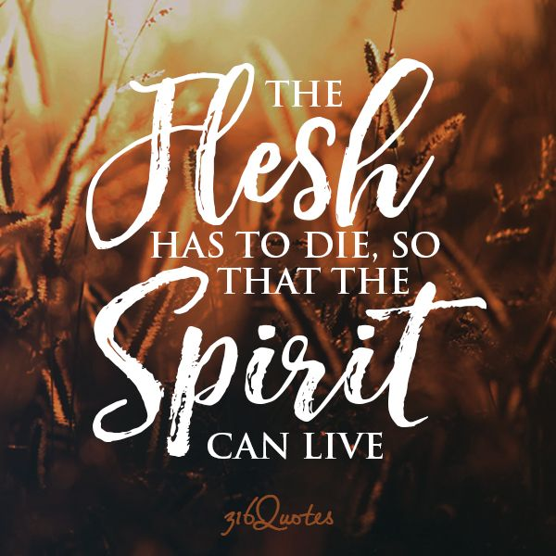

Slide 34
Romans 7:12 – 13
¹²Therefore the law is holy, and the commandment holy and just and good.
¹³Has then what is good become death to me? Certainly not! But sin, that it might appear sin, was producing death in me through what is good, so that sin through the commandment might become exceedingly sinful.

Slide 35
Romans 7:12 – 13
The fact that the Law reveals, arouses, and condemns sin, bringing death to the sinner, does not mean that the law is evil.
Rather the Law is a perfect reflection of God’s holy character and the standard for believers to please Him.
Instead of being sin, the Law is holy, and the commandment not to covet is holy, righteous, and good (7:12).

Slide 36
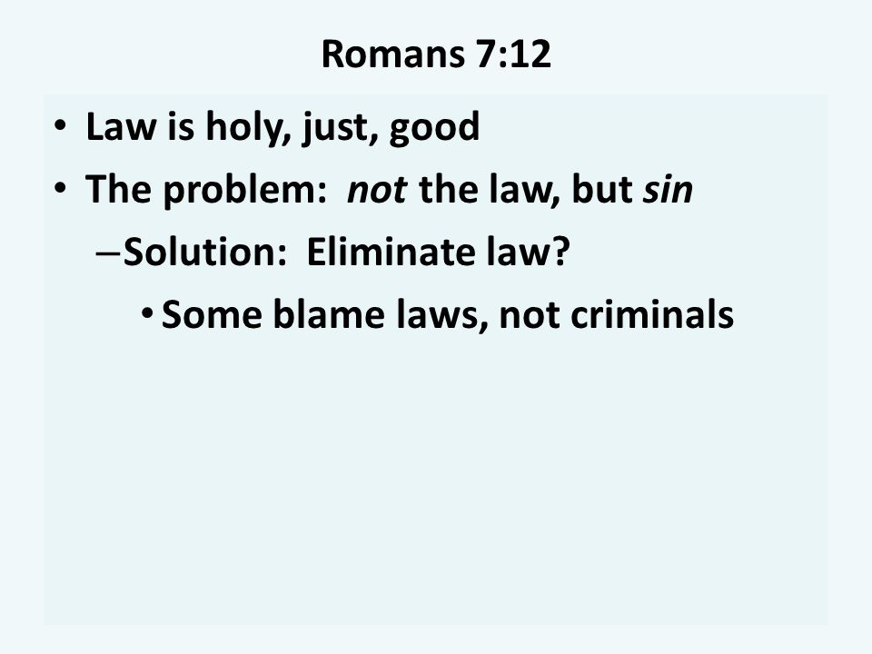

Slide 37
Romans 7:12 – 13
Paul answers the question of v13 with a vehement denial, “certainly not.” The principle of sin, not the Law, becomes death to an individual.
Sin is the cause of spiritual death, not the good law. An awareness of the true nature of sin and its deadly character, which brings sinners to see their need of salvation – the very purpose God intended the law to serve.

Slide 38
Romans 7:12 – 13
The nature of sin uses the commandments of the Law of God to reveal its true nature as opposed to God and to demonstrate its power within individuals.
Sin uses the Law, the good thing, as an agent or instrument to keep on producing death in an individual and thereby sin is seen as utterly or “exceedingly” sinful.

Slide 39


“I Am With You Always”

Slide 40
NEXT CLASS – 21 April 2021
Book of Romans
Before next class, read the below chapter in the KJV and in one other versions of the Bible, i.e., NKJV, NRSV, NIV, CEV, etc …
Read Chapter 7 thru 8
Focus on verses 7:14 – 25

