Slide 1

Portrait of a Struggling Christian
Chapter 7:14 – 25
Week 14
21 April 2021

Slide 2

“Portrait of a Struggling Christian”

Slide 3

Romans
Background:
Remember, the purpose of Paul’s Letter to the Romans is to:
[1] Announce his plans to visit Rome . . .
[2] Present a complete and detailed statement of the gospel message . . .
[3] Ease the tension and possible conflict between the Jewish and the Gentile segments in the Christian community at Rome because of his previous hounding by the Judaizers.

Slide 4
Romans
Background:
Growing out of Paul’s three purposes for writing this letter is the theme of the work. That is, the presentation of the “gospel” (1:16).
More specifically, it’s the “righteousness from God” which “is revealed” in that gospel and is understood and appropriated “by faith from first faith to last faith” (1:17).

Slide 5
Romans
Background:
This “righteousness from God” is first the righteousness God Himself possesses and manifests in all His actions; and second, it is the righteousness that God gives to human beings by grace through faith.
This involves an imputed righteous standing before God (justification) and an imparted righteous practice and a progressively transformed lifestyle.

Slide 6
Romans
Background:
The latter is due to the regenerating and indwelling Holy Spirit (regeneration and sanctification).
Practice is consummated and conformed to standing (glorification) when a believer in Jesus Christ through death and resurrection or through translation — “our adoption as sons, the redemption of our bodies” (8:23) — stands in the presence of God “conformed to the likeness of His Son” (8:29).

Slide 7
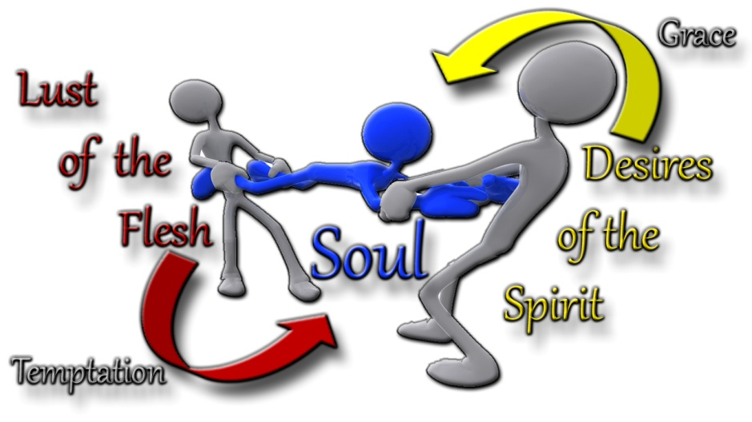
Portrait of a Struggling Christian

Slide 8
Romans 7:14 – 25
Overview:
Here, in Chapter 7, Paul discusses how the law of God applies to and affects the three kinds of men:
NATURAL – Lost and unsaved, sins are unforgiven, and he is lead by the dictates of this world.
SPIRITUAL – Jesus saves, sins are forgiven, and he is lead and guided by the Holy Spirit.
CARNAL – Jesus saves, sins are unconfessed and unforgiven, and he is lead by his flesh.

Slide 9

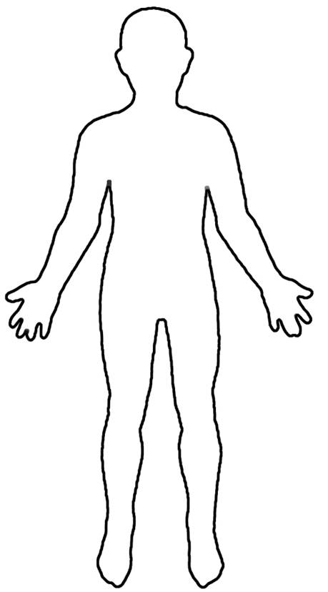

“Dust of the Ground”
“Living Soul”
“Breath of Life”
BODY
SOUL
SPIRIT
Taste
Touch
Sight
Smell
Hearing
Seat of the Holy Spirit
Intellect
Will
Emotions

Slide 10
Romans 7:14 – 25
Overview:
In the first part of “A Portrait of a Struggling Christian, Paul teaches that our connection (marriage) to Christ frees us from the Law and makes people “spiritual.”
Also, in the first part, that God uses the law to reveal the sinfulness of the flesh, and thus, “natural” people are doomed by the Law.

Slide 11
Romans 7:14 – 25
Overview:
In the second part of “A Portrait of a Struggling Christian, Paul teaches that any attempt to keep the law leads to “carnality” through . . .
The confusion of doing evil when we try to do good (7:4-16),
The corruption of our old sinful nature (7:17-20),
The conclusion of our daily struggle within with sin (7:21-23).

Slide 12
Romans 7:14 – 25
Overview:
In discussing the BODY – SOUL – SPIRIT, Paul uses the terms “me” or “flesh,” “I,” and “mind.”
As in, “I” as a carnal person living by the fleshly craving of the SOUL (7:14) . . .
As with, “me or flesh” as a natural person living by the worldly wants of the BODY (7:18) . . .
That is, the “mind” as a spiritual person of the SPIRIT warring daily against the law of sin (7:23).

Slide 13
Romans 7:14 – 25
Overview:
As a prisoner caught in the daily struggle with sin, Paul cries out for freedom. Is there any hope? Yes!
God provides the ultimate solution for sin through His only begotten Son – Jesus Christ (7:24-25).

Slide 14


Slide 15
Romans 7:14 – 16
¹⁴For we know that the law is spiritual: but I am carnal, sold under sin. ¹⁵For that which I do I allow not: for what I would, that do I not; but what I hate, that do I. ¹⁶If then I do that which I would not, I consent unto the law that it is good.

Slide 16

Portrait of a Struggling Christian

Slide 17
Romans 7:14 – 16
In relating his personal experience, Paul describes his present struggle as a Christian with indwelling sin and its continuing efforts to control his daily life.
The clause, “sold under sin” describes an unregenerate person; but sin also resides in a believer, who is still subject to sin’s penalty of physical death.
As a result, indwelling sin continues to seek to claim what it considers its property even after one has become a Christian.

Slide 18
Romans 7:14 – 16
Paul introduced the concept of “the flesh” earlier, declaring it to be the opposite of the Spirit. But he needed to explain how it continues to impact a believer, especially as the interactions become more complex.
Before someone believes, the flesh serves sin and feels the condemnation of law. Even if he or she wanted to obey the Law consistently, any endeavor would soon end in failure.

Slide 19
Romans 7:14 – 16
Once someone has received God’s grace though faith, the Holy Spirit takes up residence in the believer. And so begins the internal struggle.
The flesh continues to serve sin, while the Spirit serves righteousness . . .
“For what I am doing, I do not understand; for I am not practicing what I would like to do, but I am doing the very thing I hate. But if I do the very thing I do not want to do, I agree with the Law, confessing that the Law is good” (7:15-16).

Slide 20
Romans 7:14 – 16
Here, Paul’s experience convinced him that “the Law is good” (7:16). But he also concluded, I know that nothing good lives in me.
Paul quickly explains that by the phrase “in me” he meant in my sinful nature. This is the principle of sin that expresses itself through one’s mind and body (7:25).

Slide 21
BODY
SOUL
SPIRIT
NATURAL MAN
CARNAL MAN
SPIRITUAL MAN
“Me” or “Flesh”
Worldly Wants
“Mind”
Warring Against Sin
“I”
Fleshly Craving

Slide 22
Romans 7:14 – 16
NATURAL – Relating to or in accordance with nature; existing in or derived from nature or physical things. More specifically, those who have not been born again of the Spirit; those still unregenerated.
SPIRITUAL – Relating to or affecting the human spirit as opposed to material or physical things. Relating to, consisting of, or affecting the spirit things of a spiritual, ecclesiastical, or religious nature. More specifically, those who are born again into Christ Jesus.
CARNALITY – Relating to or given to crude bodily pleasures and appetite. More often connotes derogatorily an action or manifestation of a person’s lower nature (a slave to carnal desires); fleshly is less derogatory than carnal (a saint who had experienced fleshly temptations). More specifically, those who are born again and still live according to the flesh.

Slide 23
Romans 7:17 – 20
¹⁷Now then it is no more I that do it, but sin that dwells in me. ¹⁸For I know that in me (that is, in my flesh,) dwells no good thing: for to will is present with me; but how to perform that which is good I find not. ¹⁹For the good that I would I do not: but the evil which I would not, that I do. ²⁰Now if I do that I would not, it is no more I that do it, but sin that dwells in me.

Slide 24
Romans 7:17 – 20
Paul describes the fleshy pull toward sin as the “dwelling-within-me sin” (7:17). While he received a new nature when he believed in Jesus Christ, the flesh seemed to have a will of its own.
It’s as though Paul is conjoined to a person who loves the very things he hates the most. And the same is true for every believer.
Every Christian receives a new nature, one which wants nothing more than to behave as Jesus Christ behaves.

Slide 25
Romans 7:17 – 20
Meanwhile the flesh (Body), the old human nature, wants life to continue as it was. Here’s part of Paul’s description of the battle:
So now, no longer am I the one doing it [what I don’t want to do], but sin which dwells in me. For I know that nothing good dwells in me . . . For the willing is present in me, but the doing of the good is not (7:17-18).
For the good that I want, I do not do, but I practice the very evil that I do not want (7:19).

Slide 26
Romans 7:17 – 20
Paul then repeated in slightly different words the statement of verse 15b, and then in verse 20 he repeats in effect his statement in verse 17.
Paul recognized that even as a believe he had an indwelling principle of sin that once owned him as a slave and that still expressed itself through him to do things he did not want to do and not to do things he desired to do.
This is a problem common to all believers.

Slide 27


Slide 28
Romans 7:21 – 23
²¹I find then a law (principle), that, when I would do good, evil is present with me. ²²For I delight in the law of God after the inward man: ²³But I see another law in my members, warring against the law of my mind, and bringing me into captivity to the law of sin which is in my members.

Slide 29
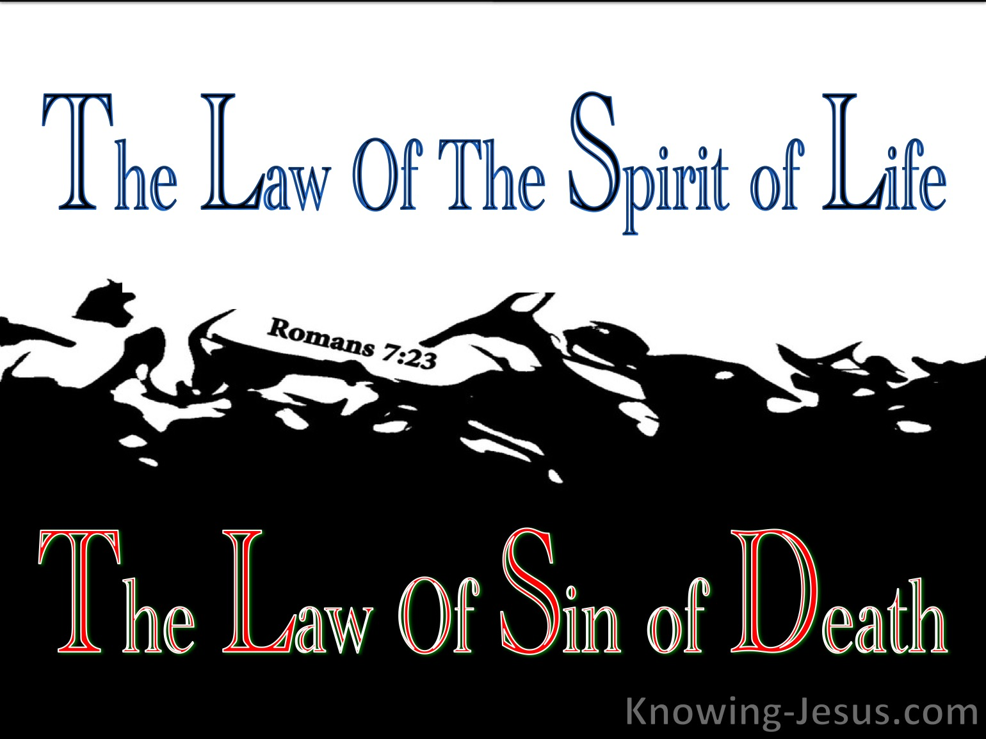

Slide 30
Romans 7:21 – 23
Paul was a person who tried to learn from his experiences, so now he concludes, I find this law at work. This is not the Mosaic Law, but a principle drawn from experience. This law or principle is the reality of ever-present evil in an individual whenever she or he wants to do good.
Because of regeneration, a believer has a new nature for loving spiritual truths. Yet, Paul sees another principle at work within him. This is the principle of sin. Paul called it “sin dwelling in me” (7:17, 20), “evil” right there with me (7:21), and “the sinful nature” (7:18, 25).

Slide 31
Romans 7:21 – 23
Anyone who has experienced physical dependence upon anything will affirm that the craving is never far away.
Treating the body to overcome physical dependence is only a beginning. The key to lifelong sobriety or recovery lies in treating the mind, which is itself a lifelong endeavor.
The addict is never really “cured.” The addiction will always be a part of his or her life. However, addicts can remain “in recovery” forever.

Slide 32
Romans 7:21 – 23
All of us are chronically addicted to sin!
Long after we are saved, our bodies crave that which gave us short-term pleasure and caused long-term anguish.
And the pull to indulge the craving for sin will always be a part of our lives . . . at least until we are freed from “the body of this death” (7:24).
As for the present? “Wretched man that I am!”

Slide 33
Romans 7:24 – 25
²⁴ O wretched man that I am! who shall deliver me from the body of this death? ²⁵I thank God through Jesus Christ our Lord. So then with the mind [Sp], I myself [S] serve the law of God; but with the flesh [B] the law of sin.

Slide 34
Romans 7:21 – 23
Paul’s description of his personal struggle with the old nature paints a bleak picture of the future for the average Christian. Wow, if the Apostle Paul felt defeated, what hope is there for us?
Paul uses the word “wretched” to describe himself. Imagine a defeated boxer, after fifteen rounds of pummeling, takes his place in the middle of the ring to hear his defeat announced to the crowd.

Slide 35
Romans 7:21 – 23
The fight Paul describes has left wretched. Unable to defeat his flesh by means of his flesh. That is, by his own ability – Paul cries out for help. The apostle asks, Who will rescue me from this body of death?
Paul recognized that as long as he was in his mortal body he would face the conflict and struggle with the indwelling sin principle and would have defeat in his own strength.

Slide 36
Romans 7:21 – 23
What, other than death, can free him [us] from a body that craves sin more powerfully than his mind craves righteousness? Who will rescue him [us] from this misery?
The answer comes quickly: “God through Jesus Christ our Lord” (7:25). Just as we [believers] are identified with Christ in His death and resurrection by faith; here and now, so we shall join our resurrected and exalted Lord for all eternity in new bodies, free forever from the presence of sin.

Slide 37
Romans 7:21 – 23
Meanwhile, in this life, Paul concluded, I myself in my mind am a slave to God’s Law, but in the sinful nature a slave to the law of sin.
While awaiting freedom from the presence of sin, believers still face the struggle between their new regenerated minds (new natures) and their old sinful natures.

Slide 38
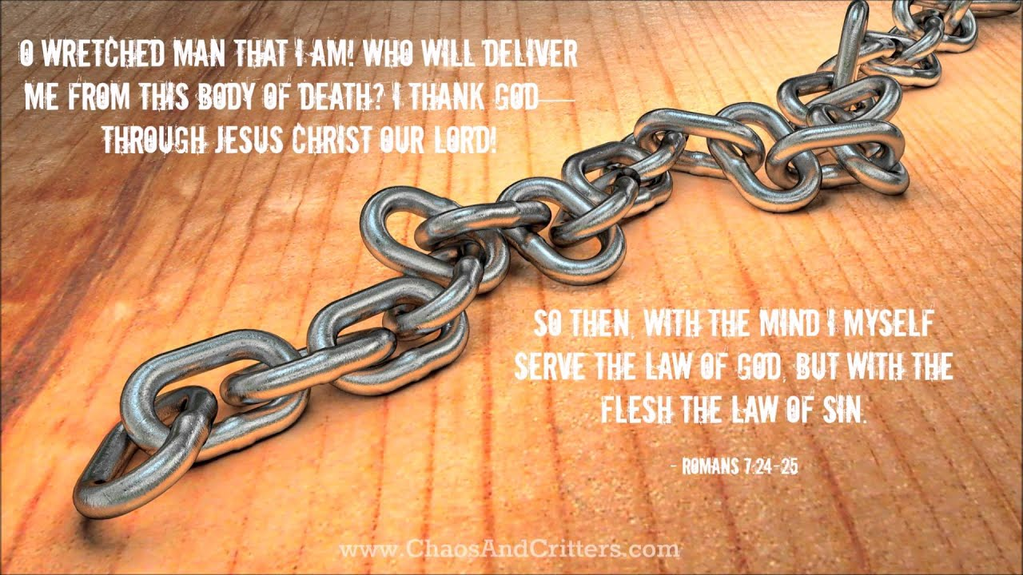
Romans 7:24 – 25

Slide 39
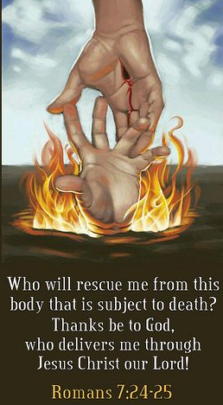

Slide 40
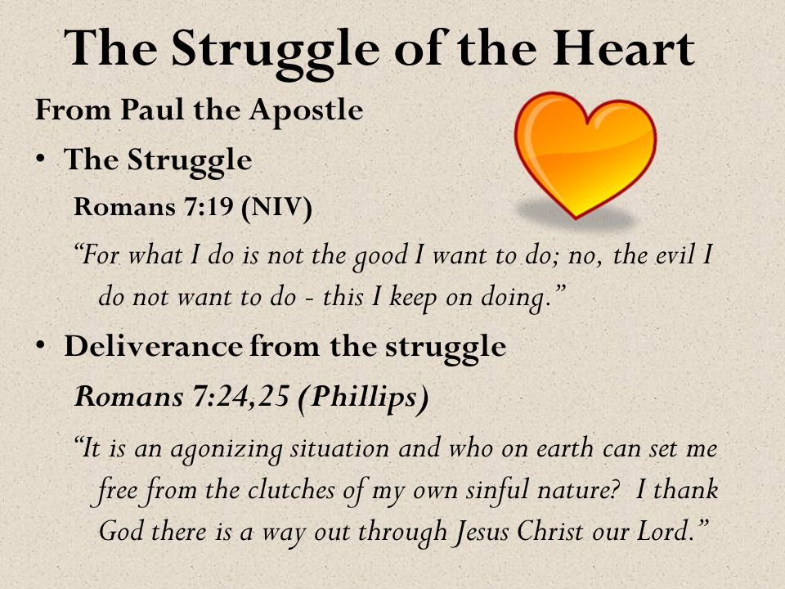

Slide 41


“I Have Already Overcome”

Slide 42
NEXT CLASS – 28 April 2021
Book of Romans
Before next class, read the below chapter in the KJV and in one other versions of the Bible, i.e., NKJV, NRSV, NIV, CEV, etc …
Read the entire Chapter 8 – we will study this chapter in three parts
First lesson: 8:1-17
Other lessons: 8:18-27 and 8:28-39

