Slide 1

A Talk About Our Walk
Chapter 8:1 – 17
28 April 2021
Week 15

Slide 2

“A Talk About Our Walk”

Slide 3

Romans
Background:
Once a believer has died to sin “in Christ,” his or her relationship with the Law is forever changed. The new covenant (Jer. 31:31-33) gives us a new rule of life: the Holy Spirit (7:1-6).
God gave the Law to humanity to confront our unrighteousness and to demonstrate our need for salvation. Once a person abandons his or her futile attempt to keep the Law and then receives God’s grace through faith in Jesus Christ, the Law has served its purpose (7:1-13).

Slide 4
Romans
Background:
The believer’s relationship with the Law is then severed.
So, what is our goal in life now that we are saved? Is it not to please God by keeping the Law? Are we not to become like Christ, who is morally perfect?
Shouldn’t we repay God’s kindness by pursuing good deeds and eradicating sin from our lives?

Slide 5
Romans
Background:
Now that we are saved from condemnation by the grace of God, are we to sanctify ourselves through fasting, praying, studying Scripture, tithing, and the other spiritual disciplines?
If Paul’s self-portrait teaches us anything, it’s that self-improvement carried out in the energy of the flesh is a vain pursuit (7:14-25).

Slide 6
Romans
Background:
You can push yourself to fatigue trying hard to be like Christ, but you’ll have an easier time catching rainbows. Some folks acknowledge the impossibility of achieving the perfection of God, but they find value in aiming high nonetheless.
Others lower the standard of perfection to bring it within easier reach and then claim victory over sin. Most people simply work themselves into a wretched exhaustion and then collapse —sometimes with destructive force.

Slide 7
Romans
Background:
But God never demanded perfection.
(Read that again—aloud!)
Untainted morality vanished with Eden. No, we are not saved by grace and then sanctified by our own labors.
The work of grace was not half done. The point of Paul’s miserable self-portrait was to demonstrate that humanity can no more purify itself of sin after salvation than before. Only God can purify a soul.

Slide 8
Romans
Background:
So, what is our duty now as believers saved by grace? Our primary purpose is to know Jesus Christ personally with ever-deepening intimacy (Phil. 3:8-11).
If we read Scripture, pray, meditate, journal, or fast, let us do it for the sole purpose of knowing His mind. If we worship, serve, partake of Communion, or spend time in the company of believers, let us learn about Him through His transforming work in others.

Slide 9
Romans
Background:
If we feed the poor, defend the weak, comfort the lonely, or proclaim the gospel to a broken and needy world, let our walking in His sandals give us firsthand knowledge of His character.
Let every trial or triumph bring us closer to knowing Christ’s nature and understanding His purpose. The spiritual disciplines are not a means to holiness; they are a means of knowing Christ.

Slide 10
Romans
Background:
And as we engage in personal piety, fellowship with other believers, and engage the world at large in the name of Christ—as we come to know Him more intimately—the Holy Spirit will do what only He can do: make us more like our Savior.
As the moon reflects the light of the sun, yet has no light of its own, so we will shine with God’s radiance as we live in proximity to His Son. Now, that is a worthy pursuit.

Slide 11


Slide 12
Romans 8:1 – 17
Overview:
In Chapter 7, Paul described the dilemma of a man who becomes a prisoner of the law of sin which is in the members of his body.
In those last few verses, Paul made reference to the hope of liberation made possible by God through Jesus Christ.
In Chapter 8, Paul amplifies on the freedom from sin found in Jesus Christ.

Slide 13
Romans 8:1 – 17
Overview:
FIRST – for those in Christ who are walking according to the Spirit, there is no condemnation for sin, for the death of Christ for sin has set us free from the law of sin and death by fulfilling the requirement of the law (8:1-4).

Slide 14
Romans 8:1 – 17
Overview:
SECOND – by setting our minds on the things of the Spirit and not the flesh, we are able to enjoy life and peace, pleasing God (8:5-8), and . . .
THIRD – we now enjoy the indwelling of the Spirit of God, by whom we can put to death the deeds of the body and enjoy both present and future blessings as the children of God (8:9-17).

Slide 15
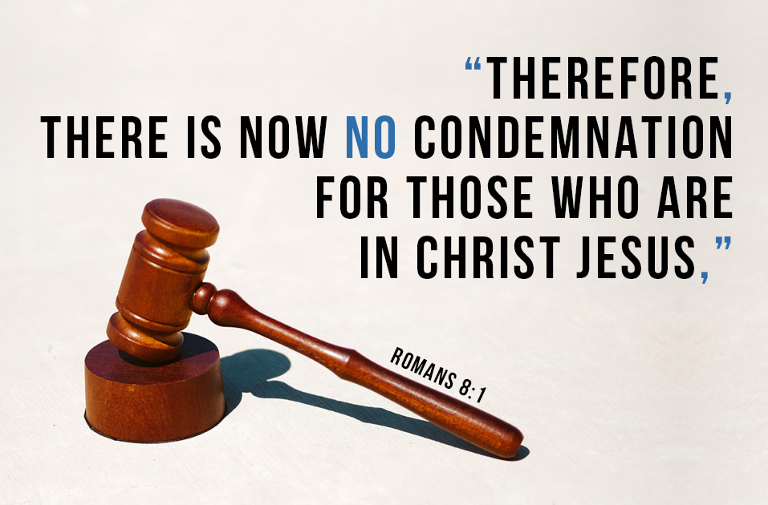

Slide 16
Romans 8:1 – 17
Like Paul, we eventually discover our own “wretchedness” in our Christian journey, defeated, ashamed, and guilt-ridden.
Regrettably, some teach that Christians are left to wrestle the flesh on their own until Judgment Day, at which time a tape of their miserable failures will be played for all to see just as the pearly gates open to receive them.
Saved by grace, but sanctified by works? That’s not good news.

Slide 17
Romans 8:1 – 17
This is the cardinal truth of every believer’s new life “in Christ” > “Therefore there is now no condemnation for those who are in Christ Jesus.”
This is the truth on which we stand, by which we live, and through which we ultimately achieve victory.
We have reached a significant turning point in Romans. From this place forward, the journey will be frequently challenging and sometimes confusing, but never exasperating. From this vantage point, the good news only gets better.

Slide 18
Romans 8:1 – 4
¹There is therefore now no condemnation to them which are in Christ Jesus, who walk not after the flesh, but after the Spirit. 2For the law of the Spirit of life in Christ Jesus hath made me free from the law of sin and death. 3For what the law could not do, in that it was weak through the flesh, God sending his own Son in the likeness of sinful flesh, and for sin, condemned sin in the flesh: 4That the righteousness of the law might be fulfilled in us, who walk not after the flesh, but after the Spirit.

Slide 19
Romans 8:1 – 4
Remember the word “therefore” connects us to the previous thought of (7:24). In Paul’s lonely and futile struggle against the flesh, he cried out, “Who will set me free from the body of this death?”
And the answer came: “God through Jesus Christ our Lord will set me free from the body of this death” (7:25).
Notice three crucial truths derived from 8:1-4:

Slide 20
Romans 8:1 – 4
  [1] We are eternally secure, now as well as when we face judgment (8:1). God has officially declared our justification, and He never rescinds His Word.
  [2] We are internally free from the control of sin, now as well as when we get to heaven (8:2). The Spirit of life has set us free (past tense with ongoing results).
[3] We are positionally righteous, now as well as when we stand before our heavenly Judge (8:3-4). What the Law could not, God did through Jesus.

Slide 21
Romans 8:1 – 4
We can appreciate Paul putting this reassurance up front. It not only consoles the wretched, it frees us to hear and absorb what he has to teach us next . . .
Jesus, by his death for us, has met the law’s demands in full. When Christ died, he cried out, ‘It is finished!’ or ‘Paid!’ (John 19:30).
Therefore, no further charges can be brought against us. No more condemnation. No more blame. No more penalties. No more guilt.

Slide 22
Romans 8:1 – 4
God has done something for us that the law could never do. The law was beautiful and good – but it sentenced us to death. But God sent his own Son in the likeness of sinful humanity and Jesus gave himself to die for us. Because of his sacrifice, we are forgiven and released.
Therefore, we are no longer on the dreary religious treadmill of knowing the right and yet doing the wrong. Instead, God has given us his own Spirit to live within us. The Spirit helps us overcome our old sinful nature (flesh), and assures us that we are now God’s children.

Slide 23
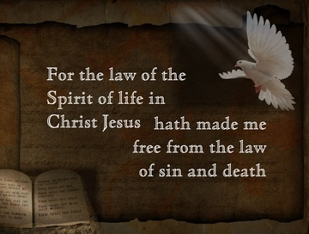
Romans 7:2

Slide 24
Romans 8:5 – 8
⁵For they that are after the flesh do mind the things of the flesh; but they that are after the Spirit the things of the Spirit. ⁶For to be carnally minded is death; but to be spiritually minded is life and peace. ⁷Because the carnal mind is enmity against God: for it is not subject to the law of God, neither indeed can be. ⁸So then they that are in the flesh cannot please God.

Slide 25
Romans 8:5 – 8
When Paul paints his dark self-portrait, we learn about the two natures struggling for control: “the flesh” [our old sin nature], and “the Spirit” – the gift of God’s presence within us.
Having been put at ease by the truths in 8:1-4, this struggle looks much different. While the old nature never gives up, never backs off, never concedes defeat, we can live with confident assurance that the Holy Spirit is stronger.
Now, the question is “To whom will we yield control?” The choice is up to you!

Slide 26
Romans 8:5 – 8
Fleshy [carnally] thinking is death; Spirit thinking is “life and peace” (8:6) . . .
Existing in the flesh can involve a headlong pursuit of sin. After all, the flesh is hostile to God. Before we received His grace and His Spirit took up residence within us, the flesh craved only evil.
A believer exists according to the flesh when she or he tries to become righteous by simply trying harder. That is the mean of Romans 3:23, “All have sinned and [fall short] of the glory of God.”

Slide 27
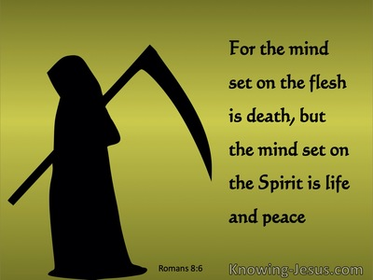
Romans 8:6

Slide 28
Romans 8:5 – 8
Fleshy thinking can have noble ideals and admirable desires, but it is also proud to the bone.
Fleshly thinking presumes to achieve godly objectives without God. It rejects the grace of God in favor of its own will, its own way, its own ability to do good on its own terms.
Fleshy thinking buys into the “self-made man or woman” philosophy and aligns itself remarkably well with the entrepreneurial spirit.

Slide 29
Romans 8:5 – 8
While rugged individualism and a can-do attitude may be good for business, this kind of thinking brings death to the spiritual life. It’ll leave you downright wretched.
However well-intentioned the flesh may appear, we must never forget that it was hostile to God before we received salvation; therefore, we are foolish to think the flesh will cooperate now.
The flesh cannot change; it can only be left behind.

Slide 30
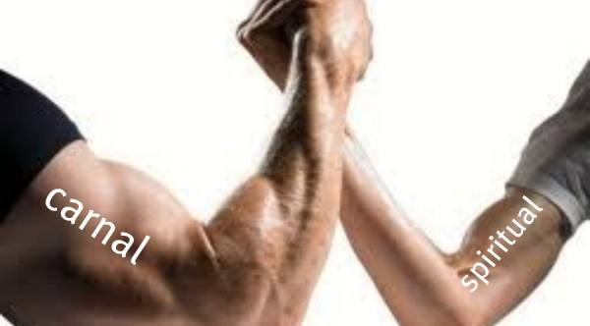
“Carnal-mindedness causes fleshly thinking”
Romans 8:7

Slide 31
Romans 8:9 – 11
⁹But ye are not in the flesh, but in the Spirit, if so be that the Spirit of God dwell in you. Now if any man have not the Spirit of Christ, he is none of his. ¹⁰And if Christ be in you, the body is dead because of sin; but the Spirit is life because of righteousness. ¹¹But if the Spirit of him that raised up Jesus from the dead dwell in you, he that raised up Christ from the dead shall also quicken your mortal bodies by his Spirit that dwells in you.

Slide 32
Romans 8:9 – 11
Paul reminds his readers that they were no longer deluded by fleshy thinking but has gained the capacity to think and choose as a result of their freedom “in Christ.”
The Spirit of God has given them this freedom. Interestingly, Paul qualifies his assurance, limiting it to those who have received God’s grace through faith. Therefore, everything the apostle taught concerning the believer does not apply to everyone in general. In fact, much of his instruction will appear as nonsense to those who are not “in the Spirit.”

Slide 33
Romans 8:9 – 11
Paul reminds his readers that they were no longer deluded by fleshy thinking but has gained the capacity to think and choose as a result of their freedom “in Christ.”
The Spirit of God has given them this freedom. Interestingly, Paul qualifies his assurance, limiting it to those who have received God’s grace through faith. Therefore, everything the apostle taught concerning the believer does not apply to everyone in general. In fact, much of his instruction will appear as nonsense to those who are not “in the Spirit.”

Slide 34
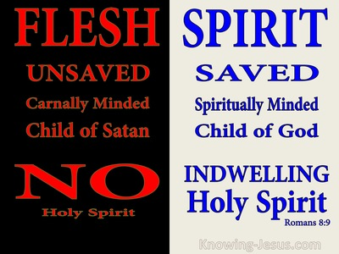

Slide 35
Romans 8:12 – 13
¹²Therefore, brethren, we are debtors, not to the flesh, to live after the flesh. ¹³For if ye live after the flesh, ye shall die: but if ye through the Spirit do mortify the deeds of the body, ye shall live.

Slide 36
Romans 8:12 – 13
Because the Spirit lives within us, and because we have access to the mind of God, we have an obligation. Sound like work.
Some teach that the sacrifice of Jesus on our behalf puts us in His debt. That we owe Christ a debt of gratitude – demanding our complete devotion to do good works until we die.
The Greek word for such teaching is hogwash!

Slide 37
Romans 8:12 – 13
We do indeed have an obligation, but it is not to do good things for God. The obligation is to allow the Spirit to do good deeds on our behalf, through us, so that we will become more like Jesus and share the blessings that are due Him.
Paul taught this in Ephesus, Philippi, Thessalonica, and perhaps a hundred other places between Jerusalem and Rome.

Slide 38
Romans 8:12 – 13
To the Ephesians, he wrote:
“For by grace are ye saved through faith; and that not of yourselves: it is the gift of God: Not of works, lest any man should boast. For we are his workmanship, created in Christ Jesus unto good works, which God has before ordained that we should walk in them” (Eph. 2:8-10).

Slide 39
Romans 8:12 – 13
To the Philippians, he wrote:
“Being confident of this very thing, that he which hath begun a good work in you will perform it until the day of Jesus Christ” (Eph. 2:8-10).
The Lord has prepared good works for us beforehand. He has the desire and the ability to prepare us for those good works. Best of all, He has promised to bring it all together to accomplish what he has determined. Our only responsibility is to let Him. If we do, we live. If not, then a death-like, miserable existence becomes our inevitable end.

Slide 40
Romans 8:14 – 17
¹⁴For as many as are led by the Spirit of God, they are the sons of God. ¹⁵For ye have not received the spirit of bondage again to fear; but ye have received the Spirit of adoption, whereby we cry, Abba, Father. ¹⁶The Spirit [him]self bears witness with our spirit, that we are the children of God: ¹⁷And if children, then heirs; heirs of God, and joint-heirs with Christ; if so be that we suffer with him, that we may be also glorified together.

Slide 41
Romans 8:14 – 17
Paul has focused on the negative (telling what not to do) long enough. He quickly turns to the positive. In each of the next four verses, we find a practical benefit of living in the Spirit.
FIRST: practical, everyday leading from God (v14). This is frequently used as a proof text to support the notion that believers receive either verbal or nonverbal messages from the Holy Spirit telling them what decisions to make or what to do next.
This is not what Paul is teaching here. The Holy Spirit is a gift, not a dictator.

Slide 42
Romans 8:14 – 17
Note how Paul phrases the sentence: “For all who are being led by the Spirit of God, these are sons of God.” Paul teachings in other portions of Scripture makes it clear that the Spirit does lead, but the believer may elect to go his or her own way, thus “grieving” the Spirit (Eph. 4:30).
This v14 is both a promise and a practical means of assurance. Those who are actively following the Spirit will bear the unmistakable evidence of that leading (cf. Gal. 5:18-25).

Slide 43
Romans 8:14 – 17
When that evidence (fruit) is visible, it assures the believer that he or she is indeed a “son of God.”
By the way, we should not replace the word “son” with “child,” even for women. Paul could have chosen the neutral Greek term for “child,” but he deliberately chose “son” to indicate the believers stand to inherit something.
In this sense, women are “sons of God” because they, no less than men, are a part of God’s estate.

Slide 44
Romans 8:14 – 17
SECOND: fearless intimacy with God (v15). Paul again reinforces the good news that believers have been emancipated. They no longer serve a master who tells them what to do, when, how, and where. We have been freed and therefore we are free indeed.
God purchased us. The payment was His Son’s death. While He had every right to own us as slaves, He tore the bill of sale into shreds and drafted a new document: adoption papers!

Slide 45
Romans 8:14 – 17
He is not merely a kinder, gentler Master; He is our “Abba” or Daddy. Intimacy with the almighty Creator of the universe! What an awesome thought.
We have an obligation, not as slaves repaying a debt, but as sons, who have a genuine stake in our daddy’s estate.
The obligation doesn’t come as orders from a harsh slave owner, but as an invitation to become a contributing member of a family.

Slide 46
Romans 8:14 – 17
THIRD: assurance of belonging to God (v16). This is the only place in the NT that seems to suggest that the Holy Spirit speaks to individual believers as a general practice. After Jesus inaugurated the new covenant, the Lord spoke through designated people. God spoke through apostle and prophets – until finishing finally with the Book of Revelation written by John.
Just because someone in the Bible experienced something, that doesn’t mean we should expect it will become a common occurrence (normative).

Slide 47
Romans 8:14 – 17
We need no other prophetic utterance until the end-time events begin to unfold. We have all the information we need. Truth be told, we have more than we can handle in a lifetime as it is.
However, at this stage in the timeline of redemption, God does not speak prophetically to, or through, people. That is one of the major tenets of the Reformation – sola scriptura – and was, in part, defines us as Protestant.

Slide 48
Romans 8:14 – 17
We have God’s Word in black ink on white paper, accessible in multiple languages, and understandable to all.
I suggest we keep our focus there. If the Holy
Spirit speaks into (or bears witness with) the souls of His beloved children, it’s only to say this: “You are my precious child.”

Slide 49
Romans 8:14 – 17
FOURTH: a continual reminder of our value before God (v17). Adoption was a common practice in Roman law. Much of Roman society depended upon a system called “patronage,” in which one person became a benefactor to less powerful people.
He, in turn, owed allegiance to his patron. Very frequently, a patron would adopt a favorite unrelated client to inherit his estate.

Slide 50
Romans 8:14 – 17
When Paul speaks of “adoption as sons,” his Roman readers would have immediately recalled that Caesar Augustus had received much of his power through adoption by his patron, Julius Caesar, the founding father of the Roman Empire.
Through adoption, believers have become coheirs with God’s one and only Son. And through our identification with Him, we stand to inherit everything that is due Him. In Revelation 5:12, we see what that entails. He will share everything with His adopter brothers and sisters; all, that is, except worship. That is His alone.

Slide 51


Slide 52


“Continue to be lead by the Spirit”

Slide 53
NEXT CLASS – 5 May 2021
Book of Romans
Before next class, read the below chapter in the KJV and in one other versions of the Bible, i.e., NKJV, NRSV, NIV, CEV, etc …
Read the entire Chapter 8 again –
Second lesson: 8:18 – 27
Third lessons: 8:28 – 39

