Slide 1

Glorying and Groaning
Chapter 8:18 – 27
5 May 2021
Week 16

Slide 2

“Glorying and Groaning”

Slide 3
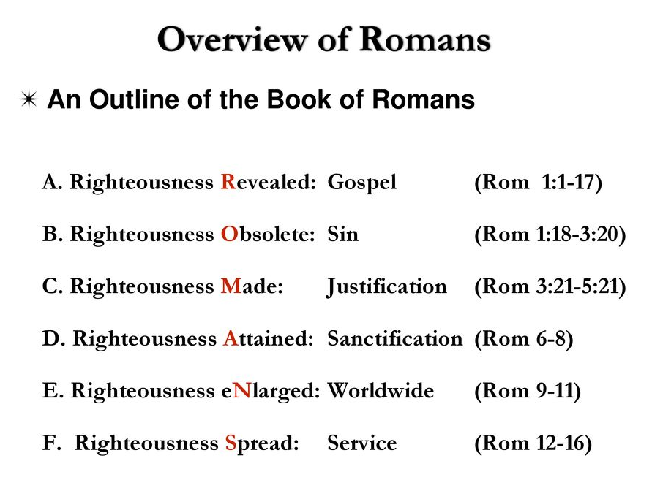

Slide 4

Romans
Background:
Paul took great care to convince believers that only unbelieving people exist according to the Flesh and that only sons of God exist according to the Spirit.
Paul assures us that the Spirit of God decided on His own to start living in and through believers. Then Paul describes what the Spirit will do for us and the blessings we will receive as a result.

Slide 5
Romans
Background:
Existing in the Spirit is not about what we do for Him; remember, we can do nothing. The Spirit life is about what He will do on our behalf, because the indwelling presence of the Holy Spirit is a gift of grace.
The same gift that redeems us from slavery to sin also rescues us from it. The free gift of salvation from sin begins now, not after we’ve gone to the grave.

Slide 6
Romans
Background:
So, what must we do? What is our obligation? The answer is uncomplicated, but difficult to do because the flesh will not surrender control easily. The answer is . . . nothing!
Nothing?! Do we have to pray, or shower every day, or wear dark clothing, or do a pile of good deeds to become more spiritual? No. Nothing. If you have the Holy Spirit with you, you are as spiritual as you’re ever going to be . . .
(control vs filled).

Slide 7
Romans
Background:
If there is an imperative (a command) to be found in Paul’s description of the Spirit life, it is to quit “trying so hard” to be spiritual. Stop all of that!
Instead, let the Spirit be spiritual. When that makes sense to you, you can be sure you are setting your mind on the things of the Spirit . . . and you are starting to understand grace.
Until then, you will not be ready to accept Paul’s teaching in the latter half of this letter to the Church at Rome.

Slide 8
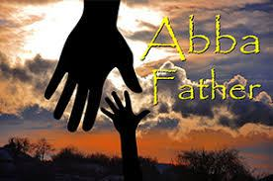

Slide 9
Romans 8:18 – 27
Overview:
In Chapter 8, Paul explains that believers receive no condemnation and are freed from sin and death. This was accomplished not through the law of Moses, but by the death of Christ. We are able to fulfill the righteousness of the law in and through Christ (8:1-8).
The believer has the indwelling help of the Holy Spirit who once strengthened Christ and raised Him from the dead. The HS now lives and abides within us and controls us. The HS strengthens us and will someday raise us from the dead (8:9-13).

Slide 10
Romans 8:18 – 27
Overview:
Also in Chapter 8, Paul explains that believers are now members of God’s family. This new adoption gives us both an intimacy with and an inheritance from the Father (8:15-17).
Now, in this lesson, Paul discusses the believer’s new hope that believers’ groans will be released from the present pain and suffering. And the future glory that today’s grief is nothing when compared with tomorrow’s glory (8:18, 23-25). Nature, too, groans in pain, but will also be liberated from decay and death (8:19-22).

Slide 11
Romans 8:18 – 27
Overview:
Also, in this lesson, Paul identifies the believer’s new prayer helper as the Holy Spirit (8:26).
The prayers of the HS are vital (indispensable), because we don’t even know what we should pray for. Yet, the HS prays for us with groaning that cannot be expressed in words as the HS pleads for us in harmony with God’s own will (8:26-27).

Slide 12
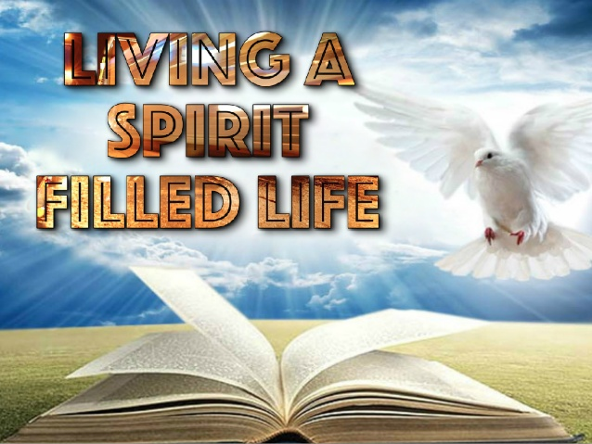

Slide 13
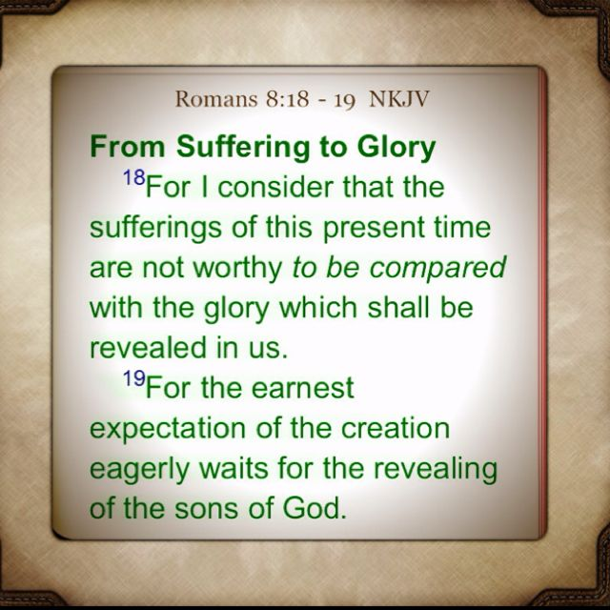
Romans 8:18 – 19

Slide 14
Romans 8:18 – 19
Paul declares that the Holy Spirit continually affirms the believer’s place in God’s family as one of His children (8:16). Furthermore, we stand to share Christ’s inheritance, which includes both blessing and suffering, as well as, glorying and groaning (8:17).
While Paul did not minimize the intensity of our present distress – including his own, which was more severe than most – he considers it a mere fraction of the future splendor we will enjoy forever.

Slide 15
Romans 8:18 – 19
Someone once said > “There is no victory without a fight, and there is no battle without wound.” This is not to suggest that sanctification can be purchased with suffering.
Paul concludes that our present sufferings are far outweighed by the glory that will be revealed in (as well as to and through) us. This future glory is so great that present sufferings are insignificant by comparison. Also the glory is forever, whereas the suffering is temporary and light. Certainly this truth can help believers endure afflictions.

Slide 16
Romans 8:18 – 19
The interrelationship of man with the physical creation of which he is a part and in which he lives was established in God’s sentence of judgment on Adam after the Fall (Gen. 3:17-19).
Paul demonstrates that this relationship has a future aspect in connection with God’s program of salvation for people. Paul states that the Creation waits in eager expectation (for the strained expectation of the creation keeps on eagerly awaiting) for the sons of God to be revealed.

Slide 17
Romans 8:18 – 19
The revealing of the sons of God will occur when Christ returns for His own. They will share His glory (8:18), and will be transformed (8:23).
All of nature (inanimate and animate) is personified as waiting eagerly for that time. The full redemptive work of God includes the reversal of the curse of Adam who open the door for disease, disaster, death, and decay into God’s once idyllic world.

Slide 18
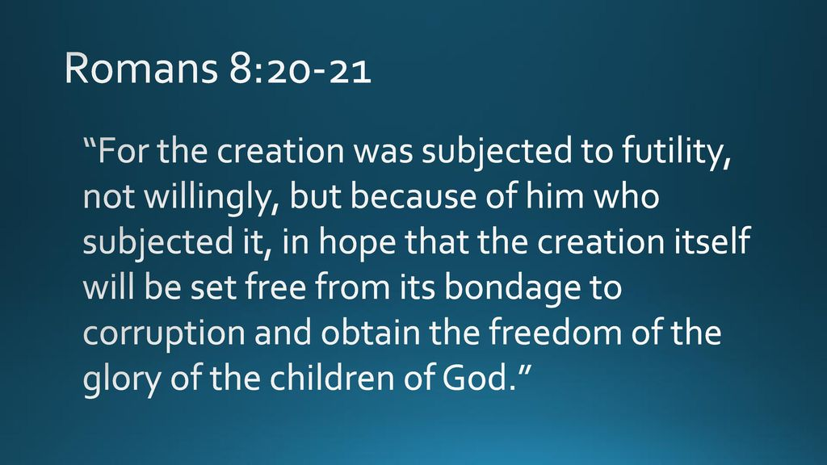
Romans 8:20 – 21

Slide 19
Romans 8:20 – 21
For the Creation was subjected to frustration (futility, frailty, purposelessness) describes the change and “decay” that prevails in all created things. This was not a voluntary subjection because the created world as such had no choice. Instead it was a decree of God, the sovereign Creator, who subjected it.
When humankind fell, creation fell. When God restores the believing remnant of humanity, creation will be restored. The Lord Himself will rule as King, and sin will have no place.

Slide 20
Romans 8:20 – 21
And yet it was in hope, that is, in anticipation of a coming day when the “frustration” would be removed. God judged the totality of His Creation along with people for their sin (Gen 3:14-19).
Similarly, since God’s program of salvation for people is one of a new Creation (2Cor 5:17), the physical world also will be re-created (Rev. 21:5). This will take place in two stages.

Slide 21
Romans 8:20 – 21
This will take place in two stages . . .
FIRST – will be the renovation of the present cosmos in conjunction with the return to earth of the Lord Jesus and the establishment of the messianic kingdom on earth (Isa. 11:5-9; 35:1-2, Amos 9:13).
SECOND – will be creation of “a new heaven and a new earth” (Rev. 21:1; cf. 2Peter 3:7-13).

Slide 22
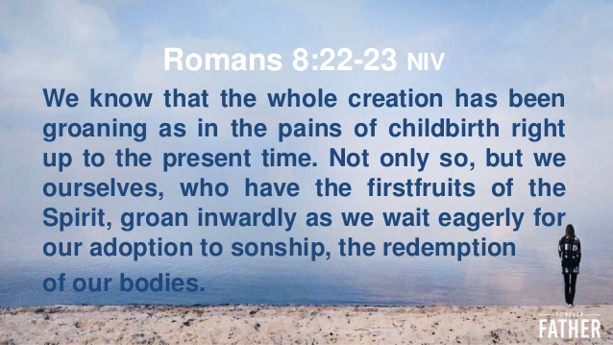
Romans 8:22 – 23

Slide 23
Romans 8:22 – 23
Until then, we live in the meantime. Until that day, creation groans in anguished expectation. This groaning is not a useless thing: Paul compares it to a woman in travail (a mother in labor). There is pain, but the pain will end when the child is delivered.
One day creation will be delivered, and the groaning creation will become a glorious creation. The believer does not focus on today’s sufferings; he looks forward to tomorrow’s glory. Today’s groaning bondage will be exchanged for tomorrow’s glorious liberty.

Slide 24
Romans 8:22 – 23
That is, when humankind fell, creation fell. When God restores the believing remnant of humanity, creation will be restored. The Lord Himself will rule as King, and sin will have no place.
The reason believers groan is because we have experienced “the firstfruits of the Spirit,” a foretaste of the glory to come. Just as the nation of Israel tasted the firstfruits of Canaan when the spies returned (Num 13:23–27), so we believers have tasted of the blessings of heaven through the ministry of the Holy Spirit.

Slide 25
Romans 8:22 – 23
This makes us want to see the Lord, receive a new body, and live with Him and serve Him forever. We are waiting for “the adoption,” which is the redemption of the body when Christ returns (Phil 3:20–21).
This is the thrilling climax to “the adoption” that took place at conversion when “the Spirit of adoption” gave us an adult standing in God’s family. When Christ returns, we shall enter into our full inheritance.

Slide 26
Romans 8:22 – 23
The believer does not get frustrated as he sees and experiences suffering and pain in this world. He knows that the temporary suffering will one day give way to eternal glory.

Slide 27


Slide 28
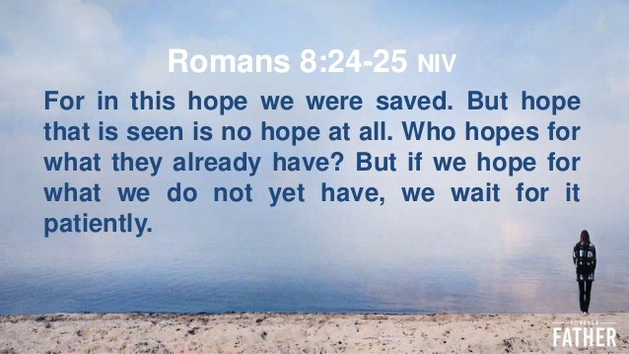
Romans 8:24 – 25

Slide 29
Romans 8:24 – 25
Meanwhile, we wait and hope. What hope? “That blessed hope and the glorious appearing of the great God and our Savior Jesus Christ” (Titus 2:13). The believer does not get frustrated as he sees and experiences suffering and pain in this world. He knows that the temporary suffering will one day give way to eternal glory.
Those who respond by faith to that promise have hope, a confident expectation of that bodily redemption. This is the final step of salvation and it was in that anticipation that we were saved.

Slide 30
Romans 8:24 – 25
The redemption of the body (8:23) obviously has not yet occurred (who hopes for what he already has?), but it is hoped for and eagerly anticipated (8:19, 23) with steadfast endurance in present sufferings (8:18).
Hope is inseparable from salvation. Our salva-tion was planned by God in ages past, bestowed in the present, and is now characterized by hope for its future completion. The believer’s hope is not based on wishful thinking or probability, but on the integrity of the clear promises of the Lord.

Slide 31
Romans 8:24 – 25
Our hope is not that we might not lose our salvation but that, by our Lord’s own guarantee, we cannot and will not lose it.
Paul refers to our hope of salvation as a helmet, symbolizing our divine protection from the blows of doubt that Satan sends to crush our hope (Eph 6:17). Our certainty of salvation does not rest in our choosing God but in His choosing us, even “﻿before the foundation of the world﻿” (﻿Eph 1:4﻿).

Slide 32
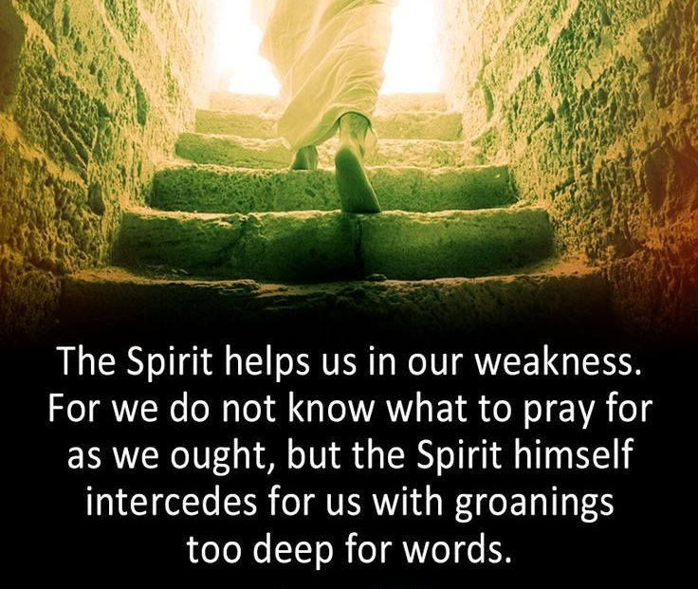
Romans 8:26

Slide 33
Romans 8:26
This verse points out that believers are not left to their own resources in their sufferings and groaning. The Holy Spirit “keeps on helping” us in our weakness. This word “helps” is rendered as someone helping another carry a heavy load.
One evidence of the believer’s weakness is the fact that we do not know what we ought to pray or “should pray as it is necessary.” In our weakness both the content and manner of proper prayer eludes us, but the Holy Spirit Himself comes to our rescue and “keeps on interceding” for us with groans that words cannot express.

Slide 34
Romans 8:26
Creation groans (8:22) and believers groan (8:23), and so does the Holy Spirit with groanings which cannot be uttered. This has nothing to do with praying in tongues, as some suggest. The groaning is done by the Holy Spirit, not believers, and is not stated in words.
Divine articulations within the Trinity that cannot be expressed in words, but carry profound appeals for the welfare of every believer. This word of the Holy Spirit parallels the high priestly work of intercession by the Lord Jesus on behalf of believers.

Slide 35
Romans 8:26
The help the Spirit gives is His interceding. Intercedes means “light upon” or “fall in with.” Moreover, “to go to meet” for consultation, conversation, or supplication.
If it were not for the sustaining power of the HS within us and Christ’s continual mediation for us as High Priest, our remaining humanness would have immediately engulfed us again in sin the moment after we were justified. If for an instant Christ and the HS were to stop their intercession for us, we would, in that instant, fall back into our sinful, damnable state of separation from God.

Slide 36
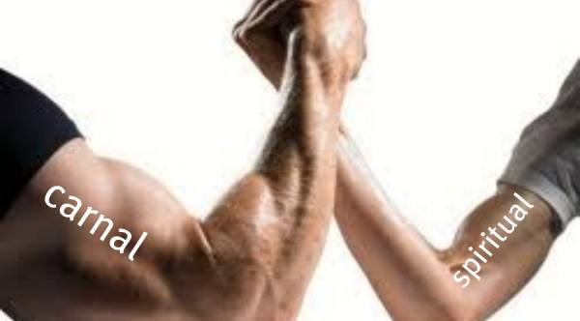
spiritual
carnal
“The Spirit helps us in our weaknesses.”
Romans 8:26

Slide 37
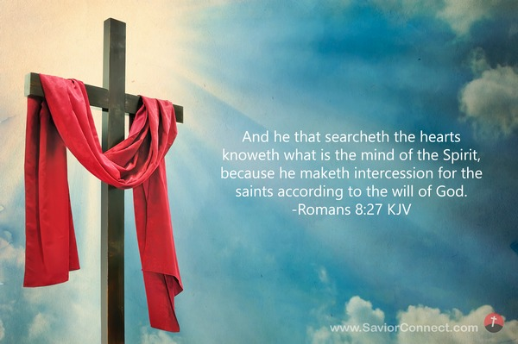
Romans 8:27

Slide 38
Romans 8:27
The One who searches our hearts is God (1Sam 16:7), and God knows (perceptively or intuitively) the mind of the Holy Spirit, because the Holy Spirit intercedes for the saints in accordance with God’s will.
Even though the Holy Spirit’s words are not expressed, the Father knows what the Holy Spirit is thinking. No words are necessary because the Father understands and agrees with what the Holy Spirit thinks.

Slide 39
Romans 8:27
This is an interesting statement about the Father’s omniscience and the intimacy within the Trinity. The Lord Jesus continually intercedes for believers in God’s presence (8:34) and the Holy Spirit also intercedes on their behalf.
Though believers are ignorant of what to pray for and how to voice those requests, the Holy Spirit voices their requests for them.

Slide 40
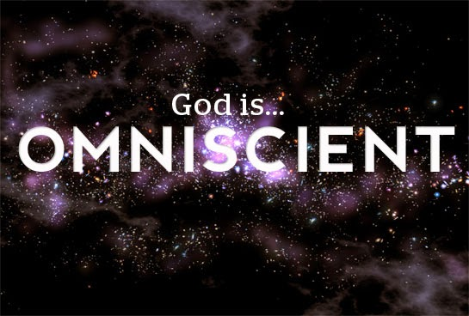

Slide 41
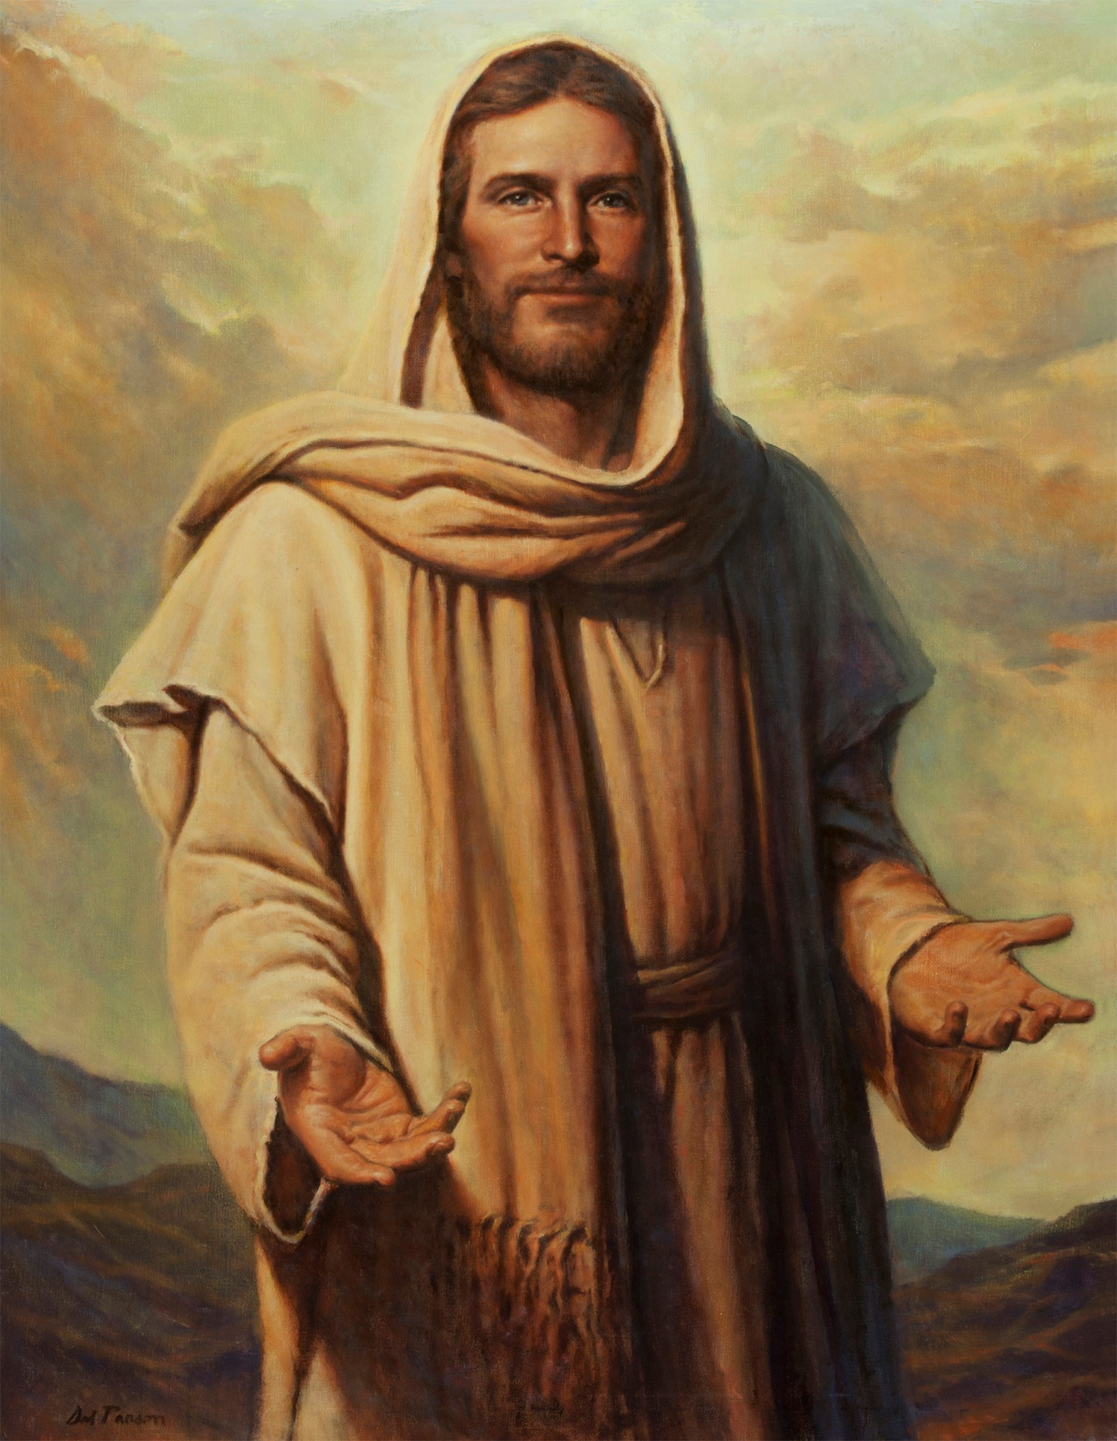

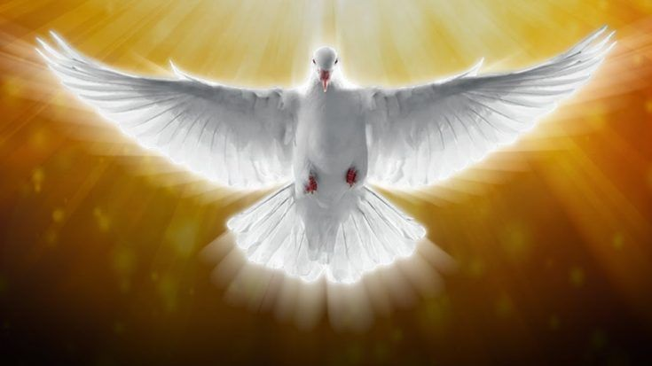
“I Am with you … always”

Slide 42
NEXT CLASS – 5 May 2021
Book of Romans
Before next class, read the below chapter in the KJV and in one other versions of the Bible, i.e., NKJV, NRSV, NIV, CEV, etc …
Read the entire Chapter 8 again –
Third lesson: 8:28 – 39 (focus)

