Slide 1

We Overwhelmingly Conquer
Chapter 8:28 – 39
12 May 2021
Week 17

Slide 2

“We Overwhelmingly Conquer”

Slide 3


Slide 4

Romans
Background:
In a real sense, Chapter 8 is the conclusion of Paul’s treatise on salvation, answering the question, “How does God save sinners?”
In chapters 1, 2, and 3 the whole world was shown condemned and lost in sin.
In chapters 3, 4, and 5 condemned sinners were seen as justified and declared righteous, if they believe on Jesus Christ.
Then in chapters 6 and 7, the method of sanctification was explained.

Slide 5
Romans
Background:
The end of chapter 7 leaves us with the lingering question, “Will this divine method of justification and sanctification last?”
In chapter 8, we find the answer to that question: if you are in Christ Jesus, you are safe!
Justification and sanctification in Christ will endure. That is, we are “preserved in Christ Jesus.”

Slide 6
Romans
Background:
In describing the problem of evil that continues to afflict the world as a result of sin, in Ch 8, Paul highlights two human limitations that tend to make matters worse.
First – “we do not see” (8:25). Our perspective is limited. We see nothing of the future and can never predict what will occur only a few minutes ahead.

Slide 7
Romans
Background:
Second – “we do not know how to pray as we should” (8:26). We may do our very best to pray in harmony with God’s will, but we frequently wish for the very opposite of what is good for us.
Fortunately, we do not have an evil genie for a god. Like Chuck Swindoll, we cannot count the number of times we have thanked God for “not granting an earlier, shortsighted pray request.”

Slide 8
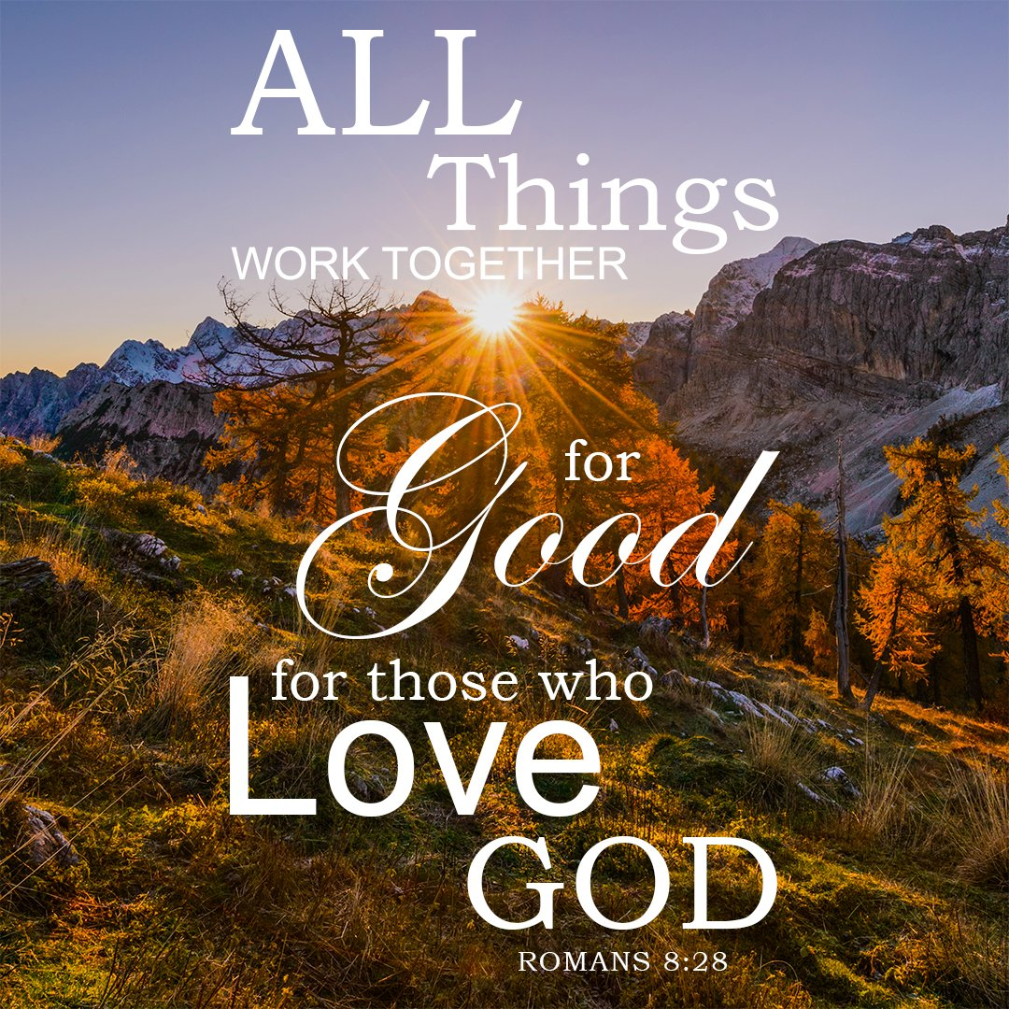

Slide 9
Romans 8:28 – 39
Overview:
In this lesson, Paul tells us that we have the privilege of the Holy Spirit and Christ Jesus interceding for us when we pray, which assures that all things will work together for good for those called according to God's purpose (8:28-30).
Finally, as God's elect we have the assurance that nothing can tear us away from God's love and that in all things we are more than conquerors through Him who loved us (8:31-39).

Slide 10
Romans 8:28 – 39
Overview:
The Holy Spirit helps us in our weakness, praying with and for us (8:26–27). It’s our relationship with God, in Christ Jesus, that brings us victory, for He has chosen us not to muddle on in the pit of sin, but to be transformed into the image of His Son (8:28–30).
On the way, God will never forsake us, nor even permit us to be charged with sin (8:31–34). We are God’s loved ones. Nothing can separate us from the love of God in Christ our Lord (8:35–39).

Slide 11

Picked out to be picked on

Slide 12
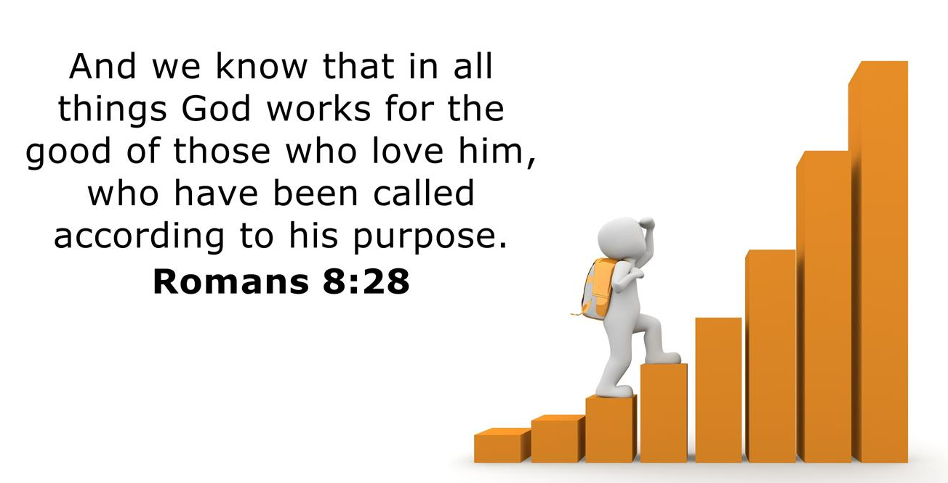
Romans 8:28

Slide 13
Romans 8:28
We do not see and know how to pray as we ought; however, we do know one all-important fact. The verse begin with “we know.” We have a promise founded upon the character of our Creator: “To those who love God, He works together all things into good, to the ones who are called according to His purpose.”
Paul cautiously chose his words and arranged them carefully to state this foundational promise. The Greek language places great importance upon word order.

Slide 14
Romans 8:28
“To those who love God ...” Paul places this phrase at the beginning of the sentence to stress that the promise is intended for believers. While the Lord acts in the best interest of everyone, He makes this particular promise exclusively to his very own “sons.”
“He works together ...” The term Paul uses is a compound of “with” and “work.” Think of a weaver carefully interlacing strands of colored thread into a preplanned pattern.

Slide 15
Romans 8:28
“All things ...” Greek writers frequently uses this term to refer to the universe – all things both seen and unseen, good and bad, real and even imagined. God utilizes everything – including the evil deeds of evil people.
“Into good ...” The proposition translated “into” carries the idea of space, as though all things are being corralled by His sovereign will. God not only has a purpose in mind as He weaves all things, He will achieve a result. And it will be good.

Slide 16
Romans 8:28
Our flesh would have us believe that the “good” that God causes is our good, that which will give us happiness, contentment, or joy. But this is only partially true. Throughout Romans, Paul uses the term “good” almost exclusively in a moral sense.
“Good” is that which pleases God because it reflects His nature and conforms to His original created order. In the beginning, He created the world good and, at the end of days, the world will be re-created good.

Slide 17
Romans 8:28
God’s “good” is not completely focused on humanity; however, people are happy, content, and joyful when they live in His goodness and with Him in proper perspective.
“To the ones who are called according to His purpose.” These people are identical to “those who love God.” Loving God and following His commands are inexorably linked. Moreover, “the called” are not only called to escape condemnation but called to join Him in accomplishing His redemptive plan for the world (Matt. 28:19-20).

Slide 18
Romans 8:28
Putting it all back together, we have: “For those who love God, the Lord sovereignly weaves the strands of every circumstance, every influence, every atom or idea they encounter for the purpose of creating moral good within them – those he has called to join His redemptive plan for the world.
When the Lord restores His universe, it will be even better than His original design. And His restoration begins with His people. To accomplish His plan, He orchestrates all things, including disease, disaster, death, and decay.

Slide 19
Romans 8:28
The world’s destructive designs then become tools in the hand of the Almighty, who will turn them to accomplish His good.
Does this mean that all things in the world are good? Clearly, they are not. The world is unfair, brutal, shocking, and demoralizing, and it contains people who relentlessly oppose God’s created order. Nevertheless, as evil tries to destroy, the Lord turns the world’s destruction into our gain.

Slide 20
Romans 8:28
If God uses evil for his purposes, does this mean He brings evil upon His people? Never! God is not the author of sin. Only good things come from God.
God did not bring evil into the world; we did that through sin, and, as a race, we perpetuate suffering through continued sin. The Lord merely allows humanity and the world to continue living as they choose, but never beyond His sovereign control over creation.

Slide 21
Romans 8:28
Overview:
In this lesson, Paul tells us that we have the privilege of the Holy Spirit and Jesus interceding for us when we pray, which assures that all things will work together for good for those called according to God's purpose (8:28).
Consider what we “do not” know and what we “do” know (8:26-28). Notice the contrast: we do not know “how to pray as we ought,” but we do know that “all things” work together to them that love God, to them who are the called according to His purpose.”

Slide 22
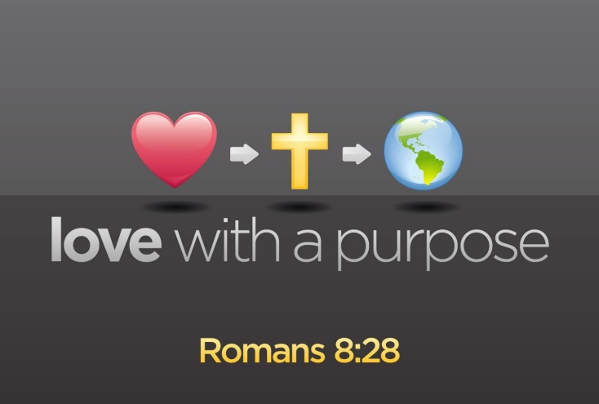

Slide 23
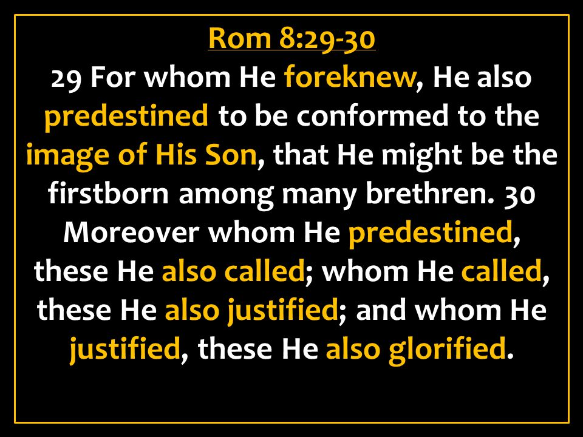
Romans 8:29 – 30

Slide 24
Romans 8:29 – 30
In these two verses, Paul uses a series of five verbs to describe the divine purpose and action. Each verb differs in meaning from the others, yet each is related to and grows out of the one which it follows.
The first two verbs (already chosen = FOREKNEW, set apart = PREDESTINED) refer back to God’s eternal purpose before time began, while the next three verbs (called = CALLED, put right with Himself = JUSTIFIED, shared His glory = GLORIFIED) describe the realization of God’s purpose in history.

Slide 25
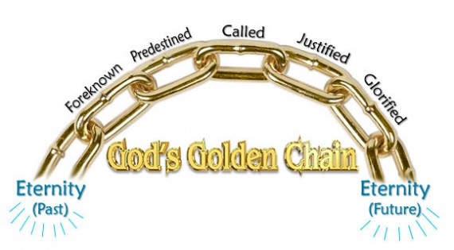

Slide 26
Romans 8:29 – 30
Keep in mind, Paul is not developing a doctrine of predestination in which he looks upon God as arbitrarily choosing some and rejecting others.
On the contrary, Paul is reflecting on his own experience and the experience of other believers, and he sees this in light of God’s eternal purpose.
In other words, Paul is saying that his own salvation and the salvation of others is a result of God’s purpose and of God’s grace; it did not happen by chance, and it was not something that the believer earned by his own merit.

Slide 27
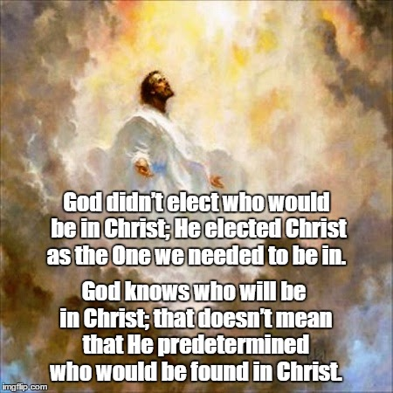

Slide 28
Romans 8:29 – 30
The verb “already chosen” [FOREKNEW ] means “to know or choose beforehand.” That is, “those whom God had designated beforehand” or “those whom God had selected out beforehand.”
God “foreknew” them, which is to say he knew them intimately even before they were born. It also convey a thorough knowledge of one person by another. In fact, it was a common euphemism for sexual intimacy shared between a married couple.

Slide 29
Romans 8:29 – 30
Those God foreknew in this intimate, active sense does not include everyone. This has led some to suggest that God deliberately passes over some, electing them to damnation.
That may be a logical inference, but we must be careful not to take Scripture beyond what it actually says. This is Paul’s teaching about believers; he wasn’t commenting on nonbelievers at this point.

Slide 30
Romans 8:29 – 30
The verb “set apart” [PREDESTINED ] means “ordained or fore-ordained.” By definition “to decide beforehand.” The distinction between these two verbs is this: the first verb (foreknew) points back to God’s choice of these people as his own, while the second verb (predestinated) indicates that God had in mind a definite goal for those persons whom he had chosen (that is, to become like his Son).
Those the Lord knew intimately before hand, he appointed in advance to be conformed (become) like Jesus in their character.

Slide 31
Romans 8:29 – 30
Thus, the one and only Son of God would become, as it were, the eldest brother of all those the Father has adopted. Although the verb “predestinated” speaks as though this action was already decided on before history began, the purpose indicated , to become like his Son, can only be accomplished at the end of history.
Those God predestined are called to believe, and those who believe are justified. Eventually, all believers will be glorified to be like Christ: to have both a pure in character and possessing an the incorruptible body of our own resurrection.

Slide 32
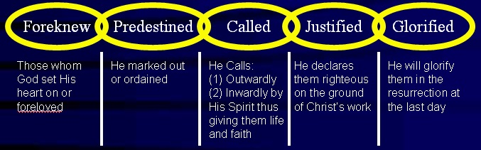
Quick Review

Slide 33
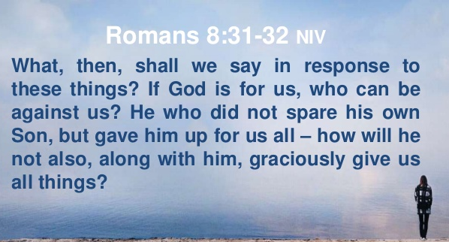
Romans 8:31 – 32

Slide 34
Romans 8:31 – 32
It is astounding to realize that God’s plan of salvation for people is a program that reaches from eternity past to eternity future which God will carry out perfectly.
Recognizing this, Paul asks and answers five questions to drive home the truth that a believer’s eternal salvation is completely secure in God’s hands (8:31-35).
FIRST – “What, then, shall we say in response to this?[31]” The obvious response would be to say “Hallelujah” and stand in sheer amazement.

Slide 35
Romans 8:31 – 32
SECOND – “If God is for us, who can be against us? [31]” Obviously, Satan and his demonic hosts are against us, but they cannot ultimately prevail and triumph over us.
God is the self-existent One and the sovereign Creator and, since He is for us, no one can oppose us successfully.

Slide 36
Romans 8:31 – 32
God is for us to the extent that He did not spare His own Son, but gave Him up for us all. That is, God offered Jesus as the Sacrifice for sin. In view of this supreme act of God’s grace, how will He not also, along with Him, graciously give us all things?
Since God gave the greatest Sacrifice of all, He will certainly not hesitate to give us all other things pertaining to and leading to our ultimate sanctification.

Slide 37
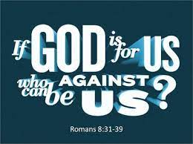

Slide 38
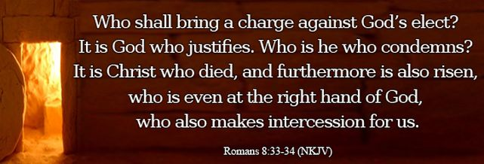
Romans 8:33 – 34

Slide 39
Romans 8:33 – 34
THIRD – “Who will bring a charge against God’s elect?[33]” That is, who will make a formal accusation in court; press charges against those whom God has chosen?
Satan’s accusations are valid, because they are based on our sinfulness and defilement. But Satan’s accusations will be thrown out of court, because it is God who justifies. God ,The Righteous Judge declares the accused person righteous on the basis of our faith in Jesus Christ. As a result, all accusations are dismissed and no one can bring an accusation that will stand.

Slide 40
Romans 8:33 – 34
FOURTH – “Who is the one who condemns? [34]” Jesus Christ is God’s appointed Judge so Paul answered this question by stating, Christ Jesus. But Jesus is the very One whom we have trusted for salvation.
The truth of the matter is “no one can accuse us, since God himself has declared us not guilty.” No one can say, We are guilty, since God himself has said, We are innocent.
The only person who can condemn us – died for us. And He now making intercession for us.

Slide 41
Romans 8:33 – 34
Notice the four great Christian doctrine:
Christ Jesus is He who died – d. of substitution (took our place and paid our debt).
Who was raised – d. of resurrection (by our identification with Him, we too, have new life).
Who is at the right hand – d. of accession (having all power in heaven and on earth).
Who also intercedes for us – d. of intercession (as our Advocate watching out for our welfare).

Slide 42
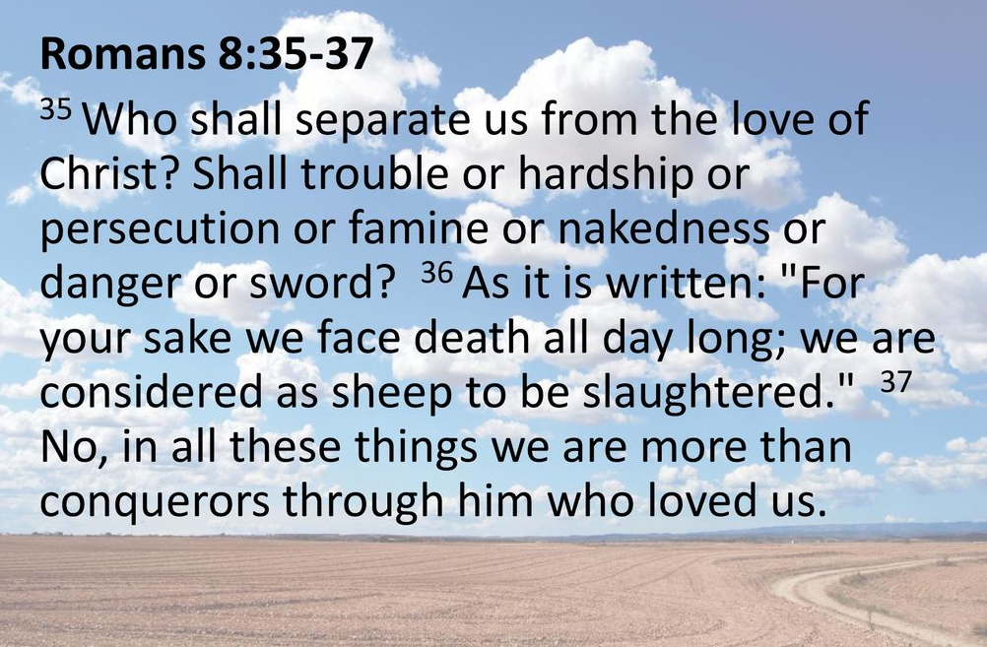
Romans 8:35 – 37

Slide 43
Romans 8:35 – 37
FIFTH – “Who will separate us from the love of Christ? [35]” Here, the “love of Christ” is His love for us (not our love for Him). Paul suggested seven situations a believer might experience that some might think could come between a believer and Christ’s love.
Tribulation (common trouble), or distress (being hemmed in), or persecution (suffering inflicted because of our relationship with Christ), or famine (hunger), or nakedness (shame), or peril (general danger), or sword (threats of death)?

Slide 44
Romans 8:35 – 37
These things – stated in increasing intensity – do not separate Christians from Christ. Instead they are part of the “all things” (8:28) God uses to bring them to conformity to His Son.
Then Paul quoted Psalm 44:22 (“we are killed all the day long”) to remind his readers that in this life the people of God must face much affliction (cf. John 16:33) including even martyrdom for some. In the early days of the church one or more Christians were martyred every day, or faced the possibility of it.

Slide 45
Romans 8:35 – 37
Their persecutors valued Christians’ lives as nothing more than animals to be butchered. All these dangers lose their terror in view of the presence of the One in whom we find ultimate safety.
In all these adversities, rather than being separated from Christ’s love, we are more than conquerors (“keep on winning a glorious victory”) through Him who loved us. Jesus Christ and His love for us enable us to triumph (8:37).

Slide 46
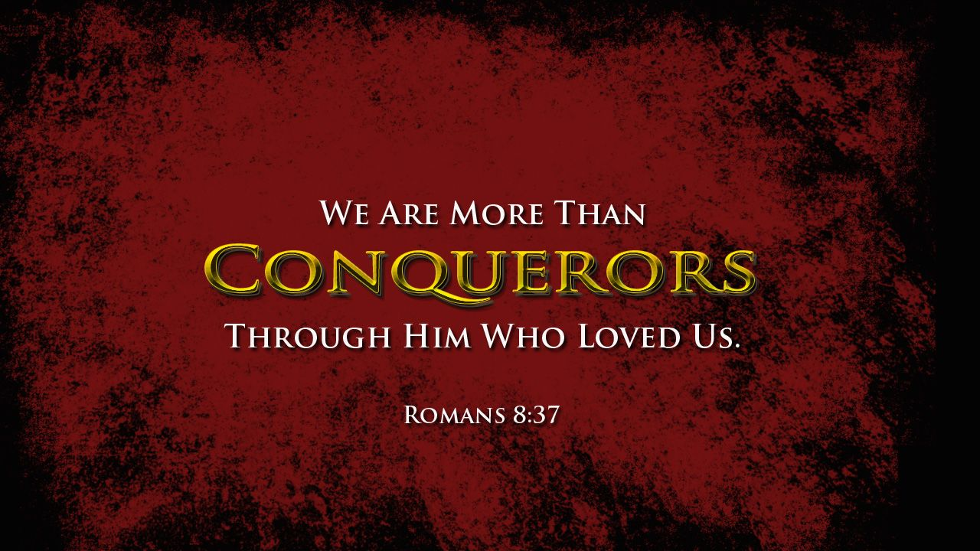

Slide 47
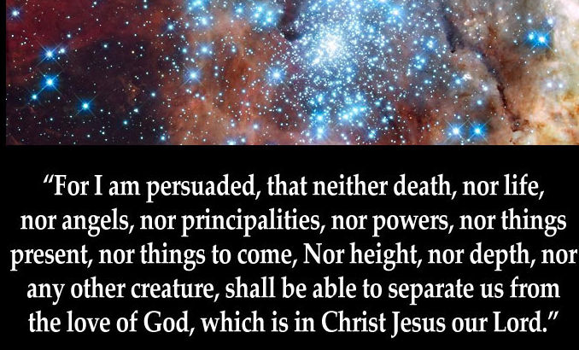
Romans 8:38 – 39

Slide 48
Romans 8:38 – 39
Paul then ended his discussion on believers’ safety and security in Jesus Christ and the certainty of our sanctification with a positive declaration > “For I am convinced [persuaded] that nothing can separate us from the love of God which is in Christ Jesus our Lord.”
Keep in mind, this is God’s love for us, not our love for God (cf. 8:35).
Next, Paul list ten elements beginning with death, as a follow-on from his previous list of seven situations that ended with death in 8:35.

Slide 49
Romans 8:38 – 39
These elements in God’s universe include the extremes of existence:
The extremes of eternity: (1) death and (2) life (in either death or life, believers are in God’s presence);
The extremes of created spiritual armies: (3) angels (angels would not and demons could not undo God’s relationship with His redeemed ones);
The spiritual enemies: (4) principalities (perhaps Satan and his demons; (5) powers (possibly human governments);

Slide 50
Romans 8:38 – 39
These elements in God’s universe include the extremes of existence:
The extremes in time: (6) the things present and (7) the things to come: nothing known now, or in the unknown time to come);
The extremes in space: (8) height and (9) depth (nothing overhead or underneath can suddenly come swooping down or bubbling up to sever us from God’s love); and (10) nothing in the entire created realm can possibly separate us.

Slide 51
Romans 8:38 – 39
Absolutely nothing in His Creation can thwart His purpose for believers in Christ. What a climactic way to affirm the certainty of our salvation.
Paul is convinced that neither anything in life nor our archenemy, death, could keep the love of Christ from us. Christ’s own death and resurrection reveal His power over anything and everything that threatens us in the natural realm.

Slide 52
Romans 8:38 – 39
Furthermore, nothing in the supernatural realm – including angels (elect or fallen) and spiritual forces – can harm us. God created all things, including everything in the supernatural realm, and He continues to rule over His universe.
Because God rules over everything in time and space, nothing can subvert His will, which is to bring His people to Himself, cleanse us of sin inside and out, shape us into the image of Christ, restore us to life, and allow us to enjoy “peace with God” forever (5:1).

Slide 53
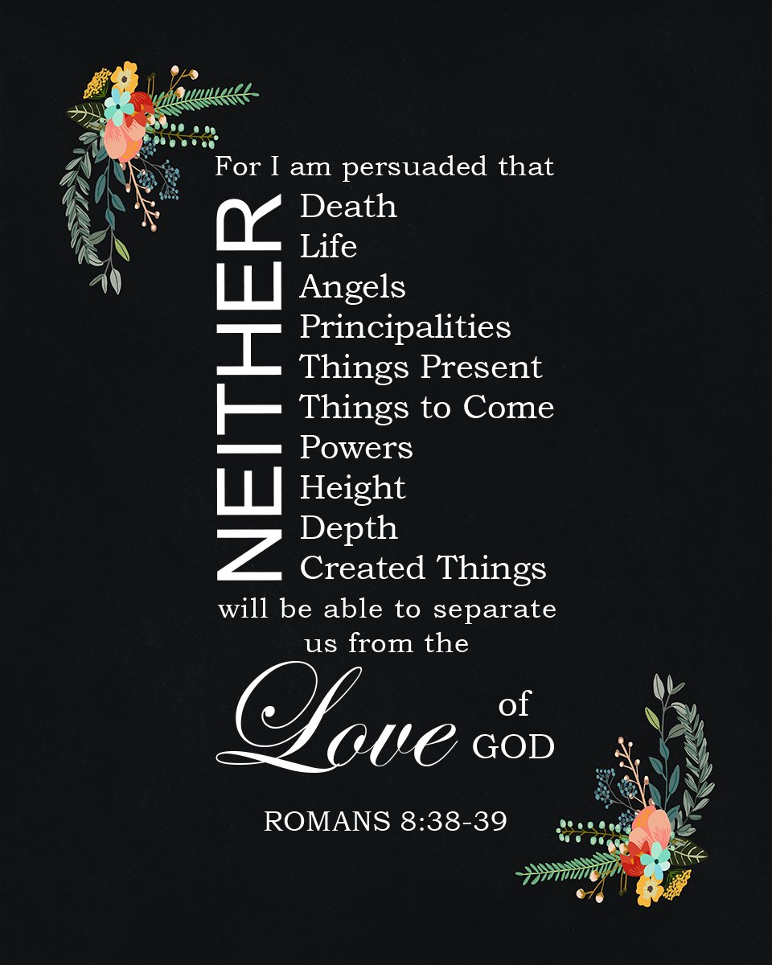

Slide 54


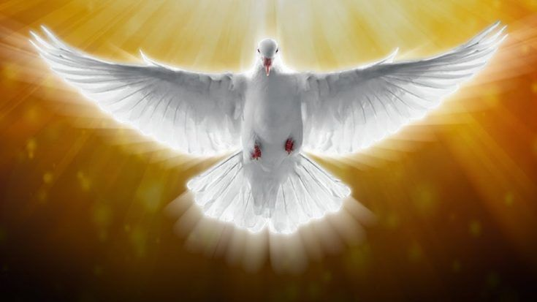
“Nothing will ever separate you from me … ”

Slide 55
NEXT CLASS – 19 May 2021
Book of Romans
Before next class, read the below chapter in the KJV and in one other versions of the Bible, i.e., NKJV, NRSV, NIV, CEV, etc …
Read the entire Chapter 9 again –
First lesson: 9:1 – xx (focus)
Second lesson: 9:xx – 33

