Slide 1

We Overwhelmingly Conquer
Chapter 8:28 – 39 (Pt. 2)
19 May 2021
Week 18

Slide 2
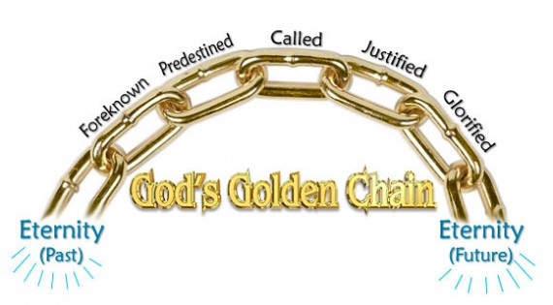
Time History
Eternity Past
Eternity Past

Slide 3

Romans 8:29 – 30
Keep in mind, Paul is not developing a doctrine of predestination in which he looks upon God as arbitrarily choosing some and rejecting others.
On the contrary, Paul is reflecting on his own experience and the experience of other believers, and he sees this in light of God’s eternal purpose.
In other words, Paul is saying that his own salvation and the salvation of others is a result of God’s purpose and of God’s grace; it did not happen by chance, and it was not something that the believer earned by his own merit.

Slide 4
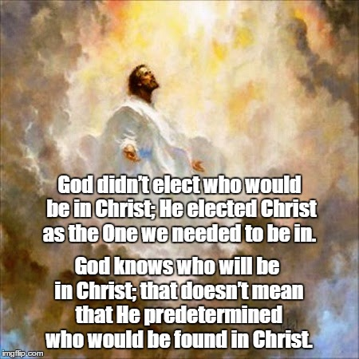

Slide 5
Romans 8:29 – 30
The verb “already chosen” [FOREKNEW ] means “to know or choose beforehand.” That is, “those whom God had designated beforehand” or “those whom God had selected out beforehand.”
God “foreknew” them, which is to say he knew them intimately even before they were born. It also convey a thorough knowledge of one person by another. In fact, it was a common euphemism for sexual intimacy shared between a married couple.

Slide 6
Romans 8:29 – 30
Those God foreknew in this intimate, active sense does not include everyone. This has led some to suggest that God deliberately passes over some, electing them to damnation.
That may be a logical inference, but we must be careful not to take Scripture beyond what it actually says. This is Paul’s teaching about believers; he wasn’t commenting on nonbelievers at this point.

Slide 7
Romans 8:29 – 30
The verb “set apart” [PREDESTINED ] means “ordained or fore-ordained.” By definition “to decide beforehand.” The distinction between these two verbs is this: the first verb (foreknew) points back to God’s choice of these people as his own, while the second verb (predestinated) indicates that God had in mind a definite goal for those persons whom he had chosen (that is, to become like his Son).
Those the Lord knew intimately before hand, he appointed in advance to be conformed (become) like Jesus in their character.

Slide 8
Romans 8:29 – 30
Thus, the one and only Son of God would become, as it were, the eldest brother of all those the Father has adopted. Although the verb “predestinated” speaks as though this action was already decided on before history began, the purpose indicated , to become like his Son, can only be accomplished at the end of history.
Those God predestined are called [summoned] to believe, and believers are justified. Eventually, all believers will be glorified to be like Christ: to have both a pure character and possessing the incorruptible body of our own resurrection.

Slide 9
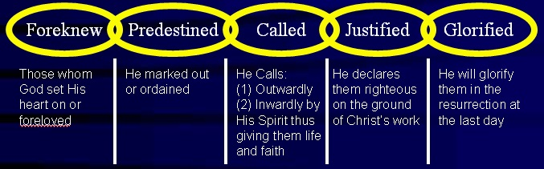
Quick Review

Slide 10
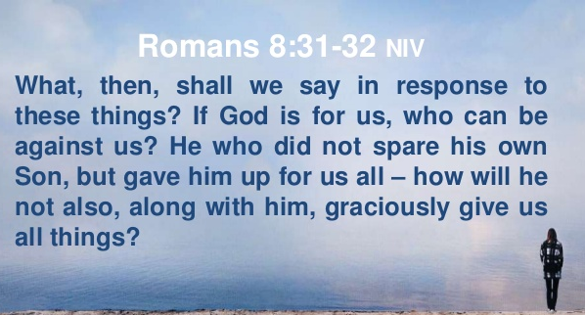
Romans 8:31 – 32

Slide 11
Romans 8:31 – 32
It is astounding to realize that God’s plan of salvation for people is a program that reaches from eternity past to eternity future which God will carry out perfectly.
Recognizing this, Paul asks and answers five questions to drive home the truth that a believer’s eternal salvation is completely secure in God’s hands (8:31-35).
FIRST – “What, then, shall we say in response to this?[31]” The obvious response would be to say “Hallelujah” and stand in sheer amazement.

Slide 12
Romans 8:31 – 32
SECOND – “If God is for us, who can be against us? [31]” Obviously, Satan and his demonic hosts are against us, but they cannot ultimately prevail and triumph over us.
God is the self-existent One and the sovereign Creator and, since He is for us, no one can oppose us successfully.

Slide 13
Romans 8:31 – 32
God is for us to the extent that He did not spare His own Son, but gave Him up for us all. That is, God offered Jesus as the Sacrifice for sin. In view of this supreme act of God’s grace, how will He not also, along with Him, graciously give us all things?
Since God gave the greatest Sacrifice of all, He will certainly not hesitate to give us all other things pertaining to and leading to our ultimate sanctification.

Slide 14
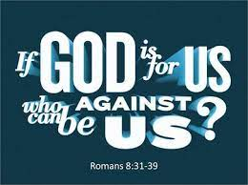

Slide 15
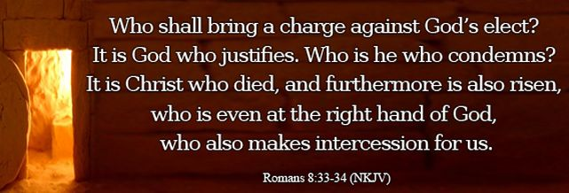
Romans 8:33 – 34

Slide 16
Romans 8:33 – 34
THIRD – “Who will bring a charge against God’s elect?[33]” That is, who will make a formal accusation in court; press charges against those whom God has chosen?
Satan’s accusations are valid, because they are based on our sinfulness and defilement. But Satan’s accusations will be thrown out of court, because it is God who justifies. God ,The Righteous Judge declares the accused person righteous on the basis of our faith in Jesus Christ. As a result, all accusations are dismissed and no one can bring an accusation that will stand.

Slide 17
Romans 8:33 – 34
FOURTH – “Who is the one who condemns? [34]” Jesus Christ is God’s appointed Judge so Paul answered this question by stating, Christ Jesus. But Jesus is the very One whom we have trusted for salvation.
The truth of the matter is “no one can accuse us, since God himself has declared us not guilty.” No one can say, We are guilty, since God himself has said, We are innocent.
The only person who can condemn us – died for us. And He now making intercession for us.

Slide 18
Romans 8:33 – 34
Notice the four great Christian doctrine:
Christ Jesus is He who died – d. of substitution (took our place and paid our debt).
Who was raised – d. of resurrection (by our identification with Him, we too, have new life).
Who is at the right hand – d. of accession (having all power in heaven and on earth).
Who also intercedes for us – d. of intercession (as our Advocate watching out for our welfare).

Slide 19
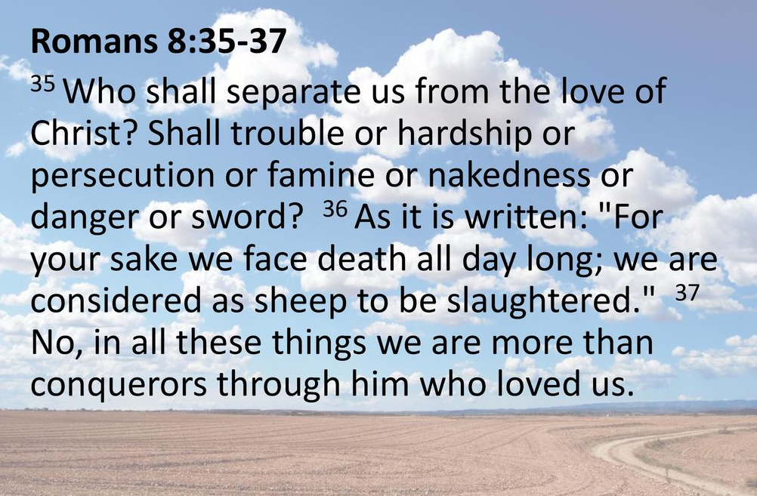
Romans 8:35 – 37

Slide 20
Romans 8:35 – 37
FIFTH – “Who will separate us from the love of Christ? [35]” Here, the “love of Christ” is His love for us (not our love for Him). Paul suggested seven situations a believer might experience that some might think could come between a believer and Christ’s love.
Tribulation (common trouble), or distress (being hemmed in), or persecution (suffering inflicted because of our relationship with Christ), or famine (hunger), or nakedness (shame), or peril (general danger), or sword (threats of death)?

Slide 21
Romans 8:35 – 37
These things – stated in increasing intensity – do not separate Christians from Christ. Instead they are part of the “all things” (8:28) God uses to bring them to conformity to His Son.
Then Paul quoted Psalm 44:22 (“we are killed all the day long”) to remind his readers that in this life the people of God must face much affliction (cf. John 16:33) including even martyrdom for some. In the early days of the church one or more Christians were martyred every day, or faced the possibility of it.

Slide 22
Romans 8:35 – 37
Their persecutors valued Christians’ lives as nothing more than animals to be butchered. All these dangers lose their terror in view of the presence of the One in whom we find ultimate safety.
In all these adversities, rather than being separated from Christ’s love, we are more than conquerors (“keep on winning a glorious victory”) through Him who loved us. Jesus Christ and His love for us enable us to triumph (8:37).

Slide 23
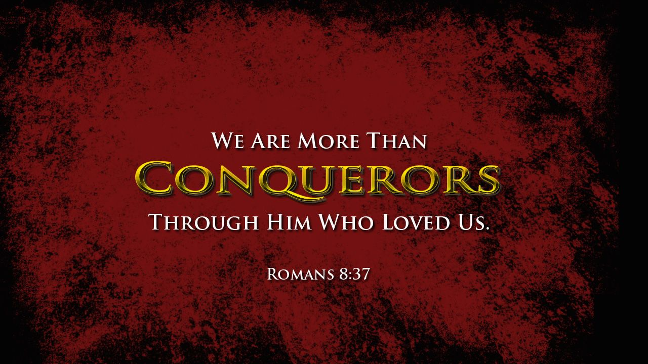

Slide 24
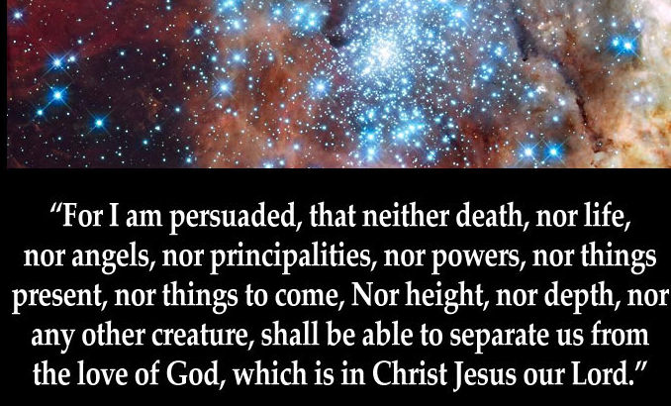
Romans 8:38 – 39

Slide 25
Romans 8:38 – 39
Paul then ended his discussion on believers’ safety and security in Jesus Christ and the certainty of our sanctification with a positive declaration > “For I am convinced [persuaded] that nothing can separate us from the love of God which is in Christ Jesus our Lord.”
Keep in mind, this is God’s love for us, not our love for God (cf. 8:35).
Next, Paul list ten elements beginning with death, as a follow-on from his previous list of seven situations that ended with death in 8:35.

Slide 26
Romans 8:38 – 39
These elements in God’s universe include the extremes of existence:
The extremes of eternity: (1) death and (2) life (in either death or life, believers are in God’s presence);
The extremes of created spiritual armies: (3) angels (angels would not and demons could not undo God’s relationship with His redeemed ones);
The spiritual enemies: (4) principalities (perhaps Satan and his demons; (5) powers (possibly human governments);

Slide 27
Romans 8:38 – 39
These elements in God’s universe include the extremes of existence:
The extremes in time: (6) the things present and (7) the things to come: nothing known now, or in the unknown time to come);
The extremes in space: (8) height and (9) depth (nothing overhead or underneath can suddenly come swooping down or bubbling up to sever us from God’s love); and (10) nothing in the entire created realm can possibly separate us.

Slide 28
Romans 8:38 – 39
Absolutely nothing in His Creation can thwart His purpose for believers in Christ. What a climactic way to affirm the certainty of our salvation.
Paul is convinced that neither anything in life nor our archenemy, death, could keep the love of Christ from us. Christ’s own death and resurrection reveal His power over anything and everything that threatens us in the natural realm.

Slide 29
Romans 8:38 – 39
Furthermore, nothing in the supernatural realm – including angels (elect or fallen) and spiritual forces – can harm us. God created all things, including everything in the supernatural realm, and He continues to rule over His universe.
Because God rules over everything in time and space, nothing can subvert His will, which is to bring His people to Himself, cleanse us of sin inside and out, shape us into the image of Christ, restore us to life, and allow us to enjoy “peace with God” forever (5:1).

Slide 30


Slide 31
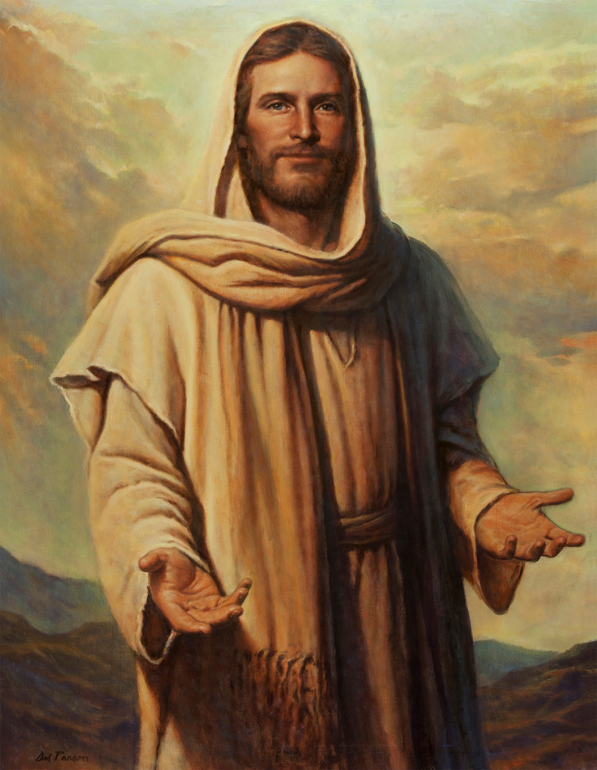

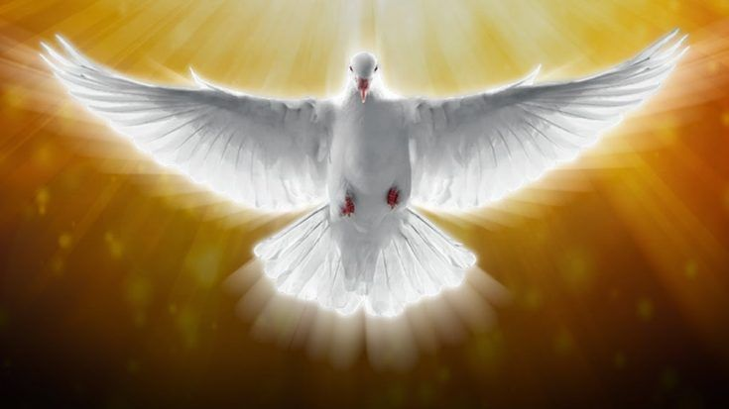
“Nothing will ever separate you from me … ”

Slide 32
NEXT CLASS – 19 May 2021
Book of Romans
Before next class, read the below chapter in the KJV and in one other versions of the Bible, i.e., NKJV, NRSV, NIV, CEV, etc …
Read the entire Chapter 9 again –
First lesson: 9:1 – 22 (focus)
Second lesson: 9:23 – 33

