Slide 1

Sovereignty of Predestination
Chapter 9:1 – 22
26 May 2021
Week 19

Slide 2

“Sovereignty of Predestination”

Slide 3

Romans
Background:
In this section, we will examine the Majesty of God (9:1 – 11:36). The almighty Creator of the universe has not hidden Himself from His creatures. His handiwork offers compelling evidence that the world was crafted by an intelligent mind.
Unfortunately, sin has dulled the senses of humanity so that, despite our instinct to look heavenward for a Creator, it takes more than a minor miracle for us to see Him.

Slide 4
Romans
Background:
A more powerful instinct is to replace Him with things of our own making. In ancient days, we replaced Him with things we dug out of the ground and whittled into one grotesque shape or another.
Now we prefer idols of amore theoretical kind, like something from-nothing scientific myths and vain philosophies that celebrate the unlimited potential of human evolution. No matter. They are, like their predecessors, substitute gods inspiring false hope.

Slide 5
Romans
Background:
Knowing that revealing Himself through nature would not suffice, the Lord also revealed Himself to humanity in dramatic, miraculous ways. He spoke audibly to some and visited others in dreams and visions.
He interacted with people in various forms throughout early history and then manifested His special presence among the Israelites in the otherworldly glow of the “shekinah” above the Ark of the Covenant.

Slide 6
Romans
Background:
He revealed His holy character through the Law of Moses and spoke to all of humanity through prophets and apostles, who dutifully and inerrantly recorded His message for all to read and apply. Ultimately, He revealed himself perfectly in the person of his Son, Jesus Christ.
The Almighty has revealed Himself in every conceivable manner humans would find meaningful, and He did it accurately and sufficiently.

Slide 7
Romans
Background:
Still, He remains a mystery. And the same can be said of His ways. Through we see Him accurately, we cannot comprehend Him fully.
A good example of God’s inscrutable nature is His tri-unity. The Bible speaks of Him as Father, Son, and Holy Spirit, three persons who affirm unity yet distinctly refer to – and even speak to – one another. Many are not satisfied simply to accept this paradox as God’s incomprehensible nature.

Slide 8
Romans
Background:
We cannot comprehend how God can be one and three yet One. Therefore, we can only admit that this section of Paul’s letter contains mysteries we have no ability to unravel. Like the enigma of God’s nature, we accept God’s sovereign plan as Scripture has revealed it and then faithfully teach it as the Holy Spirit enables us.
Unfortunately, this will not satisfy everyone. But, at the end of the day, we don’t need every secret in heaven codified, classified, cataloged, correlated, and connected.

Slide 9
Romans
Background:
In the first eight chapters of his letter to the Romans, Paul was marvelously sequential and logical in his presentation. And for the final five chapters (12-16), he was equally straightforward. Not so for this section!
In fact, most commentators begin their exposition with a warning, either acknowledging the “problems” raised by this passage or denying that any difficulties exist … Swindoll admits that both positions are correct.

Slide 10
Romans
Background:
The section is clearly difficult because it defies what we would consider logic. It is here that we learn about predestination and election. We encounter the disbelief of the Jews and the fate of God’s promises to them.
And we are forced to consider how Gentiles factor into God’s master plan for the world. But when we allow Paul’s treatise on the sovereignty of God to stand on its own, it’s quite simple to understand.

Slide 11
Romans
Background:
Therefore, we must accept Romans 9-11 like we do the will of God, which often appears contrary to common sense. In those difficult times, we must learn to trust Him and then, sooner or later, we must surrender to His way.
Then, as our perspective aligns with His and we’re no longer pushed or pulled by circumstances, we inevitably discover that He was right – as always. So let it be with this section (Romans 9:1 – 11:36).

Slide 12
Romans
Background:
In this section, we will examine three facets of God’s nature. Without too much explanation, we will encounter the “Sovereignty of God” in chapter 9, wrestle with its implications, and ultimately learn to rest in its truth.
Then we will consider the “Justice of God” in chapter 10. We will learn to accept that He does not submit to our notion of fair play; God has all the power, so He is the Judge.

Slide 13
Romans
Background:
And then we will find comfort in the “Faithfulness of God” in chapter 11. Where answers fail, we can trust in the unfailing goodness of our Creator and His unsurpassed love for His creatures … and leave it at that.
Make no mistake: Paul’s letter to the Romans is NOT about our salvation. His primary subject is the righteousness of God, of which our salvation is a part. The Lord is pursuing His own agenda.

Slide 14
Romans
Background:
Remember, it is to remove death from the throne of creation and give it to His Son so that the righteousness of God will rule all things. And He will do this whether anyone decides to join Him or not.
By the time of Paul’s writing, the majority of Jews had rejected Jesus as their Messiah and, in growing numbers, were continuing to reject God’s master plan of salvation. If God is not faithful to save His covenant people, what kind of assurance do we have as Gentile believers?

Slide 15
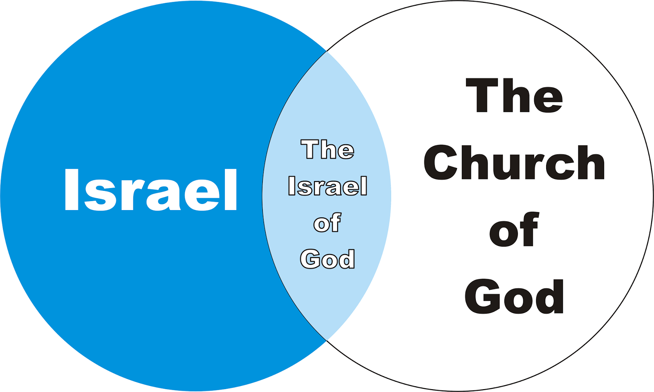
Gentiles believe Jesus
Jews believe God
Jews believe Jesus
Gentiles unsaved

Slide 16
Romans
Background:
Paul took this opportunity to address the thorny question of the Jews and their rejection of the gospel. But this is no mere parenthetical aside before resuming his main topic in chapter 12.
In many ways, this is the apex of the gospel. While Romans 8:28-39 describes God’s ultimate victory over evil, Romans 9:1-11:36 allows us a deeper glimpse into His nature. And the first attribute we see is His sovereignty.

Slide 17


Slide 18
Romans 9:1 – 33
Summary of the Chapter:
To appreciate why and how God could choose to reject the nation of Israel (except for a remnant) and accept people from among the Gentiles.
Some of Paul’s readers may have received the impression that God’s plan of saving man in Christ apart from the Law (3:21-22) implies that God has rejected His people of Israel and the promises made to them. In chapters nine through eleven, Paul explains that God has not rejected His people.

Slide 19
Romans 9:1 – 33
Summary of the Chapter:
Paul first expresses his own concern for his fellow Israelites (1-2). If it would do any good, Paul would gladly be condemned in order to save his brethren who had been the recipients of so many blessings (3-5).
But Paul quickly states that God’s promises had not failed. He reminds them that true Israel is not simply the descendants of Israel, any more than the promises to Abraham were to be carried out through all of Abraham’s descendants just because they are his physical descendants (6-8).

Slide 20
Romans 9:1 – 33
Summary of the Chapter:
Rather, it depends upon what God has chosen according to His Divine purpose. This is illustrated by contrasting what the Scriptures reveal about Isaac and Ishmael, and then about Jacob and Esau (9-13).
That God has made such distinction is illustrated further with the example of Pharaoh, where God chose to show mercy to some while He hardened others, who had already persistently rejected God’s mercy (14-18).

Slide 21
Romans 9:1 – 33
Summary of the Chapter:
That God has the right to make such choices is His, just as the potter has over the clay (19-21).
So God chose to endure “vessels of wrath” with much longsuffering, that He might make known His glorious riches to “vessels of mercy” [a point expanded upon further in chapter eleven] (22-23). And who are these “vessels of mercy?” They consist of Gentiles, and a remnant of Israel, as foretold by Hosea and Isaiah (24-29).

Slide 22
Romans 9:1 – 33
Summary of the Chapter:
Paul’s conclusion is that God’s words of promise were not just to the fleshly descendants of Abraham (as the Jews would have it), but to the faithful remnant of Israel and to the Gentiles who accepted the righteousness which is by faith.
The only reason any of the Israelites were rejected by God was because of their rejection of the Messiah, even as Isaiah foretold (30-33).

Slide 23
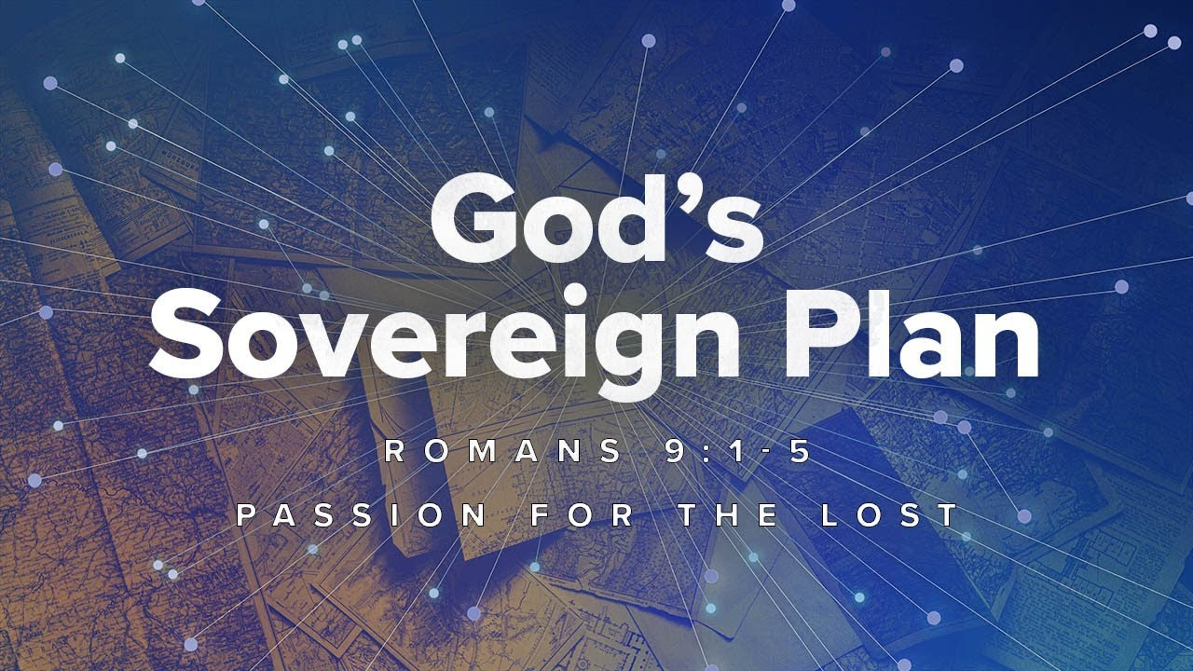

Slide 24
Romans 9:1 – 5
¹For I speak the truth in Christ—I am not lying, my conscience confirms it through the Holy Spirit, ²I have great sorrow and unceasing anguish in my heart. ³For I could wish that I myself were cursed and cut off from Christ for the sake of my people, those of my own race, ⁴the people of Israel. Theirs is the adoption to sonship; theirs the divine glory, the covenants, the receiving of the law, the temple worship and the promises. ⁵Theirs are the patriarchs, and from them is traced the human ancestry of the Messiah, who is God over all, forever praised! Amen.

Slide 25
Romans 9:1 – 5
No one more than Paul wanted the Jews to accept Jesus as the Messiah and to receive the blessings of their covenant. Paul prayed for this often and with complete confidence that he prayed according to God’s will. After all, it was certainly God’s plan to fulfill His covenant with Abraham.
The Hebrew people were to become God’s prototypical nation, ruled by Him and blessed by Him as a living invitation to submit to Him and receive His grace through faith. But they failed!

Slide 26
Romans 9:1 – 5
Even under the rule of David and Solomon, they never came close to claiming all the land that had been promised (Gen 15:18-21). Paul longed for his Jewish brothers and sisters to be saved. If only the children of the old covenant could be compelled to embrace the new covenant.
Jews look upon Christianity as anti-Semitic. When they hear Jesus is their long–awaited Messiah, the great Savior and Deliverer of Israel, they become highly incensed. Instead of seeing the gospel as the fulfillment and completion of Judaism, they see it as a destructive threat.

Slide 27
Romans 9:1 – 5
Paul even goes so far as to say he would instantly take their place in torment to see them saved (9:3). Yet, someone had already taken their place in torment – Jesus, the Messiah.
This led Paul to list seven advantages enjoyed by the Hebrew children of Abraham, none of which compelled the majority of Jews to see the truth: [1] the adoption as sons; [2] the divine glory; [3] the covenants; [4] the receiving of the Law; [5] the temple worship; [6] the promise of the Messiah; and [7] the patriarchs.

Slide 28
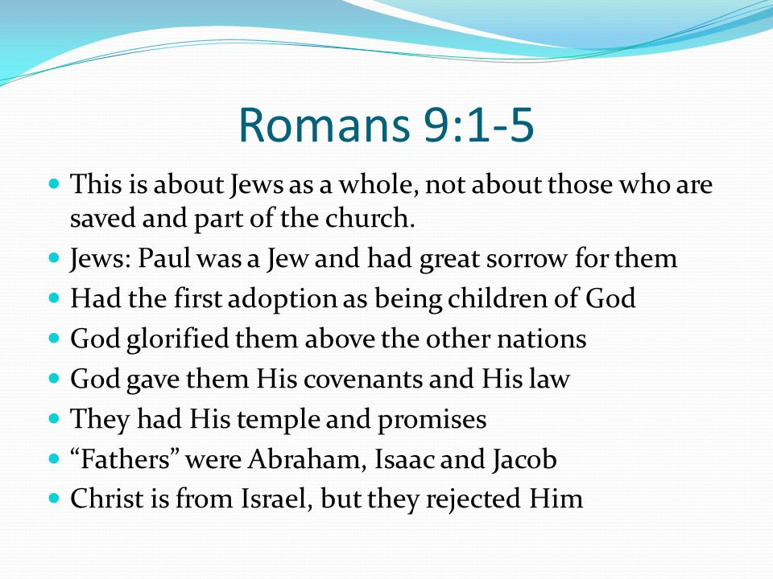

Slide 29
Romans 9:1 – 5
These seven advantages illustrate God’s perpetual faithfulness compared to Israel’s long history of stubborn rebellion. This quick inventory of Israel’s blessings and privilege underscores their lack of excuse for failing to believe.
The unbelieving majority ignored the mountain of evidence before them and chose not to trust God, proving that their unbelief is a moral issue, not an intellectual one. Israel turned their unique relationship with God into an idol – supposing heritage, not faith, would save them.

Slide 30
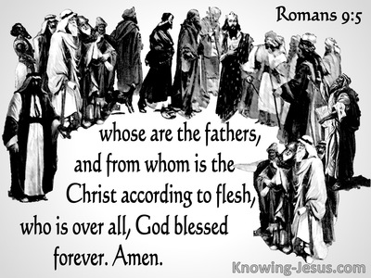

Slide 31
Romans 9:6 – 13
⁶It is not as though God’s word had failed. For not all who are descended from Israel are Israel. ⁷Nor because they are his descendants are they all Abraham’s children. On the contrary, “It is through Isaac that your offspring will be reckoned.” ⁸In other words, it is not the children by physical descent who are God’s children, but it is the children of the promise who are regarded as Abraham’s offspring. ⁹For this was how the promise was stated: “At the appointed time I will return, and Sarah will have a son.”

Slide 32
Romans 9:6 – 13
¹⁰Not only that, but Rebecca’s children were conceived at the same time by our father Isaac. ¹¹Yet, before the twins were born or had done anything good or bad — in order that God’s purpose in election might stand: ¹²not by works but by him who calls—she was told, “The older will serve the younger.” ¹³Just as it is written: “Jacob I loved, but Esau I hated.”

Slide 33


Slide 34
Romans 9:6 – 13
The true nature of Israel is defined by the sovereign choice of God, and is represented by the minority of its total population. Throughout Hebrew history, the “true Israel” was more often identified with a remnant, a numerical minority.
And this sovereign choice of God may disregard human customs or preferences. To illustrate, Paul points to two pivotal moments in Israel’s history. FIRST: Abraham had sons other than Isaac. He fathered Ishmael through Hagar, Sarah’s handmaid (Gen 16). In all, Abraham fathered no fewer than six males (Gen 25:1-2).

Slide 35
Romans 9:6 – 13
Yet, God limited His covenant with Abraham to the man’s offspring through Sarah alone. Why? Put bluntly, because God decided it would be this way. God sovereignly chose Isaac to be the bearer of the covenant.
SECOND: Isaac fathered more than one son – twins, in fact. The custom was for the firstborn male to receive a double portion of the inheritance and to succeed his father as the patriarchal leader of the clan. Esau was the oldest, yet before the twins were born, the Lord told their mother, “The older shall serve younger” (Gen 25:23).

Slide 36
Romans 9:6 – 13
This was no mere prediction. This was the sovereign choice of God that, contrary to custom, the younger boy would carry the covenant of Abraham as his descendant (Greek: sperma).
Paul’s illustration corrects two misconceptions about God’s covenant with Abraham:
FIRST – one cannot claim its promises merely because he or she carries Abraham’s DNA. Of Abraham’s many sons – no fewer than eight – only one could claim the legitimate right to the blessing.

Slide 37
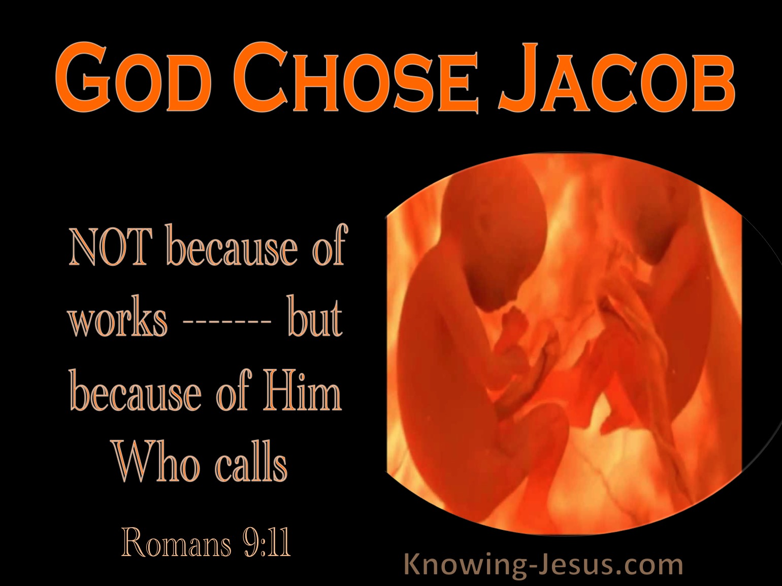

Slide 38
Romans 9:6 – 13
SECOND – only one receives the blessing by virtue of God’s choice, not on the basis of merit and not by right of custom (which is the choice of men).
Eventually, Jacob received the blessing instead of his older brother, Esau. Why? Again, because that’s the way God chose it to be, “Jacob I loved, but Esau I hated” (Mal 1:2-3).
God’s “love” for Jacob was revealed in His choice of Jacob and God’s “hatred” for Esau was seen in His rejecting Esau for the line of promise. Hatred in this sense is relative to a higher choice.

Slide 39
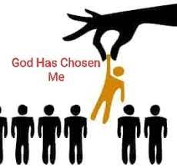

Slide 40
Romans 9:14 – 18
¹⁴What then shall we say? Is God unjust? Not at all! ¹⁵For he says to Moses, “I will have mercy on whom I have mercy, and I will have compassion on whom I have compassion.” ¹⁶It does not, therefore, depend on human desire or effort, but on God’s mercy. ¹⁷For Scripture says to Pharaoh: “I raised you up for this very purpose, that I might display my power in you and that my name might be proclaimed in all the earth.” ¹⁸Therefore God has mercy on whom he wants to have mercy, and he hardens whom he wants to harden.

Slide 41
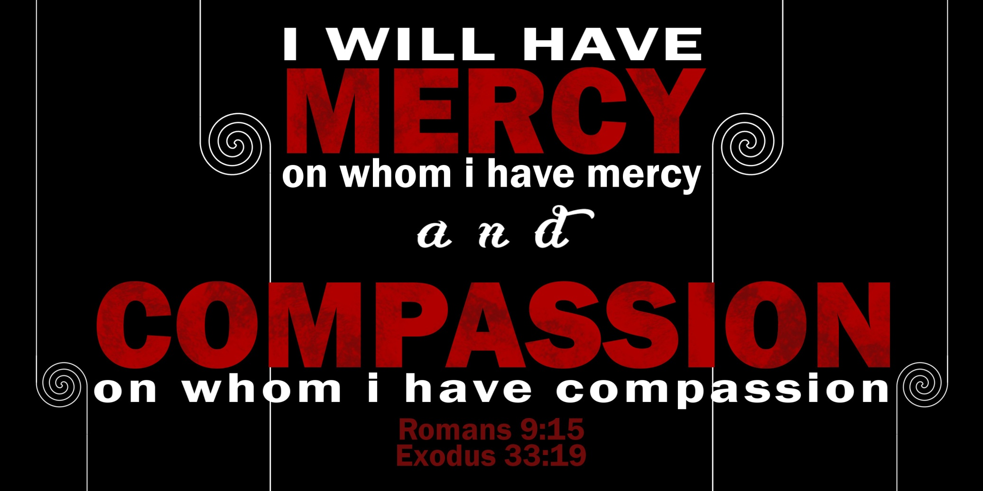

Slide 42
Romans 9:14 – 18
Here, Paul illustrates the Lord’s right to rule over creation with the story of Moses and his confrontation with the sovereign ruler of Egypt. Because grace (mercy) is a gift, the giver has the right to offer it or withhold it at will. Therefore, it cannot be earned through effort.
The case of Moses and Pharaoh is a study in contrasts. The men began their lives the same. Both were reared in the pagan household of the Egyptian sovereign. Both enjoyed a standard of living that far exceeded the mud-pit existence of slaves. Both were heirs to royal privileges.

Slide 43
Romans 9:14 – 18
However, their paths diverged when God intervened in the life of one. Though Moses was guilty of murder, the Lord hid him on the other side of nowhere and devoted the next forty years to transforming Moses’ character.
Pharaoh, on the other hand, continued his privileged existence in the palace of Egypt and eventually became its sovereign. He did not endure the humiliation of becoming a fugitive; he did not endure the hardscrabble existence of an itinerant shepherd in a wilderness. Pharaoh spent forty years living as he had before, a pagan.

Slide 44
Romans 9:14 – 18
When the proper time arrived for the next stage in God’s redemptive plan, He brought the two men face to face. Moses demanded the release of the Israelites, but Pharaoh refused, claiming the right of sovereignty over them.
At that moment, God could have erased Egypt from the face of the earth. Instead, God responded with a series of afflictions, which gradually increased in severity. God’s stated purpose: “To show you My power and in order to proclaim My name through all the earth” (Exod 9:16).

Slide 45
Romans 9:14 – 18
Pharaoh dedicated himself to evil in direct opposition to God’s redemptive plan. This was Pharaoh’s personal choice. He chose evil; God did not choose it for him. However, the Lord did “harden” him. That is, solidify his resolve to purse the evil deeply embedded in his heart. And the Lord was completely righteous in doing so.
God does not owe grace (mercy) to anyone. Therefore, He was no less just to allow Pharaoh to remain in his chosen evil and to suffer the consequences of it. The Lord turned Pharaoh’s evil into an opportunity to defeat evil.

Slide 46
Romans 9:14 – 18
That is, God turned Pharaoh’s hardness (stubbornness) into an opportunity to assert His own sovereign claim over the Israelites and to demonstrate His power to triumph over sin.
Paul recounts the divergent paths taken by Moses and Pharaoh to vindicate the righteous character of God. First, it demonstrates God’s grace, which gave both men ample opportunity to humble themselves. Second, it demonstrates God’s justice, which responded to each man according to his own choice. Salvation belongs to God, but condemnation is a personal choice.

Slide 47
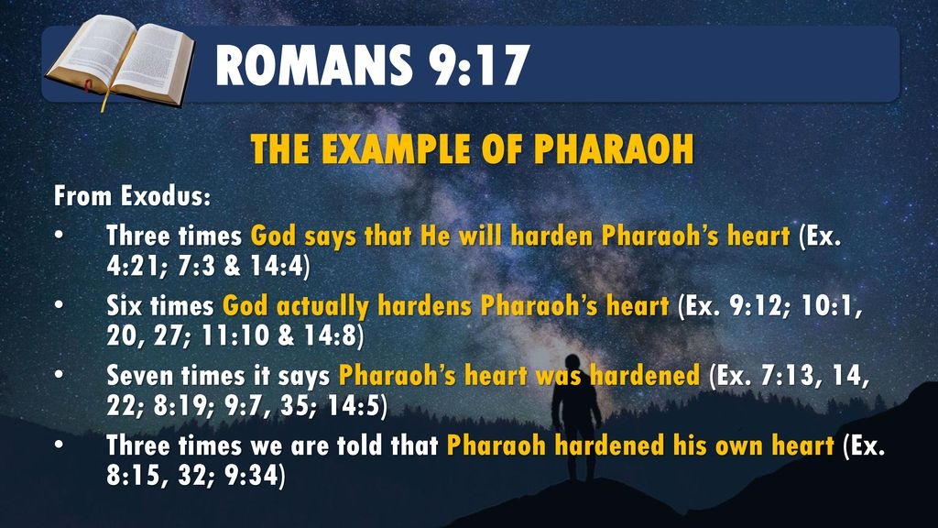

Slide 48
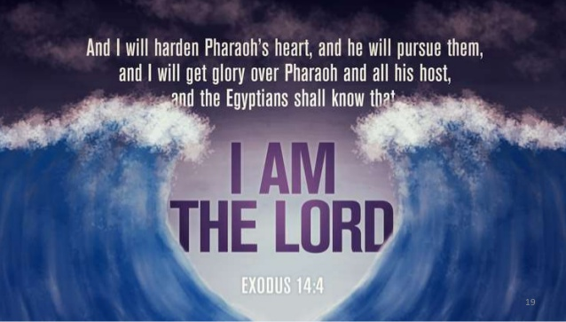

Slide 49
Romans 9:19 – 22
¹⁹One of you will say to me: “Then why does God still blame us? For who is able to resist his will?” ²⁰But who are you, a human being, to talk back to God? “Shall what is formed say to the one who formed it, ‘Why did you make me like this?’” ²¹Does not the potter have the right to make out of the same lump of clay some pottery for special purposes and some for common use? ²²What if God, although choosing to show his wrath and make his power known, bore with great patience the objects of his wrath—prepared for destruction?

Slide 50
Romans 9:19 – 22
Paul anticipates a common objection to the doctrine of predestination. If God “hardens” someone like He hardened Pharaoh, how can that person be justly condemned? Paul responses with a common OT illustration to clarify two points:
FIRST – because God is sovereign Creator, He has the right to do with His creation whatever He chooses (9:19-21). Again, God does not answer to humanity any more than He must answer to flowers. The fact that we have life is grace.

Slide 51
Romans 9:19 – 22
That we were given a limited amount of autonomy to choose our own fate is grace upon grace. And having rebelled, both as a race and as individuals, to be given hope of redemption is overwhelming, superabundant grace.
Having confirmed God’s sovereign right to do with His creation as He pleases, Paul continued his line of reasoning with an “if then” statement (9:22-23) – where the “if” is assumed to be true and it supports his second point.

Slide 52
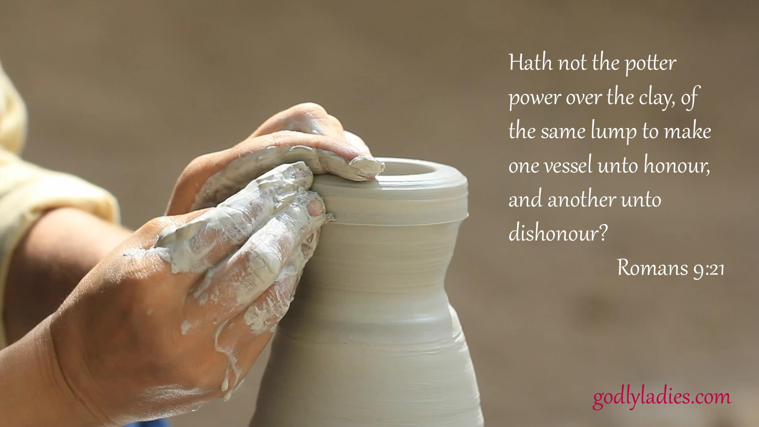

Slide 53
Romans 9:19 – 22
SECOND – we lost our right to complain about poor treatment when we chose to rebel; therefore, anything we receive other than immediate death is mercy (9:22-23).
People in need of mercy don’t have “rights.” In the case of Pharaoh, the sovereign of Egypt was given time to enjoy privileges the vast majority of his peers could barely dream of having. Grace. He was given no fewer than ten opportunities to repent of his sin. Grace upon grace. If he was extended no more than that, he was still much better off than he deserved.

Slide 54
Romans 9:19 – 22
Don’t be confused or misled by the phrase “vessels of wrath prepared for destruction” (9:22). The Greek verb translated “prepared” can be translated “vessels of wrath fitted by themselves for destruction.”
Although God has the right to mold clay into anything He chooses, he allowed Pharaoh to choose his own shape; the Lord merely hardened him. And, out of grace, God did it gradually instead of immediately.

Slide 55
Romans 9:19 – 22
All of humanity deserves immediate termination, so the fact that we live proves that God has not exercised justice. He has acted upon His sovereign right to withhold justice for a time. Rather than complaining that some will not be saved, we should see the glass as more than half-full and thank God that anyone will be saved.
Rather than complaining that He exercised His sovereign right to harden some in the sinful shapes they have chosen, we should be thankful that He exercised his sovereign right to grant mercy to anyone – including us, of all people!

Slide 56
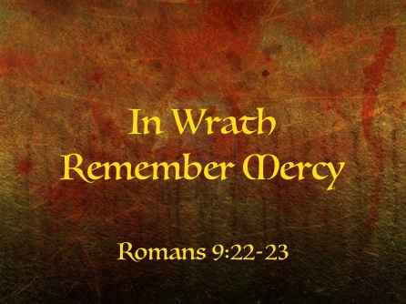

Slide 57


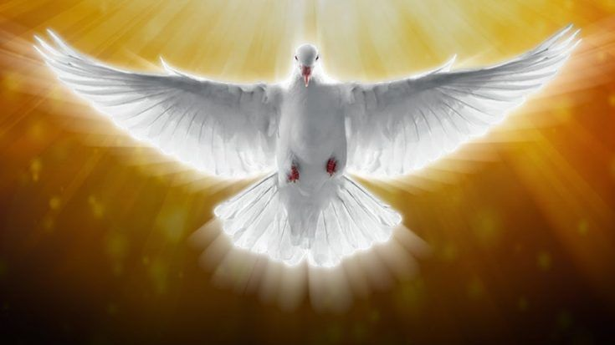
“I have chosen you, on purpose … ”

Slide 58
NEXT CLASS – 2 June 2021
Book of Romans
Before next class, read the below chapter in the KJV and in one other versions of the Bible, i.e., NKJV, NRSV, NIV, CEV, etc …
Read the entire Chapter 9 again –
1st lesson: 9:1 – 22
2nd lesson: 9:23 – 33

