Slide 1

Sovereignty of Predestination
Part Two
Chapter 9:23 – 33
2 June 2021
Week 20

Slide 2

“Sovereignty of Predestination”
Part Two

Slide 3

Romans
Background:
In this section, we will examine three facets of God’s nature. In chapter 9, we will encounter the “Sovereignty of God” and wrestle with its implications and ultimately learn to rest in its truth.
In chapter 10, we will consider the “Justice of God” and learn to accept that God does not submit to our notion of fair play; God has all the power, so He is the Judge.

Slide 4
Romans
Background:
And then in chapter 11, we will find comfort in the “Faithfulness of God.” Where answers fail, we can trust in the unfailing goodness of our Creator and His unsurpassed love for His creatures.
Remember, Paul’s letter to the Romans is NOT about our salvation. His primary subject is the righteousness of God, of which our salvation is a part. The Lord is pursuing His own agenda.

Slide 5


Slide 6
Romans 9:1 – 21
First Part of the Chapter:
To appreciate why and how God could choose to reject the nation of Israel (except for a remnant) and accept people from among the Gentiles.
Some of Paul’s readers may have received the impression that God’s plan of saving man in Christ apart from the Law (3:21-22) implies that God has rejected His people of Israel and the promises made to them. In chapters nine through eleven, Paul explains that God has not rejected His people.

Slide 7
Romans 9:1 – 21
First Part of the Chapter:
Paul first expresses his own concern for his fellow Israelites (1-2). If it would do any good, Paul would gladly be condemned in order to save his brethren who had been the recipients of so many blessings (3-5).
But Paul quickly states that God’s promises had not failed. He reminds them that true Israel is not simply the descendants of Israel, any more than the promises to Abraham were to be carried out through all of Abraham’s descendants just because they are his physical descendants (6-8).

Slide 8
Romans 9:1 – 21
First Part of the Chapter:
Rather, it depends upon what God has chosen according to His Divine purpose. This is illustrated by contrasting what the Scriptures reveal about Isaac and Ishmael, and then about Jacob and Esau (9-13).

Slide 9
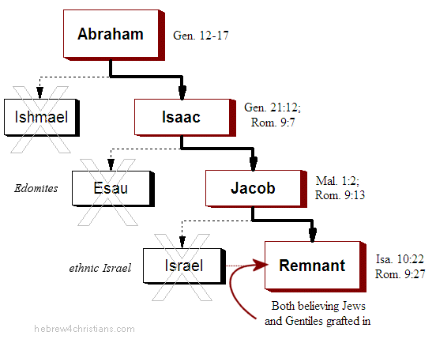

Slide 10
Romans 9:1 – 21
First Part of the Chapter:
That God has made such distinction is illustrated further with the example of Pharaoh, where God chose to show mercy to some while He hardened others, who had already persistently rejected God’s mercy (14-18).
That God has the right to make such choices is His, just as the potter has over the clay (19-21).

Slide 11
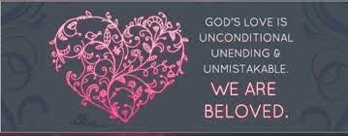
Second Half of the Chapter

Slide 12
Romans 9:22 – 33
Second Half of the Chapter:
So God chose to endure “vessels of wrath” with much longsuffering, that He might make known His glorious riches to “vessels of mercy” [a point expanded upon further in chapter eleven] (22-23). And who are these “vessels of mercy?”
They consist of Gentiles, and a remnant of Israel, as foretold by Hosea and Isaiah (24-29).

Slide 13
Romans 9:22 – 33
Second Half of the Chapter:
Paul’s conclusion is that God’s words of promise were not just to the fleshly descendants of Abraham (as the Jews would have it), but to the faithful remnant of Israel and to the Gentiles who accepted the righteousness which is by faith.
The only reason any of the Israelites were rejected by God was because of their rejection of the Messiah, even as Isaiah foretold (30-33).

Slide 14
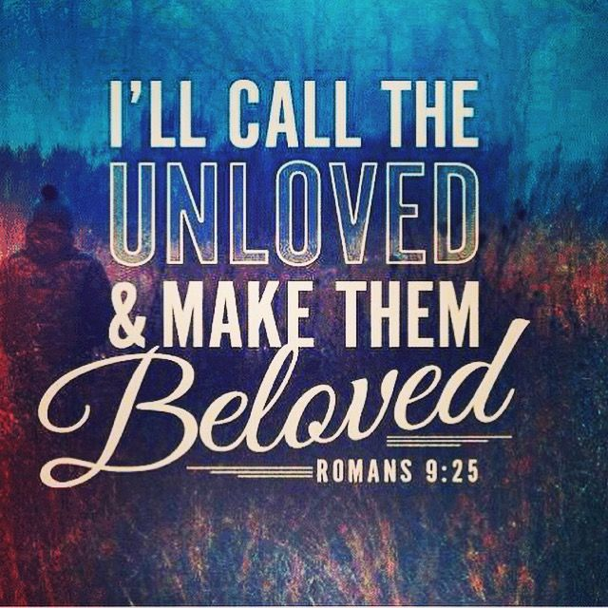

Slide 15
Romans 9:23 – 26
²³What if he did this to make the riches of his glory known to the objects of his mercy, whom he prepared in advance for glory, ²⁴Even us, whom he also called, not only from the Jews but also from the Gentiles? ²⁵As he says in Hosea: “I will call them ‘my people’ who are not my people; and I will call her ‘my loved one’ who is not my loved one,” ²⁶and, “In the very place where it was said to them, ‘You are not my people,’ there they will be called ‘children of the living God.’”

Slide 16
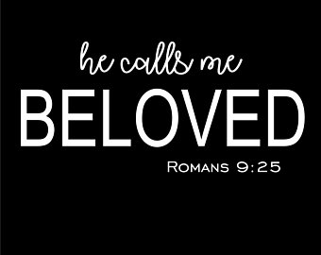

Slide 17
Romans 9:23 – 26
Romans 9:23-24 answers the question implied by 9:22: Why does the Lord “endure with much patience the vessels who had fitted themselves for destruction”?
In other words, what is the point of allowing those who are destined for destruction to continue living?
There are two reasons . . .

Slide 18
Romans 9:23 – 26
FIRST – God exist outside of time while we must progress through it. Those who are elected to receive mercy and are destined for glory will emerge from the womb lost and enslaved to sin.
They will exist for some time that way before receiving grace and becoming transformed by the Holy Spirit. The Lord has determined to allow that process to unfold through time for our sake.
All creation is allowed to see the process of mercy given to unworthy vessels, and their transformation glorifies God.

Slide 19
Romans 9:23 – 26
SECOND – God allows the progress of time within creation to separate the elect from the non-elect. God knows who has been elected to receive mercy and who has not, but we don’t. God sees and judges the inner hearts of men and women, while we see and judge only the exterior.
Someone who appears evil to us may in fact be a “vessel of mercy” yet to be transformed. For example, Paul was a murderer and a persecutor of Christians before his conversion.

Slide 20
Romans 9:23 – 26
After Christ confronted him, he gave glory to God, as when he wrote to the Ephesians, “To me, the very least of all saints, this grace was given, to preach to the Gentiles the unfathomable riches of Christ” (Eph 3:8).
Beginning in 9:25, Paul returns to the question of the Jews by recalling the words of Hosea and Isaiah. The two OT prophets told a tale of two vessels: Israel, a “vessel of wrath,” and Judah, “a vessel of mercy.” Two stories of divine election that ended very differently.

Slide 21
Romans 9:23 – 26
Hosea lived and wrote long after the realm ruled by David and Solomon had been divided into the northern kingdom of Israel and the southern kingdom of Judah.
Israel had a long history of idolatry and unfaithfulness, and despite generations of warning, they never repented. Not long after Israel rejected Hosea’s oracle, the Assyrian Empire began a series of invasions, finally wiping out the last of Israel in 722 BC.

Slide 22
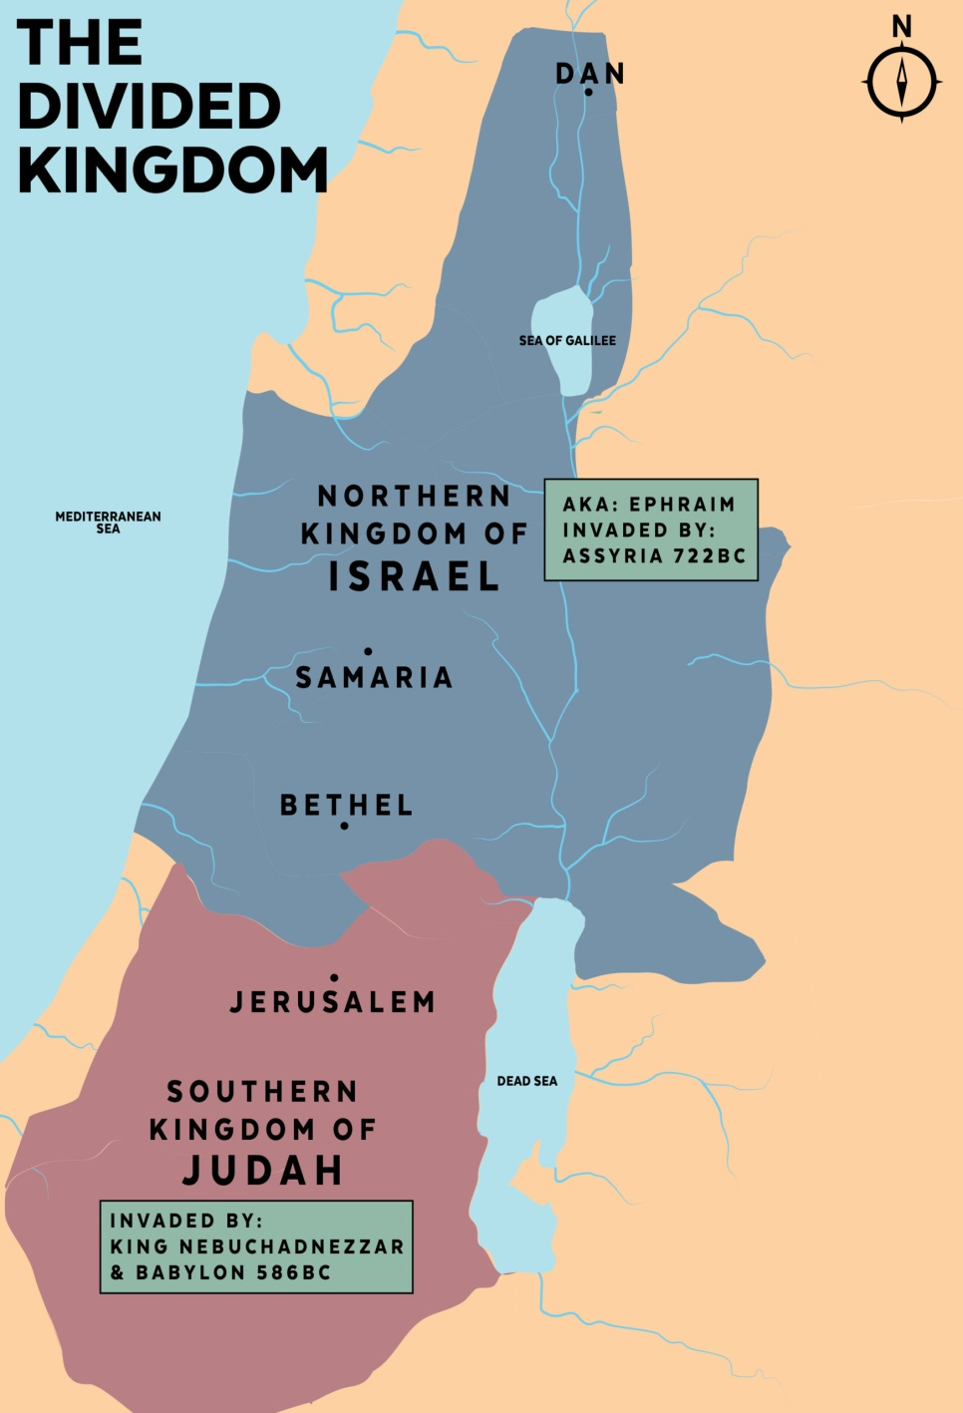

Slide 23
Romans 9:23 – 26
The invaders deported most of the inhabitants, transplanted people from other nations into Israel, and encouraged intermarriage, and within a few generations the northern tribes had lost their tribal identities.
Since then, the southern kingdom of Judah was all that remained of God’s organized, distinct covenant people.

Slide 24
Romans 9:23 – 26
Continuing the analogy of a potter, Paul refers to those whom God has not chosen for salvation, but rather allowed to incur the just penalty for their sin—God’s wrath prepared for destruction.
By Israel’s own rejection of Jesus Christ, God does not make men sinful, but He leaves them in the sin they have chosen.
The greatness of God’s character, seen especially in the grace, mercy, compassion, and forgiveness He grants sinners in Christ (vessels of mercy).

Slide 25
Romans 9:27 – 29
²⁷Isaiah cries out concerning Israel: “Though the number of the Israelites be like the sand by the sea, only the remnant will be saved. ²⁸For the Lord will carry out his sentence on earth with speed and finality.” ²⁹It is just as Isaiah said previously:
“Unless the Lord Almighty had left us descendants,
we would have become like Sodom, we would have been like Gomorrah.”

Slide 26
Romans 9:27 – 29
Isaiah was a contemporary of Hosea, prophesying in the southern kingdom of Judah, which could claim a handful of faithful kings throughout their history. Judah heeded Isaiah’s warning for a time and survived the Assyrian siege of Jerusalem.
But after one generation, they, too, fell headlong into rebellion against the Lord. Eventually, Nebuchadnezzar defeated Judah and carried the best and brightest Jews away to serve him in Babylon in 586 BC.

Slide 27
Romans 9:27 – 29
After decades of captivity, the Promised Land had been purged of faithless Hebrew kings. Then the Lord gathered a remnant of His covenant people and returned them to start again, just as Hosea and Isaiah had foretold. The rebellious Hebrews God had called “not My people” were redeemed from captivity and renamed “My people.”
As we examine this tale of two vessels, we see God repeatedly warning both Israel and Judah over a period of centuries. Both failed to heed His warning and then suffered grave consequences.

Slide 28
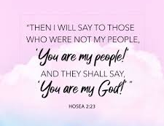

Slide 29
Romans 9:27 – 29
God was fair to both in that He pursued them with equal passion. The offer of salvation in response to repentance was the same for both. And the consequences for continued disobedience were identical: deportation and exile, just as He had warned (Deut 28:15-68).
However, He exercised His prerogative as the sovereign ruler over all creation and extended mercy to one: Judah. He preserved a remnant in order to fulfill his unconditional promises to both Abraham and David.

Slide 30
Romans 9:27 – 29
Paul extended the application of these OT prophecies. The small percentage of Hosea’s “not My people” who again became “My people” were Jews.
And Isaiah’s “remnant” were also Jews who returned with Ezra and Nehemiah to rebuild the nation. Nevertheless, Paul saw the redemption of Gentiles as deeper fulfillment of those prophecies. I love how God always exceeds expectations!

Slide 31
Romans 9:27 – 29
Paul’s point is that the scattering Isaiah described was only a preview of Israel’s rejection of the Messiah and Israel’s subsequent destruction and scattering.
Only a remnant of Israel will survive God’s wrath, solely because of His mercy.
The OT title for God “Lord of Sabaoth” is translated “Lord of hosts” and refers to His all-encompassing sovereignty.

Slide 32
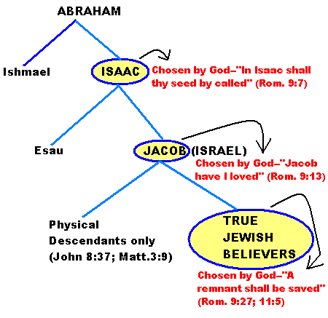
True Israel is made up of Christian Jews and Christian Gentiles

Slide 33
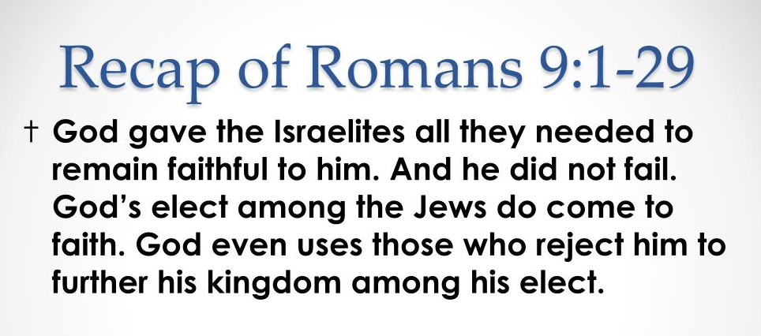

Slide 34
Romans 9:30 – 33
³⁰What then shall we say? That the Gentiles, who did not pursue righteousness, have obtained it, a righteousness that is by faith; ³¹but the people of Israel, who pursued the law as the way of righteousness, have not attained their goal. ³²Why not? Because they pursued it not by faith but as if it were by works. They stumbled over the stumbling stone. ³³As it is written: “See, I lay in Zion a stone that causes people to stumble and a rock that makes them fall, and the one who believes in him will never be put to shame.”

Slide 35
Romans 9:30 – 33
Paul concludes the lesson on God’s divine choice by reminding his readers that although God chooses some to receive His mercy, those who receive His judgment do so not because of something God has done to them, but because of their own unwillingness to believe the gospel.
Sinners are condemned for their personal sins, the primary one being the rejection of God and Christ.

Slide 36
Romans 9:30 – 33
Israel did not admit their inability to keep the Law perfectly and turn by faith to God for forgiveness. Instead a few of them kept trying to keep the Law by their own efforts. Consequently, they stumbled over the “stumbling stone.”
The Lord Jesus Christ, “The Stumbling Stone,” did not conform to the Jews’ expectations, so they rejected Him instead of responding to Him by faith.

Slide 37
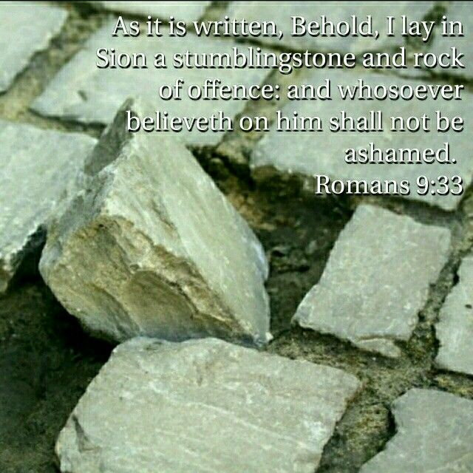

Slide 38
Romans 9:30 – 33
To show that God anticipated this, Paul quoted from Isaiah 8:14 and 28:16, combining the two statements to indicate the two contrasting reactions by men to the Stone that God placed in Zion . . .
cf. “Sion” in Romans 11:26 > “And so all Israel shall be saved: as it is written, There shall come out of Sion the Deliverer, and shall turn away ungodliness from Jacob.”

Slide 39

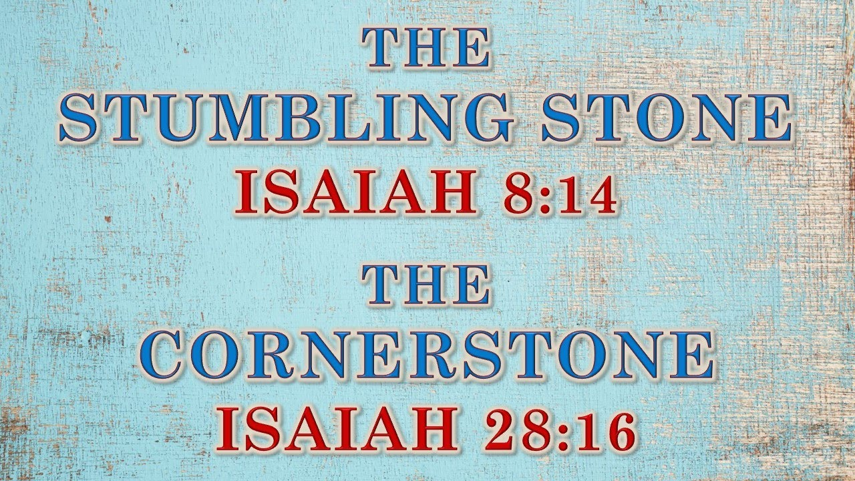

Slide 40


“… and whosoever believes on ME shall not be ashamed ”

Slide 41
NEXT CLASS – 9 June 2021
Book of Romans
Before next class, read the below chapter in the KJV and in one other versions of the Bible, i.e., NKJV, NRSV, NIV, CEV, etc …
Read the entire Chapter 10 –
1st lesson: 10:1 – 13
2nd lesson: 10:14 – 21

